Slide 1
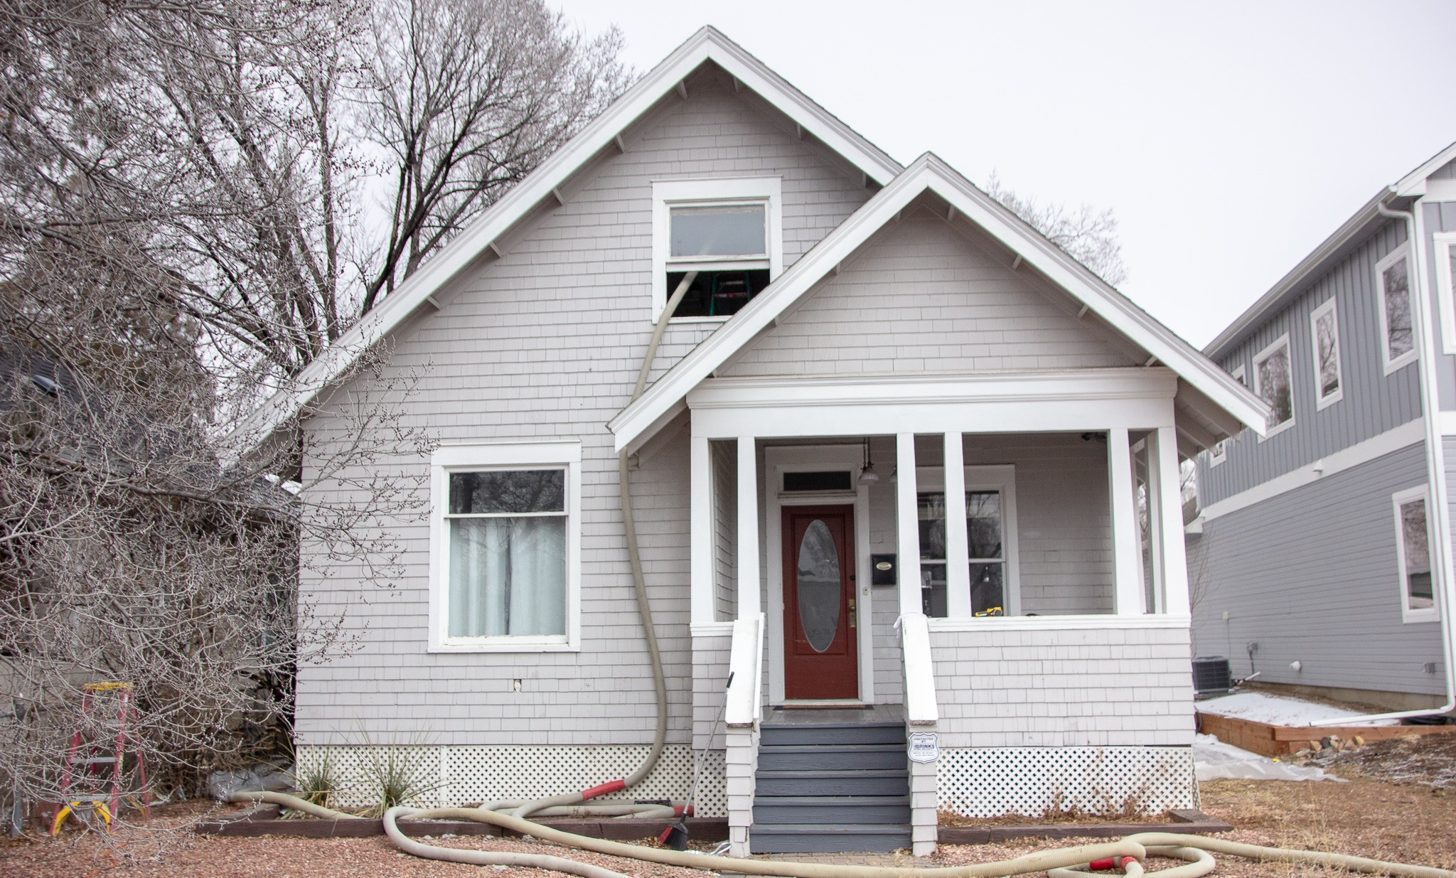
NASCSP Weatherization Assistance Program New Manager Training Series
WAP Operations and Policy Manual Updates: Best Practices and Process for Annual Updates
November 7, 2024
Ryan Harry, NASCSP Consultant
ryan@heron-e.com

Slide 2
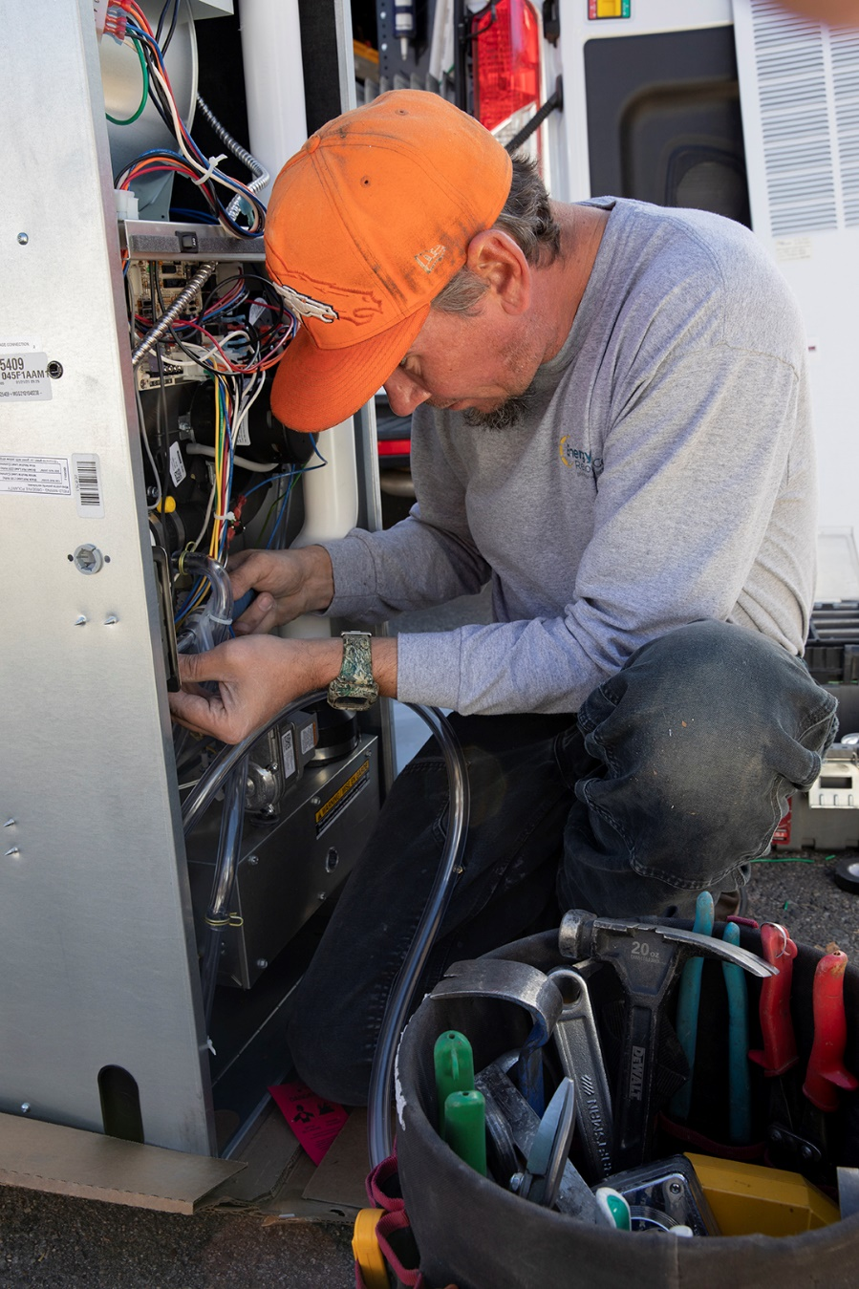
Webinar Contents
Policy manual update
Content
Strategy
Match tasks with available bandwidth
Create a calendar of update tasks
Get subgrantee involved
Establish a point person
Make a style guide
Provide training for the update
Get help if you need it

Slide 3
Question 1: How often do you currently update your policy manual?
a. Annually
b. Every 2-3 years
c. Every 4-5 years
d. Only when major changes are required
e. Unsure

Slide 4
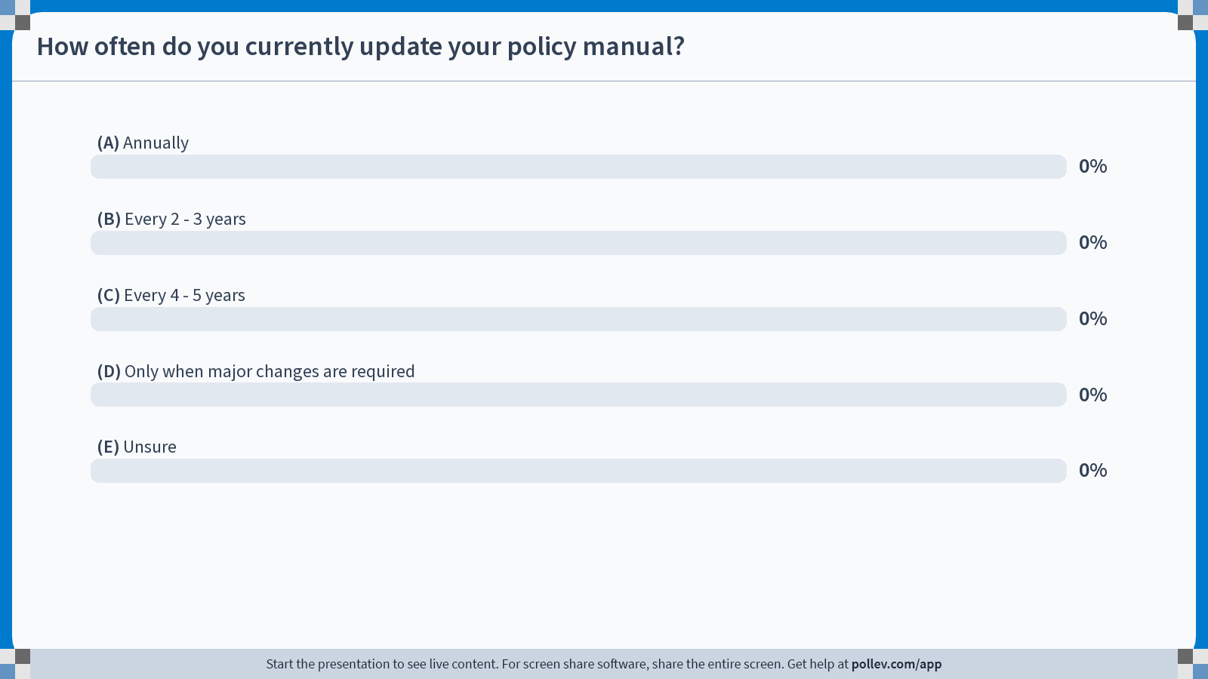
Notes:
Poll Title: Do not modify the notes in this section to avoid tampering with the Poll Everywhere activity. More info at polleverywhere.com/support How often do you currently update your policy manual? https://www.polleverywhere.com/multiple_choice_polls/jKgOuQSrunwp0c7ruomwG?state=opened&flow=Default&onscreen=persist

Slide 5
Policy Manual Update Objectives
Policy is up to date for compliance
Program improvements
Policy manual improvements
Everyone is on the same page
Subgrantees are heard and included

Slide 6
Question 2: What do you see as the primary benefit of having an annually updated policy manual?
a. Better regulatory compliance
b. Improved program performance
c. An improved policy manual
d. Easier training and communication with subgrantees and staff
e. Improved communication with subgrantees
f. Other

Slide 7
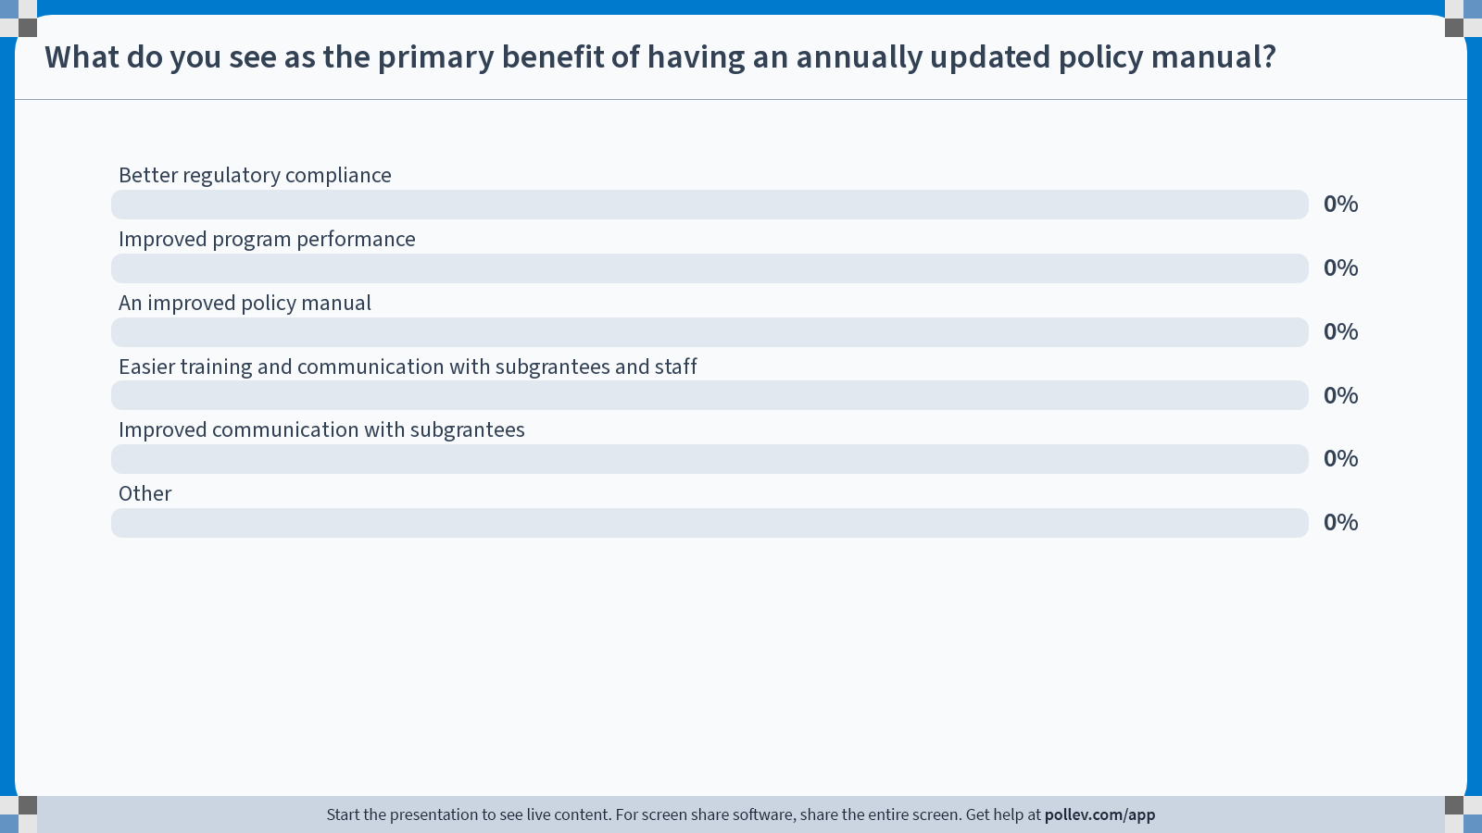
Notes:
Poll Title: Do not modify the notes in this section to avoid tampering with the Poll Everywhere activity. More info at polleverywhere.com/support What do you see as the primary benefit of having an annually updated policy manual? https://www.polleverywhere.com/multiple_choice_polls/1LRKnTnDKKM4cpGbz4uKf?state=opened&flow=Default&onscreen=persist

Slide 8
The stuff that changes…
On-going
Annual(ish)
DOE
WPNs
Hiccups
WAP
State Plan
LIHEAP
Rules
State Law
DOE
WAP
Memos
State
WAP
Memos
DOE
WAP Rules
Other Funder
Rules

Slide 9
Big Picture Content Best Practices
Gather content on a quarterly basis for on-going updates (WPNs, DOE memos, state memos, etc.)
Gather content on a semi-annual or annual basis for other resources (WAP State Plan, utility partners, etc.)
Make updates to a draft manual throughout the year
Create a style guide to make updates easier and more consistent

Slide 10
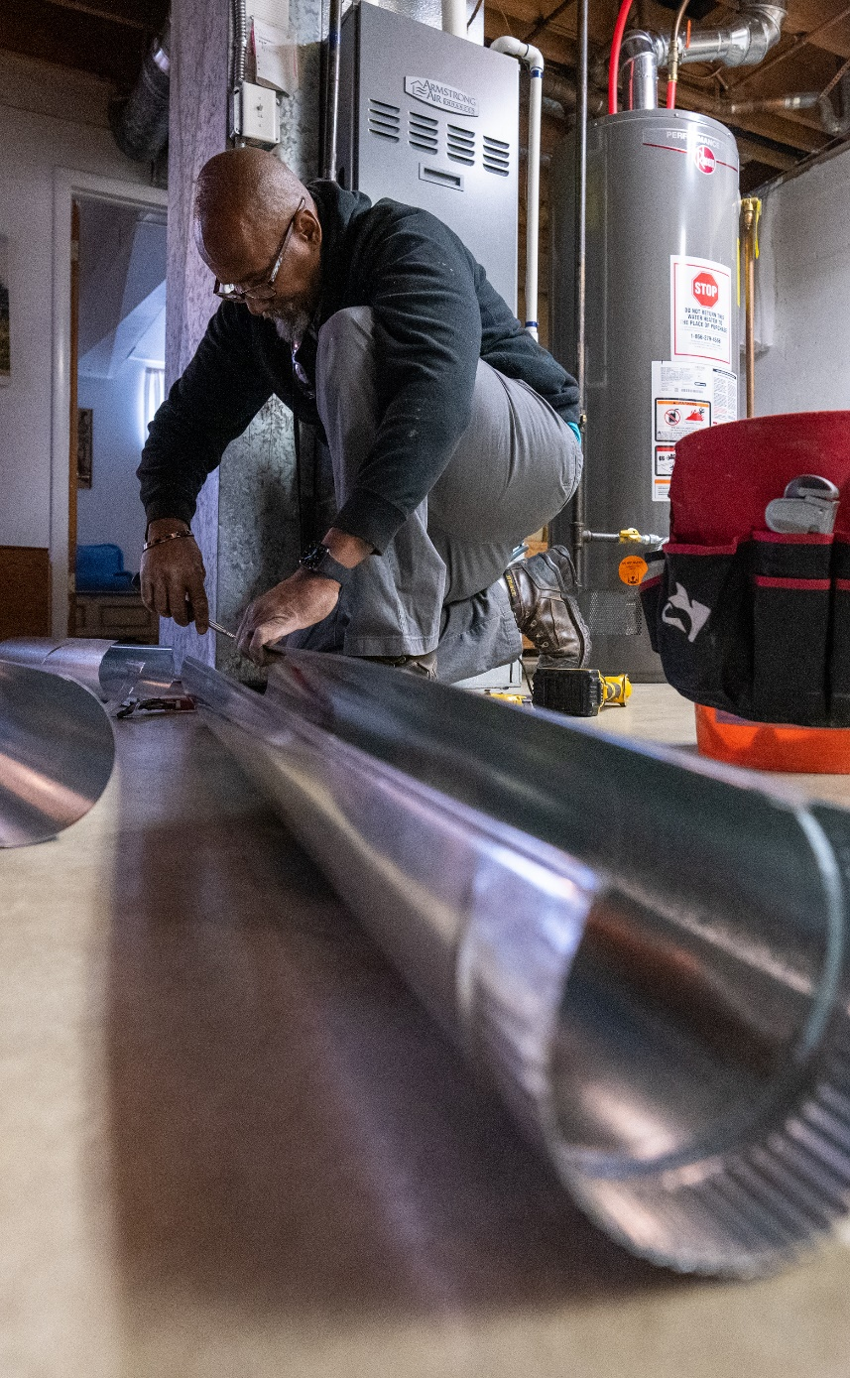
WPN and Memo Tips
Add WPNs and WAP Memos on a quarterly basis: choose four dates annually to review WPNs and WAP Memos that have been released since your previous review
Add language to reflect these changes to the manual during these quarterly updates
Notes:
Not all WPNS and Memos will be applicable for your update

Slide 11
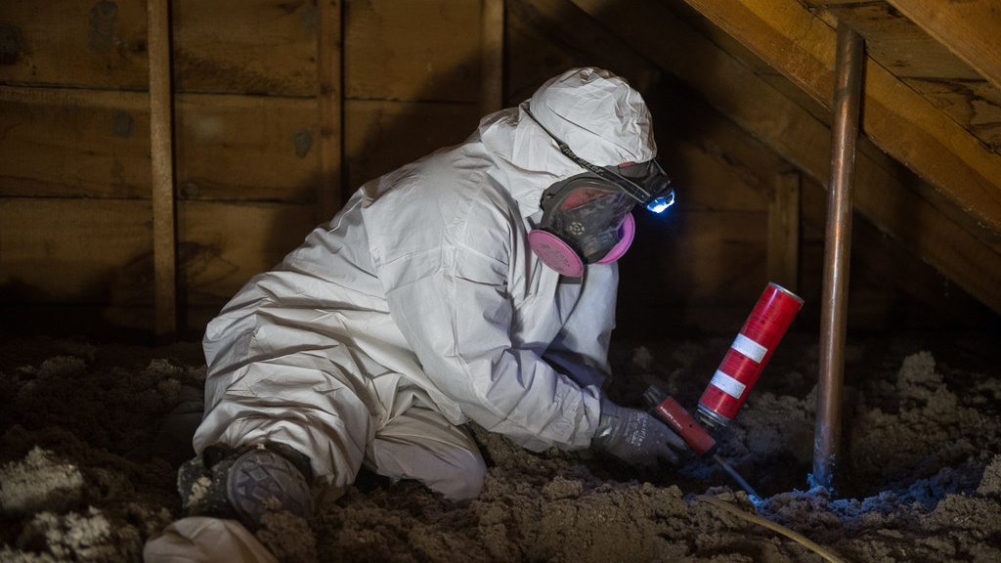
WPNs and DOE Memo Demo

Slide 12
WAP State Plan Tips
Have your policy manual updates drive state plan content rather than the other way around
Review application instructions early and begin putting together State Plan content when you have the bandwidth to do so
Have the manual update Point Person involved in the State Plan update as well

Slide 13
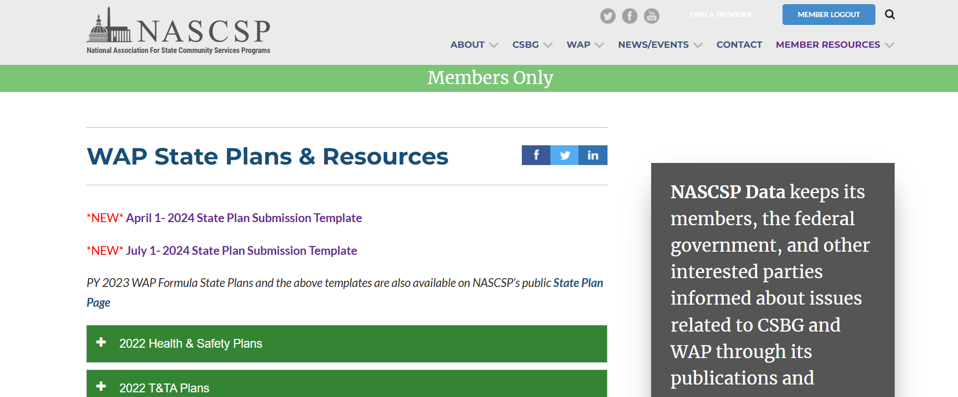
NASCSP State Plan Resources
https://nascsp.org/member-resources/wap-member-only-resources/wap-state-plans/
Previous state plans from various states
Submission Templates

Slide 14
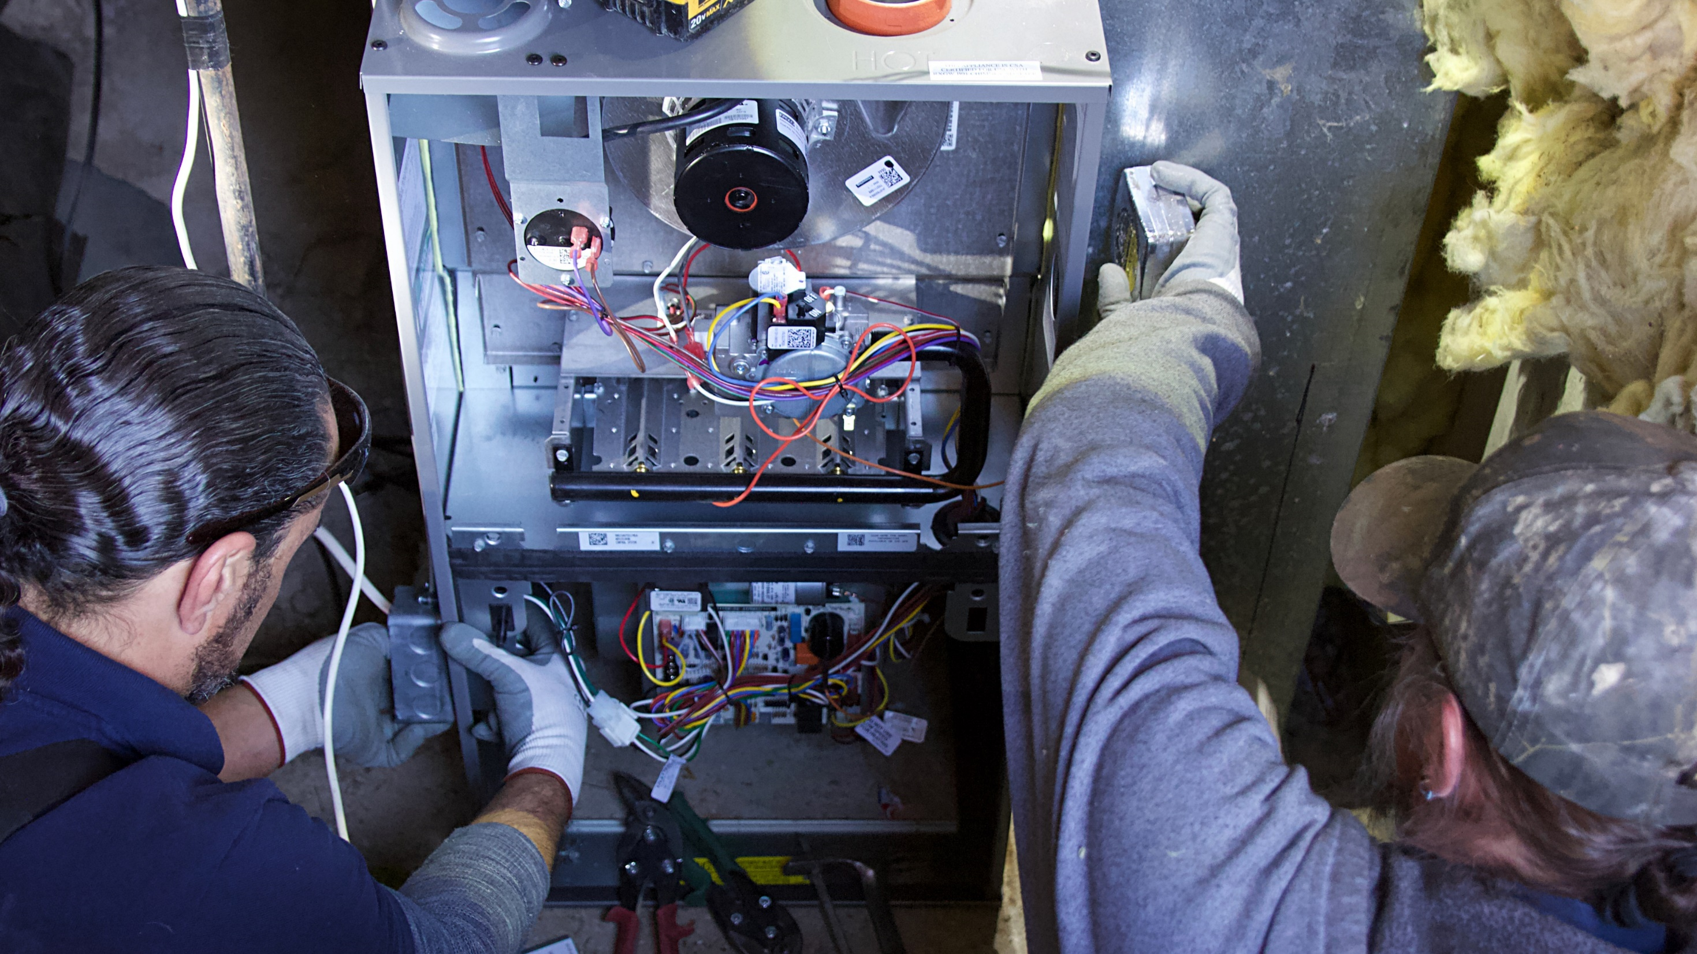
Application Instructions Demo
Notes:
People involved: Fiscal,

Slide 15
Question 3: Which aspect of your policy manual update process do you think needs the most improvement?
a. Gathering input from subgrantees
b. Reviewing new regulations
c. Communicating updates to staff
d. Setting timelines and deadlines

Slide 16
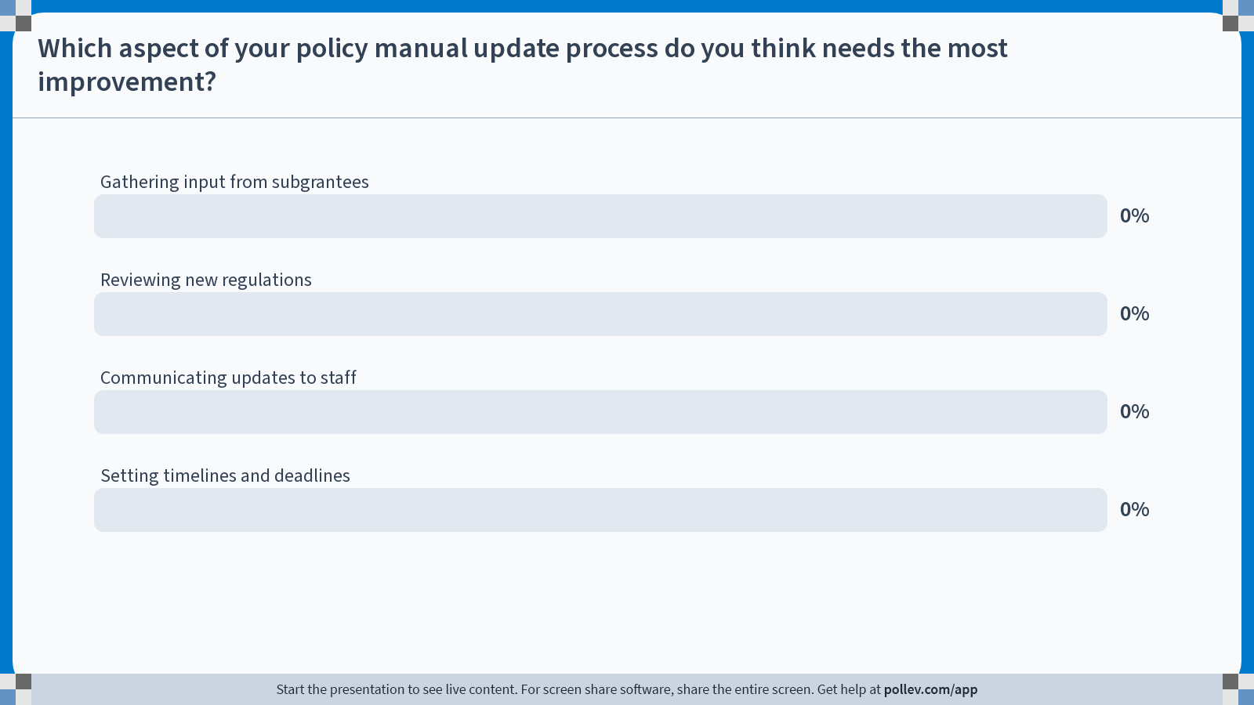
Notes:
Poll Title: Do not modify the notes in this section to avoid tampering with the Poll Everywhere activity. More info at polleverywhere.com/support Which aspect of your policy manual update process do you think needs the most improvement? https://www.polleverywhere.com/multiple_choice_polls/Pbyzj7pJZuavn3BOMOx8H?state=opened&flow=Default&onscreen=persist

Slide 17
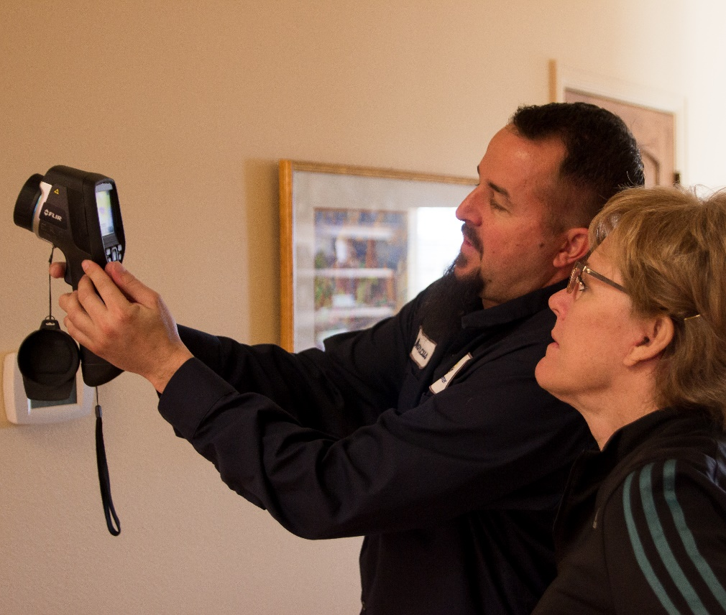
Grantee (State) Memo Tips
States should release memos to update policy in real time
Memos should be reviewed quarterly and incorporated into the draft manual as required
Some memos will expire and not carry over to become manual policy
Notes:
Memos and guidance, especially at the state level, allow for testing of policies before including them into the manual and should be used throughout the year

Slide 18
Question 4: What is the biggest challenge your team faces when updating your policy manual?
a. Time constraints
b. Coordinating input from subgrantees
c. Keeping up with regulatory changes
d. Lack of clear processes
e. Other

Slide 19
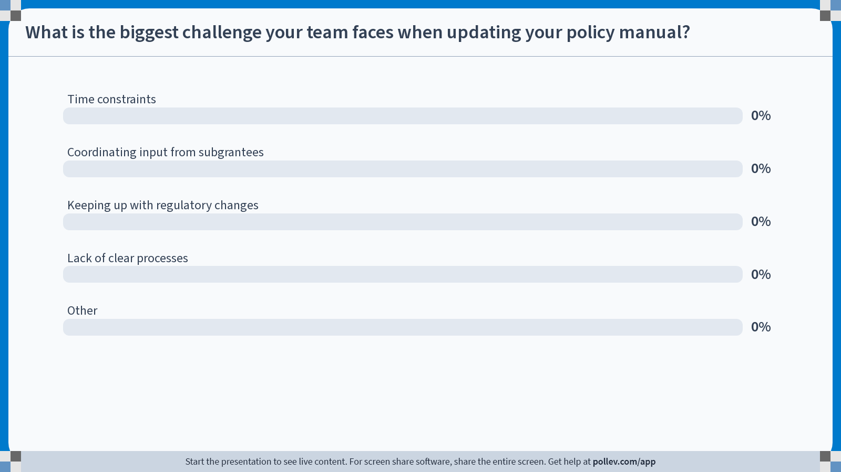
Notes:
Poll Title: Do not modify the notes in this section to avoid tampering with the Poll Everywhere activity. More info at polleverywhere.com/support What is the biggest challenge your team faces when updating your policy manual? https://www.polleverywhere.com/multiple_choice_polls/qggwxie5J2zGzlcwgKNv7?state=opened&flow=Default&onscreen=persist

Slide 20
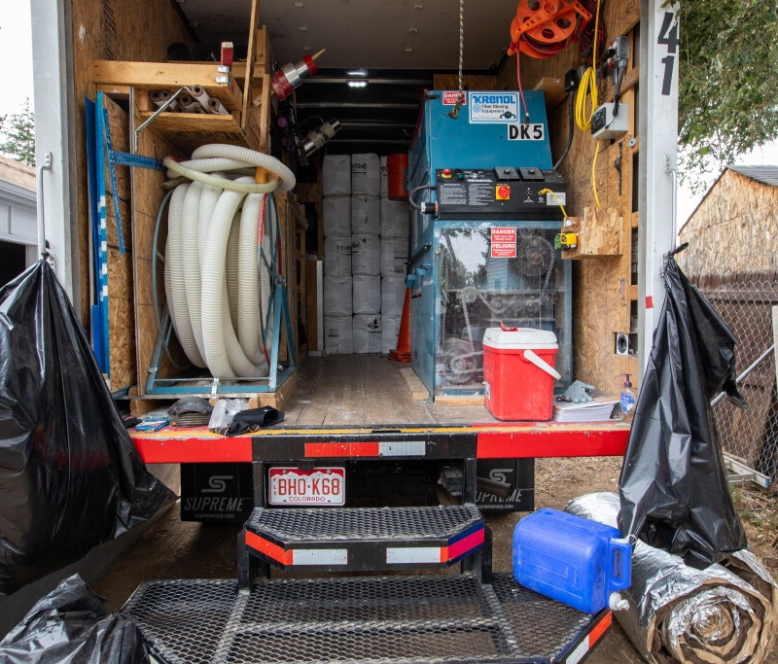
Big Picture Strategic Best Practices - 1
Start working on next year’s policy manual on the first day of this program year
Pick a release date for the policy manual and stick to it
Choose a person on your team to be the point person for the policy manual update process

Slide 21
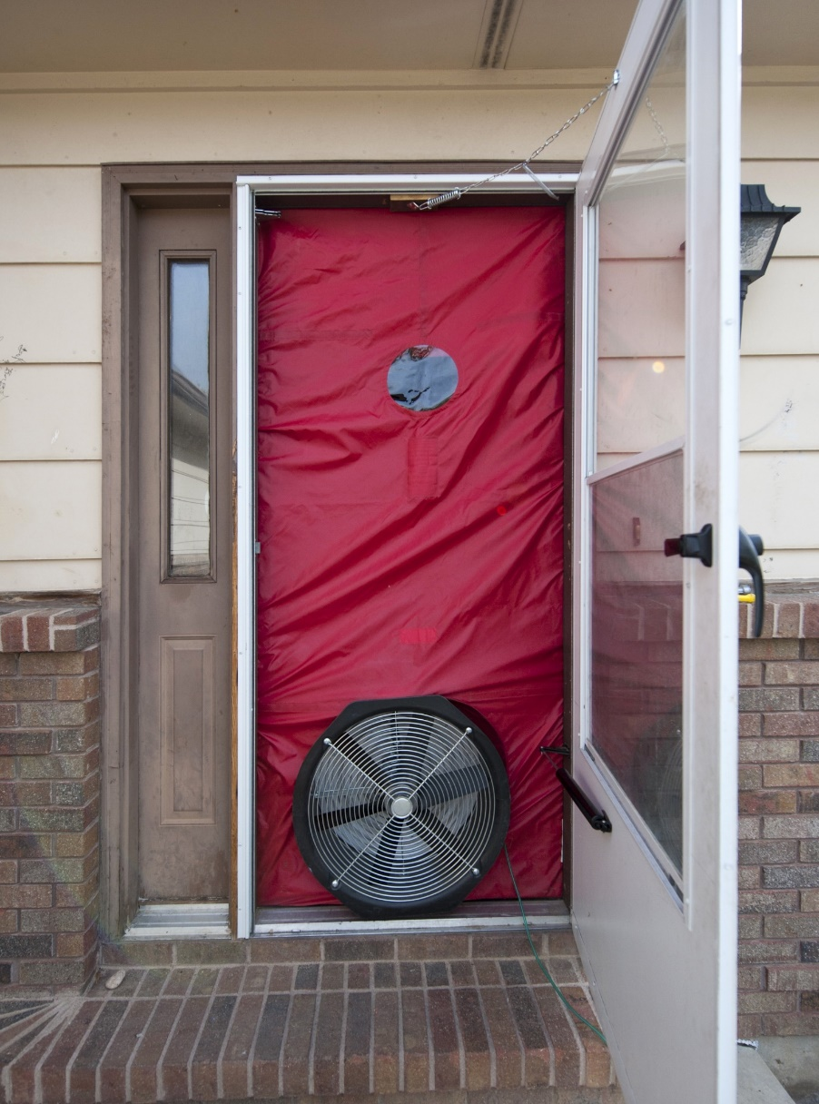
Big Picture Strategic Best Practices - 2
Establish a team for the update and make sure everyone knows their role
Make a calendar with due dates and roles/responsibilities for the policy manual update
Be strategic in determining your deadlines, avoid piling on during busy periods

Slide 23
Get as much work
done here as possible

Slide 24
Don’t wait until the busy time of year
Get as much work
done here as possible

Slide 25
Question 5: Do you currently follow a set process or schedule for updating your policy manual?
a. Yes, we have a structured process in place
b. Somewhat, but it’s not always followed
c. No, it’s done on an as-needed basis
d. Not sure

Slide 26
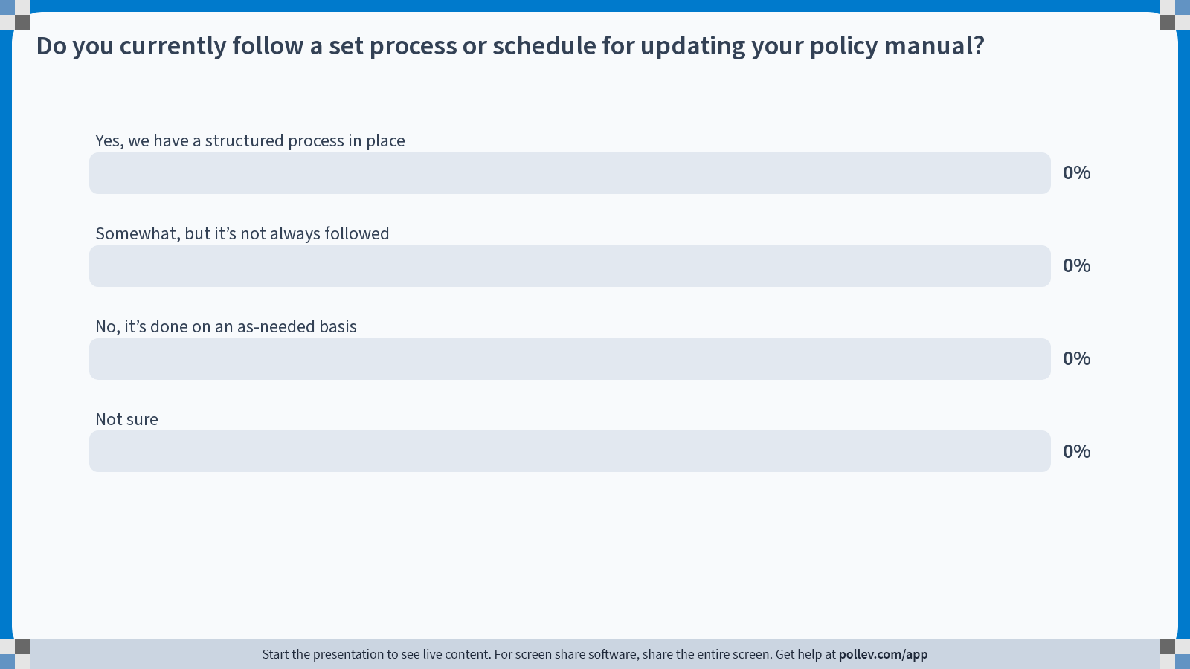
Notes:
Poll Title: Do not modify the notes in this section to avoid tampering with the Poll Everywhere activity. More info at polleverywhere.com/support Do you currently follow a set process or schedule for updating your policy manual? https://www.polleverywhere.com/multiple_choice_polls/z42An2xEqBFY9DVTmL91T?state=opened&flow=Default&onscreen=persist

Slide 27
Make a Calendar
The calendar will help keep the team accountable
Make sure everyone with responsibilities on the calendar helps create it
Provide the right level of detail (i.e. not too much or too little)
Share the calendar with the subgrantees at the appropriate time

Slide 28
Calendar Demo

Slide 29
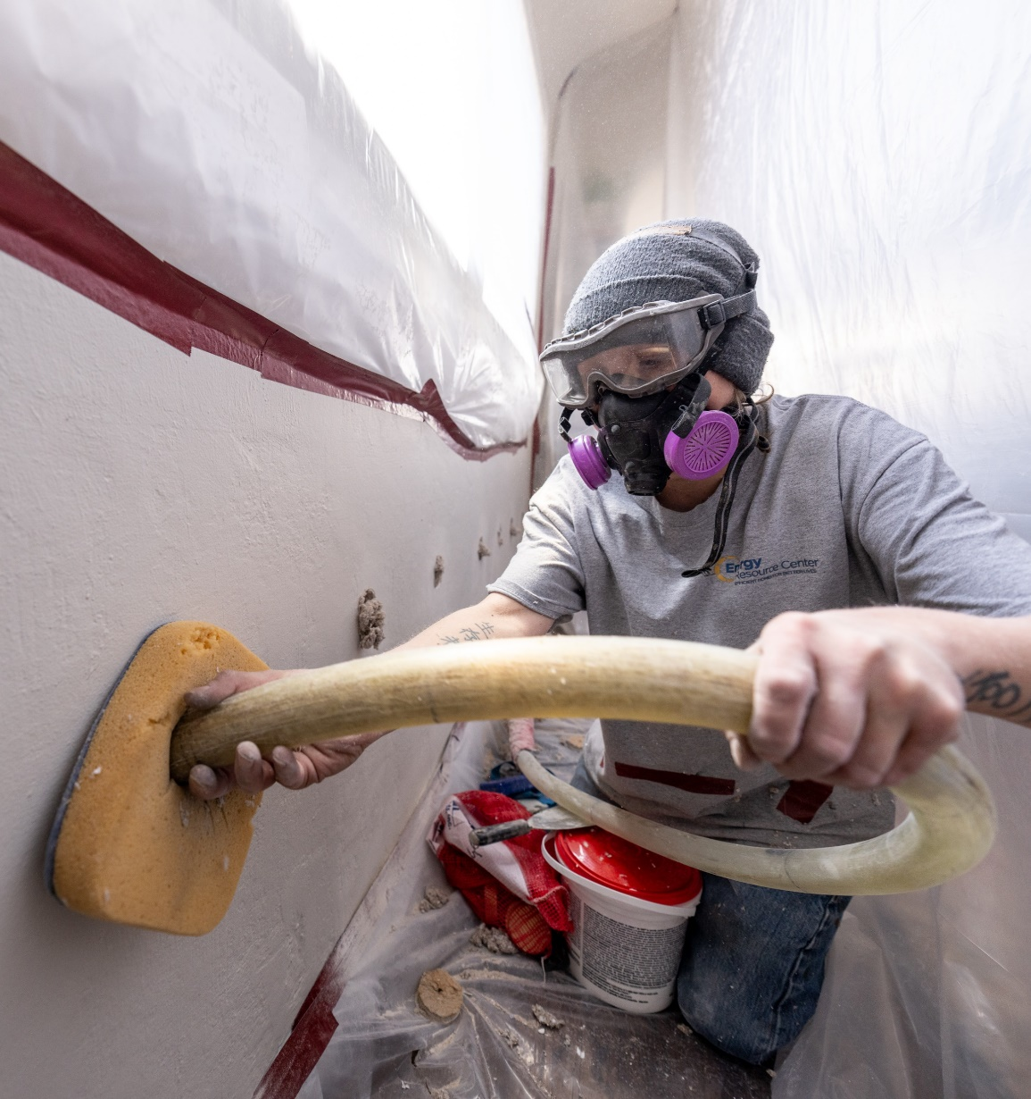
Get Subgrantees Involved
Get subgrantees involved in policy manual updates early
Provide key subgrantees with access to the draft for ongoing review
Time subgrantee review tasks to match their available bandwidth
Notes:
Times to get involved: Meetings, policy advisory

Slide 30
Survey Subgrantees
Make sure you are engaging all subgrantee staff, not just the upper-level admin staff that regularly attend meetings
Surveying subgrantee staff is a good way to do this
Find out what topics are most important to subgrantee staff and work on those

Slide 31
Choose a Point Person
The Point Person will be the hub of information for the manual and responsible for herding cats
Determine who the point person will be. Here are some desirable traits:
Has bandwidth and energy to do the tasks
Gets along well with other team members
Doesn’t have to be a subject matter expert

Slide 32
Make a Style Guide
Think of this like the guides you used for citing sources in research papers.
Style guides reduce the burden of decision making and create consistency across editors
Ask for help from AI: I need to make a style guide for a policy and procedure manual which I update annually. Can you help?

Slide 33
Style Guide Components (a few examples)
General formatting
Punctuation
Common terms
List formatting
Acronym use and definitions

Slide 34
Formatting Tips
Use formatting that makes the guide easy to update
Lists instead of paragraphs make it easy to swap out language when policies changes
Use formatting that makes referencing easy
Include a table of contents, glossary of terms, and a list of acronyms

Slide 35
Formatting Examples
My favorite is
A. Nested list formatting
Like this because
a. It makes things
i. Really easy to reference
A. Sections headings with
Numbered lists and
Bulleted sub-lists work if
For a less formal look

Slide 36
Train for New Content
Training is a critical step that is often missed during the update process.
Training will help everyone better understand the changes in the manual and the impacts of those changes
Create different training resources for different audiences:
Slide decks for grantee and subgrantee admin staff
Talking points for subgrantee auditors, installers, and QCIs that can be delivered in the field

Slide 37
Question 6: What resources would be most helpful for improving your policy manual update process?
a. Templates and checklists
b. Training and best practice guides
c. Regular communication from the DOE
d. Tools for tracking updates and revisions
e. Collaboration with other grantees

Slide 38
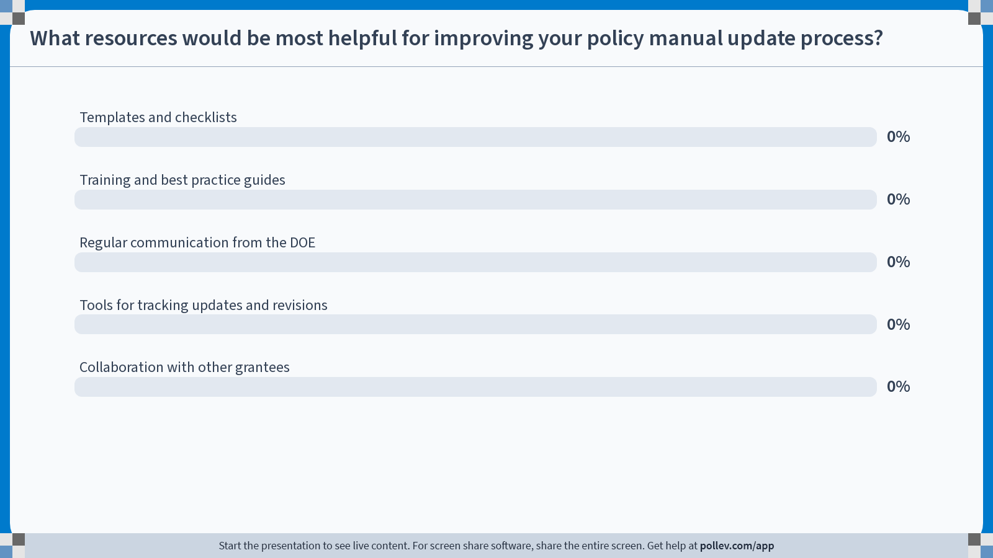
Notes:
Poll Title: Do not modify the notes in this section to avoid tampering with the Poll Everywhere activity. More info at polleverywhere.com/support What resources would be most helpful for improving your policy manual update process? https://www.polleverywhere.com/multiple_choice_polls/5y5IvXs1bC2hi4DEjUBAs?state=opened&flow=Default&onscreen=persist

Slide 39
NASCSP Can Help
NASCSP can provide assistance in updating your policy manuals
Some of the areas we can help with:
Document updating
Document formatting
Style guide creation
Expert review
Best practices review

Slide 40
NASCSP Contacts
Claudia Torres
Sr. WAP BIL Manager, NASCSP
ctorres@nascsp.org
202-717-8421
Ryan Harry
NASCSP Consultant
ryan@heron-e.com
303-910-8691
Andrea Schroer
Weatherization Director, NASCSP
aschroer@nascsp.org
202-370-3666

Slide 41
Question 7: How confident are you in your team’s ability to implement an annual policy manual update process after this webinar?
a. Very confident
b. Somewhat confident
c. Not very confident
d. Not sure yet

Slide 42
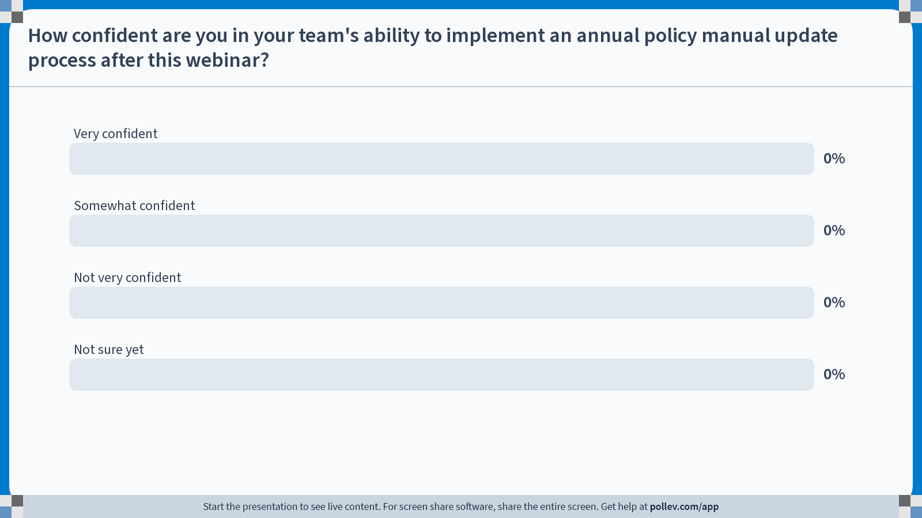
Notes:
Poll Title: Do not modify the notes in this section to avoid tampering with the Poll Everywhere activity. More info at polleverywhere.com/support How confident are you in your team's ability to implement an annual policy manual update process after this webinar? https://www.polleverywhere.com/multiple_choice_polls/xtEW9RH8QLt4Y0QLE92WK?state=opened&flow=Default&onscreen=persist

Slide 43
Open Discussion

