Slide 1

WAP BIL 6 Month Coaching Series
Session 6
Notes:
Session 6: Workforce Development and Training
Onboarding and training new employees effectively
Facilitating networks and building connections with contractors
Addressing workforce needs and supporting programmatic success

Slide 2

Workforce Development and Training

Slide 3

Agenda
Addressing Workforce Needs & Supporting Programmatic Success
Onboarding & Training New Employees Effectively
Leveraging Tools & Resources
Facilitating Networks & Engaging with Contractors
Introduction
Notes:
This hour and a half long webinar will contain 4 parts today.
Each section comes with it’s own challenges and solutions. I think we are fully aware of the challenges, so the purpose of today’s call is to focus on solutions. Let’s take a quick look at the big picture when it comes to workforce challenges and solutions.

Slide 4
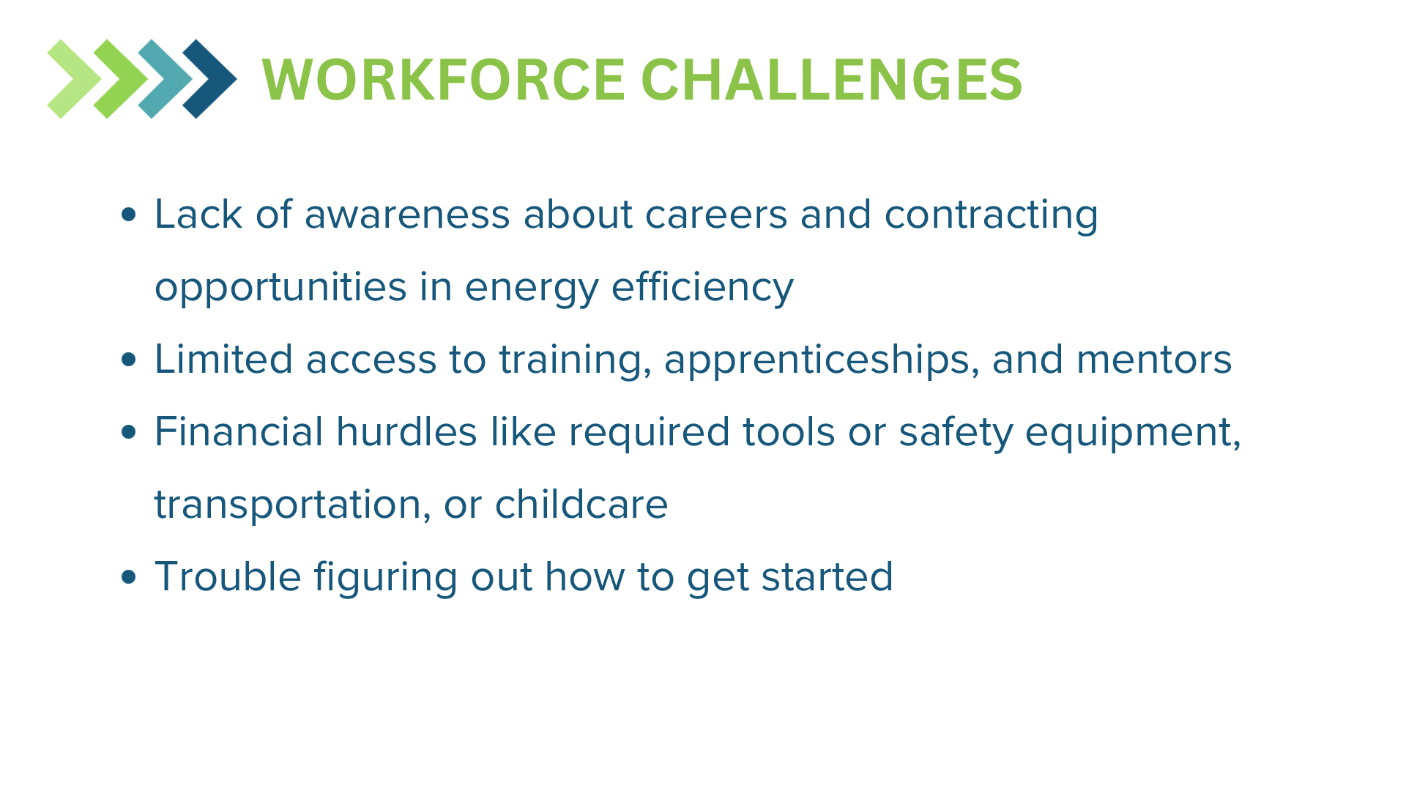

Slide 5
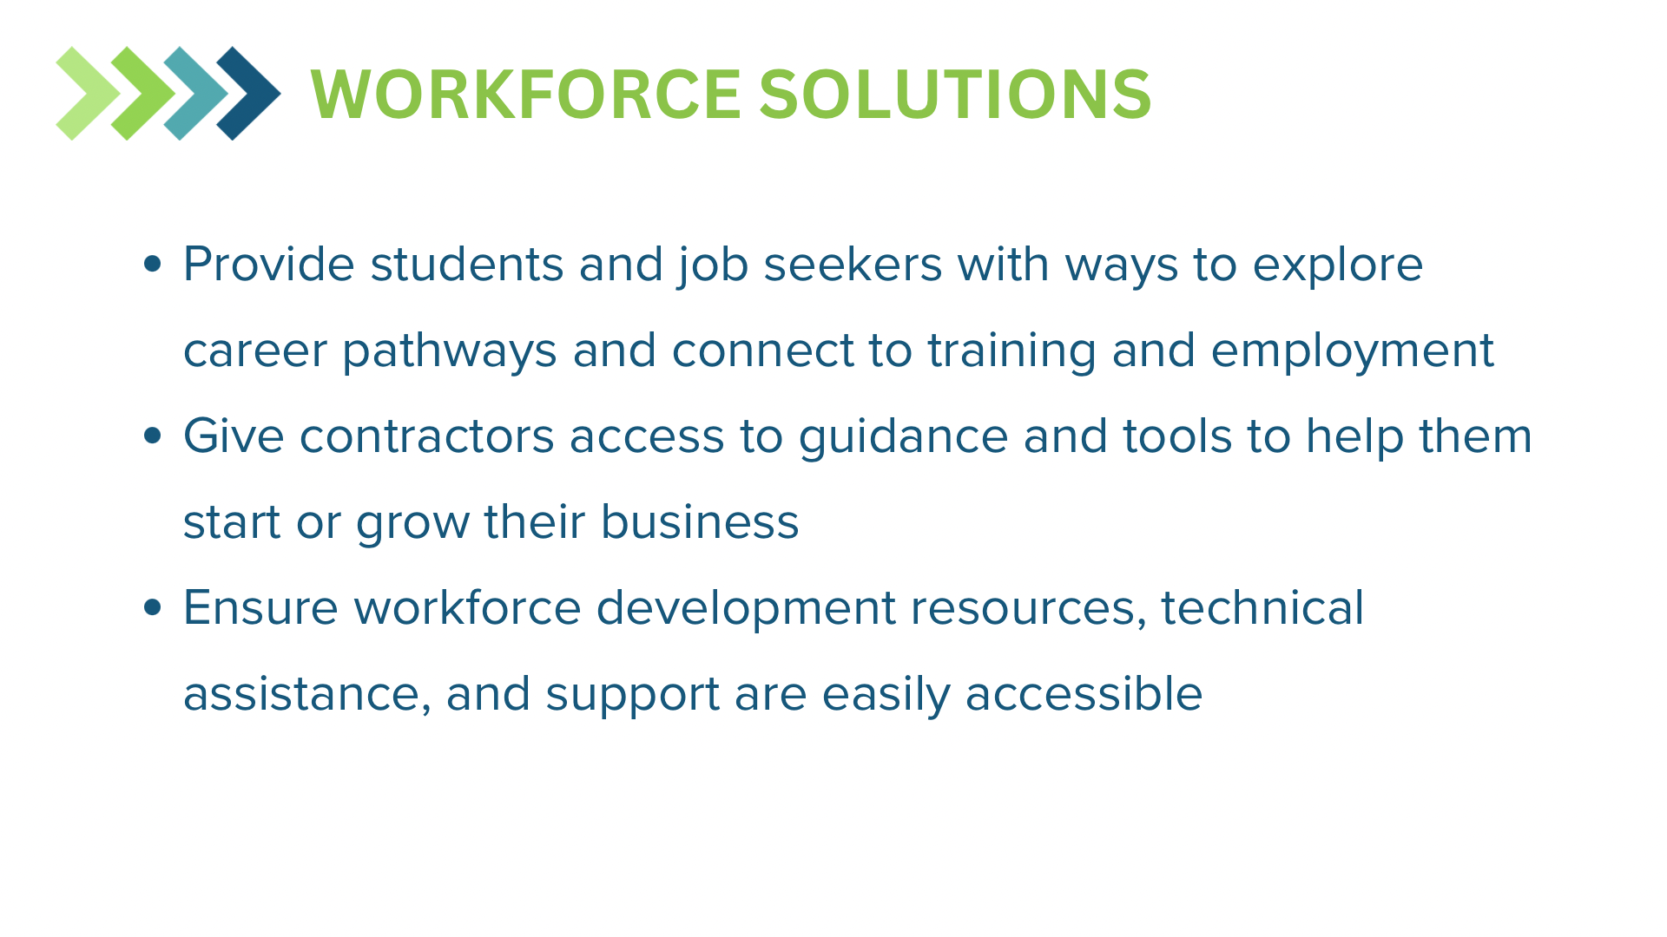

Slide 6

Addressing Workforce Needs and Supporting Programmatic Success

Slide 7
Challenge
Recruitment and Retention Difficulties
Wage Disparities
Skill Gaps
Notes:
Recruitment and Retention Difficulties:
Talent shortages in key industries, exacerbated by demographic shifts like Baby Boomer retirements and declining labor force participation.
High turnover rates due to lack of career progression opportunities and competitive compensation.
Wage Disparities:
Many positions offer wages below a living wage, impacting worker satisfaction and retention.
Persisting pay gaps further complicate workforce equity.
Skill Gaps:
Workers often lack the technical and soft skills required for weatherization projects.
Limited access to structured mentorships or apprenticeships to bridge these gaps.

Slide 8
Engagement / Poll
What is your biggest workforce challenge?

Slide 9
Solution - Competitive Compensation
Use tools like wage data analysis and the Living Wage Calculator to ensure fair pay scales across all positions.
Conduct regular pay audits to address disparities and improve transparency.
NASCSP Workforce Resources & Tools – Includes wage data and the WAP Living Wage Calculator.

Slide 10
Solution - Mentorship and Apprenticeship Programs
Implement structured mentorship programs across positions to foster professional growth, engagement, and retention.
Partner with organizations such as IREC and BPI to establish apprenticeships that align with industry standards.

Slide 11

Solution - Career Development Pathways
Offer clear career progression plans supported by robust training programs tailored to changing program needs.
Incorporate leadership succession planning into workforce development strategies.

Slide 12
Impact
Improved Recruitment Outcomes
Higher Retention Rates
Enhanced Workforce Skills
Programmatic Success!!!

Slide 13
Engagement / Poll
Share one strategy you’ve used to address workforce gaps or improve retention in your program.

Slide 14

Engaging with Contractors & Facilitating Networks

Slide 15
Contractor Challenges
Skilled Contractor Shortage
Turnover & Quality Control
Stigma Around Federal Funding
Notes:
– Finding experienced contractors willing to work in weatherization is a growing challenge.
– High turnover disrupts workflows and leads to inconsistent project quality.
– Many contractors hesitate to work with WAP due to concerns over regulations, payment timelines, and administrative burdens.

Slide 16
Engagement / Poll
What’s the biggest challenge you face in working with contractors?
Notes:
Kahoot Open Ended

Slide 17

Best Practices for Contractor Engagement

Slide 18
Why it Works: Longer bid windows attract more contractors and improve competition
Leave Bids Open Longer
Strategies for Success:
Key Benefits:
Increases contractor participation.
Allows smaller firms time to prepare proposals.
Improves bid quality and pricing.
Pre-bid meetings to clarify expectations and requirements.
Outreach campaigns to expand contractor interest
Follow-ups with potential bidders to address concerns.

Slide 19
Testing the Waters
Small Package Procurements are a low-risk way to engage new contractors.
On-the-Job Training helps contractors gain experience with WAP projects and get a better idea of scope, measures, costs, etc.
Why It Works:
Builds confidence and familiarity with program requirements.
Reduces contractor hesitation about federal funding processes.
Creates a pathway for long-term contractor engagement.

Slide 20

Expanding Outreach & Reducing Barriers
Expanding Contractor Outreach
Reducing Barriers
Metro Areas: Larger labor pools, more contractor availability.
New Markets: Recruiting from adjacent industries such as skilled trades, HVAC, and others.
Simplify Procurement: Using Requests for Qualifications (RFQ) instead of Requests for Proposals (RFP) reduces barriers for contractors who may be interested in learning more.

Slide 21
Building a Contractor Pipeline
Creating a steady pool of contractors: Ongoing recruitment, partnerships, and outreach.
Maintaining engagement & readiness: Training, support, and clear communication.
Long-term retention strategies: Strengthening relationships and reducing turnover.

Slide 22
Making WAP Attractive to Contractors

Slide 23
Overcoming Contractor Hesitation
Common Misconceptions:
Slow payments and excessive paperwork.
Too many regulations and compliance burdens.
Lack of profitability compared to private-sector work.
Changing the Narrative:
Streamlined processes and faster payments.
Reliable, consistent work with guaranteed funding.
Opportunities for business growth and long-term partnerships.

Slide 24
Wooing Contractors
Showcasing WAP’s Value:
Competitive pay and reliable work.
Consistent project flow supported by federal funding.
Simplified processes to reduce admin burden.
Building Trust Through Testimonials:
Success stories from contractors who have benefited from WAP.
Case studies on improved payment timelines and project efficiency.
Peer-to-peer engagement to encourage participation.

Slide 25
Helping Contractors Succeed
Training & Development:
Look into resources and programs to help contractors meet WAP standards.
Provide hands-on workshops and technical guidance.
Onboarding & Compliance Support:
Simplify paperwork and reporting requirements.
Dedicate assistance to navigate program expectations.

Slide 26

Engagement / Poll
Share one successful strategy you’ve used for building contractor networks.

Slide 27

Engaging & Facilitating Networks

Slide 28
Network Engagement Challenges
Limited Contractor Engagement
Inconsistent Communication
Barriers to Networking
Notes:
Contractors (and sometimes, Subgrantees) often feel disconnected from program goals, leading to lower participation and collaboration. Feedback loops between grantees, subgrantees, contractors, and community partners are often underdeveloped, resulting in misaligned expectations.
Traditional networking methods may not reach all partners, especially those in geographically dispersed or rural areas.

Slide 29

Solution - Proactive Outreach Strategies:
Host community engagement events such as fairs or hands-on workshops.
For contractors and Subgrantees, "Lunch and Learn" sessions or breakfast check-ins (e.g., donuts/tacos/burritos) go a long way to grow relationships and encourage engagement.

Slide 30
Solution - Digital Networking and Training:
Develop a professional online presence to make connections through virtual job fairs and webinars.
Provide on-demand training modules tailored to Subgrantee/contractor needs using LMS platforms

Slide 31

Solution - Partnerships:
Establish partnerships to align training with programmatic needs. These partnerships can streamline hiring processes and provide wraparound support services such as childcare or transportation. Both Subgrantees and contractors can take advantage of these partnerships.

Slide 32

Solution - Feedback Mechanisms:
Regularly collect input via surveys or focus groups to improve outreach efforts and training programs.
Make sure to capture Subgrantee and contractor feedback when developing the state plan, training plans, etc.

Slide 33

Solution - Recruitment Strategies
Expand hiring pipelines through platforms like Green Workforce Connect to reach talent pools outside of your regular network.
Engage with non-traditional candidates (e.g., career changers, returning professionals) and provide structured on-the-job training programs.

Slide 34
Impact
Stronger Relationships
Expanded Networks
Enhanced Workforce Development
Improved Program Outcomes!!!
Notes:
Improved collaboration leads to more dependable project outcomes and better alignment with program goals.
Active engagement strategies increase the pool of reliable contractors while fostering long-term professional relationships.
partnerships and tailored training programs result in a more skilled workforce that supports programmatic success.
Higher engagement scores among contractors correlate with fewer safety incidents, better quality work, and increased productivity.

Slide 35
Engagement / Poll
What is your preferred method for engaging with contractors or Subgrantees?
Notes:
Kahoot Open Ended

Slide 36

Onboarding and Training New Employees Effectively
Notes:
???
Onboarding plans
Career paths
Career Path Toolkit
Training – soft skills vs technical (plans too)
Litmos Training
Badges Toolkit

Slide 37
Challenges
High Turnover and Low Retention Rates
Skill Gaps
Inconsistent Training Approaches
Notes:
Many organizations struggle to retain new hires due to ineffective onboarding processes. Without a structured plan, employees feel disconnected and disengaged.
New hires often lack the technical or soft skills required to perform their roles effectively.
A lack of standardized training methods can lead to uneven employee performance and productivity.

Slide 38

Engagement / Poll
What is your biggest challenge in onboarding new employees?
Notes:
Kahoot Open Ended

Slide 39
Solution - Structured Onboarding Plans:
Develop
Develop comprehensive onboarding plans with clear timelines and milestones for the first days, weeks, and months.
Incorporate
Incorporate tools like the Career Path Toolkit to outline career paths and growth opportunities.
Use
Use welcome kits or personalized resources to make new hires feel valued.

Slide 40
Solution - Peer Support and Mentorship:
Assign mentors or buddies to guide new hires through their initial stages, helping them navigate company culture and expectations. See DOE WPN 22-4 Quality Work Plan Requirement Update for more information about QCI mentorships.

Slide 41
Solution - Blended Training Programs:
Combine
Combine technical training (e.g., job-specific tasks) with soft skills development (e.g., communication, teamwork).
Utilize
Utilize tools like WAP Litmos LMS for flexible learning experiences that can be accessed online.
Leverage
Leverage role-playing exercises, simulations, and e-learning modules to cater to diverse learning styles.

Slide 42
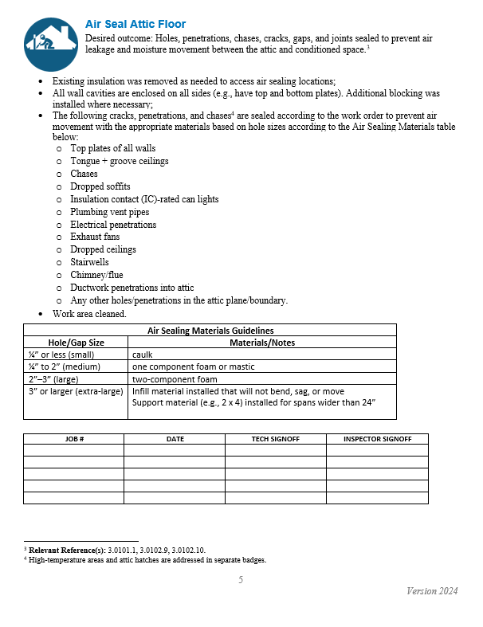
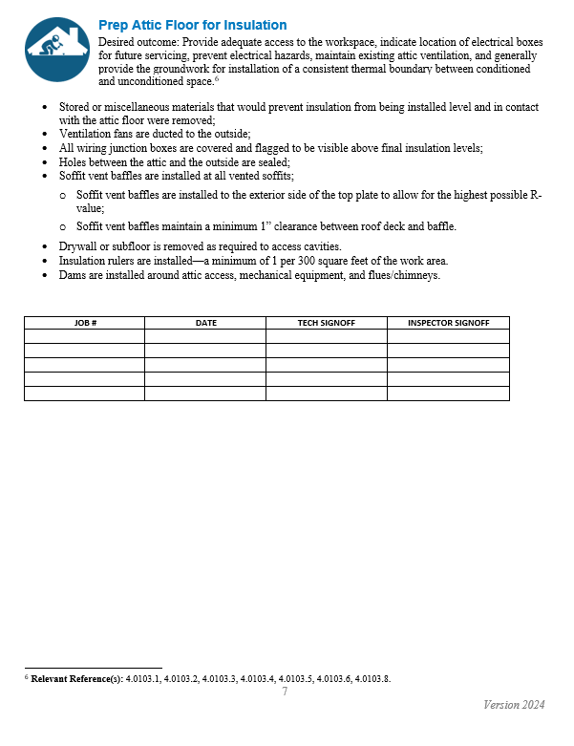
Solution - Competency-Based Recognition:
Implement competency-based systems like the Installer Badges Toolkit to recognize skills and provide stackable credentials for career advancement.
The NASCSP WAP Career Path Toolkit has resources that work alongside the NREL Badges toolkit.
https://www.energy.gov/scep/wap/installer-badges-toolkit

Slide 43
Solution - Feedback Loops:
Regularly collect feedback from new hires about their onboarding experience through surveys or one-on-one check-ins. Use this data to refine processes.

Slide 44
Impact
Improved Retention Rates
Enhanced Productivity
Higher Employee Engagement
Programmatic Success!!!
Notes:
Organizations with robust onboarding processes see improvement in new hire retention
comprehensive training programs increase productivity
Structured career paths and recognition systems boost morale and foster long-term commitment
A well-trained workforce directly supports the goals of the Weatherization Assistance Program by improving service quality and efficiency.

Slide 45
Engagement / Poll
Share a successful onboarding practice you’ve implemented or experienced.

Slide 46

Leveraging Tools & Resources

Slide 47
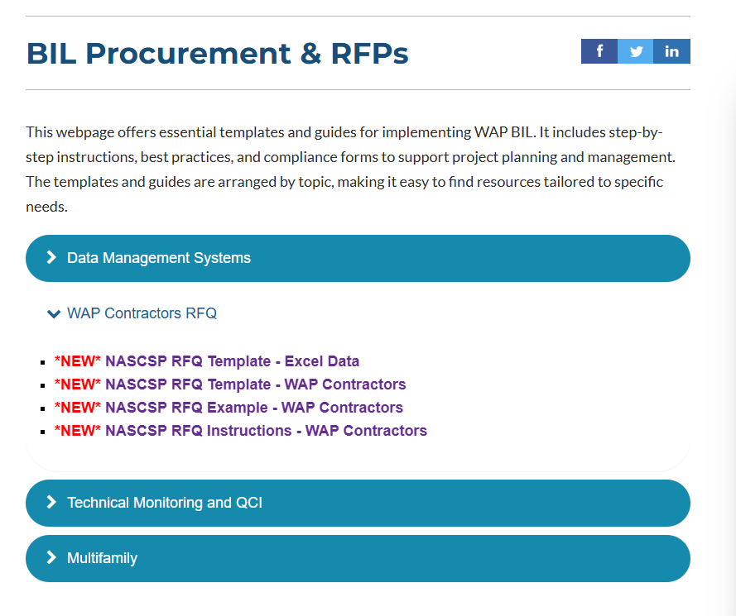
Contractor RFQ Templates from NASCSP
RFQ Templates for Contractors and other services used in WAP. These can work for both Grantees and Subgrantees. These templates are a great starting point and take half the work out of RFQ development. https://nascsp.org/bil-procurement-rfps/

Slide 48
NASCSP Workforce Resources & Tools Webpage
Weatherization Wage Data (Update coming soon!)
Workforce Partnerships & Green Workforce Connect
Living Wage Calculator (Update coming soon!)
Customizable Career Exploration Presentation
Weatherization Career Fliers (Update coming soon!)
Weatherization Career Path Toolkit
https://nascsp.org/workforce-resources-and-tools/

Slide 49
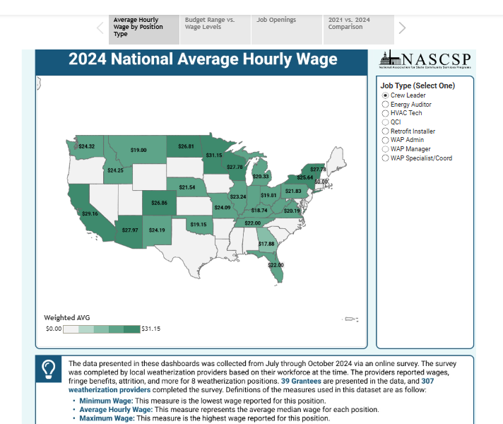
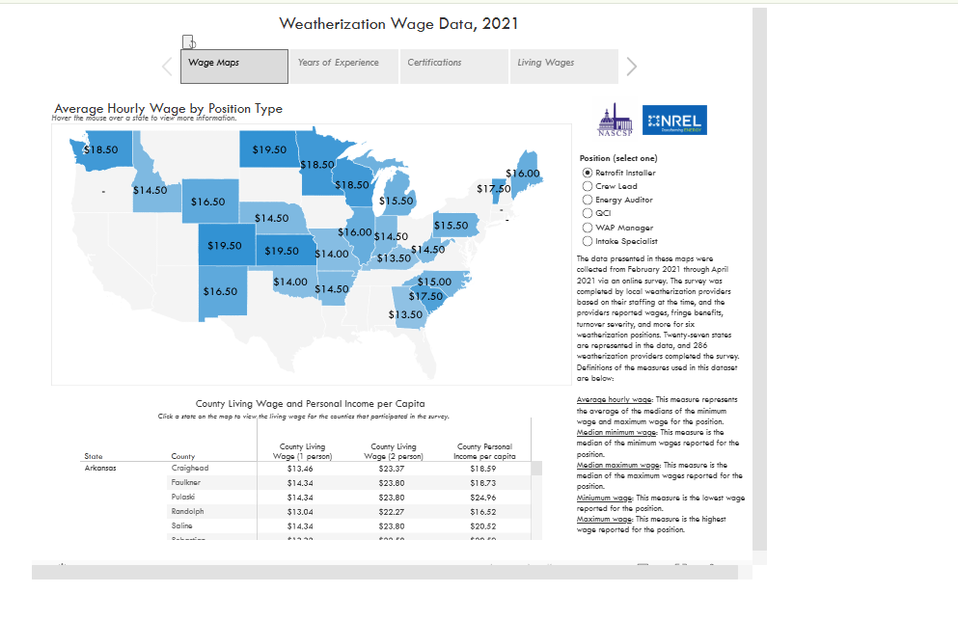
WAP Wage Data
Wage data was collected from weatherization providers across the nation in the 2021 and 2024 Weatherization Workforce & Wage Survey.
Tools include easy-to-use dashboards, data collection resources, and more!
New tools and updated data are coming soon!

Slide 50
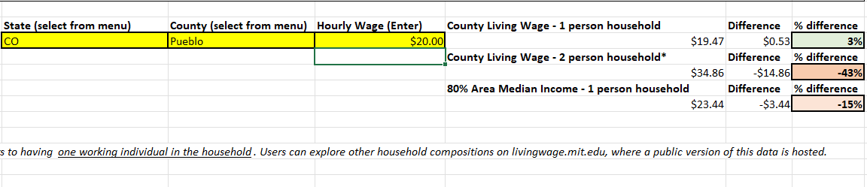
Living Wage Calculator
The calculator provides a county cost of living estimate for all counties in the 50 states and District of Columbia.
WAP employers and employees can use the calculator to help understand what employees need to support themselves.

Slide 51
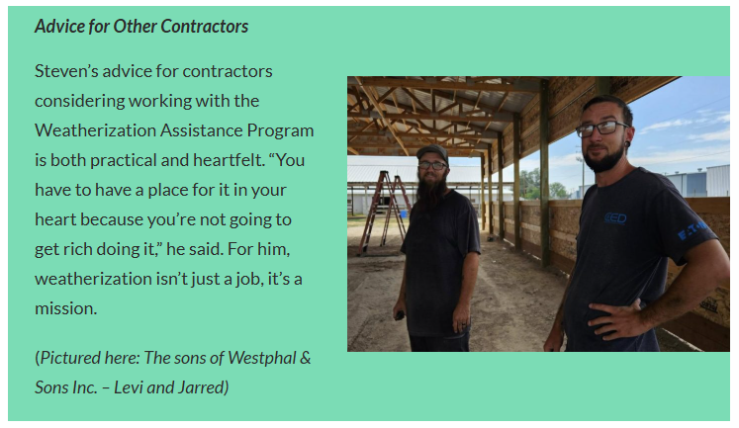
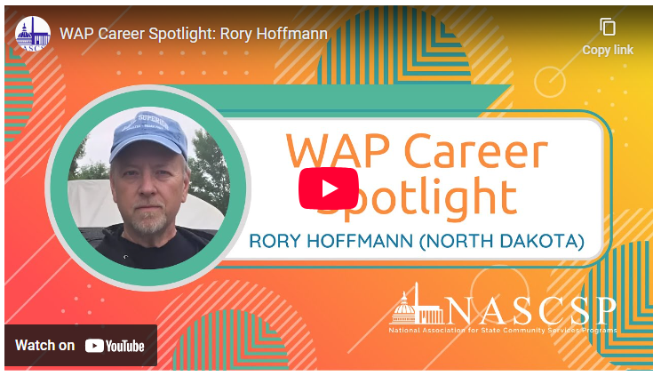
NASCSP’s National Voice (Blogs)
Career Spotlights & Contractor Highlights
Workforce success stories & innovative initiatives
https://nascsp.org/blog/

Slide 52


Slide 53
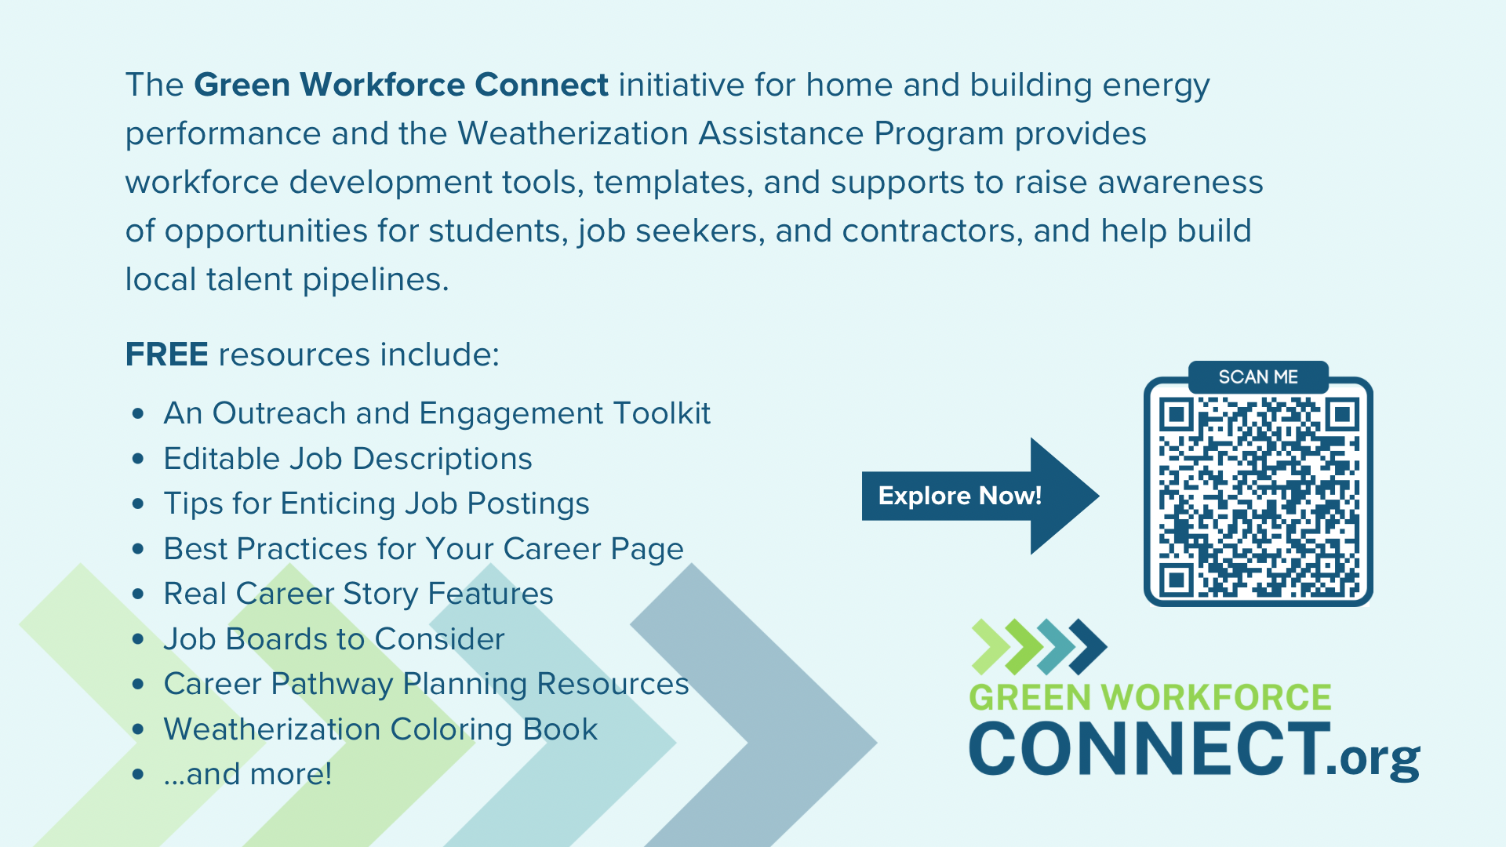

Slide 54
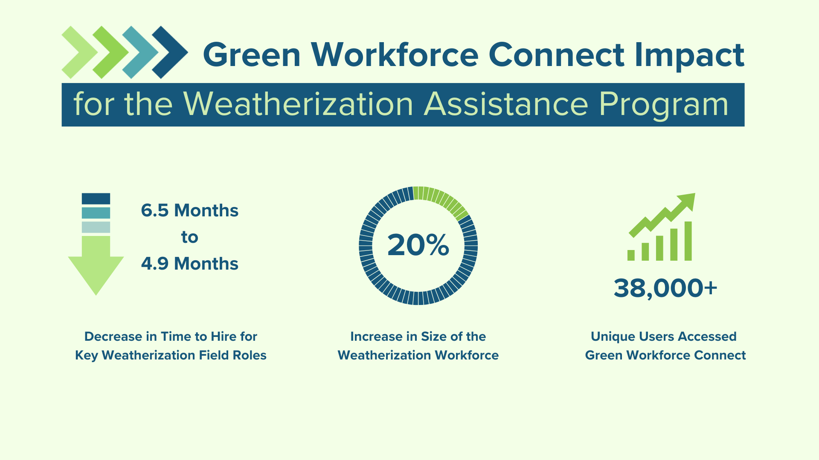

Slide 55
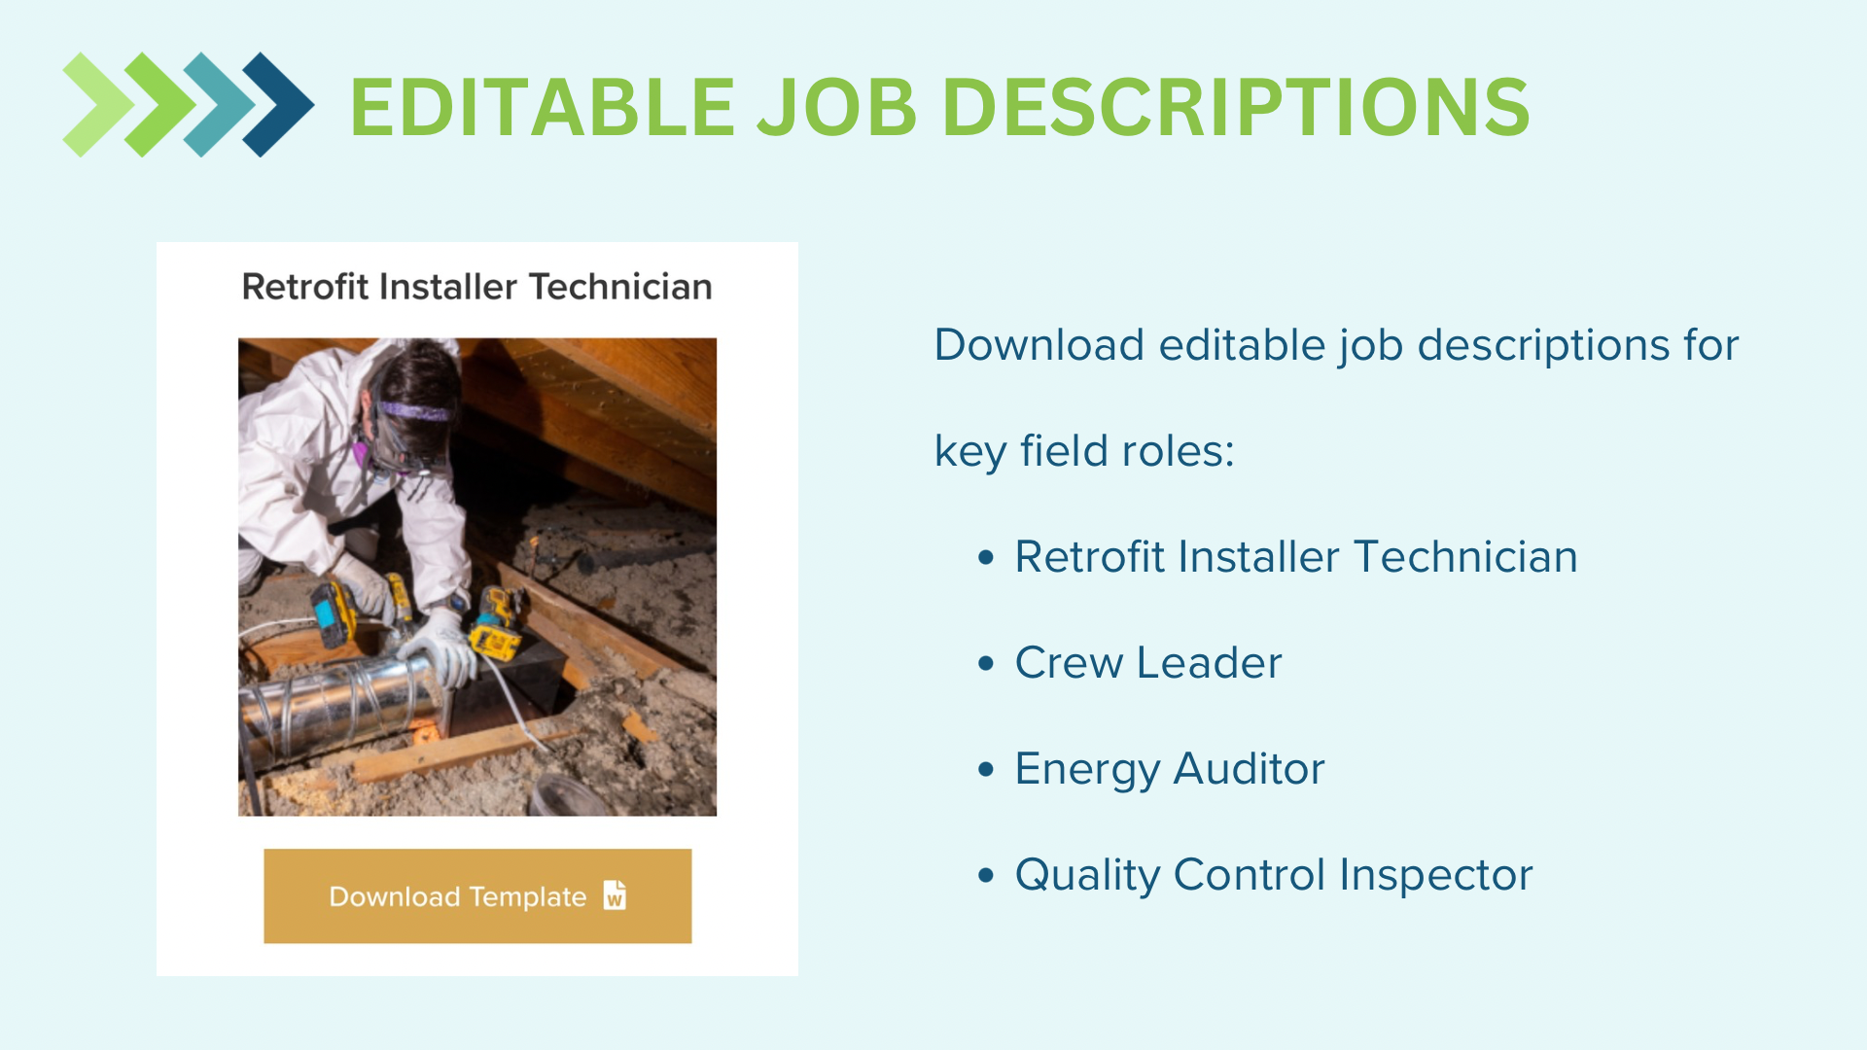

Slide 56
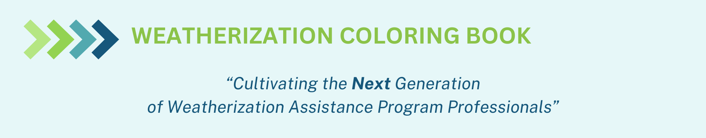

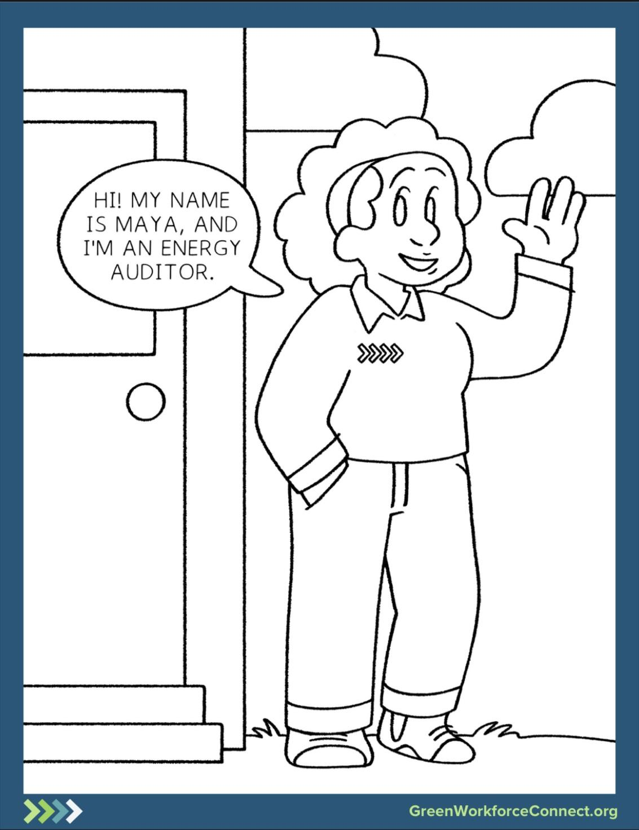
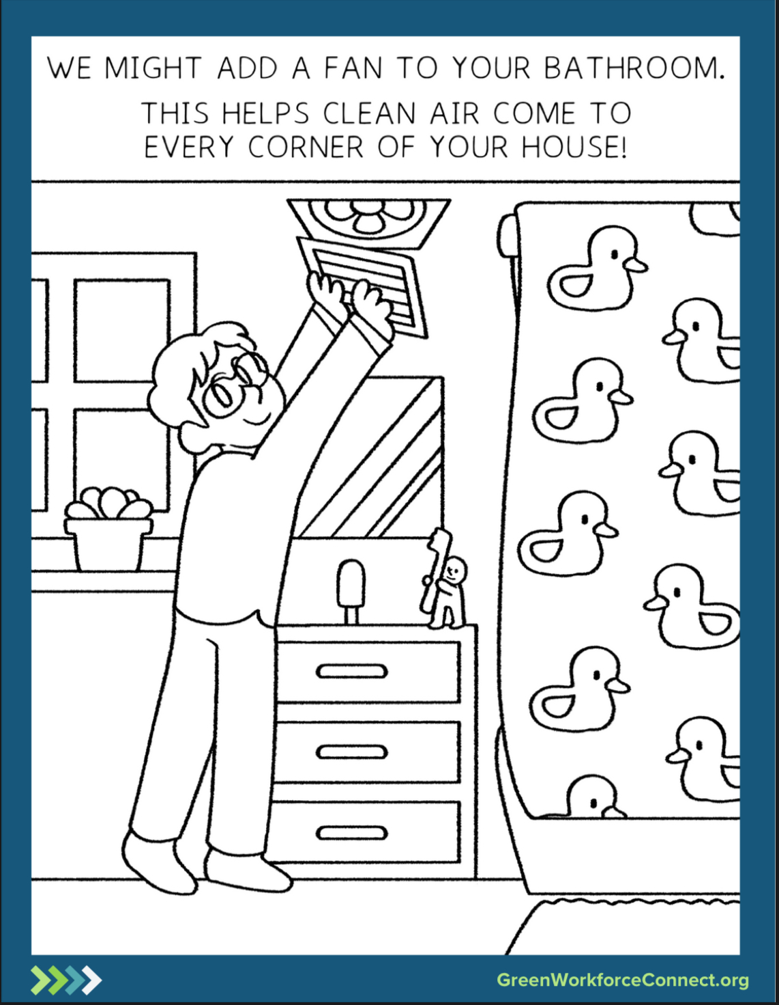

Slide 57
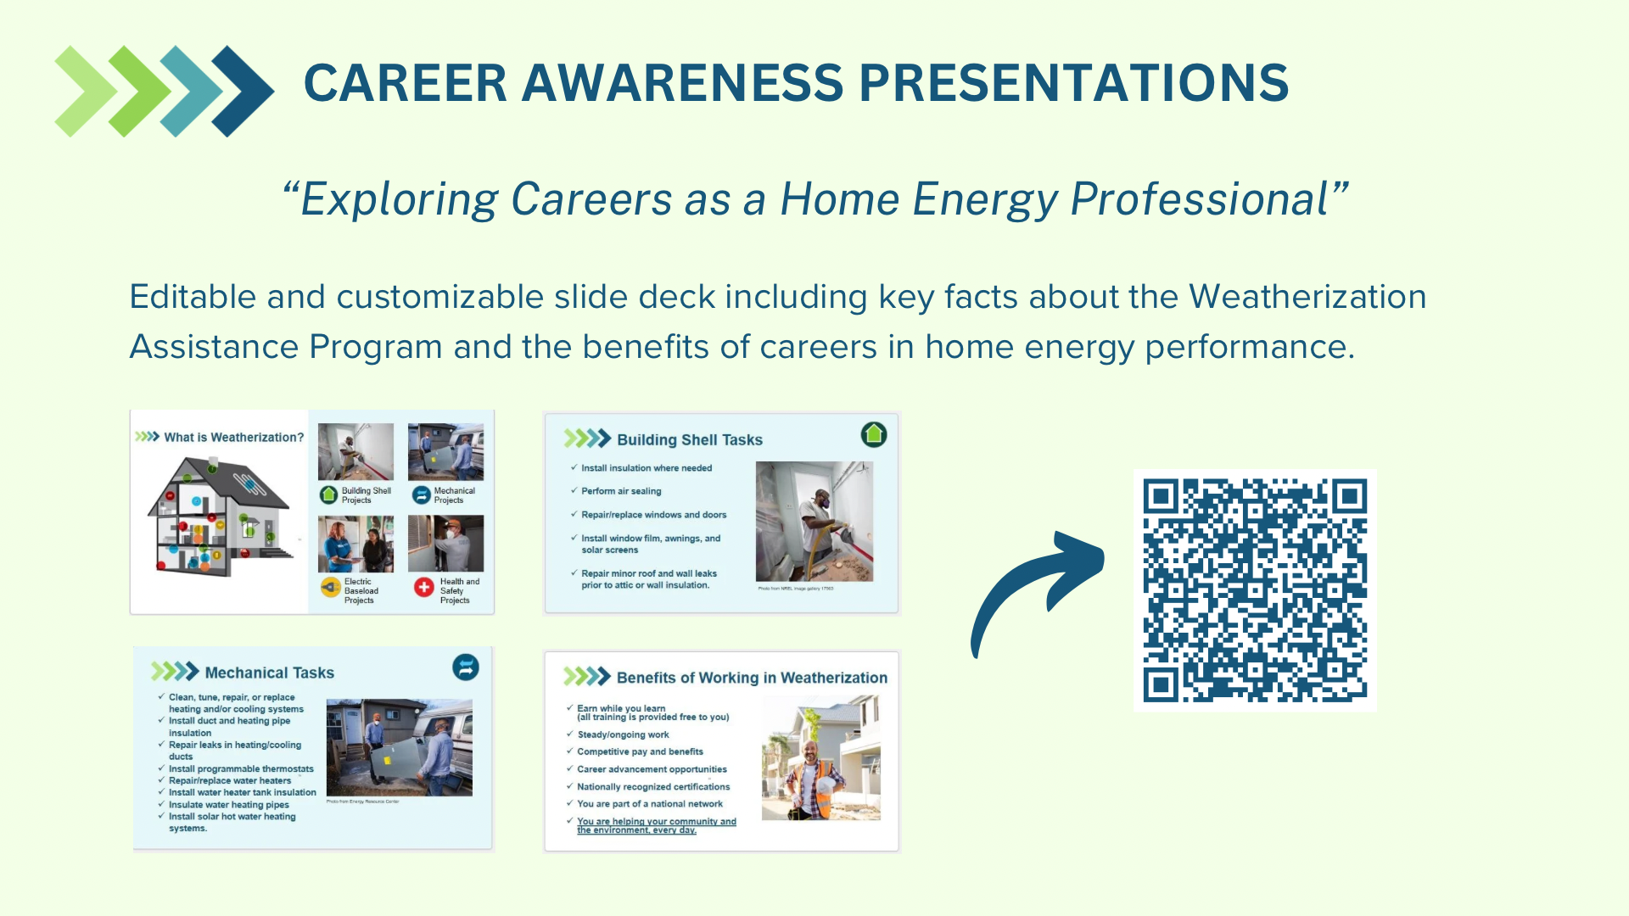

Slide 58
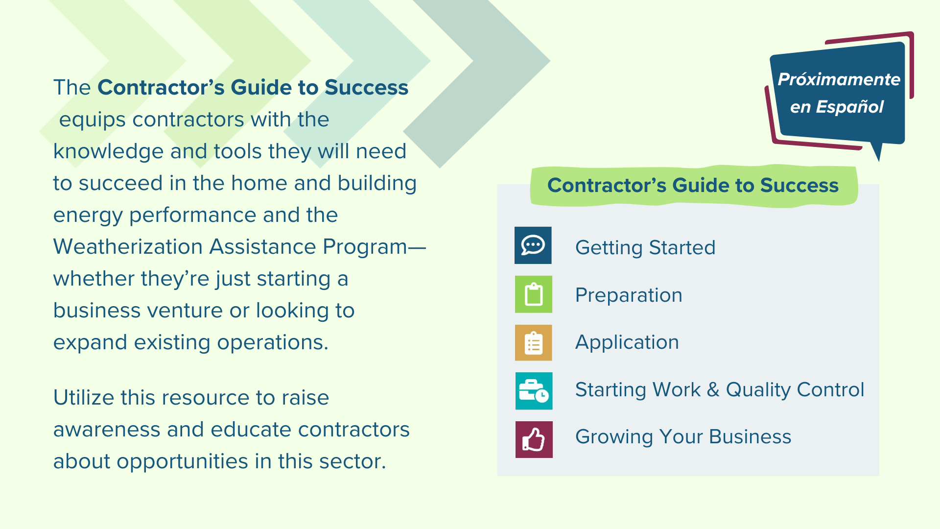

Slide 59
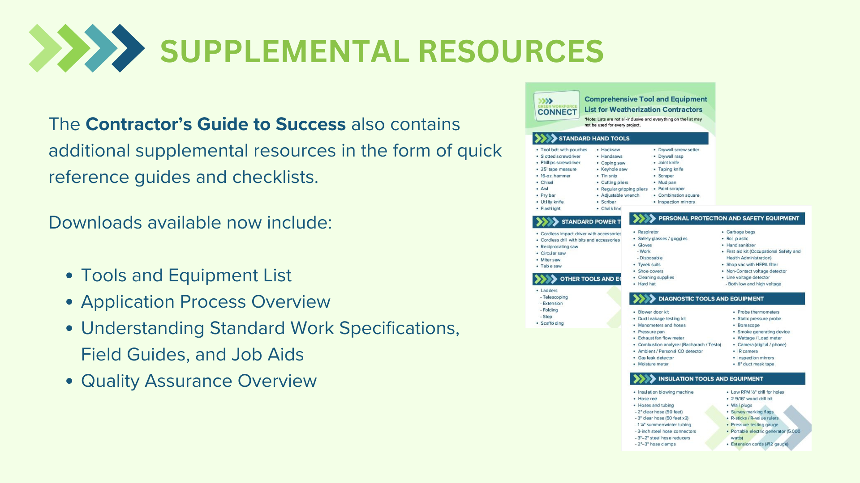
Notes:
Tools & Equipment list
https://greenworkforceconnect.org/wp-content/uploads/2023/12/CGS-Comprehensive-Tool-and-Equipment-List-for-Weatherization-Contractors.pdf
Application Process
https://greenworkforceconnect.org/wp-content/uploads/2023/12/CGS-Guide-to-Weatherization-Contractor-Applications-1.pdf
Field Guides, SWS and Job Aids
https://greenworkforceconnect.org/wp-content/uploads/2023/12/CGS-Understanding-Weatherization-Standard-Work-Specifications-Field-Guides-and-Installer-Job-Aids-.pdf
Quality Assurance
https://greenworkforceconnect.org/wp-content/uploads/2023/12/CGS-Quality-Assurance-in-Weatherization.pdf

Slide 60
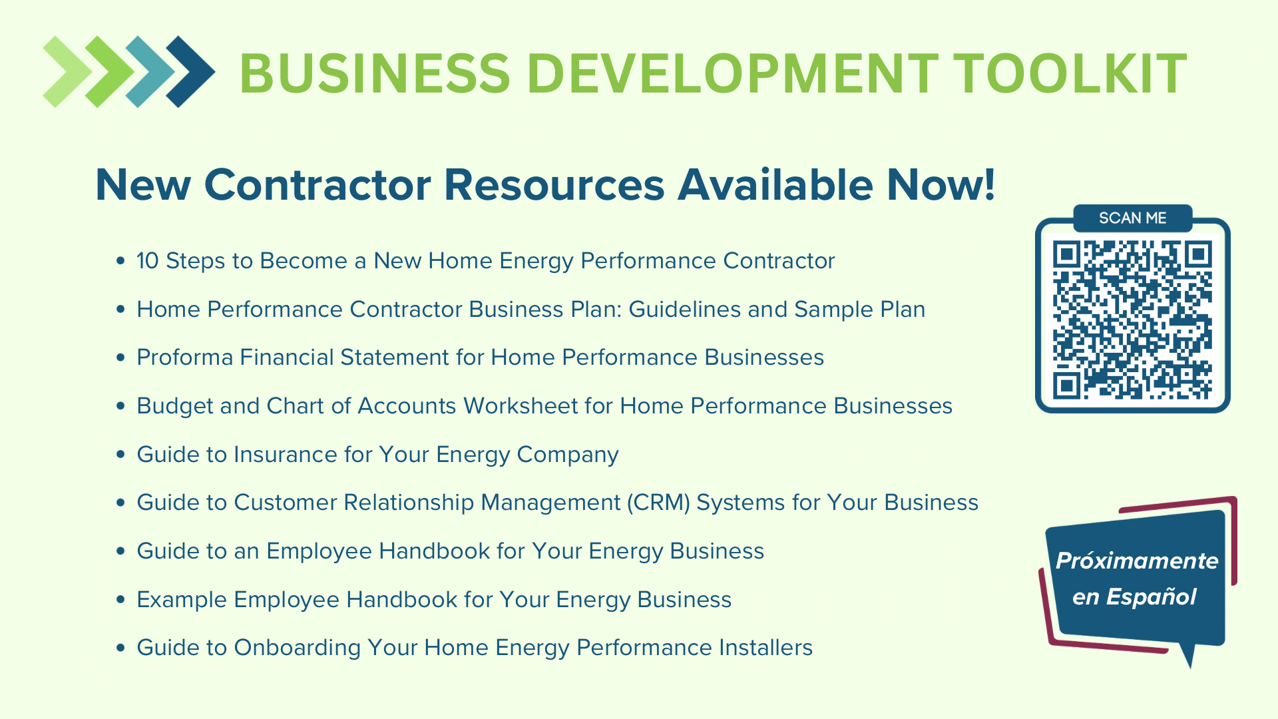

Slide 61
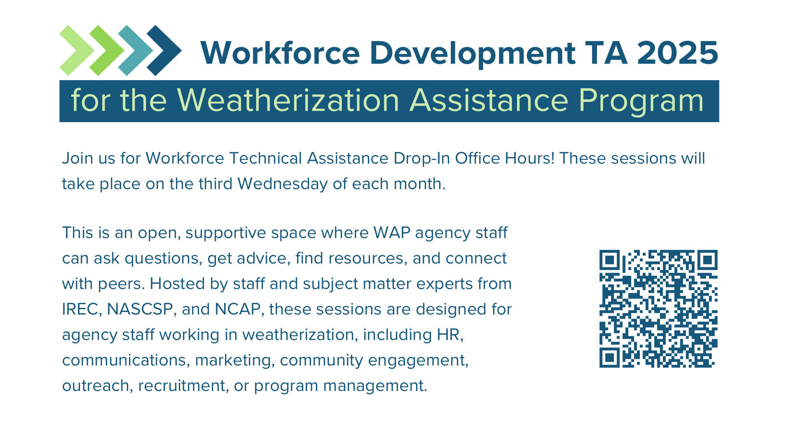
Notes:
WAP Workforce Technical Assistance Drop-In Office Hours
https://irecusa.zoom.us/meeting/register/tZEvf-uppjkjG9W4fXtmzeiMp4WVLU00gjzA

Slide 62

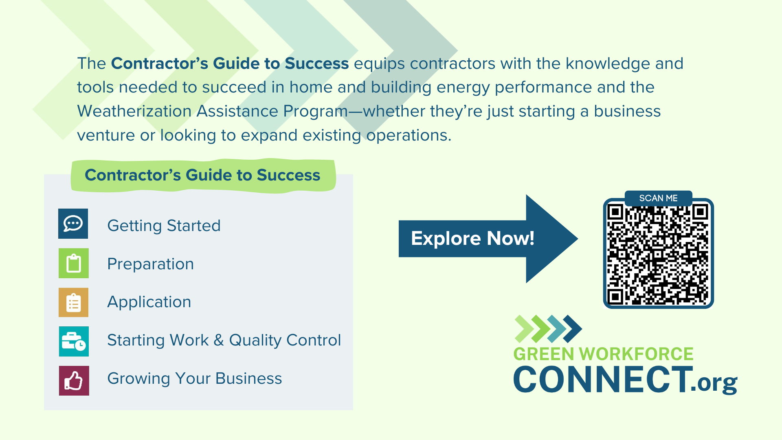
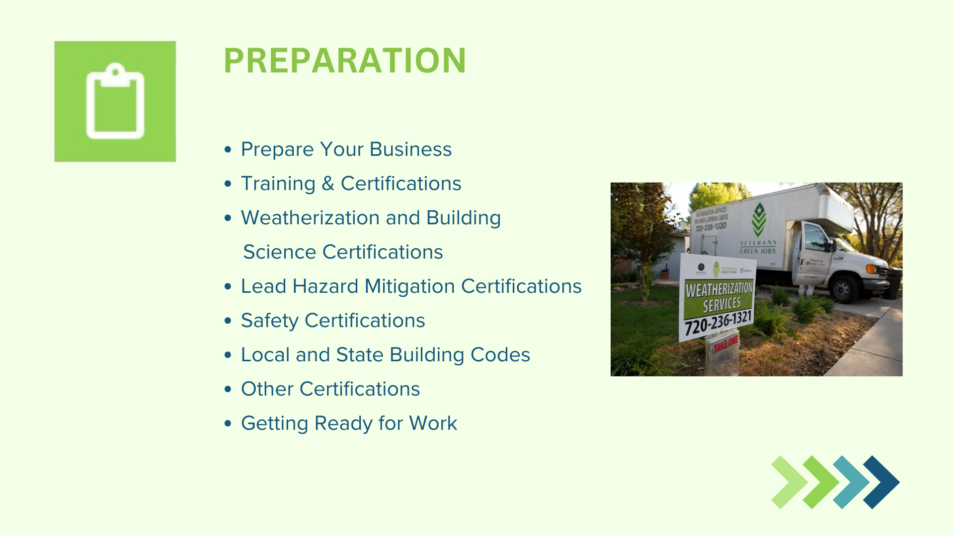
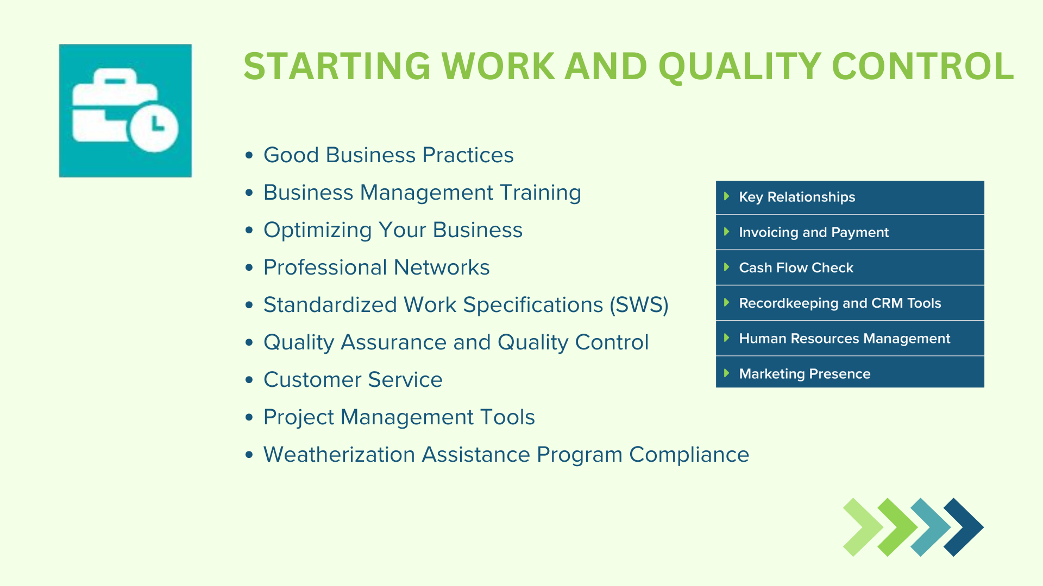
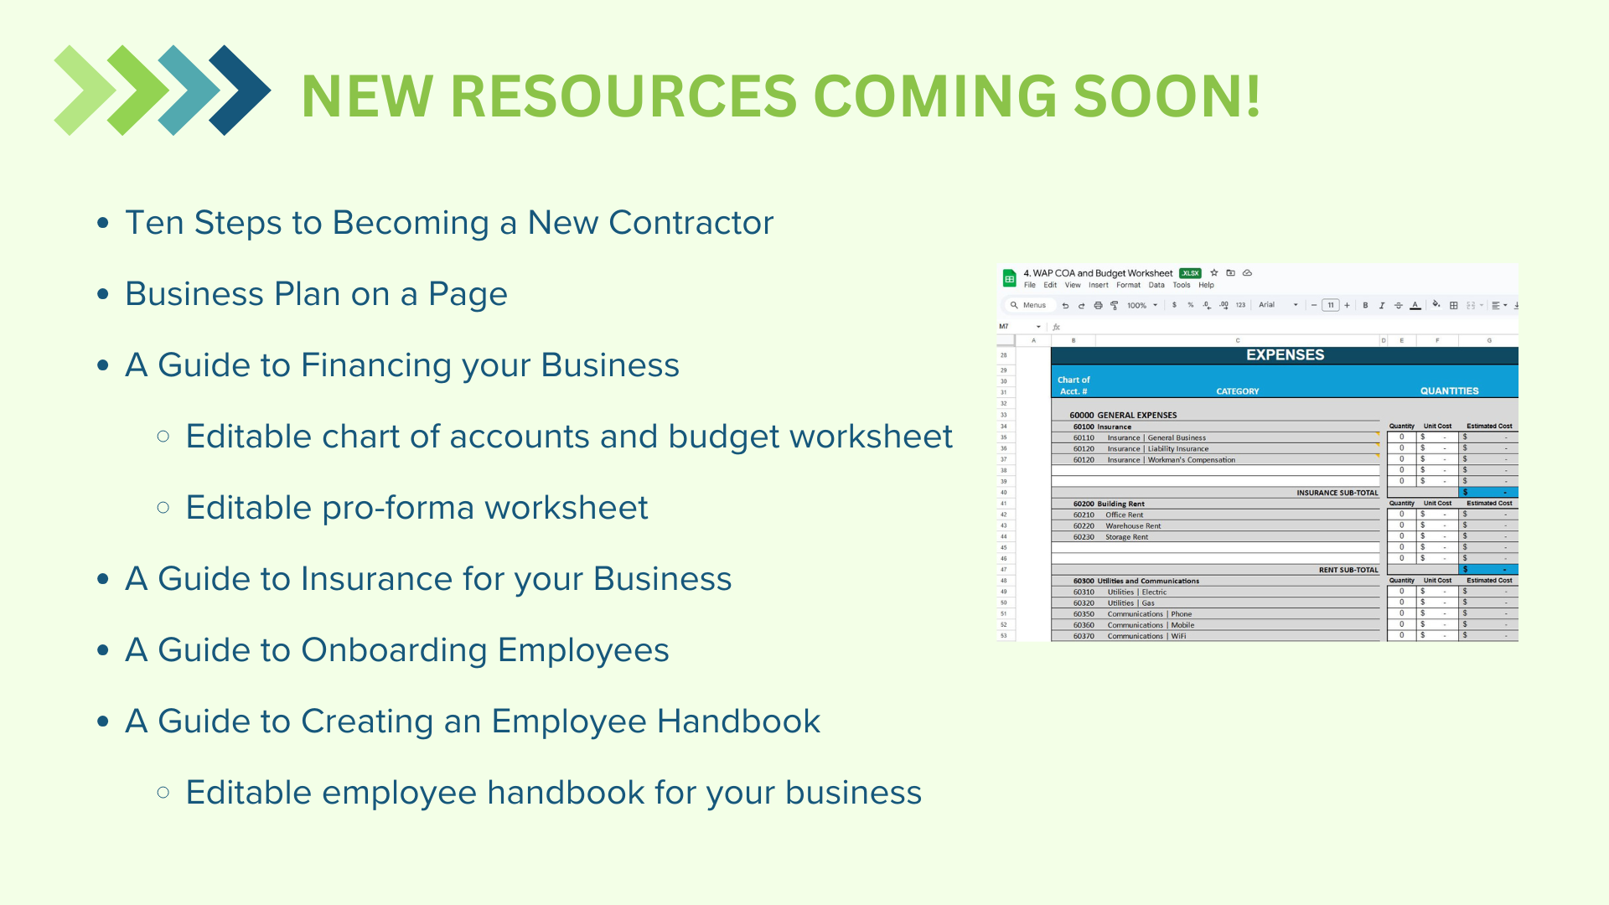
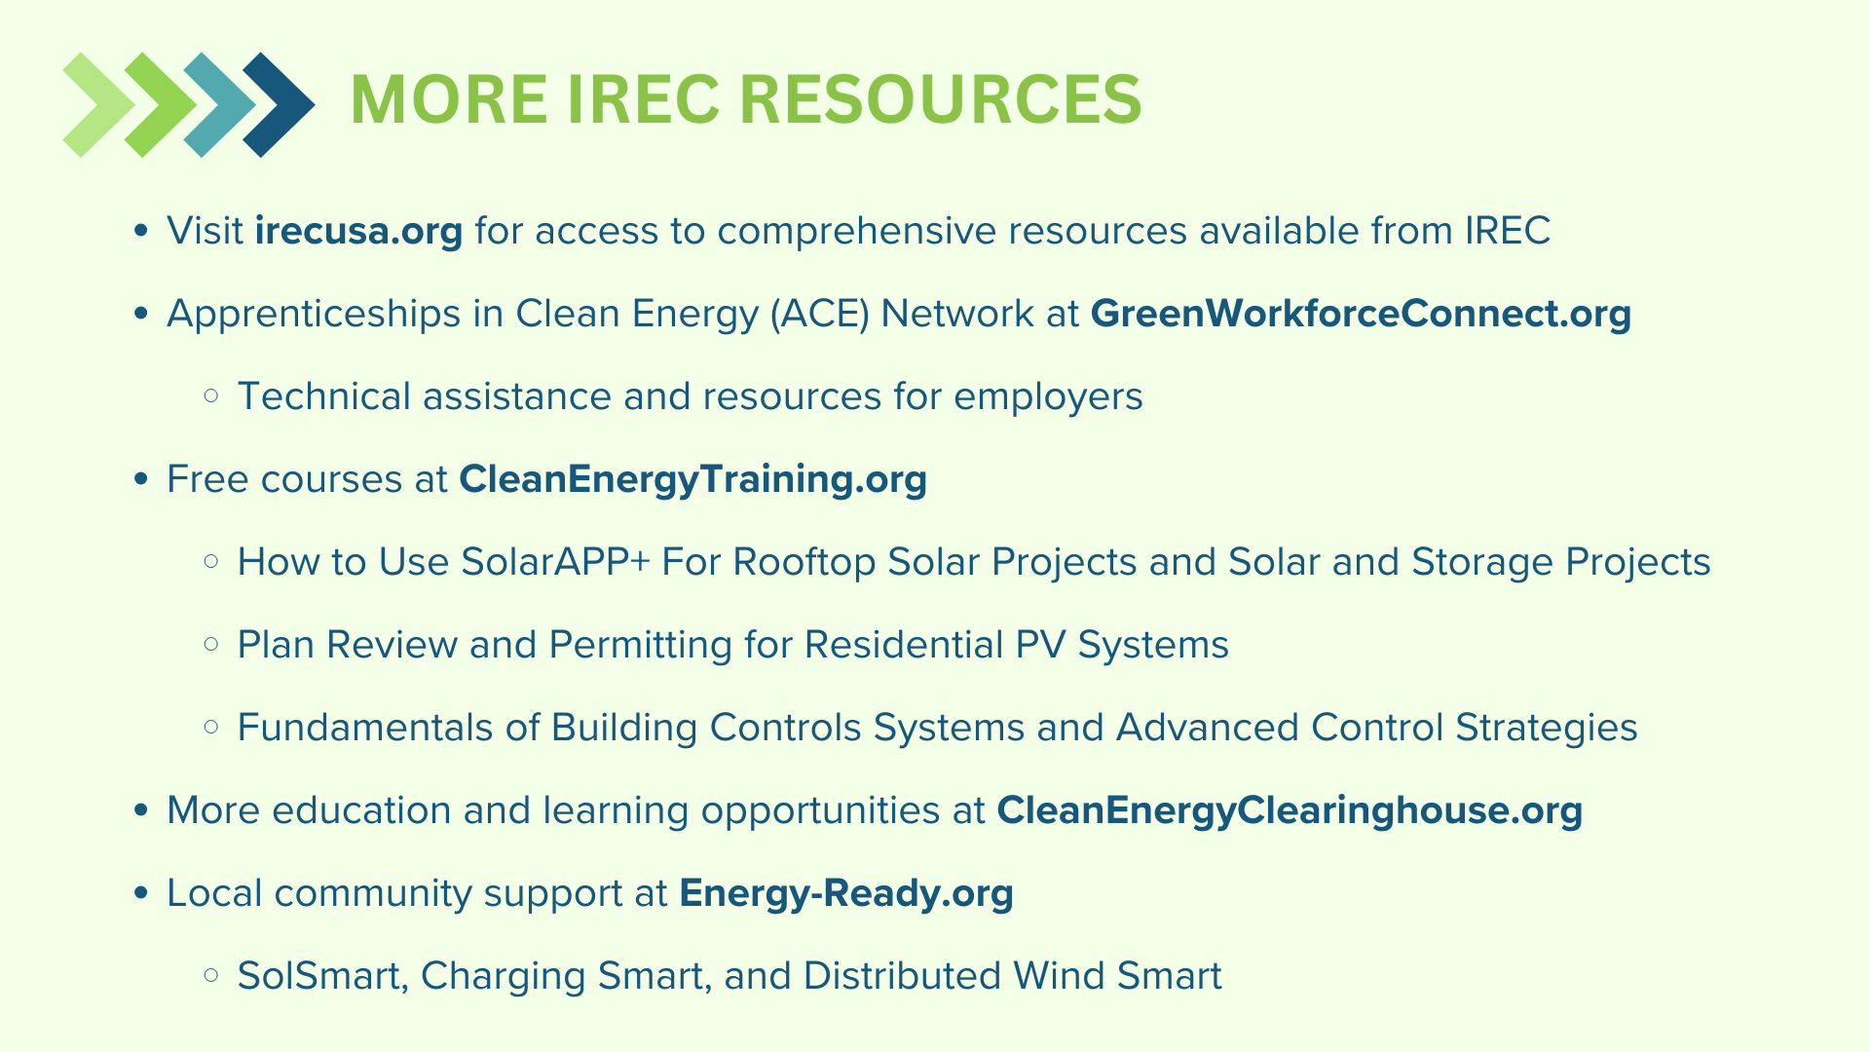
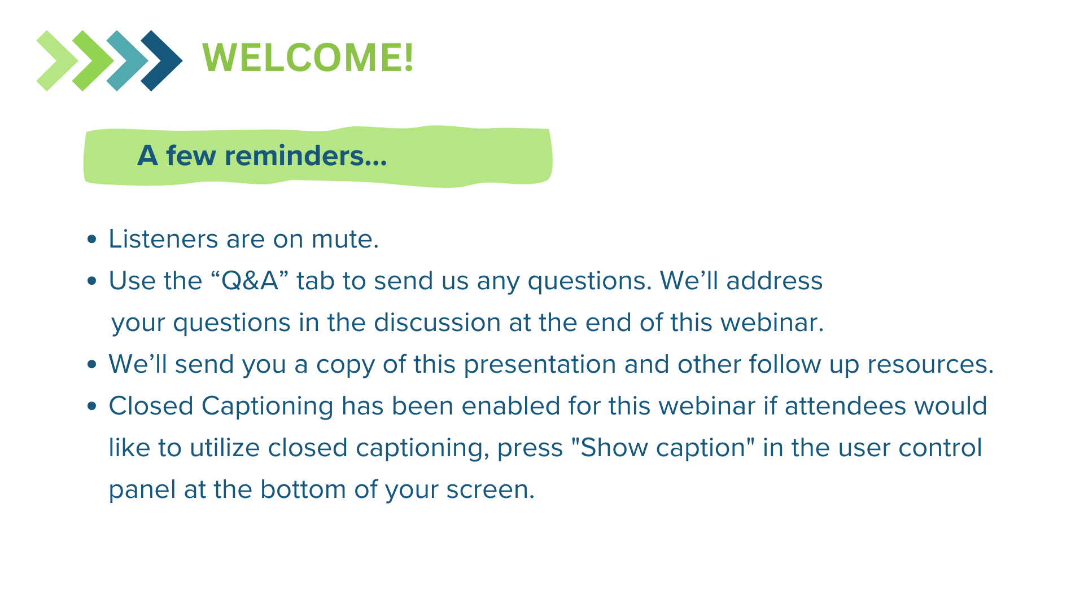
Notes:
Other GWC resources for WAP that might be helpful - including Job Descriptions
https://drive.google.com/file/d/1CBRBWca9LnMkVAnyyzD9CWBOmHkmEd4O/view?usp=sharing

Slide 63
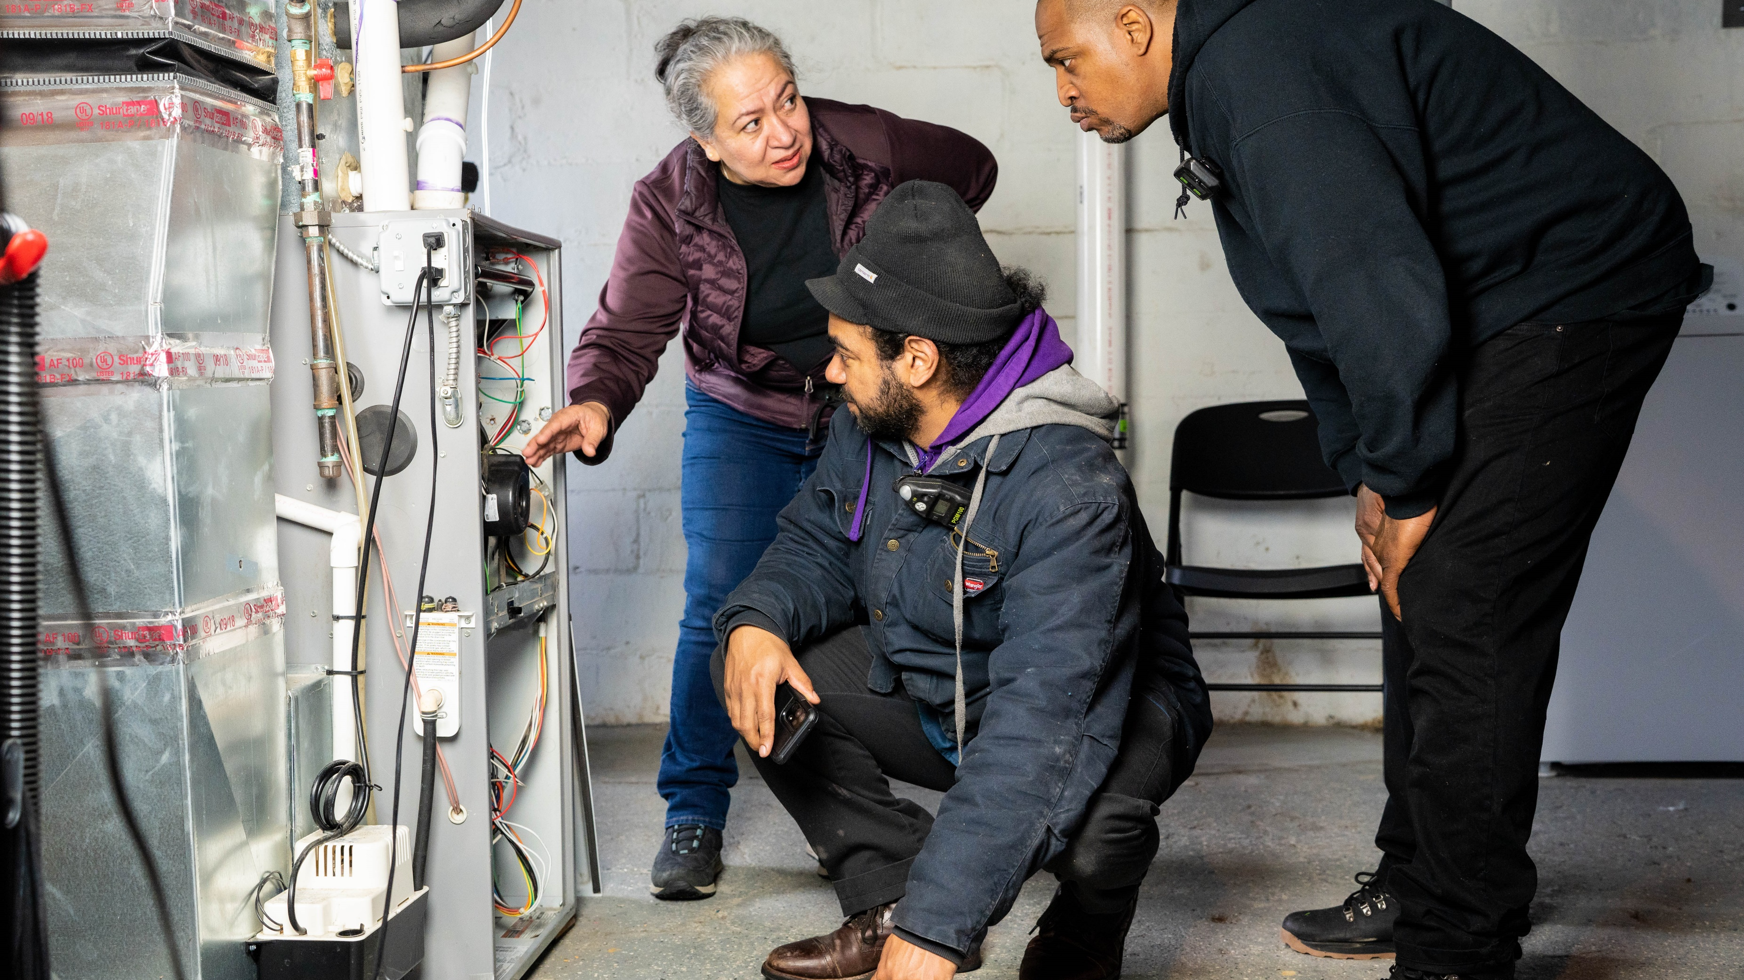

Get Started
With the Recruitment Toolkit
https://www.bpi.org/recruitment-tools/
Notes:
Get started by visiting www.bpi.org/recruitment-tools/. This is where you can download the Toolkit, checklist, and all the template materials. I’m going to try to show you the website location and some of the things that are readily available for your use.

Slide 64

Resources, Tools, and More!
NASCSP RFQ Templates
Green Workforce Connect
Contractor’s Guide to Success
Weatherization Workforce Resources
NASCSP Workforce Resources & Tools
BPI Recruitment Toolkit

Slide 65
Pitch Activity
Create a quick idea or short “pitch” to use for a tool, resource, or initiative. Draft a quick plan for hosting an engagement event for Subgrantees, contractors, and/or job seekers.
What would you do with your current scenario?
What if you had unlimited funding or resources?

Slide 66
Your Next Steps
We encourage you to take action by implementing at least one new strategy in your program. Whether it's enhancing your onboarding process, engaging contractors more effectively, or addressing other workforce needs, every step forward contributes to program success.

Slide 67

Engagement / Poll
What is one thing that you learned today (or an action) that you plan to take back with you to use and/or share?

Slide 68

Questions?
Feel free to ask any questions. We want to hear from you!

Slide 69
Thank You!
Contact: kgarvin@nascsp.org

