Slide 1
PY 2025 State Plan Development Training
Notes:
Thank you for joining us today! At this time of year when the weather turns cold, I often find myself reflecting on some of the magic of the season – spending time with friends and family, shopping for presents, decorating to create cheer. And all of this magic comes from the Annual State Planning process. My name is Jonathan Ballew and I am the Senior Program Manager for WAP at NASCSP. I am joined by my colleagues Andrea Schroer, NASCSP WAP Director, in Atlanta, GA. Claudia Torres, WAP BIL Sr. Program Manager; Kye Garvin, Workforce Program Manager, and Bryce Nguyen, WAP Program Analyst.
We will present the updates and success strategies then at the end we will take questions for us and DOE. In the next slide I have the agenda

Slide 2

AGENDA
Overview of State Plan Process
Review changes to PY ‘25 Annual Grant Guidance
WAP Memo 138
Administrative and Legal Requirements Document (ALRD)
Application Instructions
WPN 25-1
Program Management Strategies & Timely Contract Execution
LIVE Q&A with DOE
Notes:
Today this training will focus on the updates from PY 2024 to PY 2025 in the recently released state plan application guidance.
Funding amounts will be published in WPN 25-2 – not yet released

Slide 3

NASCSP Mission:
Increasing capacity in States to achieve economic security and energy efficiency in low-income communities.
Notes:
NASCSP members represent all 50 states, and DC, Puerto Rico, American Samoa, US Virgin islands, Guam and Northern Mariana Islands.
The National Association for State Community Services Programs (NASCSP) is the sole national association charged with advocating and enhancing the leadership role of States in the administration of the Community Services Block Grant (CSBG) and Weatherization Assistance Program (WAP).

Slide 4
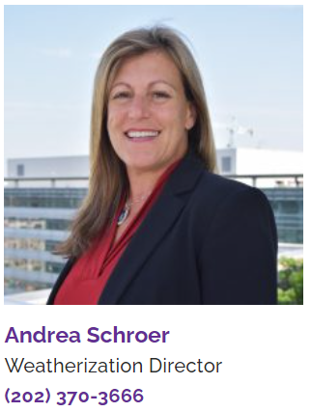


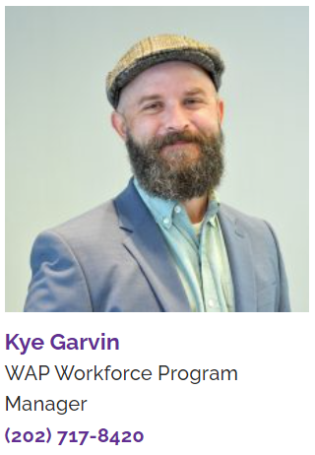
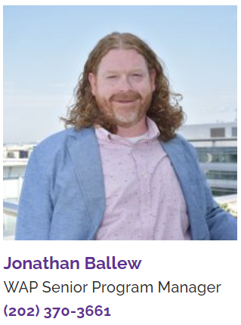
NASCSP WAP Staff
Andrea Schroer Weatherization Director | Bryce Nguyen WAP Program Analyst | Claudia Torres WAP BIL Senior Program Manager | Kye Garvin WAP Workforce Program Manager | Jonathan Ballew WAP Senior Program Manager
Notes:
our small but might team is spread out around the country and if you are new to WAP, we would love to meet you!
For years it was just Jonathan and Andrea, but in 2023 Kye Garvin joined NASCSP and last month, Bryce moved to WAP from our Research Dept.
Within NASCSP we have the WAP, CSBG and Research departments within our organization. NASCSP is funded in part by Membership dues and federal grants from DOE and OCS.

Slide 5
Process Overview
Planning, Manual and policy updates
State Plan & Budget Development
Submission and DOE PO coordination and reviews
Acceptance and Subgrantee Contract Executions
Notes:
Annual plan = 8 month process.
Who is the team? Who is running the process?
Regulations/guidance: Memo 138 – Redline memo, 25-1, application instructions, and ALRD.

Slide 6
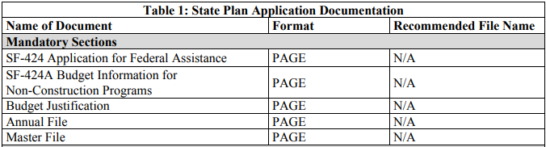
Mandatory State Plan Components
SF 424, SF 424A
Budget Justification
Annual File
Master File
Notes:
SF 424 is a required form tor new or continuing funding allocations.
Budget – more detail to provide DOE with a clear understanding of how the Grantee is proposing to use funds. Must define with leveraged funds to be included in the budget. See p. 14 of application instructions for the pros and cons of including leveraged funds into the budget. Keep in mind that defining the optional budget categories can assist in controlling the ACPU
Annual File: Subgrantees, subgrantee selection (Make sure that subgrantees and subcontracting Agencies much check the Excluded Parties Listing in SAM). Production schedule. Energy Savings estimates (DOE template available). Leveraging activities. Policy Advisory Council. State Plan Hearing. Miscellaneous.
Master File: Eligibility – building and client. Reweatherization compliance process. Describe what structures are eligible for Wx. Describe how rentals and MF buildings will be addressed. Describe deferral process. WRF plan and tracking. Definition of children. Approach to Tribal organizations. Selection of areas served. Prioritizing clients. Climatic conditions. Technical guides. Energy Audit Procedures. Final Inspection. Wx Analysis of Effectiveness. Health and safety plan. Grantee organization. Administrative funds limits. Monitoring activities. T&TA plan. Energy Crisis and Disaster Response Plan

Slide 7
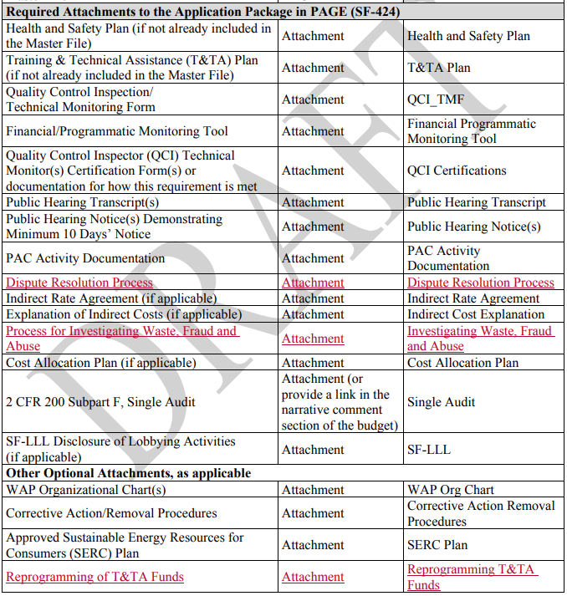
Required Attachments:
New Required Attachments:
Dispute Resolution Process
Process for investigating Waste, Fraud, and Abuse
Reprogramming of T&TA
Notes:
New attachements required this year. We will dig into these in more detail later. These attachments must be attached to the SF-424 submittal.

Slide 8
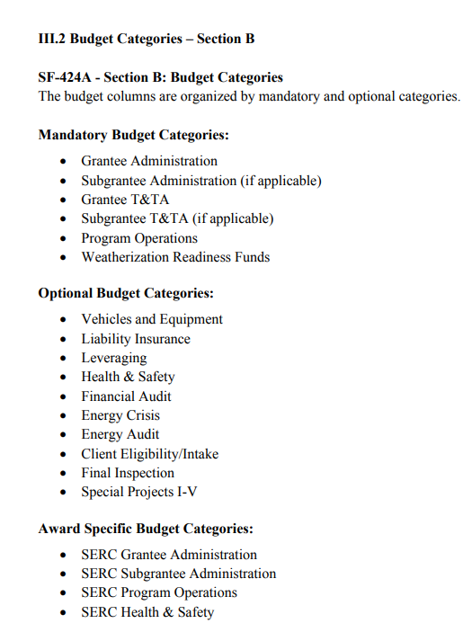
NEW Budget Categories!!
New optional budget categories:
Energy Audit
Client Eligibility/Intake
Final Inspection
WPN 24-7
Notes:
These new budget categories are essentially a raise to the ACPU!!! NASCSP advises to use all optional budget categories!! This is a best practice to control the ACPU.

Slide 9
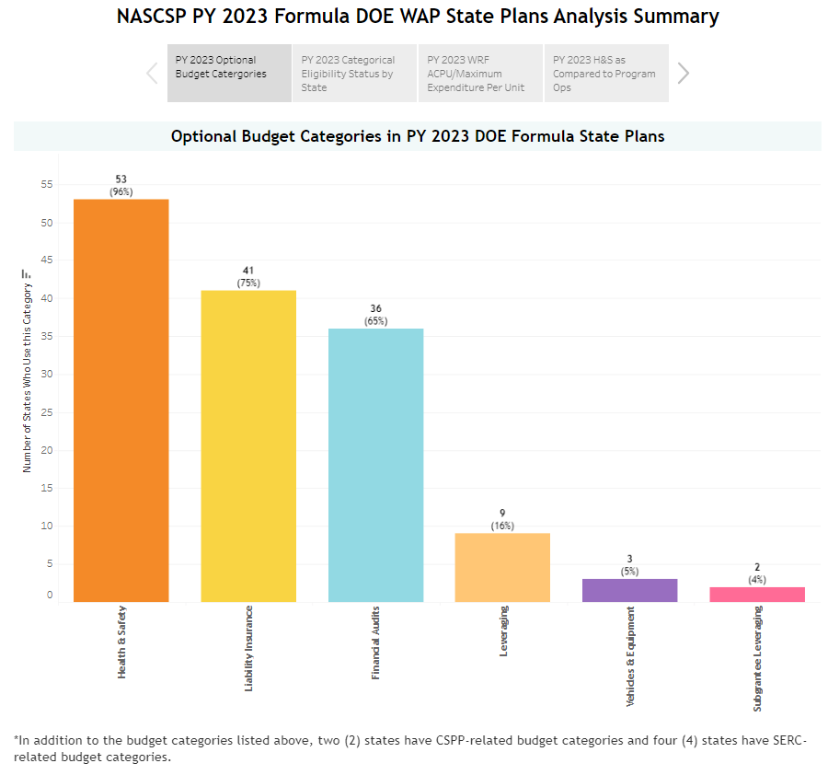
Optional Budget Categories
Grantees can help manage the Average Cost per Unit (ACPU) by utilizing Optional Budget Categories
Notes:
Aside from the Required Budget Categories (Admin / T&TA/Program Operations) DOE allows the use of OPTIONAL Budget Categories.
This is a partial list -- There are a lot of moving parts! But here are a few plan components and optional budget categories to help provide relief to the ACPU.
Vehicles - vehicles require DOE approval; Equipment $5,000 and over (survey your network for Vehicle Needs and review your Equipment Inventory)
Liability Insurance – DOE recommends using this, otherwise the LI is part of the ACPU. ACPU if you use the Optional Budget
Leveraging Plan – up to 15% of grant to develop partnerships; pay consultant to develop partnerships with utilities
Up to 15% of the allocation may be used to obtain non-Federal resources to increase the number of low-income homes weatherized and/or increase the scope or type of services provided to low-income homes
Graph is a link to the PY 23 state plan analyses

Slide 10

WAP Memo 138: The Redline Memo
WPN 25-1 Redline
2025 Administrative and Legal Requirements Document (ALRD) Redline
2025 Application Instructions Redline
DOE training
These are helpful planning resources, but WPN 25-1 must be adhered to!
This Photo by Unknown Author is licensed under CC BY
Notes:
This is a critical piece of guidance!!! This contains the redline versions of the Application Instructions, ALRD, and 25-1.

Slide 11
2025 State Plan Guidance
All Grantee Plans must adhere to PY 25 Annual Guidance!
WPN 25-1. Published 11/1/24
Administrative and Legal Requirements Document (ALRD)
Application Instructions
Attachments:
NEPA determinations for Grantees WITH Historic Preservation Programmatic Agreements
NEPA determinations for Grantees WITHOUT a Historic Preservation Programmatic Agreement.

Slide 12


Switching gears
Redline Memo
ALRD
Application Instructions
WPN 25-1
Success Strategies

Slide 13
Administrative and Legal Requirements Document (ALRD)
This is year-1 of an anticipated three-year grant
Links added for BABA information and Memo 104

Slide 14

ALRD
Updated Definition for Construction Materials.
“DOE strongly recommends that applicants complete their full application with the assumption that BABA requirements will apply to the proposed project in order to consider potential budget or schedule changes as early as possible.”
BABA guidance
This Photo by Unknown Author is licensed under CC BY

Slide 15

PY 2025 State Plan Due Dates
April 1 States
Due Date:
February 10, 2025
July 1 States
Due Date:
May 5, 2025
The complete application package is due by 12:00 noon
Contact your DOE PO as soon as you submit in PAGE
When possible, submit early to allow time for revisions
NASCSP recommends in-progress reviews with DOE PO
Notes:
Jonathan - It is important to note the State Plan Application Due Dates in the ALRD for PY20. 25
We have State Planning Templates to assist 4/1 and 7/1 states in their planning
Keep in mind – the due date for 4/1 states is the Monday following our Winter Training Conference.

Slide 16
Switching gears
Redline Memo
ALRD
Application Instructions
WPN 25-1
Success Strategies

Slide 17
Application Instructions Update
New sections:
Dispute Resolution Process
Investigating Allegations of Fraud, Waste, and Abuse
Carryover section removed
Annual Reporting:
Diversity, Equity, Inclusion and Energy Justice
Weatherization Readiness
2 CFR 200 updates
Audit required for $1M in federal funding (prev. 750K)
$10,000 Simplified Acquisition Threshold (micro-purchase)
SF 424 – mark ‘new’ application
New Optional Budget Categories

Slide 18

Application Instructions Update
New sections:
V.10 Dispute Resolution Process
New required attachment to SF-424
V.11 Investigating Allegations of Fraud, Waste, and Abuse
New required attachment to SF-424.
Notes:
Dispute Resolution Process – procedures to resolve issues. “Grantees have the responsibility to ensure Subgrantees resolve all client complaints.”
Investigating Allegations of Fraud, Waste and Abuse. Include procedures for investigating. Roles and responsibilities for the investigation.

Slide 19
Application Instructions Update: Clarifications
V.1.1: “Grantees and Subgrantees are reminded that applicants applying for weatherization must have their eligibility documentation recertified with 12 months of service.”
V.1.2: Grantees must monitor WRF as part of the annual monitoring process.

Slide 20

Application Instructions Update
2 CFR 200 updates
Audit required for $1M in federal funding (prev. 750K)
Simplified Acquisition Threshold $10,000
Formerly micro-purchase.

Slide 21
Application Instructions Update
SF 424 – mark ‘new’ application
Carryover section removed.

Slide 22
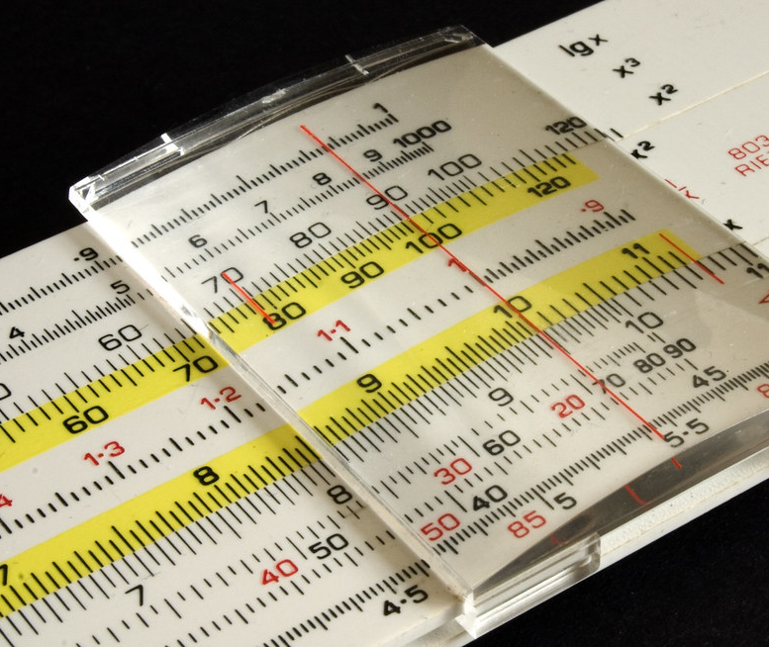
Application Instructions Update: Calculating Administrative funds
Grantee admin. budget calculation
(PY total allocation + WRF + SERC) * 7.5% (max)
Subgrantee admin. budget calculation
(PY total allocation + WRF + SERC) * 7.5% (minimum)
Additional 5%
subgrantees with an allocation less than $350,000 at the Grantee’s discretion.
*Tribes and Territories are eligible for Grantee and Subgrantee portions of admin funds
This Photo by Unknown Author is licensed under CC BY
Notes:
Subgrantees must get at least 50% of the Admin / Grantees may retain a maximum of 50%

Slide 23
Switching gears
Redline Memo
ALRD
Application Instructions
WPN 25-1
Success Strategies

Slide 24

Weatherization Program Notice 25-1
Continuous Resolution through 12/20/24.
PY25 is a new award
Allocation Data Updates (Memo 139)
2 CFR 200 Update
Equity and Justice section has been shortened
NEPA and Historic Preservation
ACPU
Program Income clarification
Notes:
WAP operating on Continuous Resolution through 12/20/24.
Grant modification process
No carryover. PY25 is a new award.
Memo 139 – new allocations
2 CFR 200 Update (10/1/24 implementation date)
Note: Simplified Acquisition Threshold (SAT)raised to $10,000. Disposition of equipment with a value less than the SAT does not require DOE approval.
Equity and justice section has been shortened
NEPA and Historic Preservation (new language)
Tribal properties – process flowchart from memo (110?)
Allocation Data Updates
Population factor, climatic factor, residential expenditure factor.
ACPU: $8,574. Solar ACPU: $4,302
Program income – must be used during period of performance.
Memo 128 has reporting requirements.

Slide 25
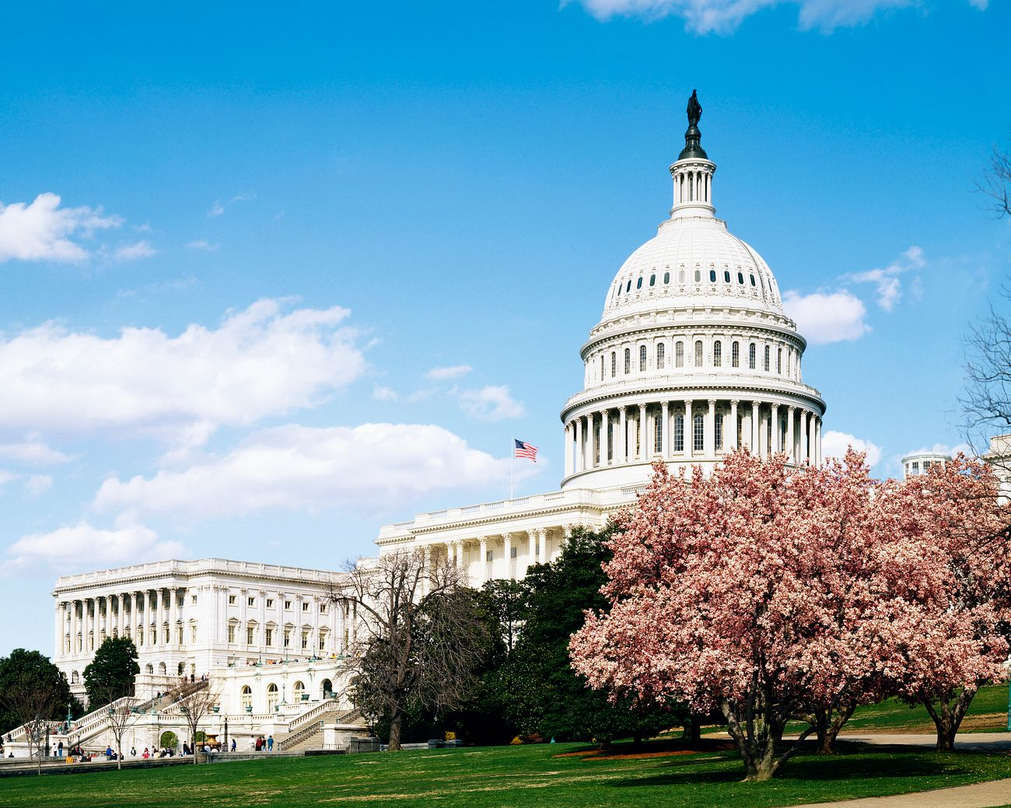
WPN 25-1 Updates: Background
WAP operating on Continuous Resolution through 12/20/24.
Until a new budget is passed, use FY 2025 Planning Estimates
Further guidance to be issued with a new CR or budget
Carryover section removed.
PY 25 starts a new 3-year award cycle.
Notes:
Do you have to put specific language about “ESTIMATE” in the public hearing and state plan?

Slide 26

WPN 25-1 Updates: Memo 139
NEW!! DOE updates data for WAP allocation formula
Population Factor
Climatic Factor
Residential Expenditure Factor
Review to see if your state went up or down in funding
FY 2025 Planning Estimates
Notes:
Population Factor: # of low-income households, per state and the number of low-income households nationwide. Updated every 5 years with Census data.
Climatic Factor: 30-year, population weighted averages of heating and cooling degree days. Data updated every 10 years with data from National Oceanic and Atmospheric (NOAA), National Climatic Data Center (NCDC). Additional information comes from the Energy Information Administration which is updated every 3 – 5 years.
Residential Expenditure Factor: Total residential low-income household energy expenditures by Grantee. Data comes from the EIA Residential Energy Consumption Survey, 3 – 5 years.

Slide 27

WPN 25-1 Updates: 1.2 – Legal Authority
2 CFR 200 Update
Simplified Acquisition Threshold (SAT) raised to $10,000.
Disposition of equipment with a value less than the SAT does not require DOE approval.
NASCSP Webinar: Significant Changes to OMB Guidance
Recording
Slides
Notes:
2 CFR 200 Update (10/1/24 implementation date)

Slide 28

WPN 25-1 Updates: 2.3 – Innovation Funding Opportunities
Memo 134 announced $36 million E&I funds
Selections anticipated in late February 2025

Slide 29

WPN 25-1 Updates: 2.6 Equity and the Justice40 Initiative
Equity and justice section has been shortened
Removed definitions
This Photo by Unknown Author is licensed under CC BY-SA

Slide 30
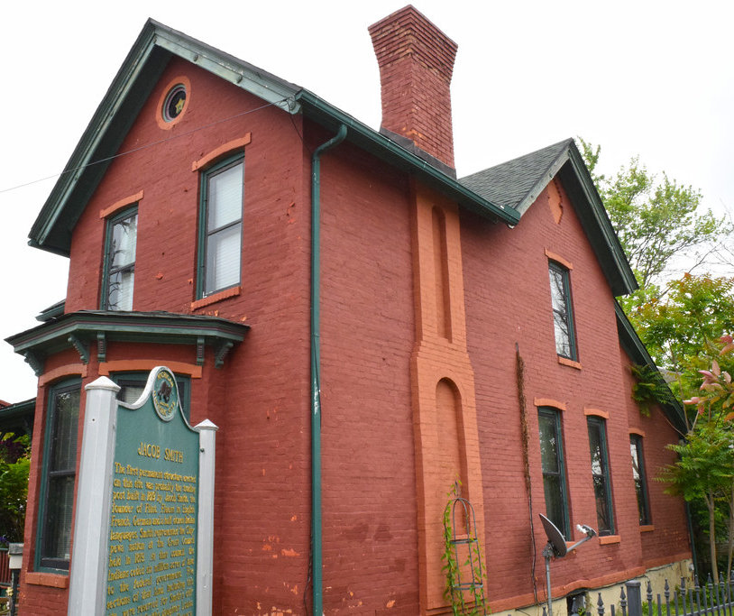
WPN 25-1 Updates: NEPA and Historic Preservation
Review NEPA determination and historic preservation Programmatic Agreement (PA).
PAs are not applicable on Tribal land. Approval from DOE NEPA
Historic Preservation Programmatic Agreements
This Photo by Unknown Author is licensed under CC BY-NC-ND
Notes:
NEPA and SHPO categorical exclusions can be found in FEDConnect
There is a link to the Historic Preservation Programmatic Agreements. All but Guam have PAs

Slide 31

WPN 25-1 Updates: Tribal Weatherization
Programmatic Agreements do not apply to Tribal land
All work requires DOE NEPA review and approval
Historic Preservation Worksheet
To be completed by Subgrantee/Tribe doing work
Submitted by Grantee to DOE P.O.
Approval required before work can begin
Notes:
The image on the right is of the 8 tribal nations in Montana. These 8 nations are comprised of 12 tribes: Assiniboine, Blackfeet, Chippewa, Cree, Crow, Gros Ventre, Kootenai, Little Shell Chippewa, Northern Cheyenne, Pend d’Oreille (“pon-der-ay), Salish, Sioux.
The Historic preservation worksheet must be used when work included in the NEPA determination is planned on homes/buildings on Tribal land that are 45-years or older.

Slide 32
WPN 25-1 Updates:
New Attachments:
NEPA Determination (W/ Historic Preservation Programmatic Agreement)
NEPA Determination (W/out Historic Preservation Programmatic Agreement)
Notes:
All Grantees but Guam have an executed Programmatic Agreement.
NEPA determination w/ PA can do the following:
Weatherization activities, provided that projects apply the restrictions of each State’s programmatic agreement with their State Historic Preservation Office (SHPO), are installed in existing buildings, are appropriately sized, and are covered by Appendix A of 10 CFR 440 and/or approved as part of the energy audit approval procedures and material approval process, and limited to:
A. Energy Conservation Measures- including purchase and installation of measures, as applicable i. Building Shell Measures:
1. Attic/Roof Insulation
2. Wall Insulation
3. Foundation Insulation
4. Air Sealing/Infiltration Reduction
5. Window replacement and treatments, such as, window film, awnings and solar screens
6. Door replacement and treatments such as, storm door, window film, solar screens
B. Mechanical Measures
Clean, tune, repair, or replace heating and/or cooling systems including switching fuel source.
ii. Install duct and distribution system insulation
iii. Seal ducts and distribution systems
iv. Install programmable thermostats
v. Repair/replace domestic water heaters, including switching fuel source.
vi. Install domestic hot water heater tank and pipe insulation c. Electric and Water Measures i. Install efficient light sources ii. Install low-flow showerheads, aerators, and toilets iii. Replace inefficient refrigerators and freezers with energy-efficient models

Slide 33

WPN 25-1 Updates: ACPU
PY 2025 Average Cost Per Unit (ACPU)
= $8,547
PY 2025 ACPU for Renewable Energy Systems
= $4,302
Notes:
Andrea - Each year, DOE has the ability to ADJUST the ACPU.
Percentage of Customer Price Index (CPI) was 8.2% / This avg includes MF buildings of 5 units or greater.

Slide 34

WPN 25-1 Updates: 3.4 Program Income
Clarification: program income must be used during period of performance.
This Photo by Unknown Author is licensed under CC BY-ND

Slide 35

WPN 25-1 Updates: 3.5 Budget/Expenditure/Carryover
PY 2025 starts a new grant cycle
No carryover
Grantees to complete the closeout process for PY 2022 – 2024

Slide 36

Once your plan is approved…
Review terms and conditions
Print them, create a plan.
Create a timeline for compliance
Delegate tasks
Postmortem of planning process + process improvement

Slide 37
Switching gears
Redline Memo
ALRD
Application Instructions
WPN 25-1
Success Strategies

Slide 38

Success Strategies for State Plan Development
Notes:
Pass to Andrea

Slide 39

Success Strategies
#1 -Start early
Update policy and procedure manuals, health and safety plans, monitoring documents, T&TA plans.
Review the new WPN and Memo releases since the last plan
Host in-person meeting with WAP Subgrantees for input into plan the quarter before your planning starts
Set placeholders on your calendar for state planning time
Do all of these prior to the core state plan development.
*NASCSP Webinar: WAP Operations and Policy Manual Updates: Best Practices and Process for Annual Updates. Recording, Slides.
Notes:
A project plan for the state planning process should be used. This is a HUGE process that requires input from many people. Treat this like a major project – outreach/engagement, kick-off meeting, timeline/project plan, scheduled check-ins, post mortem, etc.
NASCSP Webinar:

Slide 40

Success Strategies
#2 Talk to your DOE Project Officer
When WPNs come out, use your monthly calls to discuss what your project officer expects to see in the state plan
Talk through any assumptions that could affect your entire plan
Get things in WRITING – best practice
Ask for early review of parts of the plan
When in doubt, reach out
Notes:
Suggestion: use RED or another color to highlight new sections or changes to the state plan to make it easier for your DOE PO to see updates and changes.
Discuss program updates over the past year and what policy changes will support those efforts – look at the list of current WPNs and Memos from WPN 25-1, prepare questions.

Slide 41
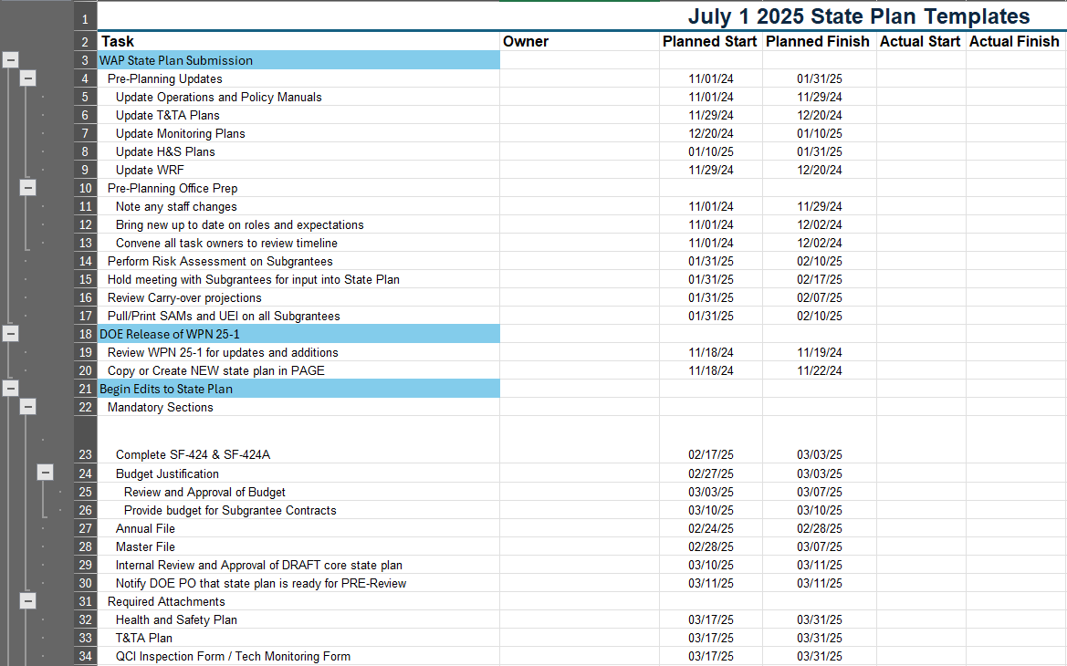
Success Strategies
#3 Develop timeline and gain commitment
Need help developing a state plan submission timeline? Please reach out to Jonathan or Claudia
Notes:
– Planning and is key! #3 Develop timeline and gain commitment
Draft EARLY AND share with all stakeholders in advance
Host meeting to review timeline to gain internal and external commitment
Need help? We can work with you to build a timeline for on time delivery.

Slide 42



Success Strategies #4 Communicate Often
Subgrantee Network
Start early in the process
Policy Advisory Council
Review performance goals and policies
Formal Public Hearing
Mandatory 10 days notice & transcript
Notes:
- Recommend a minimum of THREE meetings
1. Involving the Subgrantee network early in the planning process has been noted as a best practice on the ACSI survey
2. PAC Meetings – discuss important issues regarding quality and production performance against contracted goals.
Consider implementing a reallocation provision for underperforming Subs; good policy to discuss with your PAC
Make it so you can move fast, reallocate without a public hearing to others Subs in the network that are performing well.
3. Public Hearing – mandatory, 10 days notice, need an official transcript but virtual hearings are allowable.

Slide 43

Success Strategies
#5 Manage it through to approval
Submitting the state plan in PAGE is NOT the last step
Manage the entire process
Proactively set up pre-review meetings with CO prior to submission. Make it easy for them to see changes and updates!
Leave time in your schedule to make changes or edits
Be persistent about your timeline, your entire network is depending on YOU!

Slide 44

Aiming for Excellence!
Timely Subgrantee Contract Execution is CRITICAL in new grant program years
This is a PRIMARY duty of the Grantee
This Photo by Unknown Author is licensed under CC BY-SA-NC
Notes:
Executing contracts late will impact your Subgrantees and undermine your workforce development efforts
How long are YOU comfortable going without a paycheck?

Slide 45
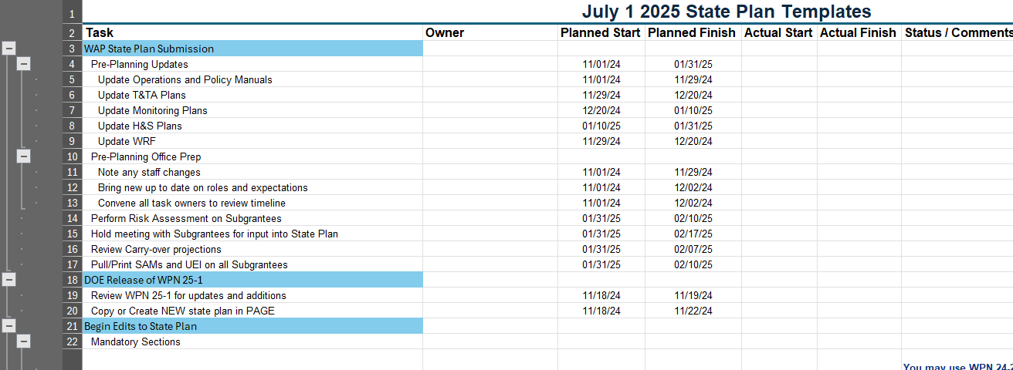
NASCSP Member Resources
State plans
Webinars
State Plan Timeline Templates
Monitoring tools
WRF resources
MF resources
Notes:
All of the approved ’24 State plans are located on our website.

Slide 46

Registration Open!
February 3 – 7, 2025. Arlington, VA
Register here
Preliminary Agendas here
NASCSP and DOE will offer New Manager Training Pre-Conference with several sessions focused on state plan development!

Slide 47

Member Questions for DOE
Notes:
Questions for DOE: Can you describe how the Continuing Resolution affects the state plan process? Is there language needed in a state plan to assist with process? How can Grantees prepare?
What would be the most common issue that you see with State Plans? What is your best piece of advice to Grantees regarding the state planning process.

Slide 48

Thank you!
Andrea Schroer
WAP Director
aschroer@nascsp.org
Jonathan Ballew
Sr. WAP Program Manager
jballew@nascsp.org
Claudia Torres
Sr. WAP BIL Program Manager
ctorres@nascsp.org
Kye Garvin
WAP Workforce Program Manager
kgarvin@nascp.org
Bryce Nguyen
WAP Program Analyst
bnguyen@nascsp.org
Amanda Rains
Senior Policy Analyst
Amanda.Rains@hq.doe.gov
Carrie Smith
Retrofit and Readiness Program Manager
Carrie.Smith@hq.doe.gov
Ray Judy
Technical Project Officer Supervisor
Ray.judy@hq.doe.gov
Notes:
STOP RECORDING

