Slide 1
Compliance Hot Spots & Opportunities

Slide 2

Compliance Hot Spots & Opportunities
Making the Most of CSBG
NASCSP Winter Training Conference
March 12, 2024
Discussion Leader: Kay Sohl
www.kaysohlconsulting.net

Slide 3
Workshop Topics:
    Meshing the demands of 2 CFR 200 and CSBG
    Cost principles: Allowability and Allocability
    Cost Allocation Plans
    Indirect Cost Rates
    Monitoring cost allocation plans and practices
    Pass-through entity challenges
    Understanding Single Audits and Dealing with Single Audit findings
    Tools and tips for monitoring CSBG compliance
    Next Steps

Slide 4


Workshop Goal
Before
After

Slide 5
Background
Uniform Guidance first took effect December 26, 2014
  Replaced OMB Circulars A-87, A-122, and A-133
Codified in the Code of Federal Regulations: 2 CFR Part 200
OMB required to review UG every 5 years (2 CFR § 200.109​)
  First significant revisions issued August 13, 2020​
    Most provisions effective November 12,2020​
    Applies to new awards and award modifications issued on or after November 12,2020​
    Revisions don’t apply to HHS awards until new rule is issued
Additional Uniform Guidance changes are on the way!

Slide 6
2023 Proposed Changes
October 5, 2023
Four main objectives for proposed revisions:
  Incorporate statutory requirements and administration priorities;
  Reduce agency and recipient burden;
  Clarify differing interpretations; and
  Rewrite sections in plain language, improving flow, and addressing inconsistent use of terms

Slide 7
OMB Decision Date for 2023 Revisions
Not yet announced
Comment period closed 12/4/23
OMB announced intention to move quickly
Increase in de minimis rate may have significant impact on CAAs

Slide 8
Highlights of 2023 Proposed Changes
Increase in Single Audit Threshold to $1 million – with indexing
Increasing amount of sub-award costs counted within MTDC from $25,000 to $50,000
Increase equipment capitalization threshold to $10,000
Clarifying & reducing prior approval requirements
Clarification of rules defining direct costs
Increasing the de minimis rate to 15% MTDC

Slide 9
Proposed Change in De Minimis Rate
Increase de minimis rate from 10% to 15%
Maintain requirement to compute de minimis rate using Modified Total Direct Cost as base
Maintain 2020 revision permitting any recipient or sub-recipient to elect to use the de minimis rate – even if they previously had a Negotiated Indirect Cost Rate
Action by HHS will still be needed to make the new de minimis rate provisions apply to HHS awards and sub-recipient agreements

Slide 10
​
Federal Agency Versions of UG
HHS: codified its own version of the Uniform Guidance as
45 CFR Part 75​
All other federal agencies adopted 2 CFR Part 200 with a few exceptions/additions:​
Dept.. of Energy: 2 CFR Part 910​
CNCS: 2 CFR Part 2205​
HUD: 2 CFR Part 2400​
DOL: 2 CFR Part 2900​
Dept.. of Education: 2 CFR Part 3474​

Slide 11
What’s In the Uniform Guidance
2 C.F.R. Part 200
Subpart A: Acronyms and Definitions​
Subpart B: General Provisions​
Subpart C: Pre-Federal Award Requirements and Contents of Federal Awards​
Subpart D: Post-Federal Award Requirements​
Subpart E: Cost Principles​
Subpart F: Audit Requirements​
Appendices: Required contract provisions, indirect costs etc.​

Slide 12
Which UG Provisions Apply to CSBG?
All these UG provisions apply to all block grants, including CSBG:
Subpart A (definitions)
Subpart B (Provisions
Subpart F (Audit Requirements)
Subpart C – only certain provisions (see next slide)

Slide 13
Provisions in Subpart C that apply to CSBG
    § 200.203 – Public notice/CFDA
    § 200.331 – Subrecipient & contractor determinations
    § 200.332 – Pass-through entities
    § 200.333 – Fixed amount subawards
*Additionally: Subpart E, Cost Principles, applies to CSBG because CSBG Act, the authorizing statute (42 U.S.C. § 9916(a)(1)(B)), specifically requires it

Slide 14
Cost Principles: Subpart E

Slide 15
2 CFR 200 - Subpart E: Cost Principles
Allowable Costs
Only allowable costs may be charged to federal awards. To be allowable must have:
  Evidence cost was incurred and/or the work was done
  Evidence purchase was necessary
  Expense not prohibited
  Allocability - Ability to associate the cost with award objective

Slide 16
Costs May Be -
Allowable
Possibly Allowable
  Example: Capital Expenditures 200.439
  Capital expenditures for general purpose equipment, buildings, and land are unallowable…except with prior written approval of the federal awarding agency or the pass-through entity
Prohibited
  Example: Alcohol 200.423

Slide 17
What is Allowable?
Sources: 2 CFR 200, specific program CFRs, State or other pass-through requirements
§ 200.1 Definitions – alphabetized directory of federal funds management concepts
Sub-part E - Cost Principles 200.420 – 200.476
  Alphabetized list by type of cost
  Factors affecting cost allowability 400.403

Slide 18
Timing is Everything !
To be allowable as charges to federal awards, cost must be:
  Incurred during the award period
  Provide benefit to the funded activity during the award period
  Approved prior to being incurred if specific approval is required
Substantiated by consistent accounting

Slide 19
Cash versus Accrual Accounting
 | Cash | Accrual
What is it? | A system which records income only when it is received and expenses only when they are paid out | A system which records income when it is earned, and expenses when the obligation to pay arises, regardless of when payment is made
What costs are charged to federal awards | Bills paid during the award period for expenses which provided benefit during award period. | Expenses which provided benefit during the award period, even if bills not paid until after the award period concludes

Slide 20
Fringe Benefits Example
§ 200.431
Cash basis accounting: charge only amounts paid during the award period. Charge cost of paid leave during the period in which leave is taken
Accrual basis accounting: charge amounts earned by employees during the award period regardless of when bills paid. Charge cost of paid leave when leave is earned

Slide 21
Allocability
Costs Benefiting More Than 1 Cost Objective
Costs that benefit more than one cost objective must be fairly allocated to all cost objectives that benefit
Organization may define Cost Objective as a program, a project, a function, or an award
Must use consistent definition

Slide 22
Cost Objective
§200.28
Cost objective means a program, function, activity, award, organizational subdivision, contract, or work unit for which cost data are desired and for which provision is made to accumulate and measure the cost… A cost objective may be a major function of the Grantee, a particular service or project, [or] a Federal award…

Slide 23
Functional Cost Objective
Budget Format
 | Total | Manage | Fund raising | Energy Assist | WAP | Early Childhood
Personnel
Prof. Services
Occupancy
XXXXX
Total Expenses

Slide 24
Funding Agreement Cost Objective
Budget Format
 | Total | Award 1 | Award 2 | Award 3 | Award 4 | Unrestricted
Personnel
Prof. Services
Occupancy
Allocated Admin
Total Expenses

Slide 25
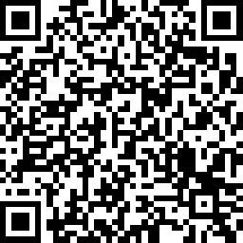
Please scan here to complete the evaluation for this session!
Notes:
Part 1

Slide 26
Cost Allocation:
Estimating Benefit Provided to Each Cost Objective
Allocation method must be reasonable and cost effective to use
May use different approaches to allocating different types of costs
Must be consistent in use of an approach for similar types of costs

Slide 27
Types of Cost
Direct
Readily identifiable
Directly assignable to federal grant activity relatively easily and w/high degree of accuracy
Indirect/ shared
Incurred for common or joint purpose
Benefits more than one cost objective
Not readily assignable to cost objective specifically benefitted, without effort disproportionate to results achieved

Slide 28
Shared or Common Costs
Costs which benefit multiple cost objectives – programs, functions, awards
Includes but not limited to Administrative costs
Impossible to track the exact benefit to each program or function – benefit to each must be estimated

Slide 29
Admin or Management Costs
May be recovered either through direct charging through cost allocation or as part of indirect cost rate
Core Admin/Management Functions:
  Executive Oversight
  Board Support
  Financial Management
  HR Management IT Management

Slide 30
Administrative Costs Include
Personnel performing admin functions
Allocated share of employer pd taxes and fringe benefits
Allocated facilities, supplies, and other costs necessary for staff to perform admin functions
Professional services associated with administrative functions

Slide 31

Admin costs not identical to indirect costs
Admin costs can be direct or indirect:
Administrative functions that benefit only one or a limited number of programs/awards may be treated as Direct Costs
Example of direct admin cost:
  Accountant performing only Head Start functions

Slide 32
4 ways to Recover
Admin & Indirect Costs
Uniform Grants Guidance
 |  | Indirect Cost Rates
Direct Charge Allocated Costs 2 CFR 200.405 (d) | 10% de minimis | Federal NICR | Pass-through NICR
All 4 methods require distinguishing costs directly attributable to a specific cost objective from costs that benefit more than one cost objective

Slide 33
Direct Charging Shared Costs
 | Prog 3 | Prog 2 | Prog 1 | Shared | Total
Total Direct Costs | 2 Million | 1 Million | 100,000 |  | 3.1 Million
Rent |  |  |  | 60,000 | 60,000
Audit |  |  |  | 20,000 | 20,000
Maintenance Staff |  |  |  | 60,000 | 60,000
Utilities |  |  |  | 10,000 | 10,000
TOTAL | 2 Million | 1 Million | 500,000 | 150,000 | 3,250,000
 | Prog 3 | Prog 2 | Prog 1 | Shared | Total
Total Direct Costs | 2 Million | 1 Million | 100,000 |  | 3.1 Million
Rent | 39,000 | 19,200 | 1,800 | 0 | 60,000
Audit | 13,000 | 6,400 | 600 | 0 | 20,000
Maintenance staff | 39,000 | 19,200 | 1,800 | 0 | 60,000
Utilities | 6,500 | 3,200 | 300 | 0 | 10,000
TOTAL | 2,097,500 | 1,048,000 | 10,500 | 0 | 3,250,000
Notes:
The magic wand is making “Shared costs” disappear

Slide 34
Key Differences
Direct Charge- Cost Allocation
Indirect Cost Rate
Allocates individual cost items based on estimated benefit provided to each cost center
May use different estimating methods for different types of costs
Must justify methods
Requires cost allocation plan
Results in direct charging of allocated costs
Distinguishes indirect from direct costs
Computes % that indirect costs comprise of a base of direct costs
Applies that % to the base of direct costs in each cost objective

Slide 35
Direct Charge through Cost Allocation: Challenges
Finding defensible allocation method
Constant flux in allocated costs as programs expand and contract
Difficult to explain why shared costs are charged as direct
Under Uniform Guidance, certain costs* may only be charged as indirect (i.e., using NICR or 10% rate)
* Preparation of grant applications

Slide 36
Common Cost Allocation Mistakes
Determining the allocation of a cost benefiting more than one objective based on the amount included in an award budget
Failing to allocate a cost to all the cost objectives which benefit from it

Slide 37
Cost Allocation Plans
Comprehensive description of agency’s treatment of direct and shared costs
Includes CAA’s definition of cost objective
Identifies types of shared costs & methods used to allocate each type
Defines agency-wide administrative costs
Identifies method used to allocate administrative costs
Identifies effective dates

Slide 38
Cost Allocation Plan Challenges
Must clarify whether concept of “indirect cost pool” is used
Must clarify which, if any, non-administrative costs are treated as part of “indirect pool”
Plan must comply with 2 CFR 200
Many pass-through entities refuse to “approve” cost allocation plans
Independent auditors may or may not examine plans carefully
Some auditors & monitors require the plan to include a certification statement

Slide 39
Exhibits Supporting the Cost Allocation Plan
Agency-wide budget illustrating application of cost allocation policies to all line-items
If % of square footage is used for allocation of facilities and related costs, floor plan measurements used to derive allocation %s
Detailed personnel schedule illustrating positions treated as direct costs and positions treated as allocated costs

Slide 40
Cost Allocation Plan Pitfalls
Costs must be allocated to all cost objectives they benefit –regardless of funding limitations
In most cases, administrative or indirect costs may not be allocated based on % of total direct costs dollars attributed to each cost objective
Use of such percentages is generally limited to calculation of indirect cost rates not in cost allocation plan to justify direct charging of allocated costs

Slide 41
4 ways to Recover
Admin & Indirect Costs
Uniform Grants Guidance
 |  | Indirect Cost Rates
Direct Charge Allocated Costs 2 CFR 200.405 (d) | 10% de minimis | Federal NICR | Pass-through NICR
All 4 methods require distinguishing costs directly attributable to a specific cost objective from costs that benefit more than one cost objective

Slide 42
Indirect Cost Rates
Distinguish indirect from direct costs
Compute % that indirect costs comprise of a base of direct costs
Applies that % to the base of direct costs in each cost objective

Slide 43



Remember Fractions????
Numerator (Top)
___________________
Denominator (Bottom)
Numerator Divided by Denominator = Percentage
Examples: ¼ = 25% ½ = 50% ¾ = 75%

Slide 44
The Numerator (top of fraction)
What’s in the Indirect Cost Pool
Indirect costs = costs for which benefit cannot be determined directly
May Include:
  All agency-wide management costs
or
  All agency-wide management costs plus other common costs like facilities, telephone, internet

Slide 45
Only Allowable Indirect Costs in Numerator
All methods of computing the Indirect Cost numerator require excluding unallowable indirect costs
Example:
  Alcohol served at Board functions is excluded as unallowable

Slide 46
Denominator (bottom of fraction)
= Direct Cost Base
De Minimis Rate – must used Modified Total Direct Costs as base
Negotiated Indirect Cost Rate – may use one of three bases:
  Modified Total Direct Costs
  Total Direct Salaries and Wages
  Total Personnel Costs – including taxes and benefits

Slide 47
Calculating the Indirect Rate
Allowable Indirect Costs
÷
Direct Cost Base
=
Indirect Cost Rate %

Slide 48
10% de Minimis Rate
Available to all nonprofits that don’t have a federally negotiated indirect rate (2020 revisions to UGG) *
No negotiation required
Modified Total Direct Costs must be used as the base for the calculation & application of rate
* Caution: HHS did not adopt 2020 revisions

Slide 49
Modified Total Direct Cost
§ 200.68
Indirect costs expressed as a % of modified total direct costs
Total direct costs include all direct costs whether or not they are funded with Federal $$
Total Direct costs includes unallowable direct costs

Slide 50
10% means 10% of MTDC
… so first determine MTDC
 |  |  |  | MTDC | Prog 1 Direct | Prog 2 Direct | Prog 3 Direct | Non-Federal Direct Costs
 |  |  |  | 4 Million | 1 Million | 2.1 Million | 700,000 | 200,000
4 million x 10% = 400,000

Slide 51
MTDC Direct Cost Base excludes:
Equipment & capital expenditures
Rental costs
Participant support costs
Charges for patient care
Tuition remission
Portion of each sub-award in excess of $25,000
Other costs that would distort distribution of indirect costs

Slide 52
Note that the 10% de minimus rate is
10% of MTDC not 10% of total costs
 |  |  |  | MTDC | Prog 1 Direct | Prog 2 Direct | Prog 3 Direct | Non-Federal Direct Costs
 |  |  |  | 4 Million | 1 Million | 2.1 Million | 700,000 | 200,000

Slide 53
Applying the 10% MTDC Rate
Total Expenses | Unallow Indirect Costs | Allowable indirect Costs | Excluded Direct Costs | MTDC | Prog 1 Direct | Prog 2 Direct | Prog 3 Direct | Non-Federal Direct Cost
4,450,000 | 10,000 | 400,000 | 40,000 | 4,000,000 | 1,000,000 | 2,100,000 | 700,000 | 200,000
Indirect Rate .10 |  | (400,000) |  | 400,000 | 100,000 | 210,000 | 70,000 | 20,000
Excluded Costs |  |  | (40,000) |  |  |  | 40,000
Unallow Indirect | (10,000) |  |  |  |  |  |  | 10,000
Total Costs |  |  |  |  | 1,100,000 | 2,310,000 | 810,000 | 230,000

Slide 54
Federally Negotiated Indirect Cost Rate
Must have direct federal award to negotiate
Negotiate with federal agency providing largest portion of direct federal funding
Submit proposed rate following 2 CFR 200 requirements
Federal agency determines rate & time period it will cover

Slide 55

Steps to Obtain a NICR
Federally Negotiated Indirect Cost Rate
  Must have direct federal award
  Find your cognizant agency and its negotiating office
  Prepare comprehensive cost-centered annual budget
  Identify direct and indirect costs
  Deal with unallowable direct and indirect costs
  Choose which method to use to compute the rate
  Allocate shared costs not included in the rate
  Propose and negotiate rate

Slide 56
Admin Cost Caps
Specific federal programs may impose statutory caps on administrative costs
Caps generally placed on Administrative not Indirect costs
Check regs to clarify base to use to compute the admin cap
Admin caps typically combine allocated and direct admin costs
10% Admin Cap computed on total direct costs may result in higher number than 32% indirect rate based on Direct Salaries
Negotiated Indirect Cost Rate may include costs that are not administrative

Slide 57
Monitoring Cost Allocation
Review NICR effective dates
Review Cost Allocation Plan
  Completeness (see cost allocation plan elements)
  Allowable allocation methods
  Effective dates
Review allocation practices
Check compliance with administrative cost caps for various awards
Review Sample Cost Allocation Plan Checklist

Slide 58
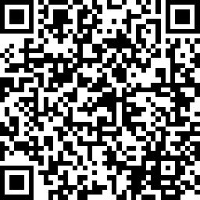
Please scan here to complete the evaluation for this session!
Notes:
Part 2

Slide 59
Pass-through Entity Challenges

Slide 60
State Agencies function as Pass-though Entities for CSBG and other Federal $$$
State agencies are recipients of federal dollars
Recipients may function as pass-through entities making awards to sub-recipients
Both recipients and sub-recipients are required to follow all federal funds management requirements
Recipients are responsible for sub-recipient compliance
CAAs, other nonprofits, and local governments may function as recipients, sub-recipients and as pass-through entities

Slide 61
When Pass-throughs award federal funds
  Need to determine whether other entity is a contractor or subrecipient
    Subrecipient: Don’t use procurement process, but must conduct pre-award risk assessment
    Contractor: Must use procurement process to select, but generally don’t need to comply with program rules
The recipient (pass-through entity) is always solely responsible to the federal government for the execution of the award

Slide 62
Sub-recipient versus Contractor Relationships
Not all awards of federal funds are “grants” subject to UGG
UGG applies to grants, awards,& cooperative agreements between federal agencies and recipients & sub-recipients
UGG does not apply to exchange-type transactions with “contractors” - subject to FARS – Federal Acquisition Regulation System

Slide 63
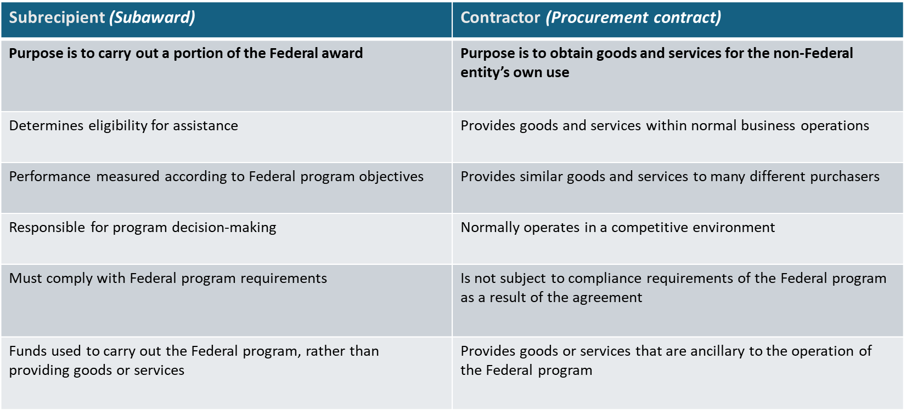
Subrecipient vs Contractor

Slide 64
Sub-recipient Agreements Must -
Identify CAA or other entity as a sub-recipient
Explicitly state the requirement to comply with § 2 CFR 200
Include ALN # * for specific federal program providing the funds
*ALN -Assistance Listing Number - new term for CFDA #

Slide 65
Common Sub-Recipient Agreement Challenges
Agreements are silent as to sub-recipient vs contractor vs beneficiary
Sub-recipient agreement is labeled “contract”
Sub-recipient agreement fails to identify ALN#
SLFRF (State & Local Fiscal Recovery Funds) does not permit sub-awards – many pass-throughs realized they needed to amend subrecipient agreements
Agreement originally states that entity is subrecipient but later amends to clarify that entity is beneficiary or contractor

Slide 66
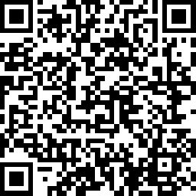
Please scan here to complete the evaluation for this session!
Notes:
Part 3

Slide 67
Single Audit Challenges & Opportunities

Slide 68
UGG Audit Requirements
Single Audit
Funds from multiple federal programs
Program-Specific Audit
Funds from a single federal program
Required when non-federal entity expends $750,000 or more of federal awards (either direct or indirect) in their fiscal year
Required when funds received from multiple federal programs- have multiple Assistance Listing
Required when non-federal entity expends $750,000 or more of federal awards (either direct or indirect) in their fiscal year
Funds must be from a single federal program – have single CFDA # (Assistance Listing)

Slide 69
Related but Not the Same
Independent Audit
Single Audit
Determine whether the org’s financial statements fairly present financial condition & activity
Audience: Board, funders, donors
Determine whether the org has complied with direct & material compliance requirements
Audience: Governmental agencies providing federal funds

Slide 70
What to look for:
Independent Audit
Single Audit
Time period audited
Auditor opinion
  Unmodified
  Modified
  Disclaimer of opinion
  Adverse
Financial health
  Cash position
  Net Assets
Auditor opinion on internal control over financial reporting & compliance
Report on compliance in major programs
SEFA – Schedule of Expenditures of Federal Awards
Findings

Slide 71
Audit Basics
Entity selects & engages an independent CPA to conduct an audit
All state licensed CPAs may conduct independent audits
Only CPAs with required continued professional education may perform Single Audits
Auditor issues written report with multiple opinions and reports

Slide 72
Independent Audit Opinion Letter
Unmodified Opinion
Report on the Financial Statements
We have audited the accompanying financial statements of XYC Community Action Agency, which comprise the statements of financial position as of December 31, 2022 and 2021, and the related statements of activities, functional expenses, and cash flows for the years, then ended and the related notes to the financial statements.

Slide 73
Auditor’s Opinion
Modified Opinion
Modified Opinion
In our opinion, except for the effects of not including the accounts of xxx Community Development Corporation in the accompanying financial statements as explained in the Basis for Qualified Opinion paragraph, the financial statements referred to above present fairly, in all material respects, the financial position as of December 31, 2019 and 2018, and the changes in its net assets and its cash flows for the years then ended in accordance with accounting principles generally accepted in the United States of America.

Slide 74
Standards for Single Audits &
Program Specific Audits
Yellow Book – Government Accountability Office (GAO) https://www.gao.gov/yellowbook
Uniform Grants Guidance 2 CFR 200 Sub-part F https://www.ecfr.gov/cgi-bin/text-idx?node=sp2.1.200.f
OMB Annual Compliance Supplement https://www.whitehouse.gov/omb/office-federal-financial-management/
Specific requirements of individual federal programs

Slide 75
Single Audit Reports
Independent Auditor’s Report on Internal Control over Financial Reporting and on Compliance
and Other Matters Based on an Audit of Financial Statements Performed in Accordance with
Government Auditing Standards ............................................................................................................................ 1
Independent Auditor’s Report on Compliance for Each Major Federal Program; Report on
Internal Control Over Compliance; and Report on the Schedule of Expenditures of Federal
Awards Required by the Uniform Guidance ........................................................................................................................... 3
Schedule of Expenditures of Federal Awards ........................................................................................................................... 6
Notes to the Schedule of Expenditures of Federal Awards ........................................................................................................................... 8
Schedule of Findings and Questioned Costs ........................................................................................................................... 9

Slide 76
Red Flags
Material Weaknesses
Significant Deficiencies
Qualified opinion on SEFA – not fairly stated
Financial Management Findings –especially repeat findings
Questioned costs
Weak cash or net asset position

Slide 77
Material Weakness
“A material weakness is a deficiency, or a combination of deficiencies, in internal control, such that there is a reasonable possibility that a material misstatement of the entity’s financial statements will not be prevented or detected and corrected on a timely basis”
“We consider the deficiencies described in the accompanying Schedule of Findings and Questioned Costs as 2019-001 and 2019-002 to be material weaknesses”

Slide 78
Significant Deficiency
“a deficiency, or combination of deficiencies, in internal control that is less severe than a material weakness, yet important enough to merit attention by those charged with governance.
“ We consider the deficiency described in the accompanying Schedule of Findings and Questioned Costs as 2019-003 to be a significant deficiency.”

Slide 79
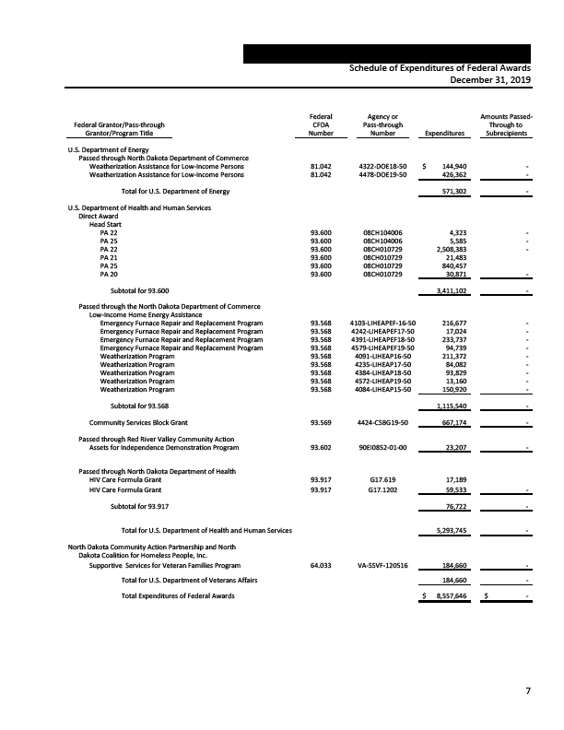
SEFA

Slide 80
Report on Schedule of Expenditures of Federal Awards Required by the Uniform Guidance
In our opinion, the schedule of expenditures of federal awards is fairly stated in all material respects in relation to the financial statements as a whole.

Slide 81
Format for Findings
Criteria
Condition
Cause
Effect
Questioned Costs
Context/Sampling
Report of Finding from Prior Year
Recommendation
Views of Responsible Officials

Slide 82
Corrective Action Plan
Prepared by auditee
Restates each finding in current audit
Identifies person responsible
Describes what auditee will do
Identifies anticipated completion date
Identifies findings from earlier years which have not been resolved

Slide 83
Monitoring response to Single Audit findings
Identify findings specific to funding your agency provides
Structure your monitoring visits & requirements to test whether auditee is implementing Corrective Action Plan
Identify control and compliance findings that relate to overall systems
Inquire about improvements & observe evidence of changes
Evaluate whether failures or delays in implementation of Corrective Action Plan pose substantial risk to management of funds provided by your agency

Slide 84
Impact of Single Audit Findings on
Risk Assessment
Review material weaknesses and significant deficiency
Identify system-wide issues – especially those not resolved after initial finding
Consider potential impact of insufficient cash and/or net assets on future capacity to meet service and financial management requirements
Establish policy regarding impact of identified risks on future funding decisions

Slide 85
Tools & Tips for Monitoring CSBG Compliance
Identify programs/services utilizing CSBG $
Clarify rationale for use of CSBG $
Review current organization-wide budget
Review cost allocation plan and procedures to determine how costs charged being charged to CSBG have been allocated & documented
Review most recent Single Audit report and findings
Review compliance with CSBG Organizational Standards including Board governance & oversight

Slide 86
Resources & Links
Cost Allocation Plan Elements
Cost Allocation Plan Checklist
CAPLAW Cost Allocation Toolkit https://caplaw.org/resources/cost-allocation-toolkit
CAPLAW CSBG Training https://caplaw.org/resources/caplaw-csbg-training-module
2 CFR 200 Uniform Grants Guidance https://www.ecfr.gov/current/title-2/subtitle-A/chapter-II/part-200?toc=1
CAPLAW FAQ on Indirect Cost https://www.caplaw.org/resources/faqs/Financial/CAPLAW_FAQ_RecoveringSharedandIndirectCosts_Sep2019.pdf

Slide 87
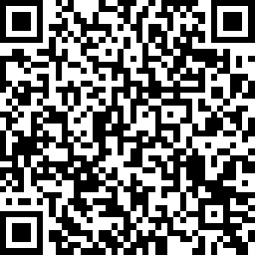
Please scan here to complete the evaluation for this session!
Notes:
Part 4

