Slide 1

A Web of Data Management Systems: What if your spreadsheets talked to each other?
By: Keenan Woods, Ph.D.
www.nascsp.org

Slide 2
ABOUT UPO: WE ARE POVERTY-FIGHTERS.
Private nonprofit human service corporation
Established on December 10, 1962
Established via gifts from both Ford and Meyer Foundation grants
Become the designated community action agency for Washington, DC in 1964
Mission: Uniting People with Opportunities
Operating budget in FY 2022 ~ $42M
NASCSP 2024 Winter Training Conference |www. nascsp.org

Slide 3
ABOUT UPO: THE NUMBERS
Customers Served in FY 2022 ~ 52,000+
Staff ~ 440+
Program Locations ~ 22
CSBG Funded Service Providers ~ 8
Headstart Centers ~ 17
Headstart Home Visitors ~ 7
Volunteers Engaged ~ 1,000+
Partnerships ~ 600+
Certified ROMA Professionals ~ 2
NASCSP 2024 Winter Training Conference |www. nascsp.org

Slide 4
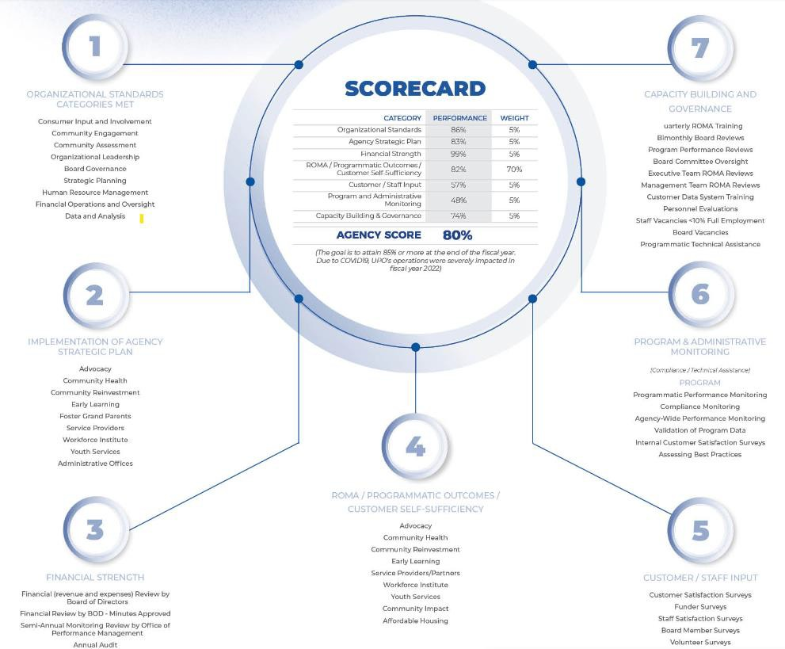
UPO’S AGENCY-WIDE SCORECARD (AWSC)
NASCSP 2024 Winter Training Conference |www. nascsp.org

Slide 5
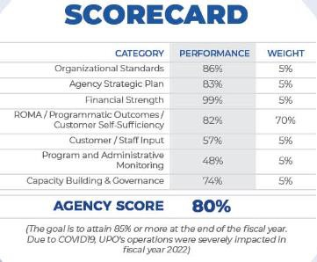
UPO’S AGENCY-WIDE SCORECARD DOMAIN
NASCSP 2024 Winter Training Conference |www. nascsp.org

Slide 6

UPO’S AWSC SATISFACTION SURVEY
NASCSP 2024 Winter Training Conference |www. nascsp.org

Slide 7
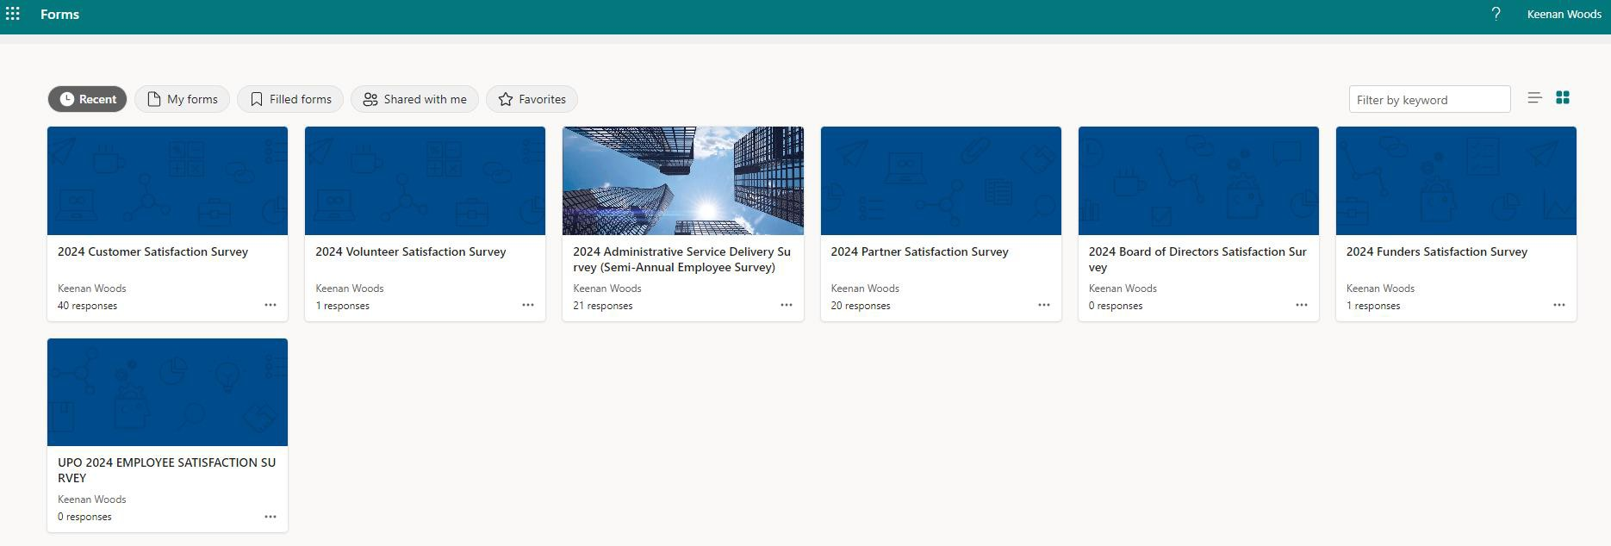
SATISFACTION SURVEY
NASCSP 2024 Winter Training Conference |www. nascsp.org

Slide 8
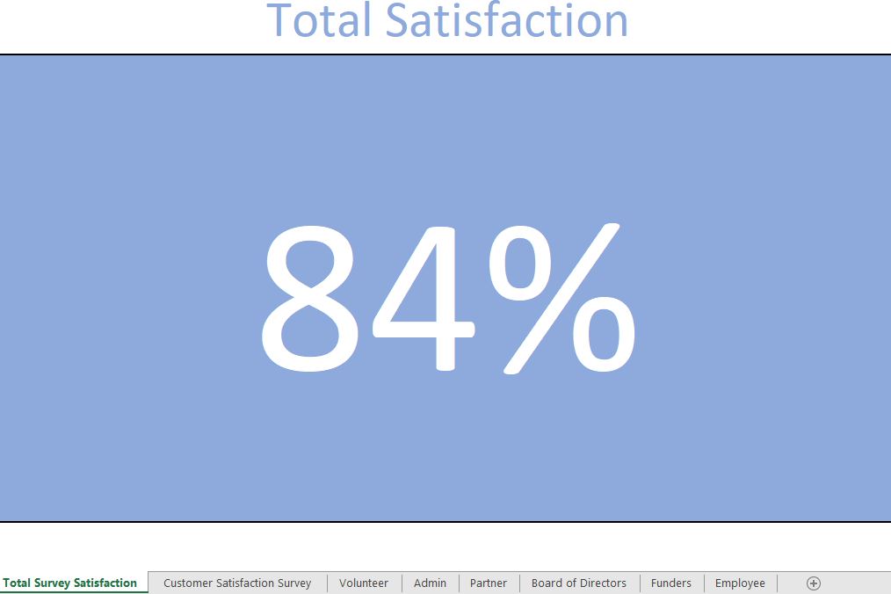
AGGRAGATE SURVEY SATISFACTION SCORE
NASCSP 2024 Winter Training Conference |www. nascsp.org

Slide 9
UPO’S AWSC
STRATEGIC PLAN
NASCSP 2024 Winter Training Conference |www. nascsp.org

Slide 10
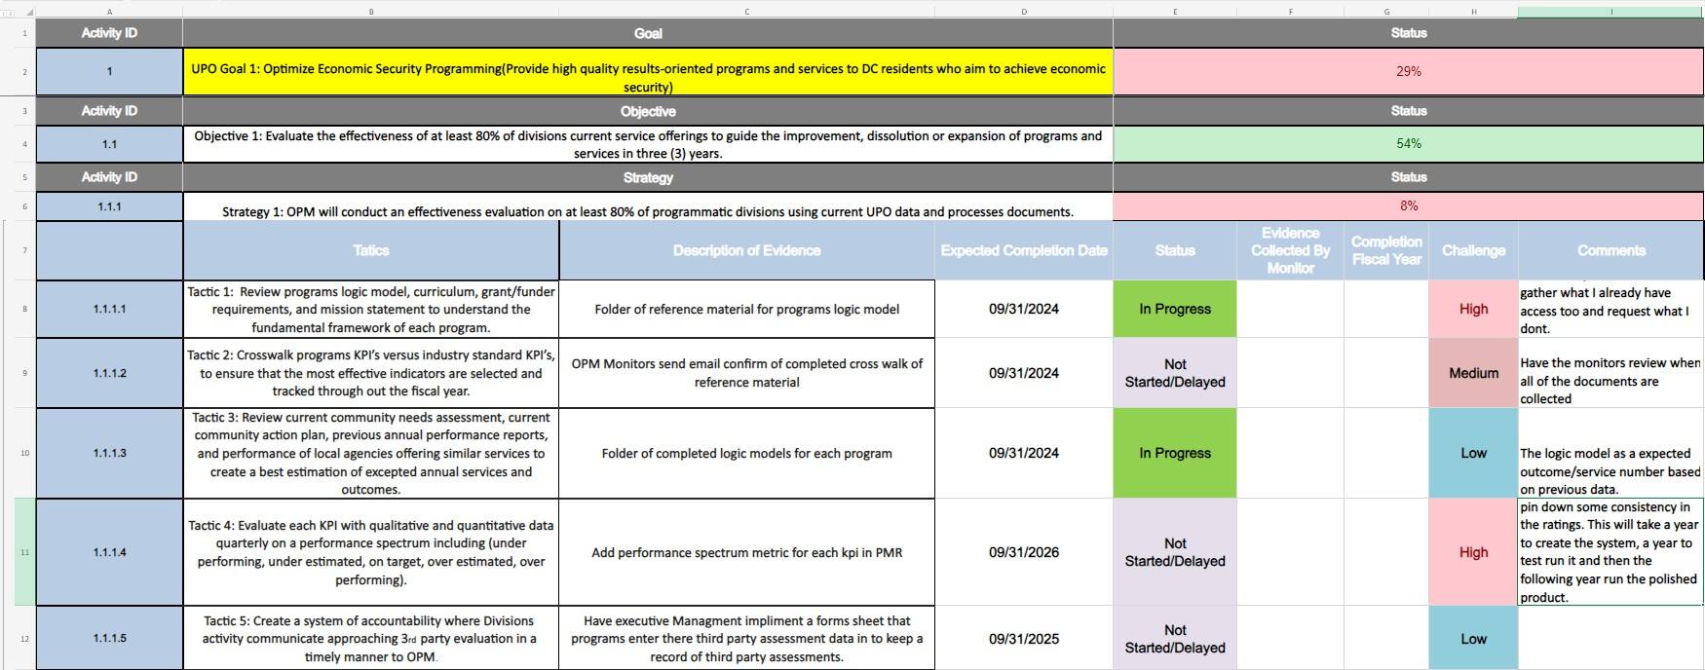
INDIVIDUAL STRATEGIC PLAN TRACKING PAGE
NASCSP 2024 Winter Training Conference |www. nascsp.org

Slide 11
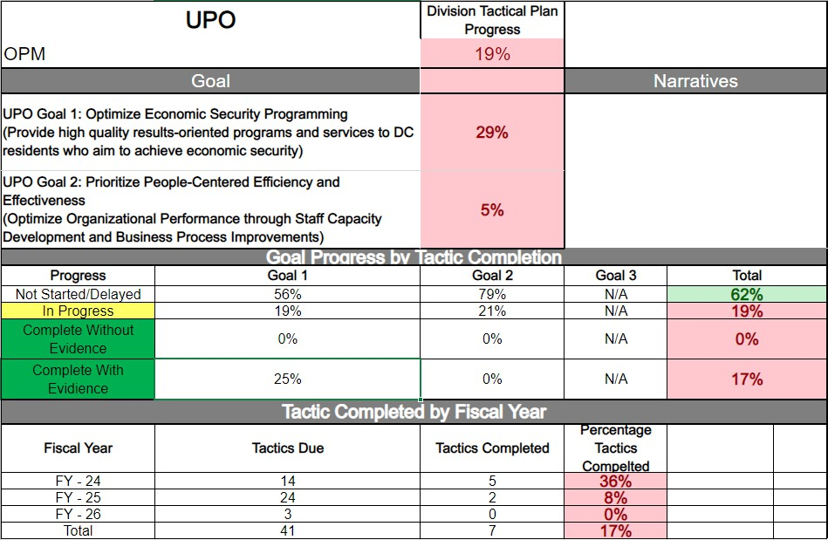
INDIVIDUAL STRATEGIC PLAN SUMMARY
NASCSP 2024 Winter Training Conference |www. nascsp.org

Slide 12
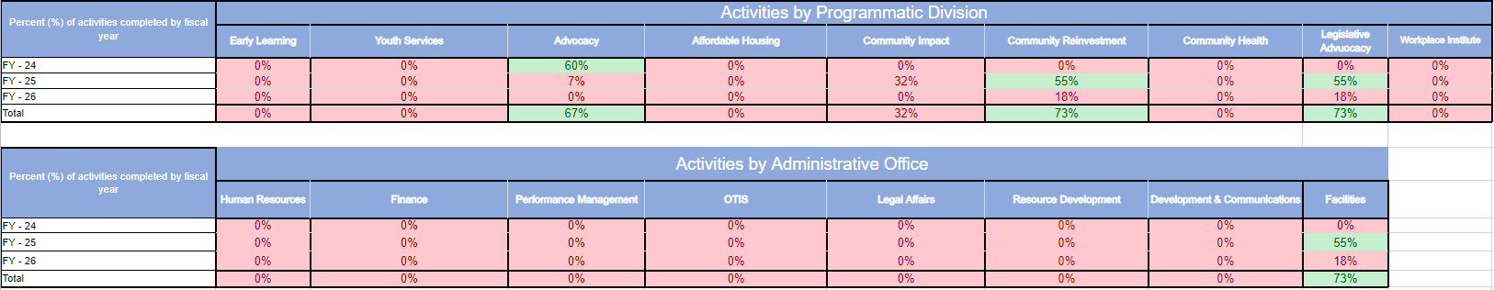
STRATEGIC PLAN EXECUTIVE SUMMARY
NASCSP 2024 Winter Training Conference |www. nascsp.org

Slide 13
UPO’S AWSC INTERNAL MONITORING
NASCSP 2024 Winter Training Conference |www. nascsp.org

Slide 14
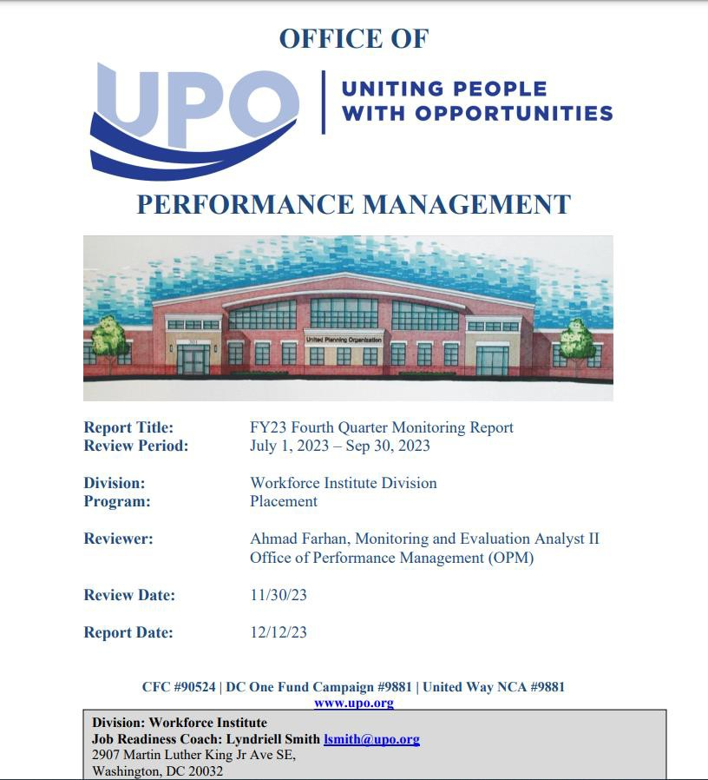
PERFORMANCE MANAGEMENT REPORT
NASCSP 2024 Winter Training Conference |www. nascsp.org

Slide 15
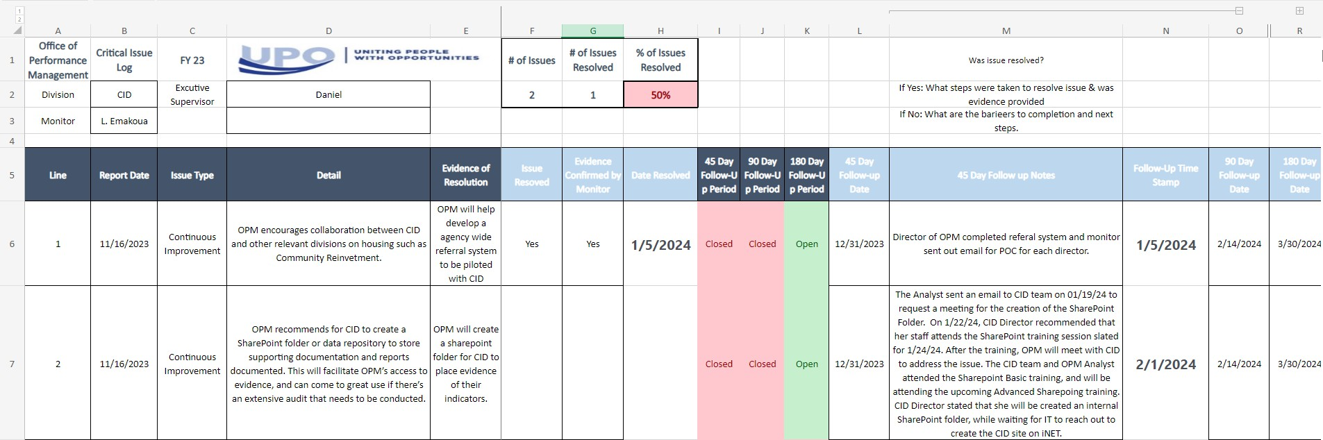
ISSUE LOG
NASCSP 2024 Winter Training Conference |www. nascsp.org

Slide 16
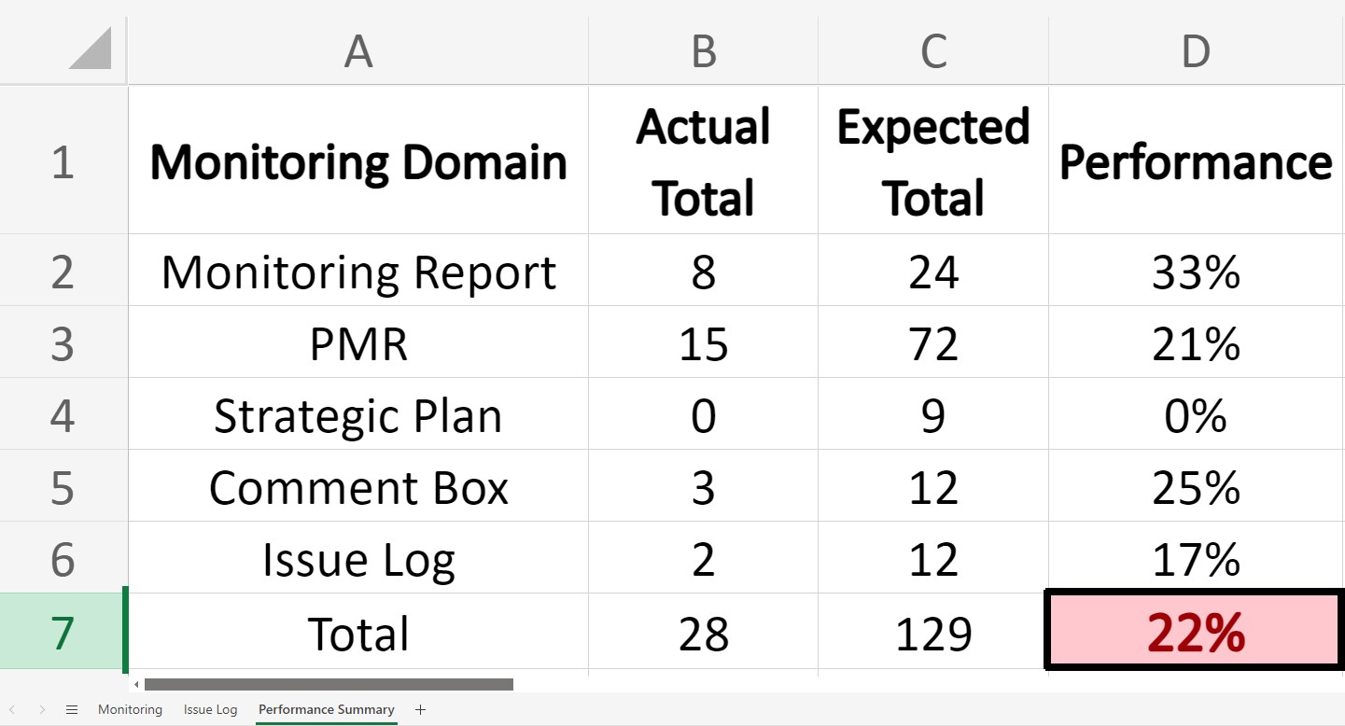
MONITORING CHECKLIST
NASCSP 2024 Winter Training Conference |www. nascsp.org

Slide 17
UPO’S AWSC FINANCIAL STRENGTH
NASCSP 2024 Winter Training Conference |www. nascsp.org

Slide 18
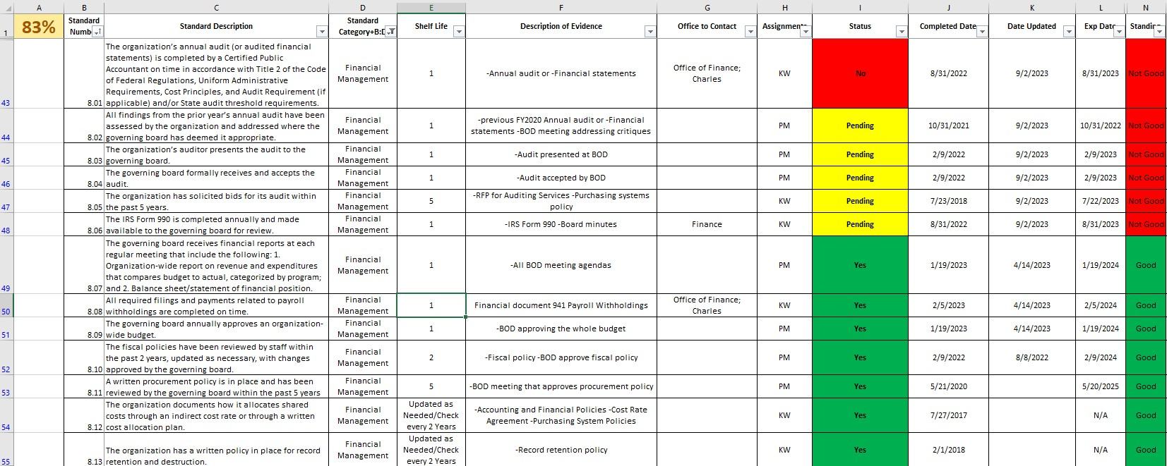
FINANCE SECTION OF ORGANIZATIONAL STANDARDS
NASCSP 2024 Winter Training Conference |www. nascsp.org

Slide 19
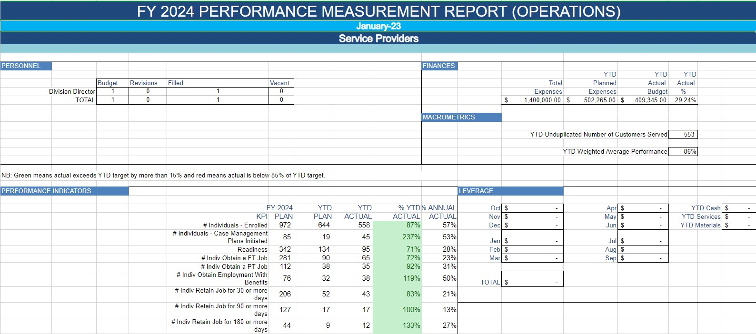
FINANCE SECTION OF PERFORMANCE MEASURMENT REPORT
NASCSP 2024 Winter Training Conference |www. nascsp.org

Slide 20
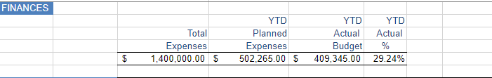
FINANCE SECTION OF PERFORMANCE MEASURMENT REPORT
NASCSP 2024 Winter Training Conference |www. nascsp.org

Slide 21
UPO’S AWSC PROGRAM PERFORMANCE
NASCSP 2024 Winter Training Conference |www. nascsp.org

Slide 22
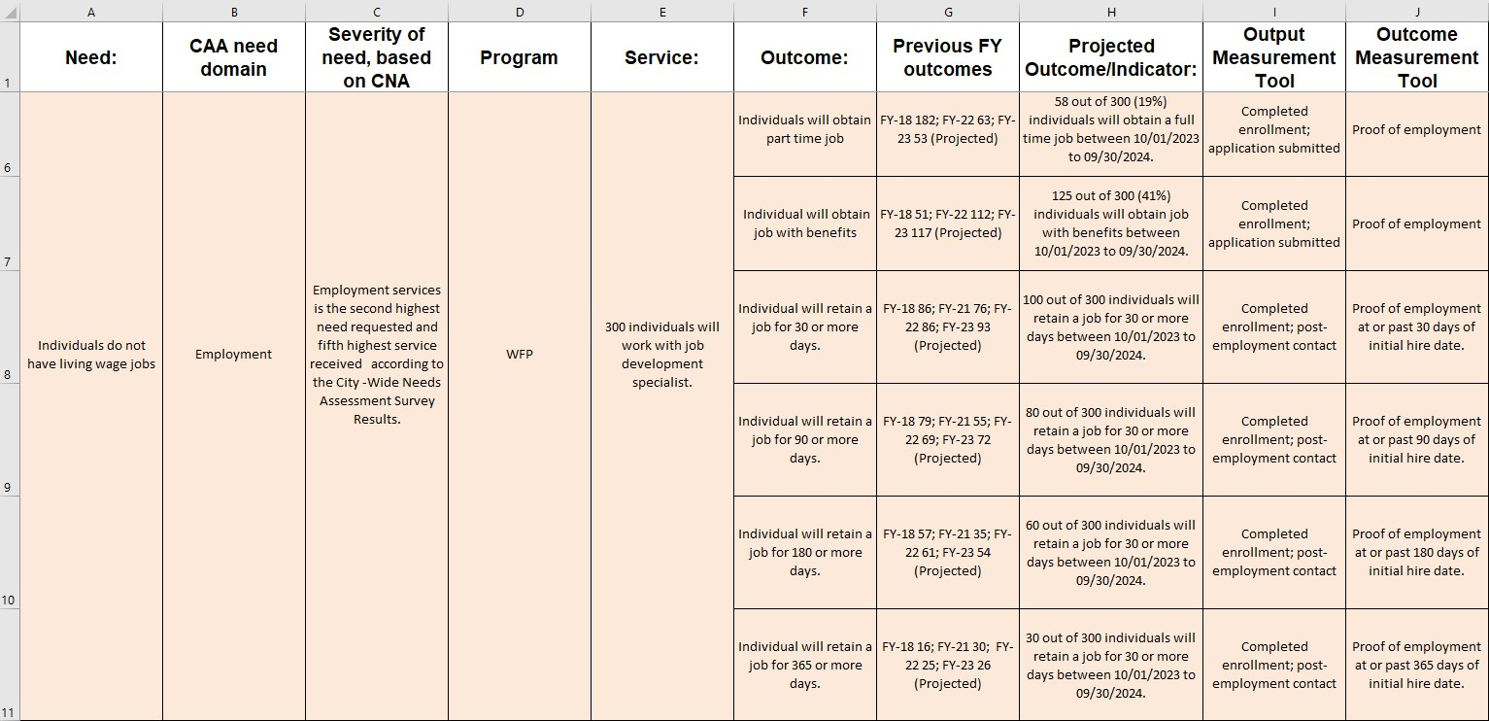
ROMA UPGRADED LOGIC MODEL
NASCSP 2024 Winter Training Conference |www. nascsp.org

Slide 23
PERFORMANCE MEASUREMENT REPORT
NASCSP 2024 Winter Training Conference |www. nascsp.org

Slide 24
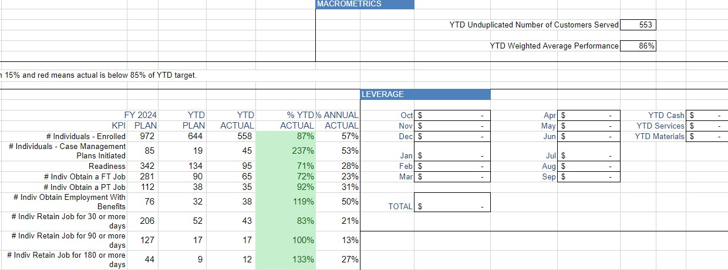
PERFORMANCE MEASUREMENT REPORT
YTD WEIGHTED AVERAGE PERFORMANCE
NASCSP 2024 Winter Training Conference |www. nascsp.org

Slide 25
UPO’S AWSC CSBG ORG STANDARDS
NASCSP 2024 Winter Training Conference |www. nascsp.org

Slide 26
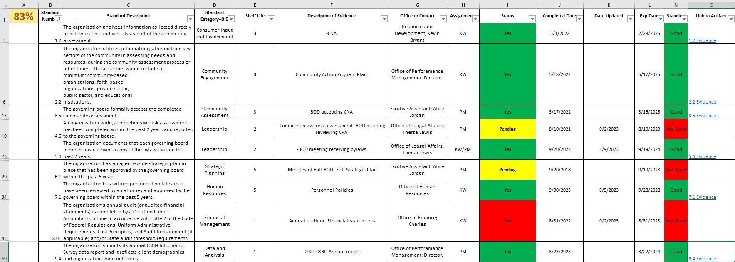
ORGANIZATIONAL STANDARDS
NASCSP 2024 Winter Training Conference |www. nascsp.org

Slide 27
UPO’S AWSC
RECAP
NASCSP 2024 Winter Training Conference |www. nascsp.org

Slide 28
UPO’S AGENCY-WIDE SCORECARD DOMAIN
NASCSP 2024 Winter Training Conference |www. nascsp.org

Slide 29
QUESTIONS?
NASCSP 2024 Winter Training Conference |www. nascsp.org

Slide 30
THANK YOU
EMAIL: KWOODS@UPO.ORG
WEBSITE: HTTPS://WWW.UPO.ORG/
NASCSP 2024 Winter Training Conference |www. nascsp.org

Slide 31
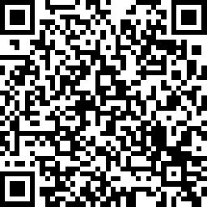
Please scan here to complete the evaluation for this session!
NASCSP 2024 Winter Training Conference |www. nascsp.org

