Slide 1
Systems Documentation

Slide 2

Systems Documentation
Beck Moore, CEO,
Mel Luckenbaugh, Director of Strategic Initiatives
Community Action Association of Pennsylvania

Slide 3
When?
Data collection challenges
Before implementing new systems
Process improvement
Looking expense reduction

Slide 4
Process Map Basics
Outlines individual steps within a process
Planning and management tool visually describing the flow of work
It may:
  Identify task owners
  Provide expected timelines
  Reveal areas for improvement

Slide 5
Benefits of Process Mapping
Increase understanding of process
Faster decision-making regarding process
Identify potential problems and bottlenecks
Encourage input from team members
Increase efficiency by improving process
Improves team performance
Increases satisfaction of team and customers
Scenario testing
Measure improvements
Standardization

Slide 6
Creating a Process Map
Identify the Process
Process Start/End
People Involved
Track the Process
List Activities in Order
Mark Pain Points – NO FIXING
Create Process Map
Determine Style
Share with Team to Finalize
Analyze
Confirm Accuracy
Highlight the Waste
Identify Inputs and Outputs
Every. Single. Step.
Create a Key
Note Areas of Improvement

Slide 7
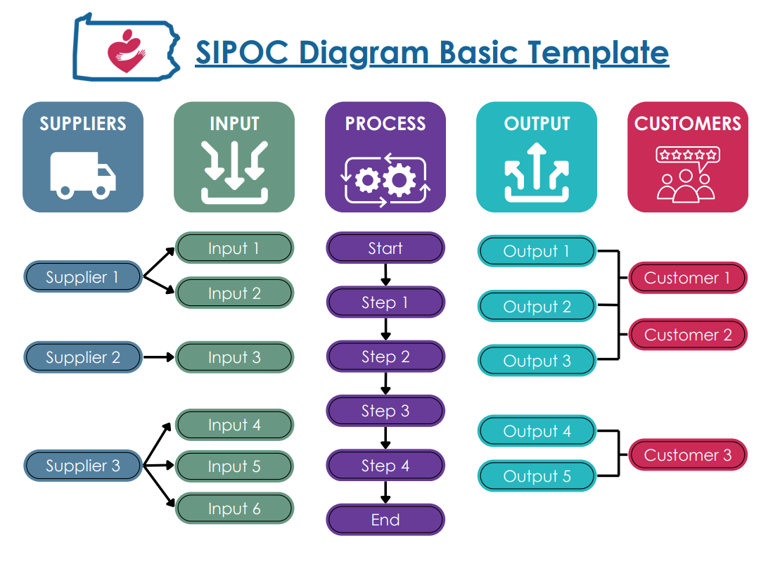
Step 1: Identifying the Process
Don’t try to swallow the ocean
Build a SIPOC from the inside out
  How do you know the process has started?
  What is the end of the process?
Who runs the process?

Slide 8
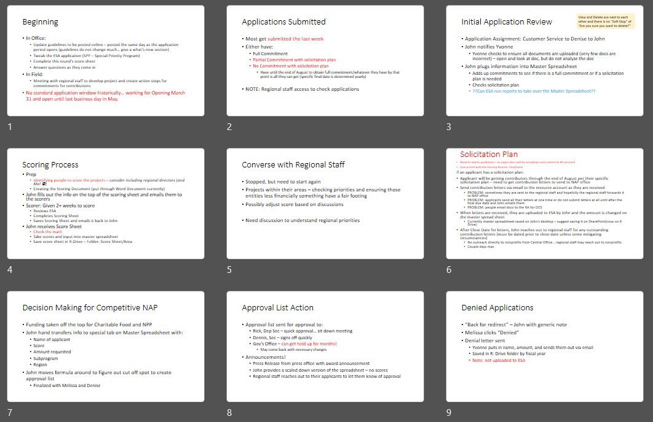
Step 2: Track the Process
Walk the Gemba
Include everyone involved
Keep asking “what happens next”
Break down all the activities into individual steps
Notate pain points, but do not talk about fixing
Use multiple sessions

Slide 9
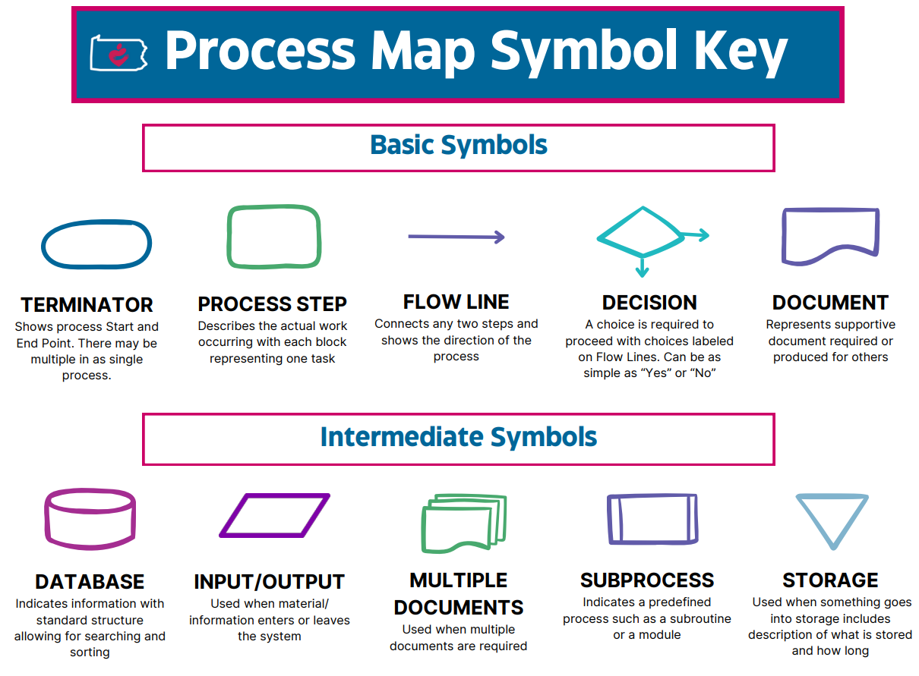
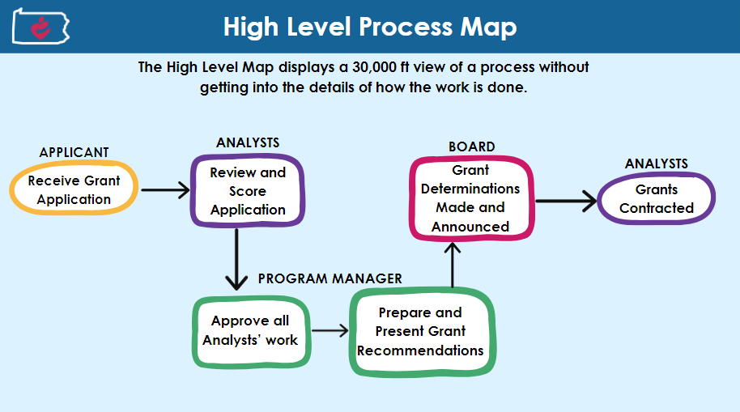
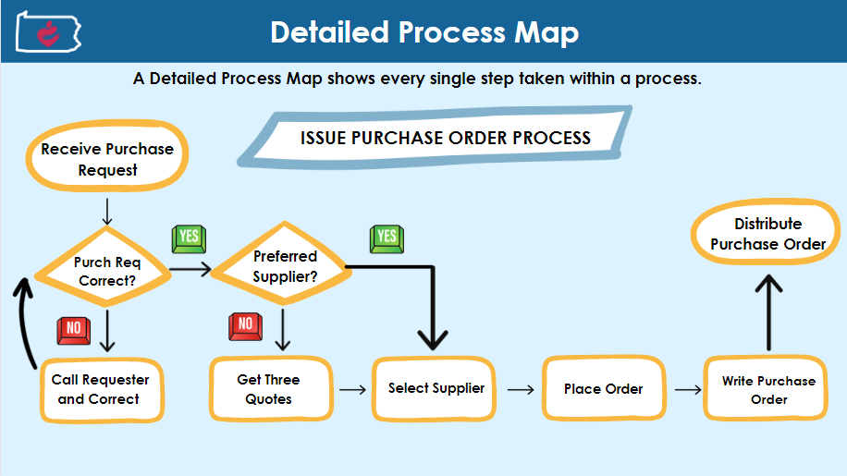
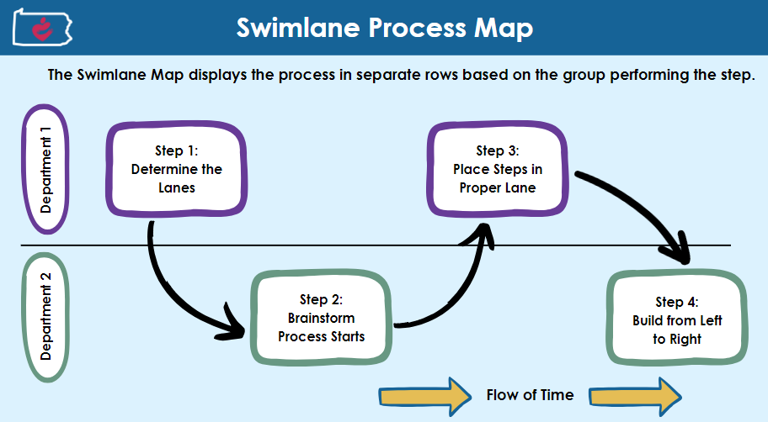
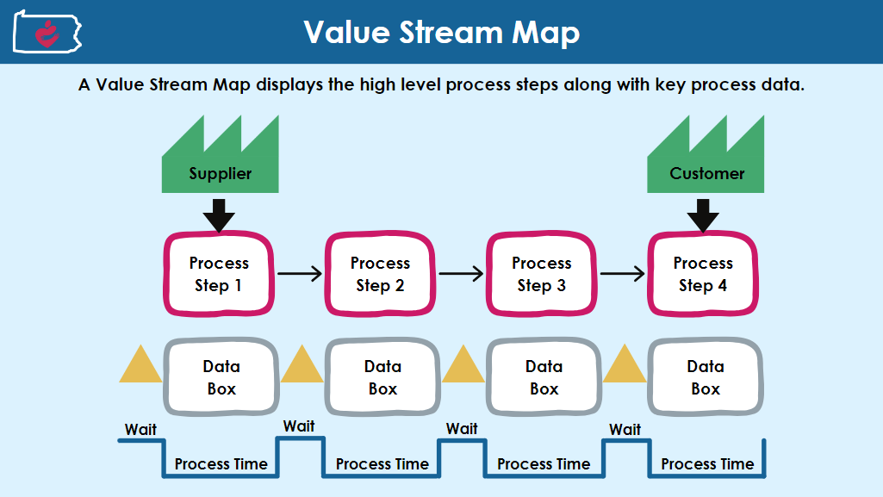
Step 3: Create Process Map
Take the process and put it into a flow chart
Provide a symbol key
Determine the style based on the audience
  High Level
  Detailed Process
  Swimlane
  Value Stream
Notes:
Lucid Chart, Visio, Canva, Word!

Slide 10

Step 4: Analyze
Review the process map with all staff involved in the process to ensure accuracy
Highlight any wastes
Rank pain points identified for action:
  Green – low hanging fruit
  Yellow – improvements that will require some effort
  Red – will require significant work to improve

Slide 11
Process Mapping
A great place to start continuous improvement
Case Study: PA Neighborhood Assistance Program

Slide 12
Neighborhood Assistance Program
Tax Credit Program
Nonprofit organization applicants
Business contributors
Five Programs in One
Neighborhood Assistance Program (NAP)
Neighborhood Partnership Program (NPP)
Special Program Priorities (SPP)
Charitable Food Program (CFP)
Enterprise Zone Program (EZP)

Slide 13
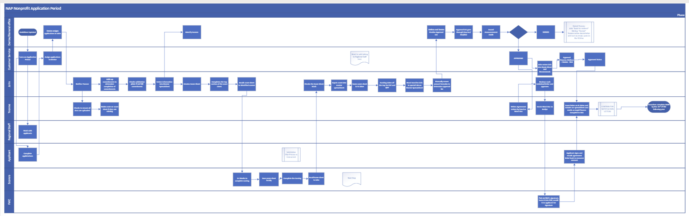
Original Funding Review Process

Slide 14
Analyzing
Problem Statement: Applications are submitted incomplete, inaccurate, and ineligible.
Identified pain points to turn into Areas of Opportunity
  Revised guidelines – reduced from 60 pages to 32 pages
  Created program specific resources
  Simplified application
  Created Standard Work documentation for new reviewers
  Automated letters
  Implemented a Kanban Board for visual management
Over 40 documented improvements in two years!!!

Slide 15
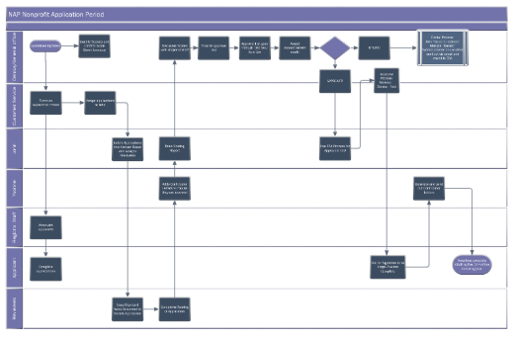
Revised Funding Review Process
Reduced from 46 steps to 23
Removed one swim-lane
Balanced out workload
Reduced bottlenecks
Eliminated re-work loops

Slide 16

Thank You!
Community Action Association of Pennsylvania
Beck Moore
  CEO, CAAP
  beck@thecaap.org
Mel Luckenbaugh
  Director of Strategic Initiatives
  mel@thecaap.org
Visit our website at www.thecaap.org to sign up for our hybrid DEI Summit on May 16th

Slide 17
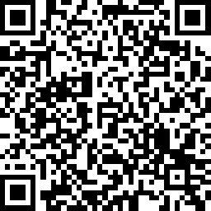
Please scan here to complete the evaluation for this session!

