Slide 1
Exploring Careers as a
Home Energy Professional

Slide 2
Introduction
Notes:
OPTIONAL SLIDE FOR PRESENTERS: Use this to list your name, your role, the name of your WAP agency, and any relevant data. Talk about why you are here today.
Ideas for content:
Agency logo
Photo of staff
Map of agency service territory.

Slide 3
Contents
1
Introduction to Weatherization
2
The Work of Weatherization
3
Jobs and Careers in Weatherization
4
OPTIONAL: Activities
5
Section Name
6
Section Name
7
Section Name
Notes:
FOR PRESENTERS: You can delete, edit, or re-arrange any of the items in this table of contents.

Slide 4
Introduction to Weatherization
Notes:
“First, I will talk about what weatherization is and why do we do it.”

Slide 5
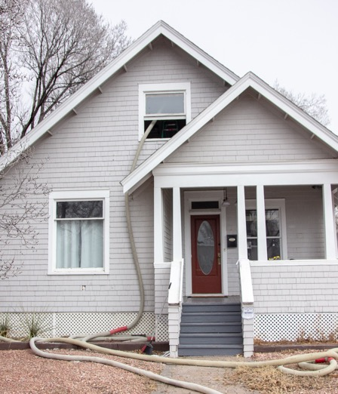
Background
In the United States, we spend more than $400 billion each year to power our homes and buildings.
As much as 30% of that energy and money is wasted through poorly constructed buildings and inefficient appliances, lighting, and other equipment.
https://www.energy.gov/eere/buildings/about-building-technologies-office
Photo by Energy Resource Center (ERC)
Notes:
“In the U.S., we spend more than $400 billion each year to power our homes and buildings. And as much as 30% of that energy and money is wasted because of poorly constructed buildings, and inefficient appliances, lighting, or other equipment.
Stepping back, pretty much every building in the U.S. today uses energy. Energy is used to heat buildings in the winter and cool them in the summer. Energy is also used for things like heating water, cooking, washing and drying clothes, and then everything else that you plug into an outlet: refrigerators, televisions, computers, cell phones, etc. Sometimes the energy used is electricity, and sometimes it is natural gas, or propane. But all of those are types of energy.”

Slide 6

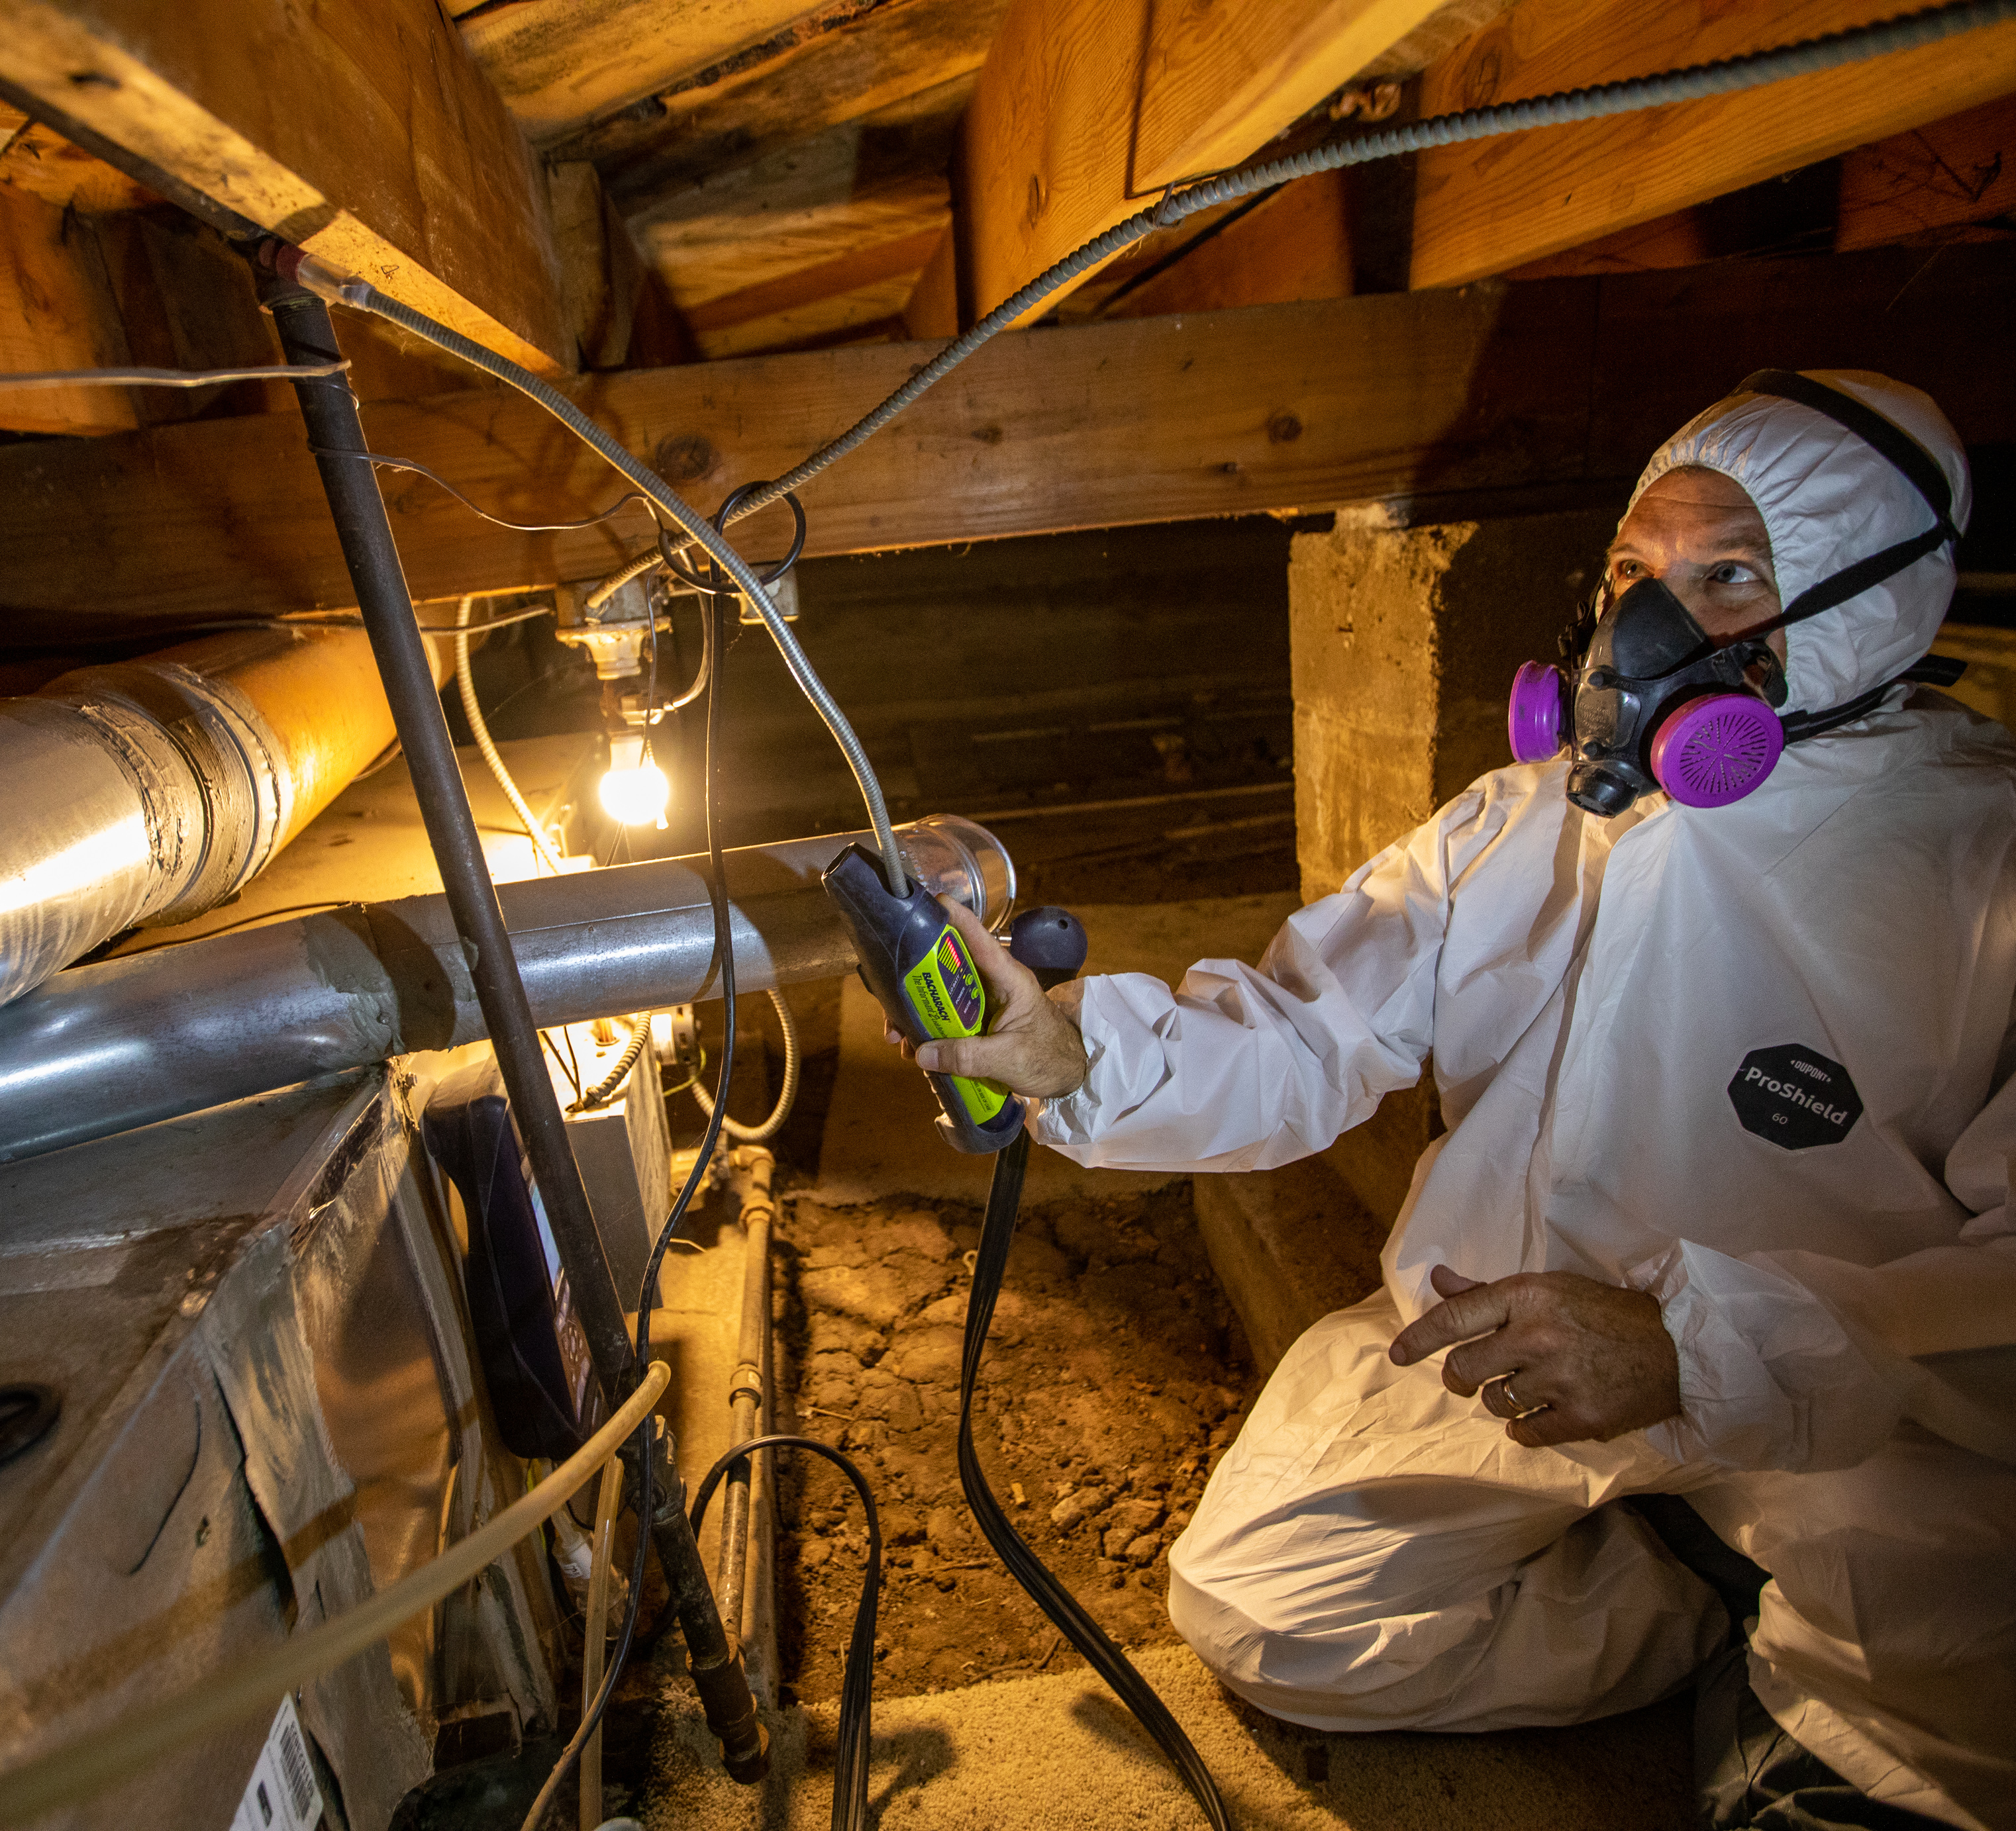
What is Weatherization?
Weatherization refers to a variety of home improvements that:
Save energy and money
on utility bills
AND
improve the health, safety, and comfort of homes for residents.
Notes:
“Weatherization encompasses a variety of building or home improvements that save money on utility bills AND improve the health, safety, and comfort of homes for the residents. We will talk more in a few minutes about the type of improvements that do this.
Everyone wants to reduce waste and save money, but this can impact households in different ways. For example, reducing an energy bill from $150 to $100 each month will make a bigger difference to someone who earns $1,000 a month compared to someone who makes $10,000 a month. This is where the Weatherization Assistance Program comes in . . .”

Slide 7
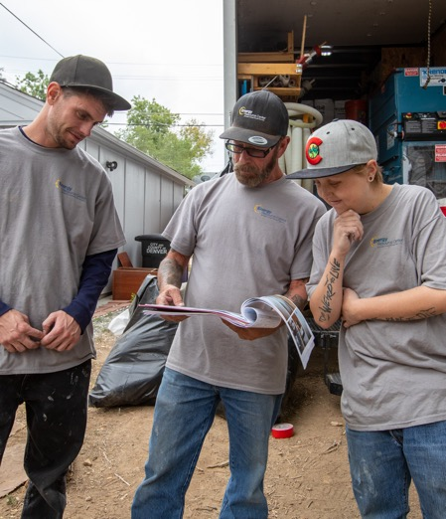
What is the Weatherization Assistance Program?
Through the Weatherization Assistance Program, a network of nearly 800 local organizations across the U.S. and its territories use funds from the U.S. Department of Energy (DOE) and other sources to weatherize the homes of low-income residents, at no cost to the those households.
https://www.energy.gov/scep/wap/weatherization-assistance-program
Photo by Werner Slocum / NREL 72232
Notes:
“The Weatherization Assistance Program is a network of nearly 800 local organizations across the U.S. that use funds from the U.S. Department of Energy and other partners to weatherize the homes of low-income residents specifically. And here is the most important part: those homes are weatherized at no cost to them.
This is important because improving your home costs money. And even if you know that your home is wasting energy and therefor money, if you don’t have the money to pay for the improvements up front, you may not be able to get the financial savings and health and safety benefits that come with it. We do this at no cost for low-income households.”

Slide 8
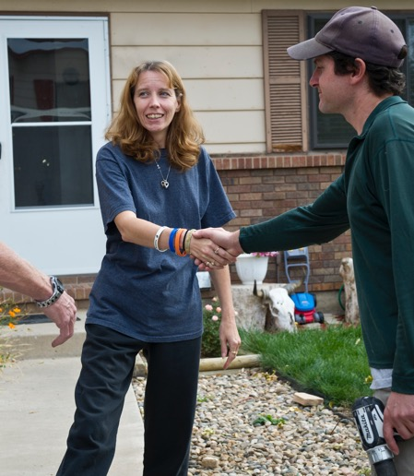
Who Do We Help?
Nationally, the Weatherization Assistance Program works with:
Homeowners
Renters
Single family homes
Multifamily homes/apartments
Manufactured homes.
Priority is given to the elderly, families with one or more members with a disability, families with children, or high energy users.
Photo by Dennis Schroeder, NREL 22092
https://www.energy.gov/scep/wap/weatherization-assistance-program
Notes:
“Who can benefit from the Weatherization Assistance Program? We work with homeowners and renters living in single family stand-alone homes, apartments, and mobile homes. And there are priorities for older residents, families where someone has a disability, families with children, and homes that have especially high energy use because of unique things like very old inefficient appliances. Or, maybe someone who is on an oxygen system to help them breath.”
OPTIONAL FOR PRESENTERS: You can change or add any additional requirements you may have (e.g., lawful presence, demographics, priorities)

Slide 9
National Impacts of Weatherization
DOE’s weatherization program funds upgrades to about 35,000 homes per year across the U.S. Our network is able to weatherize another 30,000 homes each year with other funds.
Benefits to our clients include:
$372 average annual energy cost savings
Safer and more comfortable temperatures in homes
Improvements in health.
https://www.energy.gov/sites/default/files/2023-08/2023-WAP-Fact-Sheet.pdf
https://weatherization.ornl.gov/wp-content/uploads/pdf/WAPRetroEvalFinalReports/ORNL_TM-2014_345.pdf
https://nascsp.org/wap/weatherization-publications/wap-annual-funding-surveys/
Notes:
“And what impact does that have? Nationally, the DOE weatherization program funds upgrades to about 35,000 homes each year, and another 30,000 homes are weatherized with funds from other sources like local government or utilities. DOE estimates that families save an average of $374 on their energy bills each year. Clients also report safer and more comfortable temperatures in their homes, reductions in things like noise, insect or rodent infestation, and mold, and even less need for medical attention. In a survey conducted by Oak Ridge National Laboratory, families whose homes were weatherized through WAP reported an average of $514 in medical cost savings.
These numbers are averages, which means some households see higher change and some see lower changes. But these are some pretty amazing impacts.”

Slide 10
Local Impacts of Weatherization
Notes:
OPTIONAL SLIDE FOR PRESENTERS: Here at our weatherization agency . . . .
(Provide local impact numbers such as number of households served)

Slide 11
Weatherization Success Stories
Notes:
OPTIONAL SLIDE FOR PRESENTERS
(Describe a local client success story – include story and photos a real person or family and the money they saved, or the health that was improved, can really make this come to life. Another option could be to use videos from NASCSO’s Weatherization Success Stories page: https://nascsp.org/wap/advocacy/weatherization-success-stories/)

Slide 12
The Work of Weatherization
Performed by Home Energy Professionals
Notes:
“Now we will go a little bit deeper into specific types of projects that are done to homes in weatherization.”

Slide 13
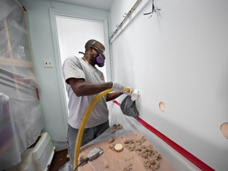
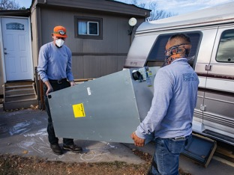
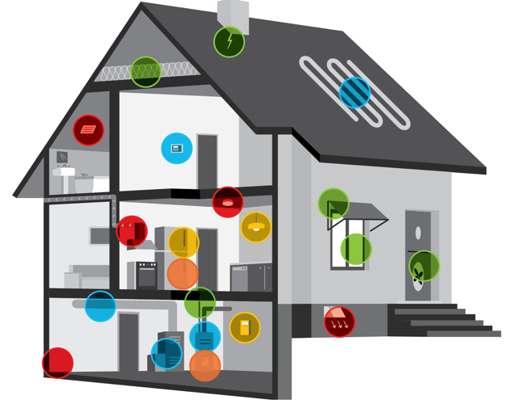


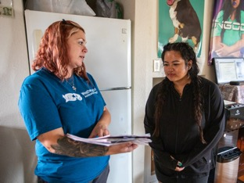
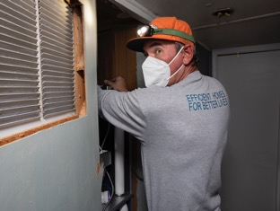


What is Weatherization?
Building Shell Projects
Mechanical Projects
Electric Baseload Projects
Health and Safety Projects
https://www.energy.gov/scep/wap/whole-house-weatherization
Notes:
“The work of weatherization falls into four main categories:
Building shell projects, which affect the exterior of the structure, including walls, windows, doors, attic, roof, and foundation. The most common building shell measures include insulation, which you see in this photo, and air sealing. Insulation is like wrapping your home in a warm jacket in the winter to keep the heat in and the cold out. Air sealing is making sure that jacket is zipped up.
Mechanical projects refer to the appliances and systems that heat or cool air or water in a building—like a furnace, air conditioner or water heater, as well as things like thermostats to help regulate temperatures.
Electric baseload refers to everything else that you plug in to an electric outlet to use, however in weatherization these are mostly things like refrigerators.
And finally, the work of weatherization is finding ways to reduce the amount of energy used without negatively impacting health or safety.
Trained professionals complete this work, and the next series of slides show more detail on what this can look like.”

Slide 14
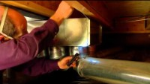
Energy 101 Video
https://www.youtube.com/watch?v=YolBP0-vkBU&list=PLACD8E92715335CB2&index=23&t=105s
Notes:
OPTIONAL FOR PRESENTERS: Depending on time, you could show this video instead of, or in addition to the following slides

Slide 15
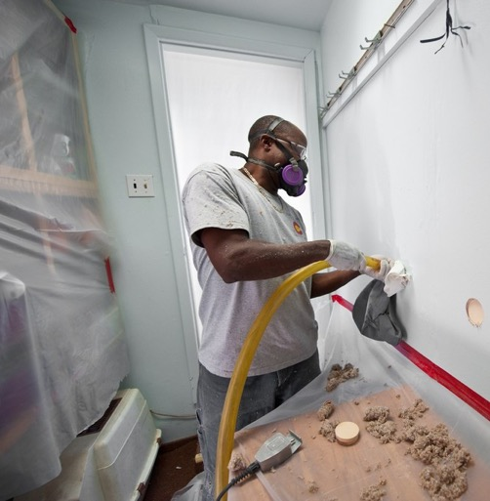
Building Shell Tasks
Install insulation where needed
Perform air sealing
Repair/replace windows and doors
Install window film, awnings, and solar screens
Repair minor roof and wall leaks prior to attic or wall insulation.
Photo from NREL image gallery 17963
Notes:
“First are projects that improve the shell of the building, which is the barrier that separates the inside of a building from the outside and its high or low temperatures and moisture. Sometimes the issues with the shell of a home are really obvious—like being able to see daylight around a window or door—but not always. Houses can have a lot of little gaps that add up to the equivalent of one or many windows being open all the time, when you don’t want them to be. Sealing the shell can reduce the amount of energy used for heating and cooling. Imagine trying to blow up a balloon that has a tiny hole in it—you may not see, feel or hear the air leaking out of that hole, but you know it is because no matter how much air you blow into it, it keeps deflating. That is what it is like trying to heat or cool a building without a well sealed building envelope. You just keep pumping energy and money in to try and maintain a certain temperature but most of it is wasted.
To improve the comfort and energy efficiency of a home, insulation can be added to walls, floors, ceilings, attics, and foundations. Air sealing is typically completed using caulk or spray foam that can get into little gaps and cracks and stop air from moving where you don’t want to it move – often around windows or doors, or in and between walls, foundations, and attics. You may also repair or replace old leaky windows or doors, or install film or coverings over windows. And some homes may also require minor repairs to roofs or walls before you can insulate.”

Slide 16
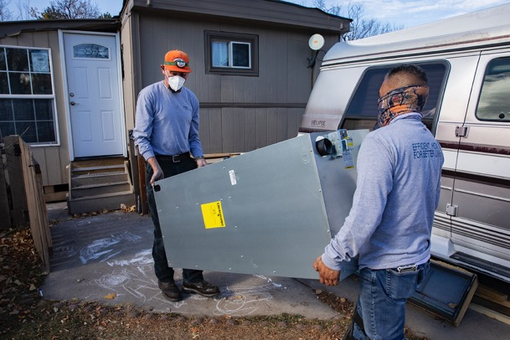
Mechanical Tasks
Clean, tune, repair, or replace heating and/or cooling systems
Install duct and heating pipe insulation
Repair leaks in heating/cooling ducts
Install programmable thermostats
Repair/replace water heaters
Install water heater tank insulation
Insulate water heating pipes
Install solar hot water heating systems.
Photo from Energy Resource Center
Notes:
“Second are mechanical measures. To give an example of how this is relevant, you could have a really well insulated and sealed building shell, but if your furnace is really old, it may be using more energy than it needs to just to heat up the building. It’s like trying to drive or ride a bike with a flat tire—if things aren’t working properly, it takes way more fuel or energy that it needs to.
Mechanical projects in homes may involve cleaning, tuning, repairing, or replacing furnaces, boilers, heat pumps, or air conditioners. But we call it a system, because it isn’t just the appliance. There are ducts—sort of like pipes—that move air from a furnace or air conditioner through the building to the grate you see in your floor or ceiling. Those ducts can be insulated so the warm or cold air stays inside. And there can be gaps or cracks in the ductwork, which means that hot or cold air you generate from the furnace or air conditioner is leaking out before it even gets into the living spaces (again, this is like blowing up the leaky balloon). And finally, most homes have thermostats, which control the temperature that a mechanical system will heat or cool a space to. Installing programmable thermostats can automatically adjust the temperature needed in a home, for example, when nobody is home or while you are sleeping—which can reduce energy use and save money.
We also may do similar work repairing and insulating hot water heaters to reduce the amount of energy needed to heat the water used in showers, sinks, and clothes washers.”

Slide 17
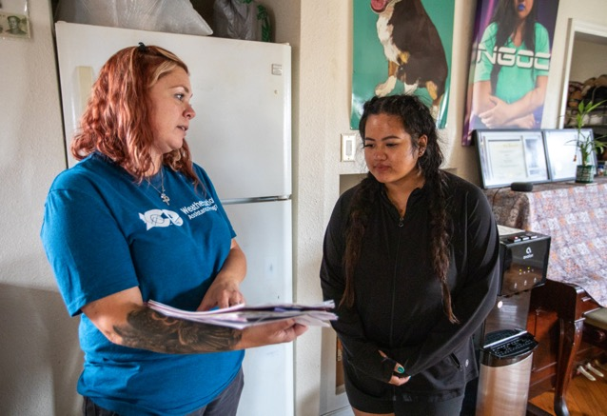

Electric Baseload Tasks
Install efficient light sources
Replace inefficient refrigerators with energy-efficient models.
Photo by Werner Slocum / NREL 722888
Notes:
Next is electric baseload. This is everything else besides space heating or cooling that you plug in to use—and just like with a furnace, newer technology allows appliances to do the same thing with less energy needed.
In weatherization, typical measures include:
Lighting retrofits, such as replacing incandescent or halogen bulbs with compact fluorescent lamps (CFLs)
Refrigerator replacement.

Slide 18
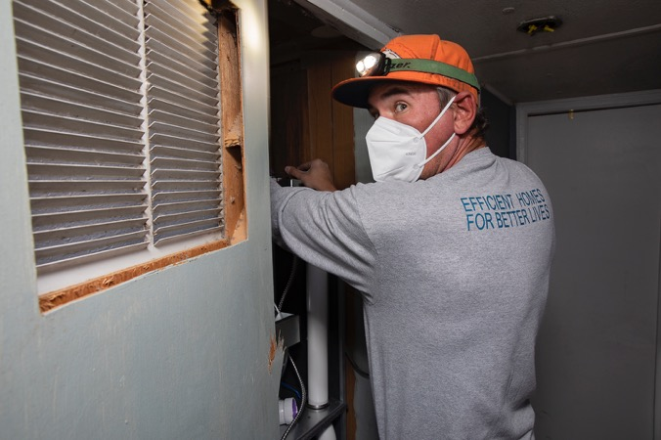
Health and Safety Tasks
Perform heating system safety testing
Perform combustion appliance safety testing
Repair/replace vent systems to ensure combustion gas drafts safely outside
Install mechanical ventilation to ensure adequate indoor air quality
Install smoke and carbon monoxide alarms when needed
Evaluate mold/moisture hazards
Perform incidental safety repairs when needed.
Photo from Energy Resource Center
Notes:
“And finally, the WAP program can do some work that will improve health and safety for clients. This can include testing appliances to make sure they are working properly and aren’t leaking natural gas or carbon monoxide. We look at potential fire hazards and install smoke and carbon monoxide alarms when needed. We look at how moisture may be getting into a building and becoming trapped, causing mold or other structural issues.
And a big part of health and safety is actually about ventilation—some of you may have fans in your bathrooms or above your stoves. You may think about these as just getting rid of smells, but mechanical ventilation is hugely important to maintaining safe indoor air quality and health. When you weatherize a home, for example, you seal up all those gaps that let in cold air in the winter and hot air in the summer. That is great from an energy perspective, but if there are materials or appliances in a home that put off dangerous gases or particles that are unhealthy to breath, then you are keeping those things in the home longer. So, in WAP, we make sure that if we are sealing off a building, we are also installing the fans and systems necessary to ensure both energy savings and safe and healthy indoor air quality for our clients.
Finally, WAP may do incidental repairs, which are those repairs necessary for the effective performance or preservation of weatherization materials. Examples could include framing or repairing windows and doors which could not otherwise be caulked or weather-stripped, or providing protective materials, such as paint, that are used to seal materials installed under this program.”

Slide 19
House As a System
https://www.energy.gov/scep/wap/whole-house-weatherization
Notes:
“The last thing I want to share on this topic is the importance of understanding that a building is a system with interacting components. We’ve already talked about how changes to the building shell may impact mechanical measures or health and safety. But this building system also includes people. People are part of this because they are both impacted by those measures, AND they can impact them. You could have the best building envelope in the world, but that doesn’t matter if you open up windows on a really cold or hot day and forget to close them, or don’t close them all the way. Or you could have a high-efficiency furnace, but maybe you don’t have a programmable thermostat and you forget to turn the heat down when you leave the home, spending unneeded energy and money heating a home when nobody is there. Or we could install proper ventilation fans, but they never get turned on.
In the Weatherization Assistance Program, we make sure that we are focusing not only on buildings, but the people in them as well.”

Slide 20
Commonly Installed Weatherization Measures
Here at (INSERT AGENCY NAME) the most commonly installed measures are:
Notes:
OPTIONAL SLIDE FOR PRESENTERS: Agencies can customize this to reflect their most commonly installed measures.

Slide 21
The Home Weatherization Process
Finding and qualifying
the client
Assessing the home
(energy audit)
Installing and inspecting
the work
Educating
the client and improving
the program
Notes:
“Before I dive into the types of jobs we need to do the work, I want to show the basic process for weatherizing a home in WAP. First, you need to find and qualify people, which we refer to as clients. While just about every home could use weatherization, remember that earlier I said that the WAP program is only for low-income households. So we need to find people that meet those qualifications, they need to hear about us and be able to understand how we may be able to help them, and they need to fill out an application to review.
If they are approved, they move to the next step where we visit and asses their home to understand things about the building envelope, mechanical systems, appliances, the health and safety of it all. Once you’ve identified what projects will improve health and safety and be cost-effective, then you do the work, and then get inspected to ensure it was done correctly. And the last step is helping the clients understand what was done and what they may need to know about their new appliances or systems. And with any program, you are always working to make improvements to how things are managed.”

Slide 22
Jobs and Careers in Weatherization
Home Energy Professionals
Notes:
“That leads us into my final topic, which is about job and career opportunities in the Weatherization Assistance Program.”

Slide 23
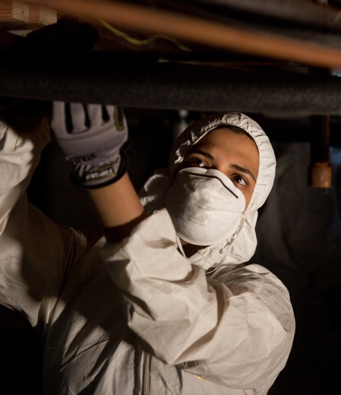
The Weatherization Workforce
Delivering health and safety improvements and bill savings to households requires skilled and passionate professionals.
Across the country, the Weatherization Assistance Program supports 8,500 career-track jobs.
https://www.energy.gov/sites/default/files/2023-08/2023-WAP-Fact-Sheet.pdf
Photo from the Energy Resource Center
Notes:
“None of the work that we do could happen without skilled and passionate workers. Nationwide, the Weatherization Assistance Program supports 8,500 jobs. “
OPTIONAL FOR SPEAKERS: Add info about how many people are employed at your agency or in your state. You can also replace the photo on this slide with a photo of your team.

Slide 24







Home Energy Career Pathways
Retrofit Installer
Crew Leader
Energy Auditor
Quality Control Inspector
Client Intake Specialist
WAP Program Manager
Notes:
“This is a list of the main jobs within the Weatherization Assistance Program. The first four are jobs related to the work done directly in and on homes. The last two are jobs that are more behind the scenes and necessary so that the work can get done. I will walk through each of these over the next 10 or 15 minutes and talk about responsibilities and experience needed. But before I do, I want to mention that for any of these careers, we offers FREE on-the-job training to support you in gaining the knowledge and skills you need to excel at your job and progress in your career.

Slide 25

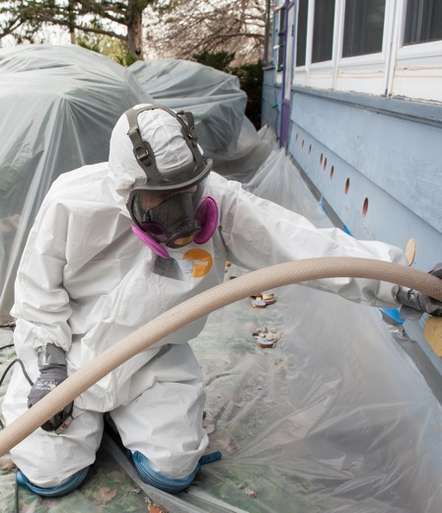
Retrofit Installer Technician
Retrofit installer technicians perform home energy-saving upgrades.
Experience with tools
Basic building science & math
Computer and phone skills
Customer service skills
Positive attitude
Photo by Dennis Schroeder / NREL 28786
Notes:
“First is retrofit installer technician, which is an entry-level position for people interested in doing weatherization work on homes. Retrofit installers are the people who perform home upgrades that result in energy savings. Weatherization installers often work in attics, basements, and crawlspaces.
Successful workers in this job will come in with some experience using basic hand and construction tools such as tape measures, drills, and saws; basic building science and math skills; ability to use a phone and basic computer processes; customer service skills, because you are working directly with clients and other staff and contractors; and finally, a positive attitude, which goes a long way. This work is important, but it is hard work in difficult spaces like attics and crawlspaces, and includes working with people who sometimes are having difficulties with their health, safety, or finances. Staying positive can make the difference between a good worker and a great WAP employee.

Slide 26

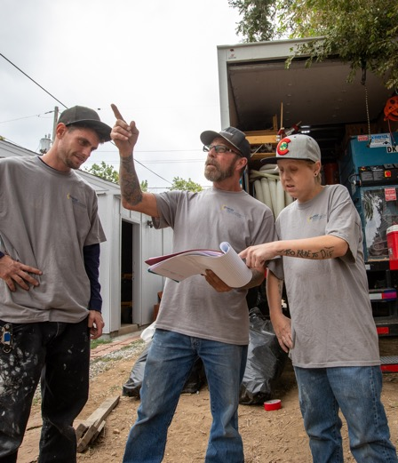
Crew Leader
Crew Leaders supervise installation of home energy-saving upgrades.
Understanding of construction and weatherization techniques
Ability to explain diagrams and manuals
Leadership and interpersonal skills
Problem-solving skills
Responsible
Photo by Werner Slocum / NREL 72233
Notes:
“Crew leaders help to install, but also supervise and manage the work done by retrofit installers and different subcontractors. Most start as retrofit installers, but even if they don’t, they need to come in with an understanding of construction and weatherization techniques. They need to be able to do the work but also explain it to others. That is related to leadership and interpersonal skills, which is something that can be taught but also comes naturally to some people. They also need to be able to problem-solve and be creative—every house is different, and you can’t always do the same thing in the same way in each home. Very often you need to think creatively about how to address a challenge in a specific situation. And finally, they need to be responsible—although crew leaders are not always the ones doing the work, they are overseeing it and making decisions about it, and are ultimately responsible for successful home improvements.”

Slide 27

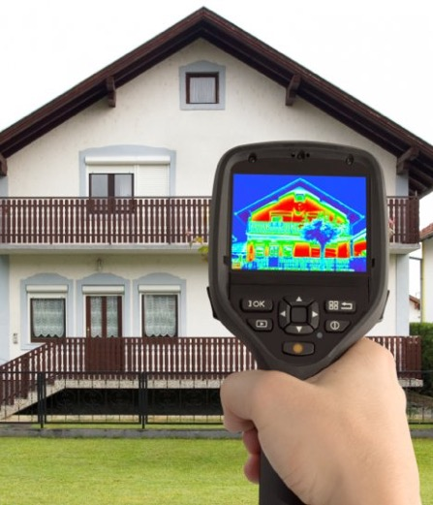
Energy Auditor
Energy auditors use a variety of technologies to assess a home and determine which measures are cost-effective.
Ability to pay attention to detail and be organized
Knowledge about building science
Understanding of construction and weatherization techniques
Ability to organize and track data
Advanced diagnostic tools and techniques
Notes:
“Energy auditors are typically the first person at someone’s house, and their job is to use a variety of technologies to assess a home and determine which measures are cost-effective. Like crew leaders, energy auditors often start as retrofit installers, but even if they don’t they need to understand building science and weatherization techniques. Organization and attention to detail is really important to everyone involved in WAP, but is absolutely essential for energy auditors, since all other work builds on their initial analysis of a home.
And finally, they need to be familiar with energy audit tools, techniques, and technologies. These technologies include things like a thermal imaging camera, which you can see in this photo and we will talk about later. This is like an X-ray for a building that shows the temperatures of different surfaces, and allows you to quickly see where heat or cold may be leaking into or out of a home. Other diagnostic tools include a blower door test which is this red thing—here you literally pump a home full of air, and like blowing up a balloon, you can use that to look for where air is escaping and can be sealed. You also take all sorts of measurements on the home, record mechanical system and appliance information, and input it all into an online or computer software program—called an energy audit tool—that uses that information and more to determine which upgrades will save the most money over time in relation to how much they cost to install.”

Slide 28

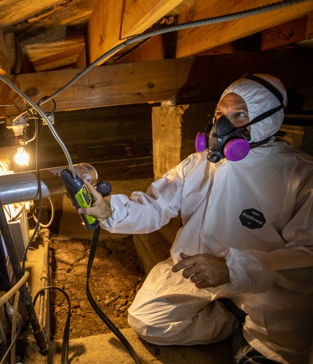
Quality Control Inspector
Inspectors ensure quality and completion of installed energy-saving upgrades.
Knowledge about building science
Understanding of construction and weatherization techniques
Ability to multitask
Organized
Attention to detail
Photo by Werner Slocum / NREL 72300
Notes:
“Quality control inspectors come in after work has been completed to make sure everything has been done correctly. This is different and separate from city inspections—it isn’t just about meeting the local building codes, but about making sure the measure was installed in such a way that it will save the most energy and improve health and safety for a client. Often these inspectors have come through the WAP program, starting as retrofit installers and crew leaders, then energy auditors. But if not, they need to have deep understanding of building science and weatherization techniques in order to do their job effectively. They need to be able to multitask—rather than working on one job at a time, a quality control inspector may look at several measures on every home and several homes in one day. And of course, they need to be organized and have a high ability to pay attention to detail since they are ensuring that work was done correctly.”

Slide 29


Client Intake Specialist
Confirms client eligibility for the program.
Knowledge about WAP and weatherization measures
Understand utility bills and financial documents
Enjoy talking with people
Organized
Attention to detail
Photo by Getty Images 1327589078
Notes:
“But before installers and inspectors can do their work, there is a whole set of staff that work more in the office and are needed to find and qualify clients. The client intake specialist is usually the first point of contact with a client. They may go to neighborhood events to talk to people about WAP and how it could benefit them. They answer people’s questions and help them submit an application and all the documentation that goes along with it. Then, they review the application to confirm if they are eligible. Client intake specialists need to understand the details of the WAP program and general information about weatherization processes and measures so that they can communicate that to clients. They also need to understand the information found on utility bills and financial documents.
Those things can all be taught, but what is especially important in this position is that they need to enjoy talking with people, be able to pay close attention to details, and be organized to ensure that all needed documentation is collected and reported correctly.”

Slide 30


Program Manager
Oversees program staff, planning,
and performance.
Leadership and interpersonal skills
Finance and business knowledge
Understanding of WAP policies and processes
Problem-solving skills
Communicate technical knowledge to a non-technical audience
Photo by Getty Images 95827884
Notes:
“The final position I will talk about here is program manager. These are people working mostly in the office who oversee all the staff, help with project planning, and make sure that individual projects and the program as a whole are performing as they need to. This person is a leader who has good communication and interpersonal skills, since so much is about supporting the employees. They need to have in depth understanding of WAP policies and processes, as well as understand how the program is paid for and how budgets work. They need to be problem solvers, and be able to talk about WAP to a variety of audiences, including some who know nothing about it.”

Slide 31

Benefits of Working in Weatherization
Earn while you learn
(all training is provided free to you)
Steady/ongoing work
Competitive pay and benefits
Career advancement opportunities
Nationally recognized certifications
You are part of a national network
You are helping your community and the environment, every day.
Photo by Energy Resource Center (ERC)
Notes:
“There are many benefits to working within the weatherization network. First, we provide all of the training you need to start with us and move through your career pathway, at no cost to you. Second, this is a steady industry—the Weatherization program has been around for almost 50 years, and has been funded every year, even when there are changes in the broader economy. We also offer competitive pay and valuable benefits: (FOR SPEAKERS, DESCRIBE WHAT YOU OFFER LOCALLY).
In addition, unlike many trades, the weatherization certifications are national, with no need to get state-specific licenses or credentials. And the skills are transferable to so many other industries if your career pathway leads you in a new direction. Even though you may work in this one location, there are thousands of workers across the country doing the same thing every day, which is cool to know that each day you are part of something bigger than you or this agency. But beyond that, what is truly unique about the Weatherization Assistance Program is that you know that every day you are helping people in your community—helping them to save money, improving the health and safety of their home, and reducing the energy they use.
Employment opportunities in the home performance industry are in high demand. The positive impact of home weatherization paired with the knowledge, skills, and abilities you learn on the job can change lives (including yours!) Come join the team!”

Slide 32
Come Join the Team!
Notes:
OPTIONAL SLIDE FOR PRESENTERS: If relevant, you can use this to talk about any job openings you have now or in the near future. Also, add a photo of your staff here!

Slide 33
Questions?
Notes:
FOR PRESENTERS: Ask if there are any other questions

Slide 34
For more information . . .
Notes:
FOR PRESENTERS: If desired, put your name and contact information in the box that says “Subtitle or additional text”

Slide 35
Activities & Resources
Notes:
OPTIONAL SLIDES FOR PRESENTERS: The following are suggested activities and resources you can do with students or share with instructors to help make the presentation more interactive and engaging.

Slide 36
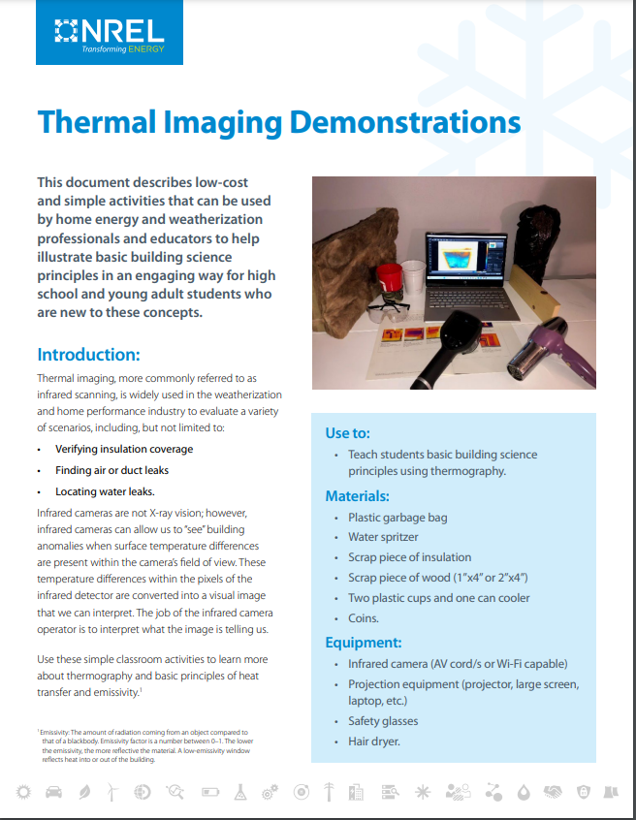
Thermal Imaging Camera
Demonstrate the basics principles of thermography
Allow students the opportunity to use and infrared camera
Activity guide linked below.
https://www.nrel.gov/docs/gen/fy24/88116.pdf

Slide 37
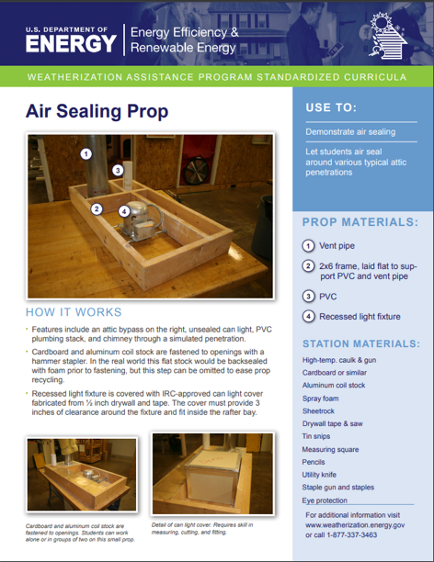
Air Sealing Prop
Demonstrate air sealing
Allow students the opportunity to air seal common air leaks
Small and large prop guides linked below.
https://nascsp.org/wp-content/uploads/2018/02/air-sealing-prop-guide.pdf
https://nascsp.org/wp-content/uploads/2018/02/usdoe_installeratticpropguide.pdf
Notes:
Use this prop and bring a hands-on activity where participants can practice air sealing typical leaks commonly found in homes. Alternatively, the prop could be used for a trainer-led demonstration which could be projected to a larger screen if audio visual equipment (e.g., camera, microphone, projector) are available.
The air sealing prop guide includes the materials necessary to build the prop and the materials students need to safely work on the prop.

Slide 38
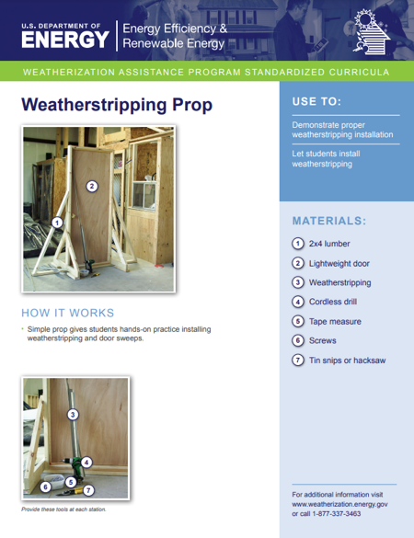
Weatherstripping Prop
Demonstrate or practice door weatherstripping and sweep installation
Allow students the opportunity to seal common door leaks
Prop guide linked below.
https://nascsp.org/wp-content/uploads/2018/02/usdoe_weatherstrippingpropguide.pdf

Slide 39
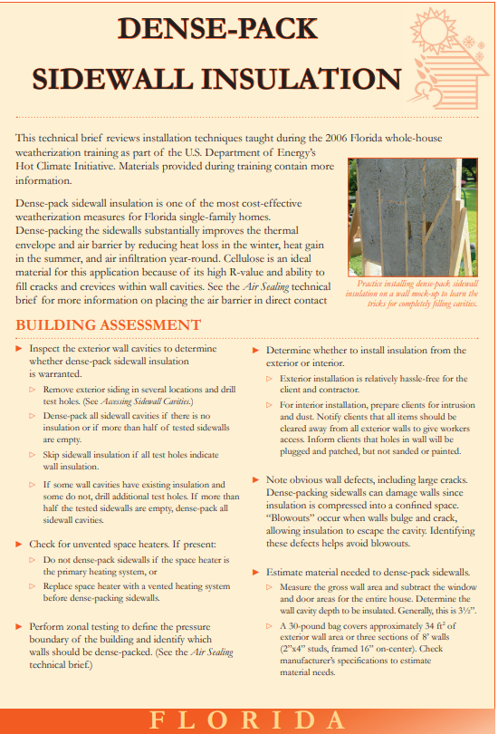
Dense Pack Insulation Guide
Dense-Pack guide includes:
  Equipment, operation, maintenance
  Preparing the house
  Building assessment
  Blowing insulation
Sidewall insulation guide and video demonstration linked below.
https://nascsp.org/wp-content/uploads/2018/02/us-doe_dense-pack-sidewall-insulation.pdf
https://www.youtube.com/watch?v=ce-mM7R11Lo

Slide 40
Additional Resources for Educators
Energy House Activity (grades 4-8)
  NEED activity to build and test a model house using different materials
  $35/kit
Building Science Kit (grades 6-8)
  NEED building science guide and activities.
  $525
Additional K-12 resources

