Slide 1

Preparing for the
Community Action Plan

Slide 2

What is the Community Action Plan?
Ensures the agency’s anti-poverty mission is clearly articulated
Describes strategies and steps to work towards results/outcomes for customers with low incomes
Describes how the CAA will meet the needs identified in the Community Needs Assessment
Provides direction for agency programs (services, strategies, & budgets)

Slide 3
Community Action Plan Requirements
The Community Action Plan (CAP) is an integral part of receiving CSBG funding each year.
To comply with the CSBG Act: CAAs must complete a Community Action Plan as a condition to receive funding through a Community Services Block Grant.
CSBG funds must be used to support activities that remove obstacles and solve problems blocking achievement of self-sufficiency.
Each agency must do a comprehensive Community Needs Assessment (CNA) to find out what obstacles and problems need to be addressed.
Then the CAA must develop a specific, short-range plan for using its resources.

Slide 4
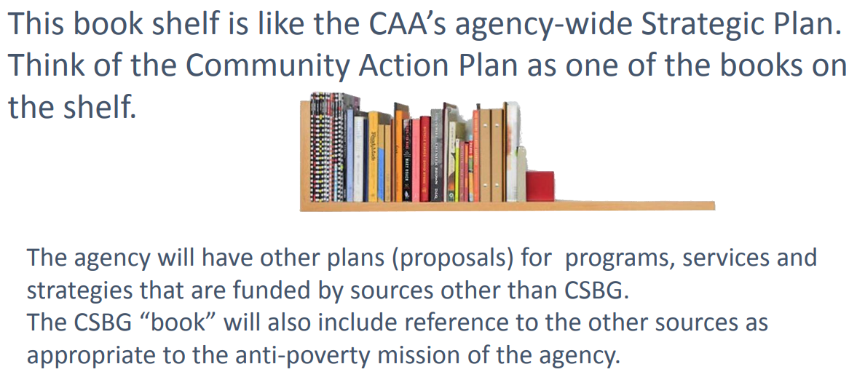

Slide 5

What are the elements of the CAP?
The Community Action Plan sets the course for the CAA’s activities for the coming year.
Key agency staff must be included in the preparation of the plan.
The Board’s program committee (or other relevant committee) should be included in the process.
Board gives final approval of the plan.
Other elements may include:
  Agency funding sources and budgets
  Program summaries and service targets
  Community Needs Assessment findings
  Tripartite board roster & documentation
  Coordination and linkages strategies
Board approval should be recorded in your agency’s board meeting minutes

Slide 6

Timeline
Step 1
Conduct a Community Needs Assessment (CNA)
Step 2
Develop CAP from CNA findings & anticipated resources, including setting targets and projecting outcomes
Step 3
Board approves CAP
Step 4
Report out on outcomes via CSBG Annual Report Module 4, and assess target accuracy to inform next CAP cycle (ROMA)

Slide 7
Setting Targets

Slide 8

Estimating Customer Performance
Outcome - Head of Household becomes employed as CNA
Service/Activity -family self sufficiency program/training for head of household
Number to be served (d) - 20 individuals in a six month period
Outcome indicator (n) -7 individuals will become employed within six months of completing training
Projected customer success rate - 7 individuals who will achieve the outcome/20 families who will receive the service=35% projected customer success rate
(N) 7 families will secure employment
(D) 20 families will receive training =35% projected customer success rate
Notes:
PM Page 103
Point out how the page in the PM is set up. At the top are the general steps and at the bottom is an example.
Top of page: there are 5 steps used to identify rate of customer performance that occur prior to service delivery. We use these steps to target, or estimate, performance for the service.
We use Carter Questions 1, 3 and 6 as a basis for calculating performance and establishing accountability measures.
Have someone read each step, and as they do, bring up each component of example on the slide and refer to the example on the bottom of page 103.
Once all 5 steps have been read and items 1-5 revealed on screen, then reveal the final element on the slide which is the estimated performance. (the percent)

Slide 9
Estimated Customer Performance
Estimated Performance 7 ---- = 35% 20
Notes:
Reminder of our estimated customer percent calculation
This chart will be filled in over the next section of the training.
See the Trainer Manual for detailed directions.

Slide 10
Measuring Actual Customer Performance
20 families actually received the service and 5 families achieved the outcome
(N) 5 individuals secured employment
(D) 20 individuals received training
=25% actual customer success rate
Notes:
PM Page 104
After the service has been provided and you know what actually happened, we can calculate our Actual Success Rate.
We use the same process as in the previous example, but we replace the projected, or targeted numbers, with the actual numbers in both the numerator and the denominator.
In order to get information about what actually occurred as a result of receiving the service, we have to follow up with the customer and use identified measurement tools to “prove” that the service was rendered, and the outcome was achieved.
We’ll discuss measurement tools in a later module.
Refer to the three bullets on PM Page 104, then pull up these elements on the slide.

Slide 11
Actual Customer Performance
Estimated Performance 7 ---- = 35% 20
Actual Performance 5 ---- = 25% 20
Notes:
Add Actual Performance to our chart.

Slide 12
When not everyone finishes the program….
We found that 5 families achieved the outcome.
Only 15 of the 20 families who enrolled actually completed the program.
(N) 5 individuals secured employment
(D) 15 individuals completed requirements of training
=33% actual customer success rate for those who completed
Notes:
PM Page 105
You will want to know how attendance has impacted the outcomes. YOU WILL NEED THIS DATA AS YOU MOVE TO ANALYSIS OF THE DATA.
Let’s assume some individuals who enroll will not complete the program.
How do the “non-completers” affect your performance rate?
Click to bring up first statement.
Click again to bring up the formula.
Notice that we are not – at this time – considering what happened to the missing 5.
You will come back to this bit of data in the Analysis phase of the cycle to ask some questions about why you had this drop out.
And what if only 15 enrolled in the first place??
if you are managing your program using results oriented practices, you will want to know how many individuals you need to serve to achieve certain goals.
Again this is something that will come up in analysis.

Slide 13
Measuring Actual Customer Performance with a Reduced Denominator
Estimated Performance 7 ---- = 35% 20
Actual Performance 5 ---- = 25% 20 (enrolled) | Actual Performance with Reduced Denominator 5 ---- = 33% 15 (completed)
Notes:
Start with just the title on this slide.
Open this discussion:
Think about this question: “when does a person seeking service become an agency customer?” (or “when does a client become a client?”)
This is a decision you will need to establish at your agency.
The answer to this question depends what you are counting and what story you want to tell.
Do you have an established process for determining who will be included in the count? Or do you count everyone who comes in for information?
Once you establish the process for “counting” a person as having received service, you will keep that number as denominator – even if people drop out of the program (or as they do not continue to work toward their goals).
HOWEVER, as we just discussed on the prior slide, you will want to ALSO know the impact of completing the program on customer success.
Click to bring up the chart, which now also has the “reduced denominator” calculation on it.
Raise the question, which fraction is better? (5/15 or 5/20) You will get “votes” from the participants for both.
Say, neither is “better” as they measure two different things.
If the question is: “Of all those that enrolled in the program, how many have successfully achieved the outcome?” the denominator or base is 20.
If the question is: “Of all those that completed the program, how many have successfully achieved the outcome?” the denominator or base is 15.
These are different statistics and therefore different stories.
What is the value of counting all of the individuals who enrolled (the 20)?
You have expended resources for all of these, so you have to know how many you started with. Also, you would want to know how many you need to enroll to achieve your expected target. If you just use the number of “completers” you would not have the information you need to manage your program.
If you reduce the denominator to account for participants who do not meet your criteria, you will still have to find a way to track all of the participants who received any service.
Another reason to use both numbers is so you know how successful your customers were when they did complete the program. This is important information to share with customers.
It can provide motivation to complete the program so they have better chance of success.

Slide 14
How good is our customer success rate?
We have:
10 out of 20 people in the employment program,
or 50%,
obtained a job six months after enrollment.
Is 50% good? How good is it?
Notes:
PM-106.....TM-103 -- Bottom of the page shows example that is on this slide.
Is there a standard percent that is accepted for our work? No. We often feel we must have high percent of success.
What kinds of percents of success do we see in other fields?
Let’s see what we can learn from other industries about success rates.
See TM-103 for calculating the percentage and enter the actual statistic (result) on the logic model.

Slide 15

Performance Standards
Let’s Talk Baseball
Batting Averages
Yogi Berra .307
Toby Hall .298
Timo Perez .276
Raul Chavez .253
Wendell Magee .247
Wendell Magee
247 hits
in 1000 times at bat =
247 divided by 1000
= .247 = 24.7%
Notes:
PM-108.....TM-106-107
In the in-person session you would pass out baseball cards.
For this training, you are going to bring up “batting averages” for five ball players.
Click to bring up Yogi, Toby, Timo, Raul and Wendell (note these are all real baseball players).
You will introduce the concept of a batting average and explain why is baseball a good example for us to use in this training
The batting average is just like the customer success rate we just produced with the calculation in our indicator statements.
The number served = the times at bat
The number achieving = the hits (gets on base)
The batting average percentage reflects the relationship between the number of times that a batter hit the ball and got on base safely (meaning that the other team did not make an error) out of the times they were at bat.
For example let’s look at Wendell Magee’s batting average of .247
.274 equals the fraction 247/1000 and the percent 24.7%.
Click to bring up the calculation for Wendell Magee. He hit and got on base 247 times out of 1000 times at bat.

Slide 16
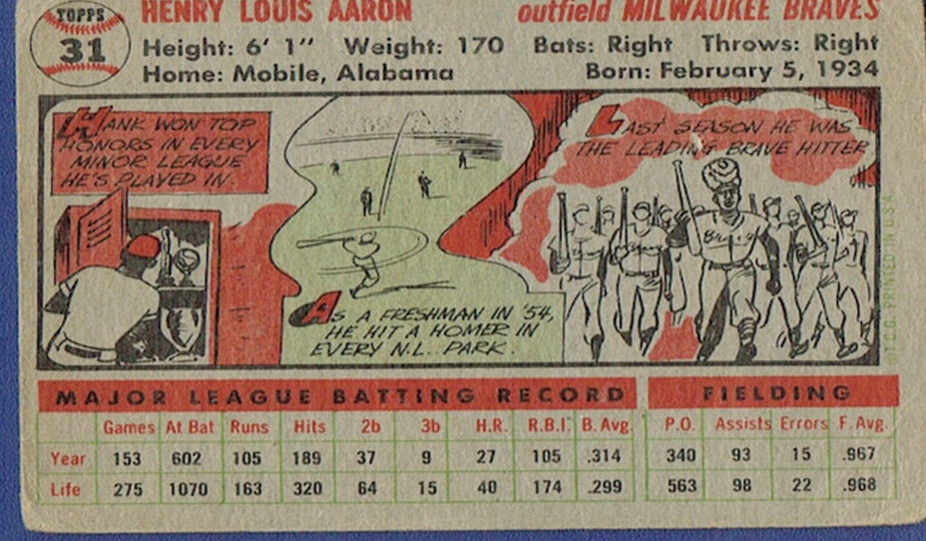
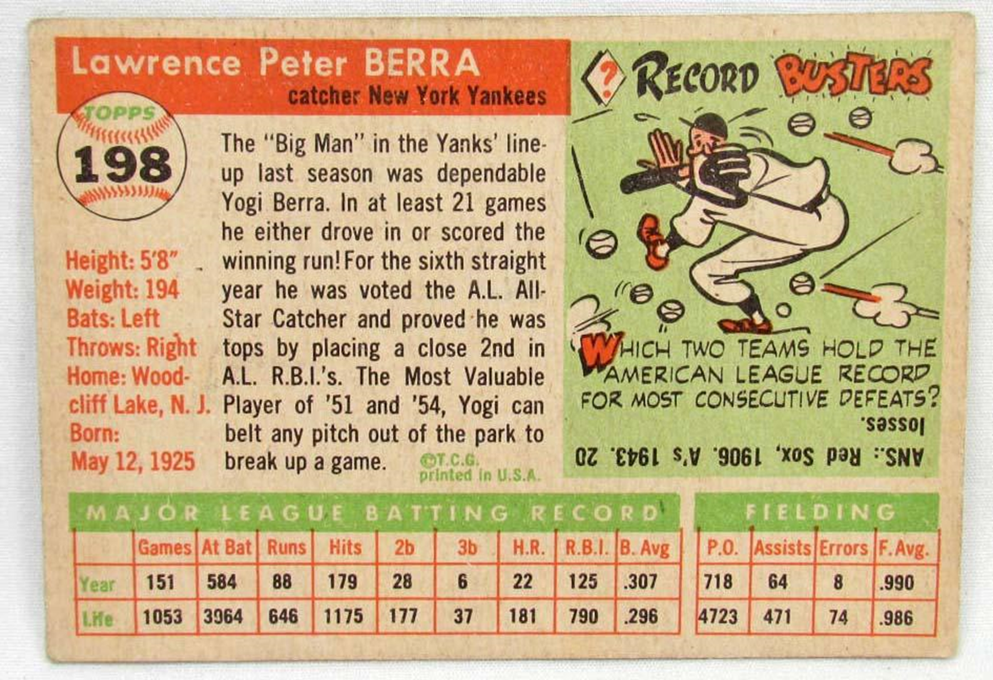
Identifying Success
Hank Aaron .314=31.4%
Yogi Berra .307=30.7%
Toby Hall .298 = 29.8%
Timo Perez .276= 27.6%
Raul Chavez .253 = 25.3%
Wendell Magee .247 =24.7%
Yogi Berra
179 hits
out of 584 times at bat
Batting Average .307=30.7%
Notes:
PM-108.....TM-106-107
This is a baseball card for Yogi Berra (his card – Lawrence Peter Berra – is on PM page 108.)
The replica of Yogi Berra’s card shows that he hit 179 times (click) out of his 584 times at bat (click), for a batting average of .307 (click) – which means 30.7%.
These numbers are the actual hits and times at bat. (Rather than using the 1000 as a denominator which we showed on the prior slide).
In baseball, averages below.250 are below average, (Click to bring up Wendell)
250-299 is average, (Click to bring up the three players in “average” category)
.300 or greater is above average or excellent, like Yogi (click to bring up his name and the star)
Here is one more baseball card -- for Henry Louis “Hank” Aaron whose batting average was .314!
A real superstar. Click to bring up Hank’s card, listing of his batting average, circle of his average on the card.
But how does anyone know that?
Baseball produced a way to share information with the public: the baseball card (like the one on this slide)
The card provides the raw data – and the person reading the card has to interpret it.
The interpretation is based on knowledge of baseball’s standards.
How many people have knowledge of what Community Action Data means? That knowledge is limited. It is up to us to share information.

Slide 17
What We Learn From Baseball
  Clearly defined the indicator (hit and get on base),
  Observed performance and kept records,
  Analyzed the data,
  Developed a benchmark of excellence
  Publicized what they have found (so the public knows 30% is super)
Notes:
PM-109......TM-107
So what does this all mean for us?
Hitting .300, or succeeding about 30% of the time is a recognized and accepted measure of excellence for baseball!
At the end of the annual baseball year, of the 900+ major league baseball players, only 20-30, or about 3%, hit above .300. These are the superstars.
If baseball had not discovered the relationship between the hitting standard and winning game, through the collection and analysis of data, we would not know that we are observing success at this level of performance!
They clearly defined what they were going to observe and analyze.
If organized baseball had said success was “hitting a home run” (rather than “hit the ball and get on base”), the successful “batting average” would fall from 30% to about 7% of the time.
This demonstrates the importance of setting the right indicator! Example, in our world we would say of the number completing the course, this many will gain skills.
Then they let the public know what success looks like.
Remember the batting averages on the baseball cards are raw data.
The circulation and collection of baseball cards helps to increase general knowledge of the “public” so they can interpret the raw data.

Slide 18
Activity
Success Measures in Industry
References for Setting Public and Nonprofit Sector Expectations
Notes:
PM-110....TM-107-108 Answers are in Trainer Manual.
Point to make about this activity:
A high percentage of success is frequently unrealistic and not attainable in human services.
Industry is comfortable with modest measures of success. Why? Because this translate into profit.
Repeat the main take away from baseball and industry standards:
Community Action must establish its own standards of performance and communicate these standards of performance to elected officials, government, public and private funders, the general public, the media, and to the staff of CAAs and CSBG eligible entities.

Slide 19
Success Measures in Industry
New Magazines
Movies
Broadway
Prescription drugs
Profitable prescription drugs to mkt
New business startups
Retail sales
On time railroad delivery
3 in 10 or 30%
One in 5 or 20%
One in 5 or 20%
1 in 5,000 or .0002%
15-20%
50%
1 in 5 or 20%
+ or - 24 hours

Slide 20
Performance Standards
There are no established standards in the Community Action world regarding customer success.
Notes:
PM-110....TM 108
Read box at bottom of PM-110:
“Community Action must establish its own standards of performance and communicate these standards of performance to elected officials, government, public and private funders, the general public, the media, and to the staff of CAAs and CSBG eligible entities.”

Slide 21

.
The outcome indicator formula we have been using produces a measure of CUSTOMER SUCCESS.
Notes:
No corresponding PM or TM.
Set-up for PM 111, “Now we want to introduce a different formula.”

Slide 22

Agency Ability to Target
A different formula
is used to calculate
AGENCY SUCCESS.
Notes:
PM-111...TM-106
This type of performance measurement relates to one of the key provisions of GPRA..
Read the underlined sentence in paragraph 3 on PM-111. “Agencies must be able to accurately identify performance goals or targets prior to beginning service”.
This calculation does not use the number of those receiving services.
This measurement of success identifies the ability of the agency to project their performance by comparing two data elements:
The number of persons actually achieving the outcome.
The number of persons projected/targeted to achieve the outcome .

Slide 23
Agency Targeting Success Rate
Estimated Performance 7 ---- = 35% 20 | Agency Targeting Success Rate 5 (actual) ----- =71% ability to 7 (target) successfully target
Actual Performance 5 ---- = 25% 20 (enrolled) | Actual Performance with Reduced Denominator 5 ---- = 33% 15 (completed)
Notes:
PM-112.....TM-109-110
You learned in the last segment that you must calculate actual performance with an indicator which includes a fraction and a percent.
Now we are going to use the two numerators of these fractions to create a new fraction.
Refer back to the example that was presented: A family self-sufficiency program has enrolled 20 families who will receive case-management services over the next six months.
It is estimated or projected that seven of the families will increase their household income by 10% at the end of the six-month period.
(click to bring up the first circle and arrow) That number (seven) becomes the denominator of the Agency Targeting Success Rate calculation.
Then, the agency determined the actual results after follow up (Make sure that you reinforce the concept that measuring actual performance requires follow-up. )
The actual performance data on this slides shows that five of the families actually increased their household income.
(click to bring up the second circle and arrow) This number (five) becomes the numerator of the Agency Targeting Success Rate Calculation.
Ask participants to observe the fraction in the upper right quadrant of the chart.
This represents the relationship between what outcome you projected your customers would achieve and what they actually achieved.
The agency’s ability to successfully target in this case is 71%
This helps you identify how well the agency is able to project its own performance, which differs from the two indicator calculations we talked about previously.
(Indicators are about customer performance. This is about how well the agency is able to project the rate of customer success.)
Note the numerator of 5 actual achieving in the “reduced denominator” quadrant
That could also be used in this calculation because it clearly shows how many actually achieved success.
(click to bring up last circle and arrow)
It doesn’t matter which fraction you use (the one with the “number enrolled” identified or with the “number completed” identified in the denominator) because you are not going to use either of those numbers. In both fractions the “5 actual” who achieved the outcome is the same and THAT is the only number you will use in the agency targeting success rate calculation.

Slide 24
Agency Targeting Success Rate
Ability to Predict Client success
Ability to Predict Agency Success
Target: 7 out of 20 people in the employment program, or 35%, will obtain a job six months after enrollment.
Actual: 9 out of 20 people in the employment program, or 45%, obtained a job six months after enrollment.
9 customers actually obtained outcome
______________________________
7 customers targeted to obtain outcome
=130% ability to successfully project performance
By the way: Can customer success be more than 100%
Notes:
T1
Let’s look at another example (on the top of page 113)
In this example, you see that the number of persons obtaining the outcome is greater than the number targeted, or projected to obtain the outcome.
What does that do to your targeting success rate?
It is more than 100%.
By the way: (this is also on page 113) Can customer success rate be more than 100%
NO – customer success rate cannot be more than 100% - you can not have more people achieve than were served.

Slide 25

Agency Targeting Success Rate
Which is better?
5 (actual)
----- = 71% ability to
7 (target) successfully target
                or
9 (actual)
---- = 130% ability to successfully target
7 (target)
Notes:
T1
Let’s look more closely at the two targeting success rate calculations that we just did. The first shows that we were under 100% and the other shows we were over 100%.
Is over performing better than under performing? No it is not, when you are talking about targeting ability.

Slide 26

Performance Standards
Agency targeting is expected to fall between 80% and 120%.
120% ->
80% <-
Notes:
T1
PM page 113
In the middle of page 113 - identifies the acceptable range in the CSBG Annual Report is plus or minus 20%.
When agency performance is outside this range (80% to 120%) then follow up from the state office is done to find out reasons for the under or over projection.
Ask participants the question: What might be some reasons why an agency has under or over projected their outcomes?
Remember: There are no established standards in the Community Action world regarding customer success.
T2 Carey will pull up virtual logic model and using the elements from column 4 and column 5, have the group calculate the agency’s targeting success rate.

Slide 27
Virtual Flip Chart
Estimated Customer Performance ---- = % | Targeting Percent ---- = %
Actual Customer Performance ---- = %
Notes:
Get verbal or chat from participants.
Enter the word document you have been using for the logic model (use info from prior work).
Calculate the targeting percent.
Restate the importance of language:
In the Customer Performance sections say “…(achieved).. Out of …(served).”
In the Targeting percent say “ actual # as compared to estimated #.”

Slide 28
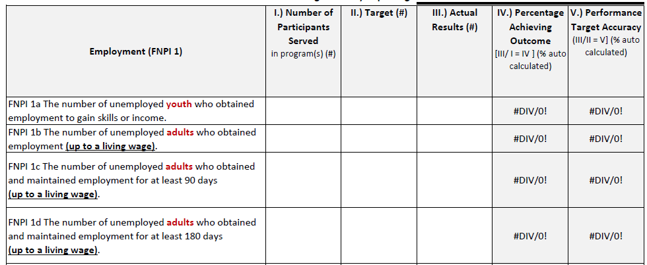
Customer Success rate
Agency Targeting Success
Expected to achieve
ACTUAL
# served
ACTUAL
# achieved
Notes:
This is the rest of the example from the CSBG Annual Report Module 4
The columns at the end are auto-calculated.
What is missing? The number expected to be served is not included in this report.

Slide 29
Questions?
Thank you!

