Slide 1
Dealing with Bad Grades

Slide 2


Slide 3

Agenda
Corrective Action Process
  Purpose
  T/TA & QIP
Funding Reduction/Termination
Complaint Process
Designation of New Entity

Slide 4

CSBG Corrective Action and the Dedesignation Process
Presenters: Jonathan Cohen, Esq.
Emily Center-Bregasi, Esq.
Monday, September 25, 2023

Slide 5
CSBG Review Process
Overview of State Responsibilities
Enter into CSBG subaward agreement with CAAs
Monitor and conduct follow-up as required
Inform of deficiency and require correction
Provide T/TA and/or QIP
Provide notice and hearing on record if deficiency not corrected
Determine if cause exists to reduce or terminate funding
Initiate reduction in or termination of funding if cause exists
Opportunity for federal review by HHS

Slide 6
Laws and Guidance
Federal Community Services Block Grant (CSBG) Act
  Section 672, et. seq. (42 U.S.C. § 9901 et. seq.)
HHS Block Grant Regulations
  45 C.F.R. Part 96
Information Memoranda (IMs) – non-binding guidance
  IM 116 , IM 138
State CSBG Laws
  Statutes, regulations, award terms and conditions, informal guidance
KEY: States primarily responsible for grant administration

Slide 7
Corrective Action
Purpose
To punish poor performance
Compliance through fear and intimidation
Feedback on effectiveness
  What’s not working?
  How can we improve it?
Opportunity to correct deficiency
  What can we do to help?

Slide 8
Corrective Action
Training and Technical Assistance
State CSBG office is required to offer T/TA, if appropriate, to help correct a deficiency
  If state provided T/TA, must prepare and submit a report to OCS describing T/TA offered
  If state didn't provide T/TA, must prepare and submit a report stating reasons it didn't do so
                Sec. 678C(a)(3)(A), (B)

Slide 9
Corrective Action
Training and Technical Assistance
T/TA may not be appropriate when:
  CAA has internal expertise and skills
  State already provided T/TA and CAA failed to implement corrective actions
  Multiple, widespread and/or repeated deficiencies
  Fraud or criminal wrongdoing involved
                IM 116

Slide 10
Corrective Action
Quality Improvement Plan
Within state’s discretion to give CAA opportunity to develop and implement a QIP to correct a deficiency​
  State may take into account the seriousness of a deficiency and the time required to correct​ it
  Sec. 678C(a)(4)

Slide 11
Corrective Action
Quality Improvement Plan
Examples of when a state CSBG office may deny a CAA the opportunity to submit a QIP include:​
  A QIP has already been instituted and a CAA has repeated findings​
  Evidence of fraud or criminal wronging doing requiring immediate action
IM 116

Slide 12
Corrective Action
Quality Improvement Plan
If State grants CAA opportunity to submit a QIP, state must:​
  Give CAA 60 days after being informed of the deficiency to develop and implement QIP
  Approve/not approve within 30 days of receiving QIP from CAA
  If state does not approve a QIP, must specify reasons why proposed plan cannot be approved
  Sec. 678C(a)(4)

Slide 13
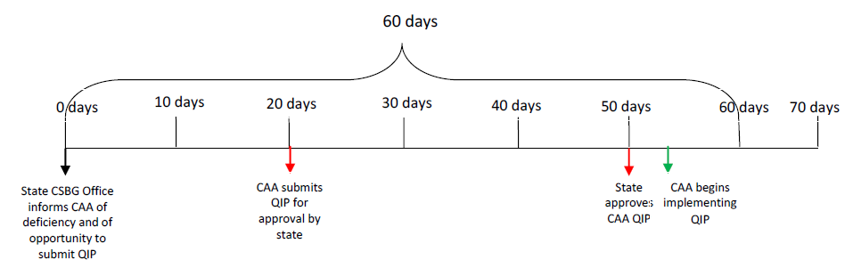
Corrective Action
Quality Improvement Plan Timeline

Slide 14
Funding Reduction/Termination
Deficiency Not Corrected
State’s Obligation When Deficiency NOT Corrected
Provide CAA notice and an opportunity for a hearing;
Based on hearing record, determine if “cause” exists;
If “cause” exists, initiate proceedings to terminate CSBG designation or reduce CSBG funding; and
Prior to reducing or terminating funding, CAA must be given the opportunity to seek federal review of state’s determination
Sec. 678C(a)(5)&(b); 676(b)(8)

Slide 15
Funding Reduction/Termination
Causes for Funding Reduction/Termination
The federal CSBG Act sets forth only two causes for which a state CSBG office may initiate a reduction in or termination of CSBG funding:​
  As part of a monitoring process
  Statewide redistribution​ of CSBG funds
Sec. 676(b)(8)​, (c)​

Slide 16
Funding Reduction/Termination
Notice Required
State determines types of notice and hearing procedures it will use to comply with federal CSBG Act​
Characteristics of adequate notice:​
  Given within reasonable timeframe​
  Includes reason for hearing​
  Establishes location and time of hearing​
  Provides information regarding additional appeal options

Slide 17
Funding Reduction/Termination
Hearing Required
Characteristics of a hearing on the record​
  Designated time for parties to present positions
  Opportunity for questions and responses
  Ability to submit documents for the record
  Availability of records and transcripts after hearing completed

Slide 18
Funding Reduction/Termination
Dedesignation of CAA
After opportunity for a hearing​, if state finds cause to terminate funding, it:
  Must give notice to CAA of its final decision
  May initiate proceedings to terminate the designation of a CAA

Slide 19
Funding Reduction/Termination
OCS Review Process
After state giving notice, CAA may submit a request for federal review and must do so:
  In writing
  Within 30 days of state’s notice
  To attention of the Division of State Assistance in OCS
State may not discontinue present or future funding until OCS confirms state’s finding of cause
Sec. 678C(b); 45 C.F.R. § 96.92; IM 116

Slide 20
Funding Reduction/Termination
OCS Review Process
OCS must complete appeal no later than 90 days after it receives from state all necessary documentation relating to state’s determination
  If OCS does not respond, state determination final after 90 days
Sec. 678C(b); 45 C.F.R. § 96.92; IM 116

Slide 21
Funding Reduction/Termination
OCS Direct Assistance
OCS has authority to provide funding directly to CAAs when state violates assurance in state plan to provide notice, an opportunity for a hearing, and a federal review
  May request direct funding from OCS in writing, describing how state violated due process requirements
If granted, direct financial assistance from OCS to CAA will continue until the state’s violation corrected
Sec. 678C(c)

Slide 22
Complaint Process
CAA may file a complaint alleging that the state failed to follow the federal CSBG Act
  Includes failure to follow certification and assurances made by state
OCS will defer to state’s interpretation of the CSBG Act unless the interpretation is clearly erroneous
45 C.F.R. § 96.50

Slide 23
Complaint Process
Complaint must:
Be submitted in writing to Director of OCS
Identify the provision, act, assurance or certification allegedly violated
Specify the basis for the violations charged
Include all relevant information know to the person submitting the complaint
45 C.F.R. § 96.50

Slide 24
Complaint Process
OCS’s responsibilities include:
  Providing a copy of the complaint to the state
  Conducting an investigation where appropriate
  Responding to the CAA within 180 days of receiving the complaint
  If OCS cannot reach a final resolution within 180 days, setting forth reasons why additional time is needed
Upon receiving the complaint from OCS, state has 60 days to respond and may request additional time
45 C.F.R. § 96.50

Slide 25
Designation of New Entity
Process
Overview
State may designate a new CAA if an area is not served, or ceases to be served
No required designation process in Federal CSBG Act
  State may solicit applications
When designating new CAA, nonprofits get priority
Sec. 676A, OCS IM 116

Slide 26
Designation of New Entity
Type of entity, 42 U.S.C. § 9909
A nonprofit organization:
Geographically located in unserved area
Capable of providing a broad range of poverty-elimination services
A nonprofit CAA:
Geographically continuous or w/in reasonable proximity of unserved area
Providing related services in unserved area
Meets CSBG requirements (i.e., tripartite board)
Agree to add board members that reside in unserved area in each sector of tripartite board

Slide 27
Designation of New Entity
Type of Entity
Only if NO nonprofit organization is identified or qualified may the state designate a political subdivision to serve as an eligible entity in the area
Sec. 676A, OCS IM 116
Choosing a New Public CAA

Slide 28

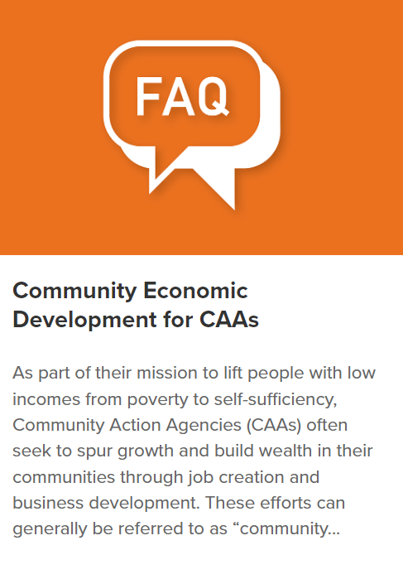
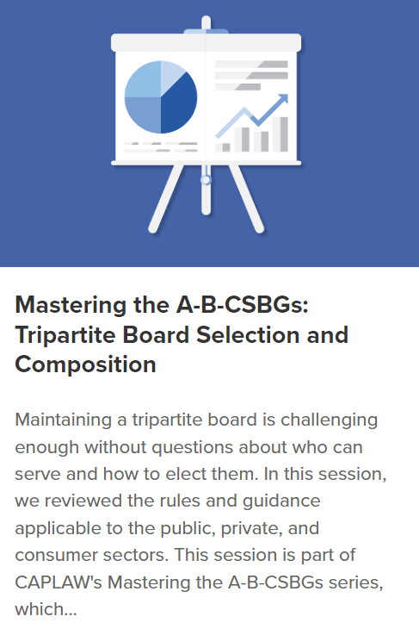
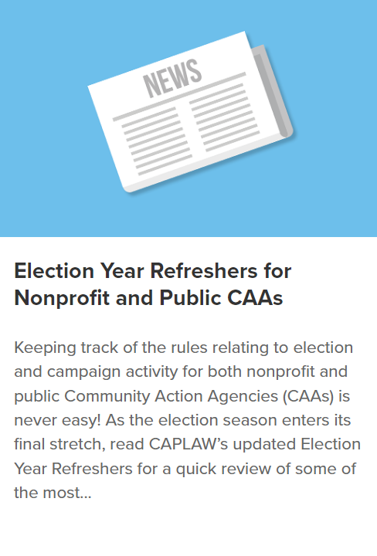
Visit CAPLAW’s
239 Resources
60 Topics
20 Types
Including:
Articles
Legal Updates
Sample Policies
Webinars
Videos
Training Modules
Interactive e-guides
Case Studies
Podcast (new!)
Resource Library!
www.caplaw.org

Slide 29


Slide 30


Slide 31
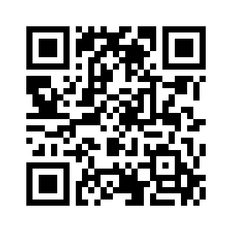
Please scan here to complete the evaluation for this session!

