Slide 1
Listening Session
NASCSP
Weatherization Assistance Program
July 2023

Slide 2





Office of State and Community Energy Programs
Our goal is to extend the capacity and capabilities of states, tribes, local governments, schools, and community-serving organizations to implement high-impact, self-sustaining clean energy projects that center the needs of low-income and Disadvantaged Communities (DACs).
SCEP does this through the management and oversight of $16 billion worth of formula grants, competitive grant awards, consumer rebate grants, and technical assistance.
SCEP Strategic Priorities
Center and deliver on J40 priorities
Deploy clean energy technologies
Catalyze local economic development
Create
jobs
Avoid pollution through place-based strategies
Reduce energy costs

Slide 3
Listening Session Agenda
WAP Improvements​
  Program and Statutory Limitations​
  Recent DOE Program Changes to Increase Impact​
  Questions for the audience: ​
    What is the most important DOE improvement? ​
    What’s missing from the list? ​
WAP Funding Status Update ​
  Bipartisan Infrastructure Law (BIL) Questions​
  Innovation Grants​
WAP BIL Data Collection

Slide 4
WAP Improvements

Slide 5
Program and Statutory Limitations
DOE and the WAP network can…
DOE can not…
Maximize interagency support for community-based weatherization job training & workforce development targeted to the low-income residents being served by this program
Utilize T&TA funds to train auditors and provide incentives in recruitment and retention
Modify and improve the Quality Control Inspector (QCI) exam and certification process
Consider a whole-house SIR
Make it easier to weatherize multifamily buildings, perform fuel switching, attract contractors by reducing paperwork and through online advertising
Change the Average Cost Per Unit (ACPU)
Change/eliminate the re-weatherization date or allow re-weatherization exceptions
Designate more Readiness funding
Change income eligibility requirements for housing types (e.g., treat manufactured home parks as multifamily and follow the 66% rule)
Provide procurement waivers

Slide 6
Recent DOE Program Changes to Increase Impact
Reduce Deferrals
Reduce Costs through Program Efficiency
  Successfully awarded 21 E&I awards focused on weatherization readiness, health & safety improvements, and other priorities.
  Weatherization Readiness WPN (23-4) and Braiding Funds WPN (22-9) have been released
  Updated and released HUD multifamily lists (WPN 22-5) on 2/8/21.
  Updated and released WPN 22-12 (MF WAP) and 22-13 (MF Rentals) on 9/14/22.
  Continuous improvement workshops scheduled for 2023.
Demonstrate New Technologies & Approaches
Enable Deeper Improvements
  Began implementation of round 1 innovation awards on 3/1/23.
  Released Memos 096 & 097 re: SERC and CSPP Grant Applications on 10/19/22.
  E&I BIL opportunity will be released in summer 2023.
  SERC BIL opportunity will be released in 2024.
  Released Regional Priority Lists for SF, MH, Low-Rise MF (WPN 22-8) on 7/1/22.
  Released WPN 22-10 on Non-Energy Impacts on 10/21/22.
  Released an update to fuel switching guidance (WPN 23-6) on 3/3/2023
Coordinate Across Federal Agencies to Leverage Funds
Target Most Heavily Burdened
  Updating MOU with HUD to include HHS and USDA that aims to streamline program eligibility, improve data sharing, expand program evaluation, coordinate workforce development, and provide joint T&TA.
  Develop tools to assist Grantees and Subgrantees.
  Awarded innovation grants 3/1/2023 and measuring estimated burden reduction in WAP innovation programs.

Slide 7
Open Discussion
What program improvements are most important?
What is missing from the list?
Please raise your hand to speak or add comments in the chat.

Slide 8
WAP Funding Status Update

Slide 9
Weatherization Assistance Program Funding
Retrofits
BIL
$3.2B WAP
FY23
$299M WAP
$30M Readiness
Innovation
BIL
$25M E&I
$70M SERC
FY23
$19.5M E&I
$6.5M SERC
T&TA
BIL
$125M
FY23
$10M

Slide 10
WAP BIL Timeline
1st Tranche of BIL Funds
15% of allocation
COMPLETED
2nd Tranche of BIL Funds
35% of allocation
Grantees finalizing their initial 5-year BIL application. As of July 24:
3rd Tranche of BIL Funds
50% of allocation
Grantees must meet all the identified goals to receive the remaining 50% of BIL funds.
IN PROCESS
All Grantees that submitted received initial 15% of funds.
BIL awards have the same start date of 7/1/2022.
40 Grantees received approval for 2nd tranche
9 plans are in FAO review.
8 plans are in the DOE WAP review process.
FUTURE

Slide 11
BIL Grants – Goals for Remaining 50% of BIL Allocation
The remaining 50% of the BIL grant will be released once the following goals are achieved:
30% of all BIL units estimated to be weatherized in approved Weatherization Plans are weatherized.
DOE-approved monitoring plan and inspection protocol implemented.
Monitoring completed at each Subgrantee at least once per year.
Local quality control efforts are in place.
At least 5% completed units inspected by Grantee QCI annually.
Grantee progress reports are acceptable and submitted in accordance with grant requirements.
Monitoring reviews by DOE confirm acceptable performance.

Slide 12
WAP Innovation Grants
Enhancement and Innovation
  Round 2 opportunity open now – Concept Papers Due August 31
  S3 eXCHANGE: Funding Opportunity Exchange (energy.gov)
Sustainable Energy Resources for Consumers
  Round 2 opportunity closed – DOE in negotiations with selected projects
  Round 3 $70M BIL opportunity planned for early 2024
Question for Discussion:
What can DOE do to help you prepare for the SERC BIL opportunity (e.g., piloting new technologies and installing renewable energy systems in your WAP)?

Slide 13
WAP BIL Data Collection

Slide 14
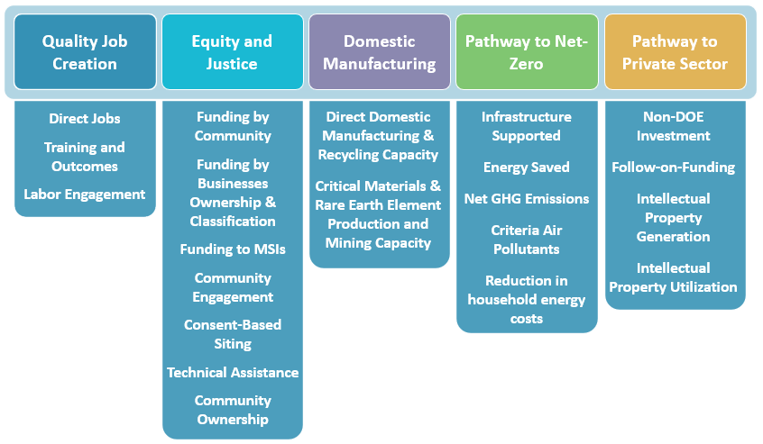
Overview – Background on BIL Metrics
BIL Investment Performance Tracking Metrics (“BIL Metrics”) are designed to be cross-cutting for BIL-funded programs, and to assess and communicate the outcomes and outputs of BIL investments.
Programs across DOE have all worked to align the most meaningful metrics to the goals and outcome of their program.
Important Context
A subset of the metrics applies to each BIL provision, based on determined relevance to eligible program activities.¹
BIL metrics do not cover all metrics programs will track.
Separately, but consistent with the BIL Metrics, the Office of Management and Budget (OMB) issued a memorandum directing agencies to collect project-level location data.²
¹ Multiple metrics fall within each of the five priority categories, and the collection of multiple datapoints is required for each metric.
² OMB Memorandum M-22-12 on “Advancing Effective Stewardship of Taxpayer Resources and Outcomes in the Implementation of the Infrastructure Investment and Jobs Act,” notes that agencies should “collect project-level location data.”

Slide 15
BIL Reporting Requirements for WAP
Equity and Justice
Community and Stakeholder Engagement
Funding Allocated to DACs
Pathway to Net Zero Emissions
Energy Saved
Pathway to Private Sector Uptake
Non-DOE Investment
Funding to Businesses by Ownership
Technical Assistance
Net Change in Point Source Criteria Pollutants
Net GHG Emissions Avoided
Reduction in Household Energy Costs
Quality Job Creation
Pay, benefits
Demographics
Types of jobs
Number of jobs

Slide 16
Data Collection
PAGE (See WAP Memo 103)
Impact Assessments
Quarterly Performance Report
  Completed Units by Subgrantee
  Multifamily buildings
  Readiness Expenditures and Unit Completions
  Renewable Energy Installed, total capacity
Annual T&TA, Monitoring & Leveraging Report
  Summary of workforce partnerships, recruitment and retention initiatives
  Weatherization Readiness
  DEI and Energy Justice
Job Training and Training Outcomes
Reductions in Household Energy Costs
Energy Savings
Fuel Switching
Investments in Disadvantaged, Tribal and Rural Communities
Funding to Small Businesses

Slide 17
Program Implementation Next Steps
Things to Know
Next Steps
DOE will assume as much burden as possible
DOE will plan and implement small-scale impact assessments to reduce the amount of data Grantees and Subgrantees will need to collect on an ongoing basis
DOE is exploring options for collecting 9-digit zip codes for clients and trainees
New data collected from PAGE will most likely continue after BIL funding
Following OMB approval, complete PAGE updates
  Provide guidance and a timeline for implementation
  Provide training to Grantees
Finalize plans for data collection and impact assessments

Slide 18
Open Discussion
Please share your comments and feedback!
What questions do you have for DOE?

Slide 19
Thank you!

