Slide 1
RAPID ROMA
UTAH and Region 8
Virtual CAP Conference
Wednesday, June 24, 2020
Presented by Dr. Barbara Mooney and Carey Gibson, MSW, NCRP

Slide 2
Workshop Objectives
Consider the usefulness of ROMA principles and practices in a time of crisis.
Has the mission changed?
Are we “results-oriented?”
Compare typical ROMA time frames with Rapid ROMA needs.
Discuss differences in Assessment and Planning.
Understand importance of observation, reporting and evaluation in short bursts.
Acknowledge that re-assessment and revision of plans may be crucial to success.
Identify how evidence of results can be collected and used for decision making.
Notes:
b

Slide 3
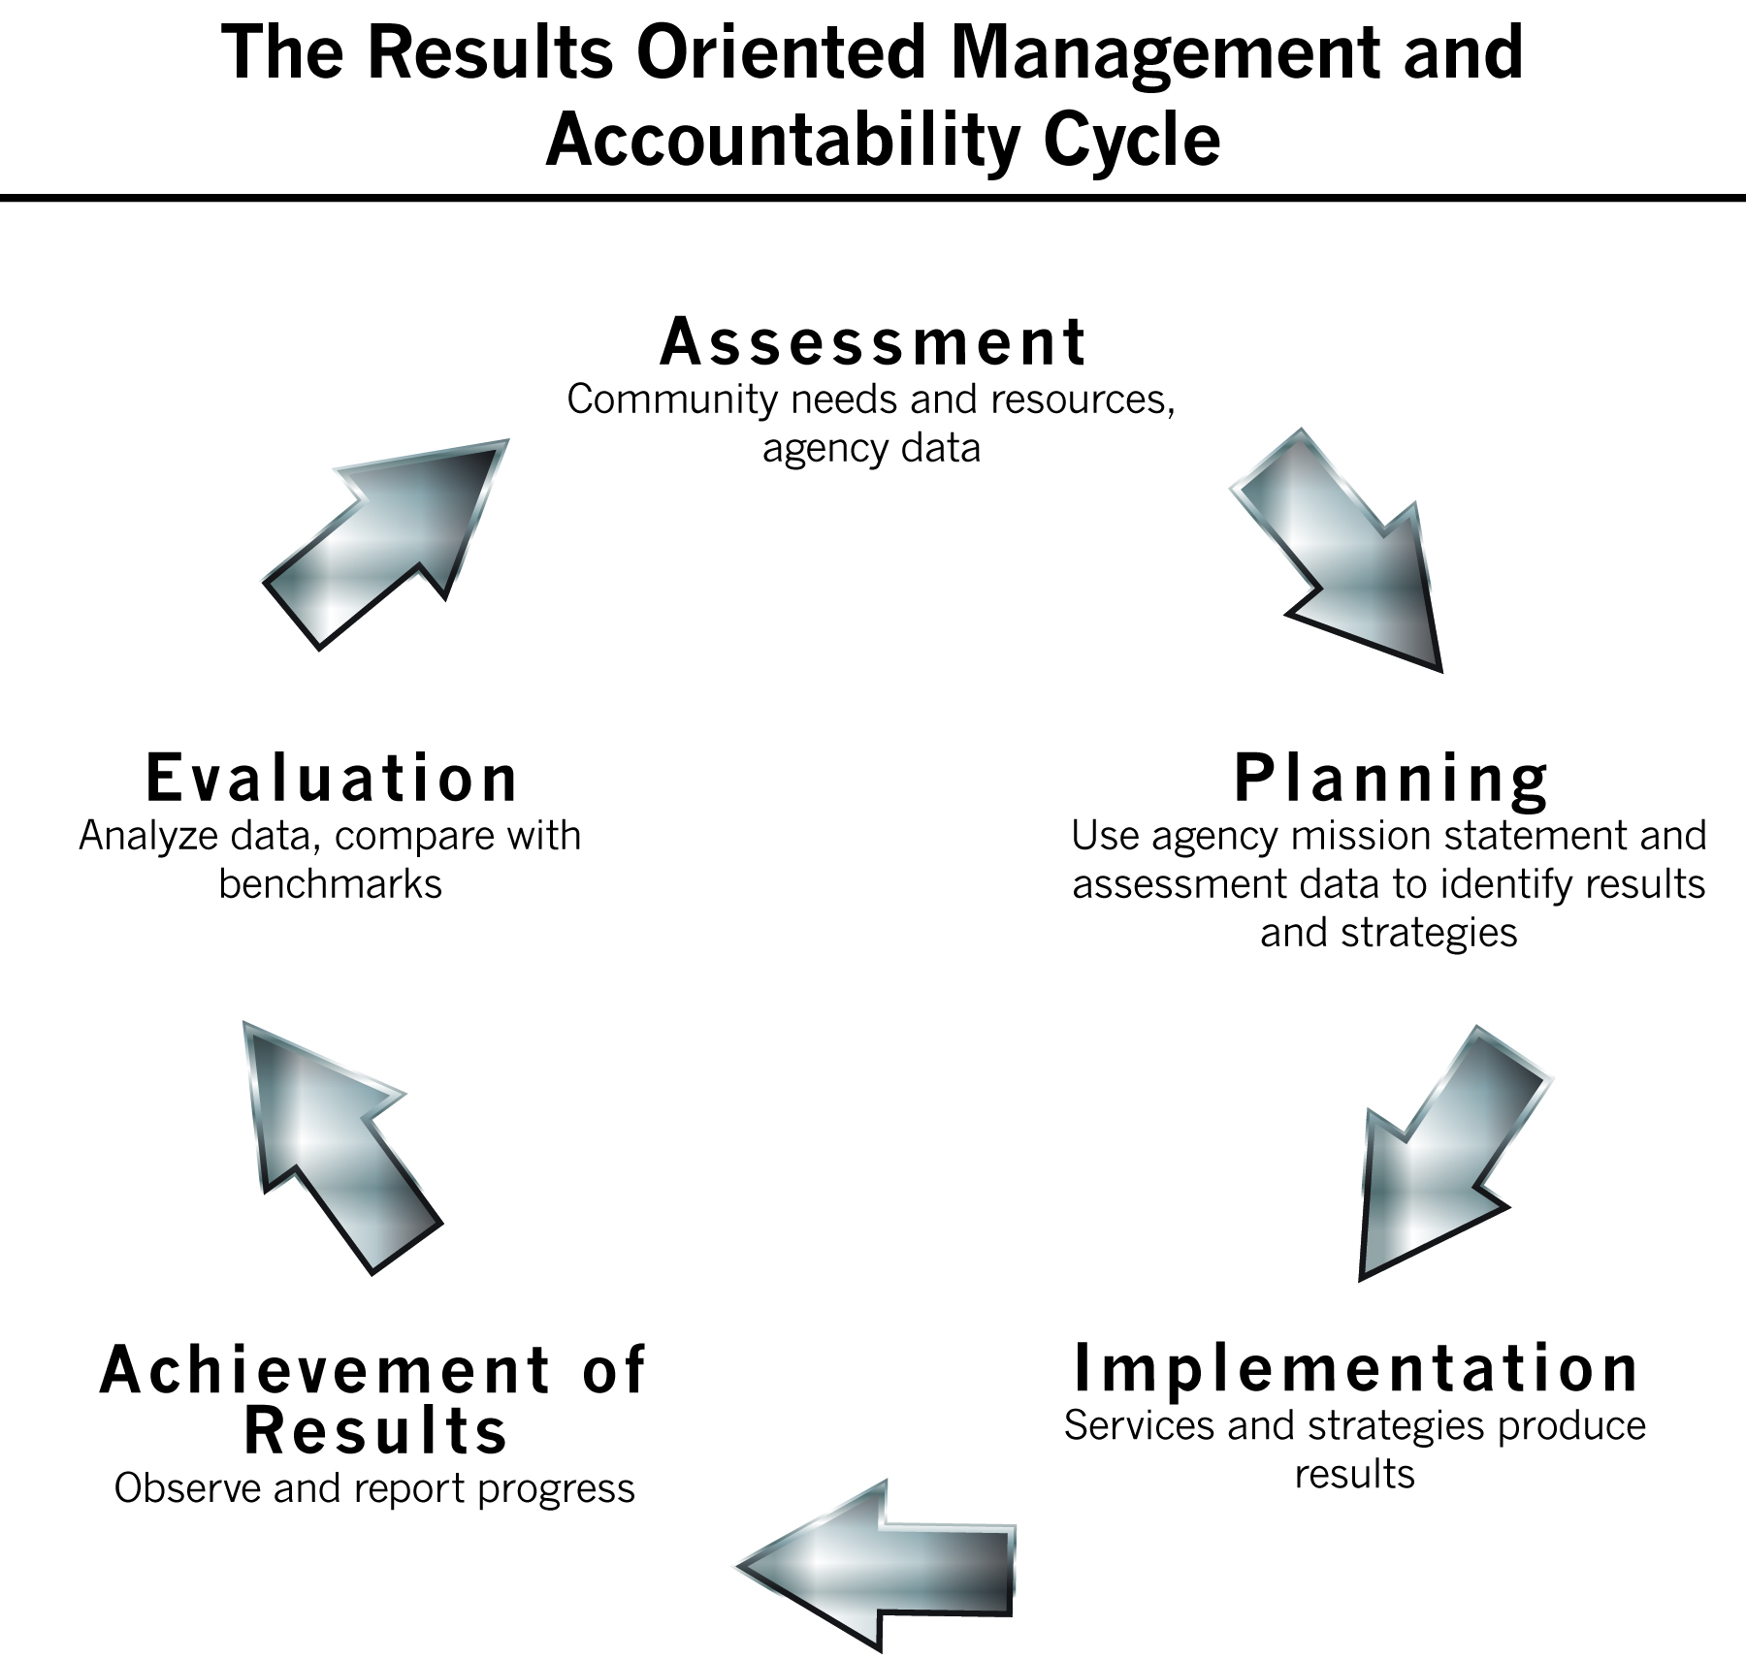
ROMA Cycle – Ongoing and In-Depth
Typical time frames for Assessment and Planning indicate agencies should engage in these processes over the course of the year.
Guidance related to Organizational Standards
“Best Practices” examples from the field
Review of the agency mission statement is a part of these activities – to ensure the agency is working to achieving its mission.

Slide 4

What is your mission?
The mission statement of your organization is the foundation for your actions and expectations.
Notes:
Agencies must make decisions about what they can do to fulfill the CSBG Act goals and purposes – as that funding is an essential part of the agency’s identity.
What are the implications of the CARES $? Does this change your mission?
If you are a private non-profit agency, you were approved by the IRS for this status because your mission meets the requirements for “charitable work.”
So it is important that you understand the mission statement – and what the assumptions are behind the statement.
We do not always think about “what we assume” but our beliefs are always behind our knowledge and are instrumental in the decisions we make.
If we think we can “reduce poverty” or “eliminate the causes of poverty” (which many CAA mission statements say) then that means that we understand why people are in poverty, and what is needed to get them out of poverty.
If you are a public agency, you will still have a mission statement that guides your work.
Standard 4.1 for public agencies indicates that the “board” or “advisory body” has reviewed the department’s mission statement within the past 5 years and assured that:
1. The mission addresses poverty; and
2. The CSBG programs and services are in alignment with the mission.
in the case of a public CAA, the mission statement may be influenced by official policy. For instance if the CSBG program is housed in the Department of Housing and Community Affairs, you would expect to see a greater focus on housing related issues. Or with Department of Commerce, a greater focus on employment and business development. Of course this isn’t always the case, but understanding the influences of official policies is important in public CAAs.

Slide 5
Anti-Poverty Mission?
What happens to your mission in the time of crisis?
Are there new needs that have been identified that you think you are able to address? Will they align with your mission?
How will addressing new needs align with the overall anti-poverty mission of the CSBG funding?
Notes:
These are questions we (CAAs) ask in typical times – and they are important in crisis as well.
Part of the problem is that we don’t have a standard definition of “poverty”
For a long time, there have been are many researchers who are trying to define the essential elements of “poverty”
There is the federal poverty guideline – that is based on the cost of food (which many people feel is inadequate)
What happens when the eligibility for services is raised from 125% to 200% PL?
Does this mean we must define poverty differently?
One researcher said that It takes courage to work in a field where the concepts and methodologies of such a complex issue are not precise enough to be useful working tools.
In other words, if we can’t define the situation, how do we work on a solution? What is essential to change to help individuals, families and communities be “better off”?

Slide 6
4 Key elements of a mission statement
Population
Services
Outcomes
Relationships
Notes:
We know the MS has 4 key elements, one of which is about the population. Routinely see reference to “low income” or “people in poverty”. If we are going to be serving 200% of poverty, will we still be faithful/in line with our mission statement?
Get responses from group.
Will your services change during this time?
What about your outcomes? If you have things like “eradicate poverty” or “achieve self sufficiency” will these still be relevant?
And what about relationships? How are you responding to this crisis? are the relationships identified in the mission statement? Like “in partnership with the community” or “ in partnership with health and human svs”? What if these are now different (faith based, business, etc).
This gives you and opportunity to look at the MS to make sure it is broad enough to be relevant in a crisis moving forward.

Slide 7
ROMA in a Crisis
The key elements of ROMA are more critical than ever when faced with a crisis.
The concept that there is “no time” for ROMA is incorrect.
ROMA will support the network to more effectively administer CARES funding.
ROMA is still ROMA in a crisis– it just may need to happen more rapidly!
Notes:
The spotlight is on the network to provide critical services to respond to the impacts of COVID-19. ROMA empowers us to do this.

Slide 8

Assessment is necessary – it just has to happen quicker than usual!!
When considering how to address COVID and deploy resources (CARES funds and other resources), each agency will have (already) some idea about what they are going to do.
Identify the new needs emerging that weren’t covered in the original assessment.
How do you find these new needs?
It is important for agencies to consider how they have identified the needs they plan to address.
Notes:
CARES Funding does NOT require a new community needs assessment; however, any time agencies are required to allocate funds to address local needs, they must have a way to identify what those needs are.
Some states are asking for more in-depth assessment processes but most are just addendums.
Needs assessment can be as simple as keeping track of the number of calls for help, and the nature of the calls.
How are they different from typical requests?
Do they have difficulty getting to your facility – or figuring out how to access remotely.

Slide 9
Needs Assessment Data:
211 Identified top needs
Unemployment data
Local News Articles
Housing statistics
Other Non-Profit reports
Agency tracking of requests for service
Notes:
This will give you data about the needs of individuals and families in your community.

Slide 10
211 Summary of Top Calls
Unemployment Data
Need | Number of Callers | Rank
Housing – Rent/Mortgage | 1526 | 1
Food | 1295 | 2
Utilities – Gas, Electric, Water | 780 | 3
Public Assistance – SNAP, TANF, Medicaid | 467 | 4
Public Health – COVID Testing | 425 | 5
County | 5/2/2019 UI Claims | 5/2/2020 UI Claims | % of Change
A | 22 | 291 | 92.44%
B | 3 | 71 | 95.77%
C | 43 | 708 | 93.83%
D | 2 | 55 | 96.36%
Notes:
This is from TX

Slide 11

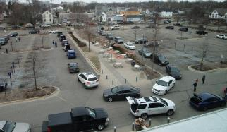
Increased demand for food
Pictures from Grand Rapids, Michigan
March 2020
Notes:
CAAs in Michigan are the main source of food distribution

Slide 12
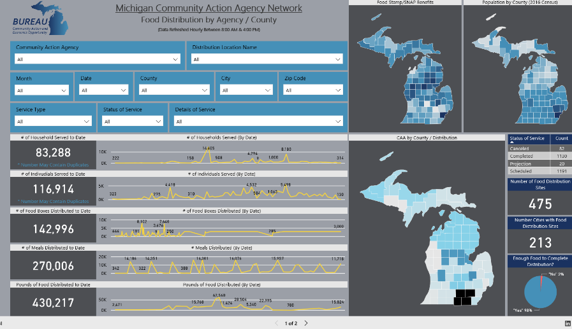
Notes:
To make sure that the distribution of food was not stopped or delayed, MI tracked how much how much food was going out and to how many people and at what site. MI tracked this and used this information to forecast what the needs would be so that they would be sure to have enough funding to kept the food supply adequate. The number served and amounts spent were used to support additional request for funds. This forecasting represents the importance of immediate analysis of data.

Slide 13

Switching from congregate to home delivered meals
Notes:
Another example of rapid response: agencies usually do congregate meals, but they had to stop, so instead home distribution of meals was implemented for seniors.

Slide 14
Also Assess Agency Needs
Staff needs:
Operation needs:
Safety
Modifications to facilities
New information
New job duties
Communication processes
…
Ability to work remotely
Technology
Other needs
Ability to perform duties in new ways (eligibility documents, e.g.)
Outreach
Notes:
Communication between:
Staff
Clients
State and CAA
Increase Capacity - Hiring: permanent or temps
Getting the word out: newly poor don’t know where the doors are
Software modifications for tracking performance and expenditures of multiple grants

Slide 15

Assessment and Planning are necessary – they just hav to happen quicker than usual!!
The agency will have to prioritize which of the many needs they have identified that they are going to address.
While this is a typical part of an assessment process, it has a different twist:
It has to happen NOW not in 6 months!
Notes:
Which needs get addressed first? Which are most critical? How do you know? Is it by the increased demand for assistance?
At some point we will have to document the needs and the decision making process.
Remember assessment of need and planning to address need can (probably will) change over time – but in this case, it could be over a quick time (such as 30 days).
When interventions are changed, data should be used in the decision to make those changes.
But you have to HAVE the data before you can use it!

Slide 16
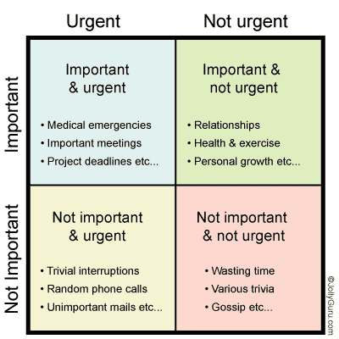

Notes:
In a crisis, you focus on the areas of highest importance and highest urgency.
You are not working for long term change, but for immediate relief.
But you can’t forget your CSBG purpose – your anti-poverty mission.
What items that are important, but not as urgent, can be addressed?
If it is important, but not urgent, don’t forget about it!! b/c then it may become another crisis!!
A lot of things may appear to be urgent, but are they truly important right now? Can you triage to conserve funds/energy so that what is urgent and important gets attention.
In times of crisis, everything can feel urgent-like it has to get done right now! But the act of planning give us the opportunity to step back and be mindful and responsive, rather than reacting.

Slide 17

Planning in the time of Rapid ROMA
How will agencies do the work of addressing the needs?
Plans, of course, will still include implementation elements:
who will do what,
where will it be done,
what needs to change in service delivery
Plans also should include some thought about how the agency will:
gather data,
report data, and
evaluate performance throughout the life of the project.
This Photo by Unknown Author is licensed under CC BY
Notes:
Move from Assessment to Planning.
At the very start of thinking about which needs and how much $ will go to each area, agencies will be putting plans into place.
They will think about delivery of service, but we should be sure they are also thinking about what data they will need (and how they will collect it) for reporting.
If plans do not include at least consideration of the need for data regarding key elements (spending, processes, numbers, etc), we will get to the end of this with little to show for our interventions.

Slide 18
TX Example: Ramp-Up Analysis Tool
Budget by Program
Current budget
Any carry-over funds
Additional COVID-related funds
Historic Performance
Typical numbers served
Average household expenditures
Average CPU for Weatherization
Projected impact of additional funds

Slide 19
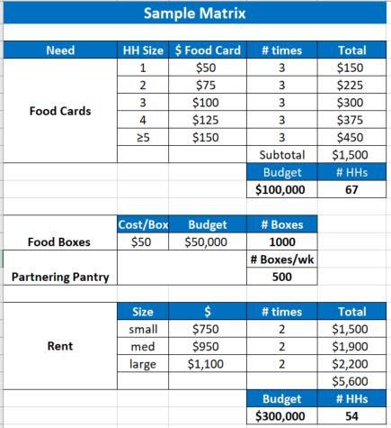
TX Example: Developing a Matrix for Service Delivery
Considering service:
How much will it cost?
How many times will the service be provided?
What is the total amount available to use?
Notes:
Taking time to step back and think about what you normally do, and how things need to adjust. Need to determine what needs to happen to spend what is likely a significantly larger amount of money in a short period of time.

Slide 20
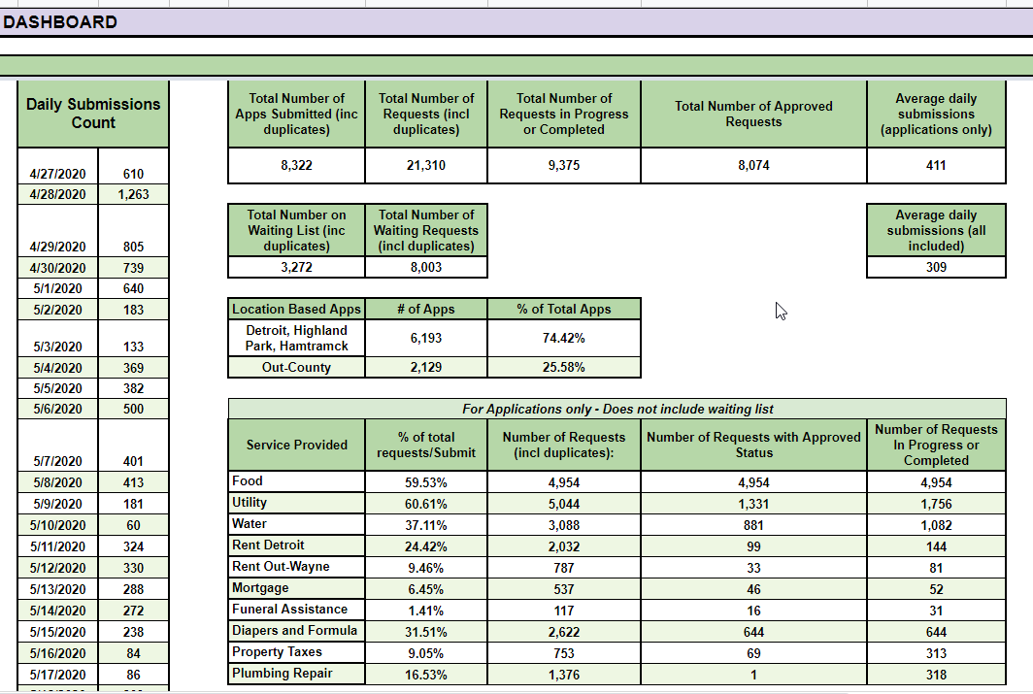

CARES Dashboard
Notes:
The agency uses this dashboard to help show how may requests have been approved (blue arrow)
And how many requests are still pending (red arrow)
This type of information can be used to help understand what the most urgent needs are, and can also be used to help allocate resources, plan for staffing, etc.
Each applicant can apply for up to 6 services, so 8000 applications can represent up to 21,000 requests for service. looking at the data, the agency determined that they would need to hire temporary staff to help meet this need. They also compared the amount of money the amount of money they had to spend to the amount of applications that had yet to be processed and used this data to support additional requests for funding.

Slide 21

Implementation isn’t just Implementation
During implementation, agencies need to be:
Observing and Reporting Progress
Evaluating
Reassessing
Planning
Modifying, expanding, correcting and (possibly) cancelling implementation
Notes:
As the ROMA Cycle is spinning, agencies will be providing services to individuals and families – will be working with partners – will be addressing agency capacity. Need to be thinking about the rest of the cycle. You are assessing as you are implementing, b/c there may be changes that are rapidly occurring and new needs surfacing.

Slide 22

Changes to the needs, plans, and targets are likely to happen.
Develop a quick and easy process to allow for amendment to the plan that embraces a continuous learning process & documents lessons learned
IE, develop a check in process to update the plan
Notes:
Implementation of services (to individuals and families) and strategies (for community and agency change) typically follow a program or grant year.
In a crisis, the implementation may be planned for the next 90 days – with a need for a review (observe, report, evaluate, re-assess) at that time to see what has changed.
Prepare for the changes.
Focus on plan as an opportunity to think strategically about how agencies will respond
Changes to the needs, plans, targets are likely
Develop a quick and easy process to allow for amendment that embraces a continuous learning process & documents lessons learned
IE, develop a check in process to update the plan
Check in with agencies to see how it’s going; how are things differing from what we thought EARLY, to allow for course correction, identified supports needed.

Slide 23
Data for Decision Making
What Changed?
Consider ways that agencies can gather data (to turn into information) that will demonstrate the most critical areas of success.
Some elements:
Data on COVID Impacts
What was been disrupted in your own community?
Has the situation improved?
Data from 211 or other government/media sources provides a “big picture” context
Inquiries/requests for service or information
Have you been meeting the needs?
Agency service data – what is the agency doing?
Notes:
We have talked about some of these data elements in the assessment discussion.
But you can’t forget about what might change.
How did 211 data change between February and June? What does the change mean to the agency plans?
Did inquiries for services change during that time?
Compare real time service and outcome data to the assessment data
After initial implementation of new services and strategies, take a review.
At 30/60/90 days: Are you still meeting the identified needs?
Are service increasing or decreasing because of other community resources?

Slide 24
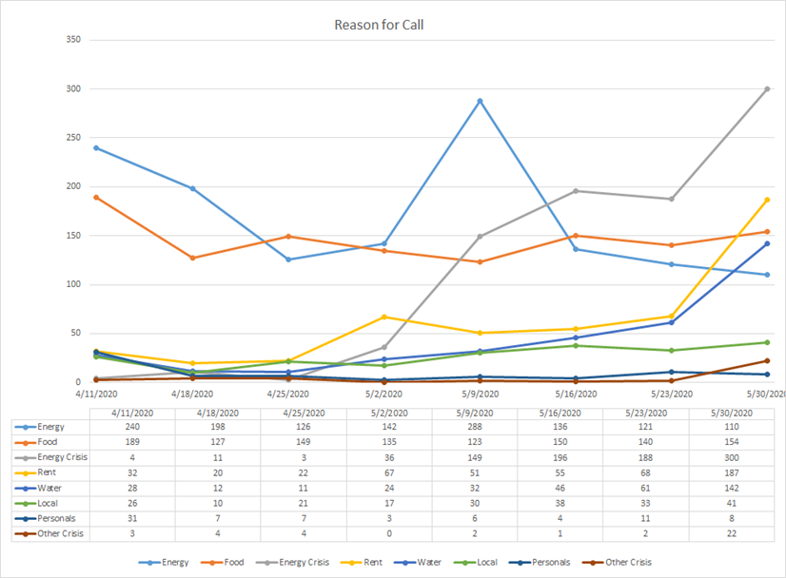
Notes:
For example, consider this data from a local agency in Iowa.
Look at uptick in energy costs-they have been going up since beginning of May. What happened at end of the month that caused the spikes in request for energy, rent and water? Are moratoriums being lifted? This graph shows how quickly needs can change.
What types of decisions can you make using this data? Will your plans need to change?
If the needs change, the plan to meet the needs may need to change, as could how the service is implemented to meet the need

Slide 25
Data for Decision Making
Keep it Simple
Did additional resources come into the community from CARES or other COVID-related relief efforts
Federal, state, local $
Did new partners step up to assist?
Who are they?
What did they provide?
Were new coalitions formed? How did they help address the needs?
Notes:
How are you keeping track of these kinds of changes?
If you don’t “observe and report” now, you won’t have the data to talk about later!

Slide 26
We have been here before. Thinking back to ARRA
When the eligibility criteria changes (as raised to 200% FPG), the agency will find that new customers present their needs in different ways. And the needs are different.
Many customers will have never been in a situation of economic and emotional crisis before.
They may be coming from different neighborhoods and may have difficulty getting to your facility – or figuring out how to access remotely.
Some of the needs are more extreme (e.g.: higher income probably means the cost of housing is higher than our traditional customers, so the cost of keeping them in their home is higher)
Our traditional customers continue to be in need, and so we must find a way to balance services to both sets of customers.
Notes:
Are there population changes that are impacting services?

Slide 27
How Will You Know?
What indicators will measure progress towards the goals?
What evidence will identify that the outcomes have occurred?
Indicators
Evidence
Notes:
While you are examining your assumptions, consider how you will know that any change has happened or that you have maintained the family in a stable situation.
Regardless of the kinds of problems you say you will address, you will have to have a way to prove that you have had an impact on the problem.
What do you believe about follow up?
We cannot follow up with our customers because they move from the location we first served them.
We cannot follow up because they don’t want to answer our questions – they got a service and they are satisfied, so why would they want to talk to us any more?
Follow up is essential to demonstrate that we have accomplished some outcomes.

Slide 28
Achieving Results
What do you expect agencies will be able to observe and report?
Area to document | Able to collect data? Barriers
Amount of $ spent | yes
How $ was braided with other resources | Should be yes?
Number of families served | Should be yes… but some services will not require demographic data be collected so “unduplicated” becomes a question.
Number of families who maintained their homes or food security | Maybe no…. May say immediate need was met, but maybe not if families were supported over time?
Increase agency capacity (as to work remotely or other aspect) | Yes
Changes to service delivery systems in the community | Yes – if agencies keep notes!
Notes:
Of course what you will achieve depends on what you PLAN to achieve.
These are just a couple ideas from discussions about what is already happening.
Those long lines of cars picking up food in many communities may be difficult to track. Should be able to say how many cars – how many boxes – but is that the same as number of families who needed food? And did the food help them?

Slide 29

Evaluation
Evaluation is ongoing and should happen throughout the process.
Document lessons learned
From the process that has had to change
To the partners that have been engaged
To the new customers served
To new (changed) services provided
To the outcomes observed
To…….
This Photo by Unknown Author is licensed under CC BY-NC-ND
Notes:
What we learned from ARRA is that when things happen really fast, and everyone is under pressure, documentation is often overlooked.
It happened so fast and we were all under pressure to respond… sound familiar??
People have them in their memories, but very few are written down. Jenae is pulling the report from ARRA with some of the lessons learned. She says they are not actually sure how many states actually increased the eligibility to 200% but they have some information that can be useful. We will get this out to you to look at – if you have ideas about what you can are hoping to document please send them to us! (use the web portal?)

Slide 30
Rapid ROMA Time Table
Assessment – what do you have documented about the past 100 days?
Planning – how did planning happen? Leadership teams suggest new services and delivery processes? How quickly did you respond with action? Was there actual “planning” that happened?
Implementation – what is the implementation period? Next 90 days? 2 years?
Reporting – internal reporting should be happening every 30 days to give you the data you need to assure you are on the right path.
Analysis of data – are you doing what you expect to do? Are you reaching the right people? Have you made any difference?
Re-assessment – this must be constantly happening

Slide 31
Take Action
What will you do tomorrow?

Slide 32
For more information:
Dr. Barbara Mooney
barbaramooney@windstream.net
Carey Gibson, MSW, NCRP
careylgibson@gmail.com

