Slide 1
The Nebraska NeWAP/LIHEAP Partnership
Lynn Chamberlin, Nebraska Dept. of Environment and Energy

Slide 2
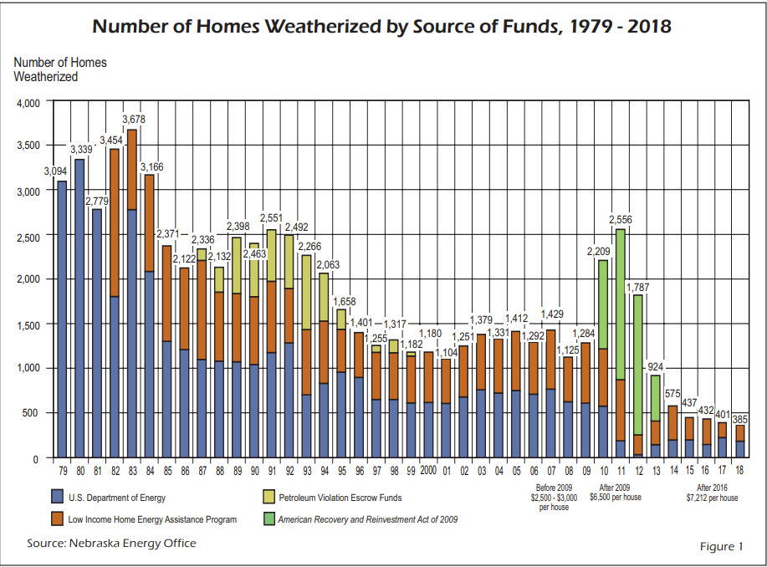
The NeWAP/LIHEAP Partnership
History
The NeWAP and LIHEAP Programs have partnered together since 1982 to provide elderly and low-income clients with energy efficiency improvements
In 2017 the two programs started to meet on a monthly basis to better provide client services and to provide a coordinated focus on the energy efficiency needs of our mutual clients
This approach has led to program improvements associated with augmented funds and sub-grantee administrative costs
During the last quarter of 2018, in partnership, the NeWAP Heating/Cooling Repair and/or Replacement Assistance Program (HCRRA) was developed

Slide 3


The NeWAP/LIHEAP HCRRA
NeDHHS Furnace or Central Air Conditioner Repair or Replacement Assistance Program
NeDHHS may pay up to $750 to repair or replace a furnace or a central air conditioning unit.
For Heating and Cooling Replacement Assistance
Clients must be at or below 130% poverty
Before NeDHHS can authorize payment, the client must:
must pay or arrange to pay the repair or replacement cost that exceeds the Department’s portion and
provide NeDHHS with receipts or a payment agreement.
If extenuating circumstances exist, NeDHHS may authorize repair or replacement assistance for more than $750.

Slide 4

The NeWAP/LIHEAP HCRRA
NeDHHS Furnace or Central Air Conditioner Repair or Replacement Assistance Program
Additionally, for Cooling Replacement Assistance a qualifying household must include a household member:
is a child under age 6 and receives ADC
is age 70 or older, or
has a severe illness or condition which is aggravated by extreme heat as verified by a medical statement signed by a licensed healthcare provider
Provisions are made thru the program for the purchase of window air conditioners
NeDHHS completed 84 units in the year prior to implementation of this NeWAP/LIHEAP HCRRA program.

Slide 5
The NeWAP/LIHEAP HCRRA
The Benefits of Implementation of the NeWAP/LIHEAP HCRRA with a portion of the NeWAP Heating/Cooling Repair and/or Replacement Assistance Program include:
Establishing a $5,000 per home cap
Uses the 200% poverty eligibility level established in the Weatherization Program
Owner occupied units “only”
Every installation receives a subgrantee QCI and CAZ
10% of all installations are monitored by state QCIs
If “post-implementation” Health & Safety issues are discovered (i.e. back-drafting, orphaned water heater venting) LIHEAP augmented funds can be used to remedy the issue
An additional $500,000 in funding + administration costs was made available and dispersed per formula grant to subgrantees

Slide 6
The NeWAP/LIHEAP HCRRA
Client verifies emergency with redtag, written documentation or subgrantee evaluation. Subgrantee:
Verifies that it is a previously weatherized client
Secures previous client files (if available) or starts new client files
Calls for HVAC bids, requiring appropriate sizing, efficiencies and warranties as per NeWAP requirements
Awards successful bid and installation is completed
Completes final QC inspection
Client verifies emergency with redtag, written documentation or subgrantee evaluation
Subgrantee verifies that it is not a previously weatherized client
If the client is not interested in weatherization
If the client is interested in weatherization
Complete NeWAP application and eligibility review
Calls for HVAC bids, requiring appropriate sizing, efficiencies and warranties as per NeWAP requirements, award successful bid, complete emergency installation and QCI
Proceed with standard weatherization process and prioritize for weatherization work

Slide 7
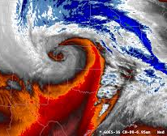
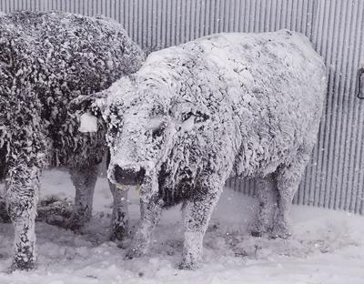
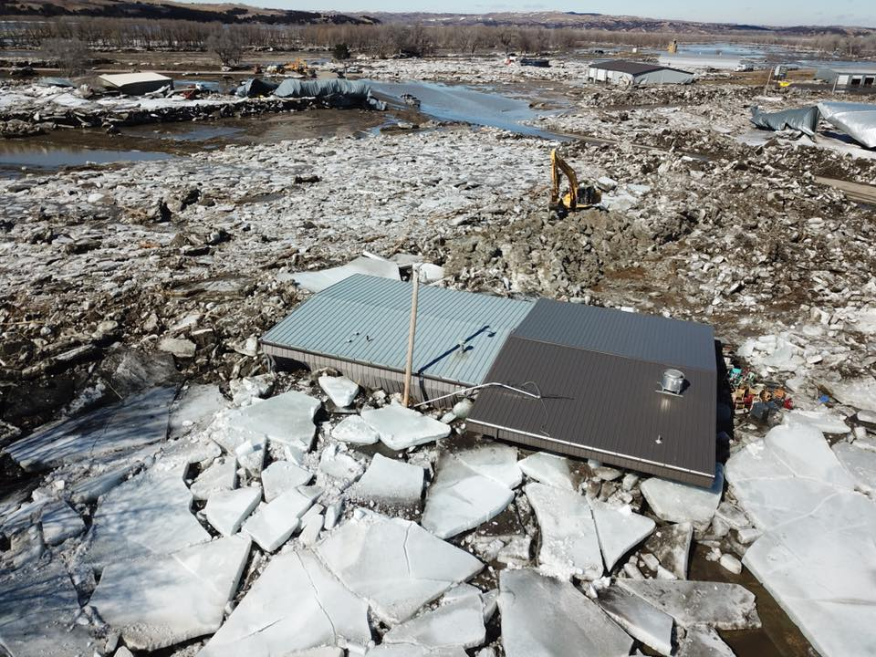
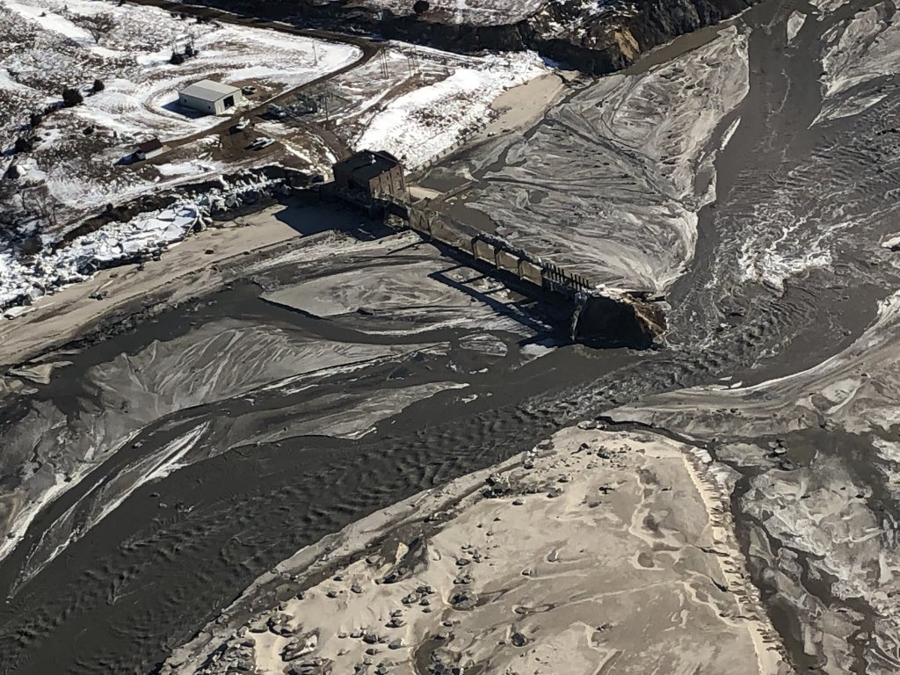
The NeWAP/LIHEAP HCRRA
Unused funds were to be evaluated by the program partners prior to the last quarter of the program year for possible conversion
The program officially started on January 1, 2019
BUT IT WASN’T A TYPICAL YEAR IN NEBRASKA!

Slide 8
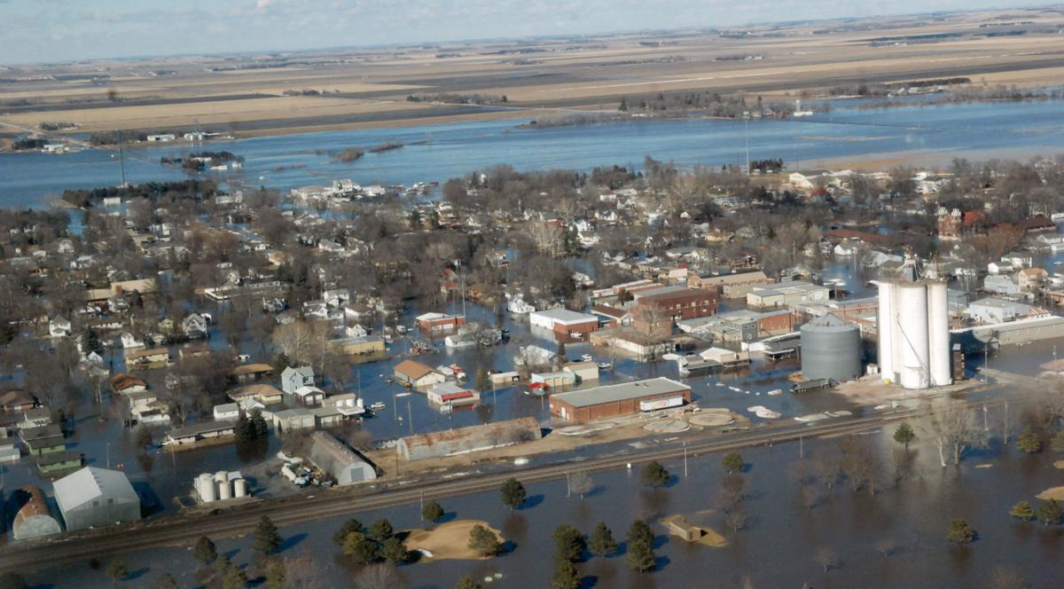
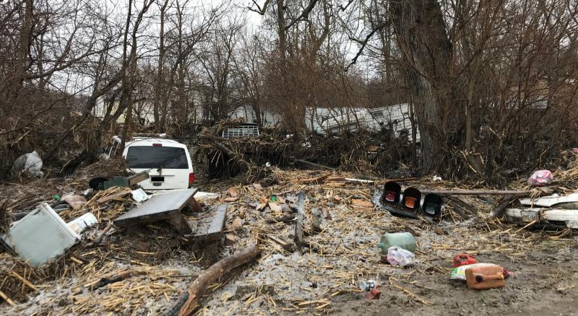
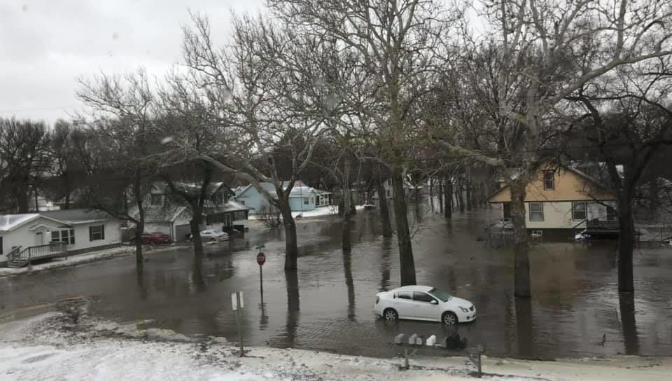
The NeWAP/LIHEAP HCRRA
Historic Flooding in March of 2019!
1–3 inches of rainfall, bombogenesis, an epic drop in air pressure that triggers historic weather, on top of late winter snow (30 inches of snow) and moisture saturated soil
Rivers and creeks throughout the eastern third of the state flooded
Eligible clients in flooded homes lost heating and cooling equipment that is still being replaced with HCRRA funding
Many homes in the southeast corner of the state still have standing water and flooded mechanical equipment in the basements

Slide 9
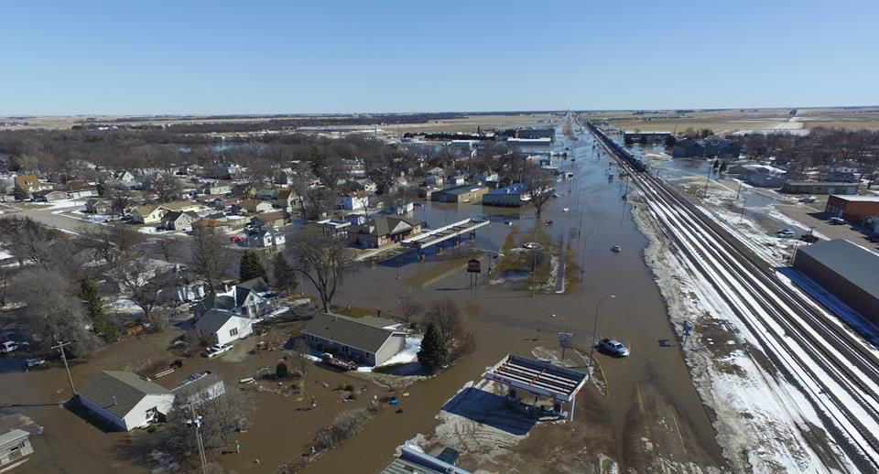
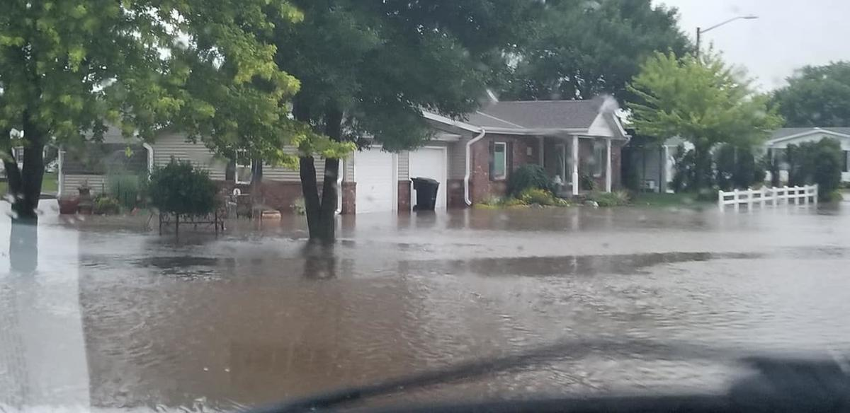
The NeWAP/LIHEAP HCRRA
May 2019 - Central Nebraska Floods
9 inches of rainfall and already swollen rivers
Flooding not only from the rainfall but also from overwhelmed sewer systems and saturated soil
To-Date Our Subgrantees Have Completed Work on HCRRA 53 Homes
Although flooding work isn’t specifically tracked thru our database, subgrantees have reported 25 of the 53 completed homes were flood victims and work is in-progress on and additional 23 flood homes
The remaining funds are obligated for work in HCRRA homes not impacted by flooding

Slide 10

The NeWAP/LIHEAP HCRRA
Contact Information
Nebraska Dept. of Environment and Energy
Lynn K. Chamberlin
402/471-3358
lynn.chamberlin@Nebraska.gov

