Slide 1



Analysis Subcommittee
DATA Task Force
Monday, March 26, 2018
3:30-4:30pm ET

Slide 2
Agenda
Discuss NASCSP Staff role
Discuss subcommittee member roles
Introductions
Priority Deliverables
Module 2 and 4 SmartForms
Brainstorm new deliverables
Prioritize and rank importance
Timeline
When does the network need specific items based on reporting periods, schedules, etc.?
Next Steps
Chair of this committee
Discuss specific deliverables
Plans for next meeting

Slide 3
Roles: NASCSP Staff vs. Members
NASCSP
Driving agent and organization
Creating and polishing resources
Providing support
Members
Identifying needs of network
Reviewing documents
Providing ideas, recommendations, & feedback

Slide 4
Introductions
Members
-Aaron Wicks
-Lise Stuart
-Tiffany Keimig
-Jutta Ulrich
-Matt Fitzgerald
-Frances Yator
-Barbara Mooney
-Katy Kujawski
-Jenae Bjelland
Name & Organization
“Why did you want to be on this subcommittee?” And/or “What do you hope to achieve?”

Slide 5
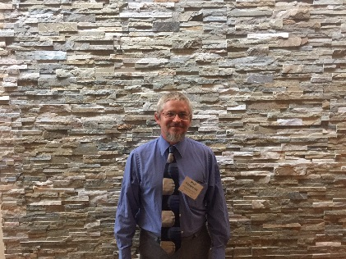

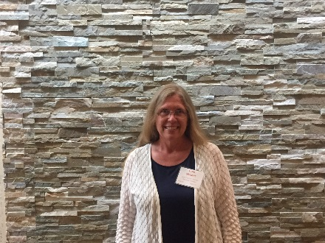

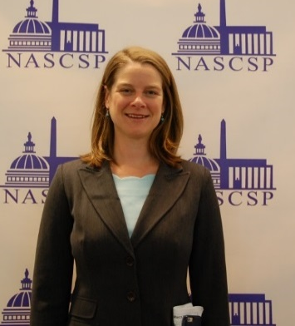
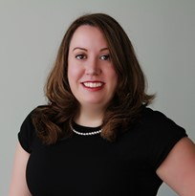


Name & Organization
“Why did you want to be on this subcommittee?” And/or “What do you hope to achieve?”
Aaron Wicks
Matt Fitzgerald
Lise Stuart
Tiffany Keimig
Katy Kujawski
Barbara Mooney
Jenae Bjelland
Jutta Ulrich
Frances Yator

Slide 6
Deliverables
Current Priorities
Module 2 and 4 SmartForm
Walk through form and process
Brainstorm new deliverables
Prioritize and assign interested members

Slide 7
Next Steps
Committee Chair
Deliverable deadline/process
Next meeting

Slide 8
Committee Chair Roles
Chair
Work with NASCSP staff on developing meeting schedule and agendas
Report out to the larger DATA TF on committee work
Work closely with the DATA Task Force co-chairs on committee deliverables and deadlines
Review and approve notes
NASCSP
Communicate with committee members to set up meetings
Ensure meetings occur on regularly
Provide WebEx
Take notes

Slide 9
Next Steps
Deliverable deadline/process
Next meeting

