Slide 1
Weatherization Day 2012
Douglas, Wyoming
October 25, 2012
Brenda Ilg
WAP Program Manager
Department of Family Services

Slide 3
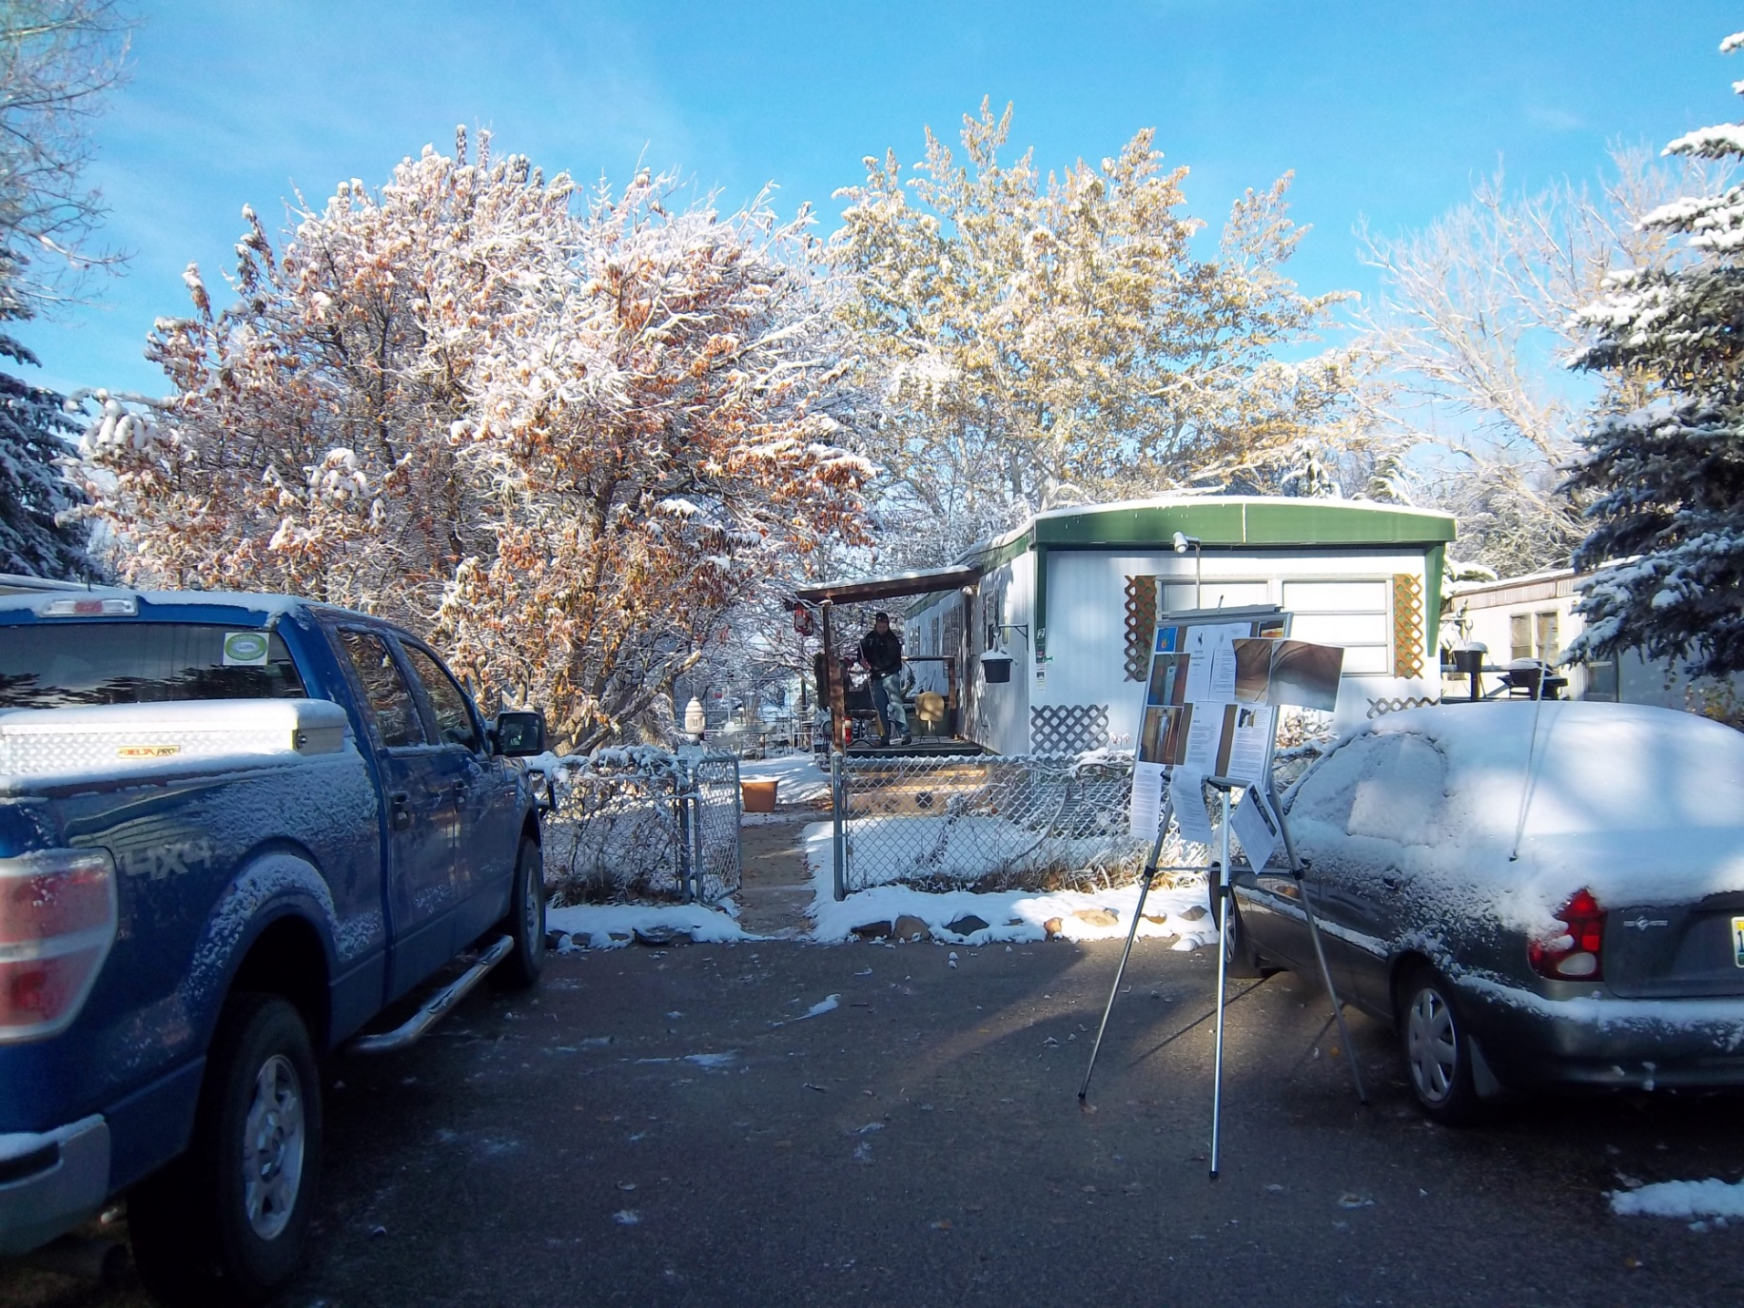

Slide 5
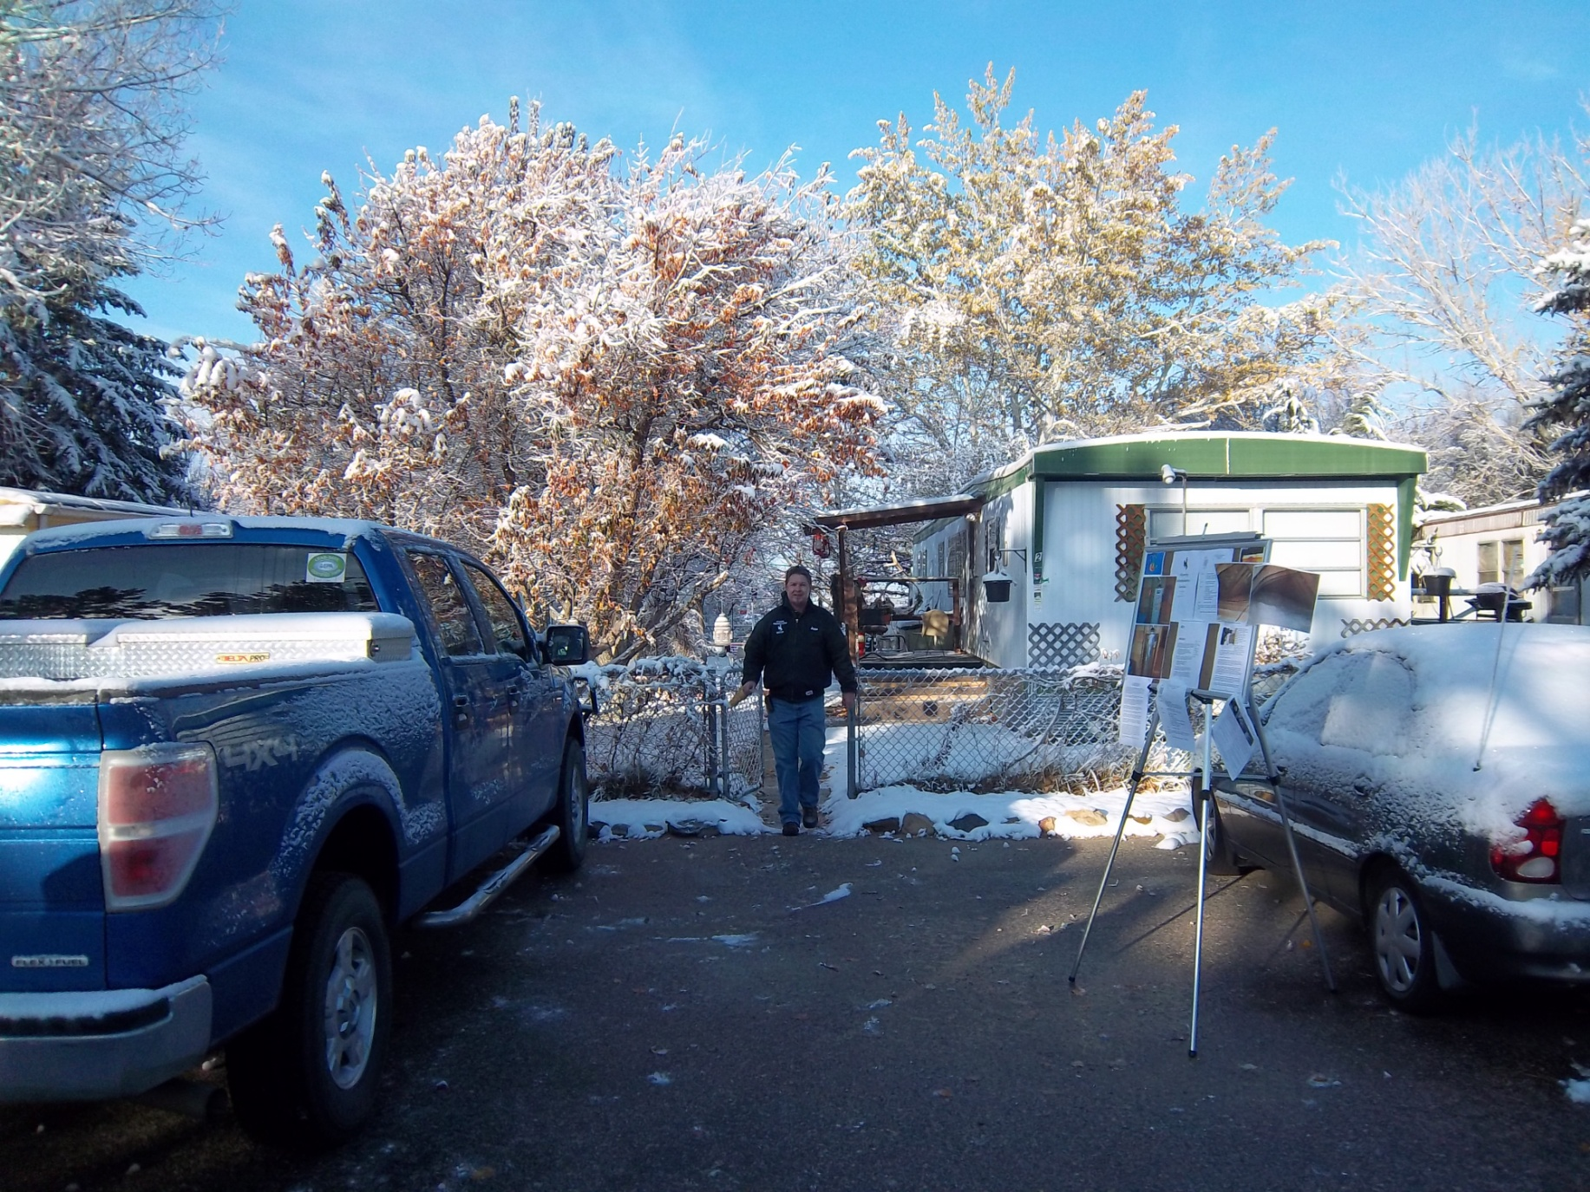

Slide 6
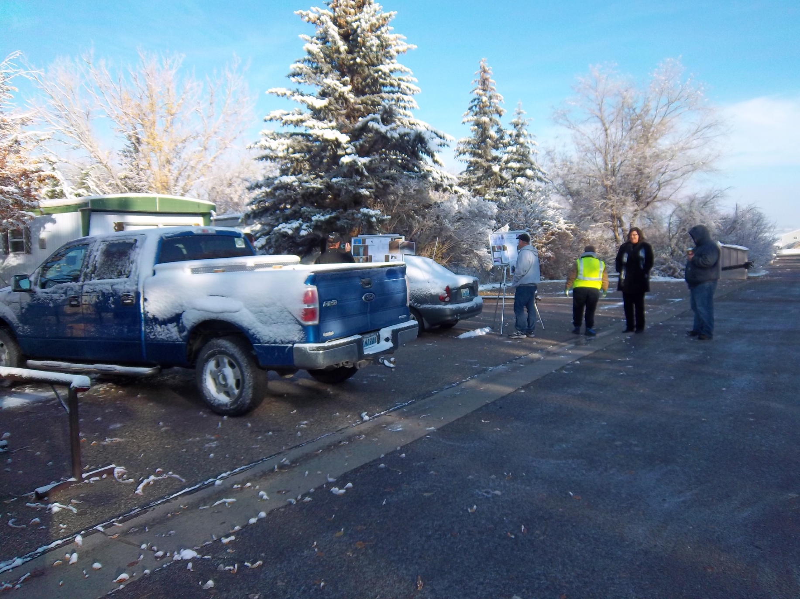

Slide 7
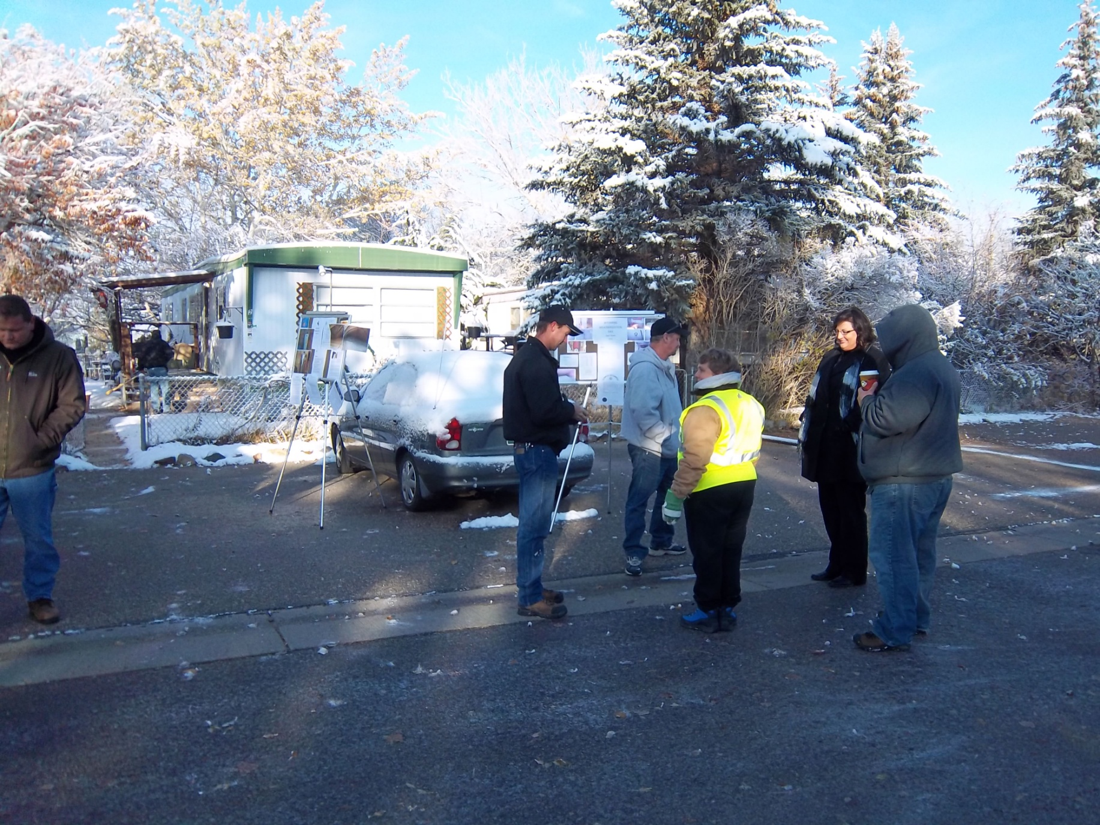

Slide 8
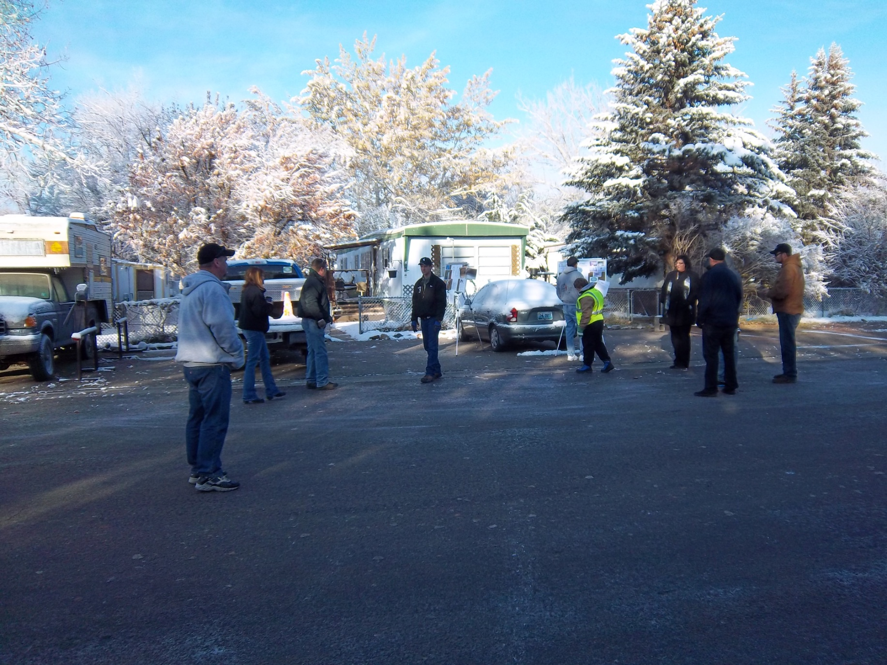

Slide 9
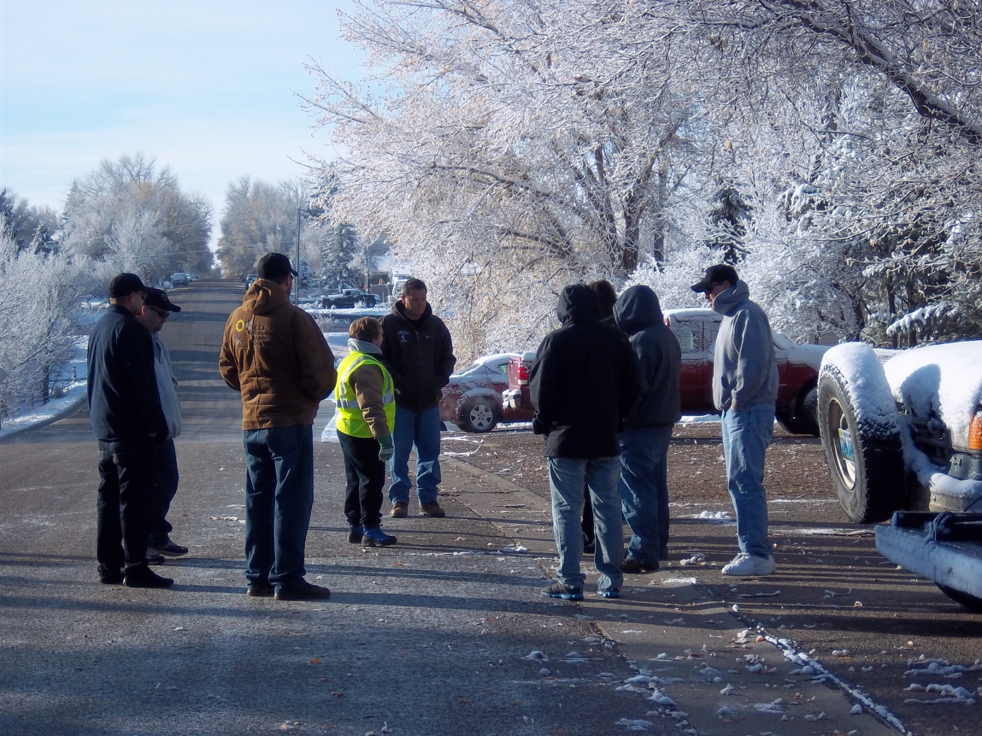

Slide 10
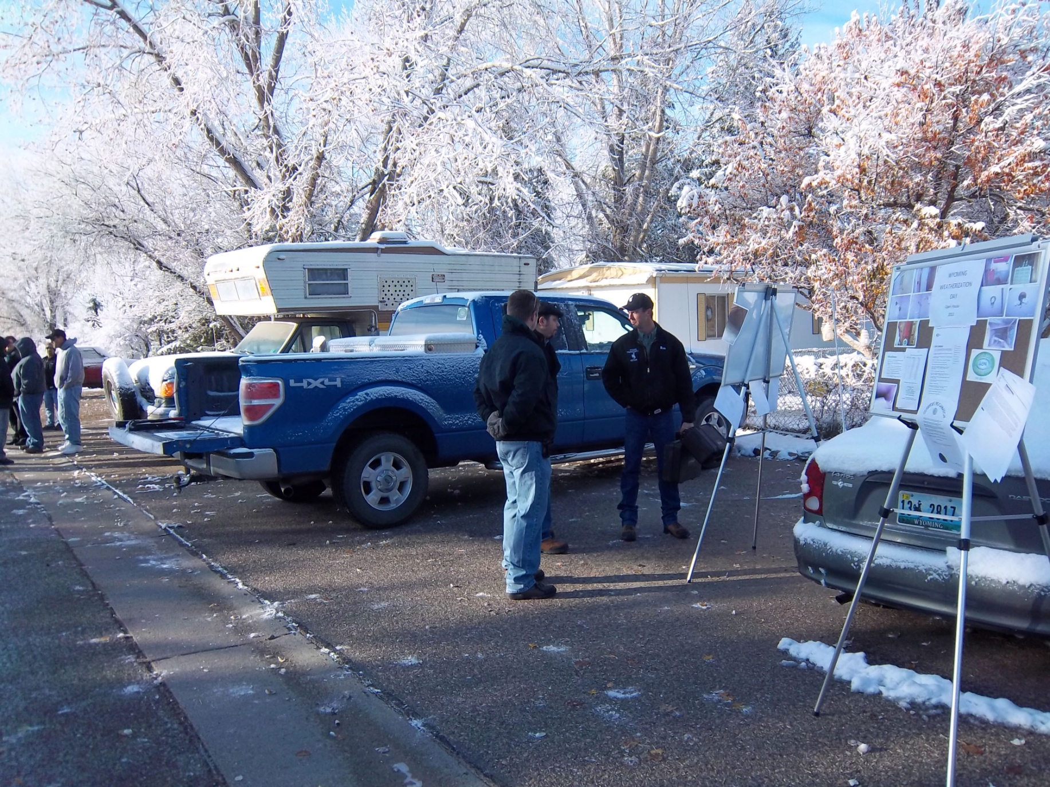
Senator Barrasso’s staff braves cold to attend event.

Slide 11
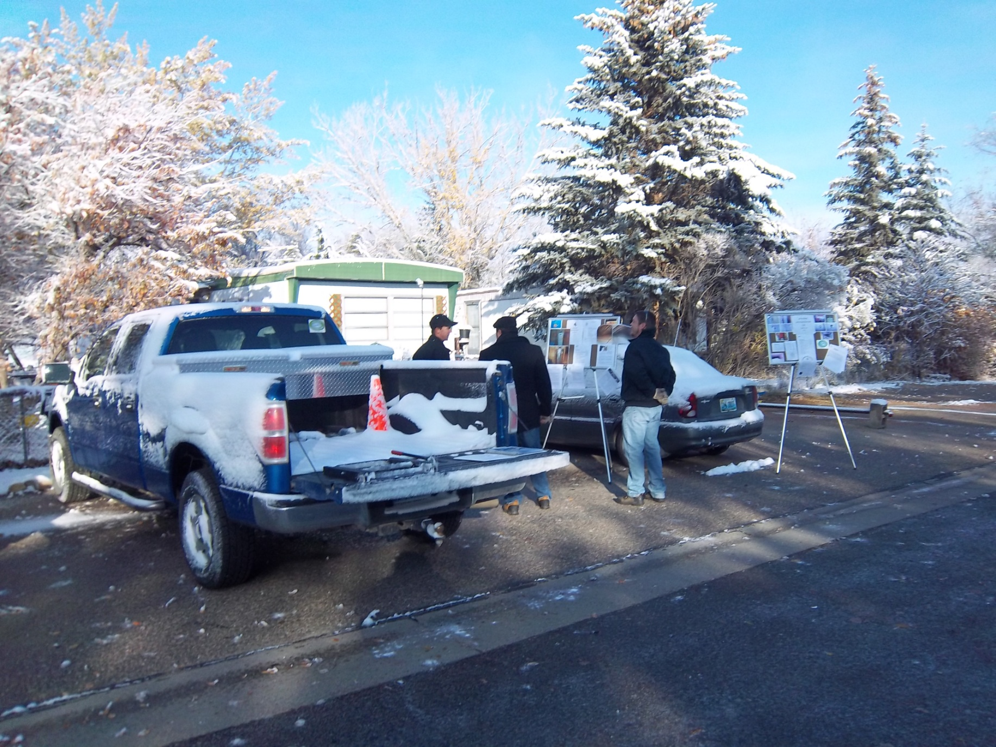

Slide 12
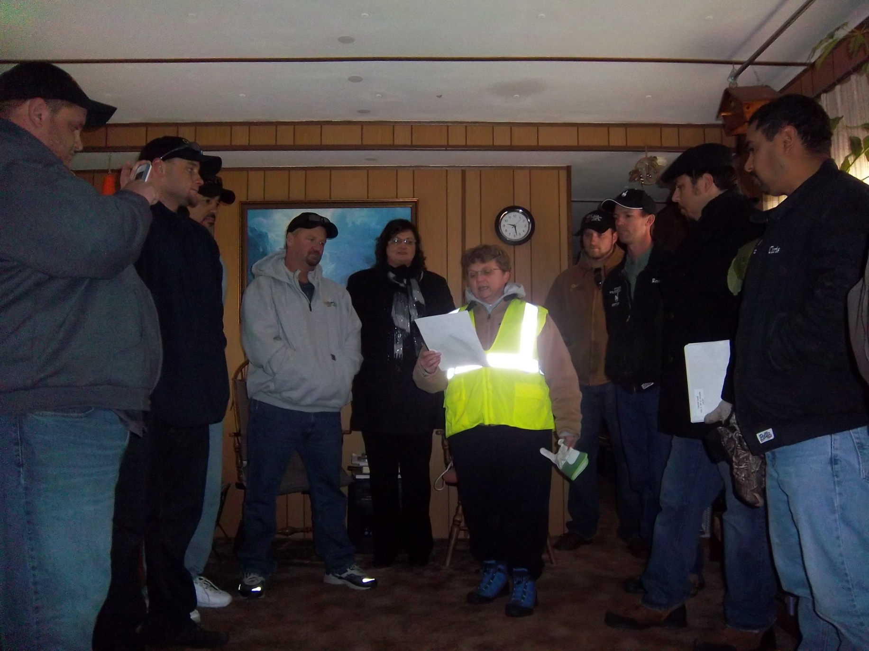
Daniel Gallegos

Slide 13
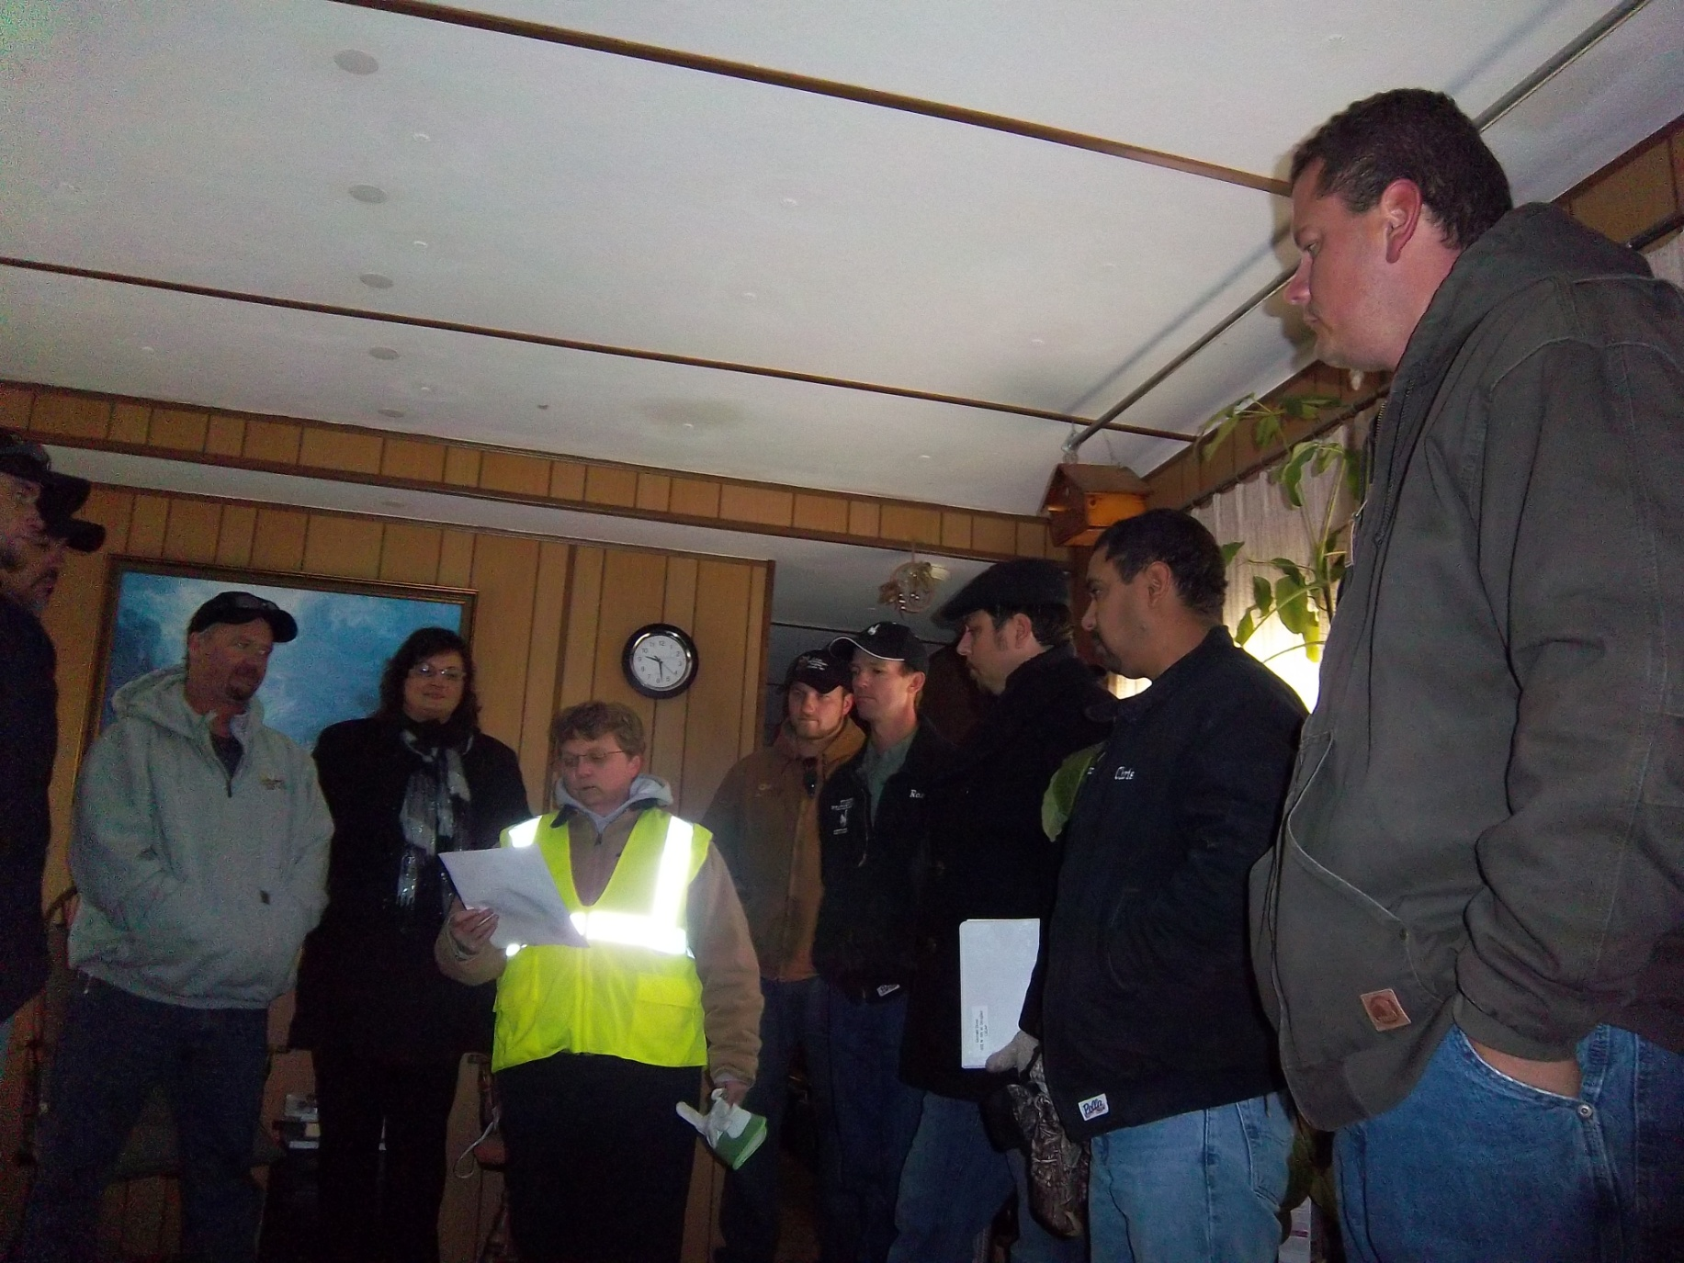

Slide 14
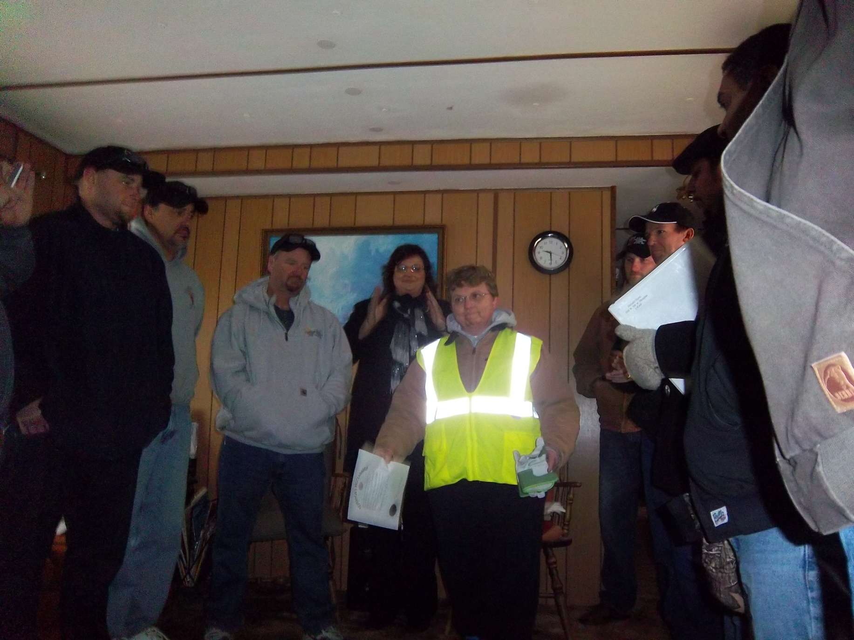

Slide 15
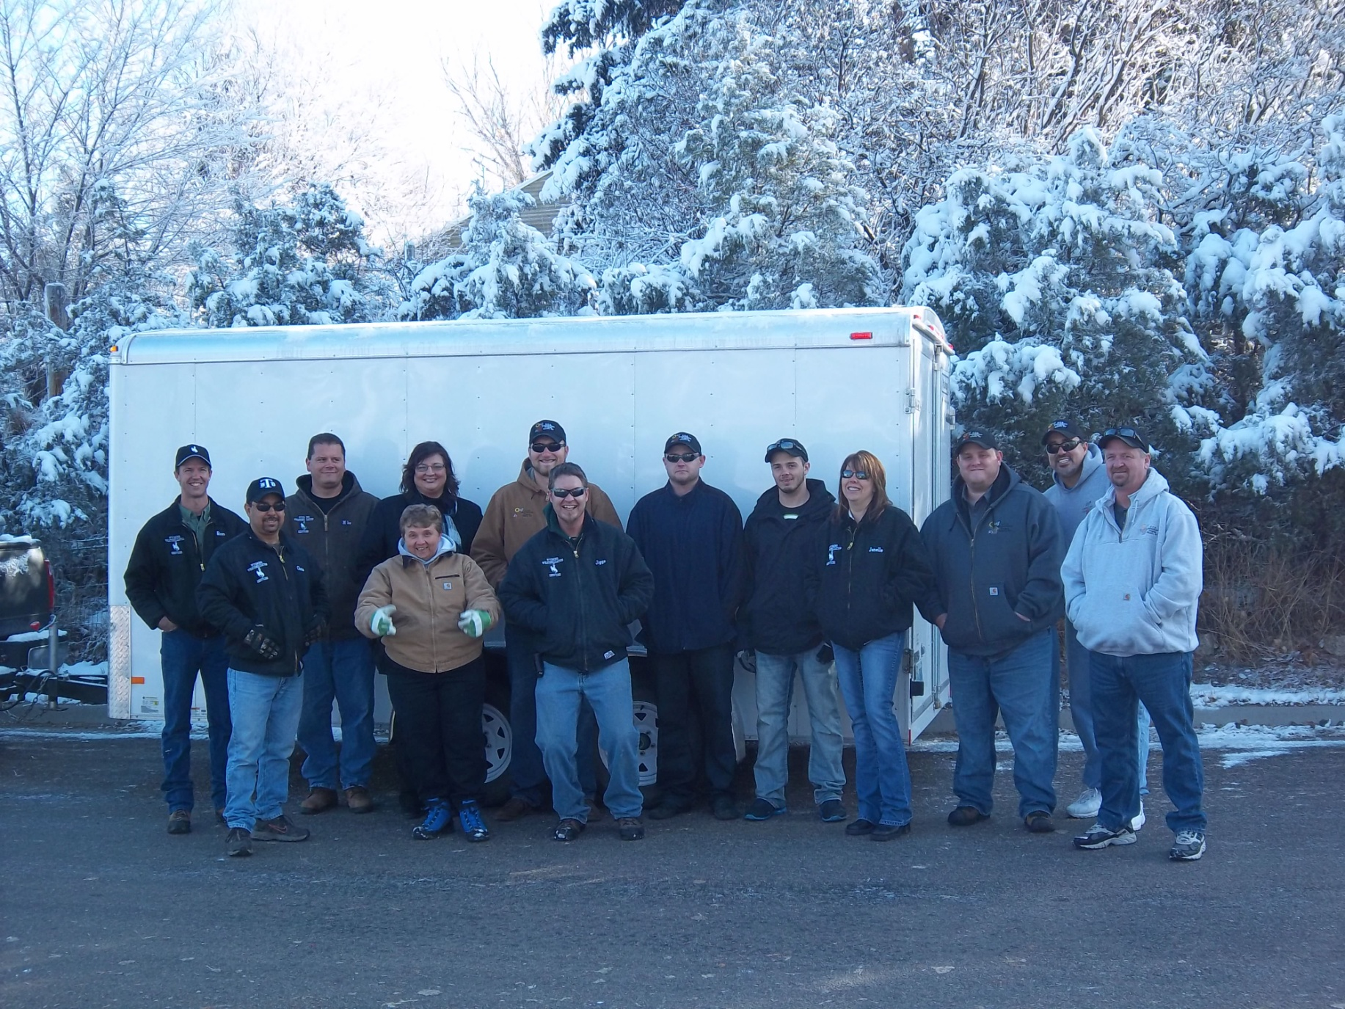
A brisk, snowy 18 degrees in Douglas, Wyoming.
WE ROCKED ARRA!

