Slide 1
Standardized Curriculum
WAP Training Plans and Resources

Slide 2
Goals of Standardized Curriculum
Compile institutional knowledge
Create baseline
Core Competencies
Flexibility
Sections
Editable
Useful to instructors of all experience levels
Free to all

Slide 3
Standardized Curriculum is not…
All things to all people
Substitute for good, engaging instructors

Slide 4
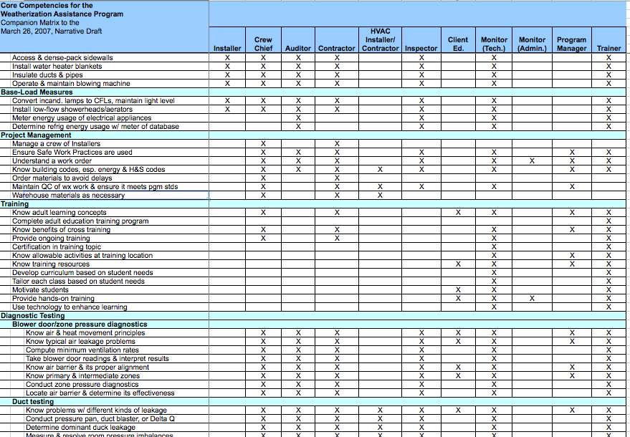
Process: Core Competencies

Slide 5
Process, cont’d
Input from Trainers and the field
Review module outlines
Create module
Technical and training review and field testing
Revisions
Roll-out
Feedback
Revisions

Slide 6
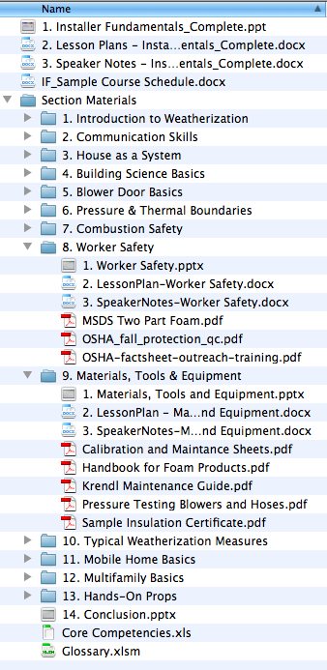
Example: Installer Fundamentals
Presentation
Speaker’s Notes
Lesson Plans
Sample Course Schedule
Hands On Props
Additional Resources
Glossary

Slide 7
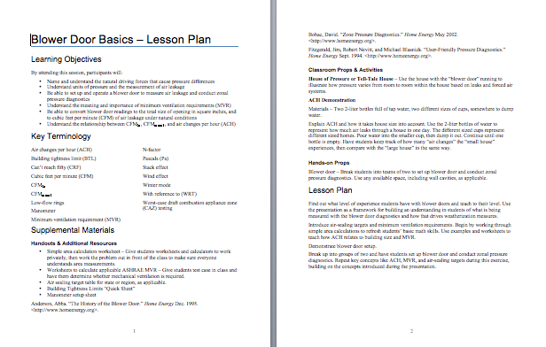
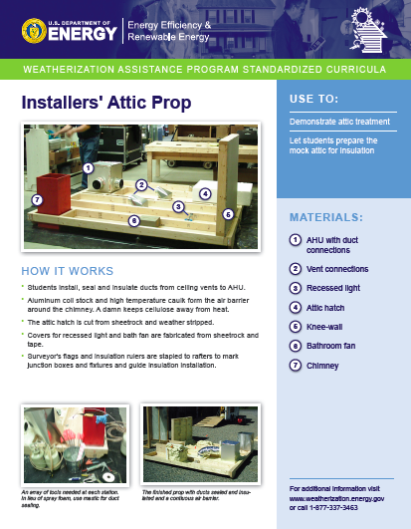
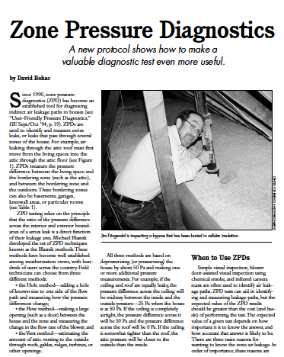
What’s Included?

Slide 8
Learning Objectives
BUILDING SCIENCE BASICS
By attending this session, participants will:
Understand the difference between thermal and air barriers
Know the proper location of thermal and air barriers
Recognize the driving forces of air leakage
Understand the connection between air leakage, energy waste, and moisture problems
Understand how air ducts affect pressure balances within the home
Understand the principle behind the blower door as a tool for measuring air leakage

Slide 9
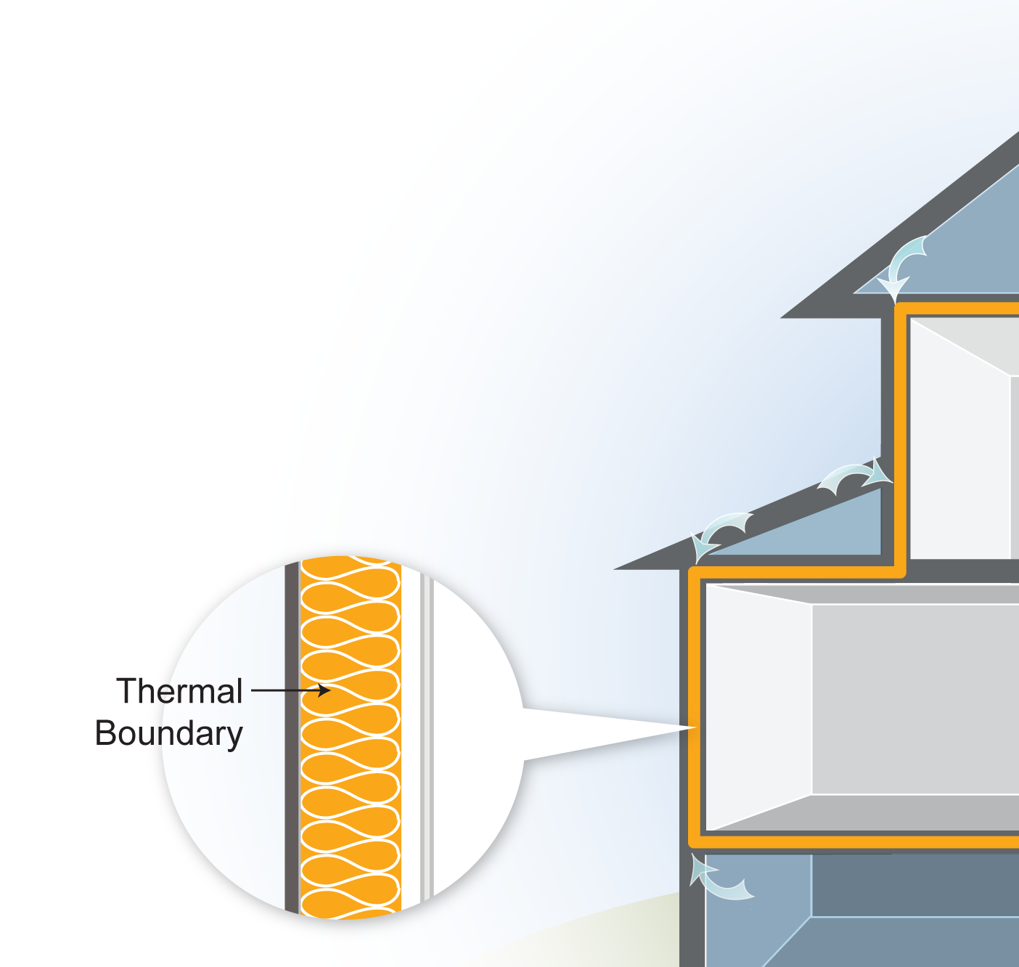
Thermal Boundary
BUILDING SCIENCE BASICS
The Thermal Boundary:
Limits heat flow between inside and outside
Easy to identify by presence of insulation
The location of insulation in relation to other building components is critical to its effectiveness
Even small areas of missing insulation are very important
Voids of 7% can reduce effective R-value by almost 50%
Notes:
The effective R-value in the attic of a 1,000-square-foot, single-story rambler insulated to R-38 falls to an effective R-value of only 19 when 70 square feet of insulation is pushed aside.
The thermal boundary is the insulation. Common materials include fiberglass batts, blown-in cellulose, and vermiculite in some older homes. If the thermal and air boundaries are continuous and in contact with each other, air will not pass through the insulation.
It is quite common for cold air to bypass the insulation, not just in low-income homes, but in large new homes as well.
Q: What materials are both the thermal boundary and the air barrier?
A: Foam board, spray foam, and dense-pack cellulose insulation, properly installed, greatly reduce airflow.

Slide 10
Notes:
The thermal boundary is usually easy to identify.
Q: Where is the air barrier?
A: The air barrier cannot always be determined through visual inspection. Pressure diagnostics are the best way to determine the location and condition of air boundaries.

Slide 11
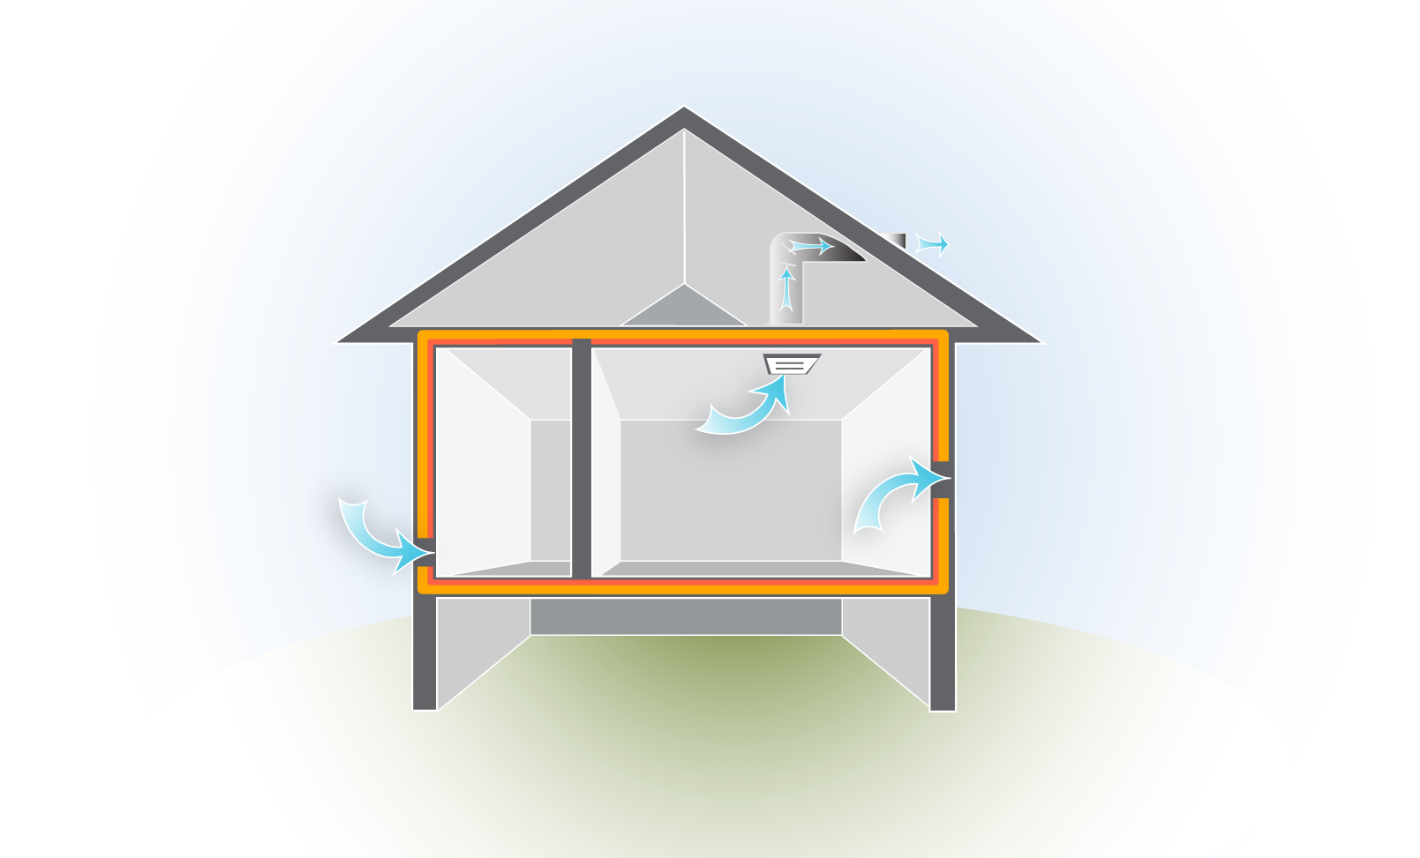
Air Leakage
BUILDING SCIENCE BASICS
Ventilation = Controlled air leakage
Infiltration = Air leaking in
Exfiltration = Air leaking out
Notes:
Q: What are some common examples of each type of air leakage?
A: Here are three common examples:
Infiltration: Cold air coming in under a door in the winter
Exfiltration: Warm air rushing up through recessed can lights into the attic in the winter
Ventilation: Bathroom fan, hood fan, heat recovery ventilation (HRV)

Slide 12
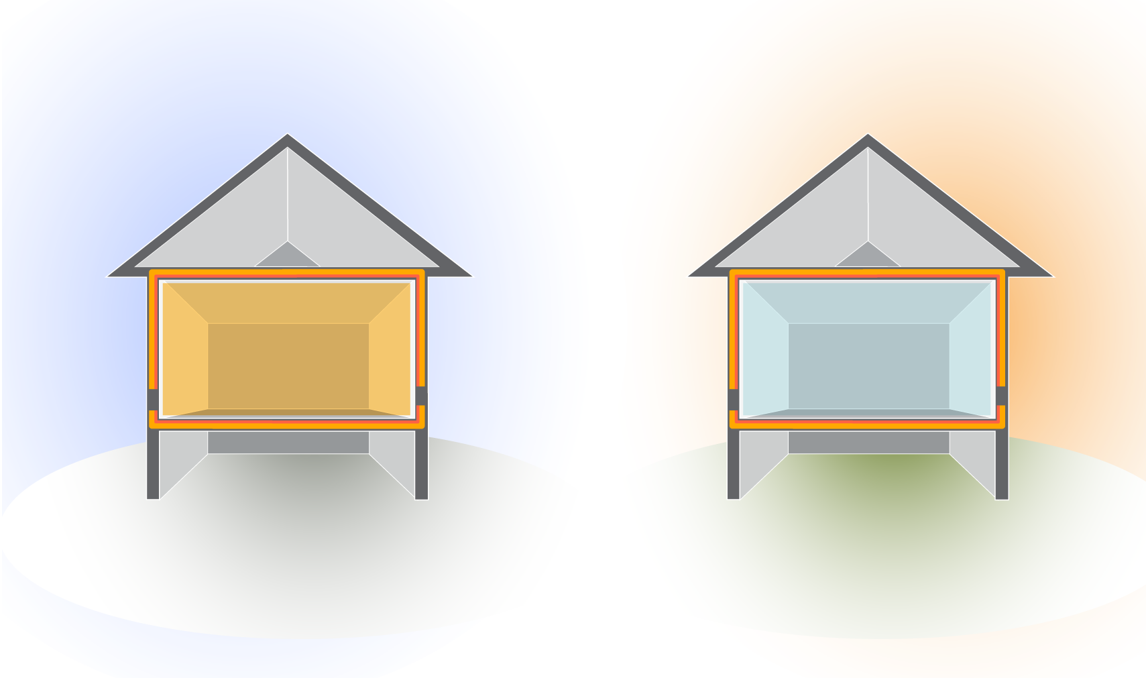
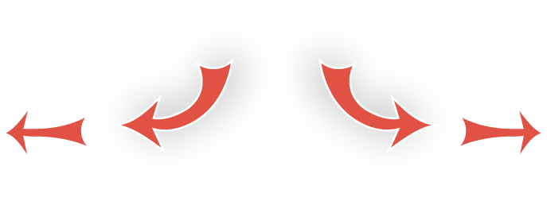
Air Leakage: Temperature
BUILDING SCIENCE BASICS
T = Temperature Difference
Winter
Summer
70°
10°
90°
70°
T=60°
T=20°
hot
cold
Flow is from _____ to _____
The higher the T, the ______ heat and air want to escape or enter the building
more
Notes:
Click ahead to reveal heat flow in winter versus summer.
Ask students to fill in the blanks before you click ahead.
The rate of heat and air transfer increases as the delta T increases. The leakage rate of a home in the summer might be 40 CFM_{natural}, but increase to 120 CFM_{natural} in the winter with the increased delta T.
Cost-effectiveness of cooling system replacements is less than for heating system replacements because of the smaller delta T.

Slide 13
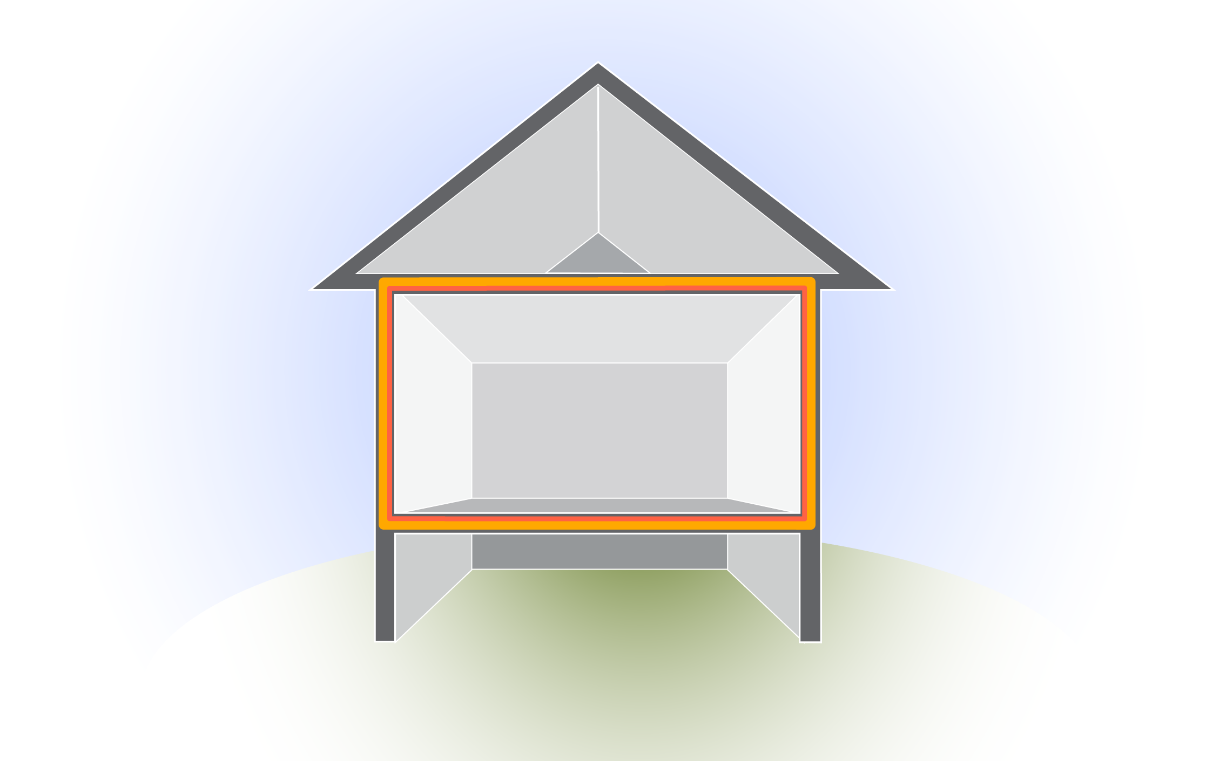
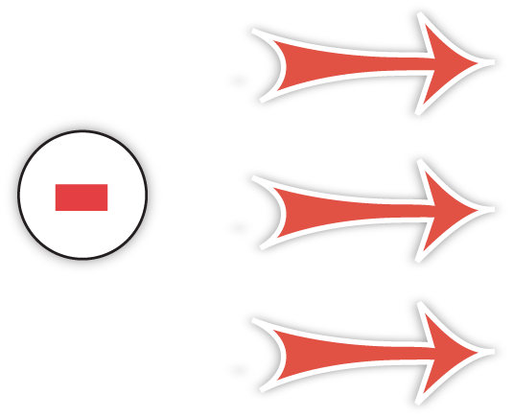
Driving Forces: Wind Effect
BUILDING SCIENCE BASICS
WIND DIRECTION
positive pressure
negative pressure
Wind creates a positive pressure on the windward side of the building . . .
Which creates a negative pressure on the other sides of the house
Notes:
Wind creates a positive pressure on the windward side of the building, which creates a negative pressure on the other sides of the house.
The leeward (protected) side of the house has negative pressure that sucks air out of the house. This is why during big storms, people will crack the windows open to equalize pressure and reduce the chances of windows blowing in or out.
During blower door tests, the hose taking external readings must be thrown clear of the wind path created by the blower door fan to avoid faulty readings due to the wind effect.

Slide 14
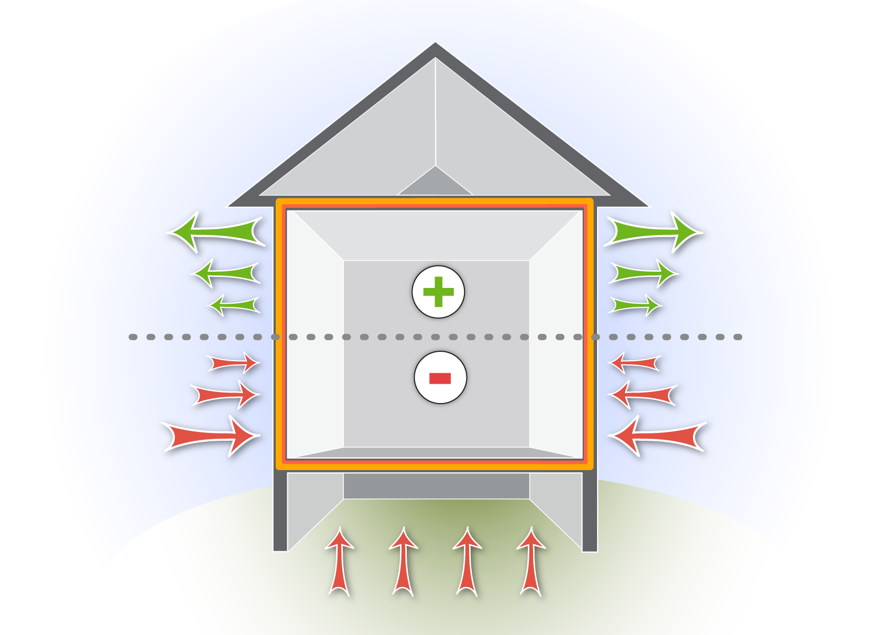
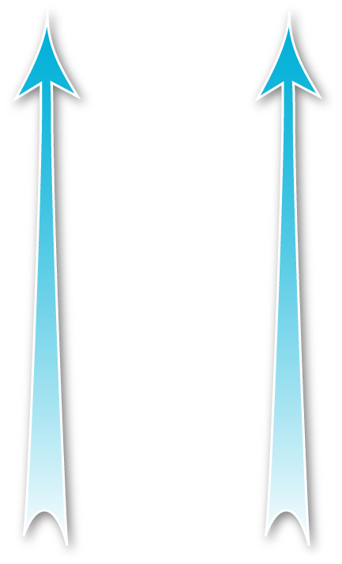
Driving Forces: Stack Effect
BUILDING SCIENCE BASICS
Stack Effect
Warmer air rises and escapes out of the top of the house. . .
Which creates a suction that pulls in outside air at the bottom of the house
positive pressure
Neutral pressure plane
negative pressure
Notes:
Click to reveal airflow rising to top and entering through bottom.
Q: What is a useful version of stack effect?
A: Proper draft of a chimney

Slide 15
Summary
BUILDING SCIENCE BASICS
Pressure and thermal boundaries should be continuous and in contact with each other
Air carries heat and moisture
Air leakage requires a hole and pressure difference
Wind, heat and fans drive pressure differences
Duct location and condition can cause room pressure imbalances
Blower door is a controlled driving force for quantifying air leakage

Slide 16
Modules
Installer Fundamentals
Installer Intermediate
Installer – Mobile Homes
Energy Auditor – Single Family
Energy Auditor - Multifamily
Crew Chief
Technical Monitoring/Inspecting
Train the Trainer
Heating System Training for Energy Auditors and Inspectors
Multifamily Specialties

Slide 17
Questions?
Kelly Cutchin
kcutchin@sms-results.com
202.558.9742

