Slide 1
Inspector’s Toolbox
QUALITY CONTROL INSPECTOR
WEATHERIZATION ASSISTANCE PROGRAM STANDARDIZED CURRICULUM – September 2012

Slide 2
Learning Objectives
INSPECTOR'S TOOLBOX
By attending this session, participants will be able to:
Identify the necessary inspection tools, equipment, and their use.
Explain the purpose of various tools used by inspectors.
Discuss the importance of following manufacturer’s recommendations for care and maintenance of tools and equipment.
Notes:
By attending this session, participants will be able to:
Identify the necessary inspection tools, equipment, and their use.
Explain the purpose of various tools used by inspectors.
Discuss the importance of following manufacturer’s recommendations for care and maintenance of tools and equipment.

Slide 3
Inspector’s Hand Tools
INSPECTOR'S TOOLBOX
Photo courtesy of The US Department of Energy
Notes:
This is a photo of assorted hand tools (clockwise from lower left):
Telescoping ladder – lightweight and convenient; easy to maneuver in tight quarters
Phillips head screwdriver
Cutting pliers
Slotted screwdriver
Adjustable wrench
Razor knife
25-ft. tape measure
A good flashlight and spare batteries
Digital camera
Pen and paper
Hand out “Tool and equipment list.” Give students a few minutes to look it over. Then ask what may be missing.

Slide 4
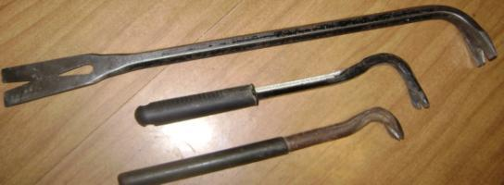
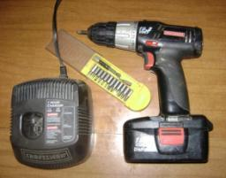
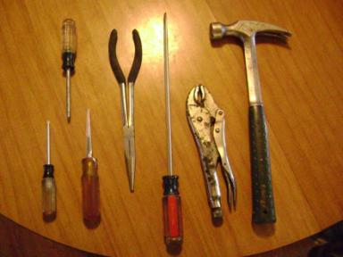
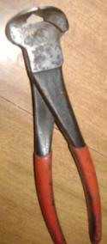
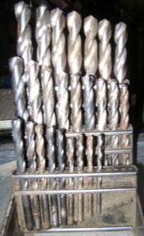
Other Specialized Tools
INSPECTOR'S TOOLBOX
Photo courtesy of The US Department of Energy
Notes:
Some situations call for a specific tool (clockwise from upper left).
Pry bars and nail pullers
Cordless drill with assorted drivers
Drill bit index
Nippers with the face ground flat – used to pull nails from cement board siding
Hammer
Locking pliers
Long reach flat blade screwdriver
Long reach pliers
Reamer – to enlarge the smoke pipe hole when testing heating appliance efficiency.
Square bit driver – used for mobile home siding
Star bit driver – used for mobile home siding
As with any and all tools, keep them clean, dry, and in a secure location. Occasionally apply light oil to friction surfaces.

Slide 5
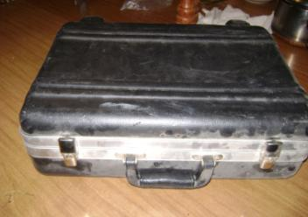
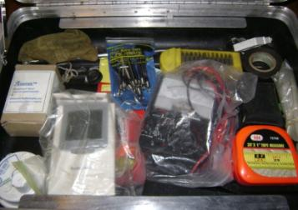
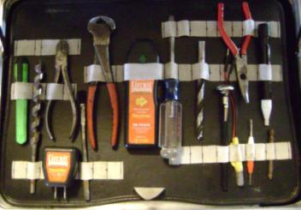
Tool Case
INSPECTOR'S TOOLBOX
Photos courtesy of The US Department of Energy
Notes:
An organized case with a place for everything makes your tools easy to find. It also reduces the chance of leaving a tool behind.

Slide 6
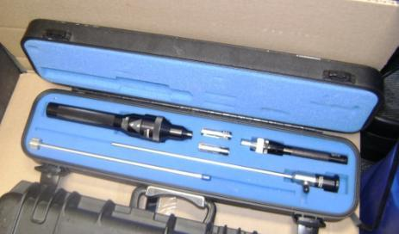
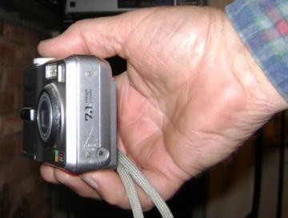
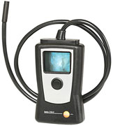
Vision Enhancers
INSPECTOR'S TOOLBOX
Borescope
Digital camera
Testo Video Pro
Photos courtesy of The US Department of Energy
Notes:
Sometimes we can’t see everything with the naked eye (clockwise from lower left):
Digital camera − A digital camera is like an eye on the end of your arm. Any place into which your hand will fit, you can see into.
Borescope − The borescope was designed to inspect the inside of diesel engines. The tube can be inserted through a 3/8 in. hole to view wall and ceiling cavities, etc.
Borescope with video − The Testo “Video Pro” is a borescope with a flexible tube for viewing inside cavities. It produces a video picture on the 3.5 in. screen.
Q: What’s a simple alternative to the above named devices?
A: Flashlight and mirror.

Slide 7
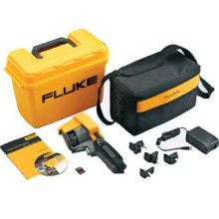
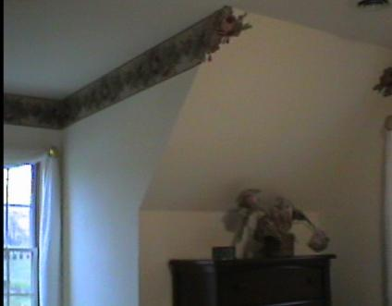
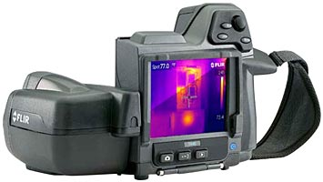
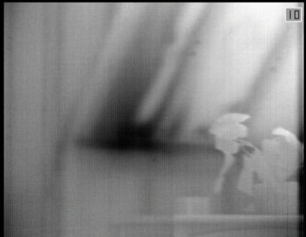
Infrared Imagers
INSPECTOR'S TOOLBOX
Fluke Infrared
Flir Infrared
Photos courtesy of PA Weatherization Training Center
Infrared imagers help auditors determine:
Air leakage and presence of insulation in inaccessible building cavities.
Effectiveness of the thermal boundary.
Cold Air
Photos courtesy of www.fluke.com and www.flir.com
Notes:
An infrared imager is an important diagnostic tool to help auditors determine:
Air leakage and presence of insulation in inaccessible building cavities.
Effectiveness of the thermal boundary.
Infrared imagers shown on left represent equipment that allows auditors and quality control inspectors to observe and document thermal flaws in the building envelope. Imagers ranging in price from $2,000 to $8,000, produce moderate to superb imagery and offer a wide variety of features.
Top Right Photo − A visible image of a knee wall and window dormer detail.
Bottom Right Photo − An infrared scan of the same area with the blower door running showing air leakage at the intersection of the knee wall and rafter cavity.

Slide 8
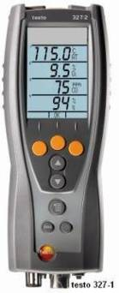
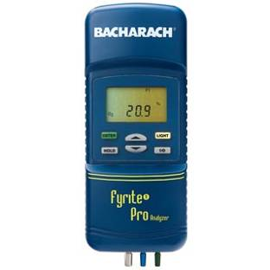
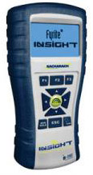
Combustion Analyzers
INSPECTOR'S TOOLBOX
Bacharach Fyrite Pro
Bacharach Fyrite Insight
Testo 327-1
Photos courtesy www.bacharach-inc.com and www.testo .com
Notes:
A wide range of combustion analyzers are available. Combustion analyzers are designed to sample flue gases in vented combustion appliances. They typically measure:
Flue gas temperature.
Oxygen.
Draft.
Carbon monoxide (CO) in ambient air or flue gases.

Slide 9
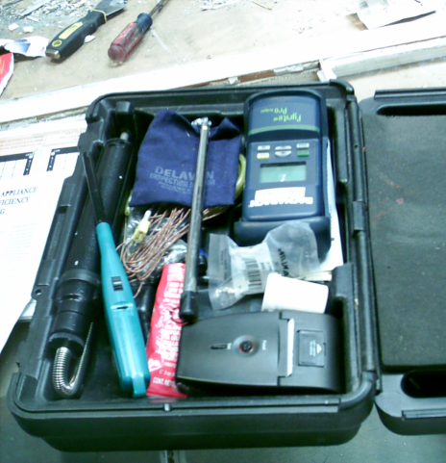
Combustion Appliance Test Kit
INSPECTOR'S TOOLBOX
Keep one case just for combustion testing.
Smoke pump and filter paper
Lighter
Combustion analyzer and manual
High-temp sealant
Appropriate drill bits for test holes
Photo courtesy of The US Department of Energy
Notes:
This photo shows combustion test equipment stored in a case.
Keep one case just for combustion testing. Pictured in this case:
Smoke pump and filter paper
Lighter
Combustion analyzer and manual
High-temp sealant
Appropriate drill bits for test holes
Organization makes the job of inspecting efficient and enjoyable.
As with all hand tools, it is better to have an assigned slot for each item so it is obvious when something is missing or out of place.

Slide 10
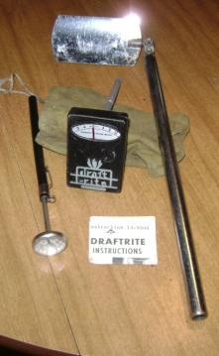
Combustion Appliance Testing
INSPECTOR'S TOOLBOX
Photos courtesy of The US Department of Energy
Above (left to right):
Thermometer
Draft gauge
Inspection mirror
Above counter-clockwise from lower left:
Pipe wrenches
Long lighter
Gas leak detector
Inspection mirror
Gas leak detection bubbles
Smoke pump and smoke test filter paper
Combustion analyzer
Notes:
These are the components of a typical combustion testing toolkit.
Picture on the left, left to right:
Thermometer
Draft gauge
Inspection mirror
Picture on the right, counter-clockwise from lower left:
Pipe wrenches
Long lighter
Gas leak detector
Inspection mirror
Gas leak detection bubbles
Smoke pump and smoke test filter paper

Slide 11
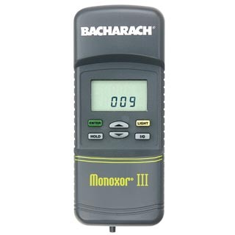
Gas Cook Stove Testing
INSPECTOR'S TOOLBOX
Photos Courtesy of NRCERT
Bacharach Monoxor III
A portable flue section concentrates combustion byproducts for an accurate CO measurement.
Photos courtesy of www.bacharach-inc.com and US Dept. of Energy
Notes:
A single purpose instrument such as the Bacharach Monoxor III shown above is useful for measuring concentrations of CO in ambient air or unvented gas cook stoves.
A portable flue section concentrates combustion byproducts for an accurate CO measurement.
Calibrate or “zero” the instrument in outside air before testing.
To protect yourself and the client, continually monitor CO in the ambient air. If CO exceeds 35 ppm as measured, stop the test immediately.
Recommend remedial action when CO levels from the burners exceed 25 ppm and 100 ppm in ovens.
As always, follow manufacturer recommendations for routine care and maintenance of the instrument.

Slide 12
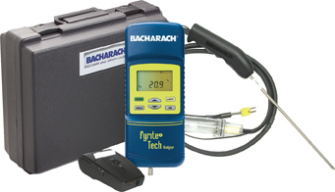
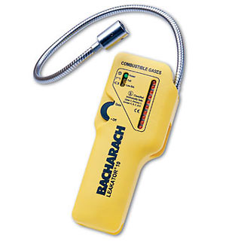
Combustion Equipment Care
INSPECTOR'S TOOLBOX
Combustion analyzers:
Calibrate every six months.
Replace O sensors every one to two years.
Carbon monoxide detectors:
Calibrate to outside air.
Replace CO sensors every three to five years.
Gas leak detectors:
Test with the gas from a cigarette lighter.
Fyrite Tech, Bacharach
Gas Leak Detector, Bacharach
Notes:
Combustion analyzers – calibrate at regular intervals according to manufacturer recommendations.
Replace oxygen sensors every one to two years.
Carbon monoxide detectors – calibrate to outside air.
Replace carbon monoxide (CO) sensors every three to five years.
Gas leak detectors – test with the gas from a cigarette lighter.
Hand out and review “Instrument Maintenance.”
In general, follow manufacturer guidelines on maintenance and calibration schedules. Document all repairs and upgrades.

Slide 13
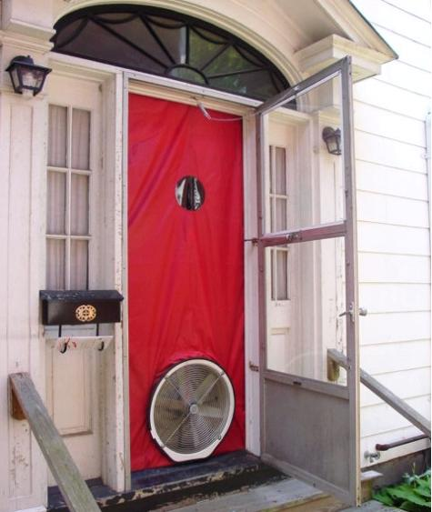
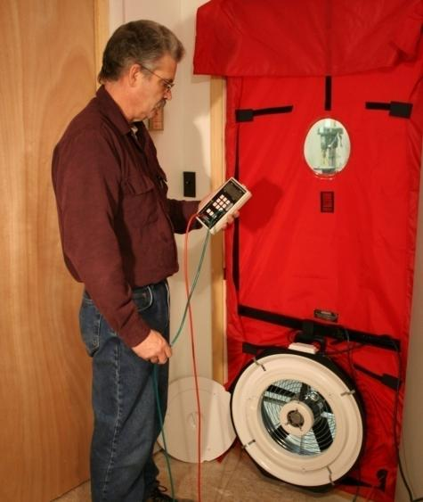
Blower Door
INSPECTOR'S TOOLBOX
Photos courtesy of The US Department of Energy
Notes:
A blower door (for locating air leakage sites) with a manometer (to check the relative leakage in each zone) is absolutely essential for performing an energy audit.
The blower door is one of the most important tools at the auditor’s command.
There are several blower door manufacturers. The pictured unit is from the Energy Conservatory. All consist of:
Fan and controls,
Shroud and frame, and
Pressure gauges or manometer.

Slide 14
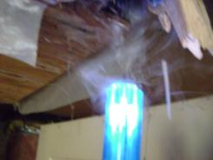
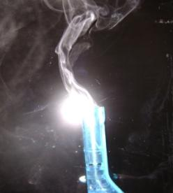
Smoke Generating Device
INSPECTOR'S TOOLBOX
Wizard Stick
Photos courtesy of The US Department of Energy
Notes:
Used in conjunction with a blower door or during the operation of a forced air distribution system, the use of a smoke-generating device can help the inspector find air leakage and duct leakage. A smoke test is performed by depressurizing the house to 30 Pascals (Pa) and then walking from room to room, creating smoke. The smoke will stream from any opening connected to the outside.
The pictured “Wizard Stick” is actually a child’s toy and produces totally non-toxic smoke. While the smoke is not heat neutral, as is the frequently used chemical titanium tetrachloride smoke, it won’t harm anyone. Notice how the smoke is moving toward the ceiling opening in the picture in the upper right of the slide.
It is possible to find attic bypasses from the attic side by depressurizing the house and then creating smoke in the attic. Again, the smoke will stream to any openings connected to the living space.

Slide 15
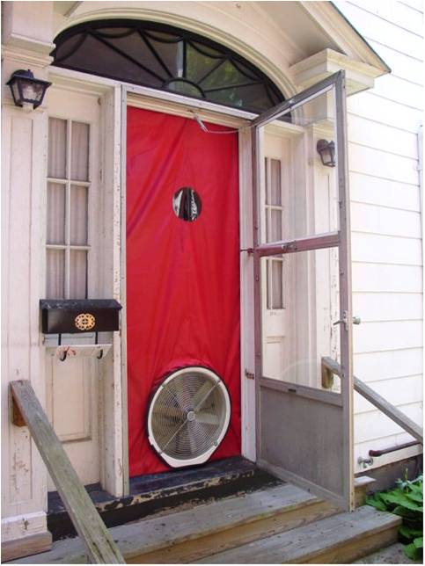
Blower Door Care
INSPECTOR'S TOOLBOX
Fan housings that are cracked or misaligned will likely cause false test results.
Minneapolis Model 3 Blower Door
Photo courtesy of The US Department of Energy
Notes:
Fan housings that are cracked or misaligned will likely cause false test results.
The blower door fan housing has a calibrated opening that can be damaged. Dropping the fan or tossing it into the back of a truck may damage the housing or shift the motor in its bracket. This will cause the fan to go out of calibration. When in doubt, test the fan unit against a known good fan. They should both produce the same reading. Swap the fan units and use the same manometer.

Slide 16
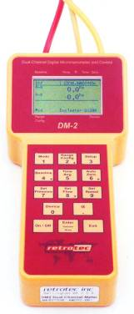
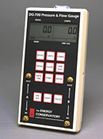
Manometers
INSPECTOR'S TOOLBOX
DG-700
(Energy Conservatory)
DM-2
(Retrotec)
Photos courtesy of The Energy Conservatory and Retrotec
Notes:
The manometers pictured are digital devices that measure pressures. They can convert that pressure to flow readings when used in conjunction with associated fans or other devices.
They are used to measure:
Leakage rate of building shell.
Zonal pressure differences.
Fan flow rates.
Duct leakage.
Chimney draft.

Slide 17
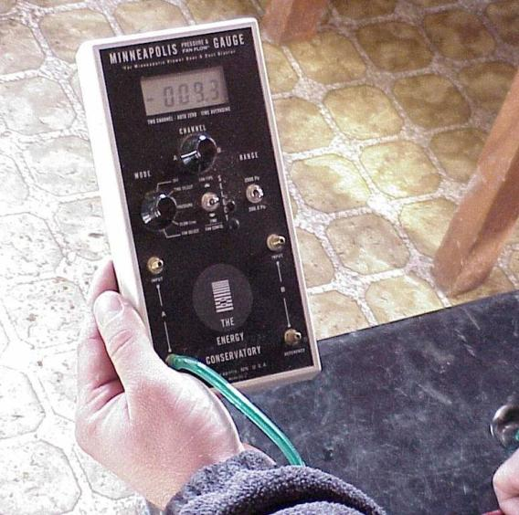
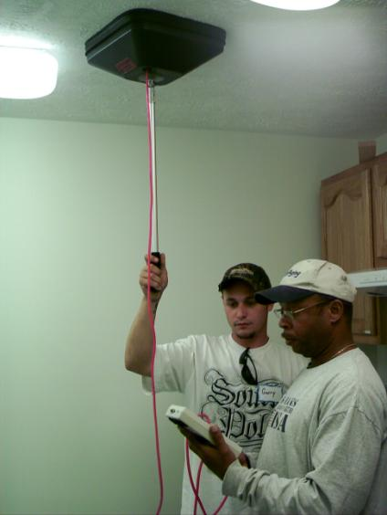
Pressure Pan
INSPECTOR'S TOOLBOX
Photo courtesy of The US Department of Energy
Photos courtesy of US Dept. of Energy
Notes:
A pressure pan is a gasketed pan with a pressure tap used in connection with the blower door and a manometer.
It is used to quantify duct leakage to outdoors. Placing the pan over any envelope opening such as a duct register or wall outlet while the house is depressurized will measure the degree of “connectivity” to the exterior.
A pressure pan may be constructed from a shallow cake pan with a stick-on foam gasket and a tap or purchased from diagnostic equipment companies who also manufacture blower doors.
Q: How many of you are routinely using pressure pans as part of your auditing protocols?
Reference the section on “how to” in the chapter on Building Assessment.

Slide 18
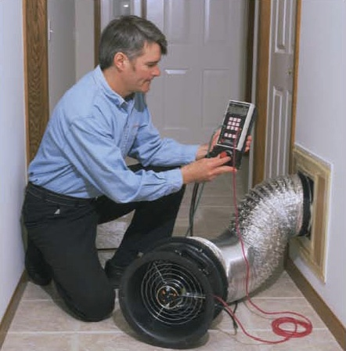
Duct Blaster
INSPECTOR'S TOOLBOX
Use duct pressurization testing to quantify:
Total duct leakage.
Duct leakage to outdoors.
Photo courtesy of Energy Conservatory
Notes:
Use duct pressurization testing to quantify:
Total duct leakage.
Duct leakage to the outdoors.
By pressurizing ducts on forced air systems with a duct blaster, you can measure total duct leakage as expressed in CFMs of airflow at a standardized pressure difference of 25 Pa.
When used in conjunction with a blower door, you can measure duct leakage to the outdoors. Assessing duct leakage to the outdoors is much more important than total duct leakage because of the energy penalty associated with the loss of conditioned air to the outdoors.
Note: Duct pressurization testing is not commonly used in the DOE WAP program but is required for quantifying duct leakage when performing “Home Performance with Energy Star” audits and some utility-funded programs.

Slide 19
Zonal Pressure Diagnostics
INSPECTOR'S TOOLBOX
Conduct zonal pressure diagnostics and interpret results to determine:
Location and effectiveness of the air barrier.
Alignment of air barrier and thermal boundary.
If the pressure of the main house with reference to the garage indicates serious leaks between the two zones.
Photo courtesy of PA Weatherization Training Center
Photo courtesy of PA WTC
Notes:
Conduct zonal pressure diagnostics (ZPD) and interpret the results to determine:
The location and effectiveness of the air barrier.
Whether the air barrier and thermal boundary are aligned.
If the pressure of the main house with reference to the garage or other connected space indicates serious leaks between the two zones.
Note: Refer to the “Blower Door Basics” section of the Installer Fundamentals curriculum and the “ZPD” section of the Energy Auditor – Single Family curriculum for more information on ZPD.

Slide 20
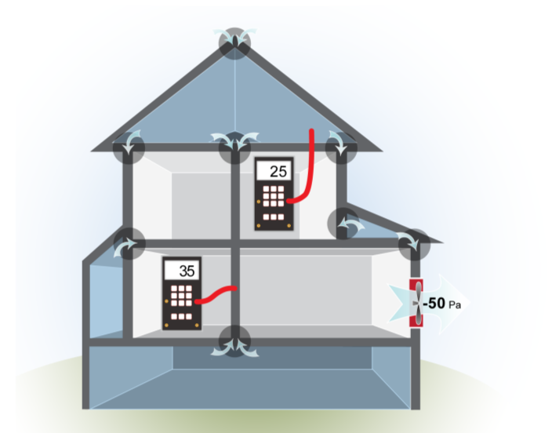
Zonal Pressure Diagnostics
INSPECTOR'S TOOLBOX
Unsealed/Uninsulated
Two-story balloon-framed house with one-story addition and unheated porch over unconditioned basement
Graphic developed for the US DOE WAP Standardized Curricula
Notes:
This is an illustration of a two-story, balloon-framed house with a one-story addition, and an unheated porch over an unheated basement.
The house is unsealed and uninsulated; zonal testing reveals connections between the floor and wall framing.
Define the thermal boundary. What’s inside? What’s outside?
Decide how to align the air and thermal boundaries. If the zones are NOT where they are supposed to be, seal holes between the inside and outside.
Note the pressure differences across the attic ceiling and interior wall. The arrows indicate there may be a connection between the house, the attic, and possibly the basement.

Slide 21
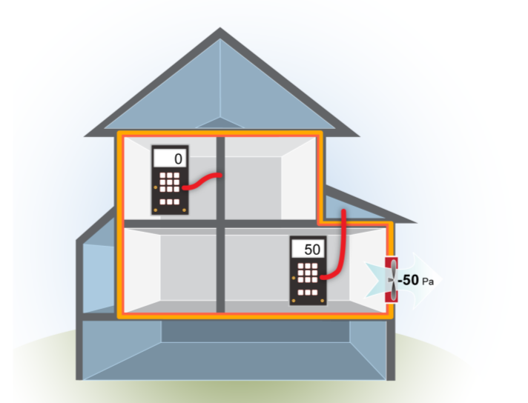
Zonal Pressure Diagnostics
INSPECTOR'S TOOLBOX
Sealed/Insulated
Air-sealed/insulated with air barrier and insulation in alignment
Graphic developed for the US DOE WAP Standardized Curricula
Notes:
The insulation is aligned with the air barrier.
The new thermal boundary includes all the surfaces that separate conditioned from unconditioned spaces. This is verified by pressure testing to the outside zones. If the installers have done a good job, outside zones should read close to 50 Pa. Inside zones should be close to 0 Pa.

Slide 22
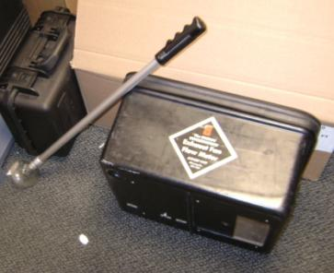
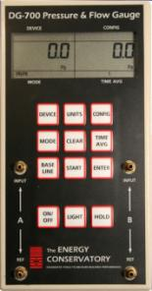
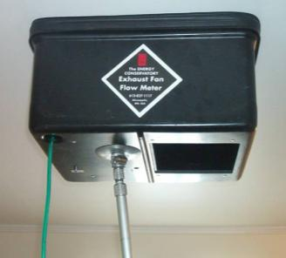
Measuring Exhaust Fan Flow
INSPECTOR'S TOOLBOX
Energy conservatory exhaust fan flow meter with DG-700 pressure and flow gauge
Photos courtesy of The US Department of Energy
Notes:
The exhaust fan flow meter (the one shown here is manufactured by the Energy Conservatory) is really a calibrated pressure pan. It requires a DG-700 pressure gauge. It is an inexpensive tool to accurately measure exhaust fan flow as required by ASHRAE 62.2, but it will measure exhaust intake only. It will not work by placing it over a fan discharge.
To use, set the DG-700 to pressure/flow and connect the flow meter tap to the upper left manometer tap. Place the meter pan over the (running) fan intake. Adjust the meter opening until a pressure reading between one and eight on the left-hand DG-700 screen is achieved. Move the meter hose to the flow tap on the upper right, and read the fan CFM on the screen above.
Having both a pressure pan and an exhaust fan flow meter isn't necessary. The flow meter’s adjustable opening can be closed so the flow meter will function as a pressure pan if desired.

Slide 23
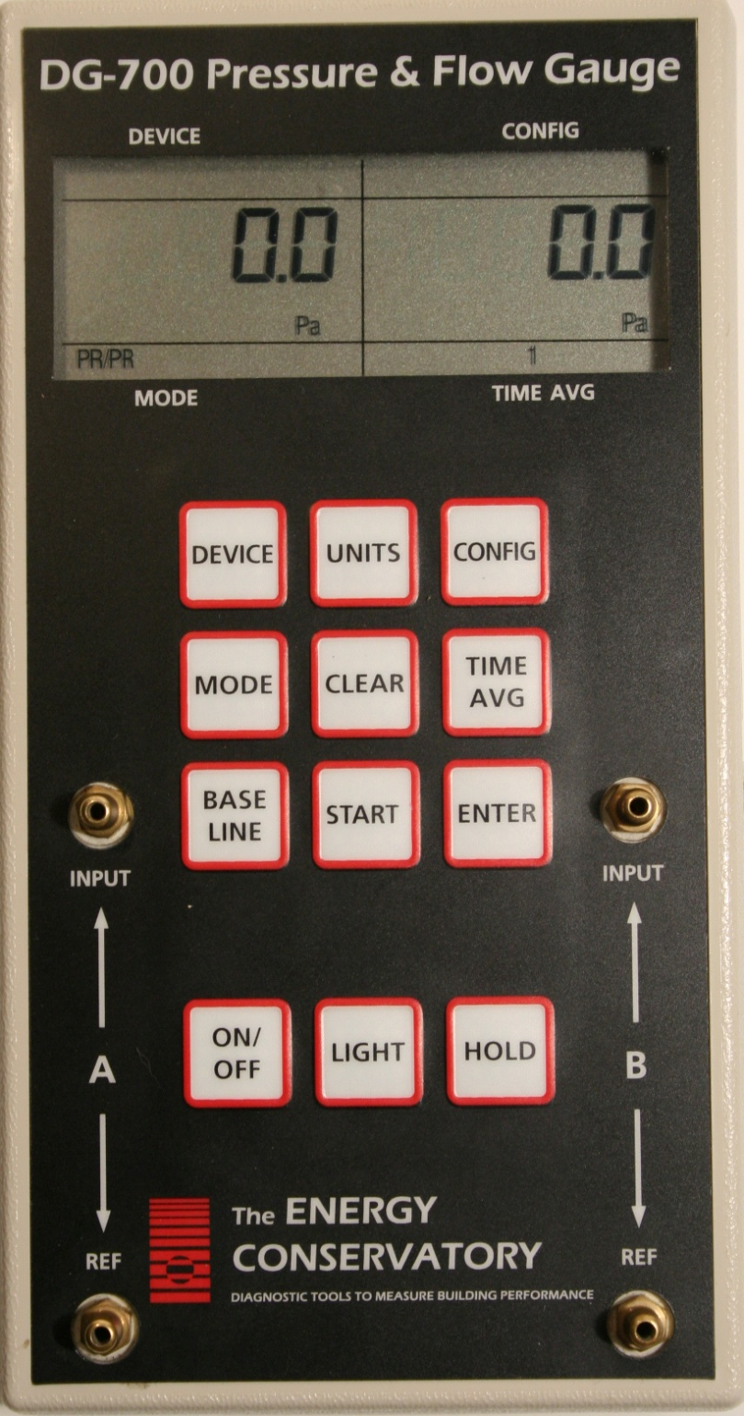
Digital Manometer
INSPECTOR'S TOOLBOX
Calibrate every six months.
Return to the manufacturer
or
Calibrate with another digital manometer of the same type
DG 700 Manometer, The Energy Conservatory
Notes:
A digital manometer should be calibrated every six months.
Return to the manufacturer for calibration, or
Calibrate with another digital manometer of the same type.
Hand out and review “Procedure for Field Calibration Check of Digital Pressure Gauges” and “Operation and Maintenance Tips for Energy Conservatory Test Instruments” or similar instructions for whatever tools are most common for the class participants.

Slide 24
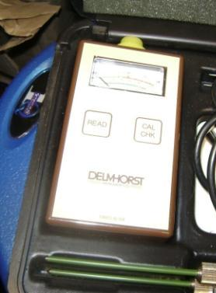
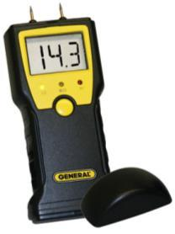
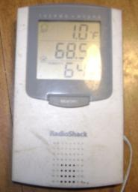
Moisture Assessment
INSPECTOR'S TOOLBOX
“Pin” or “Non-Contact” moisture meters
Indoor/outdoor thermometer
Photos courtesy of US Dept. of Energy and www.generaltools.com
Notes:
Auditors typically assess moisture by visual observation only, but more accurate information is sometimes required. Pictured left to right:
Pin meter, also called a “non-contact moisture meter.” This works by reading electrical “connectivity” between the two pin points when the points are pressed into a hard surface, such as wood. It has two sets of probes, long and short. The long probes are used to measure surfaces behind insulation without removing the insulation.²
The black and yellow unit has the short probes only. It is smaller and less expensive.³
The indoor/outdoor thermometer on the right also has an electronic relative humidity (RH) output.⁴ It’s sufficiently accurate for everything but research and much less fragile than a sling psychrometer.
²Pictured model manufactured by Delmhorst.
³Pictured model manufactured by General.
⁴Pictured model found at Radio Shack.

Slide 25
Moisture Meters
INSPECTOR'S TOOLBOX
Photos courtesy of PA WTC
Notes:
Moisture meters measure the moisture level in wood and other building materials.
In these photos, readings are taken to determine the level of moisture in the floor framing and carpet directly above a waterlogged basement.
Left photo: A contact moisture meter reads the moisture content of the floor framing. Contact meters penetrate the materials to take readings from beneath what may appear to be a dry surface. The pins leave small holes in the walls or framing.
Right photo: A non-contact meter reads the moisture level of the floor framing below the carpet being measured from above.
A pocket knife is also useful in determining moisture levels in wood. Wet lumber is softer than dry lumber and the blade of a pocket knife will penetrate saturated wood quite easily.

Slide 26
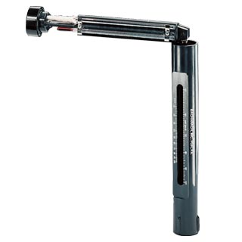
Measuring Relative Humidity
INSPECTOR’S TOOLBOX
Sling Psychrometers
Two thermometers side by side
One is wrapped in wet wick (wet bulb), the other is dry (dry bulb)
Spinning it around speeds temperature stabilization
Plot wet bulb and dry bulb temperature on psychrometric chart to determine dew point and RH
Bacharach Sling Psychrometer
http://www.bacharach-inc.com/sling-psychrometer.htm
Notes:
We can measure RH with a sling psychrometer.
A sling psychrometer has two thermometers side by side, one with a wetted wick around a bulb (the wet bulb) and one without (a dry bulb). Spinning the psychrometer in the air speeds the temperature stabilization process.
Because heat is absorbed by evaporation, the wet bulb registers a lower temperature than the dry bulb. The evaporative cooling effect means the dryer the air, the lower the wet bulb temperature with reference to the dry bulb.
The point where the wet bulb temperature stabilizes is the wet bulb temperature.
Plotting the two temperatures on a psychrometric chart gives dew point and relative humidity.
Demonstrate using a sling psychrometer if one is available.

Slide 27
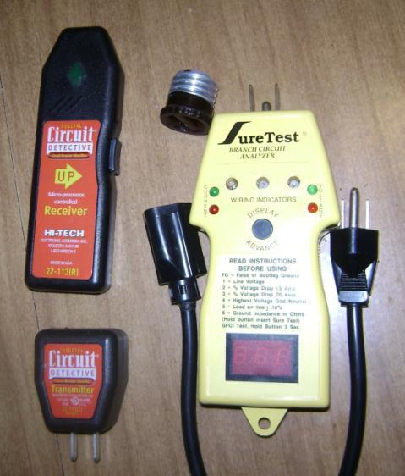
Circuit Testing & Tracing
INSPECTOR'S TOOLBOX
Live wire tester
Circuit tracer determines which fuse/breaker controls which circuit.
SureTest Circuit Tester
Photos courtesy of US Dept. of Energy
Notes:
Pictured from left to right:
The tip of the live wire tester turns red whenever it is placed near a live wire. It is most useful to determine if wiring, particularly knob and tube wiring, is still live.
The circuit tracer is a two-part tool. It is used to determine which fuse or breaker controls a circuit. This is useful when some circuits may be affected by installing insulation. Plug the lower unit into an outlet on the circuit in question. When moved past circuit breakers or fuses in the entrance box, the upper unit will indicate which breaker/fuse serves the outlet.⁵
The SureTest Circuit Tester tells users the percent overload on a given circuit, among other outputs.
⁵Pictured model found at Radio Shack.

Slide 28
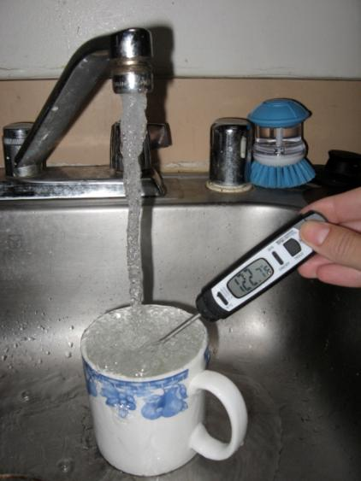
Instant Read Thermometer
INSPECTOR'S TOOLBOX
To adjust DHW temperature:
Mark original position of dial.
Verify water temperature.
Set back to 120°F.
Adjust as needed.
Photo courtesy of US Department of Energy
Notes:
An instant read thermometer helps the inspector/monitor determine if the domestic hot water temperature is appropriate for the home.
Many clients have the temperature set as high as 140°F, though 120°F is adequate for most homes. The lower temperature saves energy and prevents scalding.

Slide 29
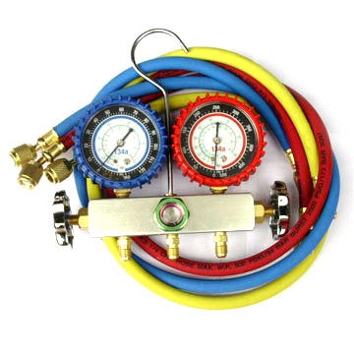
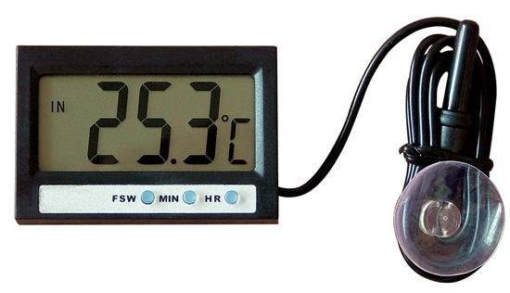
Refrigerant Testing
INSPECTOR'S TOOLBOX
Required equipment for testing/adjusting
DOT recovery cylinder for removal
Refrigeration gauge set
Digital thermometer with wet cloth (for wet bulb) or sling psychrometer
www.germes-online.com/
www.czgauge.com/
Notes:
Required equipment for testing/adjusting refrigerant includes:
Refrigeration gauge set.
Digital thermometer with wet cloth (for wet bulb reading) or sling psychrometer.
A DOT recovery cylinder for removal of excess refrigerant.

Slide 30
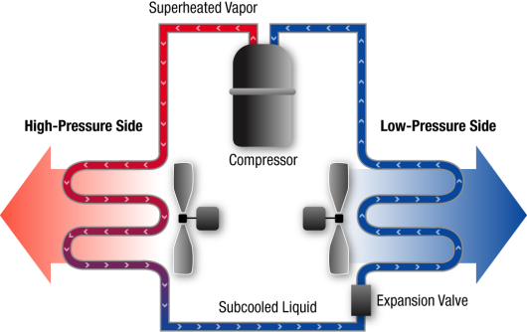
Refrigerant Charge Testing
INSPECTOR'S TOOLBOX
Superheat test:
Use for fixed-orifice or capillary tube system
Airflow must be ≥ 400 CFM per ton
Outdoor temperature must be ≥ 60°F
Charge checking at very high outdoor temperatures not recommended
Subcooling test:
Use for thermal expansion valve system
Outdoor temperature must be ≥ 60°F
Air conditioner or heat pump should be running in cooling mode for at least 10 minutes prior to testing
Superheat is the temperature difference between the evaporator and the compressor inlet.
Subcooling is the temperature difference between the middle of the condenser and the liquid service valve outside.
Image Courtesy of Energy Out West Weatherization Field Guide. Copyright Saturn 2009 www.srmi.biz
Notes:
Refrigerant charge testing is only relevant in cooling climates, and largely falls to specialized contractors, but it benefits the quality control inspector to know what should have been done.
Technicians must use different tests depending on the valve system.
Subcooling is the temperature difference between the middle of the condenser and the liquid service valve outside.
Subcooling Test:
Use for a thermal expansion valve system.
The outdoor temperature must be ≥ 60°F.
The air conditioner or heat pump should be running in cooling mode for at least 10 minutes before testing.
Superheat is the temperature difference between the evaporator and the compressor inlet.
Evaporator Superheat Test:
Use for a fixed-orifice or capillary tube system.
Airflow must be ≥ 400 CFM per ton.
Outdoor temperature must be ≥ 60°F, but checking the charge at very high outdoor temperatures is not recommended.
Energy OutWest Weatherization Field Guide, 2005. Copyright Saturn 2009. www.srmi.biz.

Slide 31
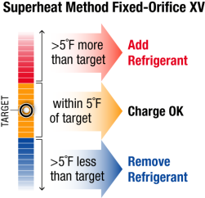
Refrigerant Charge Superheat Test
INSPECTOR'S TOOLBOX
Use Evaporator Superheat Test for capillary- tube or fixed-orifice expansion devices, operating in the cooling mode.
Verify adequate airflow.
Measure dry bulb temp of air entering outdoor coil.
Measure wet bulb temp of return air at air handler.
Use superheat table to determine recommended superheat temp.
Measure and evaluate compressor-suction pressure at suction service valve.
Measure and evaluate suction line temperature.
If superheat temp is high, add refrigerant, wait 10 minutes. Repeat test.
If superheat temp is low, remove refrigerant, wait 10 minutes. Repeat test.
For more complete instructions, refer to Section 3.8 of the Energy OutWest Field Guide.
Image courtesy of Energy Out West Weatherization Field Guide. Copyright Saturn 2009 www.srmi.biz
Notes:
Use the Evaporator Superheat Test for capillary-tube or fixed-orifice expansion devices operating in the cooling mode.
Verify adequate airflow.
Measure the dry bulb temperature of air entering the outdoor coil.
Measure the wet bulb temperature of return air at the air handler.
Use the superheat table to determine the recommended superheat temperature.
Measure and evaluate compressor-suction pressure at the suction service valve.
Measure and evaluate the suction line temperature.
If the superheat temperature is high, add refrigerant, wait 10 minutes, and repeat the test.
If the superheat temperature is low, remove refrigerant, wait 10 minutes, and repeat the test.
For more complete instructions, see section 3.8 of the Energy OutWest Field Guide.

Slide 32
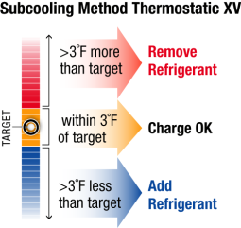
Refrigerant Charge Subcooling Test
INSPECTOR'S TOOLBOX
Use Subcooling Test for Thermal Expansion Valve (TXV) Devices
Image courtesy of Energy OutWest Weatherization Field Guide. Copyright Saturn 2009 www.srmi.biz
Notes:
Use the Subcooling Test for thermal expansion valve (TXV) devices.
Measure and convert liquid pressure at the liquid service valve.
Measure the temperature of the liquid refrigerant leaving the condenser.
Subtract the liquid refrigerant temperature from the converted condensing temperature. This is the measured subcooling.
Compare to correct subcooling from permanent sticker in condenser, manufacturer’s literature, or slide-rule.
If there is more than a 3°F variation, adjust levels.
Let the system run 10 minutes and repeat the test.
For more complete instructions, see section 3.8 of the Energy OutWest Field Guide.

Slide 33
Base Load Analysis
INSPECTOR'S TOOLBOX
Indoor/Outdoor thermometer
“Watts Up Pro” meter
“Brultech Kit 60” watt meter
Photos courtesy of the manufacturers
Notes:
Left photo: “Watts Up Pro” watt meter. When attached to any operating electrical appliance, a watt meter will measure and record the watts consumed. It can be set up to extrapolate future use from a two-hour run time sample, making it very useful for projecting refrigerator and other large appliance replacements’ SIR.
Center photo: Indoor/outdoor thermometer with RH. This unit simplifies refrigerator data gathering. Place the remote bulb in the freezer and the unit in the fresh food compartment while monitoring electrical use with a watt meter. This will provide temperature data useful for refrigerator replacement evaluation and client education.
Right photo: “Brultech Kit 60” watt meter − Another example of a commercially available watt meter and recorder.

Slide 34
Class Participation – Tips from the Field
INSPECTOR'S TOOLBOX
Class Exercise
(15 minutes)
Notes:
Tips from the field: Ask for volunteers to describe tools or professional equipment that have made them more effective inspectors.

Slide 35
Equipment Calibration Schedule
INSPECTOR'S TOOLBOX
Calibrate diagnostic instruments on a regular basis.
Maintain a record of calibrations and repairs for:
Digital manometer.
Combustion analysis equipment.
Gas leak detectors.
Carbon monoxide detectors.
Notes:
Calibrate diagnostic instruments on a regular basis.
Calibration means comparing the test results of an instrument to a known reference point. An example is calibrating a thermometer to the temperature of boiling water, which we know is 212ºF. If the thermometer reads 212ºF when placed in boiling water, it is properly calibrated.
Maintain a record of calibrations and repairs for the following kinds of equipment:
Digital manometer
Combustion analysis equipment
Gas leak detectors
Carbon monoxide detectors
Hand out and review “Equipment Calibration Schedule.” Ask students to volunteer examples of how often their agencies calibrate equipment.
Weatherization practitioners are armed with a variety of diagnostic equipment to test homes and guide their work. To make sure the readings we take are accurate, it’s important that this equipment be maintained and calibrated according to manufacturer recommendations. If something goes wrong in a house and the agency is called into court, the first question a lawyer may ask is, “When was the last time your diagnostic equipment was calibrated?”

Slide 36
Safety Upgrades
INSPECTOR'S TOOLBOX
Replace:
Aluminum ladders. Use industrial-rated, non-conductive fiberglass ladders.
Frayed or undersized extension cords.
Ungrounded power tools.
Hammers with mushroomed heads.
Dull drill bits, saw blades, utility knife blades.
Worn out respirators and safety glasses.
Notes:
Replace:
Aluminum ladders. Use industrial-rated, non-conductive fiberglass ladders. Aluminum ladders are conductive and may cause electrocution to the user if it comes in contact with a power source
Frayed or undersized extension cords. Undersized cords may cause premature failure of power tools. Frayed wires can cause electric shock to the person who contacts an uninsulated conductor (wire)
Ungrounded power tools. They may cause electric shock. Look for the existence of a three pronged grounding plug at the end of a power tool cord.
Hammers with mushroomed heads. Shrapnel from the hammer head may shear off on impact and injure the user.
Dull drill bits, saw blades, and utility knife blades. Dull tools are more dangerous than sharp ones because the user tends to force the tool and may lose control.
Worn out respirators and safety glasses. They must be replaced or maintained to assure personal protection.

Slide 37
Summary
INSPECTOR'S TOOLBOX
The tools shown in this lesson represent the majority of essential tools for performing an inspection on a completed house.
Scheduled tool and equipment maintenance avoids downtime and lost production.
As always, follow manufacturer recommendations for routine care and maintenance of diagnostic equipment.
Don’t get caught without spare batteries.
Notes:
The tools shown in this lesson represent the majority of essential tools for performing an energy audit on a house.
Scheduled tool and equipment maintenance avoids downtime and lost production.
As always, follow manufacturer recommendations for routine care and maintenance of diagnostic equipment.
Don’t get caught without spare batteries.
Use this summary slide as a jumping off point for an interactive discussion, time for review, and final questions.

