Slide 1
Desk Monitoring
QUALITY CONTROL INSPECTOR
WEATHERIZATION ASSISTANCE PROGRAM STANDARDIZED CURRICULUM – September 2012

Slide 2
Learning Objectives
DESK MONITORING
By attending this session, participants will be able to:
Identify applicable DOE regulations.
Discuss basic fiscal requirements about procurement.
Establish a paper trail from purchase order to final inspection.
Interpret an agency’s typical file structure.
Identify anomalies to know what to flag for on-site visits.
Practice completing typical file review forms.
Notes:
By attending this session, participants will be able to:
Identify applicable DOE regulations.
Discuss basic fiscal requirements about procurement.
Establish a paper trail from purchase order to final inspection.
Interpret an agency’s typical file structure.
Identify anomalies to know what to flag for on-site visits.
Practice completing typical file review forms.

Slide 3
Weatherization’s Mission
DESK MONITORING
Mission of the Weatherization Assistance Program
To reduce energy costs for low-income families, particularly for the elderly, people with disabilities, and people with children, while ensuring their health and safety.
Notes:
Monitoring by the Weatherization Assistance Program (WAP) is mandated by 10 CFR 440.
Monitoring—desk or on-site—need not be adversarial.
Desk monitoring typically consists of a file review of fiscal and programmatic requirements. The review has two goals: (1) verifying that procurement rules were followed; and (2) checking that the file is self-explanatory⎯that is, any competent reviewer can tell what was done to the home and why.
On-site monitoring also includes a client home visit to verify that (1) the billed materials were properly installed, (2) the chosen measures were the most cost-effective possible for the particular home, and (3) the client and home were treated with respect.
Use monitoring as a tool for determining training needs.
Always remember WAP’s goal of serving the client while fulfilling the Congressional mandate to save energy.

Slide 4
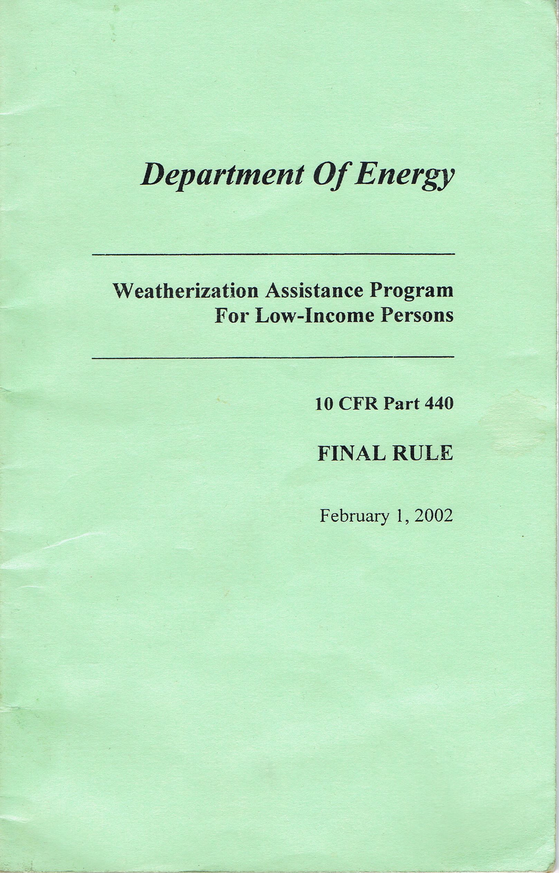
Legislation: 10 CFR 440
DESK MONITORING
The rule authorizing WAP is known as 10 CFR 440.
DOE rules are intended to guarantee taxpayer money is well spent.
The complete document is available on WAPTAC.
Notes:
DOE rules are intended to guarantee taxpayer money is well spent.
The complete 10 CFR 440 document is available on the WAPTAC website.
The rule implements a weatherization assistance program to:
Increase the energy efficiency of dwellings owned or occupied by low-income persons or to provide such persons renewable energy systems or technologies.
Reduce total residential expenditures.
Q: Name one other very important benefit provided by the WAP program besides improving energy efficiency.
A: Improve public health and safety, especially of low-income persons who are particularly vulnerable such as the elderly, persons with disabilities, and families with children.

Slide 5
Fiscal Requirements
DESK MONITORING
10 CFR 600 Covers Procurement
Weatherization files must show:
A method of selecting a contractor.
The bid process.
Three bids.
Justification for sole sourcing.
During file review check that:
Charges match bids.
Measures on final inspection match invoices.
Measures listed on client sign-off are consistent.
Notes:
Almost all purchasing decisions include factors such as delivery and handling, marginal benefit, and price fluctuations. Procurement generally involves making buying decisions under conditions of scarcity. That’s why it’s important to gather the most reliable data available and use the procurement procedures covered in 10 CFR 600.
10 CFR 600 covers procurement (§600.144 Procurement Procedures).
Weatherization files must show:
The method of selecting a contractor.
The bid process for any item not on the regular bid list.
Three bids for individual items such as heating systems.
The justification for any sole source item.
As part of the file review process, check that:
The price charged for any material or labor matches the bid.
Measures listed on the final inspection report match the contractor invoice and/or crew job report.
Measures listed on the client sign-off match the contractor invoice and/or crew job report.

Slide 6
File Organization
DESK MONITORING
Community Action Agency (CAA) files will range from highly organized to totally chaotic.
Read through the whole file to familiarize yourself with the CAA’s “style” before making any entries on the review form.
Photos courtesy of thevoyage.blogspot.com and urbanmoms.ca
Notes:
Community action agency (CAA) files will range from highly organized—count in six sheets from the cover sheet and you will find a specific form every time—to totally chaotic, such as:
Multiple copies of the same form.
Notes on scrap paper.
Blank or incomplete forms.
Missing forms.
Unreadable scrawls for signatures.
Undated and/or unsigned forms.
Read through the whole file to familiarize yourself with the CAA’s “style” before making any entries on the review form. Knowing what the CAA requires before you start can avoid a lot of erasing!

Slide 7
Minimum Contents for Client Files
DESK MONITORING
Verification of client eligibility
Client permission form
Building age documentation which may trigger:
Lead paint notification form (constructed prior to 1978)
Lead-Safe Weatherization documentation (constructed prior to 1978)
State Historic Preservation documentation (building more than 45 years old)
Mold/moisture form
Audit report
Work order a.k.a. Building Weatherization Report (BWR) or Building Job Order Sheet (BJOS)
Contractor invoice or crew materials list and hours worked
Final inspection report including any rework documentation
Client satisfaction and sign-off form
Notes:
Most client files will contain a great deal of duplicative material. Look for the essentials:
Verification of client eligibility
Client permission form
Documentation of building age, which may then require:
Lead paint notification form (if building was constructed before 1978).
Lead-safe weatherization (LSW) documentation (if building was constructed before 1978).
State historic preservation documentation (if building is more than 45 years old).
Mold/moisture form
Audit report
Work order
Invoices and/or materials list
Final inspection report, including reworks
Client satisfaction and sign-off form
Q: What other form of documentation would be extremely useful to have in a client file?
A: Digital photo documentation that reference problems or complement a specific instruction in the audit or work order.

Slide 8
File Review Essentials
DESK MONITORING
DOE required forms present
All forms legibly signed and dated
Any explanatory notes or change orders signed and dated
Unusual activities are justified:
Door or window replacement
Skipped priorities
Large expense charged to incidental purchases
Blower door or other test results not recorded
Notes:
Conducting a thorough file review is essential in ensuring there is a documented paper trail that tracks everything from the purchase order to the final inspection. The items listed in the slide show you what you should be looking for during your file review.
All forms required by DOE are present.
All forms are legibly signed and dated. Signatures and dates must be in ink, not pencil.
Any explanatory notes and change orders are signed and dated.
Unusual activities are justified:
Door or window replacement – These measures don’t typically result in SIR of one or greater at today’s prices. File should contain a valid SIR, or justification for replacement for reasons other than energy savings, and be charged accordingly.
Skipped priorities – If attic insulation is number two on the audit report, but was skipped while items with lower SIR were installed, the reason should be evident in the file.
Large expense charged to incidental purchases.
Blower door or other test results not recorded – Why not?
Q: What might a reasonable justification for not conducting a pre-Wx blower door test?
A: Presence of large amounts of friable asbestos on piping in the basement that may become airborne and enter the living space.
Q: Give examples of red flags for unjustifiable measures.
A: Windows replaced as an H&S measure.
High post Wx blower door tests indicating possible missed air sealing opportunities.

Slide 9
File Review Procedure
DESK MONITORING
Acquaint yourself with your file review form.
Read through the file and note:
Organization.
Presence of necessary forms.
Signed and dated.
Ask CAA representative to clarify any questions.
Don’t leave blanks. If inapplicable, enter “N/A”.
Use the “Notes” sections to record anything unusual to alert the on-site reviewer.
Complete, sign, and date the file review form.
Notes:
Acquaint yourself with the file review form. What information is being requested?
Read through the file and note:
Is it organized?
Are all the necessary forms present?
Are all the forms signed and dated?
Put something in every blank. (If it’s filled in, you know you’ve evaluated it!) Empty spaces indicate further searching is needed. If a field is not applicable, write “N/A”. Filling in the blanks in order is usually most efficient.
Use the “Notes” section to alert others to possible deficiencies in activities in the client’s home. The notes also provide useful information for your summary report.
When you’re done, sign and date the file review form. The file should accurately reflect what was done to the home.
Q: What is meant by the statement: “A weatherization file should be able to stand on its own”?
A: Any reasonably competent person should be able to determine from the file what was done to the dwelling and why.

Slide 10
What’s Weird?
DESK MONITORING
Replacement windows – any number
Replacement doors (to a lesser degree)
Expensive incidental repairs
Blower door numbers that are similar, file to file
Repeated instances of incomplete testing
A pattern of not doing certain measures (wall or attic insulation rare, ground covers never installed, few refrigerators replaced)
Repeated instances of missing or incomplete forms
Notes:
In time, you will know immediately what should and shouldn’t be in a file.
Familiarize yourself with the state plan, weatherization manual, priority list (if used), and audit system.
Note anything you see that doesn’t seem to fit. The following items are worth noting.
Replacement windows—any number
Replacement doors
Expensive incidental repairs
Blower door numbers that are similar among files
Repeated instances of incomplete testing
A pattern of not doing certain measures
Note if wall or attic insulation is rare, ground covers are never installed, few refrigerators replaced, etc. This may be valid, but it may also be a sign that technical support (training and other resources) is needed.
Repeated instances of missing or incomplete forms

Slide 11
Visit Report
DESK MONITORING
Within the written report:
Organize report by strengths and weaknesses.
Suggest appropriate training.
Be positive. Always keep the goal of better serving the client through program improvement foremost in your mind.
Notes:
Organize your report by strengths and weaknesses.
Suggest any training you feel is appropriate. With any criticism, offer a remedy.
Be positive. Always keep the goal of better serving the client through program improvement foremost in your mind.

Slide 12
Summary
DESK MONITORING
Monitoring is a necessary part of the weatherization process.
Desk monitoring can provide important information to indicate that training is needed or to target site visit investigations.
Use the notes sections to alert on-site monitors to possible issues in the client’s home.
Be alert for anomalies.
Include positive reinforcement in your report.
Notes:
Monitoring is a necessary part of the weatherization process.
Desk monitoring can provide important information to indicate that training is needed or to target site visit investigations.
Use the notes sections to alert on-site monitors to possible issues in the client’s home.
Be alert for anomalies.
Include positive reinforcement in your report.
Present this slide as an interactive discussion, soliciting personal examples from the trainees. Add your own personal examples and knowledge to supplement.

