Slide 1
Building Assessment
WEATHERIZATION ENERGY AUDITOR SINGLE FAMILY
WEATHERIZATION ASSISTANCE PROGRAM STANDARDIZED CURRICULUM – December 2012

Slide 2
Learning Objectives
Building assessment
By attending this session, participants will be able to:
Explain how to do a building assessment.
Describe the role clients play in helping the auditor determine health, safety, and energy needs.
List the components of an accurate visual assessment.
Recognize the importance of documenting moisture, electrical, and health and safety problems.
Determine the components of the thermal boundary.
Notes:
By attending this session, participants will be able to:
Explain how to do a building assessment.
Describe the role that clients play in helping the auditor determine health, safety, and energy needs.
List the components of an accurate visual assessment.
Recognize the importance of documenting moisture, electrical, and health and safety problems.
Determine the components of the thermal boundary.
Ask students what they would do first after arriving at a house they are about to audit. Ask what they feel is the right approach and order of conducting a building assessment.

Slide 3
Client Interview #1
Building assessment
Assessment begins with meeting and interviewing the client.
Follow the ground rules of showing respect, honesty, and understanding.
Making the client part of the auditing process often yields very important clues about:
Health and Safety
Comfort
Energy Efficiency
Photo courtesy of U.S. Department of Energy
Notes:
Assessment begins with meeting and interviewing the client.
Show respect, understanding, and honesty.
Making the client part of the auditing process often yields very important clues about:
Health and safety.
Comfort.
Energy efficiency.

Slide 4
Client Interview #2
Building assessment
Use the interview process to learn more about how the home works:
How many people live in the home?
Are there cold rooms? Hot rooms?
Do they use window shades to control solar heat gain?
Are certain parts of the house ever closed off for temperature control?
What temperature is the thermostat typically set to?
Do they use the fireplace or unvented space heaters?
What are the fuel bills?
Ask the client about issues related to health and safety:
Does anyone in the home have asthma?
Are headaches a chronic problem in the heating season?
Notes:
Use the interview process to learn more about how the home works:
How many people live in the home and how many bedrooms? This information will impact ASHAE 62.2 2010 ventilation requirements
Are there cold rooms? Hot rooms? Discovering existing issues through the client interview helps the auditor focus the detective work.
Do clients use window shades to control solar heat gain? If they are active participants in controlling the home climate, they may be more open to client education about maintaining installed weatherization measures.
Are certain parts of the house ever closed off for temperature control?
What temperature is the thermostat typically set to?
Do they use the fireplace or unvented space heaters?
What are the fuel bills?
Ask the client about issues related to health and safety:
Does anyone in the home have asthma? This may be unrelated to the home itself, but should be noted on the work order if dense-pack sidewall insulation is specified.
Are headaches a chronic problem in the heating season? Test for carbon monoxide (CO) right away.

Slide 5
Client Interview #3
Building assessment
Explain the audit process and discuss retrofit options.
Air leakage testing
Health and safety assessment
Heating and cooling assessment
Base load analysis
Existing conditions that may effect the building integrity or their own health and safety
How the home and their lives will be improved through weatherization
Notes:
Explain the audit process and discuss retrofit options:
Air leakage testing.
Health and safety assessment.
Heating and cooling assessment.
Base load analysis.
Existing conditions that may affect the building integrity or health and safety.
How the home and the clients’ lives will be improved through weatherization.
You goal is for the client to feel comfortable with you conducting your energy audit and ultimately feel like part of the process of determining what retrofit measures will best serve their needs.

Slide 6
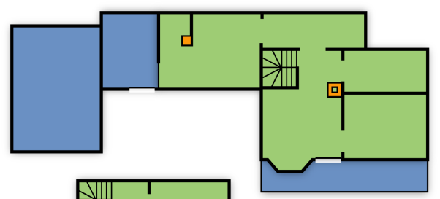
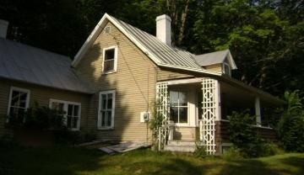
Exterior Walk Around Process
Building assessment
Start
Photos courtesy of U.S. Department of Energy
Notes:
The graphic shown is an illustration of how to conduct an exterior inspection.
Start at the entry door.
Move in a clockwise direction.
Take pictures of everything.
Return to the point of origin.

Slide 7
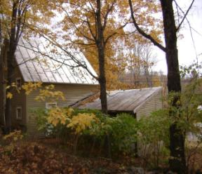
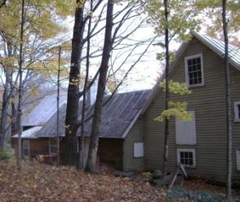
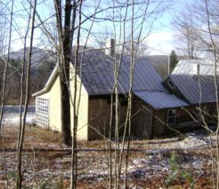
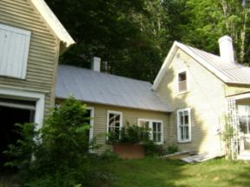
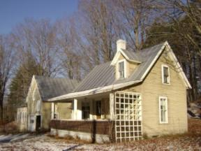
Visual Assessment – Exterior #1
Building assessment
No gutters
Steel roof
Land slopes to building
Photos courtesy of U.S. Department of Energy
Chimneys meet code height requirements
Clapboard siding in good condition
Attached Garage
No storm doors
All windows are double-pane
Window below ground
Notes:
These photos show different aspects of a home’s exterior.
Document building type and framing. Determine foundation type and percent above grade.
Document cardinal direction and orientation.
Draw a simple sketch of the building footprint and sides and note dimensions. Note and include detail on the following items.
Siding type and condition
Additions, porches, attached or tuck-under garages, cantilevers
Numbers, types, condition, and orientation of windows and doors
Roof type, covering, and condition
Chimneys exhaust vents, and possible safety problems
Water management system issues (downspouts, flashing, grade, etc.)

Slide 8
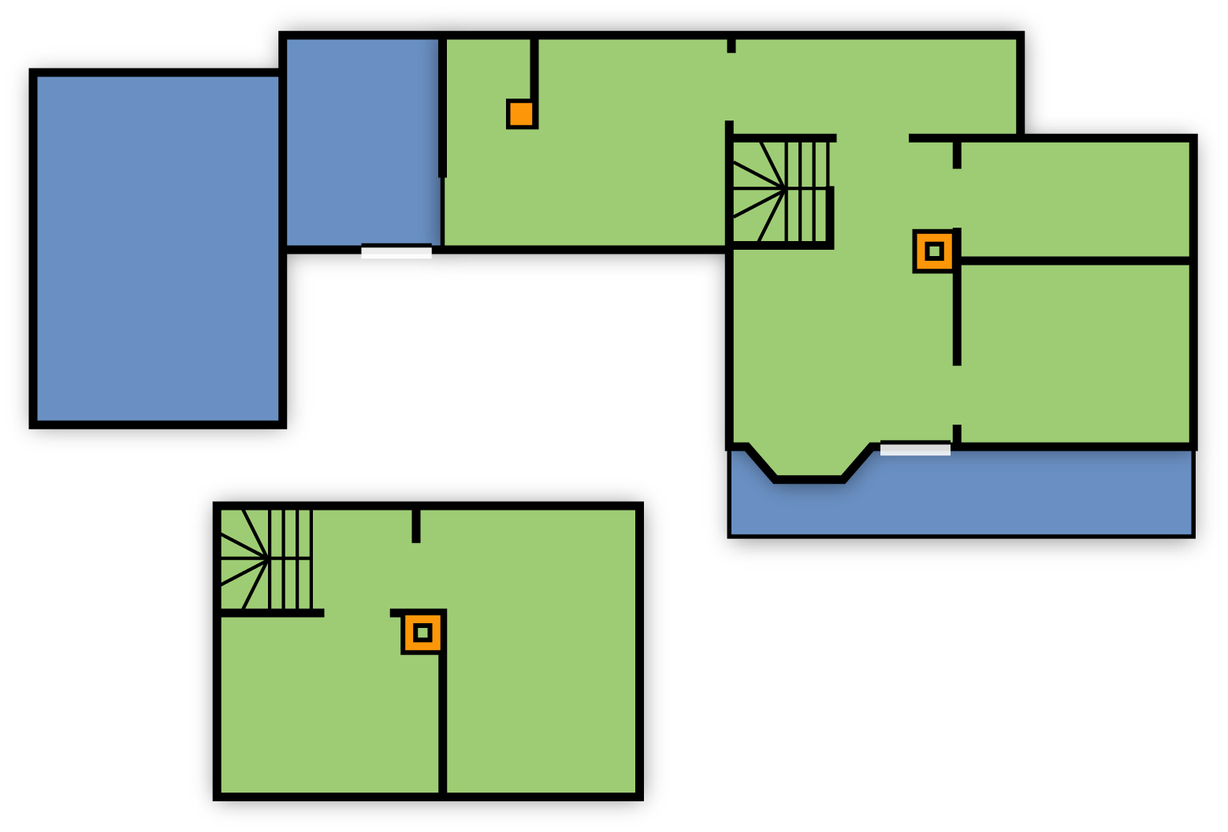
The Footprint Sketch
Building assessment
15’
16’
Den
8’
N
Shed
12’
Kitchen
Bath
Garage
16’
12’
Living
BR
Open Porch
Hall
26’
BR
= heated = no heat
• 7’ cellar under main house
• Den & kitchen floor ≈ 1’ clearance to ground
BR
Second Floor
Notes:
Sketch the footprint with exterior dimensions and indicate which direction is North.
Differentiate heated and unheated sections. To some extent this can be determined from an exterior walk-around, but will also need to be verified from the interior.
Note anything of interest.

Slide 9
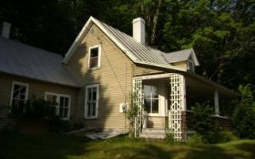
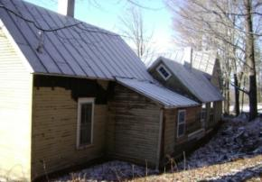
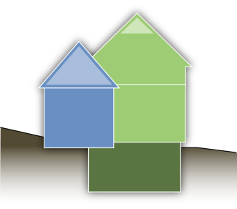
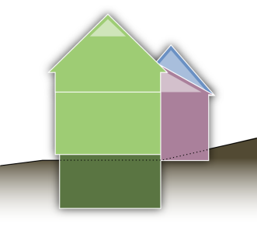
Elevations
Building assessment
Main house: 16’ x 26’ – 1 ½ story
Ell: 12’ x 15’ – 1 story
Rear addition: 8’ x 16’ – 1 story
Cellar under main house only
Photos courtesy of U.S. Department of Energy
SW Elevation
NE Elevation
All on very good rubble stone foundation.
Heated space windows and doors: (8) 12.5 sq’ windows (8) 10 sq’ windows (2) 20 sq’ doors
Second floor: Attic flat = 8’ Slopes = 8’ Eaves wall = 3’
7’
7’6”
8’
7’5”
Notes:
Record height and width of each wall (heated area only). This will be used to estimate insulation.
Note siding type. Knowing the siding type helps ensure crews will be prepared for the job. Will they need metal cutters to remove aluminum siding? Will an interior blow be required because the home has asbestos siding?
Either sketch elevations with window and door locations or take a picture of each wall for running the computer audit, specifying repair or replacement, and estimating insulation materials.
Note approximate dimensions of windows and doors.
Record the height of the exposed foundation so you can specify the basement wall insulation.
By taking accurate notes on the visual inspection, estimating materials for the work order becomes easier later.

Slide 10
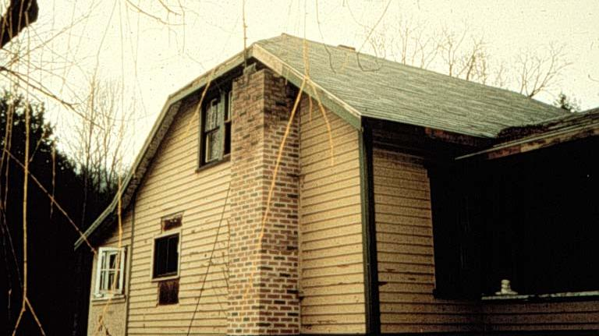
Visual Assessment – Exterior #2
Building assessment
What’s wrong with this picture?
Photo courtesy of PA Weatherization Training Center
Notes:
This is a photo of a house exterior.
Q: Anything wrong with this picture?
Click to circle trouble spot.
A: The chimney is cut off under the eaves, right next to a window.

Slide 11
Visual Assessment – Exterior #3
Building assessment
Abundance of peeling paint could indicate a high moisture load. Investigate.
Photo courtesy of PA Weatherization Training Center
Notes:
This is a photo of architectural details showing a bump-out and porch.
The degree of peeling paint on sidewalls could indicate a high interior moisture load that warrants investigation.

Slide 12
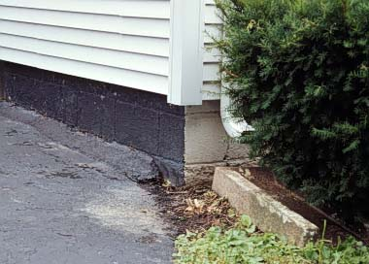
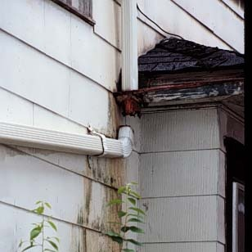
Visual Assessment – Exterior #4
Building assessment
Driveway slopes back into foundation, carrying moisture there.
A disconnected downspout causes water to pour down walls during weather events.
Water Mismanagement
Photos courtesy of PA Weatherization Training Center
Basement moisture problems may be traced back to poor exterior drainage.
Notes:
These photos show water management systems. The photo on the left shows driveway sloping back into the foundation. The photo on the right shows a disconnected downspout.
Any basement moisture problems may be traced to a poor exterior drainage plain.
Take digital photos.

Slide 13
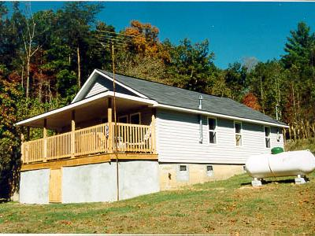
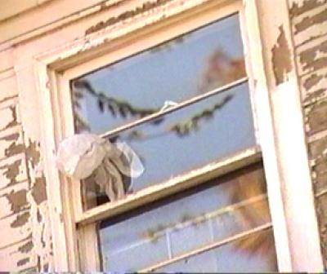
Visual Assessment – Exterior #5
Building assessment
Photos courtesy of U.S. Department of Energy
Note foundation type and percent above grade.
Note numbers of windows, types and exterior condition.
Notes:
The photo on the left shows foundations and percent above grade.
Much more detail will be obtained on closer investigation of the basement or crawl space from the interior.
Q: Roughly what percentage above grade is the basement on the left and why is that important?
A: About 50%. If the basement is conditioned, interior wall insulation could be a good option and air sealing is much more important.
Also note numbers, types, and condition of windows while examining the exterior of the home.

Slide 14
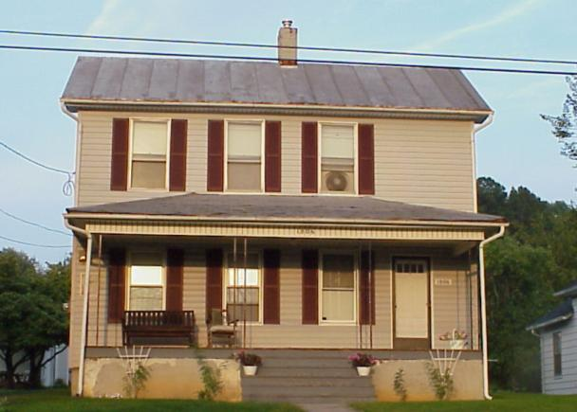
Visual Assessment – Exterior #6
Building assessment
Porch roof cavity may be open to wall cavities.
Arrows indicate air escaping from back of porch roof to adjoining wall cavities.
Photos courtesy of U.S. Department of Energy
Notes:
This photo shows a two-story house with balloon-framing where the porch framing could be open to the wall cavities of the house.
This could be one of the largest hidden air leaks in the house, making it a good candidate for air sealing with dense-packed insulation.

Slide 15
Exterior Visual Assessment – Review
Building assessment
Note and include detail on:
Building type and framing.
Foundation type and percent above grade.
Additions, porches, attached or tuck-under garages, cantilevers.
Numbers, types, condition, and orientation of windows and doors.
Cardinal direction and orientation.
Siding type and condition.
Chimneys, exhaust vents, and possible safety problems.
Roof type, covering, and condition.
Water management issues (downspouts, flashing, grade, etc.).
Draw a sketch of the building footprint and sides, noting dimensions.
Remember to note comfort, health and safety, and any other issues discovered in client interview process.
Notes:
Document building type and framing. Determine foundation type and percent above grade.
Document cardinal direction and orientation. Draw a simple sketch of the building footprint and sides and note dimensions.
Note and include detail on the following items.
Siding type and condition
Additions, porches, attached or tuck-under garages, cantilevers
Numbers, types, condition, and orientation of windows and doors
Roof type, covering, and condition
Chimneys, exhaust vents, and possible safety problems
Water management system issues (downspouts, flashing, grade, etc.)

Slide 16
Visual Assessment – Conditioned Space
Building assessment
Note and include detail on:
Area and volume of the conditioned space.
Pressure and thermal boundaries.
Lead-based paint.
Mechanical ventilation.
Evidence and sources of moisture or indoor air quality problems.
Unvented fossil fuel heaters.
Identify large air leaks such as broken glass, missing hatchway covers, large penetrations, broken ceilings and wall coverings.
Electrical or other hazards to occupants and weatherization workers.
Remember to note comfort, health and safety, and any other issues discovered in client interview process.
Notes:
Note the area and volume of the conditioned space. Locate and identify building components of the pressure and thermal boundary based on how the client uses the interior spaces.
Identify large air leaks such as broken glass, missing hatchway covers, large penetrations, broken ceilings, and damaged wall coverings. Note electrical or other hazards to occupants and weatherization workers.
Note evidence and sources of moisture or indoor air quality (IAQ) problems. Note the presence of lead-based paint.
Note the presence of unvented fossil fuel heaters. Note the presence and operational condition of mechanical ventilation. Note comfort and other issues identified in the client interview.

Slide 17
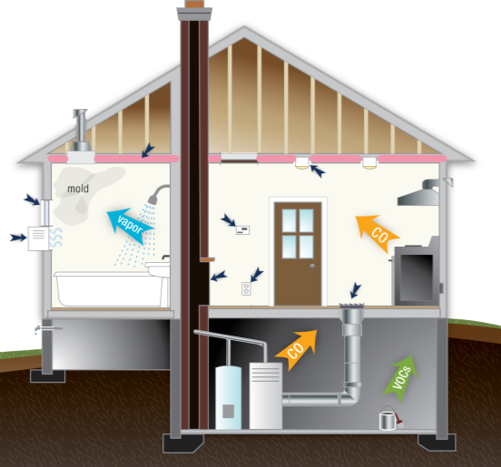
Visual Assessment – Conditioned Space
Building assessment
Note the presence, location, and condition of:
Wall insulation.
Windows and doors.
Leakage around outlets and fixtures (using a blower door).
Thermostat.
Fireplace.
Air registers.
Window A/C unit.
Recessed light fixtures.
Stored chemicals that might effect IAQ.
Image developed for the U.S. DOE WAP National Standardized Curriculum
Notes:
This is an illustration of conditioned space.
Check for wall insulation.
Inspect the condition and operation of windows and doors.
With the blower door running, check for leakage around outlets and fixtures.
Note the thermostat type and setting.
Determine if the fireplace has an operating damper or glass door.
Note the number and location of air registers.
Check for leaks around the window AC unit and whether a cover is available.
Note recessed light fixtures.

Slide 18
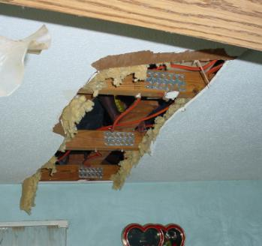
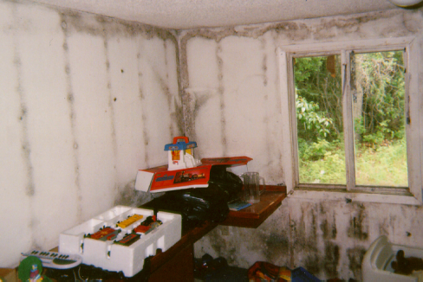
Visual Assessment – Moisture
Building assessment
Auditors should determine underlying causes of moisture damage.
Photos courtesy of U.S. Department of Energy
Damaged ceilings may indicate moisture issues.
Mold on walls indicates serious moisture issues in the home. Determine underlying causes and mitigate before any air sealing.
Notes:
These photos show a damaged ceiling and mold on walls.
Auditors should attempt to determine the underlying cause of mold problems.
Q: Should air sealing be recommended in a home where these kinds of conditions are observed?
A: Not until the underlying causes are resolved and the mold has been cleaned up. Check with your state grantee’s DOE approved Health and Safety Plan to determine allowable measures related to mold clean-up.

Slide 19
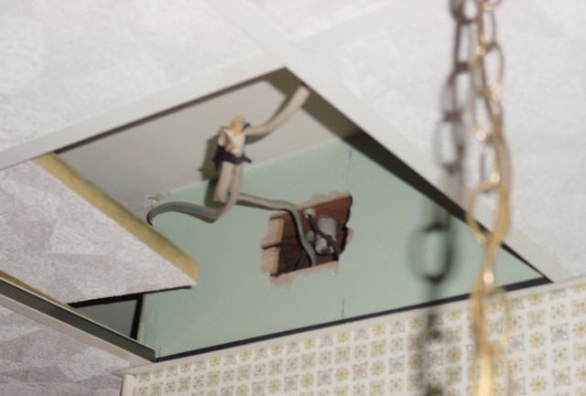
Visual Assessment – Dropped Ceilings
Building assessment
Look above tiles for hidden air leaks.
Photo courtesy of U.S. Department of Energy
Notes:
This is a photo of a dropped ceiling.
Air leakage problems often occur above dropped ceilings. Remove panels in several locations to check for damaged ceiling or utility openings.

Slide 20
Visual Assessment – Access Doors
Building assessment
Check access doors, closets and cabinets for interior leakage paths.
This opening within the plumbing wall was discovered behind an access door.
The opening is a major source of air leakage.
Photo courtesy of U.S. Department of Energy
Notes:
This photo shows an open plumbing wall behind an access door.
This is an interior bypass and a common air leakage site.

Slide 21
Visual Assessment – Space Heaters
Building assessment
Space Heater Policy
No weatherization work is allowed where unvented gas or liquid fuel space heater is primary heat source.
Removal of an unvented primary heat source is required,
Units that do not meet ANSI Z21.11.2 must be removed
Mobile Home fossil fuel heating systems must be vented to outside
Photos courtesy of U.S. Department of Energy
Notes:
Space Heater Policy
No weatherization work is allowed where an unvented gas or liquid fuel space heater is the primary heat source.
Removal of an unvented primary heat source is required as per DOE Weatherization Program Notice 11.6 (WPN 11.6)
Units that do not meet ANSI Z21.11.2 must be removed prior to weatherization but may remain until a replacement heating system is in place.
Mobile Home fossil fuel heating systems must be vented to outside. The Manufactured Home Construction and Safety Standards require all fuel-burning, heat-producing appliances in mobile homes, except ranges and ovens, to be vented to the outside. The combustion system must also be separated from the interior atmosphere, i.e., draw their combustion air from the outside.
Q: Should air sealing be recommended in a home where unvented fossil fuel space heaters are observed?
A: It depends if the heating unit is a primary or secondary heat source. DOE will not permit any DOE-funded weatherization work (including air sealing) if the completed dwelling unit is heated with an unvented gas- or liquid-fueled space heater as the primary heat source. DOE will allow unvented units to temporarily remain as secondary resources as long as they comply with ANSI Z21.11.2 or other applicable codes, such as the International Residential Code and International Fuel Gas Code.
For additional detail, see Weatherization Program Notice 11.6

Slide 22
Visual Assessment – Walls
Building assessment
Determine framing type.
Determine presence of wall insulation and thickness.
Inspect interior wall cladding.
Look for areas where insulation may spill.
Determine practicality of exterior or interior insulation installation.
Calculate the gross wall area.
Notes:
Determine framing type (balloon, platform, plank, etc.).
Determine the presence and thickness of wall insulation in multiple locations using one or more of the following methods.
Infrared scanning
Drilling and probing with a non-conductive probe or bore scope
Removing small sections of siding
Inspect interior wall cladding for damage or weakness.
Look for areas where insulation may spill (pocket doors, suspended ceilings, cabinets, closet spaces, etc.).
Determine the practicality of an exterior or interior insulation installation. Calculate the gross wall area (perimeter x height).

Slide 23
Visual Assessment – Framing Type
Building assessment
Determine Type of Wall Framing
From the attic, framing style is often evident.
Top plates indicate platform framing.
Open-topped wall cavities are a sure sign of balloon framing.
Photo courtesy of U.S. Department of Energy
Notes:
This photo shows framing on the gable end of a house from the attic.
The attic is often the best place to determine the type of framing.
Opened-topped wall cavities are a sure indication of balloon framing.
The existence of a top plate indicates platform framing.

Slide 24
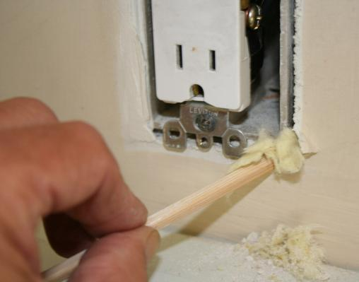
Visual Assessment – Insulation
Building assessment
Probe exterior walls to determine:
If insulation is present, what kind and how much?
Depth of the wall cavity.
Do this in several locations.
A non-conductive crochet hook is handy for pulling out a sample of existing insulation.
Photo courtesy of U.S. Department of Energy
Notes:
When assessing a building, be sure to probe walls to determine:
If insulation is present, what kind, and how much.
The depth of the wall cavity.
One of the easiest ways to check for the presence of wall insulation is to remove a receptacle cover plate along an exterior wall and probe the wall cavity with a non-conductive probe.
A plastic crochet hook, or a chop stick with a hook carved in the end of it, works great for pulling out a sample of existing insulation.
Widen the gap between the electrical box and wall sheathing slightly and insert the probe to determine wall thickness and insulation type. Do this in several locations along the exterior walls.

Slide 25
Visual Assessment – Foundation #1
Building assessment
Note and include detail on the following:
Framing type
Subspace condition
Thermal boundary
Combustion appliances
Moisture and IAQ issues
Major air leakage sites
Insulation levels.
Tuck-under garages, coal bins, etc.
Duct system
Dryer venting
Electrical or other hazards
Notes:
Note and include detail on the following:
Foundation type (slab on grade, pier and beam, full basement, crawl space, or a combination).
Conditioned or unconditioned basement or crawl space?
Components of the thermal boundary, such as the ceiling of an unconditioned basement adjacent to the conditioned space above.
Combustion appliances and hot water tank.
Moisture problems, bulk water intrusion, and other IAQ issues.
Major air bypasses and direct penetrations to the outside.
Ceiling, wall, and band joist insulation levels.
Tuck-under garages, coal bins, etc.
Condition and insulation levels of duct system.
Dryer venting.
Electrical or other hazards to occupants and weatherization workers.

Slide 26
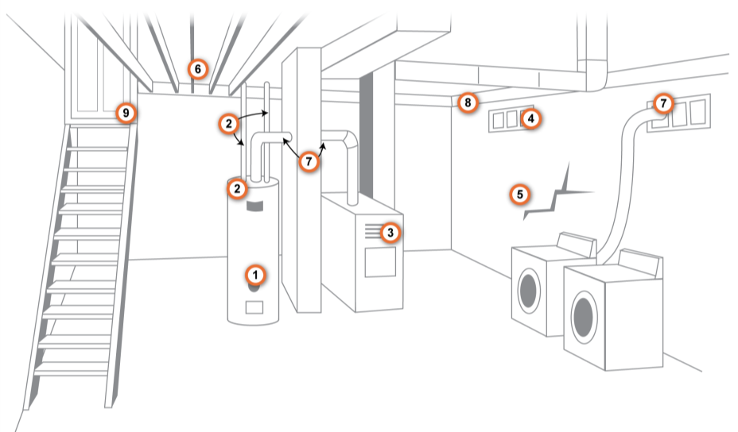
Visual Assessment – Foundation
Building assessment
Image developed for the U.S. DOE WAP National Standardized Curriculum
Notes:
This is an illustration of a full-height basement.
Ask participants to document the following:
Note the hot water tank thermostat set point.
Note insulation on tank and piping.
Inspect furnace.
Check windows and their condition.
Inspect foundation walls.
Note whether band joist and mudsill are sealed or insulated.
Check for bypasses through the floor.
Check condition of ducts
Inspect condition of interior and exterior doors.
Q: Is this basement conditioned or unconditioned?
A: It appears to be conditioned.
No duct insulation.
No thermal barrier (insulation) in basement ceiling.
Presence of washer and dryer indicate space is used by occupants.

Slide 27
Visual Assessment – Foundation #3
Building assessment
Note major air leakage sites on sketch.
Plumbing and wiring penetrations are common air leakage sites.
Photo courtesy of U.S. Department of Energy
Notes:
This photo shows a plumbing and wiring chase in the first floor ceiling.
Note major air leakage sites on your sketch.

Slide 28
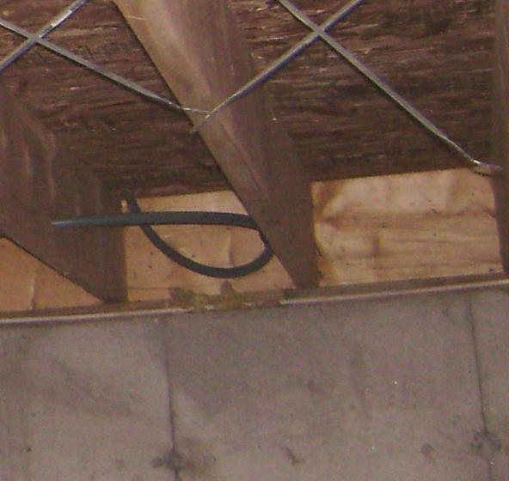
Visual Assessment – Perimeter
Building assessment
Note ceiling, wall and band joist insulation levels.
This box sill is a common perimeter leakage site in basements.
Floor joist
Band joist
Mud sill
Photo courtesy of U.S. Department of Energy
Notes:
This is a photo of a box sill, made up of the band joist, floor joist and mud sill framing.
The box sill is a common perimeter leakage site in basements.

Slide 29
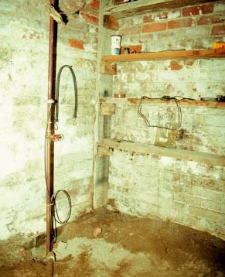
Visual Assessment – Floor
Building assessment
Note type and condition of basement or crawl space floor.
Radon issues?
Vapor retarder?
Dirt Floor Basement
Dirt floor in basement
Photo courtesy of PA Weatherization Training Center
Notes:
This photo shows a basement with a dirt floor.
This basement could be a candidate for a vapor retarder.

Slide 30
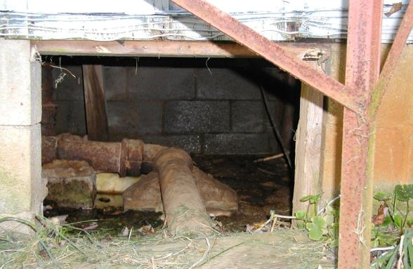
Visual Assessment – Foundation #4
Building assessment
Situations like this can hinder weatherization work.
Workers cannot access ducts, floor cavity.
Impacts the occupants’ health and safety.
Wet crawlspace
Photo courtesy of U.S. Department of Energy
Notes:
This is a photo of a wet crawl space without a door.
Q: Who else besides the home’s occupants can be affected by a wet crawl space?
A: Weatherization workers.

Slide 31
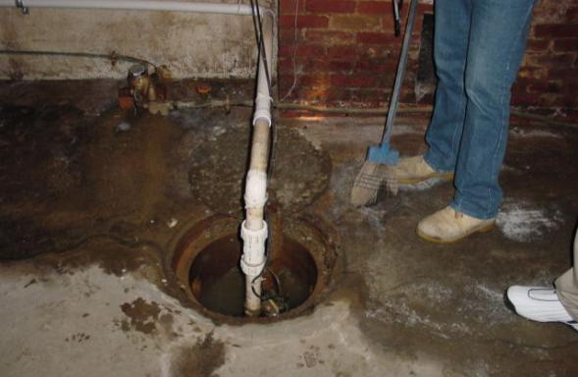
Visual Assessment – Foundation #5
Building assessment
Situations like this can hinder weatherization work.
Bulk moisture problems must be solved before weatherization work can begin.
Wet basement
Photo courtesy of PA Weatherization Training Center
Notes:
This photo shows a wet basement floor with an open sump.
Bulk moisture problems like this will need to be fixed before weatherization work can begin.
Q: What kinds of funds must be used to fix moisture problems like this?
A: Health and Safety funds, not energy efficiency funds.

Slide 32
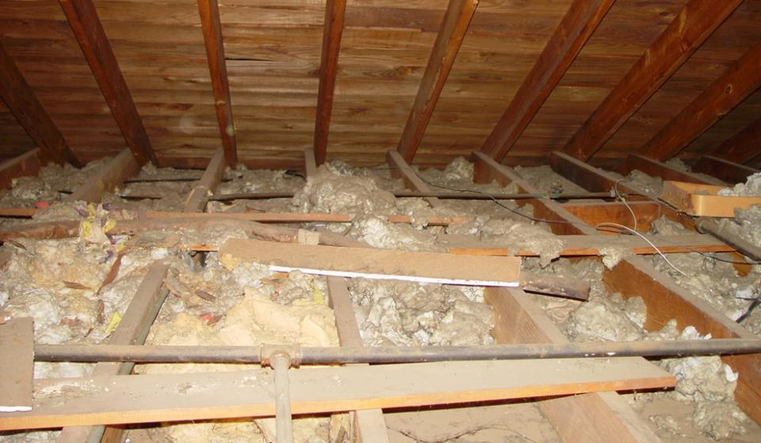
Visual Assessment – Attic Spaces #1
Building assessment
Dark, hot, unpleasant attics are where some of the most important auditing and installation work takes place.
Photo courtesy of U.S. Department of Energy
Notes:
This photo shows a typical attic space with open ceiling joists and a small amount of scattered mineral wool insulation.
Attics are dark, hot, and often hazardous places to work. But they are often where the most important work is done.
Ask students to share some of their experiences. Has anyone put their foot through a ceiling, found snakes, run into a hornet’s nest, or nearly succumbed to over-heating?

Slide 33
Visual Assessment – Attic Spaces #2
Building assessment
Note and include detail on:
Components of the thermal boundary.
Physical features (floored, un-floored, condition of ceiling, occupants’ belongings, attic hatch type).
Existing insulation levels.
Major air bypasses.
Condition and insulation level of duct systems if present.
Evidence of condensation-based moisture problems or roof leaks.
Attic ventilation.
Whether mechanical and plumbing terminations are vented to outside.
Knob-and-tube wiring or other electrical hazards.
Other hazards such as vermiculite, vermin droppings, etc.
If interior access is not available, attempt to access through an existing exterior vent or, with permission, create an interior access through a closet ceiling if possible.
Notes:
Locate and identify components of the thermal boundary.
Note physical features (floored, unfloored, condition of ceiling, occupants’ belongings, attic hatch type).
Include detail on the following:
Existing insulation levels
Major air bypasses
Condition and insulation level of duct systems if present
Evidence of condensation-based moisture problems or roof leaks
Attic ventilation
Ventilation of mechanical and plumbing terminations and whether they are vented to the outside
Knob and tube wiring and other electrical hazards
Other hazards such as vermiculite, vermin droppings, etc.
If an interior access is not available, try to access the attic through an existing exterior vent or ask permission to create an interior access through a closet ceiling.

Slide 34
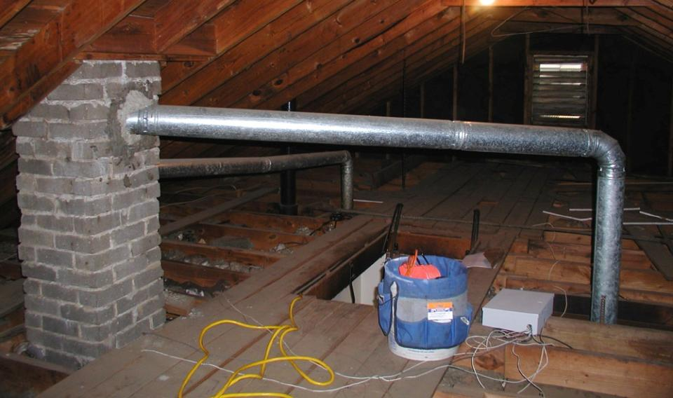
Visual Assessment – Attic Spaces #3
Building assessment
Gable vent
B-Vent
Pull-down staircase
Chimney
Floored Attic
Ceiling joist cavities
Photo courtesy of U.S. Department of Energy
Notes:
This photo shows various features of an attic.
Q: What kinds of features are worth noting in this view of the attic?
Click to reveal in this order:
Chimney
B-vent (a special type of vent approved for venting gas appliances)
Pull-down staircase
Gable vent
Open joist ceiling
Floored attic

Slide 35
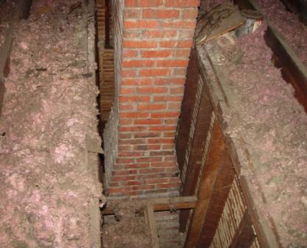
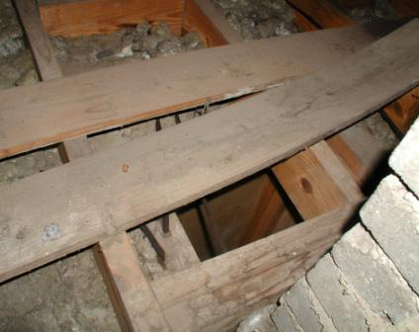
Visual Assessment – Attic Spaces #4
Building assessment
Attic bypasses
Photos courtesy of NRCERT
Major attic bypasses like these should be documented.
More materials will be needed than for typical air sealing.
Notes:
These are photos of major attic bypasses.
Document these types of bypasses. They will take significant time and materials to effectively seal and should be included in the work order for the benefit of the crew.

Slide 36
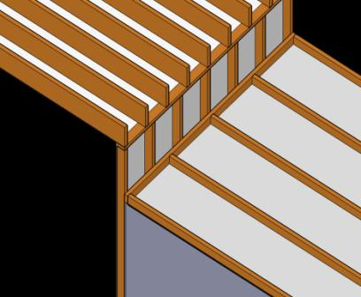
Visual Assessment – Attic Spaces #5
Building assessment
Attic bypasses:
Open wall cavities
The interior wall cavity acts as a chimney that robs the house of heat and conditioned air.
Photo courtesy of NRCERT
Notes:
This is a photo and an illustration of interior attic bypasses.
The interior wall cavities act as a chimney that robs the house of heat and conditioned air.

Slide 37
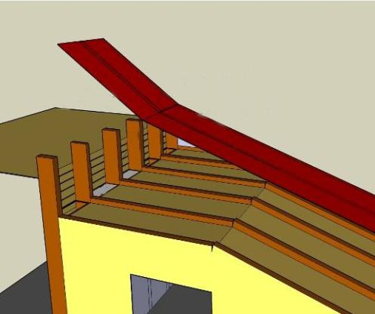
Visual Assessment – Attic Spaces #6
Building assessment
Check Addition Attics
There will likely be large air pathways between the two attics through the open stud bays.
Main attic
Addition attic
Notes:
This illustration shows an attic serving an addition off of the main attic.
There will likely be large air pathways between the two attics through the open stud bays.

Slide 38
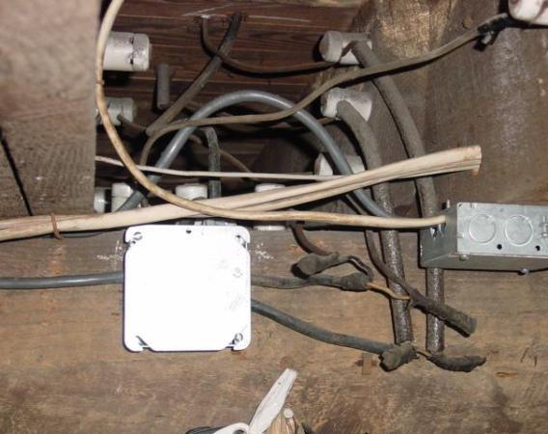
Visual Assessment – Electrical
Building assessment
Note the locations of these and any other electrical hazards:
Knob and tube wiring
Open wire splices
Uncovered junction boxes
Frayed wire, etc.
Most state codes prohibit insulation over knob-and- tube wiring.
Photo courtesy of U.S. Department of Energy
Notes:
This is a photo of knob and tube wiring.
Note the locations of the following items and other potential electrical hazards.
Knob and tube wiring
Open wire splices
Uncovered junction boxes.
Frayed wire, etc.

Slide 39
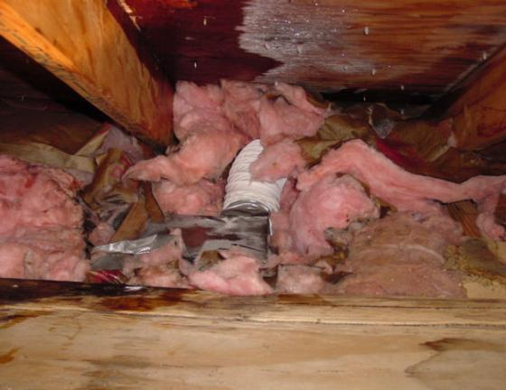
Visual Assessment – Attic Ducts
Building assessment
Note the location and condition of exhaust vents:
Are they vented directly outside?
Smooth, metal vent pipe?
Moisture damage around roof penetration?
This dryer duct, exhausting into the attic space, is causing moisture issues on the roof deck.
Photo courtesy of PA Weatherization Training Center
Notes:
This photo shows a disconnected duct from a kitchen ventilation fan and associated moisture on roof sheathing.
All ventilation exhaust fans must be vented through the roof with smooth metal pipe.

Slide 40
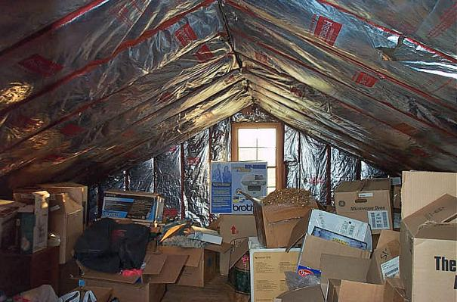
Visual Assessment – Attic Spaces
Building assessment
Storage in attics can hinder weatherization work.
Does the client need to remove materials before work begins?
Attic obstructions and an interesting thermal boundary.
Photo courtesy of U.S. Department of Energy
Notes:
This is a photo of a client’s possessions in storage.
The client’s belongings will be an obstruction to weatherization workers while performing air sealing and insulation and should be noted. Notify the client that these items may need to be moved before weatherization is performed.
Q: What else is interesting about this picture?
A: Insulation fastened to the roof deck and gable end wall. Do the roof deck and gable end wall make up the thermal boundary? Does the client want to intentionally condition the attic space? If not, the ceiling should be the thermal boundary.

Slide 41
Electrical Assessment
Building assessment
If state or local code allows adding attic insulation over knob and tube wiring, have a licensed electrician inspect and certify that it is safe.
Install type S fuses in the electrical panel.
If state or local code allows insulating wall cavities that contain or may contain knob and tube wiring, measure the voltage drop of the applicable circuits under load.
A voltage drop over 5% may indicate undersized wiring, improper splices, and other dangerous point loads due to bad connections.
Protect fixtures and electrical junctions with code approved covers.
Notes:
If state or local code allows adding attic insulation over knob and tube wiring, have a licensed electrician inspect and certify that it is safe.
Install type S fuses in the electrical panel.
If state or local code allows insulating wall cavities that contain knob and tube wiring, measure the voltage drop of the applicable circuits under load.
Voltage drop represents the percent difference between house voltage at 120 volts and reduced voltage as a result of long wiring runs, overloaded circuits, or bad connections.
Protect fixtures and electrical junctions with code-approved covers.

Slide 42
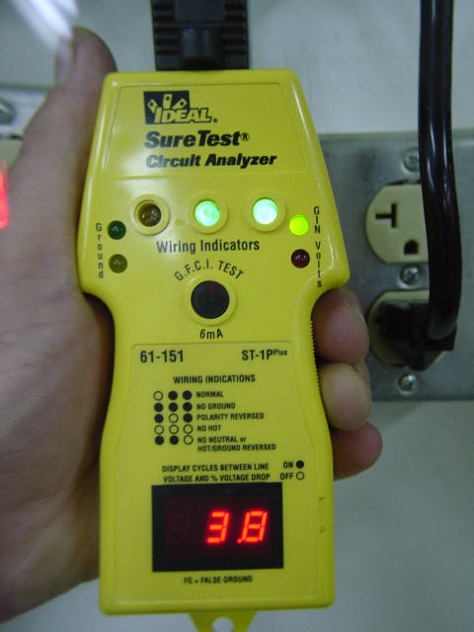
Electrical Assessment – Testing
Building assessment
Voltage Drop Testing
Reads the percentage of voltage drop on a circuit.
A difference above 5% may indicate an unsafe condition.
A qualified technician should investigate potential wiring problems.
Photo courtesy of PA Weatherization Training Center
Notes:
Below are some notes on voltage drop testing.
Plug the circuit analyzer into an outlet on the electrical circuit, which may be affected by insulation coming into contact with it. Measure the voltage drop.
This test reveals the percentage of voltage drop on a circuit.
A difference above 5% may indicate an unsafe condition.
A qualified technician should investigate potential wiring problems.

Slide 43
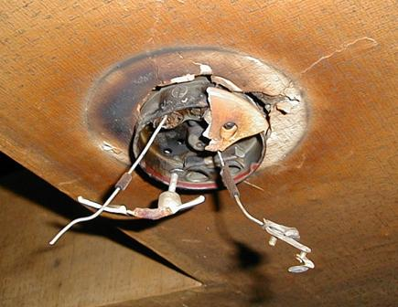
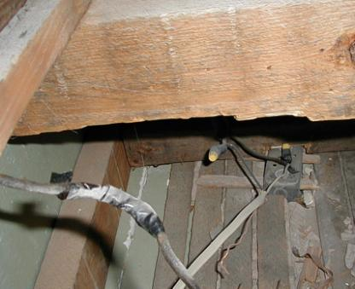
Electrical Assessment – Wiring
Building assessment
Photos courtesy of PA Weatherization Training Center
Charring on the light fixture and ceiling is evidence of a degraded wiring connection.
Taped and uncovered wiring splices such as these are unsafe and must never be covered with insulation.
Notes:
The photo on the left shows charring on a light fixture. The ceiling shows evidence of a degraded wiring connection.
The photo on the right shows taped and uncovered wiring splices. These are unsafe and must never be covered with insulation.
Loose connections associated with knob and tube wiring or improperly modified wiring may cause a high current draw (amperage). This causes high resistance which generates heat. Normally, this heat will dissipate into the air surrounding the wiring.
If the wiring is not repaired according to National Electrical Code standards and the affected area comes into contact with dense-packed insulation, it may cause a fire.
The NEC does not allow knob and tube wiring to be covered with insulation. All wiring splices must be contained within enclosed junction boxes.

Slide 44
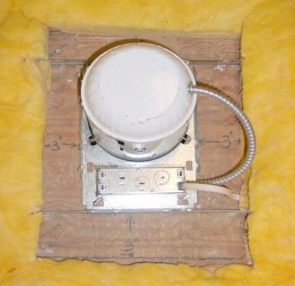
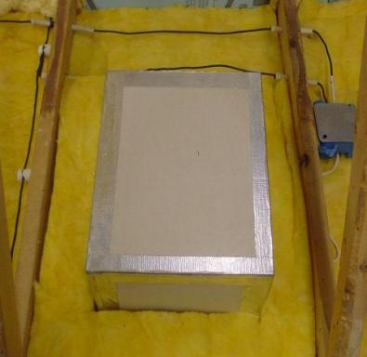
Electrical Assessment – Light Fixtures
Building assessment
Photos courtesy of PA Weatherization Training Center
Provide 3” of air space between recessed lights and insulation or other flammables.
A fabricated airtight drywall box meets electrical code requirements and provides a good seal.
Notes:
Note recessed light fixtures in attics.
A fabricated airtight drywall box meets electrical code and provides a good seal.

Slide 45
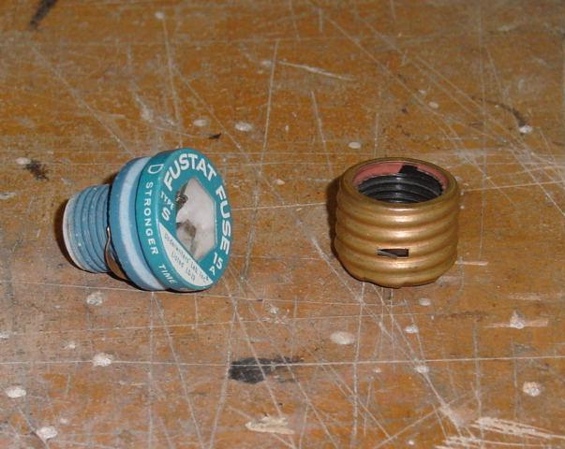
Electrical Assessment – Fuses
Building assessment
S-Type Fuses
Tamper-proof
Barbed shell screws into fuse panel
Only proper fuse will fit into shell
Color-coded
Blue-15 Amp Fuse
Photos courtesy of PA Weatherization Training Center
Notes:
S-type fuses:
Are tamper-proof.
Have a barbed shell that screws into the fuse panel.
Will only accept the properly sized fuse.
Are color coded to match their amperage.

Slide 46
Summary
Building assessment
A successful weatherization project begins with a systematic approach of visual and diagnostic evaluation.
Good building assessments begin with a thorough client interview.
A successful audit relies on the application of accurate visual assessment and diagnostic procedures.
A successful building assessment incorporates all of the knowledge of building systems and the interaction of their components.
Auditors must document moisture, electrical, and health and safety problems.
Understanding the components of the thermal boundary will help the auditor determine the most cost-effective retrofit strategies.
Notes:
A successful weatherization project begins with a systematic approach of visual and diagnostic evaluation.
Good building assessments begin with a thorough client interview.
A successful audit relies on the application of accurate visual assessment and diagnostic procedures.
A successful building assessment incorporates all of the knowledge of building systems and the interaction of their components.
Auditors must document moisture, electrical, and health and safety problems.
Understanding the components of the thermal boundary will help the auditor determine the most cost-effective retrofit strategies.
Present this slide as an interactive discussion, soliciting personal examples from the trainees. Add your own personal examples and knowledge to supplement.

