Slide 1
Regulations and Standards
QUALITY CONTROL INSPECTOR
WEATHERIZATION ASSISTANCE PROGRAM STANDARDIZED CURRICULUM – September 2012

Slide 2
Learning Objectives
REGULATIONS AND STANDARDS
By attending this session participants will be able to:
List selection criteria for weatherization measures.
Recognize Appendix A as a tool for materials selection.
Identify DOE rules and guidance.
Locate resources for residential building, electrical, and mechanical codes.
Discuss the application of codes in weatherization.
Locate resources for worker safety requirements.
Explain the differences between incidental repairs and health and safety (H&S) measures.
Describe DOE rules and guidance as they apply to incidental repairs and H&S measures.
Notes:
By attending this session participants will be able to:
List selection criteria for weatherization measures.
Recognize Appendix A as a tool for materials selection.
Identify DOE rules and guidance.
Locate resources for residential building, electrical and mechanical codes.
Discuss the application of codes in weatherization.
Locate resources for worker safety requirements.
Explain the differences between incidental repairs and health and safety (H&S) measures.
Describe DOE rules and guidance as they apply to incidental repairs and H&S measures.

Slide 3
Measure Selection Guidelines
REGULATIONS AND STANDARDS
Appendix A
SIR ≥ 1
Based on DOE-approved audit
Present Value of $
Fuel Escalation Rate
Notes:
Appendix A (Title 10 CFR Part 440) – Measures must pass cost-effectiveness guidelines and be listed in Appendix A to be installed. Exceptions are made for health and safety measures, which aren’t subject to savings-to-investment ratio (SIR) calculations.
SIR ≥ 1 – The SIR must equal at least 1 based on the approved calculation methods, which include three key components:
A DOE-approved audit – National Energy Audit Tool (NEAT), Manufactured Home Energy Audit (MHEA), or another DOE-approved audit software must be used to generate projected energy savings for the measure. The result is converted to dollar savings based on local utility rates.
The present value (PV) of money – PV considers the time value of money: $10 was worth more 15 years ago than it is today, and the $10 spent today to install a measure is very likely worth more than $10 saved 15 years from now.
The fuel escalation rate – Fuel prices change. Predicting overall savings includes predicting how much the saved energy will be worth in the future.
If you are using a DOE-approved priority list instead of an individual audit, the SIR will be calculated for a range of housing stock. The priority lists have SIR built in.

Slide 4
Appendix A
REGULATIONS AND STANDARDS
Can only install measures listed in Appendix A
Materials must meet standards for conformance based on Appendix A
Example:
REPLACEMENT WATER HEATERS | Standards for Conformance
Electric (resistance) water heaters | 10 CFR1 430 and UL3 174.
Heat pump water heaters | UL 1995, Second Edition, 1995. Electrical components to be listed by UL.
And must have SIR ≥ 1
Notes:
Appendix A provides a framework for materials and equipment selection.
Appendix A lists all the measures that may be installed. Listed measures include replacing refrigerators, but not chest freezers. Other acceptable measures include adding dense-pack sidewall insulation, window films, and solar water heaters.
Materials must meet standards for conformance based on Appendix A. These standards ensure that safe, code-compliant materials and equipment are installed.
Q: If a measure is listed in Appendix A, can it automatically be installed in any house?
A: (Click to reveal text.) No, it must still pass cost-effectiveness guidelines.
Measures listed here must still meet cost-effectiveness guidelines.
If a measure passes cost-effectiveness guidelines but is not listed in Appendix A, DOE funds cannot be used for installation.

Slide 5
SIR Data Needs
REGULATIONS AND STANDARDS
Energy consumption of existing item
Energy consumption of replacement item
Total cost of replacement:
Price and installation costs of new unit
Cost of removal and decommissioning of old unit
Local utility rates
Discount rate:
Fuel escalation rate
Present value
Notes:
To understand the data needed to calculate SIR, imagine you are considering a refrigerator replacement. You must determine:
Energy consumption of the existing item – This information can come from a database or actual metered data collected during the audit.
Energy consumption of the replacement item – Find this information on the Energy Guide label.
Total cost of replacement:
Price and installation costs of the new unit – Determine the price of the new refrigerator, including delivery and any labor costs associated with installation.
Cost of removing and decommissioning the old unit – This usually includes labor for removal and transportation, as well as the fee the local solid waste/decommissioning facility charges.
Local utility rates – These are used to translate projected energy savings into dollar savings.
Discount rate – This is the interest rate at which expected future cash flows can be discounted. It includes both the present value and fuel escalation rate and is used to account for the time value of money and the changing price of fuels.
Both the fuel escalation rate and discount rate are available from the Annual Supplement to NIST Handbook 135 and NBS Special Publication 709. This level of detail won’t typically be required of monitors and inspectors, but you should have a clear understanding of the program’s cost-effectiveness guidelines in case you ever need to evaluate whether a certain measure is allowable.

Slide 6
SIR Calculations
REGULATIONS AND STANDARDS
Alternately:
Built into DOE-approved audits
Use spreadsheet “PV” function
Notes:
SIR calculations are built into DOE-approved audits.
If you use an approved audit updated with accurate, current energy prices and installation costs, the SIR is computed automatically.
Use the spreadsheet “PV” function to calculate present value.
Excel and other spreadsheet software have a built-in “PV” function. This function is typically used to calculate loan payments, but can be used to calculate SIR with the discount rate inserted in the place of interest rate.

Slide 7
Using “PV” Function for SIR
REGULATIONS AND STANDARDS
SIR Equation =
Where:
% = DOE provided discount rate
n = Lifetime of measure, in years
Savings/Year based on local utility data
Cost = Total cost of installation
- PV (% , n , Savings/Year) ÷ Cost
Notes:
SIR = -PV (%, n, savings/year) ÷ cost
Where:
% = DOE-provided discount rate,
n = lifetime of measure, in years,
savings/year are based on local utility data, and
cost = total cost of installation.
The discount rate is generally around 3%.
The lifetime of the measure should be based on industry norms. The accepted lifetime of a refrigerator is 12 years. The accepted lifetime of insulation is 25 years.
The total cost of installation must include removal and decommissioning of the old appliance if applicable.
Q: How would it affect the SIR calculation if refrigerators only last seven years in a region due to brownouts and power surges?
A: Since the lifetime would be shortened, there would be less time for the measure to pay for itself in energy savings, so we would either have to find a less expensive refrigerator or one that is more efficient for the same price. The new refrigerator would have to pay for itself in seven years instead of 12.

Slide 8
Client Acceptance
REGULATIONS AND STANDARDS
Appendix A
SIR ≥ 1
Client Acceptance
Ultimately, if the client does not want certain measures installed, then you have two choices:
Continue with weatherization, minus the unwanted measures.
Defer weatherization services.
Notes:
Every measure must be listed in Appendix A and have an SIR of 1 or more. The client must also accept the measure because WAP is a voluntary program.
If the client does not want certain measures installed, the auditor has two choices:
Continue with weatherization, omitting the unwanted measures
Defer weatherization services
For example, clients may not want to give up their old refrigerator, and we cannot force them to accept a new one. In this situation, the auditor must determine if weatherization should continue or if services should be deferred.

Slide 9
Where to Set the Bar?
REGULATIONS AND STANDARDS
Monitor or inspect to standards that are consistent with:
DOE Rules and Guidance:
Appendix A (DOE CFR 440)
Weatherization program notices (WPN) http://www.waptac.org/
State Program Standards:
Mirror DOE rules
Defer to local authority having jurisdiction
Notes:
Monitor or inspect to standards that are consistent with:
DOE rules and guidance.
Appendix A (Title 10 CFR Part 440) – Title 10 CFR Part 440, established by the Energy Conservation in Existing Buildings Act of 1976, directs DOE to provide weatherization assistance to low-income persons. Appendix A identifies and lists the specifications for materials that may be installed on homes.
Weatherization program notices (WPN) – Program notices released by DOE to grantees provide program guidance, policy, or clarifications. Examples include WPN 11-6, “Health & Safety Guidance,” and WPN 02-6, “Weatherization Activities and Federal Lead-Based Paint Regulations.” The grantee must distribute WPNs to its subgrantees and training network.
State program standards.
Mirror DOE rules.
Defer to local authority having jurisdiction – Local codes may be more stringent than federal or state regulations or the International Residential Code (IRC). Agencies must abide by the most stringent applicable code.
Reference Appendix A and WPN 11-6.

Slide 10
Building Codes
REGULATIONS AND STANDARDS
International Codes Council (ICC)
International Residential Code (IRC) www.intlcode.org
Notes:
Monitor or inspect to standards that are consistent with the locally enforced codes.
International Codes Council (ICC) codes (I-Codes) provide minimum construction safeguards for homes, schools, and the workplace. The I-Codes are comprehensive, coordinated building safety and fire prevention codes. They are available for purchase at www.intlcode.org.
IRC, one of the I-Codes, is a comprehensive, stand-alone, residential code that creates minimum regulations for one- and two-family dwellings of three stories or less. The 09 IRC refers to the code published in 2009.

Slide 11
Electrical & Mechanical Codes
REGULATIONS AND STANDARDS
American Society of Heating, Refrigerating, and Air-Conditioning Engineers (ASHRAE) <www.ashrae.org>
National Fire Protection Association (NFPA) <www.nfpa.org>
National Electric Code (NEC) (NFPA 70) <www.nfpa.org>
The International Association of Plumbing and Mechanical Officials (IAMPO) <www.iapmo.org>
Uniform Mechanical Code (UMC)
Uniform Plumbing Code (UPC)
National Fuel Gas Code (NFGC)
Notes:
Monitor or inspect to standards that are consistent with locally enforced codes.
The American Society of Heating, Refrigerating, and Air-Conditioning Engineers (ASHRAE) www.ashrae.org develops standards for refrigeration processes and the design and maintenance of indoor environments.
The National Fire Protection Association (NFPA) develops, publishes, and disseminates codes and standards that minimize the possibility and effects of fire and other risks. Codes are available for purchase at www.nfpa.org. Frequently referenced codes in weatherization are NFPA 211, “Standard for Chimneys, Fireplaces, Vents, and Solid Fuel-Burning Appliances,” NFPA 54, “National Fuel Gas Code,” and NFPA 31, “Standard for the Installation of Oil-Burning Equipment.”
The National Electric Code (NEC), also known as NFPA 70, is a comprehensive, stand-alone, residential code that creates minimum regulations for one- and two-family dwellings of three stories or less. The 09 IRC refers to the code published in 2009. The NEC is available at www.nfpa.org.
The International Association of Plumbing and Mechanical Officials (IAPMO) (www.iapmo.org) works with governments and industry to implement comprehensive plumbing and mechanical systems codes around the world through the Uniform Mechanical Code (UMC) and the Uniform Plumbing Code (UPC).
National Fuel Gas Code – The American Gas Association (AGA) promulgates revisions of the National Fuel Gas Code through the American National Standards Institute’s (ANSI) Accredited Standards Committee. The ASC Z223 develops and publishes the National Fuel Gas Code, also known as ANSI Z223.1 and NFPA 54. The code is jointly developed with the NFPA 54 Committee. Available at www.nfpa.org.

Slide 12
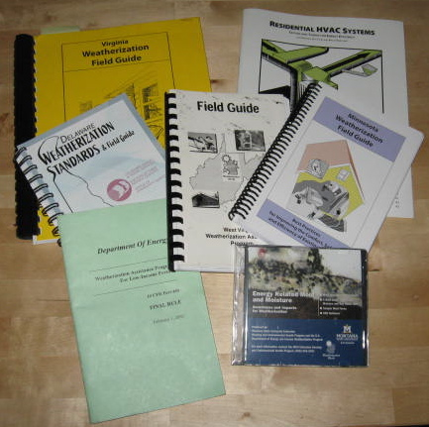
Weatherization Field Guides
REGULATIONS AND STANDARDS
Field guides include detailed instructions, best-practices, and more.
Regional field guides:
Weatherization Guidebook for Mid-Atlantic Region
Northeast Weatherization Field Guide
Southeastern Weatherization Field Guide
Energy OutWest Weatherization Field Guide
Many state field guides
Photo courtesy of the US Department of Energy
An assortment of state and tegional field guides, regulations, and training resources.
Notes:
Regional and state weatherization field guides detail installation standards and best practices. If you monitor or inspect in a region or state that has a technical field guide, make sure you refer to it. It is fine to share best practices in the field and encourage workers to adopt them, but it isn’t fair to chastise installers for doing less if they are still meeting the local standards.
Regional field guides:
Weatherization Guidebook for the Mid-Atlantic Region
Northeast Weatherization Field Guide
Southeastern Weatherization Field Guide
Energy OutWest Weatherization Field Guide
Midwest Regional Best Practices Field Guide
Many states have developed more specific field guides to help resolve technical issues and provide policy guidance. States with field guides include:
Illinois
New Mexico
Oregon
Pennsylvania
South Dakota
Texas
Utah
Wisconsin
These guides are often available through state or local offices, or on their respective websites. Crews and contractors should have the appropriate field guides at the job site for reference.

Slide 13
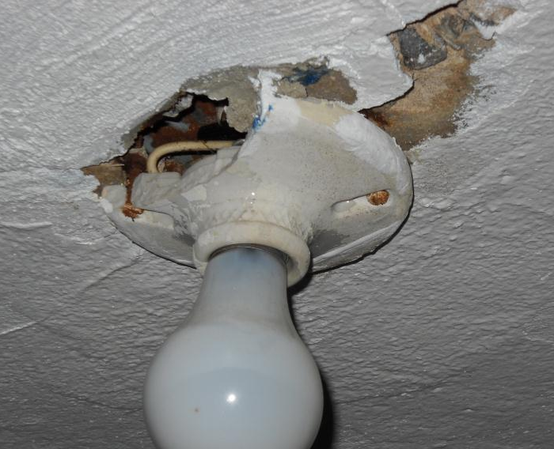
Incidental Repairs Defined
REGULATIONS AND STANDARDS
Included in SIR of the unit
Expenditures often capped by the grantee
Necessary for the effective performance or preservation of weatherization materials.
Examples:
Lighting fixture replacement when installing CFLs
Flooring repair for water heater installation
Photo courtesy of the US Department of Energy
Photo courtesy of US Dept. of Energy
Notes:
DOE guidance, in the form of WPNs, is the go-to resource for determining how things may be charged in the client file. One of the most confusing issues to some inspectors is determining whether something is an incidental repair or a health and safety measure.
The following slides introduce relevant guidance and terminology, then incorporate a game into the presentation where participants must determine whether a given measure is an incidental repair or an H&S measure.
Incidental repairs are those repairs necessary for the effective performance or preservation of weatherization materials. Incidental repairs are different from the regular energy conservation measures (ECMs) installed in homes, and some rules apply:
Incidental repairs must assist in the performance or protect energy-savings measures. Incidental repairs may be necessary to ensure the lifetime of the energy conservation measures being installed in the home.
Lighting fixture replacement – You can replace a hardwired lighting fixture if it is necessary to install energy-efficient lighting.
Wiring upgrades – This can be done when it is a component of the measure being installed, such as upgrading wiring to handle the extra load of a cooling system.
Costs must be included in the savings-to-investment ratio (SIR) calculations – Incidental repairs must pass the cost-effectiveness test. While the justification of incidental repair must be tied to a measure or specific group of measures, the price of incidental repairs can be included in the package of measures. If the SIR is still 1 or higher and the repairs meet the requirements listed above, the incidental repairs may be performed. Because of this rule, incidental repairs are self-limiting costs – they can’t exceed what will fit into the SIR of the total package of measures.
Expenditures are sometimes capped by the grantee to prevent unreasonable spending on non-energy-saving repairs. Expenditures are typically capped at a certain dollar amount per house ($500 per home, for example) or at a percentage of the maximum allowable cost per home.

Slide 14
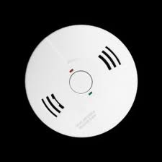
Health & Safety Measures #1
REGULATIONS AND STANDARDS
Energy-related health and safety is allowable
Expenditures are often capped by the grantee.
Examples:
Repairing gas leak
Installing smoke/CO alarms
H&S is not included in SIR calculations.
Installing smoke and CO detectors is a common health and safety measure.
Image courtesy of the diycentral.com
Notes:
When in doubt, try to relate health & safety (H&S) work to energy. If you can’t, it probably isn’t allowable.
Carbon monoxide (CO) detectors are justified because the increased house tightness due to air sealing can potentially cause higher concentrations of CO.
The grantee sets an average limit for H&S expenditures in the state plan. Expenditures are typically limited to a percentage of the maximum allowable cost per home. Since some homes don’t need any H&S work, providers can install more H&S measures in homes with greatest need, and still remain within the overall average.
Examples:
Repairing gas leaks – If you find a gas leak in a client’s home, it is crucial that it be repaired.
Installing smoke/CO alarms – This is a typical H&S measure.
H&S work is not included in SIR calculations and, therefore, not subject to the same SIR requirements as air sealing, insulation, or incidental repairs.
You must be performing energy conservation measures in the home to conduct any H&S repairs.

Slide 15
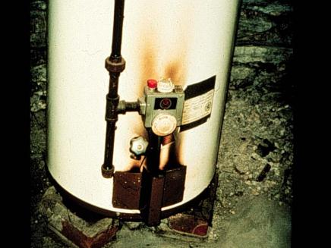
Health & Safety Measures #2
REGULATIONS AND STANDARDS
Photo courtesy of NRCERT
Photo courtesy of PA WTC
Test and repair leaky fuel lines.
Replace unsafe or leaking hot water tanks.
Notes:
Test and repair leaky fuel lines. Replace unsafe or leaking hot water tanks.
Q: Can you name some other big ticket measures under health and safety?
A: Some examples:
Replace furnaces found to have cracked heat exchangers.
Replace non-code-compliant chimney vents.
Install chimney liners.
Install kitchen and bath fans.
Repair and clean cook stoves that produce high levels of CO.

Slide 16
WPN 11-6 H&S Guidance
REGULATIONS AND STANDARDS
Drafted in 2011 to put all relevant H&S guidance in one place
Describes most common issues encountered during weatherization, what is allowed, what is required, and what is prohibited in terms of dealing with these issues
Outlines how grantees must address H&S in their grantee plan, and where more guidance may be needed at the local level
Notes:
Weatherization Program Notice (WPN) 11-6 - Health and Safety Guidance – will assist states and grantees in their development of a comprehensive approach to health and safety matters through health and safety plans.
WPN 11-6 addresses:
Allowability of H&S measures and testing, as well as training and client education requirements.
Instruction for H&S plan development.

Slide 17
H&S or Energy Conservation Measures?
REGULATIONS AND STANDARDS
WPN 11-6 - Health And Safety Guidance
“There are some instances where, depending on circumstances, the measure can be considered either a health and safety measure OR an energy conservation measure (e.g., furnaces). In those instances where the measure has a cost-effective savings-to-investment ratio (SIR) of one (1) or greater, the measure should be treated as a weatherization efficiency measure.”
Notes:
Grantees will perform the measures in WPN 11-6 with health and safety funds, unless they can be stand alone energy conservation measures, or they are defined as incidental repair in the Grantee Health & Safety Plan, effectively removing them from the health and safety budget category.
If measures such as furnace or water heater replacement can be cost-justified through the audit or priority list, then they must be cost-justified. An attempt should be made to achieve an SIR of 1 or greater for all potential energy saving measures. Once it is determined that the measure is not cost effective, it can be considered for health and safety repair or replacement.

Slide 18
H&S or Incidental Repair? #1
REGULATIONS AND STANDARDS
WPN 11-6 - Health And Safety Guidance
“Grantees should carefully consider the approach to be taken when they draft their health and safety procedures. While ease of accounting is an important consideration, Grantees should keep in mind that activities assigned to the health and safety budget category do not have to be cost-justified by the energy audit. The same items assigned to incidental repair, weatherization material, or installation cost categories must be cost-justified.”
Notes:
Defining those measures in WPN 11-6 as incidental repair in the Grantee Health & Safety Plan removes them from the health and safety budget category. This practice can help manage health and safety budget limitations, but it must be done consistently across the program. If a grantee does not remove any health and safety measures identified in 11-6 and state clearly within their health and safety plan that they will be performed as incidental repair, then they must be performed with health and safety funds.

Slide 19
H&S or Incidental Repair? #2
REGULATIONS AND STANDARDS
Eligible measures that meet the incidental repair definition (must be defined in grantee plan):
Correcting moisture creating conditions
Repairing moisture damaged areas as necessary to perform weatherization
Roofing repair
Electrical repair
Ineligible measures that do not meet the incidental repair definition:
Lead-safe work and testing
Asbestos testing, encapsulation, and mitigation
Removing pollutants
Radon testing
Notes:
Eligible measures that meet the incidental repair definition but are also allowable H&S expenditures must be clearly identified in the grantee plan as incidental repairs if that is the intended budget source. The default setting for these measures is a part of the H&S budget.
Some of the defined H&S measures do not meet the incidental repair definition and may not be defined as such in the grantee plan. These measures must always be paid for with H&S funds when applied to client homes.

Slide 20
H&S or Incidental Repair? #3
REGULATIONS AND STANDARDS
Some cases may not be so clear, such as when code compliance triggers the installation of a measure.
Several questions should be asked:
Necessary for installation of energy conservation measures or protection of client?
Specific to ensuring H&S of worker/occupant?
Part of an ECM?
What aspects of ECM are separate from H&S?
*The following Q&A does not consider the grantee’s ability to remove certain health and safety measures and define them as incidental repair in their health and safety plan.
*The
Notes:
Some cases may not be so clear, as when code compliance triggers the installation of a measure. Several questions should be asked:
Is the measure necessary in order to install weatherization or needed to protect the occupant as a result of weatherization activities?
Is the measure specific to ensuring the health and safety of the occupant/worker?
Is the activity a component of an ECM?
What parts of an ECM would have been conducted anyway, without consideration for the health and safety guidance?

Slide 21
WPN 12-9 Incidental Repair Measure Guidance
REGULATIONS AND STANDARDS
Drafted in June 2012
Provides guidance on incidental repair measures
Includes FAQ addenda, which will be regularly updated and posted at:
http://www1.eere.energy.gov/eere_faq/default.aspx?pid=10
Notes:
WPN 12-9 Incidental Repair Measure Guidance was drafted in 2012 in response to monitoring and Inspector General (IG) reports indicating widespread inconsistencies in the interpretation of DOE policy on the subject.
WPN 12-9 provides clarifying guidance on what may be charged as incidental repairs, and defines terminology so everyone is using the same word to mean the same thing.
The guidance also includes Frequently Asked Questions (FAQs) on the topic, which will be updated as needed and posted at: http://www1.eere.energy.gov/eere_faq/default.aspx?pid=10.
Begin the discussion by clarifying definitions of ancillary items, package of weatherization materials, and other terms as listed in WPN 12-9. Using the 12-9 FAQs, lead some discussion about what will qualify as incidental repairs and what won’t. Ask participants for examples from their programs.
The next few slides contain an interactive exercise. The discussion can be spread out throughout the exercise.

Slide 22
Which is it? #1
REGULATIONS AND STANDARDS
Wiring frayed and taped at outdoor fixture
Photo courtesy of the US Department of Energy
Notes:
Ask students to determine whether the following scenarios qualify as an incidental repair or health and safety measure.
Hint: It can be H&S, incidental, or neither, but sometimes depends on the purpose and justification.
Scenario #1
Wiring on an outdoor fixture is frayed and taped, audit calls for installing energy efficient lighting.
Q: Which is it? An incidental repair or a health and safety measure?
A: Incidental repair when installing energy efficient lighting – Correcting this wiring is a component of the energy efficiency measure and installing a new CFL into an unsafe fixture is not recommended.
(If energy efficiency lighting is not being installed, then fixing the wiring issue could be performed as a health and safety measure.)

Slide 23
Which is it? #2
REGULATIONS AND STANDARDS
Damaged light fixture on ceiling
Photo courtesy of the US Department of Energy
Notes:
Scenario #2
The light fixture in the ceiling is damaged.
Q: Which is it?
A: Incidental repair when installing energy efficient lighting – Replacing the fixture is a component of the energy efficiency measure and installing a new CFL into an unsafe fixture is not recommended.
If energy efficient lighting is not being installed, then replacing the fixture could be performed as a health and safety measure if necessary to perform weatherization or to avoid creating an unsafe condition because of weatherization activity. If the broken fixture will not prevent safe and effective weatherization or the weatherization work will not make the situation worse, then it should be left as is.

Slide 24
Which is it? #3
REGULATIONS AND STANDARDS
Mold in living space
Photo courtesy of the US Department of Energy
Notes:
Scenario #3
There is mold in the living space.
Q: Which is it?
A: This falls under health and safety category if insulation is being installed, and assuming that the drywall is structurally sound to handle the insulation measure. The most important thing to address is the “mold and moisture creating condition,” which would be a health and safety cost. Mold cleanup and mitigation is not allowed and client education is required.

Slide 25
Which is it? #4
REGULATIONS AND STANDARDS
Extensive live knob and tube wiring in an attic
Photo courtesy of the US Department of Energy
Notes:
Scenario #4
There is extensive live knob and tube wiring in the attic.
Q: Which is it?
A: This falls under the health and safety category. Unless the knob and tube wiring is a direct component of an energy efficiency measure, such as an electrical upgrade for a cooling system, then it would be performed as health and safety.
Grantees have the opportunity to define electrical measures as incidental repair in their health and safety plan, effectively removing them from the H&S budget category.
If it is not defined as incidental repair then it must be performed as health and safety.
If it is defined as incidental repair, then it must be charged to incidental repair and cost-justified with the package of measures consistently throughout the service territory.

Slide 26
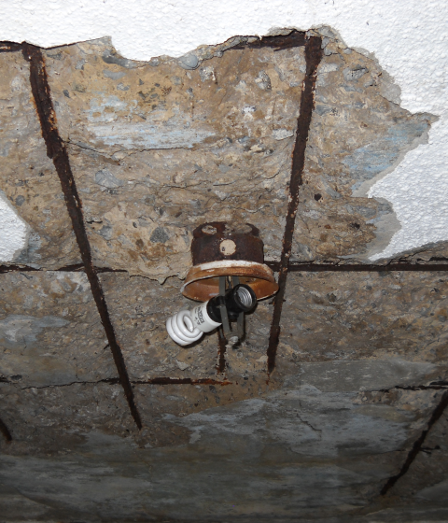
Which is it? #5
REGULATIONS AND STANDARDS
Water damage leading to failure of concrete roof/ceiling
Photos courtesy of the US Department of Energy
Notes:
Scenario #5
Water damage is leading to failure of a concrete roof and ceiling.
Q: Which is it?
A: This would fall under the health and safety category. But most likely, weatherization work would be deferred due to the extent of the structural and water problems.

Slide 27
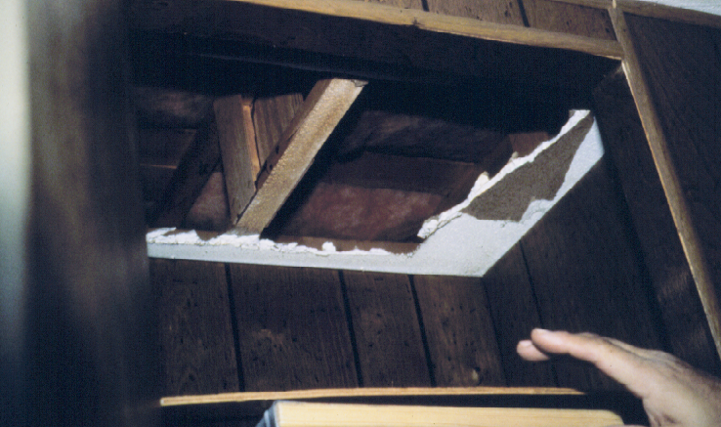
Which is it? #6
REGULATIONS AND STANDARDS
Large hole in ceiling
Photo courtesy of PA WTC
Notes:
Scenario #6
There is a large hole in the ceiling.
Q: Which is it?
A: Neither. It is an infiltration measure. This repair is part of air leakage reduction, which is an energy saving measure.

Slide 28
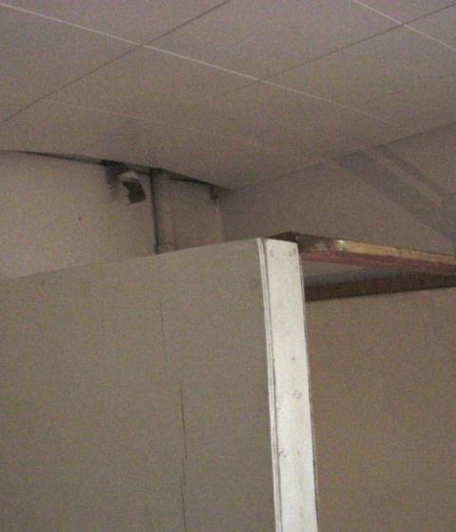
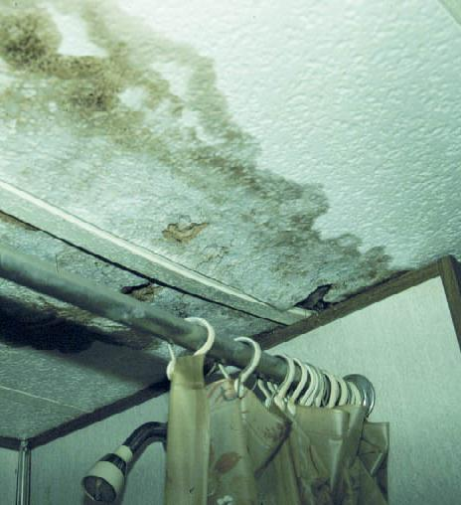
Which is it? #7
REGULATIONS AND STANDARDS
Sagging or water damaged ceilings
Photos courtesy of PA WTC
Notes:
Scenario #7
There are sagging or water-damaged ceilings.
Q. Which is it?
This could fall under incidental repair or health and safety. Repair, replace, or reinforce the ceiling to support the weight of insulation as an incidental repair. Repair of the moisture damage could also be health and safety depending on the justification in the client file.
This is a gray area that can be decided in the field but must be justified in the client file. Repairing the roof leak and/or providing mechanical bathroom ventilation is a health and safety measure – in other words correcting the “moisture creating condition.”
Grantees have the opportunity to define correcting moisture creating conditions as incidental repair in their health and safety plan, effectively removing it from the H&S budget category.
If it is defined as incidental repair then it must be charged to incidental repair and cost-justified with the package of measures consistently throughout the service territory.

Slide 29
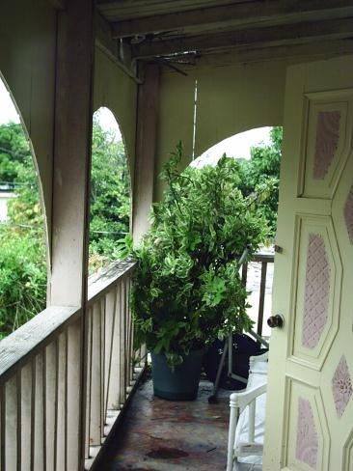
Which is it? #8
REGULATIONS AND STANDARDS
Roof leaks in bedroom
Photos courtesy of the US Department of Energy
Notes:
Scenario #8
The roof leaks into the bedroom.
Q: Which is it?
A: In the bedroom, it could be billed as health and safety.
Click to reveal the porch.
A: But actually it’s neither! The leak is located on a porch that is outside the scope of weatherization.

Slide 30
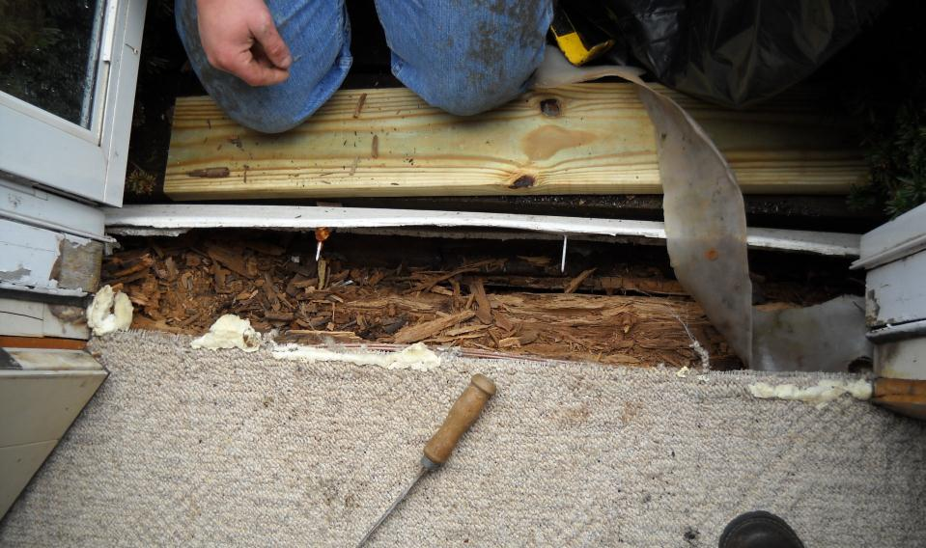
Which is it? #9
REGULATIONS AND STANDARDS
Rotted door sill
Photo courtesy of the US Department of Energy
Notes:
Scenario #9
A door sill is rotted and prevents weather stripping.
Q: Which is it?
A: This falls under incidental repair. A rotted sill is a direct component of air sealing the door with weatherstripping and door sweeps. However, this is not a justification for replacing the door.

Slide 31
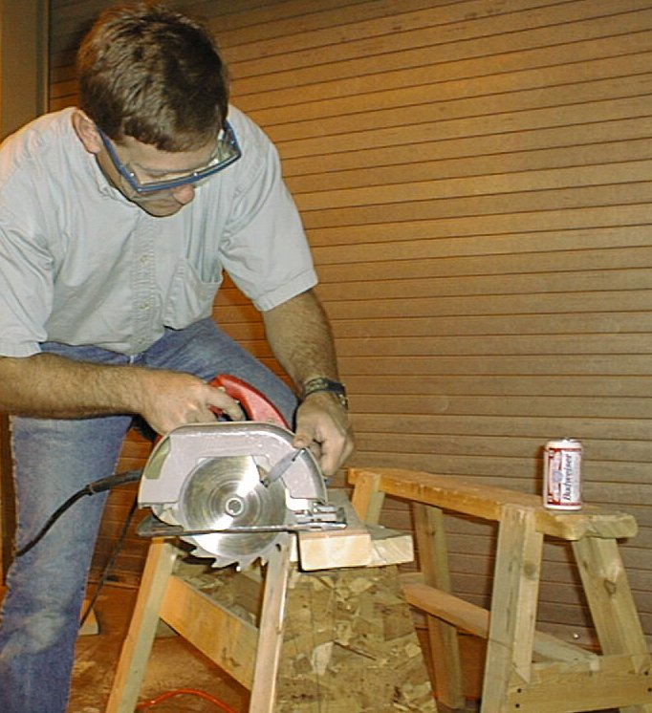
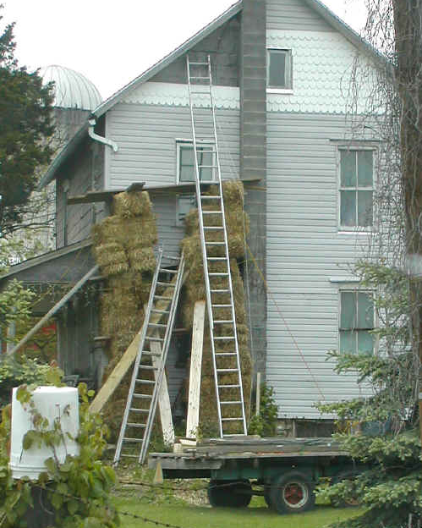
Worker Safety
REGULATIONS AND STANDARDS
Is it safe?
Photos courtesy of Pennsylvania College of Technology
Notes:
When monitoring or inspecting in-progress jobs, look at the job site and ask yourself, “Is it safe?”
Q: What’s wrong with the picture on the right?
A: Ladder scaffolding must be approved by the Occupational Safety and Health Administration (OSHA) or it must be free-standing steel scaffolding. OSHA provides various resources and sets standards for worker and workplace safety requirements.
Q: What’s wrong with the picture on the left?
A: Drinking on the job is absolutely forbidden. The short piece of lumber being cut should be clamped to the saw horse. Also, the saw blade is reversed.

Slide 32
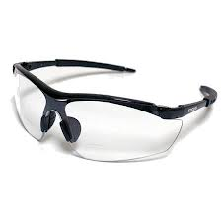
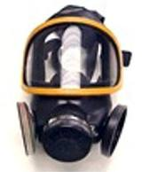
Worker Safety
REGULATIONS AND STANDARDS
On in-progress visits, make sure workers:
Follow safety regulations.
Use personal protective equipment.
Images courtesy of safetyglassesdepot.com and osha.gov
Notes:
On in-progress visits, make sure workers are:
Following safety regulations.
Wearing personal protective equipment (PPE).

Slide 33
Monitor/Inspector Requirements
REGULATIONS AND STANDARDS
Monitors and inspectors must possess a working knowledge of:
U.S. Department of Energy (DOE) Weatherization Assistance Program Regulations and Policy. <www.waptac.org>
U.S. Environmental Protection Agency (EPA) guidelines for asbestos, lead, mold, and other health hazards. <www.epa.gov>
Occupational Safety & Health Act (OSHA) standards. <www.osha.gov>
Material safety data sheets (MSDS).
Notes:
Monitors and inspectors must possess a working knowledge of:
Weatherization Assistance Program regulations and policies on worker safety.
U.S. Environmental Protection Agency (EPA) guidelines for asbestos, lead, mold, and other health hazards. In homes built before 1978, lead-safe weatherization (LWS) practices are required to minimize the dangers of lead dust. An EPA Certified Renovator must be on site to oversee any work that disturbs lead paint.
Occupational Safety & Health Act (OSHA) standards (available at <www.osha.gov>).
Material Safety Data Sheets (MSDS). These contain data on the properties of potentially unsafe substances. MSDS provide workers and emergency personnel with procedures for safely handling or working with those substances.
Hand out the MSDS on two-part foam, “OSHA Fall Protection Tips,” and “OSHA Fact Sheet – Outreach Training Program.” Review documents in class, pointing out the important elements.

Slide 34
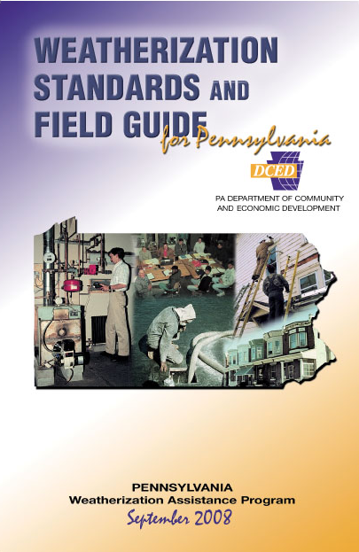
Best Practices
REGULATIONS AND STANDARDS
Best Practices:
Explain how to do the right things the right way.
Go well beyond standards.
Offer a consistent technical approach.
Promote quality workmanship.
Help with quality assurance.
Courtesy of the Pennsylvania College of Technology
Notes:
As a monitor or inspector, you may visit and evaluate more than one contractor or agency. This puts you in an ideal position to share best practices throughout the network. Use site visits as an opportunity to commend good work and perform impromptu on-the-job training when the opportunity presents itself.
Best practices are guidelines for how work should be performed by auditors and workers in the field.
Best practices include:
Explain how to do the right things the right way.
Go well beyond standards.
Offer a consistent technical approach.
Promote quality workmanship.
Help with quality assurance.
Field guides are an effective means of communicating best practices. One example is the “Midwest Weatherization Best Practices Field Guide.” Technical briefs, such as “Combustion Appliance Safety & Efficiency Testing” published as part of the DOE Hot Climate Initiative, are another excellent resource.
Reference the “Midwest Weatherization Best Practices Field Guide” and hand out “Combustion Appliance Safety & Efficiency Testing.”

Slide 35
What is Required?
REGULATIONS AND STANDARDS
Exercise: What is Required?
45 Minutes
Notes:
While monitoring or inspecting, you may have to determine whether measures were installed in accordance with local codes. The following exercise gives you some practice.
Introduce Exercise #1: What Is Required? (45 minutes). Refer to Lesson Plan for details. Hand out Applicable Codes Table.

Slide 36
Insulate over Knob and Tube Wiring
REGULATIONS AND STANDARDS
Photo courtesy of the US Department of Energy
Notes:
Knob and tube wiring is common in homes built before World War II. Properly installed and used as designed, it is safe. Problems typically arise from circuit over-fusing and overloading and from amateur modifications.
Codes and rules govern weatherization measures that come into contact with knob and tube wiring.
The 2008 NEC 314.29 requires that all wiring junction boxes remain accessible. Flagging all boxes before insulating over them achieves this easily.
The 2008 NEC 394.12 forbids enveloping knob and tube wiring in thermal insulation. While it is a national code, it is enforced at the state and local levels.
Usually, one of the national building codes⎯all of which reference the NEC for electrical requirements⎯is the basis for state and local codes. Therefore, if a building code is in effect, the NEC knob and tube ban is also in effect, unless the code has been amended locally.
DOE’s official position on installation of thermal insulation around knob and tube wiring is stated in DOE’s October 21, 1988, memorandum: “…it is the state’s responsibility to ensure that such work be in conformance with the applicable codes in the jurisdiction where the work is being performed.”
DOE policy allows insulating around knob and tube wiring if certain conditions are satisfied:
All affected live knob and tube wiring is visually examined to see that it is in good condition, and tested to see that the circuit voltage drop is less than 10%.
The circuit breaker or fuse controlling the circuit is matched to the wire gauge.
#14 wire = 15 amp fuse/circuit breaker
#20 wire = 20 amp fuse/circuit breaker
Correct amperage “S” type fuses are installed if the fuse panel has screw-in fuses.
All affected circuits in walls are evaluated, not just visible wiring in attics.
A state weatherization program wishing to take advantage of the DOE policy must say it is doing so in its DOE state plan, and must also determine that the activity is allowable under any applicable state and local codes.
Applicable codes/rules:
2008 National Electric Code 314.29 and 394.12
DOE Memorandum

Slide 37
Attic Venting
REGULATIONS AND STANDARDS
Photo Source: US Department of Energy
Add attic venting as necessary
Attic flat: 8 ft. x 26 ft.
Slopes: 8 ft. x 26 ft. x 2
Existing: Two 12 in. x 18 in. louvered end vents
No ridge vents; No soffit vents
All ceilings coated with vapor barrier paint
Notes:
Add attic venting as needed. Attic (and crawl space) venting is extremely controversial. The IRC requirement for attic venting of 1 sq. ft. of net free vent area for every 300 sq. ft. of attic space (1/300) is an arbitrary number dating back to a 1942 document with no citations or references¹.
Refer interested students to DOE’s Building America program or <www.buildingscience.com>. Both have extensive coverage of the pros and cons of attic and crawl space venting, along with code-approved alternatives.
Applicable codes/rules:
IRC 806.1 – 806.4
EPA/OSHA lead paint rules and regulations (if house was built before 1978)
¹Rose, William B. Early History of Attic Ventilation. Building Research Council – School of Architecture, University of Illinois at Urbana-Champaign. 1995.

Slide 38
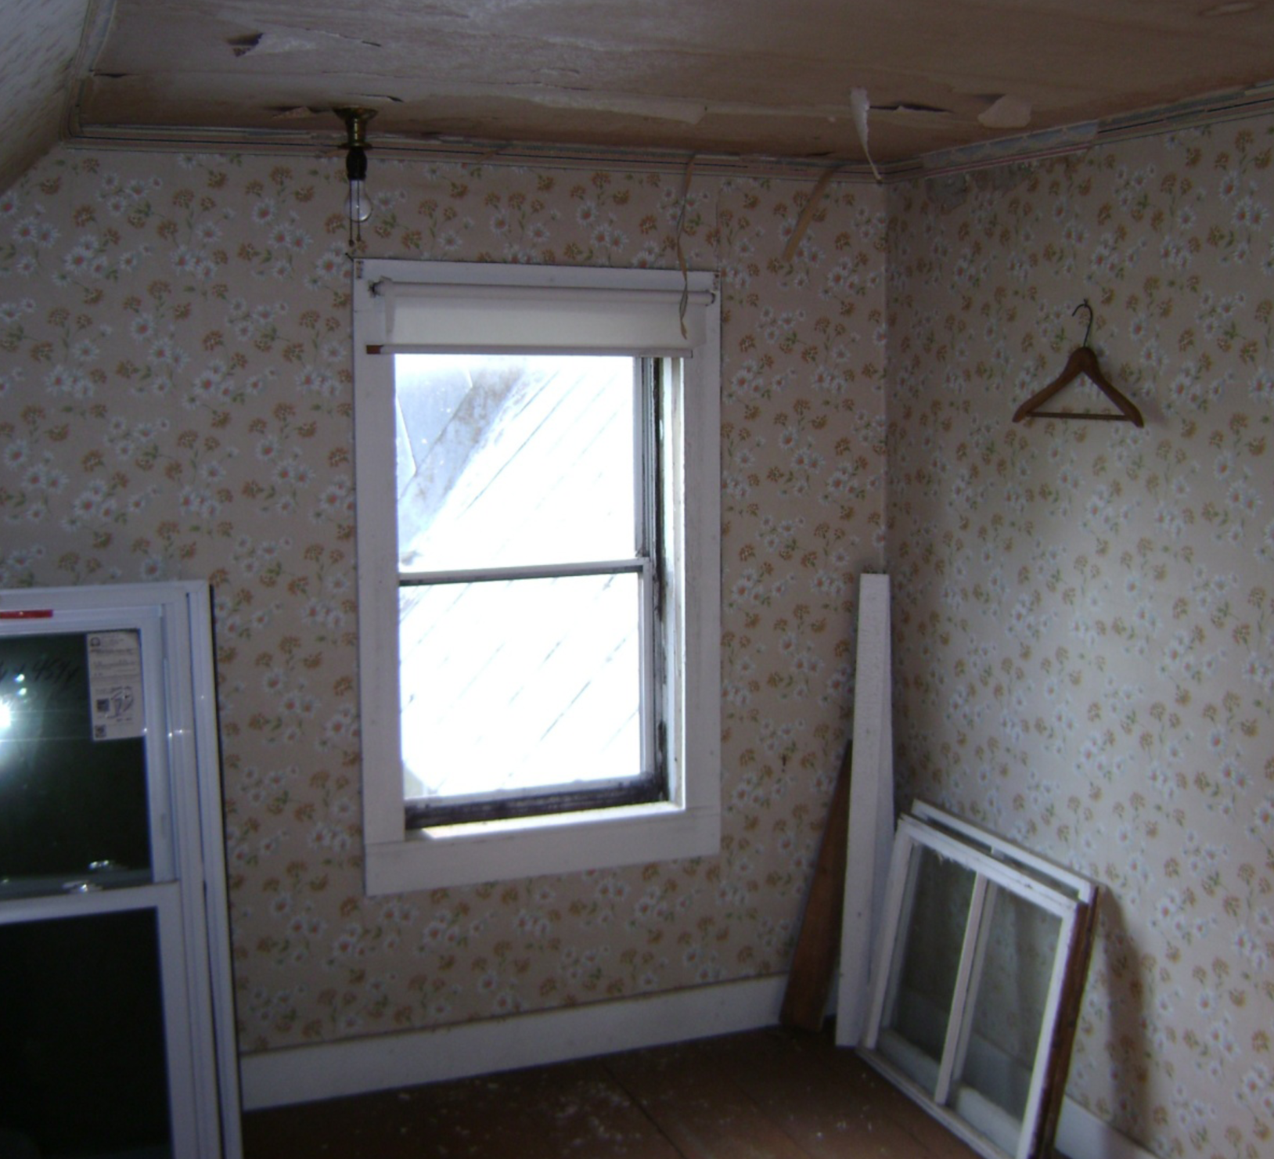
Replace Bedroom Window
REGULATIONS AND STANDARDS
House built in 1900
2nd floor bedroom has only one window
Sash area is 27 in. x 44 in.
Existing window is single hung
Photo courtesy of the US Department of Energy
Notes:
Applicable codes/rules:
National Fire Protection Association egress code, 2006 & 2009 IRC 310.1 - 310.4
Q: Is the replacement window “grandfathered?”
A: No.
WPN 09-6 and EPA/OSHA lead paint rules and regulations (if house was built before 1978)

Slide 39
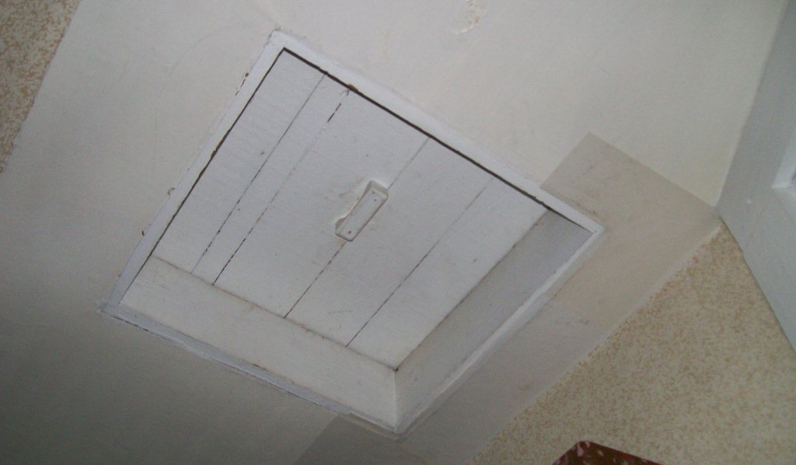
Replace Attic Hatch
REGULATIONS AND STANDARDS
Photo courtesy of the US Department of Energy
Notes:
Applicable codes/rules:
2009 IRC 807.1
WPN 09-6 and EPA/OSHA lead paint rules and regulations (if house was built before 1978)

Slide 40
Install New Bath Fan & Control
REGULATIONS AND STANDARDS
How many CFM?
How controlled?
Photo courtesy of the US Department of Energy
Notes:
Applicable codes/rules:
National Electric Code
Anyone can disconnect electrical wiring, but only a licensed electrician or the resident homeowner can connect electrical equipment.
2009 IRC 1501.1 – Bath fan may not discharge into any part of the attic
WPN 09-6 and EPA/OSHA lead paint rules and regulations
ASHRAE 62.2 -2010
Note: Use next slide for volume and square footage of conditioned space.

Slide 41
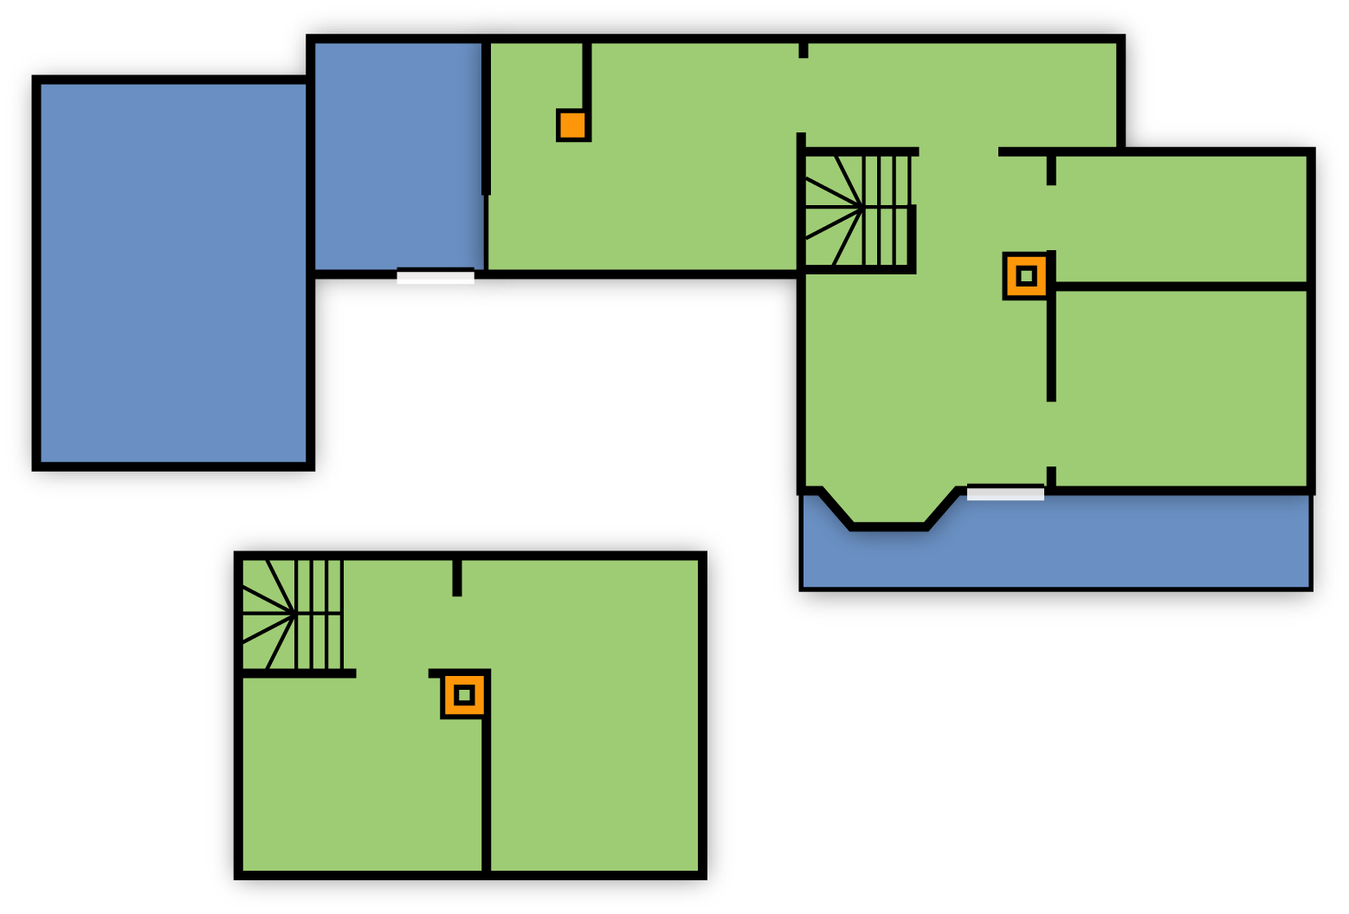
Floor Plan
REGULATIONS AND STANDARDS
15’
16’
Den
8’
N
Shed
12’
Kitchen
Bath
Garage
16’
Heated volume = (+/-) 9,000 cu’
12’
Living
BR
Open Porch
Hall
26’
BR
= heated = no heat
• 7 ft. cellar under main house.
• Den & kitchen floor ≈ 1 ft. clearance to ground.
BR
Second Floor
Image created for the US DOE WAP National Standardized Curriculum
Notes:
Use dimensions from this slide to calculate bath fan cubic feet per minute (CFM) and run time.
Refer to Lesson Plan for calculations.

Slide 42
Summary
REGULATIONS AND STANDARDS
Measures must be listed and conform to Appendix A standards.
Measures must have SIR ≥ 1 based on local costs and savings.
Client must accept measures.
Inspect or monitor to applicable rules and codes.
When monitoring in-progress units, ensure that safe work practices are used.
Incorporate training into monitoring and inspecting whenever possible by sharing best practices in the field.
Ensure measures are clearly and accurately charged as either incidental repairs or H&S measures consistently.
Notes:
Measures must be listed and conform to Appendix A standards.
Measures must have an SIR ≥ 1 based on local costs and savings.
Measures may not be installed if the client does not accept them.
Inspect or monitor to applicable rules and codes. Make sure installers know the applicable standards.
When monitoring in-progress units, ensure that safe work practices are used.
Incorporate training into monitoring and inspecting whenever possible by sharing best practices in the field.
Ensure measures are clearly and accurately charged as either incidental repairs or H&S measures consistently. Refer to WPN 12-9 (or most recent) for definitions and guidance of incidental repair measures.
Present this slide as an interactive discussion, soliciting personal examples from the trainees. Add your own personal examples and knowledge to supplement.

