Slide 1
House as a System
QUALITY CONTROL INSPECTOR
WEATHERIZATION ASSISTANCE PROGRAM STANDARDIZED CURRICULUM – September 2012

Slide 2
Learning Objectives
House as a system
By attending this session, participants will be able to:
Discuss the potential for interaction among building components and mechanical systems.
Give examples of how air sealing a home can negatively affect building durability and indoor air quality.
Recognize typical air leakage sites and explain how to deal with them.
Notes:
By attending this session, participants will be able to:
Discuss the potential for interaction among building components and mechanical systems.
Give examples of how air sealing a home can negatively affect indoor air quality.
Recognize typical air leakage sites and explain how to deal with them.

Slide 3
House as a System
House as a system
A house is a system of interdependent parts.
The operation of one part affects many others.
When they all work together, the house is comfortable, safe, efficient, and durable.
A house will experience problems when its house parts don’t work together properly.
Some obvious, some invisible
Some now, some years down the road
Notes:
A house is a system of interdependent parts: mechanical and physical components.
The operation of one part affects many others.
When they all work together, the house is comfortable, safe, efficient, and durable.
If we approach the house as a system of interactive parts, the savings mount and health and safety issues are avoided.
Air sealing and insulating a home reduces the heating and cooling load. A replacement furnace in a sealed and insulated home can be smaller than the existing furnace. The initial price of the smaller unit is lower, and the long-term operating costs will be less.
A house will experience problems when its house parts don’t work together properly.
Some problems are obvious. Some are invisible.
Some problems appear now. Some appear years down the road.
Building failures are symptoms of failures in the house as a system. As weatherization workers, we need to find the underlying problem, not just replace the rotted wood.

Slide 4
House as a System
House as a system
Diagram courtesy of John Tooley
Notes:
Click to highlight arrows pointing to various elements, as outlined in list below.
Buildings are systems. Everything in a building has the potential to interact with everything else.
Moisture through concrete, grading, landscaping, gutters, and downspouts
Moisture from cooking, showering, and faucet aerators
Air infiltration at windows and doors
Air exfiltration at cathedral ceilings and recessed light fixtures, i.e., “can lights” or “pot lights”
Garages and carbon monoxide (CO)
Atmospheric combustion appliances
Occupants and how they use the home
The tighter the building, the stronger the interaction will be.
Codes that control trades practices were, for the most part, written when this potential was essentially insignificant. Consequently, individual tradesmen performing code-compliant work can create potentially harmful situations without realizing they have done so.
Example: Heating codes commonly ensure sufficient combustion air by requiring so many cubic feet of space per BTU/hr input of the appliance. These codes were established when basements were commonly rubble stone or granite slabs. Concrete is inherently tighter, but the codes haven’t changed to reflect that.
Energy auditors, and now technical monitors and inspectors, are the only people commonly trained in house-as-a-system science!

Slide 5
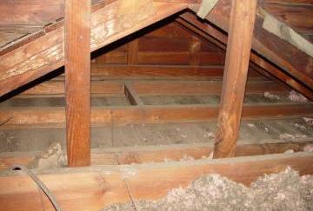
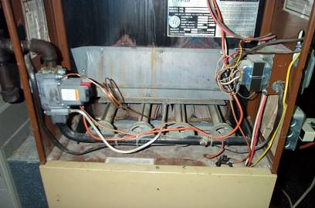
Examples – House as a System
House as a system
Photos courtesy of The US Department of Energy
An uninsulated attic...
…makes the heating and cooling system work harder than necessary.
Notes:
An uninsulated attic or other failure in the thermal boundary or air barrier makes the heating and/or cooling system work harder.

Slide 6
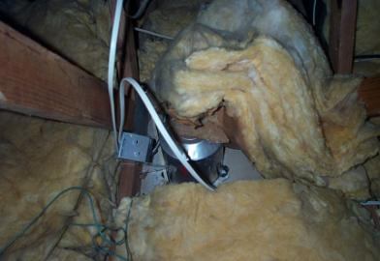
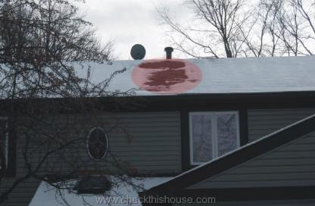
Examples – House as a System
House as a system
Photos courtesy of The US Department of Energy
Leaky recessed lighting fixtures...
…increases heat loss/gain, and can cause ice dams.
Notes:
Leaky recessed light fixtures increase heat loss and gain and can cause ice dams and moisture problems. Note the highlighted portion of the photo on the right showing the melted snow. Melted snow on parts of the roof often indicate a leak in the thermal and/or pressure boundary allowing heat to escape into the attic.

Slide 7
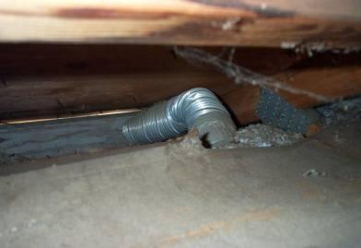
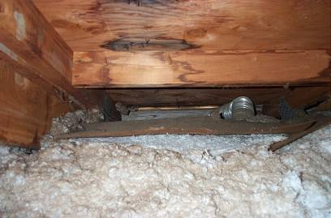
Examples – House as a System
House as a system
Photos courtesy of The US Department of Energy
This bathroom exhaust fan does not exhaust to outdoors–just to the soffit.
The moisture condenses on the roof deck and trusses causing damage.
Notes:
Fans that exhaust into the attic or crawl space cause moisture to condense on the roof deck and trusses, weakening the structure. This problem could exist unnoticed for years, causing poor indoor air quality (IAQ) and expensive structural damage.

Slide 8
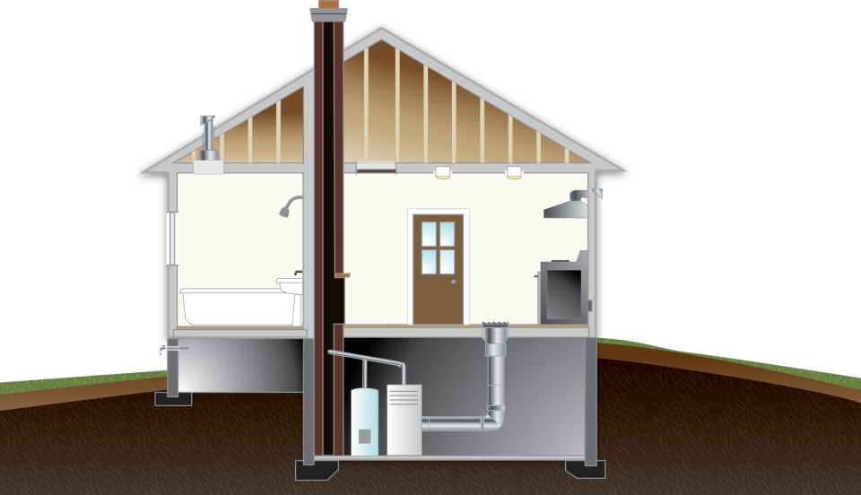
Ventilation & Air Change
House as a system
Why seal the leaks at all?
Image created for the US DOE WAP National Standardized Curriculum
Notes:
Click to reveal arrows indicating air leaking in and again to reveal air leaking out.
Plugging the holes and then putting in fans is counterintuitive to most people. But air sealing without attention to adequate ventilation can cause poor IAQ because odors and moisture can build up. The moisture can lead to mold, mildew, and degraded building durability.
The “old-timers” believed that “houses have to breathe,” and left them loose. But leaving houses leaky enough to provide good indoor air quality in spring and fall also leaves them drafty, which makes them expensive to heat and cool.
The first energy crisis inspired a wave of insulating without considering moisture build-up or IAQ. The results were odors, rot, and mold.
A house that is properly air sealed and mechanically vented has the correct amount of air exchange all the time. Heating properly air-sealed homes is also significantly cheaper than “letting the house breathe.”
The blue arrows represent infiltration, the red arrows represent exfiltration. Because holes at the top and bottom are the ones most involved with the stack effect, sealing them is the first priority.
Intermediate-level holes⎯those around living space windows and doors⎯are more of a comfort issue than an energy conservation issue simply because the stack effect has little effect on them.
Wind-driven air leakage, which can occur at windows and doors, is mostly a function of building exposure. Unless the building is severely exposed to the wind, window and door leakage will have little effect on the air change rate. In homes with normal exposure, it is acceptable to only weatherstrip and air seal the windows and doors the homeowner complains about.

Slide 9
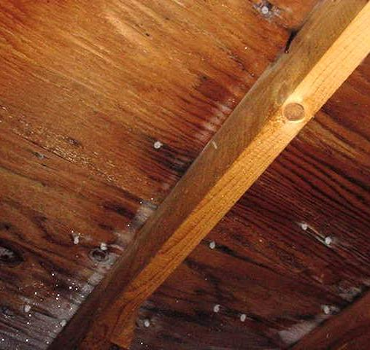
In the Attic…
House as a system
2 in. x 6 in. rafters with plywood decking
White “dots” are frost on nail points
Photo courtesy of The US Department of Energy
Notes:
Small holes in the attic floor⎯at pipes, wires, and the chimney chase⎯allow heated air from the living space to enter the attic.
The entering air will be relatively warm and wet compared to a cold attic in winter.
Moisture from the warm-wet air condenses on the first cold surface it contacts⎯typically, the most northerly walls and the underside of the roof deck.
The water reacts to gravity, runs down to stain the ceiling, and looks like a roof leak.

Slide 10
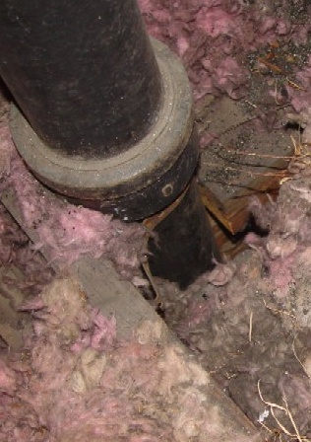
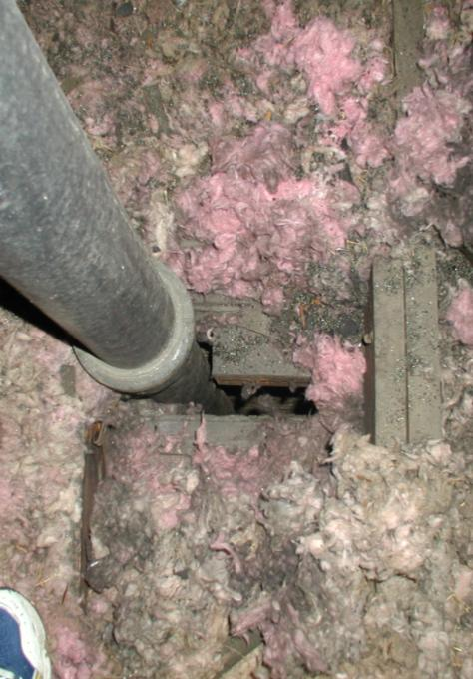
Plumbing pipe and dirty insulation are clues…
…that an attic bypass is allowing air flow through the insulation.
Photos courtesy of The US Department of Energy
Notes:
These are photos of pipe/wire bypasses.
Dirty insulation⎯particularly fiberglass⎯can help you pinpoint air bypasses.

Slide 11
Chimney Chases
House as a system
Photo courtesy of The US Department of Energy
Notes:
Chimney chases are almost universally ignored during initial construction. There is little differentiation between new and old construction.
From an energy perspective, the area around the chimney is absolutely the worst place to have a vertical hole in a house.
It is the only hole that’s guaranteed to be a bypass between the basement and the attic. The chimney’s heat causes the air column around it to suck air from the basement and pressurize the attic.
Many prematurely failed roofs in heating climates are solely attributable to an unsealed chimney chase simply because the air pulled from the basement is often very humid. The resulting condensation on the underside of the roof deck can cause it to rot and load the underside of the shingles with moisture, causing them to expand and curl up at the ends. As the sun dries them, the shingles contract back to their normal shape. The constant flexing causes premature shingle failure.

Slide 12
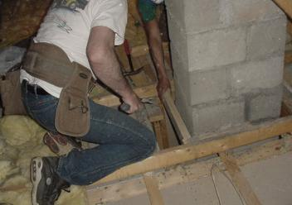
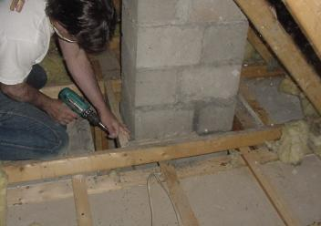
Treating the Chimney Chase
House as a system
Photos courtesy of The US Department of Energy
Notes:
Dirty fiberglass around the chimney points to an air leak from below.
Clearances are important. Fire code requires a 2 in. clearance from combustibles.
The air seal from the chimney to the ceiling below must be complete.
Note the “shine” below the tape to the left of the chimney in the upper right picture. That’s a light reflecting off the boiler smoke pipe in the basement.

Slide 13
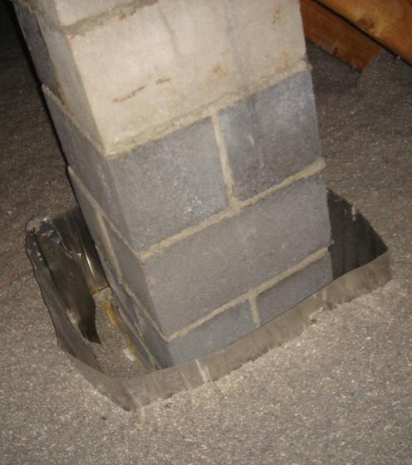
Sealed Chimney Bypass
House as a system
Sealed chimney bypass…
…with insulation barrier.
Photos courtesy of The US Department of Energy
Notes:
The red line between the chimney and the metal air barrier is high-temperature caulk, which is required by code.
The underside of the metal is caulked to the ceiling framing.
Scrap pieces of drywall complete the air seal from new framing to the existing ceiling.
The last step is installing a metal dam to keep insulation at least 2 in. away from the chimney.

Slide 14
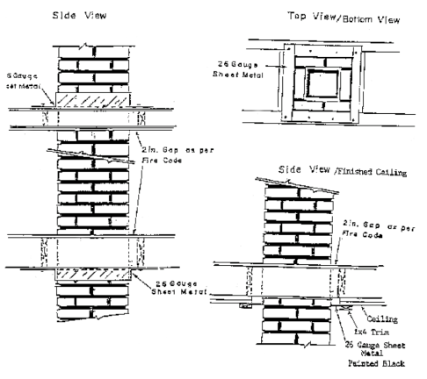
An Alternative Method
House as a system
Detail for Sealing Thermal Bypass Around Chimney
Photos courtesy of The US Department of Energy
Notes:
The image on the left is a diagram from Maine’s DOE WAP Manual.
With an exposed chimney, it is permissible to create the air seal in the living space at the ceiling if 1) it matches the general style and construction quality of the home and 2) the homeowner agrees.
The insulation dam is still required in the attic.

Slide 15
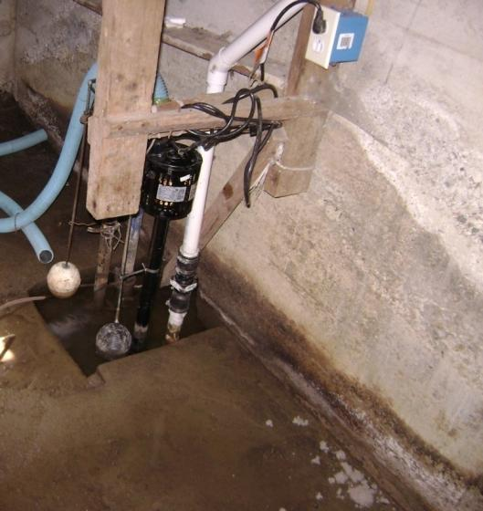
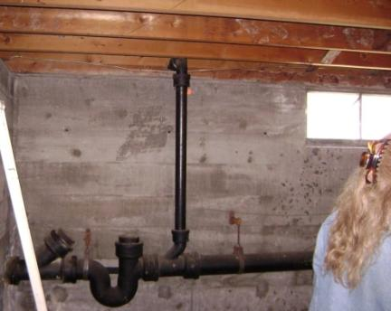
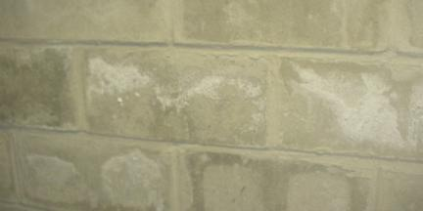
In the Basement
House as a system
Minor mold on floor stringers
Spauling
Mold on cement blocks
High water mark
High standing water
Spauling on cement blocks
Photos courtesy of The US Department of Energy
Notes:
Notice the spauling (the white, chalk-like coating on the concrete caused by water picking up salts as it migrates through the concrete, then leaving them on the surface when it evaporates) as well as the high water mark and standing water. The sewer cleanout is plugged with a wood stopper. There is minor mold on the cement blocks and floor stringers.
Q: Square foot for square foot, what evaporates more water vapor into the air: standing water or concrete without a vapor barrier?
A: Concrete, because it has more surface area.
Without a vapor retarder in, on, or below the concrete floor, ground moisture is constantly radiated into the basement.
Even with a vapor retarder, ground moisture will enter the basement through cracks and holes.
Soil gases will enter with the moisture.
Mechanical appliances can produce airborne pollutants.
Many things stored in the basement can give off gas. Typically, we find detergents, paint, hobby chemicals, cleaning solvents, etc.
Dirt floors and crawl spaces are even more problematic.
Basements are typically well connected to the living space. Whatever is in the basement, occupants breathe in the living space.
Duct leaks can have many consequences:
The heat that leaks out of the ducts warms an area you don’t want heated.
Cold air is pulled into the heating system from the basement.
Heated air is forced out of the home.
Basement pollutants are delivered to the living space.
Remember: Whatever is in the basement, occupants breathe in the living space.

Slide 16
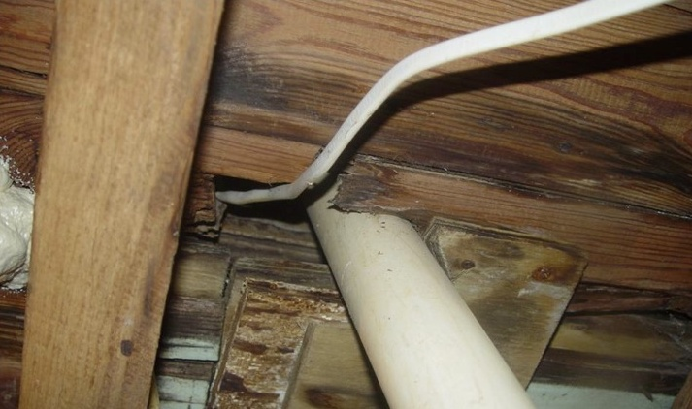
Plumbing and Wire Opening
House as a system
Photo courtesy of The US Department of Energy
Notes:
All types of holes give basement air free access into first-floor wall cavities. They will be connected, in turn, to upper floor cavities and the attic.

Slide 17
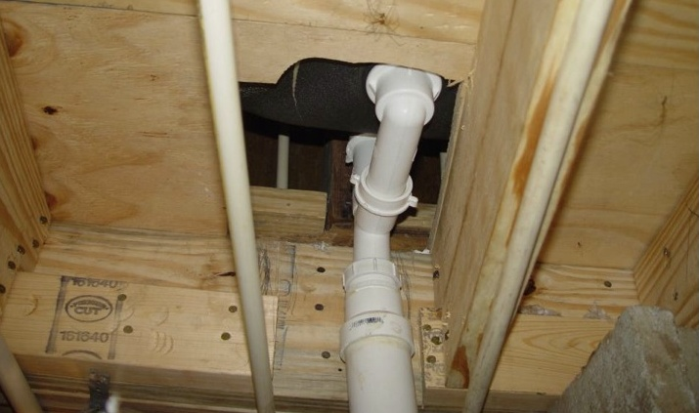
Under the Tub
House as a system
Photo courtesy of The US Department of Energy
Notes:
This opening under the tub looks innocent enough. It is almost certainly connected to vertical chases behind the tub/shower that are, in turn, connected to upper floor cavities and the attic.

Slide 18
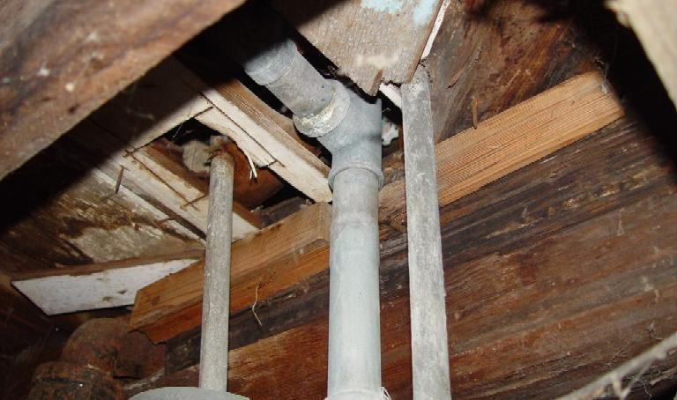
Another Tub
House as a system
Photo courtesy of The US Department of Energy
Notes:
The situation in the photo here is similar to the previous slide but in an older home.

Slide 19
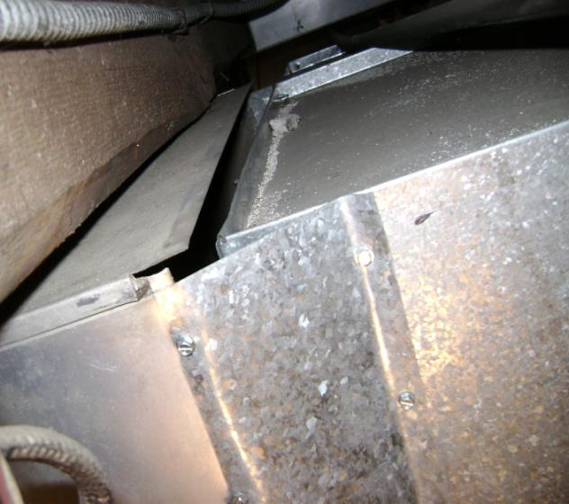
More in the Basement
House as a system
Top of connection between heat delivery plenum and main trunk
Photo courtesy of The US Department of Energy
Notes:
The installer couldn’t fit his arm into the space between the plenum and the ceiling so he didn’t bother finishing this job.
This situation pressurizes the basement, forcing air out along the sill. It can “power rot” the basement box sill assembly, while wasting significant energy.
The “cure” was drywall mesh tape, a good quality duct mastic such as RDC #6, and a short stick.

Slide 20
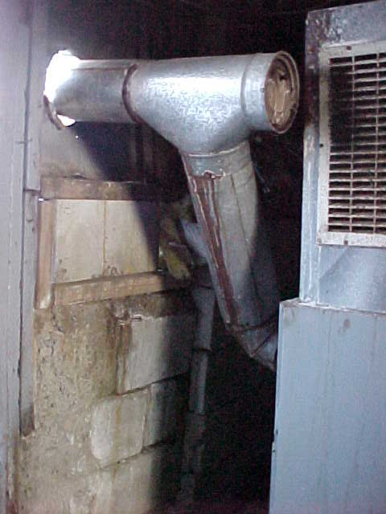
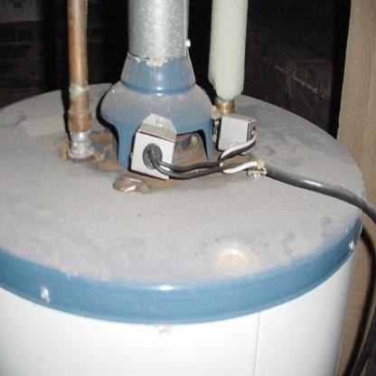
More in the Basement
House as a system
Danger!
Grille cut into return plenum sucks on barometric damper
Thermocouples shut off flame when backdrafting occurs, but real culprit is leaky return ductwork on furnace (not shown).
Photos courtesy of The US Department of Energy
Notes:
The picture to the left shows a grille cut into the return plenum to prevent the duct from banging when the air handler started up. The air handler fan now sucks directly on the barometric damper. This house has, in effect, a power vent chimney. All combustion byproducts are being delivered to the occupants to breathe. This is extremely dangerous!
Even oil units can produce CO under these conditions. Oil combustion also produces aldehydes⎯toxic byproducts of oil combustion⎯and other pollutants.
On the right, we see the top of an atmospheric gas water heater. Because the vent system backdrafted repeatedly to the point of burning the paint off the water heater, someone installed thermocouples to shut down the gas flame whenever backdrafting occurred. The real culprit was leaky return ductwork on a warm air furnace (not pictured) sucking on the basement.

Slide 21
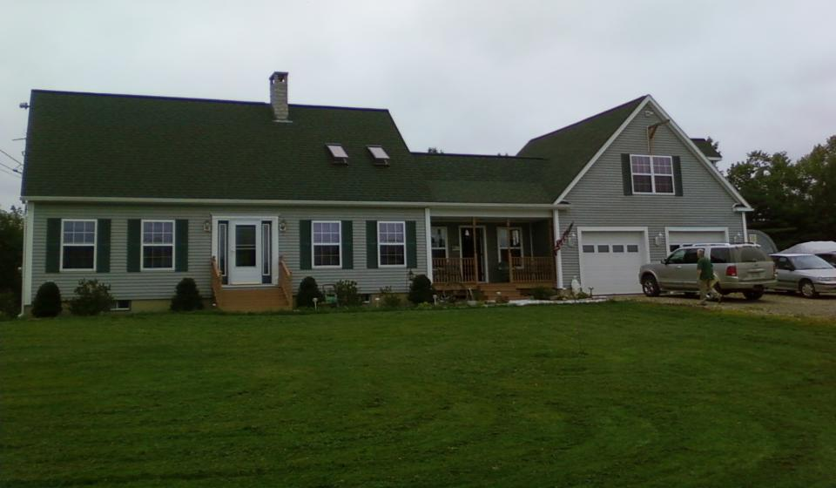
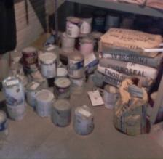
In the Garage
House as a system
Photos courtesy of The US Department of Energy
Notes:
Q: What are some pollutants typically stored in the garage?
Click to reveal selection of pollutants typically found in the garage.
The garage floor has the same moisture characteristics as the basement floor.
Garages are even more likely than basements to contain stored “off-gassers,” such as automobiles, lawn mowers, and other fossil-fueled machines.
Catalytic converters in cars emit low levels of CO for approximately four hours after the car is shut off!
Garages typically have a low “air-feed” (the lower edge of the overhead door) and high “relief” (pipe and wire penetrations near the ceiling). Or they are totally open to the living space attic. Anything breathable in the garage is soon inside the home.
It is extremely important to isolate the garage from the living space to the greatest degree possible to ensure our weatherization activities⎯particularly measures that reduce the natural air change rate in the living space⎯do not concentrate pollutants that previously escaped. A post-weatherization check of any isolation measures using pressure diagnostics is imperative!

Slide 22
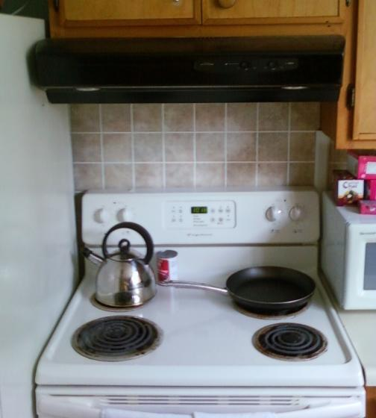
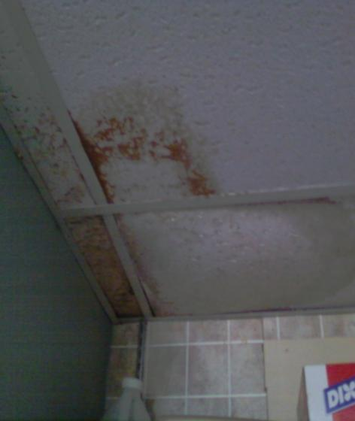
In the Kitchen and Bathroom
House as a system
Photos courtesy of The US Department of Energy
Notes:
Showering creates large amounts of airborne moisture, as does cooking without using pot lids.
Existing vent fans are typically underpowered and noisy. Often, they’re not vented to the exterior. When they are, the ducts often leak or restrict airflow. Even a good fan does nothing if it isn’t used.
Remember when evaluating homes with gas ranges or cooktops that gas code requires they be vented to the building exterior through a hard-ducted vent hood. Recirculating models do not satisfy the code requirement. Always consider installing good quality CO detectors in homes with gas appliances.
With a properly functioning ventilation system, moisture and other pollutants are kept from entering the home. Any pollutant⎯and moisture is considered a pollutant for the purposes of this discussion⎯created in the home is transported safely outside through exhaust ventilation and ductwork. However, in many homes, the fans or ducts are loud, leaky, non-existent or otherwise not up to the job. Moisture created within the home condenses on cool building surfaces, both in the living space and in the attic, and causes mold, mildew, poor IAQ, and structural damage.

Slide 23
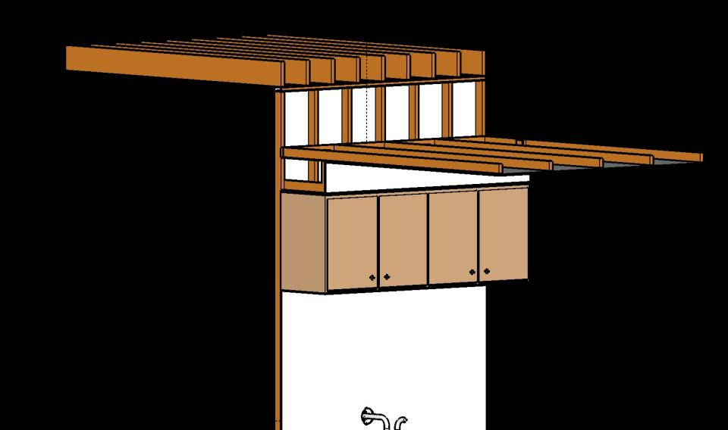
Dropped Soffits
House as a system
Kitchen wall cabinets mounted under soffit or valance
Image created for the US DOE WAP National Standardized Curriculum
Notes:
Ceiling drywall isn’t typically extended over cabinet dropped soffits.
Even if the attic is insulated, attic air has free access to the cavity, cooling the walls and cabinet.

Slide 24
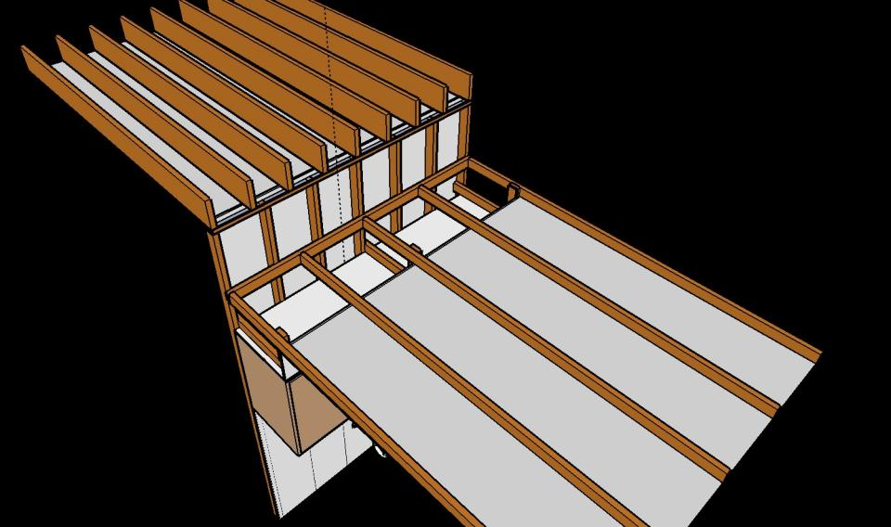
Dropped Soffits
House as a system
If you see soffit-mounted cabinets, remember to investigate during attic inspection.
Image created for the US DOE WAP National Standardized Curriculum
Notes:
If you see soffit-mounted cabinets, remember to investigate during attic inspection.

Slide 25
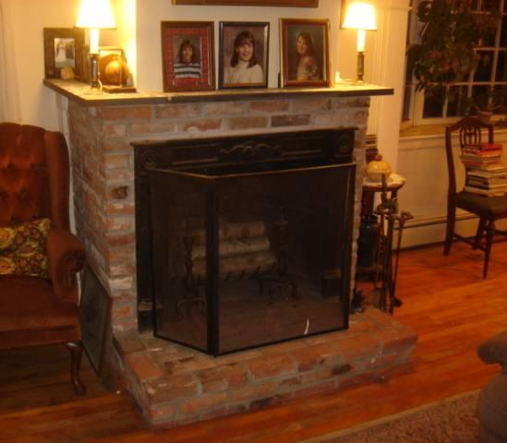
In the Living Room
House as a system
Fireplaces “net cool” all but the smallest spaces.
Photo courtesy of The US Department of Energy
Notes:
An “open-burn” fireplace (one without glass doors) pulls so much heated air from the living space it actually may cool the surrounding space.
Wing chairs and footstools were invented to shield people from the rush of air heading to open fireplaces in castles.

Slide 26
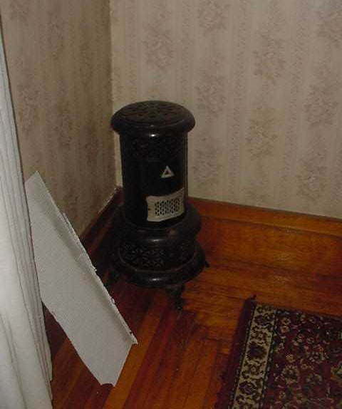
Unvented Space Heaters
House as a system
Then there are
vent-free fireplaces,
kerosene heaters,
and homemade stuff.
Photo courtesy of The US Department of Energy
Notes:
This is a photo of a kerosene wick burner heater, the predecessor of the Kerosun and other unvented space heaters.
Kerosene wick burner heaters are almost universally illegal because of their unhealthy emissions and because of the likelihood of fire. Vent-free gas fireplaces are illegal in many states because they tend to produce high levels of CO.
Instructions for vent-free fireplaces usually say to set the gas flame to blue with a yellow tip for low CO production. Further on, the instructions often say to close the air gate down for a more realistic yellow flame. A yellow flame indicates high CO production.

Slide 27
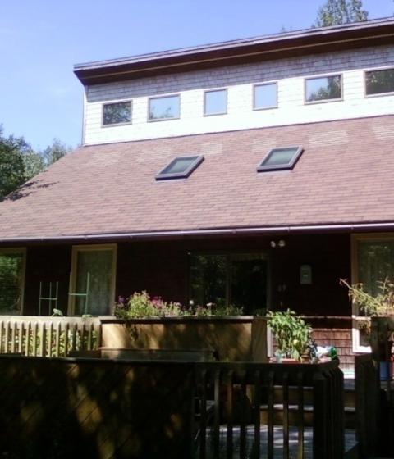
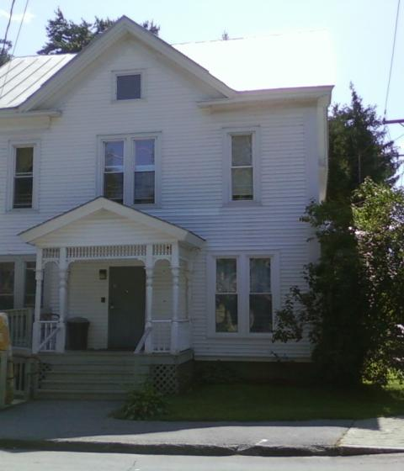
Outside
House as a system
Trees and bushes against a building prevent wall assemblies from drying.
Cathedral ceilings invite moisture and mold problems. Roof windows or recessed lights will further complicate matters.
Photos courtesy of The US Department of Energy
Notes:
The house-as-a-system concept doesn’t stop at the walls. Factors outside the home that affect structural integrity and home performance include:
Roof leaks – Water leaking into the attic damages insulation, reducing the effective R-value and increasing heating and cooling bills.
Gutters (or lack of) – Poorly installed or clogged gutters can cause moisture to drip down exterior surfaces, infiltrating cracks and crevices. This can cause structural damage and reduce effective R-values of wall insulation.
Landscaping
Ground slope – Any landscaping that guides moisture toward the home, rather than away, is poor landscaping.
Vegetation
Good design: A deciduous tree planted on the south side of the house can shade it in summer and allow low winter sun to warm the home during the heating season.
Bad design: Trees and bushes of any type that reduce air movement around the building retard drying of building components and can promote building rot.
Building design
Any building design⎯low slope or flat roof additions, abutting dormers, etc.⎯that allows water to puddle or channels it toward other building components is a poor design.

Slide 28
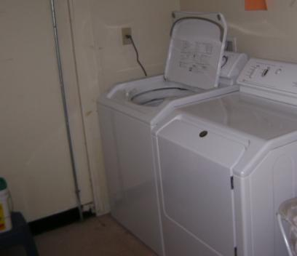
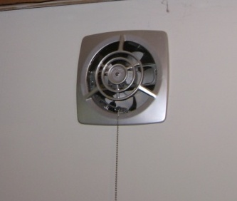
Mechanical Ventilation
House as a system
All exhaust appliances “suck” on the house.
Photos courtesy of The US Department of Energy
Notes:
Mechanical ventilation is essential in today’s homes to balance good indoor air quality and energy conservation. Homes left loose enough for moisture and odor control without using mechanical ventilation waste energy.
Types of mechanical ventilation include:
Bathroom and kitchen fans.
Clothes drier.
Central vacuum.
Whole-house ventilation.
Central heating and cooling systems.
Mechanical ventilation can pull moist exterior air into wall and ceiling assemblies in cooling environments. It may also cause backdrafting in any environment.

Slide 29
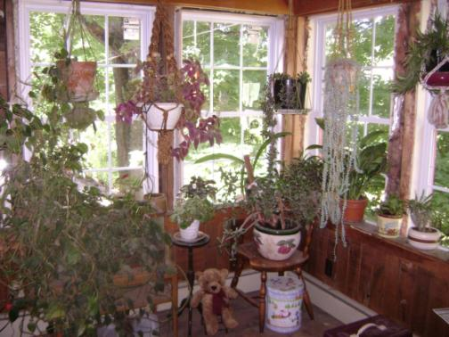
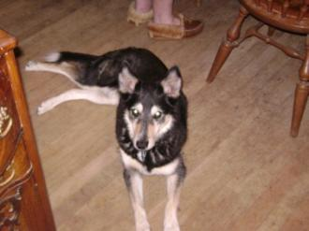
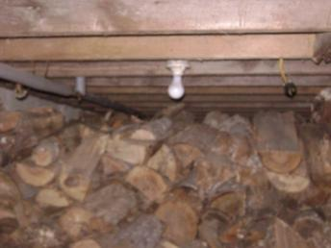
Occupant Behavior
House as a system
Photos courtesy of The US Department of Energy
Notes:
Occupant behavior is the most arbitrary factor in the IAQ and energy use of all homes. When conducting the final inspection or monitoring interview, find out how the clients use their home, and whether the auditor gave them advice for protecting IAQ.
To protect IAQ, clients should avoid:
Storing firewood inside (or outside right next to the home).
Air drying clothes inside – even in the basement.
Having numerous plants.
Using chemicals indoors without adequate ventilation.
Using “energy conservation” gadgets such as a dryer draft diverter, which will dump wash chemicals into the home along with any reclaimed heat from the dryer.
Energy use is affected by lifestyle.
Sleeping with windows open
Under or over dressing
Leaving any windows and doors open when the heat or A/C is on
Typically, it falls to the auditor to assess the impact of occupant behavior on their measure recommendations. It is extremely difficult to get someone to change a habit, and what makes sense to the auditor may not make sense to the client.

Slide 30
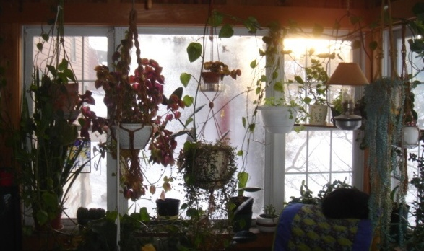
What’s Going On?
House as a system
Heavy condensation on center window.
No condensation on side windows.
Why? What is the most likely moisture source?
Photo courtesy of The US Department of Energy
Notes:
Side windows are double glazed; the center window is single glazed.
When plant watering, all water poured into plant soil eventually evaporates into the room.
Evaporated water is condensing on the cold, single-paned center window.

Slide 31
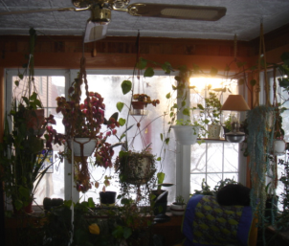
What Should Be Done?
House as a system
Add a storm window.
Replace the entire window unit.
Advise the homeowner to run the ceiling fan.
Get rid of the plants.
Photo courtesy of The US Department of Energy
It Depends!
Notes:
Choices:
Add a storm window − Relatively inexpensive with fair return (improves existing R-1 to R-2).
Replace the window unit − More expensive with better return (R-1 to ≈ R-3.5).
Run the ceiling fan − No initial cost and will raise the glass temperature over dew point, but will increase heat loss through windows and use electricity.
Eliminate the plants − Free but interferes with client lifestyle and doesn’t reduce space heat consumption.
Any of the four will work.
In the private sector, the decision would rest on homeowner resources and motivations. With DOE funding, the auditor must make the best choice for each house, considering 1) the client, 2) the future use of the building, and 3) the SIR. As the inspector or monitor, it falls to you to determine whether the auditor made an appropriate choice.

Slide 32
Something to Think About
House as a system
Houses:
Are tighter.
Have more exhaust appliances.
Have “weaker” natural draft combustion appliances.
Have less drying potential.
Diagram courtesy of John Tooley
Notes:
This slide lists the four reasons why John Tooley, a senior building science consultant for Advanced Energy, believes house-as-a-system science should dominate energy conservation retrofit decisions.
This slide and the next six were all inspired by information from John.

Slide 33
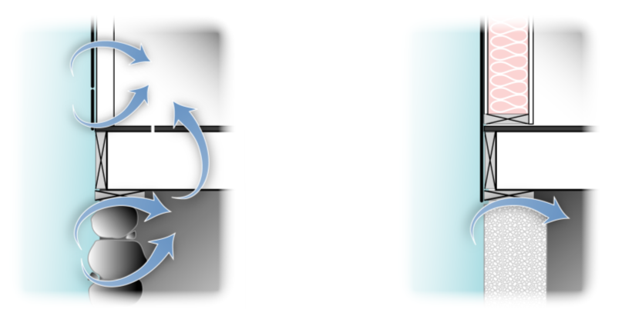
Today’s Houses Are Tighter
House as a system
Old
Boarded exterior with lath & plaster interior walls
New
Plywood & drywall
Images created for the DOE WAP National Standardized Curriculum
Notes:
Today’s houses are tighter than older houses, just by virtue of modern building materials. Compare the materials of newer homes vs. older homes:
Plywood and drywall vs. boards and plaster
Platform vs. balloon framing
Concrete vs. granite slabs or rubble stone and brick
Concrete vs. dirt floors
Vinyl thermo pane windows vs. wood sash and storms
Insulated doors vs. wooden doors
Modern caulks

Slide 34
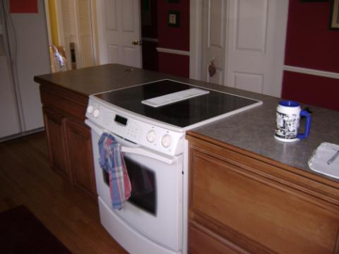
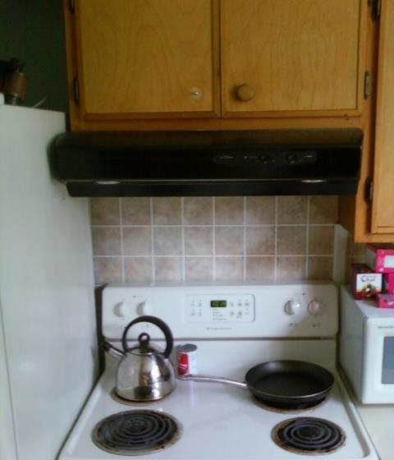
Today’s Houses Have More and Bigger Fans
House as a system
Photos courtesy of The US Department of Energy
Notes:
In addition to being tighter, today’s homes have more driving forces sucking energy from them:
More and stronger exhaust appliances
400+ CFM Jenn-aire (upper left) vs. 50 CFM kitchen paddle fan hood (right)
Direct through-the-wall fan (below)
Clothes dryers vs. drying rack or clothes line
Central vacuum
Air handlers
Central AC
Stronger furnace fans
Whole house ventilation fans
Bigger and more powerful fans in general
Tighter construction coupled with more and bigger fans increases the risks associated with depressurization, namely backdrafting of natural draft appliances.

Slide 35
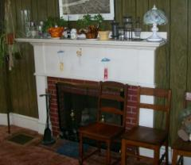
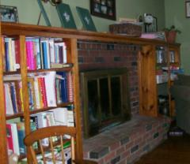
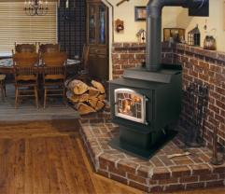
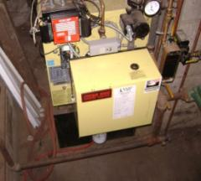
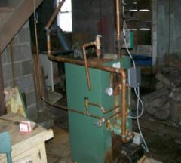
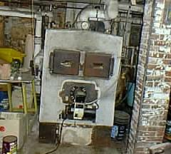
Today’s Houses Have Weaker Draft Appliances
House as a system
The weaker the draft (i.e., the higher the efficiency), the less air moves through the heating system & therefore the house.
Air Tight Wood Stove
Kuma Stoves kumastoves.com
Open fireplaces
Glass doors reduce air loss
System 2000™ 90+%
High Mass drybase boiler 80%
Converted coal boiler 50%
Photos courtesy of The US Department of Energy
Notes:
Click to reveal the progression of appliances from open fireplaces to fireplaces with glass doors to air tight woodstove to coal boiler to 80% drybase boiler and finally to a 90%+ furnace.
Ask students to name an appliance with weaker draft each step of the way.
Heating efficiency ratings are simply the percentage of consumed energy that goes up the chimney, i.e., as efficiency increases, less heat and air go up the chimney.
As we increase heating appliance efficiency, we reduce draft, which, in turn, moves less air through the building, reducing its drying capability.
The final step in efficiency improvement is a sealed combustion unit, which gets its combustion air from the outside and consequently does nothing to dry the building at all.

Slide 36
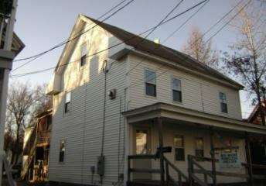
Today’s Houses Have Less Drying Potential
House as a system
The old house got wet in the summer (humid) & dried in the winter (low humidity).
The new house gets just as wet but can’t dry; therefore poor IAQ and mold/mildew.
Photos courtesy of The US Department of Energy
Older Home:
Balloon-framed two-story home (lots of stack effect).
Boards, plaster & lathe.
No insulation.
Construction style and materials inherently leaky.
Newer Home:
Low (little stack effect).
Plywood & drywall.
Construction style and materials inherently tighter than older home.
Notes:
Air moves readily through uninsulated walls and ceilings. Cavities filled with insulation slow or stop air movement.
Years ago, houses were designed to cycle wet to dry annually. That is, they got wet in humid times and dried out when the humidity dropped.
Energy savings measures generally interfere with this cycle and require moisture mitigation.
These circumstances led to the common belief that cellulose rots buildings. When cellulose first gained popularity after the first energy crisis, installers were not aware of the necessity for moisture control. The result was a large number of damaged buildings. We now know that moisture control is essential when insulating and air sealing buildings.
Modern homes generally spread out rather than up (think “ranch” vs. Victorian”), reducing the stack effect.
Better caulks and sealants, tighter construction details, and man-made materials all help keep moisture in.

Slide 37
Lifestyle Changes
House as a system
Notes:
We’ve transformed from an agrarian society to an industrialized one and from an active outdoor lifestyle to a sedentary indoor one.
Daily showers vs. weekly baths
Water “sports” include hot tubs, multiple showerheads, saunas, and indoor pools

Slide 38
Summary
House as a system
We build very differently than we did 40 years ago.
Economic pressure is driving the move to tighter houses with smaller margins of safety.
The tighter a house is, the more influence individual components have on the others.
All pollutants inside the pressure boundary will eventually be dispersed over the entire area.
Altering a building or its mechanicals can have unexpected consequences.
Notes:
We build very differently than we did 40 years ago.
Economic pressure is driving the move to tighter houses with smaller margins of safety.
The tighter a house is, the more influence individual components have on the others.
All pollutants inside the pressure boundary will eventually be dispersed throughout the entire living area.
Altering a building or its mechanical system can have unexpected consequences.
Present this slide as an interactive discussion, soliciting personal examples from the trainees. Add your own personal examples and knowledge to supplement.

