Slide 1
Auditor’s Toolbox
WEATHERIZATION ENERGY AUDITOR SINGLE FAMILY
WEATHERIZATION ASSISTANCE PROGRAM STANDARDIZED CURRICULUM – December 2012

Slide 2
Learning Objectives
Auditor’s Toolbox
By attending this session, participants will be able to:
Identify the necessary auditing tools, equipment, and their use.
Explain the purpose of various tools used by auditors.
Discuss the importance of following manufacturer’s recommendations for care and maintenance of tools and equipment.
Notes:
By attending this session, participants will be able to:
Identify the necessary auditing tools, equipment, and their use.
Explain the purpose of various tools used by auditors.
Discuss the importance of following manufacturer’s recommendations for care and maintenance of tools and equipment.

Slide 3
Auditor’s Hand Tools
Auditor’s Toolbox
Photo courtesy of The US Department of Energy
Notes:
Assorted hand tools (clockwise from lower left):
Telescoping ladder – lightweight and convenient; easy to maneuver in tight quarters
Phillips head screwdriver
Cutting pliers
Slotted screwdriver
Adjustable wrench
Razor knife
25 ft. tape measure
A good flashlight and spare batteries
Digital camera
Pen and paper
Hand out “Auditor Tool and Equipment List.” Give students a few minutes to look it over, then ask what may be missing.

Slide 4
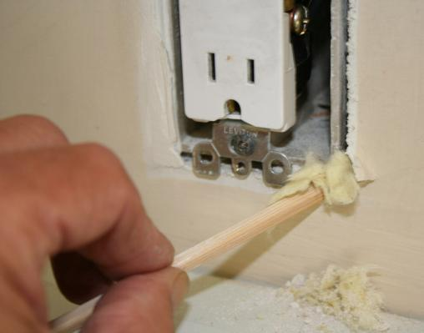
A Very Specialized Probe
Auditor’s Toolbox
Probe exterior walls to determine:
What kind and how much insulation is present.
Depth of the wall cavity.
Do this in several locations.
A non-conductive crochet hook is handy for pulling out a sample of existing insulation.
Photo courtesy of U.S. Department of Energy
Notes:
Probe walls to determine:
What kind and how much insulation is present.
The depth of the wall cavity.
One of the easiest ways to check for the presence of wall insulation is to remove a receptacle cover plate along an exterior wall and probe the wall cavity with a non-conductive probe.
A plastic crochet hook or a chop stick with a hook carved in the end of it works great for pulling out a sample of existing insulation.
Widen the gap between the electrical box and wall sheathing slightly and insert the probe to determine wall thickness and insulation type. Do this in several locations along the exterior walls.
Q: What other techniques can be used to check for existing wall insulation?
A: Infrared, selective siding removal where possible and where minimally invasive, small test hole on interior wall board and bore scope.

Slide 5
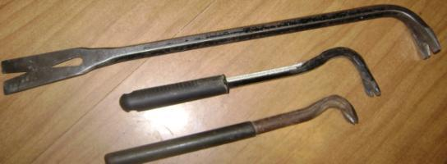
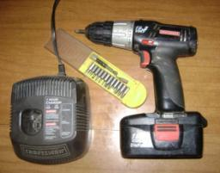
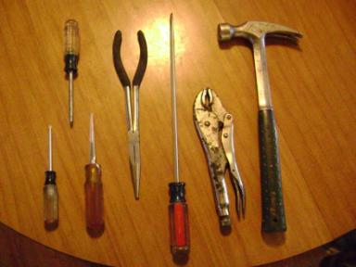
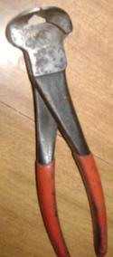
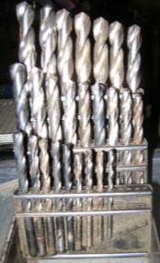
Other Specialized Tools
Auditor’s Toolbox
Photos courtesy of The US Department of Energy
Notes:
Some situations call for a specific tool (clockwise from upper left):
Pry bars and nail pullers
Cordless drill motor with assorted drivers
Drill index
Nippers with the face ground flat – used to pull nails from cement board siding
Hammer
Locking pliers
Long reach flat blade screwdriver
Long reach pliers
Reamer – to enlarge the smoke pipe hole when testing heating appliance efficiency
Square bit driver – used for mobile home siding
Star bit driver – used for mobile home siding
As with any and all tools, keep them clean, dry, and in a secure location. Occasionally apply light oil to friction surfaces.

Slide 6
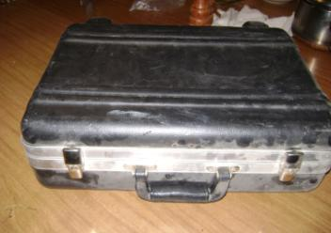
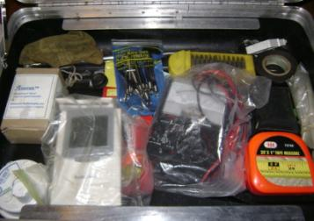
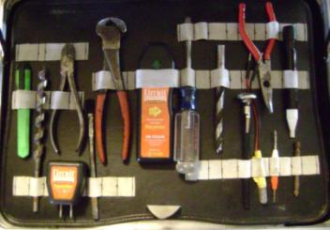
Tool Case
Auditor’s Toolbox
Photos courtesy of The US Department of Energy
Notes:
An organized case with a place for everything makes your tools easy to find. It also reduces the chance of leaving a tool behind.

Slide 7
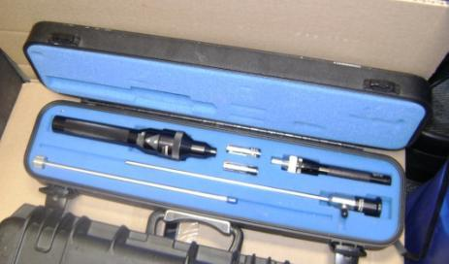
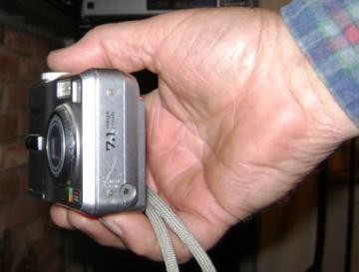
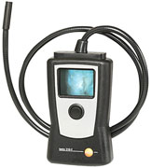
Vision Enhancers
Auditor’s Toolbox
Borescope
Digital camera
Testo Video Pro
Photos courtesy of The US Department of Energy
Notes:
Sometimes we can’t see everything we need to with the naked eye (clockwise from upper left):
Digital camera − A digital camera is like an eye on the end of your arm. You can see into any place your hand will fit.
Borescope − The borescope was designed to inspect the inside of diesel engines. The tube can be inserted through a 3/8 in. hole to view wall and ceiling cavities, etc.
Borescope with video − The Testo “Video Pro” is a borescope with a flexible tube for viewing inside cavities. It produces a video picture on the 3.5 in. screen.
Q: What’s a simple alternative to the above named devices?
A: Flashlight and mirror.

Slide 8
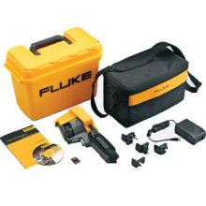
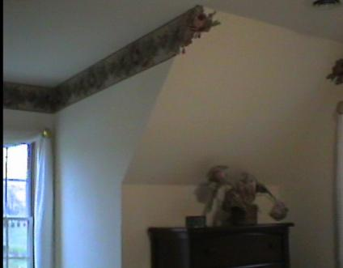
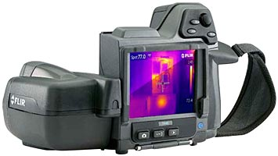
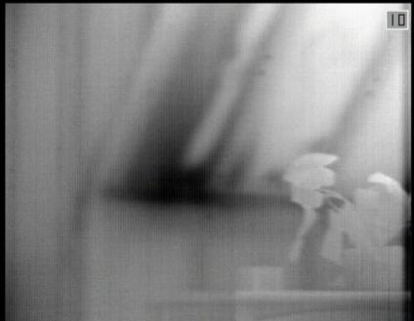
Infrared Imagers
Auditor’s Toolbox
Fluke Infrared
Flir Infrared
Photos courtesy of PA Weatherization Training Center
Infrared imagers help auditors determine:
Air leakage and presence of insulation in inaccessible building cavities.
Effectiveness of the thermal boundary.
Cold air
Photos courtesy of The US Department of Energy
Equipment photos courtesy of www.fluke.com and www.flir.com
Notes:
An infrared (IR) imager is an important diagnostic tool to help auditors determine:
Air leakage and presence of insulation in inaccessible building cavities.
Effectiveness of the thermal boundary.
Infrared imagers shown on left represent equipment that allows auditors and quality control specialists to observe and document thermal flaws in the building envelope. Imagers range in price from $2,000 to $8,000, produce moderate to superb imagery, and offer a wide variety of features.
Top right photo − A visible image of a knee wall and window dormer detail.
Bottom right photo − An infrared scan of the same area with the blower door running showing air leakage at the intersection of the knee wall and rafter cavity.

Slide 9
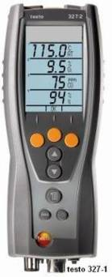
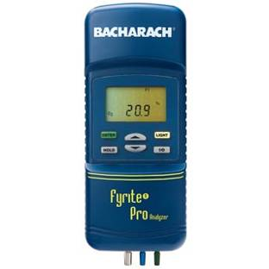
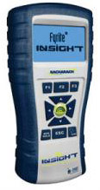
Combustion Analyzers
Auditor’s Toolbox
Bacharach Fyrite Pro
Bacharach Fyrite Insight
Testo 327-1
Photos courtesy of the manufacturers
Notes:
A wide range of combustion analyzers are available. Combustion analyzers are designed to sample flue gases in vented combustion appliances and measure:
Flue gas temperature.
Oxygen.
Draft.
Carbon monoxide (CO) in ambient air or flue gases.

Slide 10
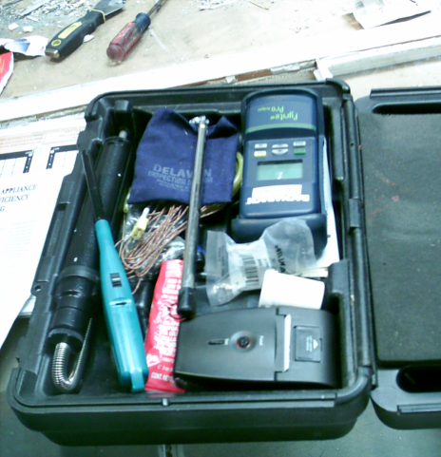
Combustion Appliance Test Kit
Auditor’s Toolbox
Keep one case just for combustion testing.
Smoke pump and filter paper
Lighter
Combustion analyzer and manual
High-temp sealant
Appropriate drill bits for test holes
Photo courtesy of The US Department of Energy
Notes:
The photo above shows combustion test equipment stored in a case.
Auditors should keep one case solely for combustion testing equipment. Pictured in this case:
Smoke pump and filter paper
Lighter
Combustion analyzer and manual
High-temp sealant
Appropriate drill bits for test holes
Organization makes the job of auditing efficient and enjoyable.
As with all hand tools, it is better to have an assigned slot for each item so it is obvious when something is missing or out of place.

Slide 11
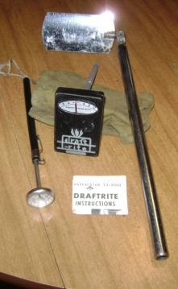
Combustion Appliance Testing
Auditor’s Toolbox
Photos courtesy of The US Department of Energy
Above (left to right):
Thermometer
Draft gauge
Inspection mirror
Above counter-clockwise from lower left:
Pipe wrenches
Long lighter
Gas leak detector
Inspection mirror
Gas leak detection bubbles
Smoke pump and smoke test filter paper
Combustion analyzer
Notes:
Shown in these photos are the components of a typical combustion testing toolkit.
In the photo on the left, left to right:
Thermometer
Draft gauge
Inspection mirror
In the photo on the right, counter-clockwise from lower left:
Pipe wrenches
Long lighter
Gas leak detector
Inspection mirror
Gas leak detection bubbles
Smoke pump and smoke test filter paper

Slide 12
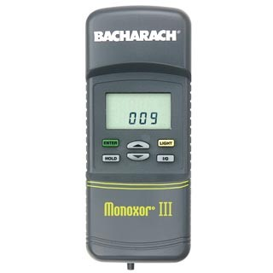
Gas Cook Stove Testing
Auditor’s Toolbox
Photos Courtesy of NRCERT
Bacharach Monoxor III
A portable flue section concentrates combustion byproducts for an accurate CO measurement.
Photos courtesy of www.bacharach-inc.com and US Dept. of Energy
Notes:
A single purpose instrument such as the Bacharach Monoxor III shown above is useful for measuring concentrations of CO in ambient air or unvented gas cook stoves
A portable flue section concentrates combustion byproducts for an accurate CO measurement.
Calibrate or “zero” the instrument in outside air before testing.
To protect yourself and the client, continually monitor CO in the ambient air. If CO exceeds 35 ppm as measured, stop the test immediately.
Recommend remedial action when CO levels from the burners exceed 25 ppm and 100 ppm in ovens.
As always, follow manufacturer recommendations for routine care and maintenance of the instrument.

Slide 13
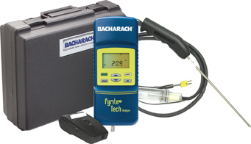
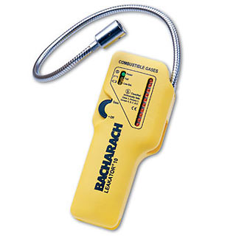
Combustion Equipment Care
Auditor’s Toolbox
Calibrate combustion analyzers every six months
Replace oxygen sensors every one to two years
Calibrate carbon monoxide detectors to outside air
Replace CO sensors every three to five years
Test gas leak detectors with the gas from a cigarette lighter
Fyrite Tech, Bacharach
Gas Leak Detector, Bacharach
Notes:
Combustion analyzers – calibrate at regular intervals according to manufacturer recommendations.
Replace oxygen sensors every one to two years.
Carbon monoxide detectors – calibrate to outside air.
Replace carbon monoxide (CO) sensors every three to five years.
Gas leak detectors – test with the gas from a cigarette lighter.
Hand out “Instrument Maintenance” and review with students.
In general, follow manufacturers’ guidelines on maintenance and calibration schedules. Document all repairs and upgrades.

Slide 14
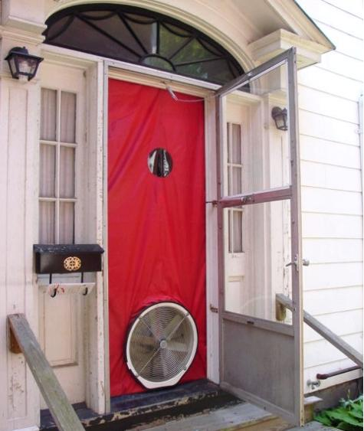
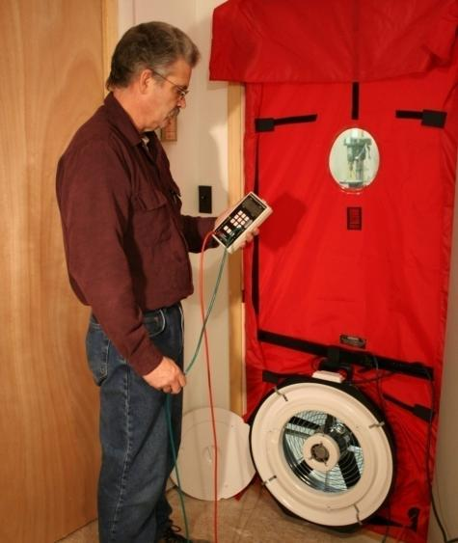
Blower Door
Auditor’s Toolbox
Photo courtesy of The Energy Conservatory
Photo courtesy of PA Weatherization Training Center (WTC)
Notes:
A blower door (for locating air leakage sites) with a manometer (to check the relative leakage in each zone) is absolutely essential for performing an energy audit.
The blower door is one of the most important tools at the auditor’s command.
There are several blower door manufacturers. The pictured unit is from the Energy Conservatory. All consist of:
Fan and controls.
Shroud and frame.
Pressure gauges or manometer.

Slide 15
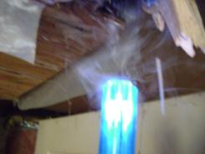
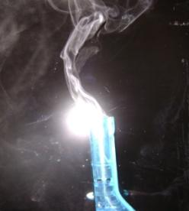
Smoke Generating Device
Auditor’s Toolbox
Wizard Stick
Photos courtesy of The US Department of Energy
Notes:
Used in conjunction with a blower door or during the operation of a forced air distribution system, the use of smoke generating device can help the auditor find air leakage and duct leakage. A smoke test is performed by depressurizing the house to 30 Pascals (Pa) and then walking from room to room, creating smoke. The smoke will stream from any opening connected to the outside.
The pictured “Wizard Stick” is actually a child’s toy and produces totally non-toxic smoke. While the smoke is not heat neutral, as is the frequently used chemical titanium tetrachloride smoke, it won’t harm anyone. Notice how the smoke is moving toward the ceiling opening in the picture in the upper right of the slide.
It is possible to find attic bypasses from the attic side by depressurizing the house and then creating smoke in the attic. Again, the smoke will stream to any openings connected to the living space.

Slide 16
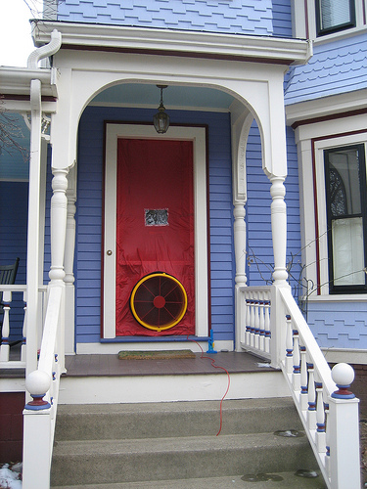
Blower Door Care
Auditor’s Toolbox
Fan housings that are cracked or misaligned will likely cause false test results.
Photo courtesy of Retrotec
Notes:
Fan housings that are cracked or misaligned will likely cause false test results.
The blower door fan housing has a calibrated opening that can be damaged. Dropping the fan or tossing it into the back of a truck may damage the housing or shift the motor in its bracket. This will cause the fan to go out of calibration. When in doubt, test the fan unit against a known good fan to assure they produce the same reading. Swap the fan units and use the same manometer.

Slide 17
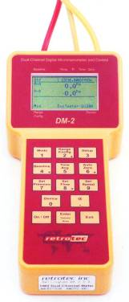
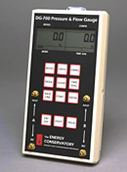
Manometers
Auditor’s Toolbox
DG-700
(Energy Conservatory)
DM-2
(Retrotec)
Photos courtesy of The Energy Conservatory and Retrotec
Notes:
The manometers pictured are digital devices that measure pressures and flows.
They are used to measure:
Leakage rate of building shell.
Zonal pressure differences.
Fan flow rates.
Duct leakage.
Chimney draft.

Slide 18
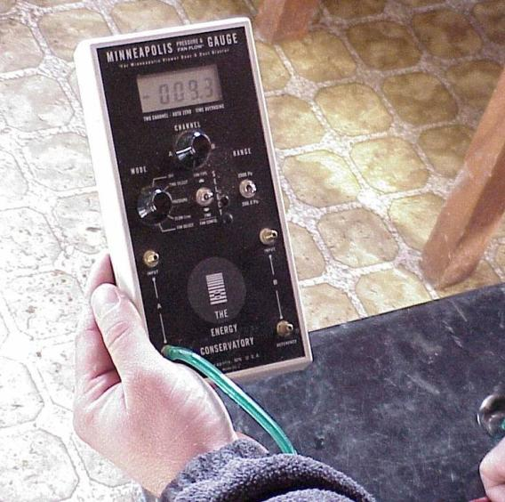
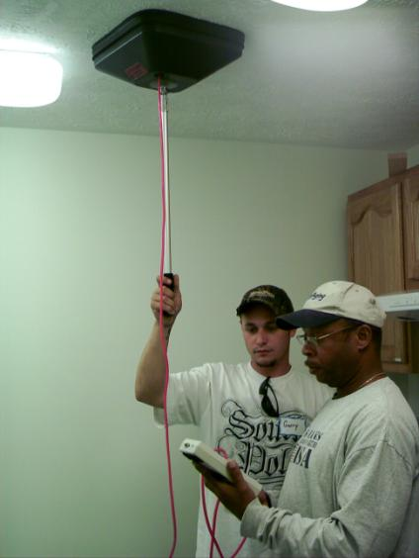
Pressure Pan
Auditor’s Toolbox
Photo courtesy of The US Department of Energy
Photos courtesy of US Dept. of Energy
Notes:
A pressure pan is a gasketed pan with a pressure tap, and is used in connection with the blower door.
It is used to quantify duct leakage to outdoors. Placing the pan over any envelope opening such as a duct register or wall outlet with the house depressurized will measure the degree of “connectivity” to the exterior.
A pressure pan may be constructed from a shallow cake pan with a stick-on foam gasket and a tap or purchased from diagnostic equipment companies who also manufacture blower doors.
How many of you are routinely using pressure pans as part of your auditing protocols?
Reference the section on “how to” in the chapter on Building Assessment.

Slide 19
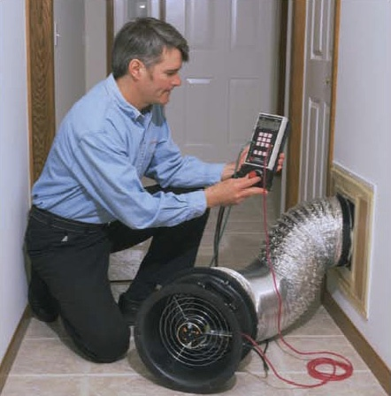
Duct Blaster
Auditor’s Toolbox
Use duct pressurization testing to quantify:
Total duct leakage.
Duct leakage to outdoors.
Photos courtesy of The Energy Conservatory
Notes:
Use duct pressurization testing to quantify:
Total duct leakage.
Duct leakage to the outdoors.
By pressurizing ducts on forced air systems with a duct blaster, you can measure total duct leakage as expressed in CFMs of airflow at a standardized pressure difference of 25 Pa.
When used in conjunction with a blower door, you can measure duct leakage to the outdoors. Assessing duct leakage to the outdoors is much more important than total duct leakage because of the energy penalty associated with the loss of conditioned air to the outdoors.
Note: Duct pressurization testing is not commonly used in the DOE WAP program but is required for quantifying duct leakage when performing “Home Performance with Energy Star” audits and some utility-funded programs.

Slide 20
Zonal Pressure Diagnostics
Auditor’s Toolbox
Conduct zonal pressure diagnostics and interpret results to determine:
Location and effectiveness of the air barrier.
Alignment of air barrier and thermal boundary.
If the pressure of the main house WRT garage indicates serious leaks between the two zones.
Photo courtesy of PA Weatherization Training Center
Photo courtesy of PA Weatherization Training Center (WTC)
Notes:
Conduct zonal pressure diagnostics (ZPD) and interpret the results to determine:
The location and effectiveness of the air barrier.
Whether the air barrier and thermal boundary are aligned.
If the pressure of the main house with reference to the garage indicates serious leaks between the two zones.
Refer to the Zone Pressure Diagnostics chapter of this curriculum for more information on ZPD.

Slide 21
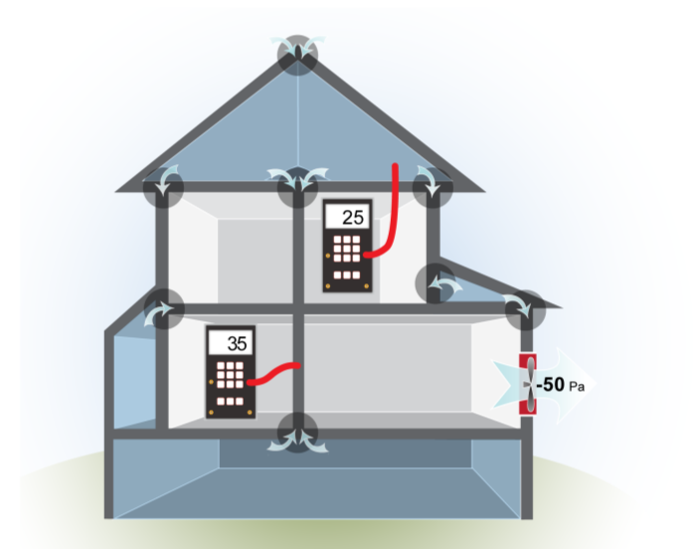
Zonal Pressure Diagnostics
Auditor’s Toolbox
Unsealed/Uninsulated
Two-story balloon-framed house with one-story addition and unheated porch over unconditioned basement
Image developed for the US DOE WAP National Standardized Curriculum
Notes:
This illustration is of a two-story, balloon-framed house with a one-story addition and an unheated porch over an unheated basement.
The house is unsealed and uninsulated; zonal testing reveals connections between the floor and wall framing.
Define the thermal boundary. What’s inside? What’s outside?
Decide how to align the air and thermal boundaries. If the zones are NOT where they are supposed to be, seal holes between the inside and outside.
Note the pressure differences across the attic ceiling and interior wall. The arrows indicate there may be a connection between the house, the attic, and possibly the basement.

Slide 22
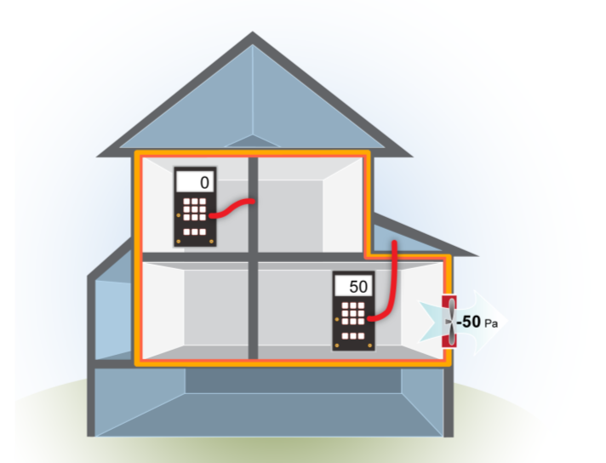
Zonal Pressure Diagnostics
Auditor’s Toolbox
Sealed/Insulated
Air-sealed/insulated with air barrier and insulation in alignment
Image developed for the US DOE WAP National Standardized Curriculum
Notes:
The insulation is aligned with the air barrier.
The new thermal boundary includes all the surfaces that separate conditioned from unconditioned spaces. This is verified by pressure testing to the outside zones. If you’ve done a good job, outside zones should read close to 50 Pa. Inside zones should be close to 0 Pa.

Slide 23
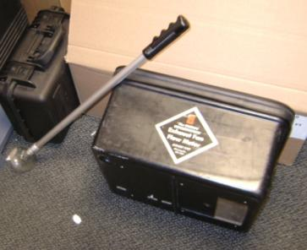
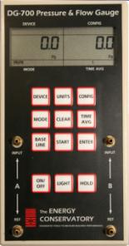
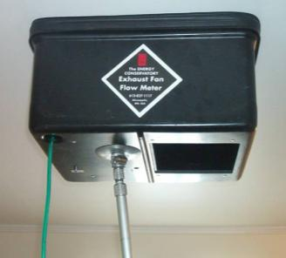
Measuring Exhaust Fan Flow
Auditor’s Toolbox
Energy conservatory exhaust fan flow meter with DG-700 pressure and flow gauge
Photos courtesy of The US Department of Energy
Notes:
The exhaust fan flow meter (the one shown here is manufactured by the Energy Conservatory) is really a calibrated pressure pan. It requires a DG-700 pressure and flow gauge. It is an inexpensive tool to accurately measure exhaust fan flow as required by ASHRAE 62.2, but it will measure exhaust intake only. It will not work by placing it over a fan discharge.
To use, set the DG-700 to pressure/flow and connect the flow meter tap to the upper left manometer tap. Place the meter pan over the (running) fan intake. Adjust the meter opening until a pressure reading between 1 and 8 on the left hand DG-700 screen is achieved. Move the meter hose to the flow tap on the upper right, and read the fan CFM on the screen above.
Having both a pressure pan and an exhaust fan flow meter isn't necessary. The flow meter adjustable opening can be closed so the flow meter will function as a pressure pan if desired.

Slide 24
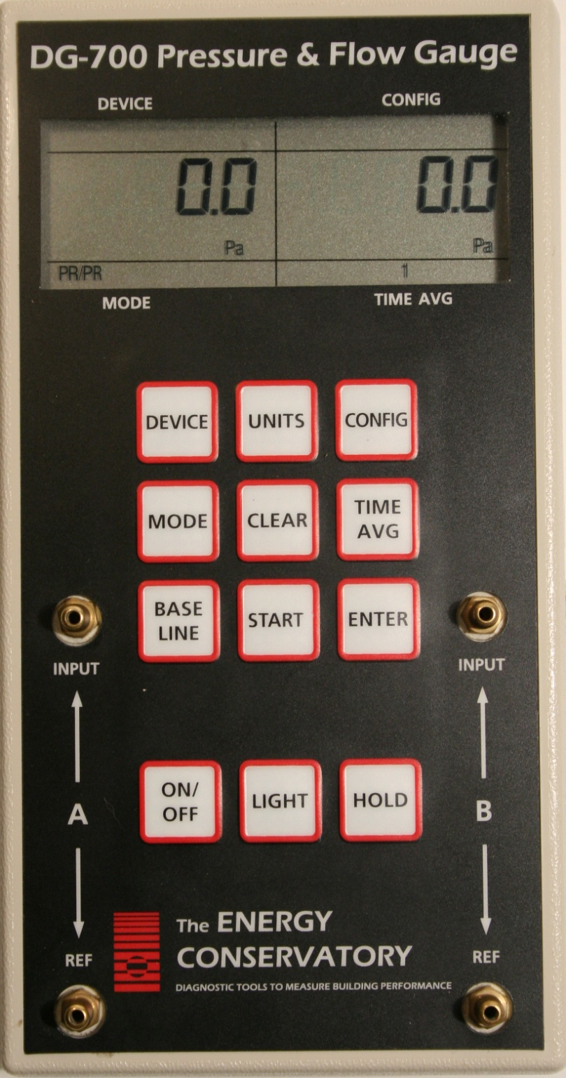
Digital Manometer
Auditor’s Toolbox
Calibrate every six months.
Return to the manufacturer
or
Calibrate with another digital manometer of the same type
DG 700 Manometer, The Energy Conservatory
Notes:
Calibrate a digital manometer every six months.
Return to the manufacturer for calibration.
Calibrate with another digital manometer of the same type.
Hand out and review “Procedure for Field Calibration Check of Digital Pressure Gauges” and “Operation and Maintenance Tips for Energy Conservatory Test Instruments.”

Slide 25
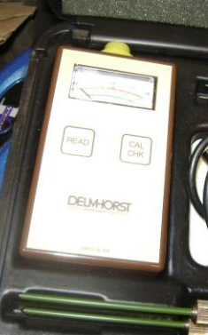
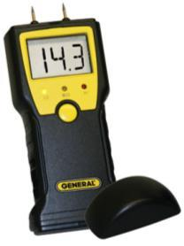
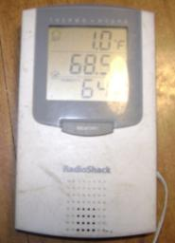
Moisture Assessment
Auditor’s Toolbox
“Pin” or “Non-Contact” moisture meters
Psychrometer
Indoor/Outdoor Thermometer
Photos courtesy of US Dept. of Energy and www.generaltools.com
Notes:
Auditors typically assess moisture by visual observation only, but more accurate information is sometimes required. Pictured left to right:
Pin meter, also called “non-contact moisture meter” − This works by reading electrical “connectivity” between the two pin points, much like a lie detector, when the points are pressed into a hard surface, such as wood. It has two sets of probes, long and short. The long probes are used to measure surfaces behind insulation without removing the insulation.²
The black and yellow unit has the short probes only. It is smaller and less expensive.³
The black “L” shaped tool is a sling psychrometer. It has two tube thermometers side by side. One has a wetted sock over it; the other is bare. Spinning it in the air produces wet and dry temperatures. Plotting the temperatures on a psychometric chart produces not only the relative humidity (RH), but also a host of other valuable information.
The indoor/outdoor thermometer on the right also has an electronic RH output.⁴ It’s sufficiently accurate for all but research and much less fragile than a sling psychrometer.
²Pictured model manufactured by Delmhorst.
³Pictured model manufactured by General.
⁴Pictured model found at Radio Shack.

Slide 26
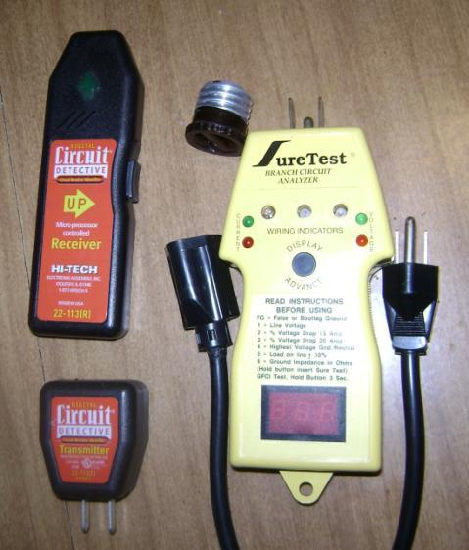
Circuit Testing & Tracing
Auditor’s Toolbox
Live wire tester, especially useful for determining if knob & tube wiring is still live.
Circuit tracer determines which fuse/breaker controls which circuit.
Tells auditor percent overload on circuit, among other outputs.
Photos courtesy of US Dept. of Energy
Notes:
Pictured from left to right:
The tip of the live wire tester turns red whenever it is placed near a live wire. It is most useful to determine if wiring⎯particularly knob and tube wiring—is still live.
The circuit tracer on the left is a two-part tool. It is used to determine which fuse/breaker controls a circuit that may be affected by installing insulation. Plug the lower unit into an outlet on the circuit in question. When moved past circuit breakers or fuses in the entrance box, the upper unit will indicate which breaker/fuse serves the outlet.⁵
When plugged into an outlet, the SureTest Pro, shown at far right, will provide a number of outputs. The one of interest to auditors is the percent of overload on the circuit, used to determine if it is safe to place insulation around the wire serving the outlet.
⁵Pictured model found at Radio Shack.

Slide 27
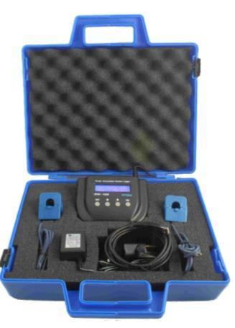
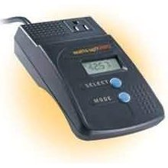
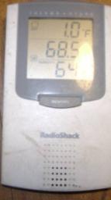
Base Load Analysis
Auditor’s Toolbox
“Watts Up Pro” meter
Indoor/outdoor thermometer
“Brultech Kit 60” watt meter
Photos courtesy of the manufacturers
Notes:
Photo on left – “Watts Up Pro” watt meter. When attached to any operating electrical appliance, a watt meter will measure and record the watts consumed. It can be set up to extrapolate future use from a two-hour run time sample, making it very useful in making refrigerator and other large appliance replacements’ savings-to-investment ratio (SIR) projections.
Photo in middle – Indoor/outdoor thermometer with RH. This unit simplifies refrigerator data gathering. Place the remote bulb in the freezer and the unit in the fresh food compartment while monitoring electrical use with a watt meter. This will provide temperature data useful for refrigerator replacement evaluation and client education.
Photo on right – “Brultech Kit 60” watt meter − Another example of a commercially available watt meter and recorder.

Slide 28
Class Participation – Tips from the Field
Class Exercise
(15 minutes)
Notes:
Tips from the field. Ask for volunteers to describe tools or professional equipment that have made them more effective auditors. Add your own personal examples to start or add to the discussion.

Slide 29
Equipment Calibration Schedule
Auditor’s Toolbox
Calibrate diagnostic instruments on a regular basis.
Maintain a record of calibrations and repairs for:
Digital manometers.
Combustion analysis equipment.
Gas leak detectors.
Carbon monoxide detectors.
Notes:
Calibrate diagnostic instruments on a regular basis.
Calibration means comparing the test results of an instrument to a known reference point. An example is calibrating a thermometer to the temperature of boiling water, which we know is 212ºF. If the thermometer reads 212ºF when placed in boiling water, it is properly calibrated.
Maintain a record of calibrations and repairs for the following kinds of equipment:
Digital manometer
Combustion analysis equipment
Gas leak detectors
Carbon monoxide detectors
Hand out and review “Equipment Calibration Schedule.” Ask students to volunteer examples of how often their agencies calibrate equipment.
Weatherization practitioners are armed with a variety of diagnostic equipment to test homes and guide their work. To make sure the readings we take are accurate, it’s important that this equipment be maintained and calibrated according to manufacturer recommendations. If something goes wrong in a house and the agency is called into court, the first question a lawyer may ask is, “When was the last time your diagnostic equipment was calibrated?”

Slide 30
Safety Upgrades
Auditor’s Toolbox
Replace:
Aluminum ladders – use industrial-rated, non-conductive fiberglass ladders.
Frayed or undersized extension cords.
Ungrounded power tools.
Hammers with mushroomed heads.
Dull drill bits, saw blades, utility knife blades.
Worn out respirators and safety glasses.
Notes:
Replace:
Aluminum ladders. Use industrial-rated, non-conductive fiberglass ladders. Aluminum ladders are conductive and may cause electrocution to the user if it comes in contact with a power source
Frayed or undersized extension cords. Undersized cords may cause premature failure of power tools. Frayed wires can cause electric shock to the person who contacts an uninsulated conductor (wire).
Ungrounded power tools. They may cause electric shock. Look for the existence of a three pronged grounding plug at the end of a power tool cord.
Hammers with mushroomed heads. Shrapnel from the hammer head may shear off on impact and injure the user.
Dull drill bits, dull saw blades, and dull utility knife blades. Dull tools are more dangerous than sharp ones because the user tends to force the tool and may lose control.
Worn out respirators and safety glasses. They must be replaced or maintained to assure personal protection.

Slide 31
Summary
Auditor’s Toolbox
The tools shown in this lesson represent the majority of essential tools for performing an energy audit on a house.
Scheduled tool and equipment maintenance avoids downtime and lost production.
As always, follow manufacturer recommendations for routine care and maintenance of diagnostic equipment.
Don’t get caught without spare batteries.
Notes:
The tools shown in this lesson represent the majority of essential tools for performing an energy audit on a house.
Scheduled tool and equipment maintenance avoids downtime and lost production.
As always, follow manufacturer recommendations for routine care and maintenance of diagnostic equipment.
Don’t get caught without spare batteries.
Present this slide as an interactive discussion, soliciting personal examples from the trainees. Add your own personal examples and knowledge to supplement.

