Slide 1
Generating a Work Order
WEATHERIZATION ENERGY AUDITOR SINGLE FAMILY
WEATHERIZATION ASSISTANCE PROGRAM STANDARDIZED CURRICULUM – December 2012

Slide 2
Learning Objectives
Generating a Work Order
By attending this session, participants will be able to:
Formulate solutions to handle typical barriers to weatherization resources.
Determine health and safety measures.
Compose an analysis report (work order).
Propose work specifications.
Notes:
By attending this session, participants will be able to:
Formulate solutions to handle typical barriers to weatherization resources.
Determine health and safety measures.
Compose an analysis report (work order).
Propose work specifications.

Slide 3
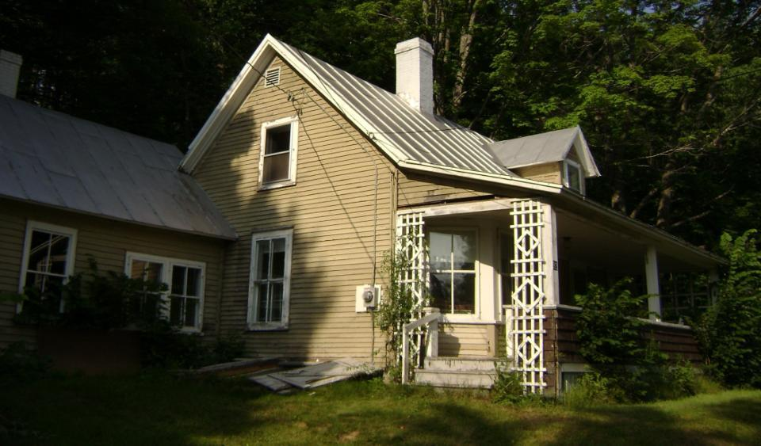
The Sample House
Generating a Work Order
(Pictures of various audit forms)
Photo courtesy of the U.S. Department of Energy
Notes:
Generating a complete work scope or work order relies on recording accurate observations during the site audit.
Tell the class they will use this sample house to generate a work order from their observations.
Hand out copies of slides 3 through 9 and discuss each slide as you go through the presentation.
Have the class take field notes during the discussion. Using guidance in the Lesson Plan, take students through the process of generating a work order.
Ask the class to volunteer other examples from their own experiences as memories are jogged by the scenarios presented in the slides. Discuss what was done and why this was or was not appropriate.

Slide 4
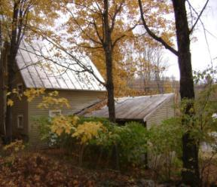
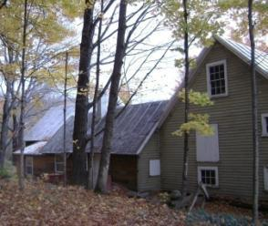
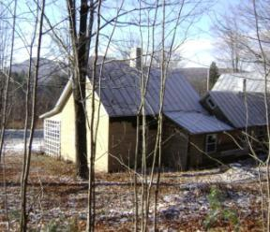
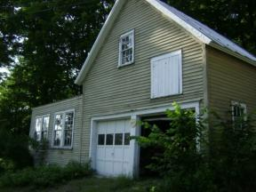
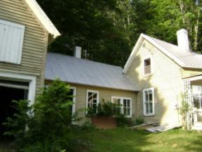
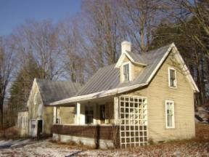
Exterior Walk-Around
Generating a Work Order
No gutters
Steel roof
Land slopes to building
Photos courtesy of Tony Gill
Chimneys meet code height requirements
Clapboard siding in good condition
Attached garage
No storm doors
All windows are double-pane
Window below ground
Notes:
Click to call out details of the home listed in the order below.
Chimneys look good and they meet code height requirements.
All windows are wood primary with either wood or aluminum storm windows.
The land behind the home slopes to the building. Is groundwater a consideration? This can be discovered through a client interview and specific indoor observations, especially in the basement or crawl space.
There are no gutters.
With a steel roof, any installed ventilation, either passive attic ventilation or bath fans, must exit through the gable ends.
Clapboard siding is in good condition.
There are no storm doors.

Slide 5
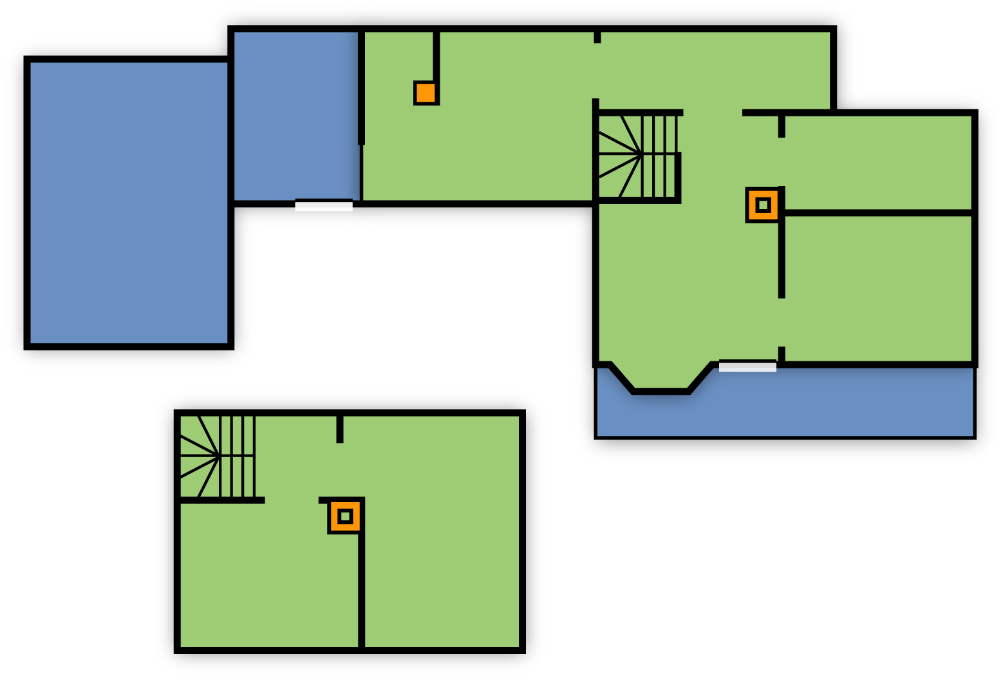
Footprint Sketch
Generating a Work Order
15 ft.
16 ft.
Den
8 ft.
N
Shed
12 ft.
Kitchen
Bath
Garage
16 ft.
12 ft.
Living
BR
Open Porch
Hall
26 ft.
BR
= heated = no heat
• 7 ft. cellar under main house
• Den & kitchen floor ≈ 1ft. clearance to ground
BR
Second Floor
Notes:
On the footprint sketch:
Note north direction.
Note chimney locations.
Note exterior dimensions are collected on site and will be used to estimate square footage of wall insulation and footprint.

Slide 6
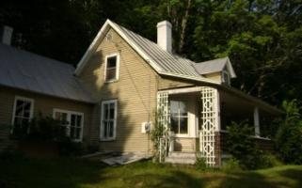
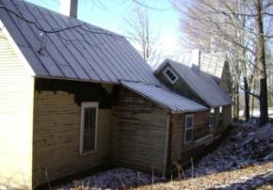
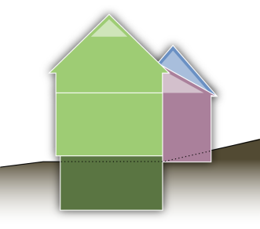
Elevations
Generating a Work Order
Main house: 16’ x 26’ – 1 ½ story
Ell: 12’ x 15’ – 1 story
Rear addition: 8’ x 16’ – 1 story
Cellar under main house only
SW Elevation
NE Elevation
All on very good rubble stone foundation.
Heated space windows & doors: (8) 12.5 sq’ windows, (8) 10 sq’ windows and (2) 20 sq’ doors.
Second floor: Attic flat = 8’ Slopes = 8’ Eaves wall = 3’
7’
7’6”
8’
7’5”
Photos courtesy of the U.S. Department of Energy
Notes:
For elevations:
Note the distance from the ground to the highest heated point for the ventilation calculation.
Note the number and dimensions of windows and doors.
Note the type and amount of exposed foundation.

Slide 7
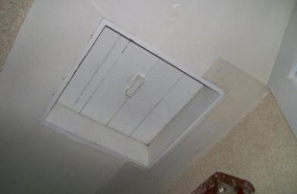
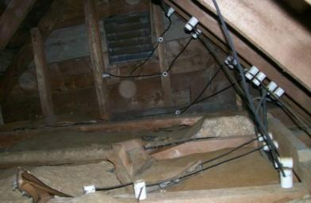
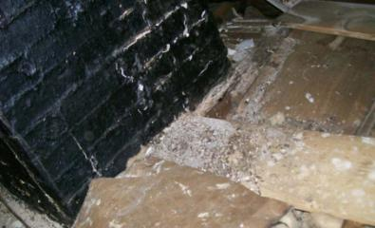
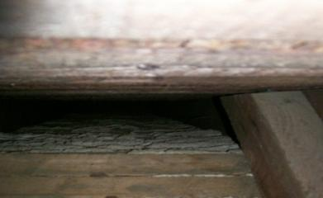
Interior Walk-Through: Attic
Generating a Work Order
Hatch
K&T wiring in attic
R-7 Rockwool batts on flat
R-7 Rockwool batts on flat
Empty slopes
Roof tar coated chimney
Photos courtesy of the U.S .Department of Energy
Notes:
Ask students what they notice in the pictures. Click to reveal call-out boxes.
The hatch is inadequate (cracks, no weatherstrip, no fastening method).
The knob and tube #14 wiring is in good condition. There are two circuits, each on a 15-amp breaker. The tested voltage drop is about 3%.
The balance of the house was rewired, so the small amount of existing knob and tube is no barrier to weatherization in this instance.
The attic is functionally uninsulated.
The double brick chimney serving the warm air furnace is coated with roof tar and in contact with the framing.
Because the chimney serves a relatively low flue temperature (as opposed to a wood stove), lining it should suffice to mitigate the fire hazard.
There is a minor roof leak at the flashing.

Slide 8
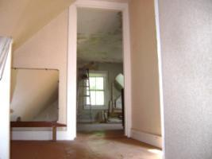
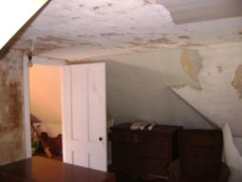
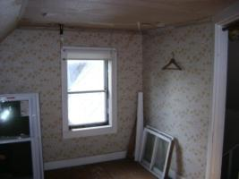
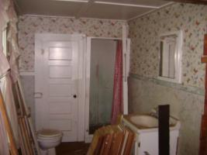
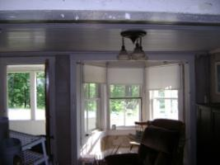
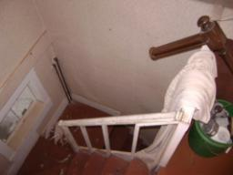
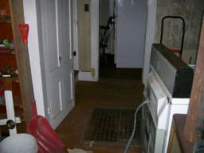
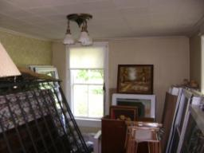
Walk-Through: Living Area
Generating a Work Order
Peeling wallpaper
Unvented space heater
Photos courtesy of the U.S. Department of Energy
Notes:
Ask students what they notice in the pictures. Click to reveal call-out boxes.
The unvented Kerosun™ space heater is very dangerous. It can create poor indoor air quality (IAQ) in all but the leakiest homes.
Peeling wallpaper in the upstairs bedroom indicates excessive moisture. This may be from space heater use or from the client keeping the bedroom door closed during the heating season.

Slide 9
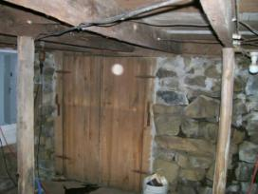
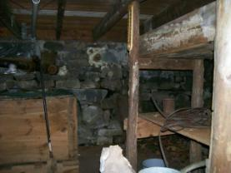
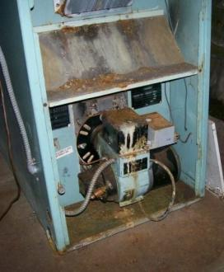
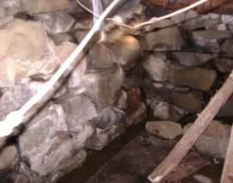
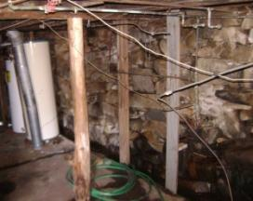
Walk-Through: Basement
Generating a Work Order
New 100 Amp electric service entrance
Cellar runway door
Clogged perimeter drain
Warm air furnace in poor condition
Photos courtesy of the U.S. Department of Energy
Notes:
Ask students what they notice in the pictures. Click to reveal call-out boxes.
The rubble stone foundation is in good shape. Note the stones have been pointed.
The warm air furnace is in poor condition based on visual inspection.
The perimeter drain is clogged with debris. Note: Homeowner reports that the drain has always kept up with any water coming through the cellar walls. The floor never gets wet.
The runway door is in good condition.

Slide 10
Creating the Work Order – Step 1
Generating a Work Order
Review site findings to ascertain there are no barriers to weatherization
Client status doesn’t match file information
Refer to outreach for correction/recertification
Unvented space heater in use
Deferral of services letter to client
Building beyond cost effective repair
Deferral of services letter to client
Building slated for demolition or urban renewal
Deferral of services letter to client
Dangerous/defective heating system
Evaluate and repair or replace as necessary
Notes:
Click to reveal the issues (bulleted list below), and ask the class for suggested solutions before clicking again to reveal the response. There are 6 issues and 6 responses listed on the slide in the same order as below.
Review your on-site findings to be sure there are no “deal breakers.” Examples are as follows:
The client status information in the file does not match your observations (e.g., obvious unreported income, client moved, client is deceased).
Response: Refer to community action agency outreach department for recertification.
There are unvented combustion appliances or other insurmountable health or safety issues.
Response: Send a deferral of services letter to the client.
Note: According to WPN 08-4, weatherization may proceed on a home with unvented space heaters as long as they are not its primary heat source. It is always preferable for homeowners to agree to remove unvented space heaters from the home for health and safety reasons. See WNP 08-4 for more details and guidance.
The building is in such disrepair that effective weatherization is impossible.
Response: Send a deferral of services letter to the client.
The building is slated for demolition or urban renewal.
Response: Send a deferral of services letter to the client explaining why weatherization will not be done.
The heating system is dangerous.
Response: Repair or replace the heating system before beginning weatherization activities.
Ask the class to list possible barriers to weatherization in the pictured house. Discuss how each problem should be resolved.
Suggested answer: Send a deferral of services letter to the client saying, “Before we will be able to weatherize your home, two actions on your part will be necessary:
1) Clean the debris from your basement interior perimeter drain so that it will function properly. (This may be added to the work order if the client is elderly and/or disabled and will not be able to complete the task. Include additional labor in SIR calculations.)
2) Sign and return the enclosed agreement not to use the unvented space heater inside your weatherized home. After we receive the signed form and confirm the drain has been cleaned, we will arrange for weatherization of your home.”
Ask the class to volunteer other examples from their own experience and how the issues were resolved.
Refer to the “Deferral of Services” module more information about when deferral is allowed and when it is required.

Slide 11
Creating the Work Order – Step 2
Generating a Work Order
Den
N
Shed
Kitchen
Bath
Garage
Living
BR
Open Porch
Hall
= heated = no heat
BR
BR
Designate the building envelope
Second Floor
Notes:
Have the class designate the building envelope and develop a list of appropriate measures for the pictured house. Prioritize the tasks.

Slide 12
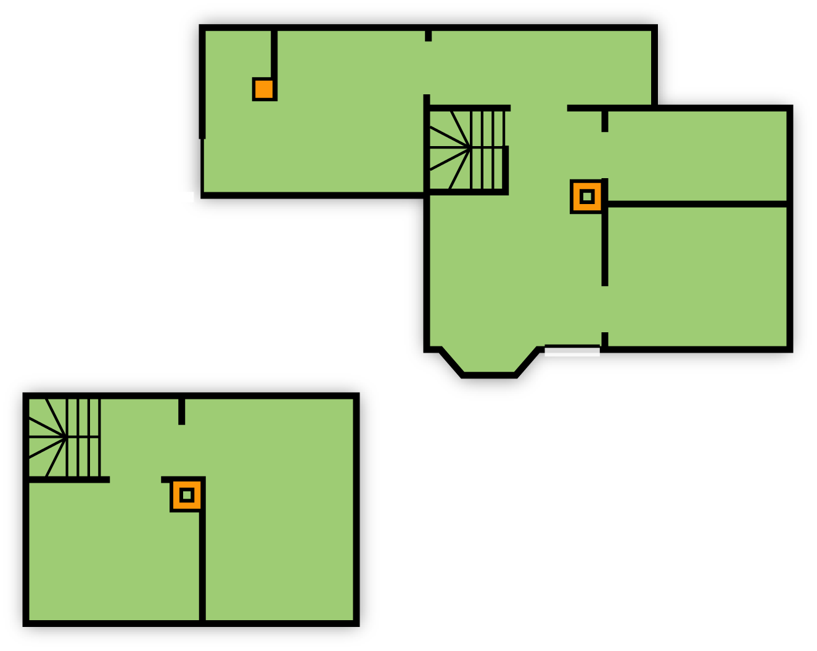
Step 2, Continued
Generating a Work Order
Den
N
Shed
Kitchen
Bath
Garage
Living
BR
Open Porch
Hall
Choose and prioritize measures
Include any additional necessary repairs
BR
BR
Second Floor
Notes:
The building envelope has been designated in this illustration. Review class lists, using the following examples:
Prioritize health and safety issues.
Address heating system problems.
Example: Clean/tune/evaluate the furnace. Repair/replace as necessary. Seal all ductwork.
Example: Install a chimney liner.
Example: Install barriers in the attics around both chimneys to keep insulation at least 2 inches from the masonry.
Address the moisture problems.
Example: Clean the cellar perimeter drain. If not done by the homeowner, this must be done by the crew.
Example: If the homeowner reported cellar flooding during rainstorms, gutters should be considered. Because he says the cellar floor stays dry, gutters would be an unneeded expense.
Example: Install 6-mil poly vapor retarder on ground under kitchen and rear addition.
Isolate the garage.
Example: Carefully air seal all penetrations in the wall between the kitchen and unheated shed to isolate the attached garage from the living space. Stuff large openings with scrap fiberglass and coat with spray foam to seal. Seal around electrical wires with spray foam. Install weatherstripping and a door sweep on the kitchen door. Use zone pressure diagnostics (ZPD) upon completion to evaluate the air seal.
Designate building envelope surfaces. Select necessary measures to create continuous and contiguous air, heat, and moisture barriers at envelope surfaces.
Example: Air seal the attic flat and slopes, exterior walls, wall between kitchen and shed, crawl space perimeter, and basement.
Example: Air seal all penetrations from the living space to the attic. Treat the attic hatch. Insulate the attic flat. Dense pack slopes. Install sash locks on the upstairs bedroom windows. Dense pack the exterior and house-to-shed walls. Add weatherstripping and door sweeps at the front and rear doors. Close off the uphill basement window. Two-part foam the box sills in the basement and crawl space.
Include any additional repairs needed to protect the chosen energy conservation measures.
Example: Seal the roof leak at the main house chimney.
Enter selected measures into the audit program or refer to priority list for task prioritization.
Decide on the energy conservation measures and the cost of the total job (including any additional necessary repair tasks) to produce an SIR of 1.0 or better.
Identify necessary health and safety tasks.
Example: Install a brand name or equivalent 1.5-sone bath fan vented to the gable end per the State Technical Manual. Use metal duct sloped slightly to the exterior. Insulate the duct. Seal all joints.
Determine that the total projected cost for the job does not exceed any state- or subgrantee-imposed dollar limit.

Slide 13
Creating the Work Order – Step 3
Generating a Work Order
The work order should be well organized with terminology the contractor/installer understands and should include:
Clear travel directions.
Any client issues.
Photo of front of house.
Accurate dimensions and material quantities.
Specific insulation products and installation methods.
Diagrams and pictures to pinpoint each measure location.
Notes covering anything unusual.
Name and phone number of CAA contact person.
Notes:
The completed work order should be well organized with terminology the contractor/installer understands. It should include:
Clear travel directions and client contact information.
Notes about any client issues – best contact times, deafness, need for a translator, etc.
A photo of the front of the house, showing the street number if possible.
Accurate dimensions and material quantities.
Specific insulation products and installation methods.
Diagrams and pictures to pinpoint the location of each weatherization measure.
Notes about anything unusual – special instructions, do not treat “X,” etc.
Name and phone number of community action agency contact person, should extra clarification be needed or unforeseen conditions arise.

Slide 14
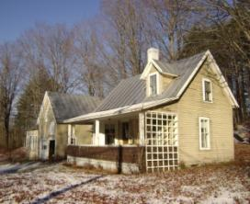
Work Order Appearance
Generating a Work Order
Sample front page of work order
John Homeowner
92 Norton Hill Road
Anytown, USA
(XXX) XXX-XXXX (Call after 8:00 AM)
Turn onto Norton Hill Rd from Main Street at Anytown PO. Yellow House 0.6 mile on right.
Photo courtesy of Tony Gill
#92 on post
Notes:
The front page of the work order should include the following:
Picture
Client name, address, and phone number
Clear directions to the home

Slide 15
Summary
Generating a Work Order
Determine that the home meets all program requirements, check for program “barriers.”
Select and prioritize measures.
Create work order. It should:
Be clear and concise.
Be legible.
Include pictures and diagrams.
Provide positive building identification and clear directions.
Provide auditor contact info for any needed clarification.
Notes:
Determine that the home meets all program requirements; check for program barriers.
Select and prioritize measures.
Create the work order.
Clear and concise
Legible
Include pictures and diagrams
Provide a picture including the street number if possible and clear directions.
Provide auditor contact information.
Present this slide as an interactive discussion, soliciting personal examples from the trainees. Add your own personal examples and knowledge to supplement.

