Slide 1
Building Shell Retrofit Strategies
WEATHERIZATION ENERGY AUDITOR SINGLE FAMILY
WEATHERIZATION ASSISTANCE PROGRAM STANDARDIZED CURRICULUM – December 2012

Slide 2
Learning Objectives
Building Shell Retrofit Strategies
By attending this session, participants will be able to:
Discuss how to prioritize building shell retrofits.
Discuss selected strategies for major building shell retrofits in different types of single-family housing stock.
Describe specifications for various building shell retrofits.
Identify material and installation options.
Explain thermal and air barrier alignment.
Notes:
By attending this session, participants will be able to:
Discuss how to prioritize building shell retrofits.
Discuss selected strategies for major building shell retrofits in different types of single-family housing stock.
Describe specifications for various building shell retrofits.
Identify material and installation options.
Explain thermal and air barrier alignment.

Slide 3
Sample Single-Family Home Priority List
Building Shell Retrofit Strategies
BUILDING SHELL RETROFITS
Air Seal as per blower door and zone pressure diagnostic protocols
Duct Sealing as per blower door guided and duct diagnostic protocols
Insulation Components | No Insulation | R-11 Existing | R-19 Existing
Open Attic Ceilings | add R-38 blown | Add R-19 blown | Add R-11 blown
Closed Floor Cavities (adjacent to unconditioned spaces) | fill to 3.5 lbs/ft² with loose-fill insulation where dimensions allow
Open Wall Cavities (adjacent to unconditioned spaces) | add R-13 batt and cover with air barrier | NA | NA
Closed Wall Cavities (adjacent to unconditioned spaces) | fill to 3.5 lbs/ft² with loose-fill insulation | NA | NA
Open Floor Cavities (in unconditioned basements and crawl spaces) | add R-19 batt | NA | NA
Sill Box and Foundation Walls (in conditioned basements or crawl spaces) | seal penetrations and add R-13 batt or two-part spray foam | NA | NA
Deteriorated Windows and Doors Beyond Repair | Replace
Notes:
Work order specifications should be based on a DOE-approved audit measure selection tool or priority list.
Measures on this sample priority list are based on cost-effectiveness. The most cost-effective measures are at the top of the list.
Skipping measures is discouraged unless serious, unsolvable problems prevent their consideration.
Q: What are some examples of serious unsolvable problems?
A: If insulating the attic requires a whole new roof be constructed, it may be outside the scope of weatherization work.
A: Flooded basement associated with poor drainage may preclude air sealing.
Although window and door replacement appears last on the list, some may be in such disrepair that their replacement as an infiltration measure is justified.

Slide 4
General Air Leakage
Building Shell Retrofit Strategies
Photo courtesy of EnergyStar.gov
Notes:
Specify air sealing activities as the number one priority. This graphic illustrates typical leakage sites. Note the leakage under the floor cavity into the knee-wall attic.
Review of terminology:
Direct leakage occurs at direct openings to outdoors. Leakage enters and exits at the same location. Direct leakage is common around doors and windows.
Indirect Leakage enters at one location, moves through building cavities and exits at a different location. Indirect leakage is common in older homes where interior walls have no top plates. Another typical example of indirect leakage is when a porch roof joins the side of a house. Often the siding is left off where the porch roof and house intersect. Cold air in the porch attic flows into the floor cavity of the home, and into wall cavities or soffits. This is evidenced by a cold wall or floor in the winter. The blower door is used to track these leaks.
Q: What are some typical spots for direct leakage?
A: Direct leakage occurs in places where there are penetrations in the building envelope. Examples are dryer vents and areas around doors and windows.
Q: What are some examples of indirect leakage?
A: Indirect leakage occurs in plumbing chaseways, attic hatches, and electrical outlets.

Slide 5
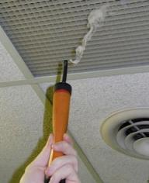
Air Sealing Strategies
Building Shell Retrofit Strategies
Blower door-directed
With the blower door running, use a smoke stick to locate and seal air leaks.
Checklist-guided with blower door check
Installers check typical leakage sites:
Flues and plumbing vents
Recessed fixtures (lights and fans)
Wire pathways
Chimney penetrations
Dirty insulation
Seal leaks, then check with blower door to make sure CFM reduction was successful.
Photo courtesy of the U.S. Department of Energy
Notes:
There are two general approaches to air sealing. Many crews probably use a combination of the two:
Blower door-directed air sealing: With the blower door running, installers use a smoke stick to locate and seal air leaks.
Checklist-guided air sealing with blower door check: Crews have a checklist or just know the typical leakage sites. They check and seal typical “hot spots” for air leakage:
Flues and plumbing vents
Recessed fixtures (lights and fans)
Wire pathways
Chimney penetrations
Dirty insulation
Q: When you see dirty insulation, what could that indicate?
A: That air is being filtered through that insulation as it pours through a leak in the air barrier. Inspect the area near dirty insulation.
After air sealing, the crew conducts a blower door test to make sure air flow reduction was successful.
Whichever approach taken, it is helpful to the crew if the auditor makes notes of specific trouble spots discovered during the house assessment.

Slide 6
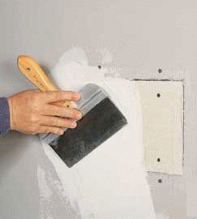
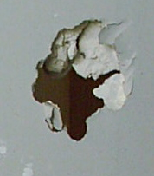
Drywall Repair
Building Shell Retrofit Strategies
Sometimes air sealing requires repairing damaged drywall.
Photos courtesy of the U.S. Department of Energy
Notes:
Sometimes sealing air leaks requires repairing drywall. Make sure crews are aware of these repair needs so they will have the appropriate materials on site.

Slide 7
Primary Air Infiltration Sites
Building Shell Retrofit Strategies
5% Fans and Vents
12% Windows
Floors, Walls, and Ceilings 36%
13% Doors
Electric Outlets 2%
15% Plumbing Penetrations
Fireplace 16%
Data courtesy of California Energy Commission
Notes:
The graph shows typical leakage sites.
The attic is not separated out, but it is the largest piece of the “floors, walls, and ceiling” category, making up more than one-third of all air leakage.
Many people think replacing windows is crucial. According to this graph, windows come in fifth, behind floors, walls and ceilings, fireplaces, plumbing penetrations, and doors, in terms of air leakage.
Q: What do you think is the more cost-effective approach: sealing air leaks in the attic, walls, and ceiling, or replacing windows?
A: Sealing air leaks. It is less expensive than replacing windows, and it provides more CFM50 reduction.

Slide 8
Duct Specifications
Building Shell Retrofit Strategies
Specify duct sealing where ducts are located in unconditioned spaces.
Ducts in unconditioned spaces should be insulated to recommended levels.
Seal all returns in spaces where atmospheric fossil fuel appliances are located.
It is often necessary to remove duct insulation to properly seal ducts. Seal with mastic, then re-insulate.
Photos courtesy of the U.S. Department of Energy
Notes:
Specify duct sealing where ducts are located in unconditioned spaces.
Ducts in unconditioned spaces should be insulated to recommended levels, typically at least R-6. Insulation levels are based on cost-effectiveness. They are determined through a DOE- approved audit or priority list.
Seal all returns in spaces where combustion appliances are located.
Ducts located in unconditioned spaces may leak to the outside and are therefore included in building shell measures. By the same token, a distribution system that uses building framing for supplies or returns must be sealed.
Q: What is an example of a return that uses a building cavity?
A: Metal panning on the underside of a basement sealing joist cavity that serves a return air plenum is often connected to a leaky exterior wall cavity.

Slide 9
Attic Specifications
Building Shell Retrofit Strategies
Seal all bypasses
Photos courtesy of the U.S. Department of Energy
Notes:
These are photos of air leakage locations.
While investigating the attic space, the auditor should draw a simple sketch noting specific areas to seal and include it in the work order.
The auditor should specify that all bypasses must be sealed. There may be some bypasses the weatherization installer will find that the auditor did not discover on the initial visit.

Slide 10
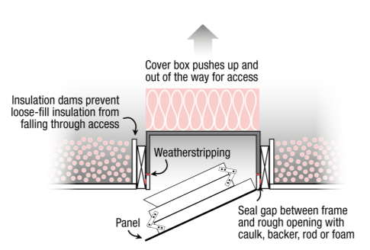
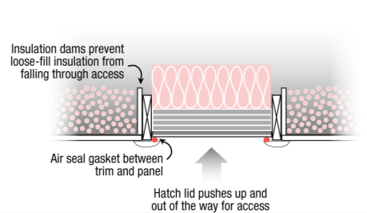
Attic Specifications
Building Shell Retrofit Strategies
Insulate hatches. Note insulation dams.
Scuttle Hole Cover
Pull-Down Attic Stairs
Graphics courtesy of http://www.energysavers.gov/your_home/insulation_airsealing/index.cfm/mytopic=11400
Notes:
Attic hatches must be weatherstripped and insulated to the same level as the attic ceiling.
Pull-down staircases present a special challenge because they protrude into the attic when folded.
Specify a fabricated or commercially available insulated cover.

Slide 11
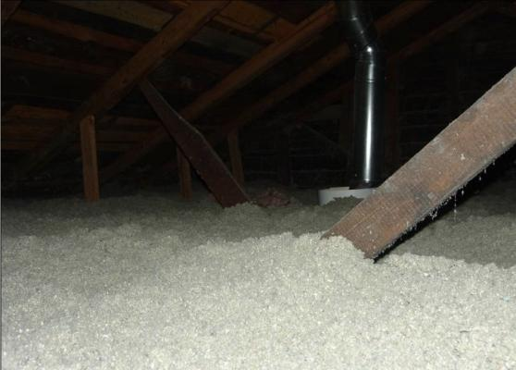
Attic Specifications – Open Joist
Building Shell Retrofit Strategies
Insulate to cost-effective levels with loose-fill insulation.
Photo courtesy of the U.S. Department of Energy
Notes:
Open joist attics in cold climates are generally upgraded to the range between R-30 and R-38 depending on climate, fuel cost, and other variables.

Slide 12
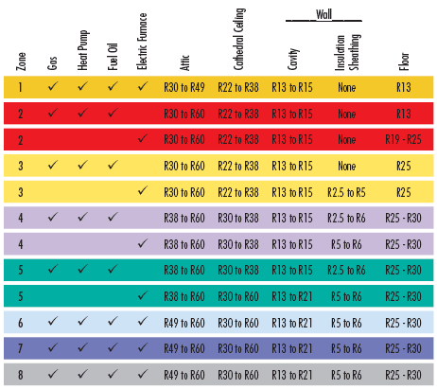
Cost-Effective Insulation Levels
Building Shell Retrofit Strategies
Notes:
This table shows cost-effective insulation levels. Attics range from R-30 to R-60, depending on the region and heating fuel and equipment.
Since the delta-T is typically lower in cooling climates, savings from cooling equipment are not as high as from heating equipment. This is why the southern regions have lower recommended R-values.

Slide 13
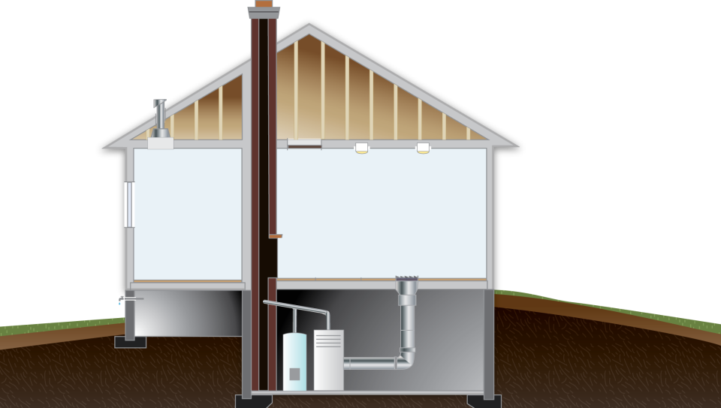
Not Enough Insulation
Building Shell Retrofit Strategies
Graphic developed for the U.S. DOE WAP Standardized Curricula
Notes:
When there is too little insulation, the heating and cooling equipment has to work harder and the energy bills remain high.

Slide 14
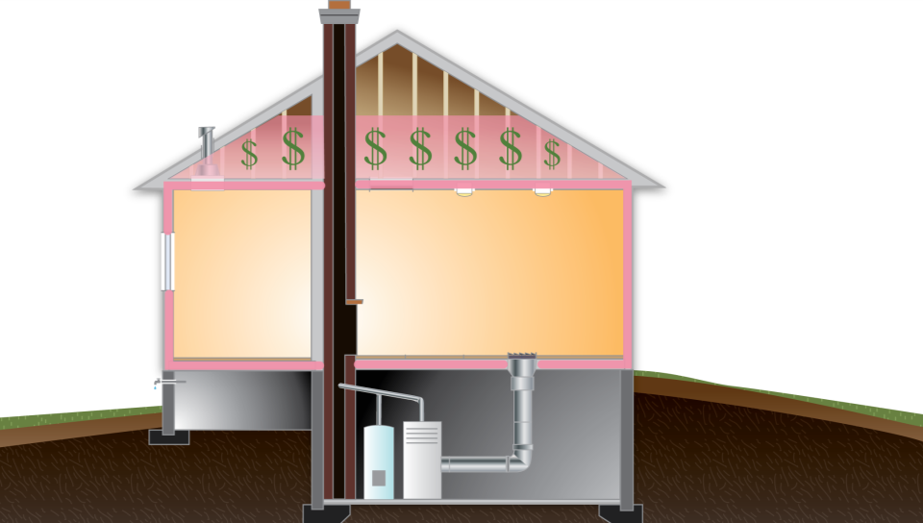
Too Much Insulation
Building Shell Retrofit Strategies
Graphic developed for the U.S. DOE WAP Standardized Curricula
Notes:
Too much insulation will never pay back.
Energy saved from insulation above recommended levels would never equal the cost of installing that insulation.

Slide 15
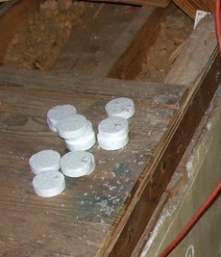
Attic Specifications – Floored Attic
Building Shell Retrofit Strategies
Dense-pack under floors
Target = 3.5 pounds per cubic foot.
Ultimate R-value limited by size of joists.
Photo courtesy of the U.S. Department of Energy
Photo courtesy of the PA WTC
Notes:
The depth of the cavities restricts insulation levels in floored attics.
Depths can range from 6 to 10 inches, depending on the width of ceiling floor joists.
Because it is an enclosed space, specify dense-pack insulation at proper density, e.g., 3.5 pounds per cubic foot for cellulose.
Specify sealing of bypasses into interior walls first.

Slide 16
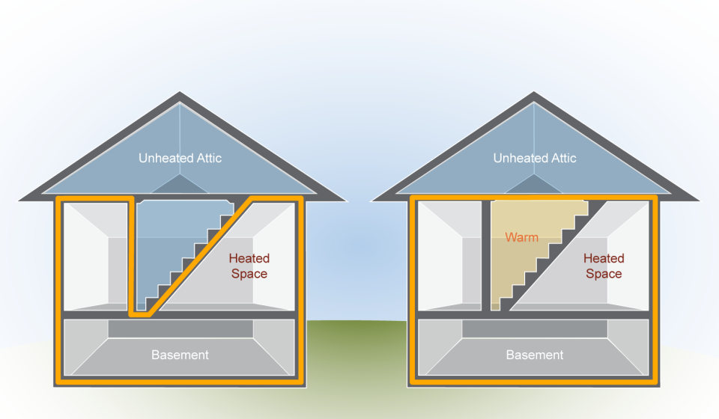
Walk-Up Attics
Building Shell Retrofit Strategies
Where is the thermal boundary?
Where should it be?
Graphics developed for the U.S. DOE WAP Standardized Curricula
Notes:
Q: Where is the thermal boundary? Where should it be?
A: It should enclose the conditioned space and nothing else. If occupants use the attic often, the thermal boundary might encompass the stairwell leading up to the attic, effectively putting that staircase “outside.”
The thermal boundary is often tricky to define depending on how the occupant uses the house, and what’s considered conditioned space and what is not. In this illustration, the staircase and the door leading to the unheated attic make up the thermal boundary. The auditor may decide to improve the existing thermal boundary by air sealing the attic staircase and access door as illustrated on the left.
Alternatively, the auditor may decide to create a new thermal boundary by calling for a removable lid that is air sealed and insulated, as pictured on the right if the occupants do not use the attic often. Also, the staircase now becomes a conditioned space by default. That space must be heated to prevent condensation problems.
In either case, this thought process helps the auditor make decisions about the present or future location of the thermal boundary.

Slide 17
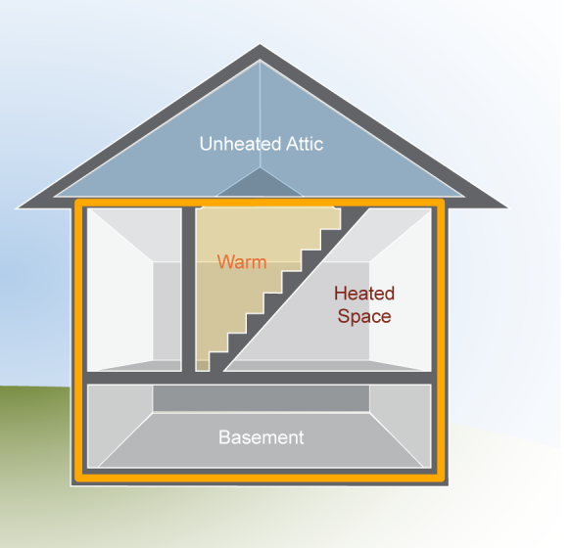
Walk-Up Attics
Building Shell Retrofit Strategies
If the client does not use the attic often:
An insulated, airtight cover can be installed on top of stairwell.
The pressure and thermal boundaries are aligned at the level of the attic floor.
This approach brings the stairwell into the conditioned space.
It is also cheaper and faster than the alternative.
Graphic developed for the U.S. DOE WAP Standardized Curricula
Notes:
If the client does not use the attic often, an insulated, airtight cover can be installed on top of the stairwell without hindering their lifestyle. This brings the stairwell into the conditioned space. It is also faster and cheaper than the alternative.

Slide 18
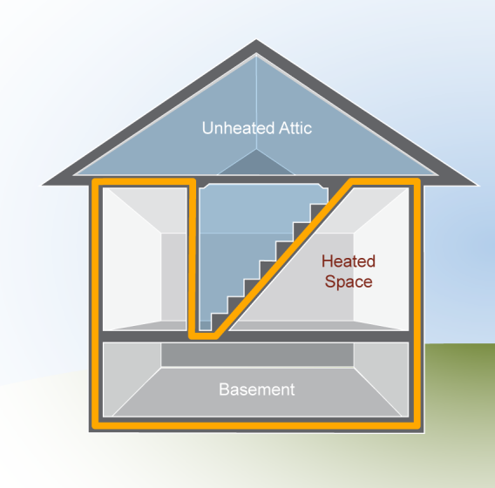
Walk-Up Attics
Building Shell Retrofit Strategies
If the client uses the attic fairly often:
The pressure and thermal boundaries must be established at the stairs, stairwell walls, and door to the attic stairs.
This approach leaves the stairwell open to the attic and outside the conditioned space.
Graphic developed for the U.S. DOE WAP Standardized Curricula
Notes:
If the client uses the attic access often, the sidewalls that border either side of the staircase and stair treads can be air sealed and dense-packed with blown-in insulation, putting the stairway outside the pressure and thermal boundaries and maintaining easy access because there is no attic hatch to lift.
Specify that the access door be weatherstripped and insulated with rigid foam board on the attic side.

Slide 19
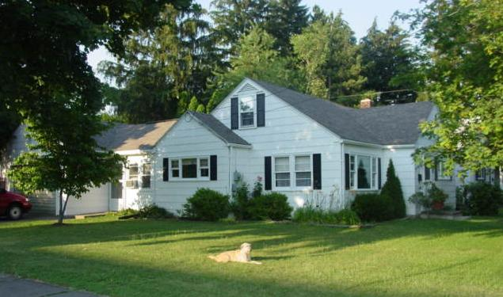
1.5-Story Cape Cod House
Building Shell Retrofit Strategies
Photo courtesy of Bill Van der Meer
Notes:
The basement and wall framing in Cape Cod homes and platform-framed homes are similar. The attic space is where the similarities end.
The half story above the first floor is surrounded by unconditioned spaces consisting of knee-wall attics on the sides, rafter cavities, and a small collar-beam attic at the peak.
Q. Why are Cape Cod home attics a challenge to air seal and insulate?
A. Because of their complicated air pathways and constricted spaces.

Slide 20
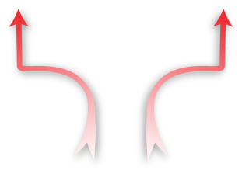
Cape Cod Attic
Building Shell Retrofit Strategies
Pressure difference of the floor cavity with reference to the house should be 0 Pa. But, is it?
Graphic developed for the U.S. DOE WAP Standardized Curricula
Notes:
This illustration represents an unsealed and uninsulated knee-wall attic with critical air leakage junctions.

Slide 21
Define the Air Barrier
Building Shell Retrofit Strategies
Targeted air sealing defines air barrier.
Graphic developed for the U.S. DOE WAP Standardized Curricula
Notes:
Targeted air sealing defines the air barrier.
The red spots indicate where we would target air sealing prior to installing insulation.
Q. What are some methods commonly used to air seal these areas?
A. Dense packing within a burlap or other porous sack to create blockages at these junctures often works.
To seal the knee wall to the attic floor, garbage bags stuffed with fiberglass shoved into the holes then sealed with foam, or foam board or other air tight material cut to fit and sealed with foam.

Slide 22
Cape Attic
Building Shell Retrofit Strategies
Pressure and thermal boundaries are now aligned.
Graphic developed for the U.S. DOE WAP Standardized Curricula
Notes:
This illustration of how the air barrier and insulation should be aligned in a 1.5-story house with a knee-wall attic. Note that the critical air sealing junctions have been sealed.
Specify the following:
Dense-packed insulation in the roof rafter bays.
Appropriate R-value insulation on the knee-walls can be batts covered with house wrap, spray foam, etc.
Loose-fill insulation of appropriate R-value on the knee-wall attic floor and collar-beam floor.

Slide 23
Cape Attic
Building Shell Retrofit Strategies
Two-part foam used on the cold side of a knee-wall aligns pressure and thermal boundaries.
Specify that floor joists under the wall must be sealed.
If knob and tube wiring is present in knee wall attic floor, using spray foam to bring pressure and thermal boundary to the roof deck is appropriate.*
Photo courtesy of Anthony Cox
* ½ lb. foam lets water leaks be detected and is preferred to 2 lb. foam in roof applications.
Notes:
This photo shows an example of a two-part foam application on the cold side of an attic knee-wall in a 1.5-story Cape Cod house.
Q. What other air leakage sites associated with kneewalls are very important to seal?
A. It is very important to specify that the floor joists underneath the wall must be sealed.

Slide 24
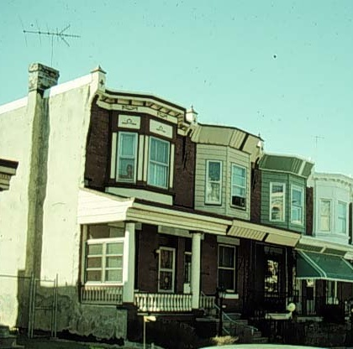
Row Homes
Building Shell Retrofit Strategies
Long, narrow floor plans.
Minimal exterior exposure, except on end units.
Uncapped party walls and shallow attics are typically very leaky.
Photo courtesy of PA WTC
Notes:
Row homes are a typical form of housing in large urban areas, such as Philadelphia and New York City.
They are often masonry and constructed with a long and narrow floor plan.
With the exception of the end units, they are buffered on the sides. The only exterior sidewall exposure is at the front and rear.
They are typically very leaky owing to their furred-out exterior masonry walls and large bypasses that open into shallow and nearly flat roof cavities.
Furring strips are rough sawn 1 in. x 3 in. strips of lumber that provide support for lath and plaster wall coverings. Furring strips extend into the attic space above the conditioned space where the gaps between them are major air leakage sites.

Slide 25
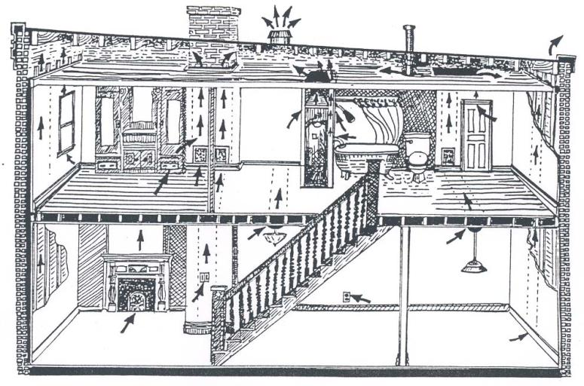
Row Homes
Building Shell Retrofit Strategies
Graphic source: PA WTC
Graphic courtesy of Grass Roots Alliance for a Solar Pennsylvania
Notes:
A cutaway drawing of a row home exposes some of the big air leaks through the top of the home and into a shallow roof cavity.
Note furred-out exterior walls, chimney chaseways, and the dropped ceiling in the closet.

Slide 26
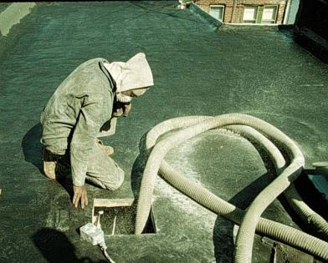
Row Homes - Attics
Building Shell Retrofit Strategies
Row home attics involve a lot of crawling around.
Seal attic penetrations and wall tops.
Dense-pack insulation in shallowest space, loose-fill to desired R-value towards front.
Seal access hole.
Photo courtesy of the PA WTC
Notes:
Specify attic sealing and insulation where cost-effective.
A row house roof retrofit involves a lot of crawling to seal the spaces that are accessible.
Seal attic penetrations and wall tops.
Blown insulation is dense-packed into the restricted space toward the rear and loose-filled toward the front to desired depth.
The access hole is then covered with a single large roof vent.

Slide 27
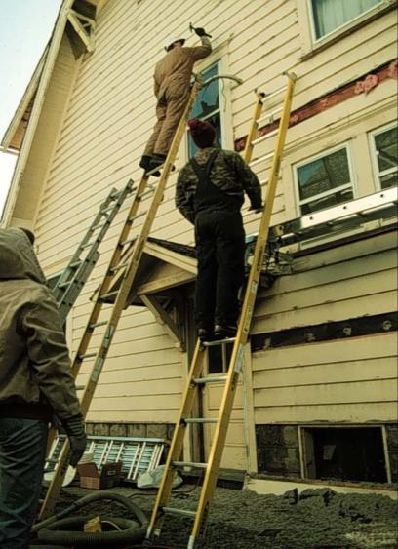
Sidewalls
Building Shell Retrofit Strategies
Specify the following for uninsulated wood-framed wall cavities:
Dense-pack insulation installed at a density of 3.5 lb. per cu. ft.
Special attention to critical junctures within the building envelope
It is generally not cost-effective to re-insulate walls with existing fiberglass insulation.
Photo courtesy of PA WTC
Notes:
Specify the following for uninsulated, wood-framed wall cavities:
After meeting all of the structural and safety criteria, dense-pack uninsulated wall cavities in wood-frame houses with a loose-fill insulation product at appropriate density, e.g., 3.5 pounds per cubic foot for cellulose.
Pay special attention to critical junctures within the building envelope. Important locations include porch roof cavities, where the walls of an addition meet the main house and changes in ceiling height.
Q. Why is it generally not cost-effective to re-insulate walls with existing fiberglass batt insulation?
A. It is technically very difficult to maneuver a fill tube in a wall with existing batt insulation so that a technician can cost effectively add more dense-packed insulation.

Slide 28
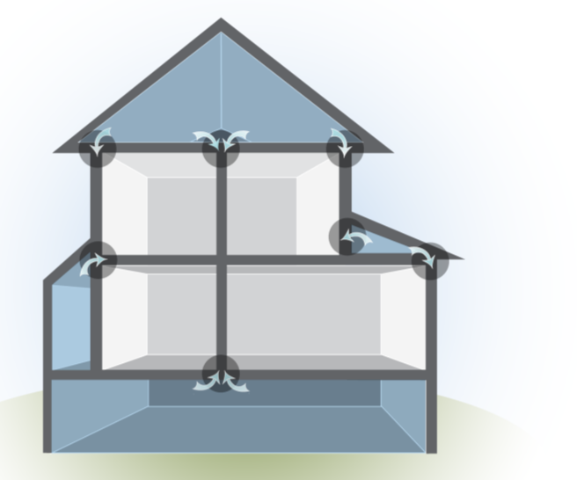
Porches and Additions
Building Shell Retrofit Strategies
Leaky connection to wall cavity
Unsealed/Uninsulated
Two-story, balloon-framed house with one-story addition and unheated porch over unconditioned basement.
Graphic developed for the U.S. DOE WAP Standardized Curricula
Notes:
This is an illustration of a two-story, balloon-framed house with a one-story addition and an unheated porch over an unheated basement.
The house is unsealed and uninsulated.
Zone pressure diagnostics (ZPD) revealed interconnections between the floor and wall framing. The arrows indicate that there may be a connection between the house, the attic spaces, and possibly the basement.
Properly installed dense-packed insulation greatly reduces air leakage and will help solve the problem.

Slide 29
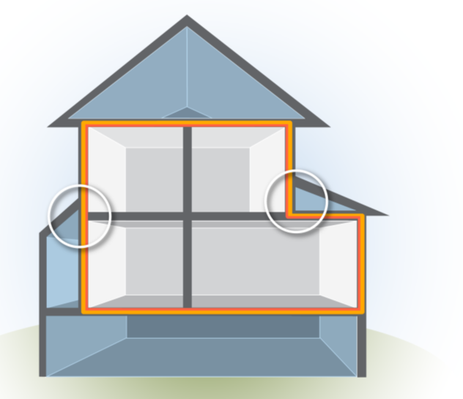
Porches and Additions
Building Shell Retrofit Strategies
Critical junctions
Air-sealed/Insulated with air barrier and insulation in alignment.
Graphic developed for the U.S. DOE WAP Standardized Curricula
Notes:
A completed job consists of insulation that is aligned with the air barrier. The new thermal boundary includes all the surfaces that separate conditioned from unconditioned spaces.

Slide 30
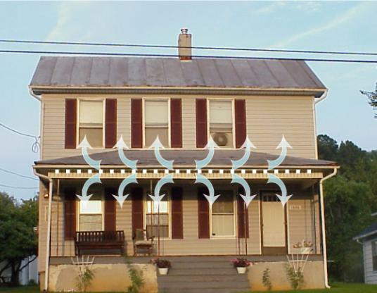
Porches and Additions
Building Shell Retrofit Strategies
Porch roof cavity open to wall cavities
Photo courtesy of Anthony Cox
Notes:
This photo of a two-story balloon-framed house shows where the porch framing could be open to the wall cavities of the house.
Q. Why is this feature so important to treat?
A. This could be one of the largest hidden air leaks in the house, making it a good candidate for air sealing with dense-packed insulation in the wall cavities, and in the entire porch roof if the walls cannot be accessed and sealed off from the roof cavity.

Slide 31
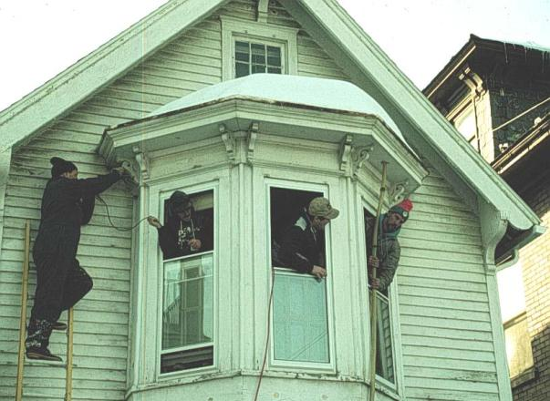
Bay Window Framing
Building Shell Retrofit Strategies
Bay window framing is complex
Dense-pack insulation
Photo courtesy of The PA WTC
Notes:
A bay window has complicated framing and should be dense-packed as part of a sidewall insulation job.

Slide 32
Tuck-Under Garage Ceiling
Building Shell Retrofit Strategies
Photo courtesy of the PA WTC
Notes:
This photo shows a tuck-under garage on a platform-framed house.
Significant conductive heat loss is associated with a floor cavity that separates an unconditioned garage and the conditioned space above.
Specify dense-packed insulation in the enclosed floor cavity.
Q: What are other problems associated with tuck-under garages and what should be done about them?
A: Air leakage between the house and garage can bring pollutants into the living space, creating poor IAQ. Seal all penetrations to the living space.

Slide 33
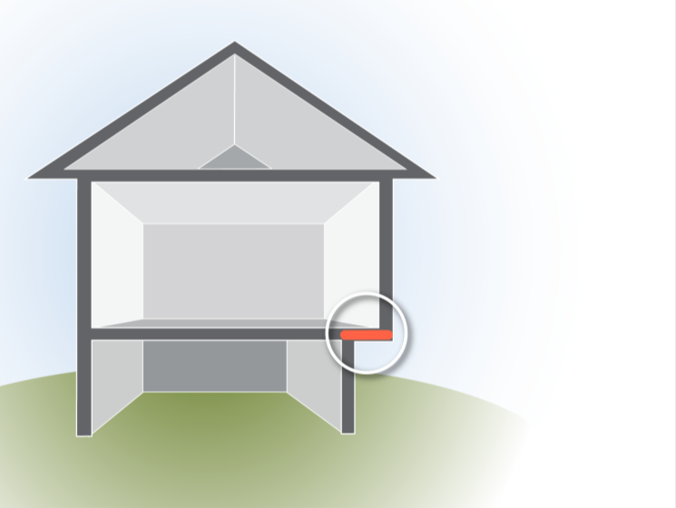
Cantilevered Floors
Building Shell Retrofit Strategies
Cantilevered floor is exposed to outdoor temperatures.
Specify dense-pack insulation if none exists.
Cantilevered floor
Photo courtesy of the PA WTC
Notes:
This is an illustration and construction photo showing a cantilevered floor.
A cantilevered floor extends beyond the foundation of the framed structure below it. The floor is exposed to outside conditions.
If uninsulated, specify dense-packed insulation in the floor cavity.

Slide 34
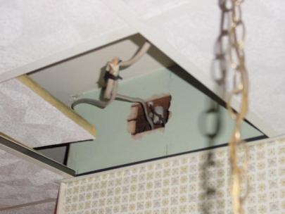
Interior Air Leakage Sites
Building Shell Retrofit Strategies
In older homes, interior leaks, as shown on right, are often linked through complicated framing directly to outside.
Sealing big air leaks results in massive air leakage reduction at relatively low cost for materials and labor.
Photos courtesy of The US Department of Energy
Notes:
These photos show large interior leaks.
Interior holes in older balloon-framed homes are usually connected through a series of intricate framing pathways to the outside.
Examples are damaged ceilings above dropped ceilings, as pictured on the right.
Specify installation of a continuous air barrier of drywall or other sheet material.
Plumbing penetrations are another large leakage site that should be given top priority. They are called “cheap leaks” because the significant air leakage reductions that result from fixing them are a good value in terms of time and materials.
Q: What are some examples of other large penetrations associated with the interior?
A. Unused fireplaces, built-in drawers, pocket doors, etc.

Slide 35
Interior Air Leakage Sites
Building Shell Retrofit Strategies
Specify cost-effective air sealing by:
Addressing large leaks first.
Not focusing on smaller inconsequential leaks.
Pocket Door
Graphic courtesy of Grass Roots Alliance for a Solar Pennsylvania
Graphic source: PA WTC
Notes:
Examine this illustration of a pocket door.
Pocket doors are common features in balloon-framed homes. They slide into the wall cavities and are typically very leaky.
Typical air sealing in the attic should address walls without top-plates, short-circuiting air leakage from the pocket door to the attic.
The pocket doors are often in walls that abut exterior walls, and need to be addressed before dense-packed sidewall insulation can be installed. Specify the following:
Pull the pocket door out of the doorway.
Stuff pieces of unfaced fiberglass insulation all the way back toward the exterior wall to act as a backing material. A broomstick or other long, narrow tool works well to maneuver the backing material into place.
Dense-pack exterior walls as usual.
Reinstall pocket door and make sure door is operational. Vacuum out excess insulation if needed.

Slide 36
Recessed Light Fixtures
Building Shell Retrofit Strategies
Also known as can lights
Often leak air to attic
Photos courtesy of PA WTC
Notes:
Examine these photos of can lights
Recessed can lights are a common lighting option in modern homes. They are often very leaky.
If accessible from the attic, specify installation of a fabricated or commercially available code-compliant cover, as shown in the picture on the lower right.
Q: What are some alternate trade names for recessed can lights?
A: Pot lights, top hats, and down lights.

Slide 37
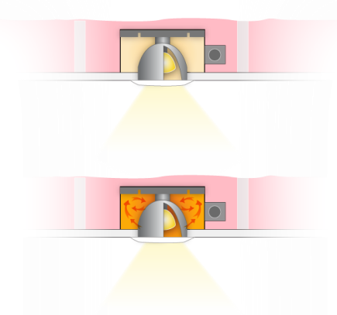
Recessed Light Fixtures
Building Shell Retrofit Strategies
Recessed Light Fixtures
IC rated fixtures can be covered in insulation.
Non-IC rated fixtures cannot.
Covering non-IC rated fixtures leads to heat build up:
Reduces bulb life.
Produces fire hazard.
IC fated fixture
Non-IC rated fixture
Graphics developed for the U.S. DOE WAP Standardized Curricula
Notes:
IC rated recessed light fixtures can be completely covered with insulation.
If the fixtures are not IC rated, covering them with insulation can cause dangerous heat buildup in the fixture. In a best-case scenario, this heat buildup will substantially shorten the life of the light bulb in the fixture. The worst-case scenario: fire.

Slide 38
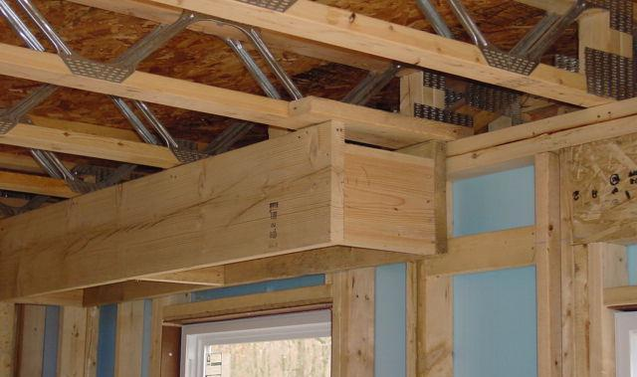
Dropped Soffits
Building Shell Retrofit Strategies
Dropped soffit in kitchen is open to the second-story floor system.
Photo courtesy of PA WTC
Notes:
The dropped soffit shown here is an example of a common hidden air leakage site.
The open framing on a platform-framed house (pictured on the right) shows a direct connection from the soffit to the trussed floor framing above. Specify sealing and insulating of the cavity.

Slide 39
Interior Air Sealing Locations
Building Shell Retrofit Strategies
Graphic courtesy of the U.S. Department of Energy Fact Sheet
Notes:
This illustration shows other typical air leakage locations in platform-framed homes.
Q: Which of these leakage locations is the most important to fix?
A: The kitchen soffit
Q: Which is the least important?
A: Electrical outlets

Slide 40
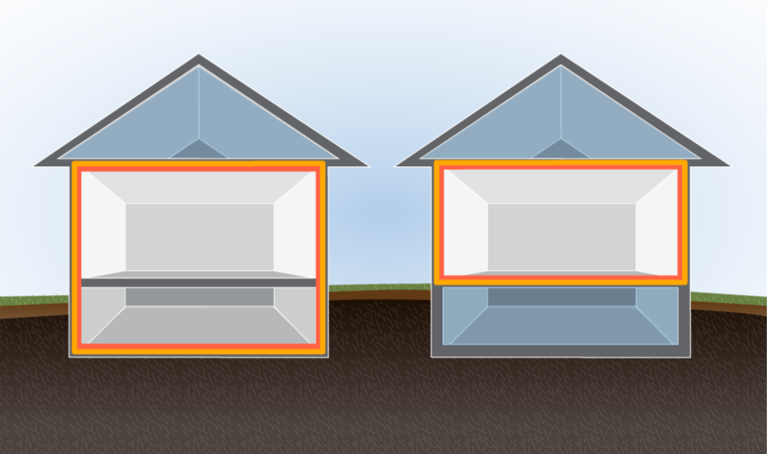
Basements: Conditioned or Unconditioned?
Building Shell Retrofit Strategies
Air Barrier
Thermal Barrier
Conditioned
Main Level
Conditioned
Main Level
ABOVE
GRADE
Conditioned
Basement
Unconditioned
Basement
BELOW
GRADE
Conditioned Basement
Unconditioned Basement
Graphics developed for the U.S. DOE WAP Standardized Curricula
Notes:
When trying to determine how to retro fit a basement or crawl space, consider these factors as you decide whether to bring it into the conditioned space or treat it as unconditioned space:
The type of basement or crawl space.
How the space is being used.
Where it is best to locate the pressure and thermal boundaries.
Whether the available retrofit options are cost-effective.
In either case, a basement retrofit should result in alignment of the air and thermal barriers, as shown.

Slide 41
Conditioned or Unconditioned?
Building Shell Retrofit Strategies
Guidelines
Conditioned
More than 50% below grade
Relatively tight or unvented foundation
A living space
Intentional or unintentional space conditioning
Unconditioned
Less than 50% below grade
Leaky, vented, or severely degraded foundation
Not a living space
No intentional or unintentional space conditioning
Notes:
Guidelines for conditioned space are as follows:
More than 50% below grade.
Relatively tight or unvented foundation.
A living space.
Intentional or unintentional space conditioning.
Guidelines for unconditioned space are as follows:
Less than 50% below grade.
Leaky, vented, or severely degraded foundation.
Not a living space.
No space conditioning.
The guidelines stated above are subjective but a decision will drive the retrofit strategies.
Above- or below-grade considerations are less critical than establishing whether the basement is intentionally or unintentionally conditioned.
The presence of a washer and dryer or stored items indicate limited activity and could therefore qualify that area as a conditioned space.

Slide 42
Basement Diagnostics
Building Shell Retrofit Strategies
Zone Pressure Diagnostics (ZPD)
Determine interconnectivity of basement or crawl space WRT house.
Pressure Pan Testing
Determine relative leakiness of ducts to outside.
CAZ Testing
Diagnose problems caused by negative pressures.
Photo courtesy of PA WTC
Notes:
Zone pressure diagnostics determine the interconnectivity of the basement or crawl space with reference to the house.
Zone pressure diagnostics help the auditor determine the state and location of the air and thermal barriers.
For conditioned basements or crawl spaces, the pressure difference with regard to the house should read close to 0 Pa. In this case, the foundation walls become the pressure boundary.
If you decide to leave the basement outside, the basement ceiling becomes the pressure boundary. In this case, the pressure difference of the basement with regard to the house may read anywhere between 0 and 50 Pa depending on how leaky the foundation walls are to the outside.
Pressure pan testing determines the relative leakiness of ducts to the outside.
Whether the space is conditioned or unconditioned, pressure pan testing should yield results close to 0 Pa to assure that ducts are not leaking to the outside.
Supply leaks to the inside of a tight basement are not important because they are located within the pressure boundary.
Combustion appliance zone testing diagnoses problems caused by negative pressures.
Always perform worst case CAZ testing to assure safe operation of combustion appliances in the basement. Mitigate any problems.

Slide 43
Basement Retrofit Options - Unconditioned
Building Shell Retrofit Strategies
Unconditioned Basement Specifications
Air seal between the basement and house.
Seal all return and supply ducts.
Insulate all duct work to recommended R-value.
Insulate open floor joists to recommended R-value with fiberglass batt insulation.
Insulate enclosed floor cavities with dense-pack insulation.
Pressure pan measurements on duct registers should read close to 0 Pascals.
Notes:
Specify the following for unconditioned basements:
Air seal all bypasses between the basement and house.
Seal all return and supply ducts.
Insulate all duct work to the recommended R-value. Insulation levels are based on cost-effective criteria determined through a DOE- approved audit or priority list.
Insulate open floor joists to the recommended R-value with batt insulation supported by wire supports and with the vapor barrier to the heated side.
Insulate closed floor cavities with dense-packed insulation.

Slide 44
Basement Retrofit Options - Conditioned
Building Shell Retrofit Strategies
Conditioned Basement Specifications
Air seal perimeter mud sill, band joist, and all air pathways between the basement and the house.
Seal return plenum and all return ducts for safety.
Mechanically reconnect boot to register transitions, repair broken trunk lines and branch ducts.
Insulate band joist area to recommended R-value.
Consider insulating basement walls.
Use ZPD to verify that the conditioned crawl space WRT house is close to 0 Pascals.
Notes:
Specify the following for conditioned basements:
Air seal the perimeter mud sill, the band joist, and all air pathways between the basement and the house.
Seal off portions of the basement that are in unconditioned areas such as coal bins or vented crawl spaces that are part of the basement.
Seal the return plenum and all return ducts for safety.
Mechanically reconnect boots to register transitions. Repair broken trunk lines and branch ducts.
Insulate the band joist area to the recommended R-value with polystyrene board or two-part spray foam.
Consider insulating above-grade basement walls with two-part spray foam or batt insulation.
Use ZPD to verify the conditioned crawl space WRT house is close to 0 Pascals.
Q: If the basement is conditioned, should the entire height of the basement walls be insulated?
A: No. Insulate above-grade walls extended to no more than 2 feet below grade. This depth roughly corresponds to the average frost depth in cold climates. The soil becomes increasingly warmer with increasing depth, making it no longer cost-effective to insulate.
For more details refer to the “Basements and Crawl spaces” section of Installer Intermediate curriculum.

Slide 45
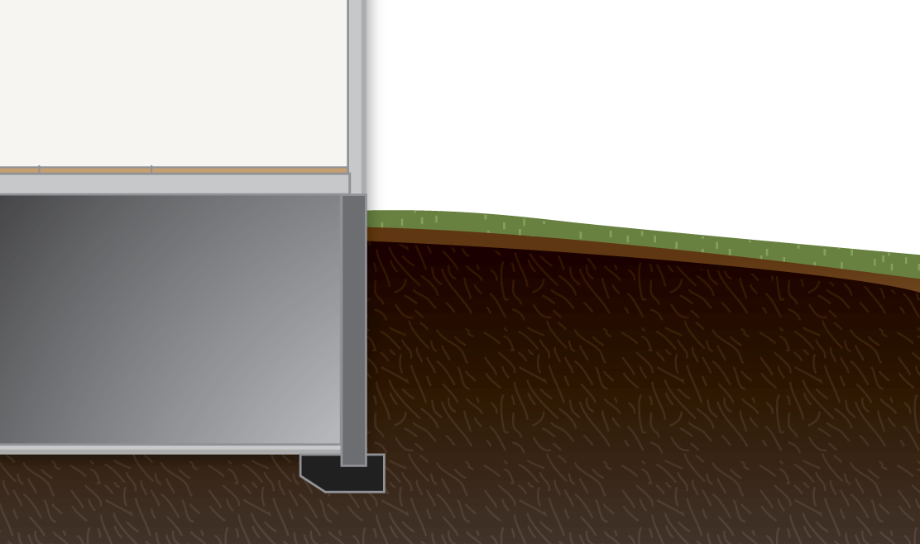
Heat Loss by Soil Depth
Building Shell Retrofit Strategies
Manual J HTM (Btu/hr/sq ft)
Butte, MT
Kokomo, IN
Tampa,
FL
2 ft
43.5
35.7
15.3
5 ft
10.6
8.7
3.7
>6 ft
7.4
6.1
2.6
Notes:
The temperature-moderating effects of the surrounding earth reduce average Delta-T below grade.
Insulating basement walls that are more than 2 feet below grade yields a fraction of the savings achieved by insulating above-grade walls.

Slide 46
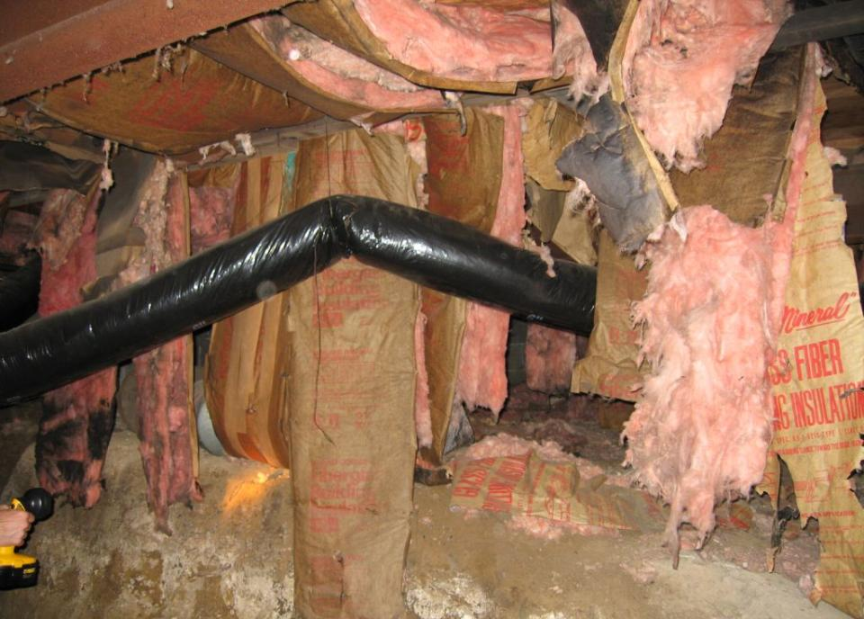
Photo courtesy of INCAA
Notes:
This photo shows wet and degraded insulation in a vented, unconditioned crawl space.
It is the job of the auditor to play detective and determine the underlying causes of moisture damage like the damage shown here.
Q: Does it make sense to reinstall fiberglass batts if the moisture problems have not been resolved?
A: No. If you have not solved the moisture problem, the symptoms will reoccur. We’ll take a look at several crawl space retrofit options that should cure moisture problems.

Slide 47
Unconditioned Crawl Space Retrofit
Building Shell Retrofit Strategies
Remove debris and resolve moisture issues.
Air seal perimeter mud sill, band joist, and all air pathways between the basement and the house.
Seal all return and supply ducts.
Install ground vapor retarder (6-mil plastic).
Seal foundation vents.
Insulate ductwork to recommended R-value.
Insulate floor joists to recommended R-value.
Notes:
In some cases, it may be more cost-effective to air seal and insulate the floor between the crawl space and the house. This leaves the crawl space unconditioned.
For an unconditioned crawl space, the auditor might specify:
Remove debris and resolve moisture issues.
Air seal the perimeter mud sill, band joist, and all air pathways between the basement and the house.
Seal all returns and supply ducts.
Install a ground vapor retarder (6-mil plastic). This will help prevent ground-source moisture vapor from entering the crawl space.
Seal foundation vents. This will prevent moisture-laden air from entering the crawl space, where it can condense on cold surfaces.
Insulate ductwork to the recommended R-value.
Insulate floor joists to the recommended R-value.
When the floor becomes the pressure and thermal boundary, bulk moisture problems caused by poor drainage around the foundation must also be resolved.
Although the floor is now the primary air barrier, some programs also air seal the perimeter mud sill and band joist to prevent outside air from washing underneath or penetrating the floor insulation.

Slide 48
Conditioned Crawl Space Retrofit
Building Shell Retrofit Strategies
Remove debris and resolve moisture issues.
Install vapor retarder on the crawl space soil.
Seal foundation vents.
Air seal band joist area, cracks in the foundation, access door, etc.
Seal bypasses through floor of house.
Duct runs may be left uninsulated.
Seal all returns and supplies.
Insulate foundation walls with two-part foam or fiberglass insulation.
Notes:
Many building scientists have found that creating a conditioned crawl is beneficial for maintaining the building’s integrity. Crawl space conditioning also increases surface temperatures, thereby preventing condensation problems.
For a conditioned crawl space, the auditor might specify:
Remove debris and resolve moisture issues.
Install a vapor retarder on the crawl space soil.
Seal foundation vents.
Air seal the band joist area, cracks in the foundation, and access door
Seal bypasses through the floor of the house.
Seal all return and supply ducts. Duct runs may be left uninsulated.
Insulate foundation walls with two-part foam or batt insulation.
Several state WAP programs have embraced the concept and have the methods and techniques in place to do it.

Slide 49
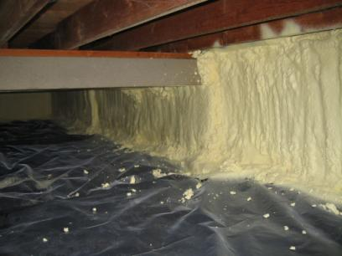
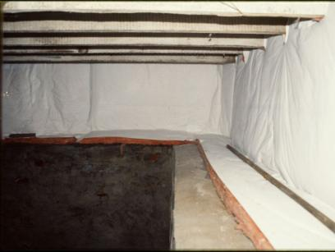
Conditioned Crawl Space Retrofit
Building Shell Retrofit Strategies
Spray foam insulation
Fiberglass insulation
INCAP Photo
Photos courtesy of INCAA
Notes:
These photos show spray-foam insulation and fiberglass insulation of a crawl space.
Spray-foam:
A two-part foam application on the foundation walls shown on the left provides an air-sealed and insulated wall. Note the continuous vapor retarder overlapped by the foam application.
Fiberglass insulation:
Insulation specifically designed for metal buildings in 4 ft.-wide R-11 batts (shown on the right) is suspended horizontally from the sub-floor and draped against the inside of the crawl space wall.
Foam is preferred because it is more dependable in keeping the walls above the dew point. Dew point is the temperature at which water vapor condenses to liquid form.
Q: Why might fiberglass batts installed on a foundation wall cause a problem?
A: Condensation may form between the insulation and cool masonry walls.

Slide 50
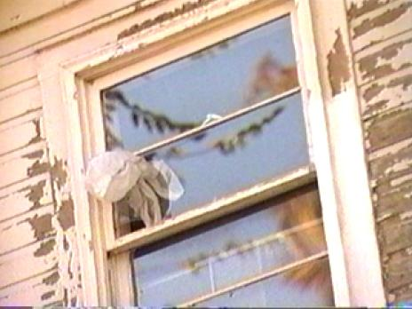
Window Treatments
Building Shell Retrofit Strategies
Where applicable specify:
Replace broken glass.
Replace broken sash locks.
Weatherstrip meeting rails and sliding surfaces.
Install pulley seals.
Caulk interior trim.
Photo courtesy of the U.S. Department of Energy
Repairing the broken pane will reduce air leakage significantly for much lower cost than window replacement.
Notes:
Where applicable, specify the following:
Replace broken glass.
Replace broken sash locks.
Weatherstrip meeting rails and sliding surfaces. Meeting rails are where the upper and lower sashes meet.
Install pulley seals. Pulleys are in many older homes. They are a component of the sash counterweight system that helps control the movement of the lower sash. They are recessed into the window frame above the lower sash. The gaps around them allow air to enter from the wall cavity where the sash weights are located.
Caulk interior trim.
Window sealing is often simple but can be time consuming.
Spending a great deal of time sealing every possible joint is not cost-effective compared to fixing large attic bypasses or big duct leaks to the outside. However, drafts related to window air leakage are often the most bothersome to homeowners.
Besides fixing obvious problems such as broken glass or misaligned sashes, window sealing should be limited to areas where homeowners spend a lot of time.

Slide 51
Guidelines for Window Replacement
Building Shell Retrofit Strategies
Not usually a cost-effective measure in WAP unless:
The replacement may be justified as an incidental repair
The replacement has a demonstrated SIR of 1 or greater
Always attempt to repair or improve existing windows.
Window replacement should not be considered as an infiltration measure.
Window selection should consider climate.
High SHGC in cold climates, low SHGC in hot climates.
Placement of low-e coatings on interior pane in cold climates and on exterior panes in hot climates.
Notes:
Windows are not usually a cost-effective measure in the Weatherization Assistance Program unless:
The replacement may be justified as an incidental repair.
The replacement has a demonstrated SIR of 1 or greater. Always attempt to repair or improve existing windows.
Window replacement should not be considered as an infiltration measure.
Window selection should reflect the climate:
Choose windows with high solar heat gain coefficient (SHGC) in cold climates and low SHGC in hot climates.
Choose low-e coatings on interior panes in cold climates and on exterior panes in hot climates.
Q: True or false: According to DOE Guidance, windows may be replaced with health and safety funds.
A. False: Windows may only be replaced as an Incidental Repair Measure (IRM) or as an energy conservation measure if it is determined that they have an SIR of 1 or greater.

Slide 52
Other Allowable Window Treatments
Building Shell Retrofit Strategies
Interior storm windows
Moveable insulation systems
Client education
Photo courtesy of the U.S. Department of Energy
Notes:
Other allowable window treatments include the following:
Interior storm windows
Moveable insulation systems
Education, encouraging clients to use:
Simple methods for high and low ventilation during warm periods
Draperies during cold periods

Slide 53
Doors
Building Shell Retrofit Strategies
A good candidate for replacement.
Replacements are not often cost-effective because of their high cost and relatively low impact on energy savings.
Potentially significant air leakage and comfort issues due to operational problems and poor seals.
Photos courtesy of WV GEOEO
Notes:
This photo shows a door on a mobile home that is a good candidate for replacement.
Most replacements are not cost-effective because of their high cost and relatively low impact on energy savings.
This door may be cost-effective to replace due to significant air leakage and comfort issues related to operational problems and poor seals.
Solid wood core doors generally have an R-value of 2.5.
ENERGY STAR-qualified, foam-filled steel doors have an R-value close to 6.
The relatively small amount of energy savings does not justify the cost of replacement in any but the most extreme circumstances.

Slide 54
Door Fixes
Building Shell Retrofit Strategies
Specify weatherstripping, door stops, door sweeps or thresholds.
Specify repair or replacement of locksets, latches and hinges.
Specify a replacement door only when:
Existing door creates a hazard to health, safety, or building durability.
Existing door is damaged or weathered beyond repair and the replacement material and labor cost is less than cost of repair.
Photos courtesy of WV GEOEO
Notes:
For door fixes:
Specify weatherstripping, door stops, door sweeps, and/or thresholds.
Specify repair or replacement of locksets, latches, and hinges.
Specify a replacement door only when the existing door:
Creates a hazard to health, safety, or building durability.
Is damaged or weathered beyond repair and the replacement material and labor cost is less than the cost of repair.
Solid wood core doors generally have an R-value of 2.5. ENERGY STAR-qualified, foam-filled steel doors have an R-value close to 6.
The relatively small amount of energy savings does not justify the cost of replacement except when the existing door is beyond repair.

Slide 55
Summary
Building Shell Retrofit Strategies
Building shells are as complex and varied as the housing stock.
Successful building shell retrofits require traditional as well as innovative materials and techniques to solve problems.
Prioritization of measures through cost-effective weatherization results in the biggest energy savings for the investment made in materials and labor.
Notes:
Building shells are as complex and varied as the housing stock.
Successful building shell retrofits require traditional as well as innovative materials and techniques to solve problems.
Prioritizing measures through cost-effective weatherization results in the biggest energy savings for the investment in materials and labor.
Present this slide as an interactive discussion, soliciting personal examples from the trainees. Add your own personal examples and knowledge to supplement.

