Slide 1
Mobile Home Assessment
WEATHERIZATION ENERGY AUDITOR SINGLE FAMILY
WEATHERIZATION ASSISTANCE PROGRAM STANDARDIZED CURRICULUM – December 2012

Slide 2
Learning Objectives
Mobile Home Assessment
By attending this session, participants will be able to:
Discuss mobile home characteristics and components.
Evaluate problems and opportunities.
Review cost-effective retrofit options.
Determine health and safety measures.
Discuss diagnostic approaches to evaluating mobile homes.
Discuss visual checks and specifications.
Examine conditions for deferral of service.
Notes:
By attending this session, participants will be able to:
Discuss mobile home characteristics and components.
Evaluate problems and opportunities.
Review cost-effective retrofit options.
Determine health and safety measures.
Discuss diagnostic approaches to evaluating mobile homes.
Discuss visual checks and specifications.
Examine conditions for deferral of service.

Slide 3
Background
Mobile Home Assessment
Mobile homes comprise at least 25% of the households that qualify for weatherization nationwide.
Advances in weatherization materials and retrofit techniques open up huge opportunities for energy savings.
Photo courtesy of the U.S. Department of Energy
Notes:
This is a photo of two mobile homes connected by a foyer or conditioned breezeway.
At least 25% of the households that qualify for weatherization are mobile homes.
Advances in weatherization materials and retrofit techniques open up huge opportunities for energy savings.
Mobile homes come in many shapes, sizes, and configurations.
Mobile homes have received a bad reputation for their light (cheap) construction and association with poverty.
Their construction is unique and specialized retrofits are required.
Mobile homes and the clients who occupy them deserve the same respect and attention to detail as other homes and clients.

Slide 4
Some Mobile Home Characteristics
Mobile Home Assessment
Wooden frame bolted to a steel chassis
Constructed in long, narrow segments in a factory; delivered and completed on site
Shallow roof cavities
Interior panels provide structural rigidity
Single framing for door and window openings
Sealed combustion heating systems
Notes:
Characteristics of mobile homes include the following:
Wooden frame bolted to a steel chassis
Constructed in long, narrow segments in a factory; delivered and completed on site.
Shallow roof cavities
Interior panels provide structural rigidity
Single framing for door and window openings
Sealed combustion heating systems
Ask students how they think mobile home building construction details are different from site-built home building details. This discussion leads into the next slides on mobile home characteristics and components.

Slide 5
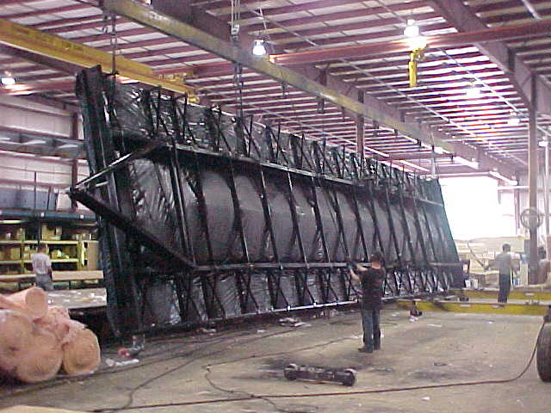
Mobile Home Belly System
Mobile Home Assessment
Photo courtesy of PA WTC
Notes:
Mobile home (HUD Code) manufacturing processes haven’t changed much over the years. The basic structure includes the following:
A floor system more commonly known as the mobile home belly.
The belly contains the insulation, duct system, and plumbing, and is enclosed by the sub-floors and finished floors, as well as a rodent barrier underneath.
Q. How does this support system different from that of a single family home?
A. Single family homes have perimeter support by a masonry foundation wall where a mobile home is supported by the two center I-beams.

Slide 6
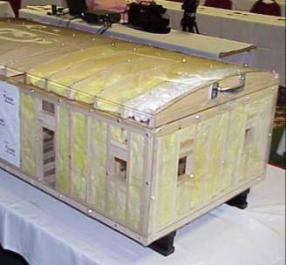
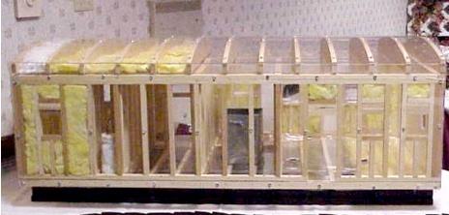
Mobile Home Components
Mobile Home Assessment
8
12
8
4
11
7
9
3
10
6
5
2
1
Photos courtesy of the U.S. Department of Energy
Main beam
Band joist
Rough window opening
Bowstring trusses
Floor joists
Heating/AC duct
Top plate
Ceiling joist cavity
Wall section
Rough door opening
Vapor barrier
Blown-in insulation
Notes:
These are photos of major mobile home components.
The majority of existing mobiles are integrated, self-contained homes. The floor plans of these “single wides” range from about 700 to 1,000 square feet.
Modern mobile homes can be built in multiple sections, known as “double wides” or “triple wides,” and bolted together on site.

Slide 7
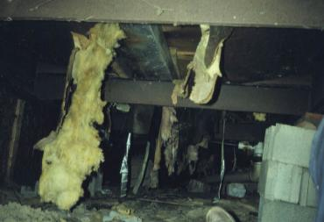
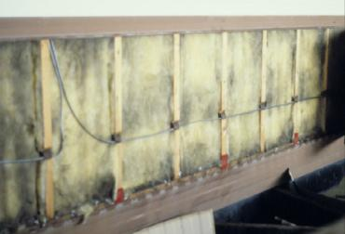
Problems and Opportunities
Mobile Home Assessment
Mobile homes built before 1976 consume 1.5 to 2 times more energy than a site-built home.
Why?
Low thermal mass (thin and poorly insulated floors, walls, and ceilings)
Conductive materials (metal windows and door frames)
Large open areas and penetrations in the floor system
High surface-to-floor area ratio
Poor duct design, components, and installation
Photos courtesy of PA WTC
Notes:
Mobile homes built before 1976 consume 1.5 to 2 times more energy than a site-built home. Why?
Low thermal mass (thin and poorly insulated floors, walls, and ceilings)
Conductive materials (metal window and door frames)
Large open areas and penetrations in the floor system
High surface-to-floor area ratio.
Q. What does “high surface to floor area ratio” mean?
A. High surface-to-floor area ratio” means that all sides of a mobile home are exposed to ambient conditions (floors, walls, roof)
Site-built homes have basements, slabs, or crawl spaces to buffer them from the elements.
Poor duct design, components, and installation

Slide 8
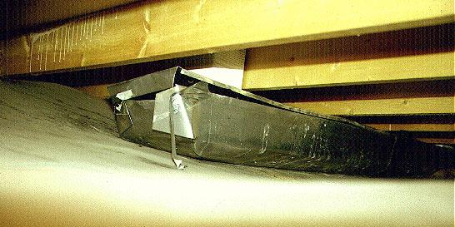
Problems and Opportunities
Mobile Home Assessment
Photo courtesy of PA WTC
Notes:
This photo shows typical kinds of duct leakage in a mobile home belly cavity.
This was a factory-built problem waiting to happen. (Note separated duct tape).

Slide 9
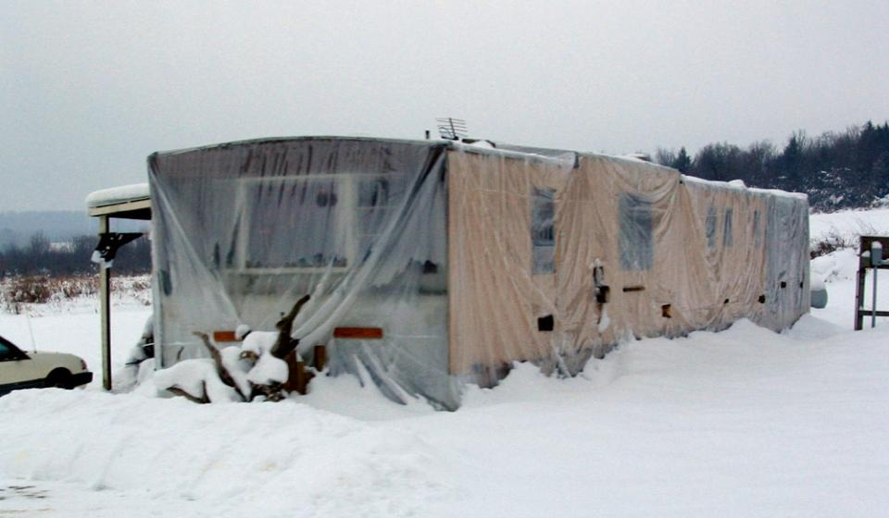
Problems and Opportunities
Mobile Home Assessment
Photo courtesy of PA WTC
Notes:
This photo shows a mobile home wrapped in plastic, underscoring the thermal losses associated with mobile homes.
The homeowner took matters into his own hands to enhance comfort. As the weather warms, he removes the plastic and installs a fresh sheet in the fall.
That must be a good-sized twist tie holding it all together.
Ask students what kinds of experiences they’ve had with mobile homes and what kinds of measures they’ve installed.

Slide 10
Mobile Home Construction Eras
Mobile Home Assessment
Pre-HUD Code (before 1976)
Little or no insulation (less than R-6)
2x2 or 2x3 stud walls
Jalousie windows
HUD Code and Upgrades (post 1976)
Set insulation standards per climate zones
2x4 exterior walls and single-hung slider windows
Bathroom and kitchen exhaust fans
Vapor barriers in ceiling
R-8 or better insulation levels
Notes:
Pre-HUD Code (before 1976)
Little or no insulation (less than R-6)
2 x 2 or 2 x 3 stud walls
Jalousie windows
HUD Code and upgrades (post-1976)
Set insulation standards per climate zones
2 x 4 exterior walls and single-hung slider windows
Bathroom and kitchen exhaust fans
Vapor barriers in ceiling
R-8 or better insulation levels
Ask how these insulation levels compare to insulation levels for code-compliant site-built homes (Reference local IRC codes).
Recognizing when a mobile home was built should drive its retrofit strategies.
Mobile homes built before 1976 were some of the worst in terms of an overall lack of energy efficiency. They were constructed in factories all over the nation and there were very few standards.
A home built for a hot climate might find its way to the state of Maine and be unable to withstand the snow load, much less contain the proper insulation.
In 1976, Congress passed the Manufactured Housing Safety and Construction Act, which established a federally enforced performance-based code.
The U.S. Department of Housing and Urban Development (HUD) was charged with rulemaking and enforcement of the HUD Code.
Although HUD Code insulation standards were higher (with R-8 minimums throughout) it is generally cost-effective under WAP to install additional insulation in post-HUD code mobile home bellies, walls, and roof cavities where clearances allow.

Slide 11
Sample Measure Selection Priority List
Mobile Home Assessment
MECHANICAL RETROFITS
Repair or replace furnaces per health, safety, and efficiency protocols
MOBILE HOME SHELL AND DUCT RETROFITS
Air seal per blower door-guided protocols and targeted air leakage reductions
Duct seal per blower door-guided and duct diagnostic protocols
Insulation Component | No Insulation | Pre HUD Code with minimal existing Insulation | Post HUD Code with higher insulation levels
Floor System | Fill cavity where dimensions allow
Wall System | Add R-11-13 batts | Add R-13 batts where dimensions allow
Roof System | Fill cavity where dimensions allow
BASE LOAD MEASURES
Lighting | Replace incandescent and halogen lamps with CFL lamps
Domestic Hot Water Measures | Add R-11 wrap, pipe insulation, and other water heating measures where manufacturer specs allow
Refrigerator Replacement | Replace as per DOE and state standards
WINDOWS AND DOORS
Deteriorated window units beyond repair | Replace with factory replacement slider or double-hung units and self-storing storm windows
Deteriorated doors beyond repair | Replace with factory replacement types
Notes:
This table shows a priority list developed by a state and approved by DOE based on the Mobile Home Energy Audit software (MHEA) developed at Oak Ridge National Laboratory (ORNL).
By modeling various mobile home configurations and inputting fuel cost, climate data, material costs, and labor costs, DOE determined that shell measures such as duct sealing, air sealing, and insulation are cost-effective retrofits.
Measures must have a savings-to-investment ratio (SIR) of 1 or greater.
While windows and doors generally do not have favorable SIRs, replacements are allowable as infiltration measures if the existing windows and doors are beyond repair.
The interaction of mechanical, base load, and building shell measures are considered in the evaluation. Base load use is defined as year-round energy consumption not related to space conditioning. Refrigeration, lighting, and domestic water heating are examples of base load use.
The MHEA software calculates interactions automatically.

Slide 12
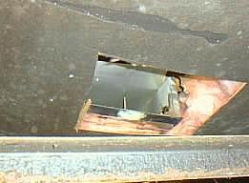
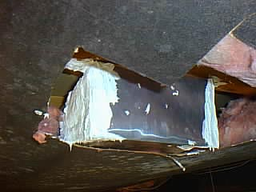
Retrofit Options – Duct Systems
Mobile Home Assessment
Performance-based duct treatments include:
Visual and diagnostic assessment.
Sealing and repair.
Converting belly return system.
Cleaning.
Removing obstructions.
System balancing.
Replacing damaged registers.
Post-repair diagnostics.
Open ended duct
Repair
Challenging but very important!
Photos courtesy of Tony Gill
Notes:
Performance-based duct treatments are challenging but very important. They include the following:
Visual and diagnostic assessment
Sealing and repair
Converting belly return system
Cleaning
Removing obstructions.
System balancing
Replacing damaged registers
Post-repair diagnostics
Duct sealing and repair is probably the most cost-effective measure that can be applied to mobile homes.
Ducts are located within the belly cavity and are therefore outside the thermal boundary.
Q: Why is duct sealing so important in mobile homes?
A: All that separates them from the outdoors is a thin rodent barrier that is often torn or completely missing.
Duct sealing and repair is difficult work, often with low clearances, a wet ground, and obstructions. The work requires attention to detail.

Slide 13
Retrofit Options – Heating Systems
Mobile Home Assessment
Heating system retrofits include:
Visual and diagnostic testing.
Cleaning dirty burners.
Cleaning and adjusting blowers.
Replacing furnace filters.
Repairing excessive temperature rise problems.
Adjusting operating temperatures.
Replacing unsafe or inefficient furnaces.
Should only be attempted by qualified heating technicians.
Photo courtesy of the U.S. Department of Energy
Notes:
Heating system retrofits include:
Visual and diagnostic testing.
Cleaning dirty burners.
Cleaning and adjusting blowers.
Replacing furnace filters.
Repairing excessive temperature rise problems.
Adjusting operating temperatures.
Replacing unsafe or inefficient furnaces.
This should only be attempted by qualified heating technicians.

Slide 14
Retrofit Options – Belly Insulation
Mobile Home Assessment
Re-insulating the mobile
home belly is cost-effective.
Increases thermal performance
Possible air leakage reductions between 25% and 50%
Enhanced occupant comfort
Very challenging, but
achievable with the right
tools and good training.
Photo courtesy of PA WTC
Notes:
Re-insulating the mobile home belly is almost always cost-effective. Benefits include the following:
Increases thermal performance.
Air leakage reductions between 25% and 50% are possible.
Enhances occupant comfort.
Installing belly insulation is very challenging but achievable with the right tools and good training. It involves:
Air sealing all penetrations to the living area.
Repairing the rodent barrier.
Drilling access holes through the rim joist.
Filling the belly cavity with loose-fill insulation.

Slide 15
Retrofit Options – Sidewall Insulation
Mobile Home Assessment
Re-insulating sidewalls
is also a very cost-effective
retrofit.
Increases thermal performance
Reduces air leakage
Reduces noise
Photo courtesy of Tony Gill
Technically not difficult
or time consuming.
Notes:
Re-insulating sidewalls is also usually a very cost-effective retrofit.
Increases thermal performance
Reduces air leakage
Reduces noise
Technically it is not difficult or time consuming.
Installing sidewall insulation involves:
Partially detaching the siding.
Pulling out the old insulation.
Stuffing thicker batts into the wall cavities.
Reattaching the siding.
Q: Can this be done on all mobile homes?
A: No, because it depends on whether you can achieve a favorable SIR for the measure.

Slide 16
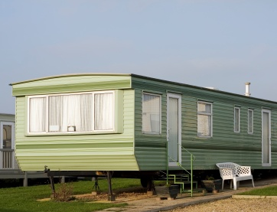
Retrofit Options – Roof Insulation
Mobile Home Assessment
Re-insulating roof cavities on mobile homes is cost-effective.
Increases thermal performance
Provides cooling savings
Reduces roof rumble
Moderately challenging,
but achievable with
the right tools and
good training.
Photo courtesy of the U.S. Department of Energy
Notes:
Re-insulating roof cavities on mobile homes is typically cost-effective.
Increases thermal performance, saving on heating and cooling bills
Provides cooling systems
Reduces roof rumble
High winds can cause the metal roof panels of a mobile home to flex and buckle, causing noise. Additional roof cavity insulation can dampen this effect.
Insulating roof cavities is moderately challenging but achievable with the right tools and good training. It involves:
Repairing ceilings.
Accessing the roof cavity through the ends, top, sides, or interior ceiling.
Filling the roof cavity with loose-fill insulation.
Repairing access points.

Slide 17
Retrofit Options - Other Measures
Mobile Home Assessment
Window and door replacement
Hot water conservation measures
Health and safety measures
Incidental repairs
Standard base load measures
Cooling measures for hot climates, including:
Reflective roof coatings
Shade screens and awnings
Window films
Photo courtesy of WV GOEO
Notes:
Other retrofit options include the following:
Window and door replacement
Hot water conservation measures
Health and safety measures
Standard base load measures (refrigerator replacement, hot water tank improvements, and installation of compact fluorescent lamps)
Cooling measures for hot climates, including:
Reflective roof coatings
Shade screens and awnings
Window films
Incidental repair

Slide 18
Sequence of Retrofit Options
Mobile Home Assessment
Perform blower door-guided air sealing.
Diagnose, repair, seal, and improve duct systems.
Diagnose and repair or replace furnace.
Prepare and insulate the belly cavity.
Prepare and insulate walls.
Prepare and insulate roof cavity.
Inspect and apply domestic water heater improvements and standard base load measures.
Inspect and repair or replace windows and doors.
Notes:
The sequence of retrofit options includes the following:
Perform blower door-guided air sealing.
Diagnose, repair, seal, and improve duct systems.
Diagnose and repair or replace furnace.
Prepare and insulate the belly cavity.
Prepare and insulate walls.
Prepare and insulate roof cavity.
Inspect and apply domestic water heater improvements and standard base load measures.
Inspect and repair or replace windows and doors.
The sequence of retrofit options follows a priority list based on the level of cost-effectiveness.
Health and safety measures such as adding mechanical ventilation, replacing hot water tanks, and replacing furnaces are not considered under cost-effective criteria but are often top priority measures in weatherization.

Slide 19
Exterior Assessment - Overview
Mobile Home Assessment
Footprint sketch, dimensions and external features (additions, porches etc.)
Construction era (look for a certification label)
Structural integrity and level (windows and doors being out of square)
Condition of the siding, windows, doors
Drainage, raw sewage, plumbing leaks underneath
Other safety hazards
Notes:
Items in an exterior assessment include the following:
Footprint sketch, dimensions, and external features (additions, porches, etc.).
Construction era (look for a certification label).
Structural integrity and level (windows and doors being out of square).
Condition of the siding, windows, and doors.
Drainage, raw sewage, or plumbing leaks underneath.
Other safety hazards.

Slide 20
Exterior Assessment - Overview
Mobile Home Assessment
Condition of the belly and rodent barrier
Belly insulation levels
Floor joist direction
Water damage to side sills
Condition of the roof
Condition of chimney vent terminations
Feasibility of installing belly, wall, and roof insulation
Notes:
Items in an exterior assessment include the following (continued):
Condition of the belly and rodent barrier
Belly insulation levels
Floor joist direction
Water damage to side sills
Condition of the roof
Condition of chimney vent terminations
Feasibility of installing belly, wall, and roof insulation

Slide 21
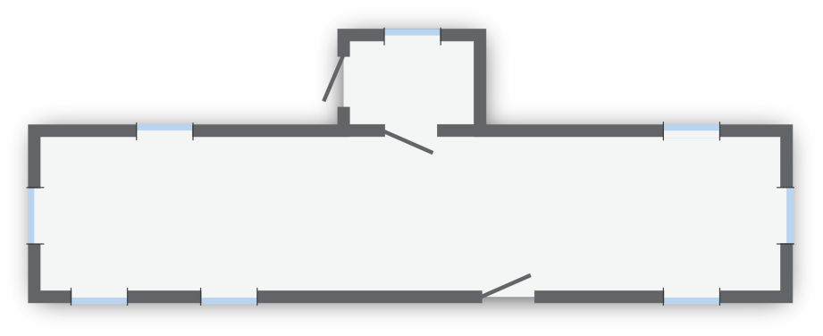
Sketch
Mobile Home Assessment
10 ft.
8 ft.
12 ft.
60 ft.
Graphic developed for the U.S. DOE WAP Standardized Curricula
Draw an exterior sketch showing dimensions of the home, additions, porches etc.
Show relative locations of door and windows.
Notes:
Draw a sketch showing dimensions of the home and external features.
Show relative locations of door and windows.

Slide 22
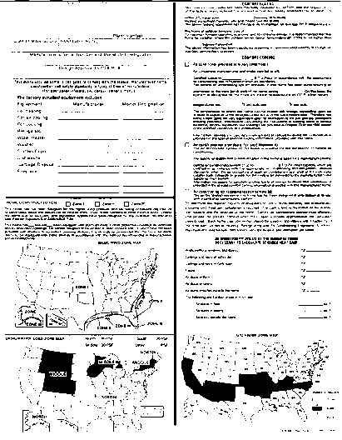
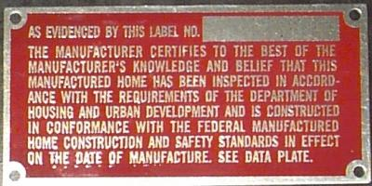
Discuss mobile home characteristics and components.
Evaluate problems and opportunities.
Review cost-effective retrofit options.
Determine health and safety measures.
Discuss diagnostic approaches to evaluating mobile homes.
Discuss visual checks and specifications.
Examine conditions for deferral of service.
Determining the Construction Era
Mobile Home Assessment
Identifying post-1976 HUD Code (mobile) homes
Data Plate
Photos courtesy of Bill Van der Meer
Certification label
Notes:
This image is a scan of a data plate and a certification label for HUD Code homes.
A data plate and certification label note the existence of ventilation fans and other distinctive features, but also indicate that a home was built under the HUD Code.
Homes built before 1976 will not have these labels.
The data plate is permanently affixed to the home, usually in a bedroom closet, the electrical panel box cover, or kitchen cabinet.
The data plate contains the name and address of the manufacturer, serial and model numbers, date of manufacturer, and certification label numbers.
It lists major factory-installed appliances, along with the wind and snow loads for which the home was designed.
The certification label is a metal plate fastened to the exterior of the home showing that it meets all construction requirements under the HUD Code.
Q: How can knowing the age of a mobile home help an auditor?
A: It can help determine insulation levels, window types.

Slide 23
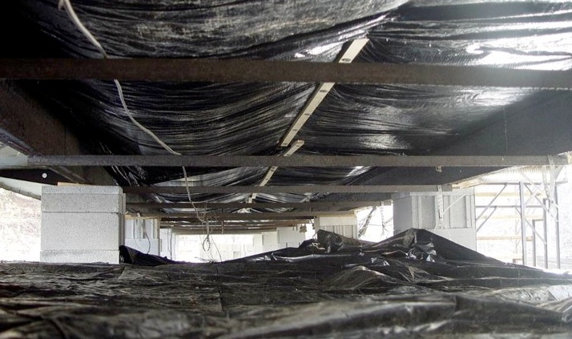
Belly Retrofit
Mobile Home Assessment
Rodent barrier
Block piers
Lay down a ground vapor retarder
Photo courtesy of the U.S. Department of Energy
Notes:
This photo shows features of a level foundation, adequate support piers, a continuous rodent barrier, and a ground vapor retarder.
If no vapor barrier is present, specify 6-mil sheet plastic to cover the entire crawl space.
The purpose of the vapor retarder is to prevent ground moisture vapor from entering the belly cavity.

Slide 24
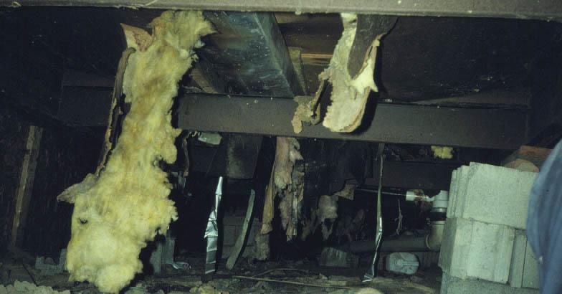
Replacing the Rodent Barrier
Mobile Home Assessment
When replacing the rodent barrier is the only option…
Photo courtesy of PA WTC
Notes:
This photo shows a severely damaged rodent barrier.
Consider replacing the entire rodent barrier with a tough vapor permeable house wrap such as Typar.
Q: If the duct leaks, where does the warm air go?
A: Outside, wasting all that energy.

Slide 25
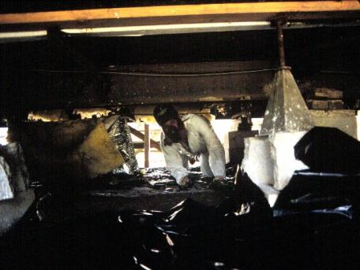
Belly or Not
Mobile Home Assessment
Factors to consider:
Insufficient clearance
Significant plumbing leaks.
Structural problems
Standing water or open sewage
Major obstructions
Electrical hazards
Photos courtesy of WV GOEO
Health and safety of workers and long-term integrity of the client’s home should be the main concerns.
Notes:
Factors to consider are:
Insufficient clearance
Significant plumbing leaks
Structural problems
Standing water or open sewage
Major obstructions
Electrical hazards
The health and safety of workers and the long-term integrity of the client’s home should be the main concerns.

Slide 26
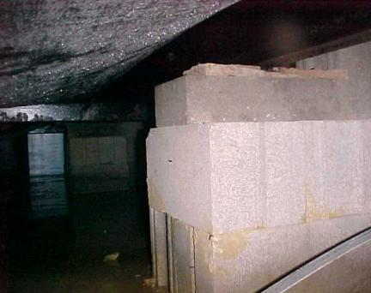
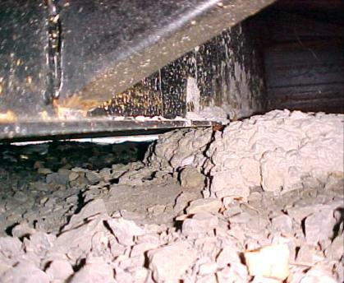
Drainage and Clearance
Mobile Home Assessment
Photos courtesy of PA WTC
Water problems
Insufficient clearance
Notes:
Photos of standing water and low clearance.
These kinds of issues would preclude insulating the belly.
The site should be well drained with no standing water in the crawl space. Vertical clearance should be sufficient to allow installers access to important components such as the ducts and rodent barrier.

Slide 27
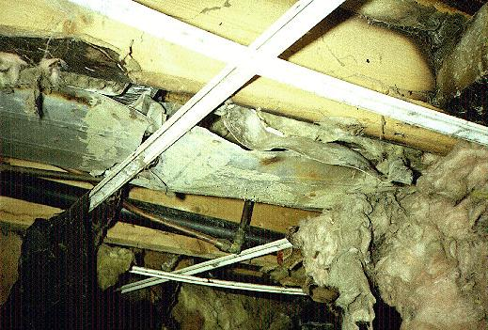
Check the Belly Cavity
Mobile Home Assessment
The auditor should note:
Duct location and condition.
Return air system.
Joist spacing and direction.
How much belly repair is required.
Minor repairable plumbing leaks.
Air leakage sites.
Photo courtesy of PA WTC
Notes:
The auditor should note:
Duct location and condition.
Return air system
Joist spacing and direction.
How much belly repair is required.
Minor repairable plumbing leaks.
Air leakage sites.
With limited time and tools, auditors should focus on general features they can see without having to access the enclosed belly.
Installers will access the belly cavity to a much greater extent to locate and repair duct leaks and other problems.
If possible, the auditor should look underneath at several vantage points along the length and ends of the home. A tear in the rodent barrier may allow the auditor to determine the depth of the floor cavity, joist spacing, and the level of insulation.
A majority of mobile home belly cavities will benefit from additional loose-fill fiberglass insulation. If the belly is not accessible, the work scope should specify additional insulation where possible.

Slide 28
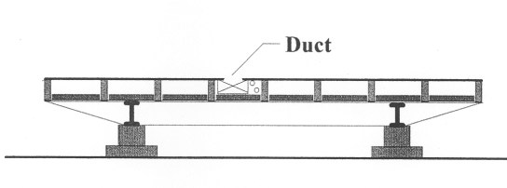
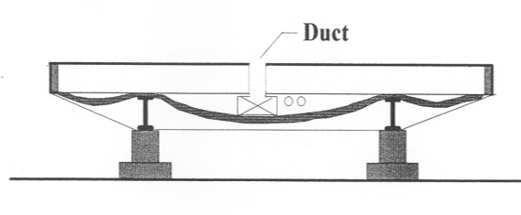
Joist Spacing and Direction
Mobile Home Assessment
Main beam
Outrigger beam
Rodent barrier
Floor joists
4
Lengthwise Floor Joist System
1
3
2
Crosswise Floor Joist System
Graphics developed for the U.S. DOE WAP Standardized Curricula
Notes:
Typical construction details of a mobile home belly.
Note floor system has a steel chassis, floor joists, insulation, and duct system sandwiched together. The double set of main I-beams provide center loading through the masonry piers and to the ground.
In a lengthwise floor joist configuration, the main duct is located inside the joist cavities.
In a crosswise floor joist configuration, the main duct is located beneath the floor joists and connected by boots to the sub-floor.
The auditor can easily determine joist direction by looking for a telltale hump in the floor formed by the main duct run in the center, as shown in the illustration on the lower right. This configuration is also known as a dropped down belly.
Mobile home duct systems are extremely vulnerable because they are located on the cold side of the thermal boundary.
All that separates the ducts from the outside is a thin rodent barrier, which is prone to damage over time. When ducts leak, they leak to the outside.

Slide 29
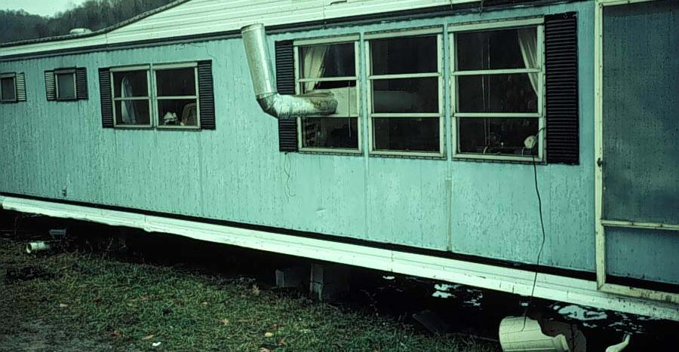
Safety Hazards
Mobile Home Assessment
Unsafe chimney
Temporary foundation
Raw sewage
Photo courtesy of PA WTC
Notes:
These types of conditions are grounds for deferral of services if the safety issues cannot be resolved within the budget.
Are there significant electrical or other safety hazards that would preclude performing a belly retrofit?
Health and safety funds may be used to correct the problems but must be accomplished within reasonable price guidelines (typically set by the state).
They should be limited to resolving minor problems such as plumbing leaks, minor drainage issues, and floor repair.
Q: At first glance does this look like a job that should be deferred?
A: Yes! Big problems such as raw sewage, major structural deficiencies, or significant ponding of water underneath the home, are generally considered outside the scope of the program.

Slide 30
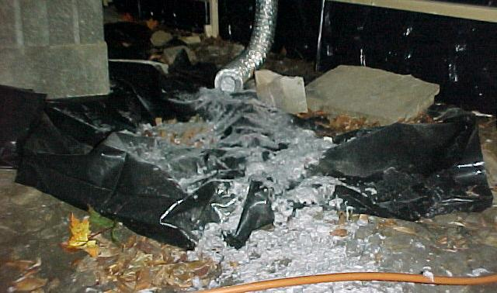
Plan to re-route dryer vent to outside!
Mobile Home Assessment
Photo courtesy of WV GOEO
Notes:
This photo shows an open dryer vent in the crawl space.
Q: What are some potential problems that could be caused by the situation shown in the photo?
A: Some possible answers:
Poor indoor air quality
Structural damage as high-moisture interacts with building components
Health issues, if rodents or other critters find the plentiful, soft lint an attractive place to live…

Slide 31
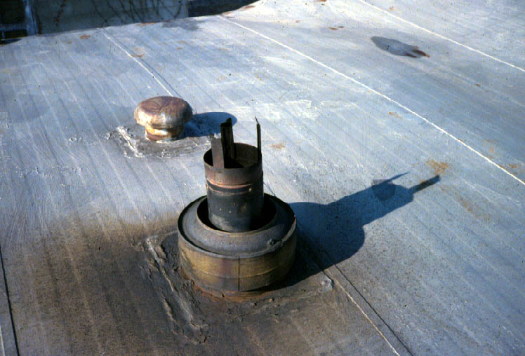
Roof and Chimney Terminations
Mobile Home Assessment
Photo courtesy of PA WTC
Notes:
Check the general condition of the roof.
Look for rust, corrosion, or structural flaws.
Now is a good time to check the condition of the chimney roof jack assembly, which is an integral part of the heating system and often subject to corrosion.
The chimney assembly that penetrates the roof and includes the flashing and chimney cap assemblies is known as the roof jack. Check for excessive rust and corrosion to determine whether it needs to be replaced.
Avoid stepping onto the roof deck because this may break the seals of the roof coating along the seams of the metal roof sections.

Slide 32
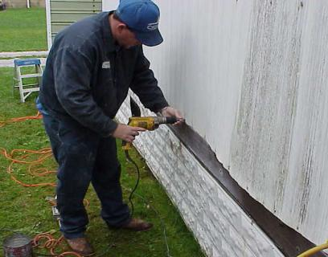
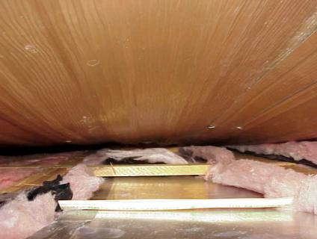
Sidewalls
Mobile Home Assessment
Photos courtesy of WV GOEO
Remove screws from the bottom of a wall panel.
Take a peek inside the wall cavity to estimate the thickness of existing insulation.
Notes:
Remove screws from the bottom of a wall panel.
Take a peek inside the wall cavity to estimate the thickness of existing insulation.
Pre-HUD Code homes have very thin wall cavities consisting of 2” x 3” wall framing, horizontal banding, and R-6 insulation.
If possible, specify reinsulating with high density R-13 fiberglass batt insulation.
If the sidewall is not accessible, the work scope should specify additional insulation where possible.

Slide 33
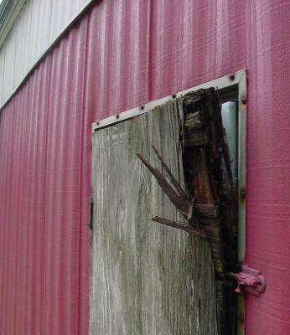
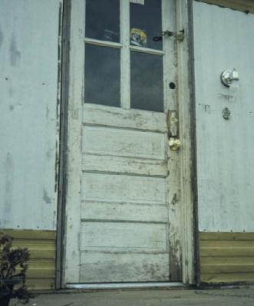
Doors
Mobile Home Assessment
Photo courtesy of PA WTC
Photo courtesy of WV GOEO
A DHWT closet door in need of replacement.
A good candidate for replacement.
Notes:
Note the condition and operation of doors, paying particular attention to the latching mechanism and effectiveness of the seal.
Door replacement is not cost-effective unless units are beyond repair or there’s a significant infiltration problem that can’t be resolved.
Mobile home doors will either swing to the inside or to the outside. Always specify replacement doors of the same type.
If replacing a natural gas- or propane- fired DHWT access door, specify a louvered door.
True or False: Doors may be replaced as an Energy Conservation Measure (ECM)
Answer: It depends….on whether it is determined that a replacement door has a favorable SIR.

Slide 34
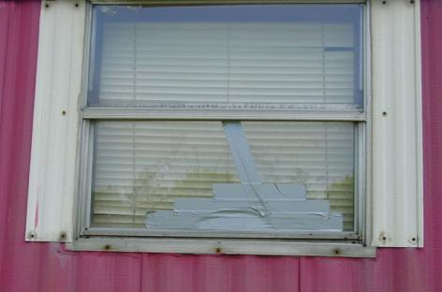
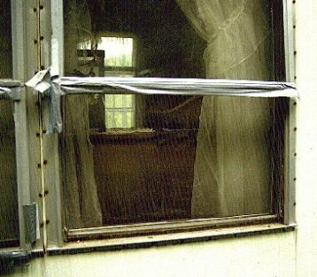
Windows
Mobile Home Assessment
Photos courtesy of PA WTC
Jalousie windows (some are not worth fixing)
Notes:
Jalousie windows:
are a kind of awning window that swings outward.
consist of multiple panes
are mechanically operated through a series of arms and cranks
are very prone to mechanical failure over time.
Faulty units can sometimes be fixed by replacing a stripped window crank or making other minor repairs. Note any broken glass and specify the size and location of the window.
Settling of the home causes the frames to become out of square so that the window will not close properly.
In many cases, the only option is to replace them with factory replacement types.
Windows that come with self-storing storms and a thermal break are recommended. A thermal break is a nonconductive material incorporated into the window frame that retards the flow of heat through the frame to the outside.
Q. True or false: According to DOE Guidance, windows may be replaced with health and safety funds.
A. False: Windows may only be replaced as an “Incidental Repair Measure (IRM)” or an ECM if it is determined that they have an SIR of 1 or greater.

Slide 35
Interior Assessment - Overview
Mobile Home Assessment
Create a sketch of the interior showing layout of rooms, furnace and register locations. Note:
Water damage to ceiling, walls, and floors.
Presence of mold.
Interior plumbing leaks.
Open combustion appliances (space heaters, water heaters, gas cook stoves).
Notes:
Create a sketch of the interior showing layout of rooms, furnace and register locations.
Note:
Water damage to ceiling, walls and floors.
Presence of mold.
Interior plumbing leaks.
Open combustion appliances (space heaters, water heaters, gas cook stoves).

Slide 36
Interior Assessment - Overview
Mobile Home Assessment
Type of return system
Condition of registers, boots, and ducts
Furnace vent pipes and clearance to combustibles
Electrical safety issues
Operation of mechanical exhaust ventilation where applicable
Dryer venting
Notes:
Note the:
Type of return system.
Condition of registers, boots, and ducts.
Furnace vent pipes and clearance to combustibles.
Electrical safety issues.
Operation of mechanical exhaust ventilation where applicable.
Dryer venting.

Slide 37
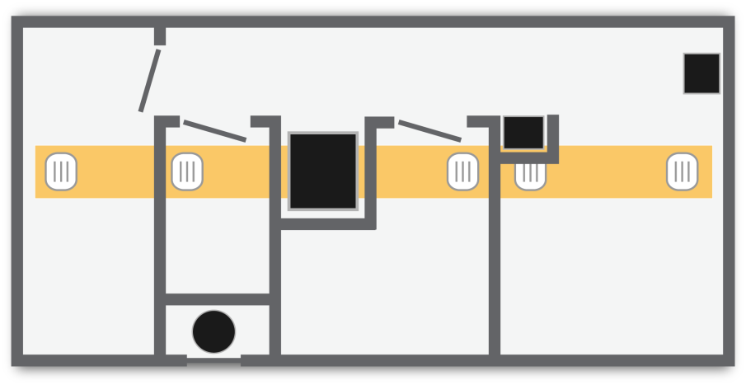
Interior Sketch
Mobile Home Assessment
Kitchen
Range
Dryer
Furnace
Master Bedroom
Bedroom
Living Room
Hot Water
Graphic developed for the U.S. DOE WAP Standardized Curricula
Notes:
Complete the sketch started on the outside of the home to include the layout of interior partitions, the duct system, and other major features. Note air leaks, dryer venting, mold, weak floors, and other problems.

Slide 38
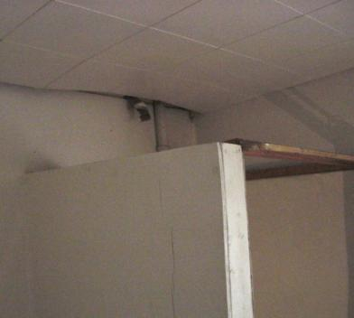
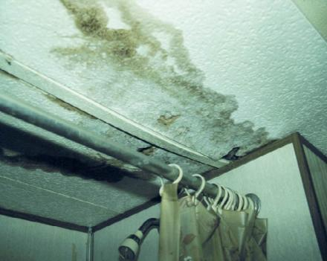
Ceilings
Mobile Home Assessment
Photos courtesy of PA WTC
Inspect ceilings for weaknesses
Notes:
Inspect the ceilings for leaks, holes, and bulges.

Slide 39
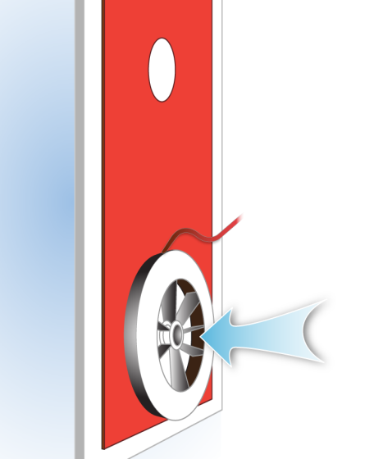
Blower Door Test
Mobile Home Assessment
Conduct a blower door test to:
Determine the air leakage rate of the house at CFM_{50.}
Locate air leaks.
Graphic developed for the U.S. DOE WAP Standardized Curricula
Notes:
Conduct a blower door test to:
Determine the air leakage rate of the house at CFM ⁵⁰.
Locate air leaks.
Q. What does a high CFM⁵⁰ reading tell us?
A. The home is leaky and has a lot of room for improvement.
Q. Does the blower door indicate the types of holes/air leaks? For example, hairline cracks versus smooth bore holes through a single surface?
A. No, not in the way we usually conduct the tests. We would need to run five tests at various pressure differences to gather the hole type.

Slide 40
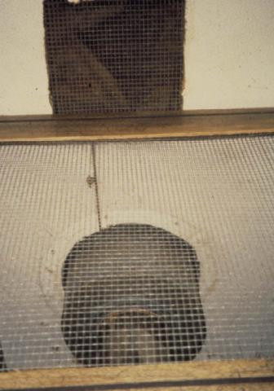
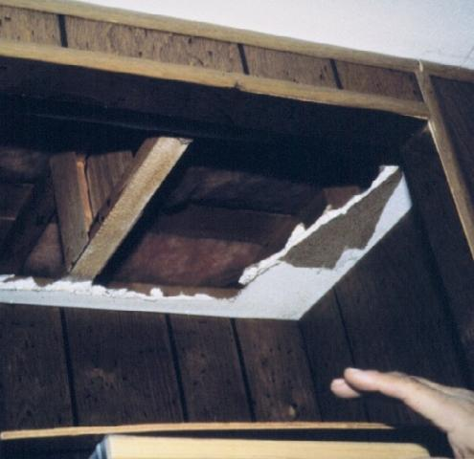
Ceiling Air Leakage
Mobile Home Assessment
Locate and seal all attic penetrations.
Photos courtesy of PA WTC
Notes:
Specify air sealing of gaps through the ceiling.
If the roof cavity is accessible, check the insulation levels. In most cases, mobile home roof cavities have sufficient clearance for additional loose-fill fiberglass insulation.
If the roof cavity is not accessible, the work scope should specify additional insulation where possible.

Slide 41
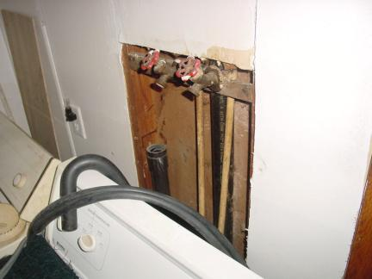
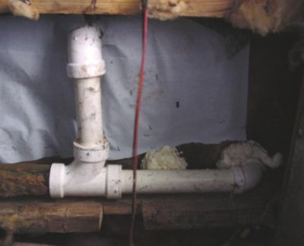
Interior Air Leakage
Mobile Home Assessment
Photos courtesy of PA WTC
Seal plumbing penetrations from the top…
…and from the belly cavity.
Notes:
Note and specify sealing of all air leaks.
Q: For what other reason besides convective air loss would you want to seal leaks to the belly cavity?
A: To prevent insulation from entering the living space while blowing it.

Slide 42
Moisture and IAQ
Mobile Home Assessment
Problems caused by:
Poor thermal characteristics
Condensation
Poor exterior drainage
Lack of mechanical ventilation
Client behavior
Photos courtesy of PA WTC
Notes:
Problems can be caused by:
Poor thermal characteristics, such as low insulation levels in wall cavities that can cause condensation problems in wall and roof cavities.
Condensation on metal siding, roofing, and windows.
Poor exterior drainage.
Lack of mechanical ventilation.
Client behavior (such as the client using an unvented kerosene space heater or humidifier).

Slide 43
Cook Stove Testing
Mobile Home Assessment
Why Test Gas Cook Stoves?
Elevated levels of CO are common.
People often use them as a heat source.
CO kills.
Knowledge implies action.
Photo Courtesy of NRCERT
Notes:
Why test gas cook stoves?
Ask why we should test for CO on cook stoves. Wait for responses. Then click to reveal the answers below.
People sometimes use them as a heat source.
Elevated levels of CO are common.
CO kills.
Knowledge implies action.
Gas- and propane-fired cook stoves release combustion byproducts into the air. They must be tested and repaired if CO exceeds suggested action levels.

Slide 44
Gas Cook Stove Testing
Mobile Home Assessment
Photos courtesy of NRCERT
Measure the CO content in ambient air and visually assess the flame and condition of the burners.
Notes:
Measure the CO content in ambient air and visually assess the flame and condition of the burners.
Calibrate or “zero” the instrument in outside air before testing.
To protect yourself and the client, continually monitor CO in the ambient air. If CO in the ambient area is equal to or exceeds 35 ppm as measured, stop the test immediately.
Specify clean and tune if the flame has any discoloration, flame impingement, or an irregular pattern or if burners are visibly dirty, corroded, or bent.
Calibrate or “zero” the instrument in outside air before testing.

Slide 45
Gas Cook Stove Testing
Mobile Home Assessment
Photos courtesy of NRCERT
Prepare the oven for a test by removing stored items, aluminum foil, etc.
Insert the probe of the analyzer into the oven vent and read the CO content after the oven has warmed.
Notes:
The photo on left shows preparation of the oven for a test by removing stored items, aluminum foil, etc.
The photo on the right shows how to insert the probe of the combustion analyzer into the oven vent and read the CO content after the oven has reached steady state (sufficiently warmed).
Calibrate or “zero” the instrument in outside air before testing.
To protect yourself and the client, continually monitor CO in the ambient air. If CO in the ambient area exceeds 35 ppm as measured, stop the test immediately.
Remedial action is required when CO levels exceed 100 ppm as measured at the oven vent.

Slide 46
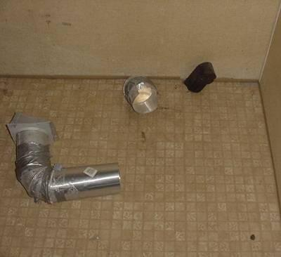
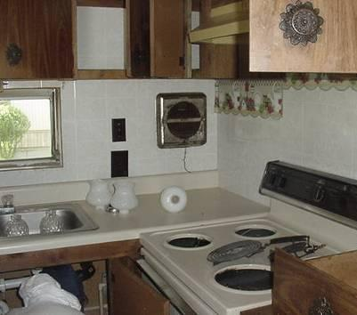
Dryers and Exhaust Fans
Mobile Home Assessment
Photos courtesy of the U.S. Department of Energy
Dryer vent must be vented to daylight (outdoors).
Replace inoperable exhaust fans.
Notes:
The dryer vent must be vented to the outdoors.
Replace plastic flex duct with smooth metal vent pipe.
Specify smooth metal pipe for dryer venting where none exists.
Replace inoperable exhaust fans.
Test the operation of mechanical exhaust fans. They must be vented outdoors.
Recirculating range hood exhaust fans are not acceptable.
Q: What’s the name of the new standard that governs the amount of mechanical ventilation required in homes?
A: American Society of Heating, Refrigerating, and Air-Conditioning Engineers (ASHRAE) 62.2 2010

Slide 47
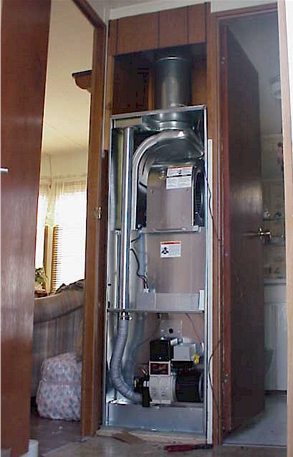
Heating System Characteristics
Mobile Home Assessment
Specifically designed for use in mobile homes
Usually located in a closet
Sealed combustion with dedicated combustion air inlets
Short metal chimney design
Compact, interchangeable burners
Downflow air distribution system (the fan is located above the heat exchanger, which forces conditioned air into the ducts below the furnace unit)
Ducts located in the belly cavity
May mix outside air with conditioned air
Flue
Heat exchanger
Blower
Combustion air
Burner
Photo courtesy of WV GOEO
Notes:
The photo shows a new oil-burning furnace and major components.
Specifically designed for use in mobile homes.
Usually located in a closet.
Sealed combustion with dedicated combustion air inlets.
Short metal chimney design.
Compact, interchangeable burners.
Downflow air distribution system (the fan is located above the heat exchanger, which forces conditioned air into the ducts below the furnace unit).
Ducts located in the belly cavity.
May mix outside air with conditioned air.
Take time to point out the major furnace components in the photograph.

Slide 48
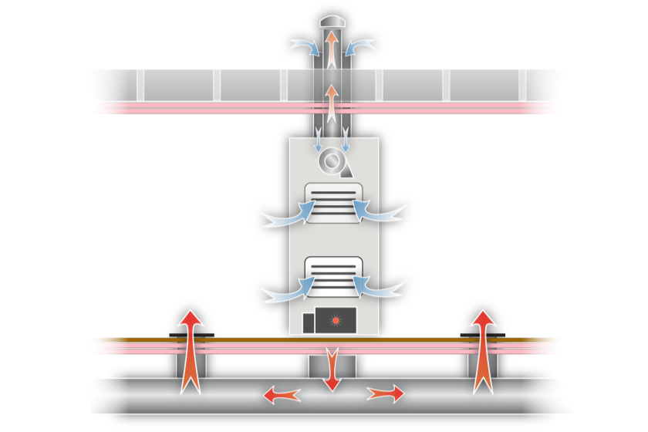
Heating System Characteristics
Mobile Home Assessment
Exhaust
Fresh Air Intake
Supply Air Fan
Return Air Intake
Gas or Oil Burner
Supply Air Duct
Graphic developed for the U.S. DOE WAP Standardized Curricula
Notes:
Elevation drawing of a furnace and duct system and the flow of combustion air, flue gas, and conditioned air.
Mobile homes require furnaces designed and approved for use in mobile homes.
Mobile home furnaces are direct-vented, sealed combustion units that require an outdoor air source for combustion.
The furnace will either draw its combustion air through a concentric space created by a double-wall chimney or through a vent in the floor.
Note the position of the fan above the heat exchanger, which forces conditioned air into the ducts below the furnace unit.
Show and tell: Mobile home furnace with parts labeled in lab on a real furnace.

Slide 49
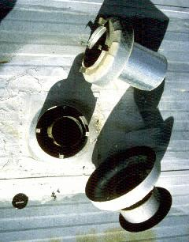
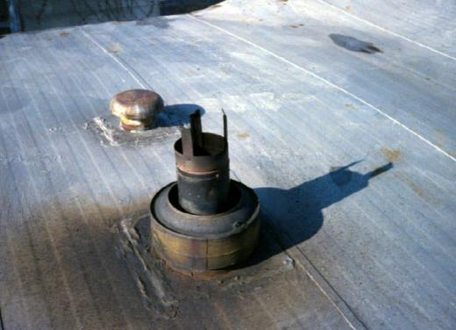
Chimney
Mobile Home Assessment
Photos courtesy of the U.S. Department of Energy
Gas or propane
Oil
Notes:
These photos of chimney terminations show two types of configurations.
Gas or propane furnaces have two concentric flues, as shown on the left. The inner flue is for exhaust and the outer flue is for combustion air.
Oil furnaces are served by a single flue for exhaust gases. The outer cylinder maintains clearance to combustibles, as shown on the right.
Combustion air to an oil burner is provided through a metal sleeve that penetrates the floor and belly cavity to the open crawl space underneath the home.

Slide 50
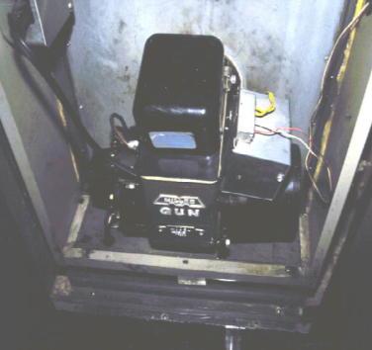
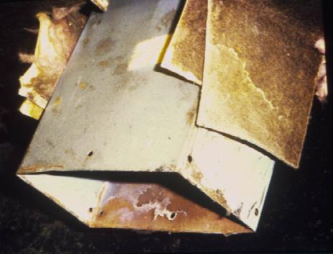
Oil Heat
Mobile Home Assessment
Photos courtesy of PA WTC
Oil Burner and Combustion Air Inlet
Notes:
The photo on right shows
Many oil burners draw combustion air through a duct coupled to the crawl space.
The photo on the left shows
One of the biggest problems with oil-burning systems occurs when the fuel tank has been allowed to run empty. As a result, sludge will accumulate on the bottom of the tank, causing the burner to malfunction.
Educate the client that an oil burner should be inspected at least once a year by a qualified oil-heating technician.
Specify cleaning and tuning oil burners where appropriate. Cleaning and tuning oil burners involves:
Replacing the fuel filter.
Replacing the fuel nozzle.
Adjusting the fuel to air ratio.
Testing the primary cad cell safety control:
A cad cell is a flame sensor composed of cadmium sulfide. It senses whether a flame is present during a burner cycle. If a flame is not detected by the cad cell, it activates a relay, which shuts the burner down.
Show and tell: Show the parts of an oil burner and how they work.

Slide 51
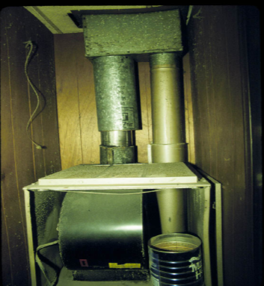
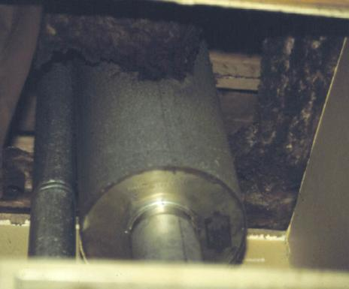
Make-up Air
Mobile Home Assessment
Fresh air inlet
Fresh air inlet
Photos courtesy of PA WTC
Notes:
Some systems are designed to mix outside air with conditioned air.
When the blower turns on, air is drawn from the attic space through a three-inch circular vent that runs from the attic into the blower compartment on the return side of the system.
This is an intentional design feature. Do not seal these openings when doing a roof insulation retrofit. These openings terminate in the attic space directly above the furnace and should be dammed off at the same time as the chimney before insulating the attic.

Slide 52
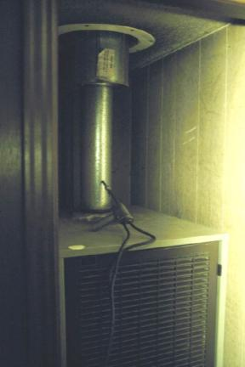
Furnace Testing Protocol
Mobile Home Assessment
Furnaces must be tested to assess:
Safety (fuel leaks, clearances, etc.).
Flue gas temperatures.
Oxygen (O₂) or carbon dioxide (CO₂).
Carbon monoxide (CO) levels.
Draft.
Condition of the heat exchanger .
Temperature rise.
Operating fan temperatures.
Test hole
Photo courtesy of PA WTC
Single wall flue for oil heat
Notes:
This is a photo of an oil furnace showing a single-wall flue graduated to a double-wall flue to maintain clearance to combustibles. Note the test hole where samples of flue gases will be taken and draft measured.
Furnaces must be tested to assess:
Safety (fuel leaks, clearances, etc.).
Flue gas temperatures.
Oxygen (O₂) or carbon dioxide content.
Carbon monoxide content.
Draft.
Condition of the heat exchanger.
Temperature rise.
Operating fan temperatures.

Slide 53
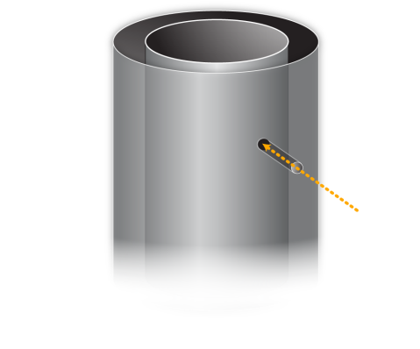
Test Procedure for Sealed Combustion Gas Furnaces
Mobile Home Assessment
The double-walled concentric flue of a mobile home gas or propane furnace must be drilled to sample flue gases and check draft.
Check with the manufacturer for the approved methods for drilling and sealing the test sample hole.
Inserting a stainless steel bolt coated with high-temperature silicone through the outer and inner flue is usually acceptable.
Test hole
Graphic developed for the U.S. DOE WAP Standardized Curricula
Notes:
Sealed combustion on a mobile home gas furnace is accomplished through the outer sleeve of a double-walled vent pipe.
Combustion air entering through the roof jack assembly is made available to the burner through an outer sleeve that encircles the inner vent pipe. The vented combustion gases must not mix with combustion air.
Manufacturers of mobile home furnaces recognize the need for on-site testing of combustion gas and draft pressure on gas-burning appliances by qualified technicians. This requires penetrating the outer and inner sleeves to insert the probe of the combustion analyzer into the flue gas area.
Several manufacturers have agreed on a procedure to access and reseal the sleeves without compromising the equipment or warranty on the heating equipment:
Drill a ¼-inch hole through the outer and inner sleeves of the chimney flue assembly.
Extract a flue gas sample. Record the carbon monoxide levels and oxygen or carbon dioxide content.
Record the stack temperature. Wait until the temperature has stabilized, roughly 10 minutes into burner operation.
Test draft.
Enlarge the hole on the outer flue just enough to accommodate sealing the inner test hole.
Apply high-temperature sealant, such as silicone RTV DOW 732 or similar non-hardening sealant, to the inner test hole.
Apply sealant to the outer hole and cover with aluminum tape.

Slide 54
Testing Equipment - Criteria
Mobile Home Assessment
Combustion analyzers should be able to read and calculate for:
Flue gas oxygen content .
Flue gas temperature.
Ambient temperature.
Flue gas carbon monoxide.
Combustion efficiency.
Flue gas carbon dioxide content.
Flue gas CO air-free content.
Photo courtesy of Bacharach, Inc.
http://www.bacharach-inc.com/fyrite-tech.htm
Notes:
Combustion analyzers should be able to read and calculate for:
Flue gas oxygen content.
Flue gas temperature.
Ambient temperature.
Flue gas carbon monoxide content.
Combustion efficiency.
Flue gas carbon dioxide content.
Flue gas CO air-free content.
A combustion analyzer measures flue gas samples to determine the safety and efficiency of the combustion process.
Oxygen content or carbon dioxide content and flue gas temperature are measured to determine steady-state efficiency (also known as combustion efficiency).
Carbon monoxide is a dangerous combustion byproduct. If excessive amounts are detected in the flue gas sample, the furnace must be repaired or replaced.
Show and tell: Combustion analyzer

Slide 55
Selected Testing Equipment
Mobile Home Assessment
Draft gauge
Smoke tester (for oil)
Photo Courtesy of Bacharach, Inc.
Photo Courtesy of Bacharach, Inc.
Inspection mirror
Digital probe thermometer
Photo Courtesy of Bacharach, Inc.
Photo Courtesy of Omni Controls
Notes:
These photos show selected test equipment.
Draft gauge: For testing chimney draft.
Smoke tester: For testing the amount of chimney smoke that serves an oil-burning furnace.
Inspection mirror: For looking into constricted spaces.
Digital probe thermometer: For testing temperature rise and fan operating temperatures.
Show and tell: Selected testing equipment

Slide 56
Furnace Testing Methods - Visual
Mobile Home Assessment
Check for:
Dirt and debris.
Burner alignment.
Soot, evidence of flame roll-out.
Condition of the heat exchanger.
Vent pipe and roof termination.
Gas or oil leaks.
Condition of the wiring.
Condition of the air filter.
Photo courtesy of INCAA
Notes:
This photo shows a rusted heat exchanger.
Q. Where do the combustion byproducts go?
A. Into the living space assisted by the blower.
Check for:
Dirt and debris.
Burner alignment.
Soot, evidence of flame roll-out.
Condition of the heat exchanger.
Vent pipe and roof termination.
Gas or oil leaks.
Condition of the wiring.
Condition of the air filter.

Slide 57
Furnace Testing Methods - Analyzer
Mobile Home Assessment
Test for:
Steady-state efficiency.
Cracked heat exchanger.
Carbon monoxide levels.
Smoke (oil).
Temperature rise.
Safety shut-off features.
Photos Courtesy of Bacharach, Inc.
Notes:
Test for:
Steady-state efficiency.
Cracked heat exchanger.
Carbon monoxide (Recommendation: levels not to exceed 100 parts per million in the flue gases).
Smoke (oil).
Temperature rise.
Safety shut-off features.
The next set of slides will cover each of these tests in more detail.

Slide 58
Heat Exchanger Leakage Testing
Mobile Home Assessment
Test Methods
Look for rust on the burner ports.
Measure flue gas concentration before and after blower starts.
There should be no more than 1% oxygen change when the blower starts.
Observe change in draft, CO, or flame when blower turns on.
Look for flame-damaged areas on the heat exchanger.
Cracked heat exchanger
Photo courtesy of INCAA
Notes:
Test methods include the following:
Look for rust on the burner ports.
Measure the flue gas concentration before and after the blower starts.
There should be no more than 1% oxygen change when the blower starts.
Observe the change in draft, CO, or flame when the blower turns on.
Look for flame-damaged areas on the heat exchanger.
Q: Why is it so important to look for cracks in a heat exchanger of a forced air furnace:
A: Combustion byproducts and conditioned house air should never mix.
Use both visual checks and the combustion analyzer to assess the condition of the heat exchanger.
If any of these conditions are present, the likely cause is a cracked heat exchanger. Furnaces with cracked heat exchangers should be replaced as a health and safety measure.

Slide 59
Temperature Rise Test
Mobile Home Assessment
Place a thermometer probe into the return plenum and another one in the closest supply duct.
Record the temperatures.
Calculate the difference to determine the temperature rise.
Should be between 40˚ and 90˚ or no greater than the manufacturer’s specs.
Excessive temperature rise indicates insufficient air flow as a result of:
Dirty filter.
Blockages.
Insufficient return or supply duct cross sectional area.
Low fan speed or dirty fan.
Temperature rise test locations
Temp Probe
Temp Probe
Graphic developed for the U.S. DOE WAP Standardized Curricula
Notes:
Temperature rise test steps include the following:
Place a thermometer probe into the return plenum and another one in the closest supply duct.
Record the temperatures.
Calculate the difference to determine the temperature rise. The temperature rise is also called heat rise and represents the temperature difference between return air and supply air.
The temperature rise should be between 40° and 90°, or no greater than the manufacturer’s specifications.
Excessive temperature rise indicates insufficient airflow as a result of:
A dirty filter
Blockages
Insufficient return or supply duct cross-sectional area
Low fan speed or a dirty fan
Show and tell: Dirty air filter

Slide 60
Fan Operating Temperature Testing
Mobile Home Assessment
Verify fan operating temperatures:
High Limit – set at factory (200˚)
Fan-On (100˚ – 120˚)
Fan-Off (90˚ – 100˚)
Record the temperatures by placing a thermometer probe into or the closest register to the supply plenum.
Fan-on/Fan-off test location
Temp Probe
Graphic developed for the U.S. DOE WAP Standardized Curricula
Notes:
Fan operating temperature testing steps include the following:
Verify fan operating temperatures:
High limit (200°)
Fan on (100° – 120°)
Fan off (90° – 100°)
Q: What’s the basis for the above named recommended operating temperatures?
A: Manufacturer recommendations
Record the temperatures by placing one thermometer probe into the blower compartment and the other in the supply register closest to the furnace.
The high limit is a safety feature that causes the burner to shut down if the maximum temperature in the supply plenum reaches 200°. This is factory set.
The fan-on and fan-off temperatures are adjustable to meet the comfort needs of occupants. Although they are set at the factory, the fan-on and fan-off temperatures should be recorded and adjusted if necessary.

Slide 61
Blower Maintenance
Mobile Home Assessment
Photo courtesy of PA WTC
Photo courtesy of NRCERT
Remove and clean the blower.
Notes:
Furnace blowers, often called squirrel cages, work less efficiently if dirt accumulates on the fins.
Specify blower maintenance, generally a low-cost measure, where appropriate.
Removing the blower from a mobile home is fairly easy. Remove the bolts, unplug the power lead, and slide it out.
Clean the blower fins with compressed air or a stiff brush and reinstall.

Slide 62
Filter Replacement
Mobile Home Assessment
Photo courtesy of NRCERT
Change out the furnace filter, and educate the client.
Notes:
Air filters are often so clogged that airflow is drastically reduced. This restriction may cause heat exchangers to overheat and fail over time.
Educate clients to check the condition of their filter every month during the heating season and replace it if necessary. Show them a replacement filter and compare it to the old dirty filter. This will help drive home the point that air must flow freely through the filter to help maintain comfort and lengthen the life of the furnace.
Clients need to understand that dirty filters can affect their comfort and reduce the life of the furnace.

Slide 63
Electrical Checks
Mobile Home Assessment
Photo courtesy of NRCERT
Check for safety of electrical components.
Notes:
This photo shows a dangerous wiring connection.
Exposed wiring connections such as those pictured here can pose a hazard. Contact between the wiring leads will cause a short circuit. Also note the sharp edge where the leads exit the furnace cabinet. Over time, vibrations may cause the wire to become frayed on this sharp edge and lead to a serious and even life-threatening short circuit. These wires should be stabilized by a circular wire clamp mounted on the furnace cabinet.
Look for disconnected or improperly connected wiring and specify repairs.
Wiring must be enclosed in a code-compliant junction box.

Slide 64
Clearance to Combustibles
Mobile Home Assessment
Photos courtesy of Tony Gill
Check clearance to combustibles.
Notes:
These are photos of a flue through a ceiling penetration.
Refer to NFPA code for clearances.
Seal the chimney opening with metal coil stock and high-temperature silicone caulk.

Slide 65
Furnace Clean and Tune
Mobile Home Assessment
Clean dirty burners.
Clean and adjust blower.
Replace furnace filter and educate clients how to replace.
Fix excessive temperature rise problems.
Check and adjust fan operating temperatures.
Notes:
Where appropriate, specify cleaning and tuning of heating equipment by qualified heating technicians.
Clean dirty burners.
Clean and adjust the blower.
Replace the furnace filter and teach clients how to do the same.
Fix excessive temperature-rise problems.
Check and adjust fan operating temperatures.

Slide 66
Furnace Replacement
Mobile Home Assessment
A furnace should be replaced if any of the following conditions exist:
The furnace has a cracked heat exchanger.
Repair and retrofit exceeds half the cost of replacement.
The furnace is inoperable or irreparable.
Photo courtesy of WV GOEO
Notes:
A furnace should be replaced if any of the following conditions exist:
The furnace has a cracked heat exchanger.
Repair and retrofit exceeds half the cost of replacement.
The furnace is inoperable or irreparable.

Slide 67
Furnace Replacement
Mobile Home Assessment
Select a furnace specifically designed for use in a mobile home.
Size the furnace to meet the heating load requirement of the home.
Note the differences between the old furnace and the new one.
Check to see how combustion air is supplied to the furnace.
Follow manufacturer’s installation instructions exactly.
The chimney assembly and roof jack will often need to be replaced.
Photo courtesy of the U.S. Department of Energy
Notes:
When doing a furnace replacement:
Select a furnace specifically designed for use in a mobile home.
Furnace should be sized to meet the heating load requirement of the home according to a Manual J heat loss calculation.
Q: What’s Manual J all about? Can anyone tell me?
A: This is a method developed by the Air Conditioning Contractors of America (ACCA) to size heating and cooling equipment.
Using Manual J, a contractor calculates heat loss from the building through walls and ceilings, leaky ductwork, and infiltration sites.
Design conditions for the area are also used as inputs into load calculations. The building’s heat load is calculated, enabling the contractor to select a correctly sized furnace.
Note the differences between the old furnace and the new one, and educate clients about those differences.
Check to see how combustion air is supplied to the furnace.
Specify that installers follow the manufacturer’s installation instructions exactly.
The chimney assembly and roof jack often need to be replaced as part of furnace replacements.

Slide 68
Duct Leakage
Mobile Home Assessment
Return Air
Furnace
Vents
Duct
Graphic developed for the U.S. DOE WAP Standardized Curricula
Notes:
This is a drawing of a typical furnace and duct system layout in a mobile home.
Mobile home furnaces are usually centrally located in a closet off the central hallway with access through a louvered door.
This layout shows a central hallway return.
Supply ducts run the length of the home and deliver air to various rooms. Return air is drawn back to the furnace through a louvered door at the furnace closet.

Slide 69
Visual Checks
Mobile Home Assessment
Photos courtesy of NRCERT
The old flashlight and mirror trick.
Is that a squeegee
down there?!
Notes:
To do a visual check:
Insert a flashlight through the duct opening and lay it flat in the duct run.
A mirror will reveal many problems, including holes, obstructions, and collapsed sections.

Slide 70
Duct Leakage Photos
Mobile Home Assessment
Branch duct leakage
Large holes
Photos courtesy of PA WTC
Notes:
These photos show duct leakage.
These types of big leaks are common but hidden and auditors sometimes miss them.

Slide 71
Typical Duct Leakage Sites
Mobile Home Assessment
Typical Air Leakage Locations
Register Boot
Furnace Connection
Branch Duct
Duct Termination
TRUNK DUCT
Crossover Duct
Graphic developed for the U.S. DOE WAP Standardized Curricula
Notes:
This illustration shows typical leakage locations.
Register boots, ends, branch ducts, crossovers, and furnace connections are common duct leak locations.
Because access is limited, auditors should use a flashlight and mirror to check for duct leaks.
Q: What test do you use to quantify duct leakage?
A: Pressure Pan Testing
Leakage can be quantified through pressure pan testing.

Slide 72
Pressure Pan Testing
Mobile Home Assessment
Depressurize home to –50 Pascals.
Pressure pan each register location.
Record pressure differences.
Repair and retest.
The goal is to reduce pressure pan readings at each register location to less than 1 pascal.
Photo courtesy of NRCERT
Notes:
Pressure pan testing steps include the following:
Depressurize the home to -50 Pa.
Pressure pan each register location.
Record the pressure differences.
A high number indicates that there is a major connection to the outside.
Numbers closer to 0 Pa indicate less of a connection to the outside.
Specify the target reading for installers’ duct sealing efforts. Typical target is 1 to 2 Pa or less, but this varies. Refer to applicable program standards for guidelines.
Show and tell: Pressure pan and digital manometer

Slide 73
Belly Return System Conversion
Mobile Home Assessment
Permanently seal all return registers (including the register in the floor of the furnace closet).
Create a hallway return system.
Add a louver to the furnace closet door.
Undercut doors to adjacent rooms or provide louvers.
Verify good air flow with a pressure balancing test.
Graphic developed for the U.S. DOE WAP Standardized Curricula
Notes:
The illustration shows the elimination of all floor returns that communicate with the belly cavity.
The belly return system uses the belly cavity as a return plenum where air is drawn back to the furnace through a louver in the floor of the furnace closet.
Q: Why would it be important to modify a belly return system?
A: The belly return system is vulnerable when large holes or tears occur in the rodent barrier. Unconditioned outside air will be drawn into the return system, which is likely to result in infiltration or moisture problems and pressure imbalances in the home.
A conversion to a hallway return system is therefore recommended.
To convert the return system, specify:
Permanently seal all return registers (including the register in the floor of the furnace closet).
Create a hallway return system.
Add a louver to the furnace closet door.
Undercut the doors to adjacent rooms or provide louvers.
Verify that there is good airflow with a temperature rise test.

Slide 74
Mobile Home Hot Water Heaters
Mobile Home Assessment
Photo courtesy of the U.S. Department of Energy
Graphic courtesy of Blevins http://www.blevinsinc.com/
Smaller than single-family home heaters
Contained within a closet along an outside wall
Gets combustion air from outside through a louvered door
Notes:
Mobile home hot water heaters
Are smaller than single-family home heaters
Are contained within a closet along an outside wall
Get combustion air from outside through a louvered door or floor vent
Mobile home water heaters are narrower so they fit in smaller spaces and maintain clearance from combustibles.
They also cost more than those designed for single-family homes so people are always tempted to make standard-sized models fit.
Atmospheric (open combustion) hot water tanks are not permitted in mobile homes. An auditor who spots this code violation should call for a replacement as a health and safety measure.
If it’s a gas heater, pay special attention to the flue area and check for adequate draft.
If the heater is electric, check for loose wiring and temperature settings that are too high.
Check the water heater's pressure relief (pop-off) valve for corrosion.
Call for an insulated tank jacket if specifications permit.

Slide 75
Hot Water Tank Replacement
Mobile Home Assessment
A tank that got away!
Photo courtesy of WV GOEO
Notes:
This photo shows a tank that fell through the floor.
This is more common than you think.
The leaking tank caused the floor to rot.
The chimney flue fell away, causing combustion byproducts to vent into the house.
Specify floor repair as an infiltration measure and the tank replacement as a health and safety measure.
Q: True or false: As per DOE guidance, leaking water tanks may be replaced with health and safety funds.
A: True: They may be replaced on a case by case basis. See Weatherization Program Notice 11-6.

Slide 76
Other Measures
Mobile Home Assessment
Minor incidental repairs to protect weatherization measures.
Standard base load measures such as refrigerator replacement and lighting upgrades.
Cooling measures for hot climates including:
Reflective roof coatings.
Shade screens and awnings.
Window films.
Photo courtesy of NRCERT
Water damaged floors are a common problem in mobile homes
Notes:
Other measures include the following:
Minor incidental repairs to protect weatherization measures such as small floor or roof repairs.
One of the most common structural problems technicians face is water-damaged floors in kitchens, bathrooms, and entryways.
Standard base load measures such as refrigerator replacement and lighting upgrades.
Refer to the “Base load” section of the Energy Auditor curriculum for more details.
Cooling measures for hot climates, including:
Reflective roof coatings − In certain hot climates, white roof coating is an allowable and cost-effective measure.
Shade screens and awnings
Window films
Refer to the” Cooling Measures” section of the Energy Auditor curriculum for more details.

Slide 77
Summary
Mobile Home Assessment
Mobile home construction details differ depending on the era the home was built.
Mobile home fossil fuel-fired furnaces and domestic hot water tanks must be sealed combustion units.
Huge opportunities exist for improving the performance of these structures through well-thought-out recommendations.
A successful audit requires a thorough knowledge of a mobile home’s unique structural characteristics and mechanical systems.
Notes:
Mobile home construction details differ depending on the era the home was built.
Mobile home fossil fuel-fired furnaces and domestic hot water tanks must be sealed combustion units.
Huge opportunities exist for improving the performance of these structures through well-thought-out recommendations.
A successful audit requires a thorough knowledge of a mobile home’s unique structural characteristics and mechanical systems.
Present this slide as an interactive discussion, soliciting personal examples from the trainees. Add your own personal examples and knowledge to supplement.

