Slide 1
WEATHERIZATION ENERGY AUDITOR SINGLE FAMILY
Interpreting Infrared

Slide 2
Learning Objectives
INTERPRETING INFRARED
By attending this session, participants will be able to:
Explain the strengths and limitations of infrared (IR) thermography.
Interpret IR images as they relate to weatherization opportunities.
Demonstrate how to assess the quality of installed weatherization measures using IR images.
Use IR imaging in conjunction with blower door to track infiltration and direct air sealing activities.
Notes:
By attending this session, participants will be able to:
Explain the strengths and limitations of infrared (IR) thermography.
Interpret IR images as they relate to weatherization opportunities.
Demonstrate how to assess the quality of installed weatherization measures using IR images.
Use IR imaging in conjunction with the blower door to track infiltration and guide air sealing activities.

Slide 3
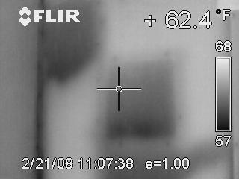
Infrared Capability
INTERPRETING INFRARED
IR cannot see through anything.
Sees surface temperatures only
Cannot see color
Cannot see air
Photo courtesy of Tony Gill
Notes:
There are many myths about infrared (IR). Here is the truth:
IR cannot see through anything.
IR sees surface temperatures only.
IR cannot see color. Color is created by an integral computer chip.
IR cannot see air. It sees solid objects only.
IR cameras are usually set to show cold as dark and warm as light.
Shades of grey are “in between” temperatures.
Some high-end cameras include a temperature scale superimposed on the image.
The date/time stamp on saved images will indicate exterior temperature conditions, allowing the viewer to better interpret what is depicted. For example, an interior image of a wall taken in August would appear warm where it is poorly insulated. The same poorly insulated area would appear cold in January.
The camera can be set to show a color image.
Color can be a good sales tool because it is so dramatic. The color is computer generated, so it lacks the sharp definition seen in grey scale.
Grey scale is clearest, easiest to interpret, and therefore best for inspections.
Practice one mode and use it consistently.
The slide shows a typical IR image of a wall with a door.
Click to show door with window outline.
The upper left area is settling or has a void caused by poor blowing.
Click to highlight that area.
A blower door will accentuate air leakage. More on that later.

Slide 4
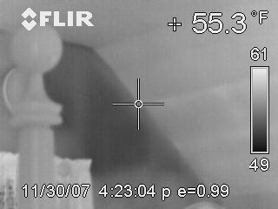
Insulation Settled in End Wall Bays
INTERPRETING INFRARED
Photo courtesy of Tony Gill
Notes:
This picture shows a bedroom with sloped ceiling to the right; bedpost is in the foreground.
Q: Why does the bedpost appear warmer than the wall?
A: It is the same temperature as the room air, which is warmer than the wall. IR cannot “see” air; it only sees objects warmed or cooled by air contacting the object.
Click to highlight wall voids.
Solid dark areas indicate no insulation in the cavities.
Q: What would we see if it were a warm summer day?
A: Black and white would be reversed; that is, the insulation void would appear warm and the bedpost and sloped ceiling would appear cold.

Slide 5
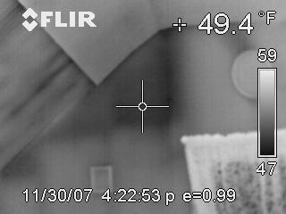
Missed Bay, Low Density Bays, Infiltration
INTERPRETING INFRARED
Photo courtesy of Tony Gill
Notes:
The picture shows an end wall with a window. There is a sloped ceiling to the left. Drywall was installed over the original plaster and lathe on the ceiling flat and upper part of the sloped ceiling.
The darkest area indicates an empty wall bay.
Click to highlight empty wall bay.
The lighter shade indicates partially insulated bays along the slope and over the window.
Click to remove red highlight and show green highlight of partially insulated bays.
The dark stripes extending down the sloped ceiling from the lower edge of the drywall indicate wind-driven infiltration. Air from the attic is cooling the surface of the plaster.
Click to remove green highlights and show yellow arrows.

Slide 6
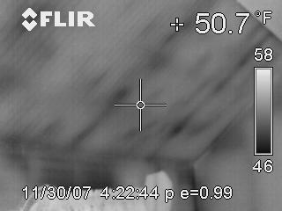
Poorly Blown Cellulose in a Sloped Ceiling
INTERPRETING INFRARED
Photo courtesy of Tony Gill
Notes:
The picture shows a sloped ceiling and knee wall with a window below it.
Point out window outline in lower portion of photo. Click to highlight partially insulated bays above window.
This is a post and beam (timber frame) house. The heavy dark lines are the main roof support timbers.
Click to highlight timbers.
The narrow dark lines parallel to the timbers are the spaces between the ceiling lathes.
A properly blown ceiling would appear as a solid shade with no variation as is seen in the end wall.
Click to highlight the end wall area. Click again to remove outline.

Slide 7
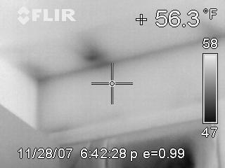
Wind Driven Infiltration at Dropped Soffit
INTERPRETING INFRARED
Photo courtesy of Tony Gill
Notes:
The picture shows outside air cooling a ceiling.
Click to highlight dark areas.
The feathery edges are a typical air infiltration pattern.
Click to point out the direction of the air movement. Click again to remove arrows.
The size and intensity of the dark areas indicate relative importance.

Slide 8
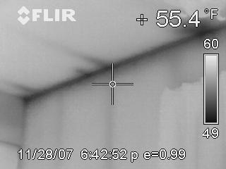
Wind Driven Infiltration
INTERPRETING INFRARED
Wind-driven infiltration over ceiling at eaves side of house.
Photo courtesy of Tony Gill
Notes:
This photo shows wind-driven infiltration over the ceiling at the eaves side of the house.
The dark streaks are caused by outside air blowing over a ceiling from soffit vents at the eaves.

Slide 9
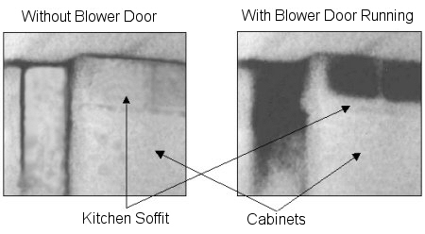
IR and the Blower Door
INTERPRETING INFRARED
Without Blower Door
With Blower Door Running
Kitchen Soffit
Cabinets
Photos courtesy of Tony Gill
Notes:
The photos show an exterior wall with a dropped soffit over kitchen cabinets. The left picture is under natural conditions; the right is with a blower door operating. The blower door is pulling cold air from the attic into the dropped soffit and closest wall bay.

Slide 10
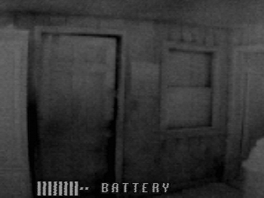
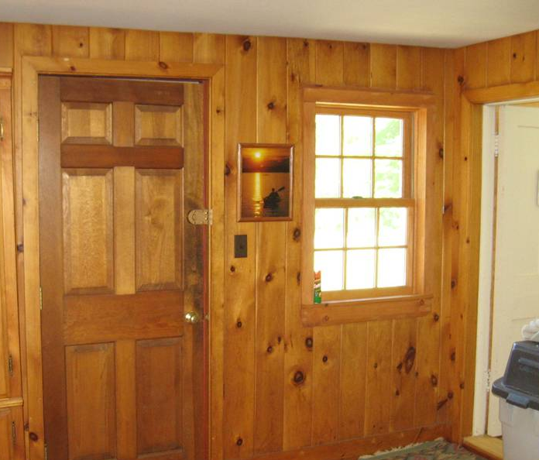
IR and the Blower Door
INTERPRETING INFRARED
Photos courtesy of Tony Gill
Notes:
On the right, the photo shows a typical tongue-and-groove, pine-paneled wall.
On the left, the IR image shows the same wall with a blower door operating.
Note how air is infiltrating every board.
Q: Is the weatherstrip on the door effective?
A: No. There is significant infiltration along the strike edge and the top of the door.

Slide 11
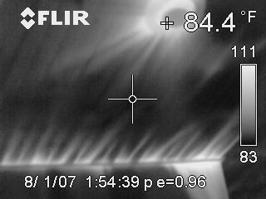
Blower Door Driven Infiltration #1
INTERPRETING INFRARED
Infiltration at light fixture
Infiltration at ceiling/wall junction
Photo courtesy of Tony Gill
Notes:
This blower door test was conducted mid-day on August 1.
The white streaks at the wall/ceiling junction are caused by hot exterior air being pulled into the attic at the soffit venting by a blower door.
The large white area at the right end of the knee wall is an insulation void.
The streaks radiating from the ceiling light fixture are caused by hot attic air being pulled into the room around the fixture by the blower door.
Q: What should be done?
A: (1) Install blocking and vent chutes between rafter tails to direct soffit vent air up the underside of the roof. (2) Seal the wire penetrations in the ceiling drywall.

Slide 12
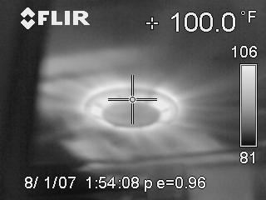
Blower Door Driven Infiltration #2
INTERPRETING INFRARED
Infiltration at bath ceiling fan/light fixture
Power Point slides
Photo courtesy of Tony Gill
Notes:
Note the date and time of the blower door test recorded on the picture: 8/1/07 @ 1:54 PM. This is the hottest part of the day. The attic above the pictured ceiling will be extremely hot.
Intense heat at the fan/light unit⎯106°F⎯ is shown.
This picture was taken in northern Maine. Air that hot was almost certainly coming from the hot attic and not directly from the outdoors. That rules out a faulty backdraft damper in the fan unit as the cause of leakage.
This image is probably showing that the fan unit housing has not been sealed to the ceiling.

Slide 13
Summary
INTERPRETING INFRARED
IR imaging sees surface temperature only.
Interpreting IR requires putting images in context.
IR imaging cannot see through anything.
Images are easiest to interpret when there is a large temperature difference, and they always require a trained technician for accurate interpretation.
In conjunction with the blower door, IR imaging is a powerful tool for diagnosing infiltration and targeting air sealing activities.
Notes:
IR imaging sees surface temperatures only.
Interpreting IR requires putting images in context. What is on the other side of the surface being inspected? Be careful not to jump to conclusions.
IR imaging cannot see through anything.
Images are easiest to interpret when there is a large temperature difference, and they always require a trained technician for accurate interpretation.
In conjunction with a blower door, IR imaging is a powerful tool for diagnosing infiltration and targeting air sealing activities. Using IR with a blower door gives far superior results than using either tool alone.

