Slide 1
General Construction and Carpentry
WEATHERIZATION ENERGY AUDITOR SINGLE FAMILY
WEATHERIZATION ASSISTANCE PROGRAM STANDARDIZED CURRICULUM – December 2012

Slide 2
Learning Objectives
GENERAL CONSTRUCTION AND CARPENTRY
By attending this session, participants will be able to:
Define residential house construction terminology.
Recognize characteristics of various types of structural framing.
Identify different foundation, wall, roof, window, and door systems.
Recognize characteristics of balloon and platform framing.
Explain the impact that different framing types have on air leakage.
Review window and door installation processes.
Notes:
By attending this session, participants will be able to:
Define residential house construction terminology.
Recognize different structural framing types.
Identify different foundation, wall, roof, window, and door systems.
Recognize characteristics of balloon and platform framing.
Explain the impact that different framing types have on air leakage.
Review window and door installation processes.

Slide 3
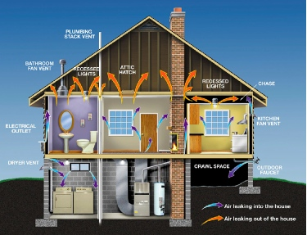
Photo courtesy of U.S. Department of Energy
Notes:
Take a look at this cross section of a typical house and point out the basic features such as the foundation, and the kinds of equipment that reside there. Move up to the living space and attic. Then point out some classic air leakage sites as labeled. Have students note the direction of air leakage.
The structure of a house, its framing, and other architectural features determine how a house loses heat. An understanding of how houses are put together and residential nomenclature are important to the auditor’s ability to communicate retrofit strategies to crews and contractors.

Slide 4
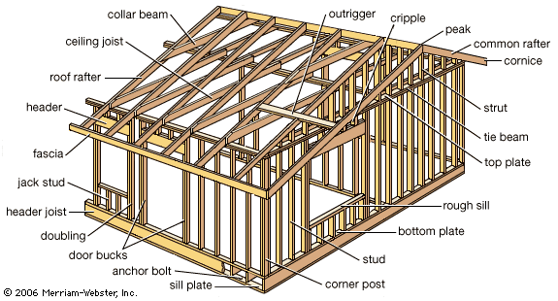
House Framing Terminology
GENERAL CONSTRUCTION AND CARPENTRY
Illustration courtesy of Construction Invio.com
Notes:
This is an illustration of generalized construction of a residential structure.
Point out the parts on the slide and use the lab prop to test students on proper identification of the parts.
If helpful, create a slide that hides the labels and have students name the framing and other details as you point to them.

Slide 5
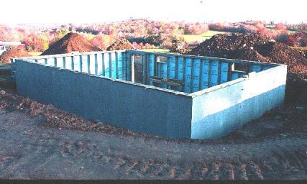
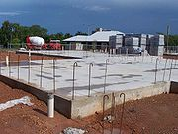
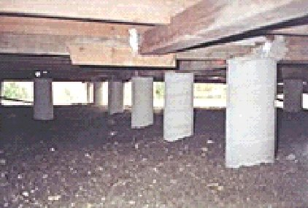
Foundation Types
GENERAL CONSTRUCTION AND CARPENTRY
Basement or Crawl Space Foundation
Slab on Grade Foundation
Photo courtesy of PA WTC
Photo courtesy of Wikipedia
Photo courtesy of Wikipedia
Pier and Beam Foundation
Notes:
Foundation characterisics of a basement include:
Basements are defined as full-height, below-grade structures that provide support for the home.
They contain the mechanical systems and often serve as limited use areas but may also be finished, full-use areas.
Temperature-moderating effects of the surrounding earth help maintain the interior space at a fairly constant temperature throughout the year.
Foundation characteristics of crawl spaces include:
Crawl spaces are constructed in the same manner as full basements but are more shallow.
Foundation heights up to three feet are typical.
They contain duct runs, plumbing, etc.
Because they are mostly above grade, unheated, and generally vented to the outside, the interior space experiences outside temperatures throughout the year.

Slide 6
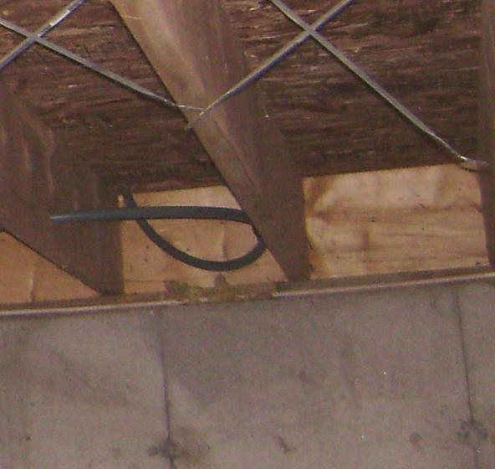
Visual Assessment - Perimeter
GENERAL CONSTRUCTION AND CARPENTRY
Floor Joists
Note floor joists, band joist, and mud sill that make up what is known as the “box sill.”
This box sill is a common perimeter leakage site in basements.
Band Joist
Mud Sill
Photo courtesy of U.S. Department of Energy
Notes:
This is a photo of a box sill. The box sill shown is made up of the band joist and mud sill framing.
The box sill is a common perimeter leakage site in basements.

Slide 7
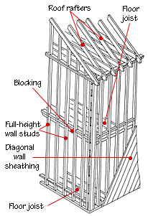
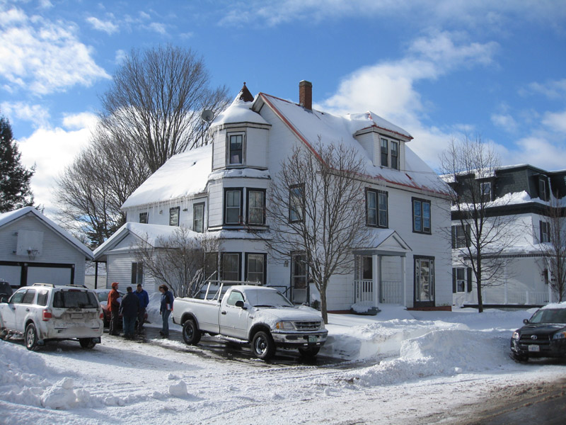
Balloon Framing
GENERAL CONSTRUCTION AND CARPENTRY
Photo courtesy of the US Department of Energy
Illustration courtesy of Don Vandervort’s Home Tips.com
Notes:
Balloon framing is a style of framing that uses long, vertical framing for the exterior walls and some interior walls. These long "studs" extend uninterrupted from the sill on top of the foundation up to the roof eaves. Floor joists are fastened to, and supported by, ledger boards that extend around the interior perimeter of the exterior wall. Balloon framing was the most common type of wood-frame construction from the late 19th century through the late 1930s and is found throughout the entire United States.
The disadvantage of balloon framing from an energy standpoint are the numerous air pathways through the framed wall and floor cavities. Air coming in at the bottom of the house is warmed and rises to the attic.
Q: In addition to the leaky outside walls, can you name some other types of indirect air leakage commonly associated with balloon framed homes?
A: Plumbing chaseways, chimney chaseways, pocket doors, built in hutches, dropped ceilings in closets.

Slide 8
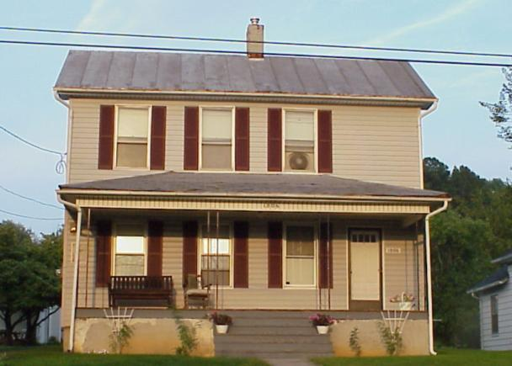
Air Leakage in Balloon Frame
GENERAL CONSTRUCTION AND CARPENTRY
Porch roof cavity may be open to wall cavities.
Arrows indicate air escaping from back of porch roof to adjoining wall cavities.
Photo courtesy of the US Department of Energy
Notes:
This is a photo of a two-story house with balloon framing where the porch framing could be open to the wall cavities of the house.
This could be one of the largest hidden air leaks in the house, making it a good candidate for air sealing with dense-packed insulation.

Slide 9
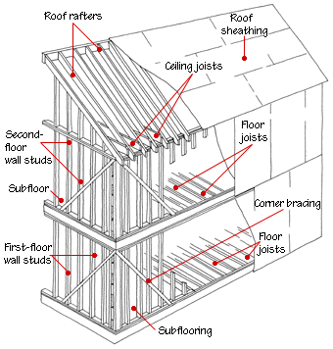
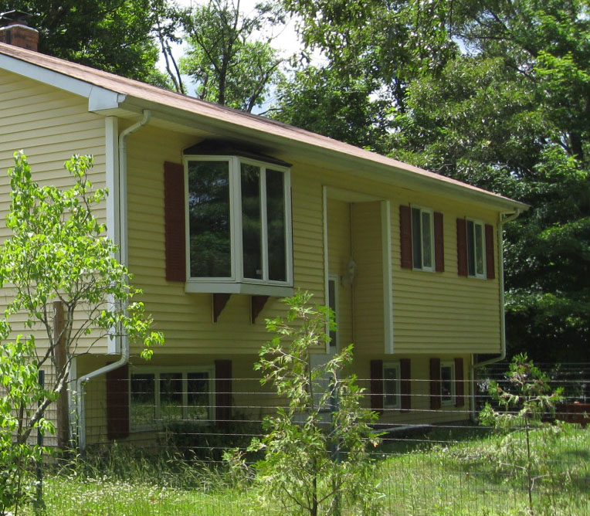
Platform Framing
GENERAL CONSTRUCTION AND CARPENTRY
Photo courtesy of the US Department of Energy
Illustration courtesy of Don Vandervort’s Home Tips.com
Notes:
Platform framing replaced balloon framing following in the late 1930s and is the most commonly used framing method today.
With platform framing, the exterior wall framing is fastened to a platform or deck made up of floor joists, a band joist, and subflooring. Subsequent stories are added by constructing additional platforms that are supported by the exterior wall below it. After the last set of walls are constructed, roof rafters or trusses are installed on the double top plate of the exterior walls.
Platform framing eliminates the need for draft stops that are required in balloon-framed walls, making this type of housing less susceptible to vertical air leakage than balloon framed walls.
Platform-frame houses still have their share of inherent air leakage problems.
Q: In the photo, note how the second level of this “split level” home cantilevers over the first level. What’s a potential problem there?
A: There may be holes or tears in the covering on the underside of the cantilevered floor, allowing outside air to enter the floor cavity between the two levels.

Slide 10
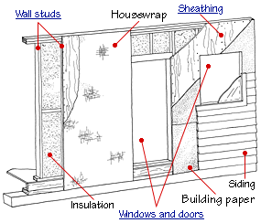
Wall Construction Details
GENERAL CONSTRUCTION AND CARPENTRY
Illustration courtesy of Don Vandervort’s Home Tips.com
Notes:
Note the various components of a typical framed wall section including insulation, sheathing, house wrap, sheathing, and siding.
Q: Is this an example of balloon framing or platform framing?
A: Platform framing.
Q: Why?
A: It’s platform framing because it has a top plate, which is the horizontal framing member on the top of the vertical wall studs. Balloon framing does not use a top plate between first and second stories (see slide 6 and 8).

Slide 11
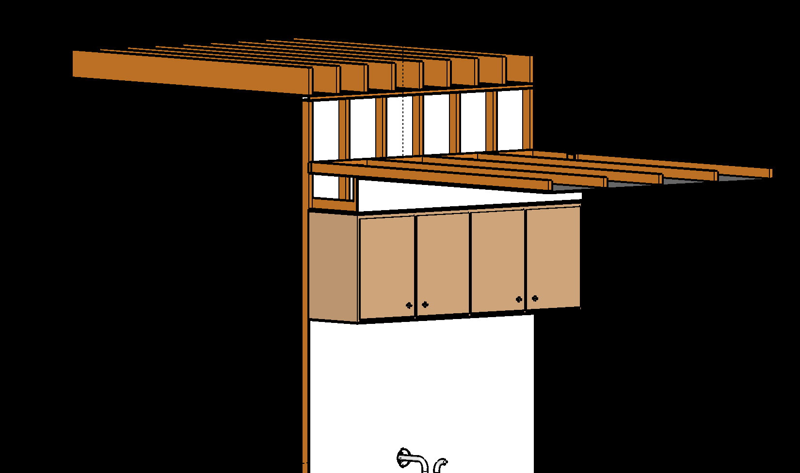
Air Leakage in Platform Frame
GENERAL CONSTRUCTION AND CARPENTRY
Kitchen wall cabinets mounted under soffit or valance.
Graphic courtesy of Anthony Cox
Notes:
Pressure and thermal boundaries often become misaligned at dropped soffits.
This drawing shows a change in ceiling height and a dropped soffit, two causes for the gaps.
Even without a change in ceiling height, dropped soffits cause misalignment in the pressure and thermal boundaries. The pressure boundary, which is the sheetrock, drops below the level of the attic floor and is not typically sealed at the top.

Slide 12
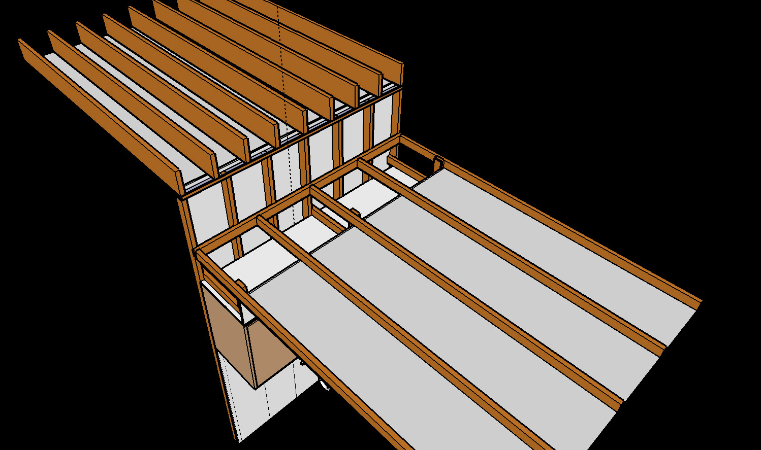
Air Leakage in Platform Frame
GENERAL CONSTRUCTION AND CARPENTRY
If you see soffit-mounted cabinets, remember to investigate during attic inspection.
Graphic courtesy of Anthony Cox
Notes:
If you see soffit-mounted cabinets in the kitchen, bathroom, or elsewhere, remember to investigate them when you inspect the attic.

Slide 13
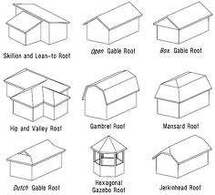
Roof Construction Types
GENERAL CONSTRUCTION AND CARPENTRY
Skillion and Lean-to Roof
Open Gable Roof
Box Gable Roof
Hip and Valley Roof
Gambrel Roof
Mansard Roof
Dutch Gable Roof
Hexagonal Gazebo Roof
Jerkinhead Roof
Illustration courtesy of finalarchitecture.com
Notes:
These are illustrations of various roof types.
Q: Of the many types of roof structures shown, pick the two most common residential roof types.
A: 1) Gable roof and 2) hip and valley roof

Slide 14
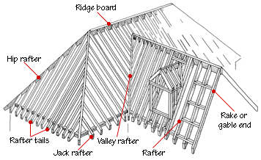
Roof Framing Details
GENERAL CONSTRUCTION AND CARPENTRY
Illustration courtesy of Don Vandervort’s Home Tips.com
Notes:
Have students name the parts of the roof framing on the slide.
Note how the ridge beam double top plates tie in all of the common and valley rafters.

Slide 15
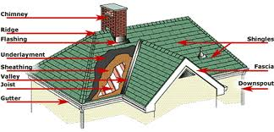
Roof Features and Terms
GENERAL CONSTRUCTION AND CARPENTRY
Illustration courtesy of Jay Carter Roofing
Notes:
Note the exterior features of the roof.
Point out the exterior features of a roof.

Slide 16
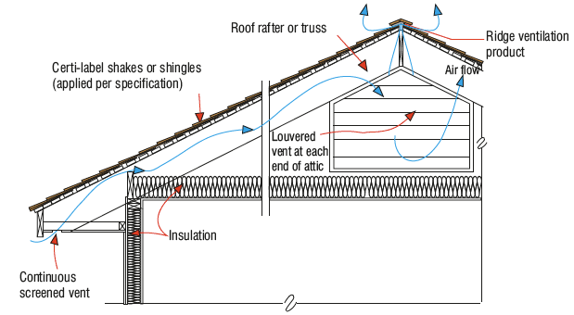
Roof Eaves Detail
GENERAL CONSTRUCTION AND CARPENTRY
Illustration courtesy of Cedar Shake and Shingle Bureau
Notes:
Note detail of the roof eave and how the insulation blanket is a consistent depth all of the way out to the exterior wall. Also illustrated is the flow of passive ventilating air from the eaves through the ridge and gable vent.

Slide 17
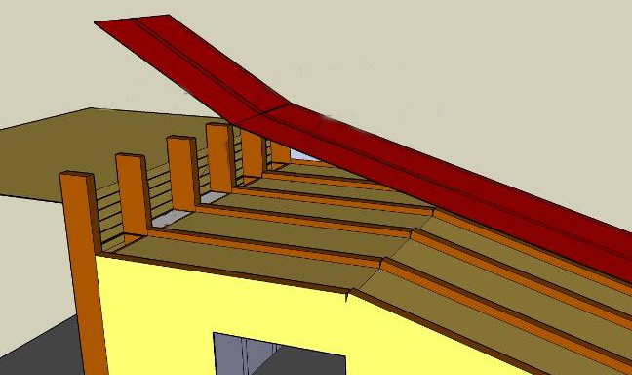
Knee Wall Attics
GENERAL CONSTRUCTION AND CARPENTRY
Main Attic
Open Wall Cavities
Knee wall Attic
Graphic courtesy of Anthony Cox
Notes:
Knee wall attics, typical in 1½-story Cape Cod-style homes, are common sources of gaps in the pressure and thermal boundaries.
Even when the ceiling height of the living space below doesn’t change, the knee wall itself is usually uninsulated.
The interior wall is also often left without a top plate. Convective heat loss occurs through the wall cavity.

Slide 18
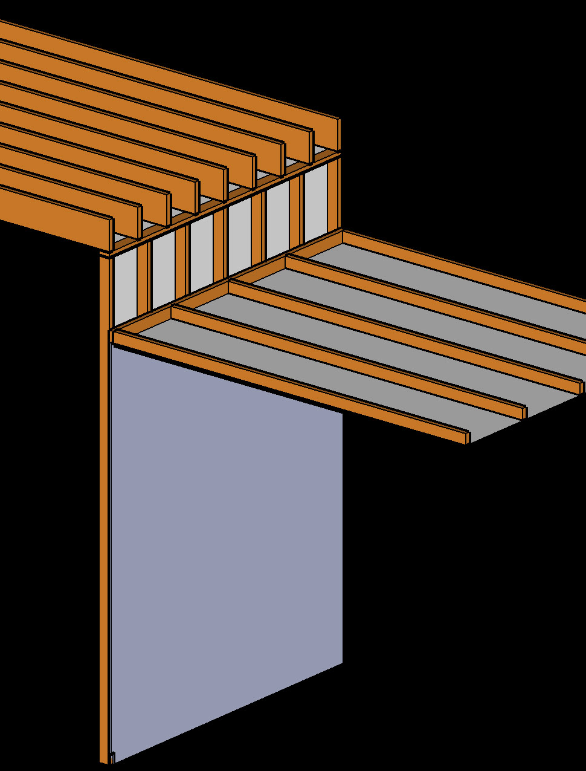
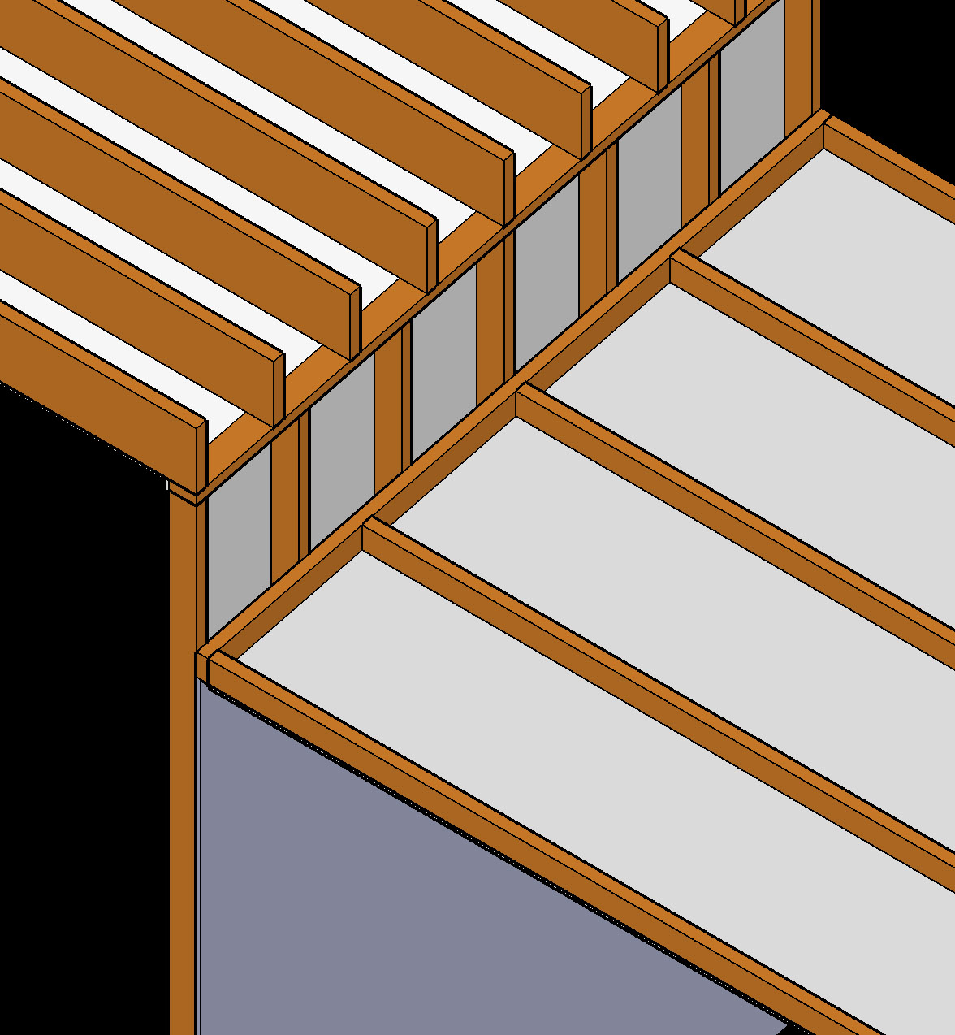
Changes in Ceiling Height
GENERAL CONSTRUCTION AND CARPENTRY
The interior wall cavities act as a chimney that robs the house of heat and conditioned air.
Graphic courtesy of Anthony Cox
Notes:
Often there is no wall cap in this kind of construction.
The open wall top allows even more heat loss, since the interior wall acts as a chimney, carrying conditioned air and moisture away from the conditioned space.

Slide 19
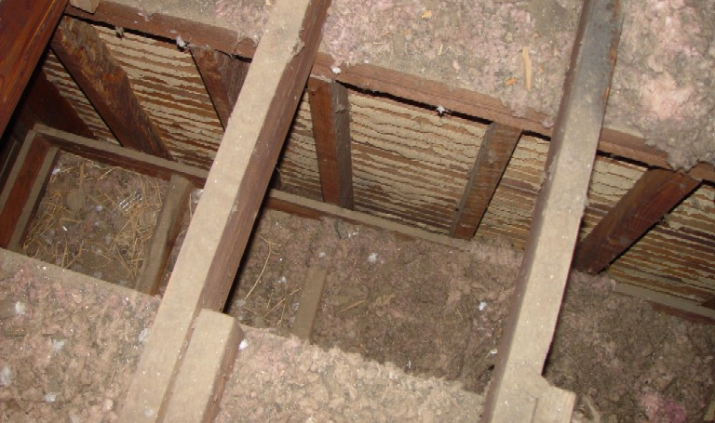
Dropped Ceiling Over Closet
GENERAL CONSTRUCTION AND CARPENTRY
In older homes the ceiling level changes in closets, causing gaps in the pressure and thermal boundaries.
Closet ceiling
Photo courtesy of the US Department of Energy
Notes:
In older homes, the ceiling level changes in closets, causing gaps in the pressure and thermal boundaries.
The uninsulated bedroom and bathroom walls are exposed to essentially outdoor temperatures.
Q: What kind of framing is this and why?
A: Balloon framing because there’s no top plate on the closet ceiling.

Slide 20
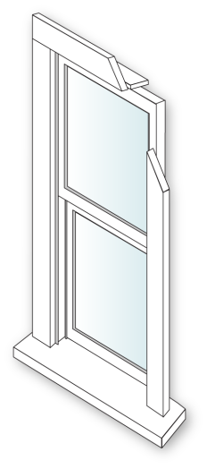
Window Terminology
GENERAL CONSTRUCTION AND CARPENTRY
Head Jamb
Upper Sash
Glass Plane
Typical Wood Window
Exterior
Side Jamb
Lower Sash
Stop
Trim
Sill (sloped)
Image developed for US DOE WAP National Standardized Curricula
Notes:
A typical double-hung window has numerous components. Understanding window terminology lets installers communicate effectively with each other when installing windows.
Head jamb − Groove at the top of the window that allows the window sashes to slide into place and sit inside the window frame.
Upper sash − The top portion of the window comprised of a pane of glass set inside a frame. The upper sash is fixed in a single-hung window and slides up and down in a double-hung window.
Glass pane − In the window shown in the slide, there are two panes of glass – one in the top sash and one in the bottom sash.
Side jamb − Grooves in window that allow the window sashes to slide up and down or side to side.
Trim − Extends beyond the end of the window frame on the outside of the window opening. This allows the window to fit flush with the exterior wall when the window is installed.
Window Stop − A wood trim member nailed to the window frame to hold, position, or separate window parts. The stop is often molded into the jamb liners on sliding windows.
Lower sash − The bottom portion of the window comprised of a pane of glass set inside a frame. The lower sash is fixed in a single-hung window and slides up and down in a double-hung window.
Sill − The very bottom of the window. The sill is usually sloped to allow water to run off the bottom of the window in rain or during cleaning.

Slide 21
Window Types
GENERAL CONSTRUCTION AND CARPENTRY
Casement
Awning
Picture
Double Hung
Slider
Image developed for US DOE WAP National Standardized Curricula
Notes:
The illustrations show several common window types.
Casement windows have a single operable sash that swings outward on a horizontal plane. Casement window frames that have gone out of square due to settling can stick and quite possibly render these types of windows inoperable.
Awning windows are essentially casement windows that swing vertically. Awning windows are often used in basements. Jalousie windows, found on older mobile homes, are a type of awning window.
Picture windows have no operable sashes and are used primarily for aesthetics.
Double-hung windows have operable upper and lower sashes that slide vertically in a channel. Upper sashes are often painted shut.
A slider window is essentially a double-hung window turned on its side so the sashes move horizontally.

Slide 22
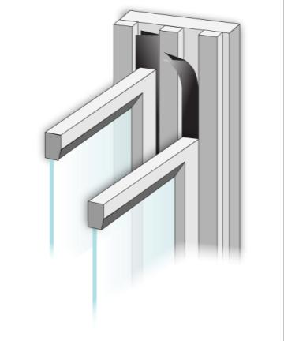
Window Treatments
GENERAL CONSTRUCTION AND CARPENTRY
V-Channels
Where applicable:
Replace broken glass.
Replace broken sash locks.
Weatherstrip meeting rails and sliding surfaces.
Install pulley seals.
Caulk interior trim.
Stop
Upper Sash
Lower Sash
Notes:
Where applicable:
Replace broken glass.
Replace broken sash locks.
Weatherstrip meeting rails and sliding surfaces.
Install pulley seals.
Caulk interior trim.
Window repairs are usually simple but can be time consuming. Spending a great deal of time sealing every possible joint is not cost effective compared to fixing big duct leaks to the outside or large attic bypasses. However, air leakage around windows is noticeable to clients who sit near the windows during cold weather. Fixing these leaks will be appreciated.
Besides fixing obvious problems such as broken glass or misaligned sashes, very detailed window repairs such as weatherstripping, fixing broken sash locks, and caulking trim should be limited to high-activity areas where comfort is an issue.

Slide 23
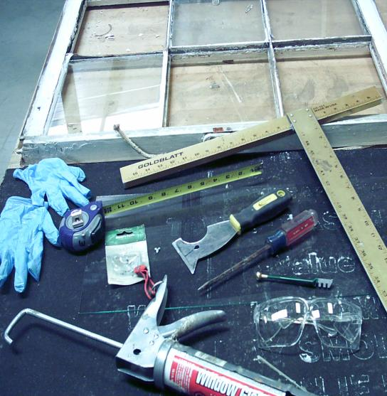
Glass Replacement
GENERAL CONSTRUCTION AND CARPENTRY
Remove broken pane.
Measure opening and cut new pane from glass sheet.
Install, point and glaze replacement pane.
Photo courtesy of the US Department of Energy
Notes:
When replacing glass, be sure to remove the broken pane. Next, measure the opening and cut a new pane from a glass sheet.
Important glazier tools:
Drywall square
Glass cutter
Wax crayon
Tape measure
Glaziers’ points
Putty knife
Safety glasses and gloves
Glazing compound

Slide 24
Guidelines for Window Replacement
GENERAL CONSTRUCTION AND CARPENTRY
Window replacement is not an option unless:
It is shown to have a favorable SIR
It can be justified as an Incidental Repair
Always attempt to repair or improve existing windows before considering replacement.
Window replacement should not be considered a measure to reduce air infiltration or as a health and safety measure.
Window selection should reflect the climate.
Choose high SHGC in cold climates and low SHGC in hot climates.
Look for low-e coatings on interior panes in cold climates and on exterior panes in hot climates.
Notes:
Window replacement is not cost effective unless:
It is shown to have a favorable savings-to-investment ratio (SIR).
It can be justified as an incidental repair. Always attempt to repair or improve existing windows before considering replacement.
Window replacement should not be considered a measure to reduce air infiltration or as a health and safety measure.
Window selection should reflect the climate.
Choose high SHGC (solar heat gain coefficient) in cold climates and low SHGC in hot climates.
Look for low-e coatings on interior panes in cold climates and on exterior panes in hot climates.
Weatherization measures must have an SIR equal to or greater than 1 to be considered.

Slide 25
In-Jamb Replacement Method (Double Hung Window)
GENERAL CONSTRUCTION AND CARPENTRY
Remove existing frame, sash pulley weights, etc.
TIP: Score all painted joints with a sharp utility knife prior to removal of window trim. Use a thin-bladed pry bar to prevent marring the trim.
Install a complete vinyl unit that fits inside the existing frame against the exterior window stops.
Seal perimeter with low expanding foam to ensure an air tight installation.
Reinstall existing interior trim and seal with caulk.
Always employ lead-safe work practices when lead-based paint will be disturbed.
Notes:
When window replacement is justified, one of the most practical window retrofits is to replace the frame and sash with commercially available, custom-ordered vinyl replacement windows.
Remove the existing frame, sash pulley weights, etc.
Score all painted joints with a sharp utility knife before removing the window trim. Use a thin-bladed pry bar to avoid damaging the trim.
Install a complete vinyl unit that fits inside the existing frame against the exterior window stops.
Seal the perimeter with low expanding foam to ensure an airtight installation.
Reinstall the existing interior trim and seal with caulk.
Always use lead-safe work practices when lead-based paint will be disturbed.
Advantages:
Retains existing glass area
Simple to install
Energy-efficient upgrade
Does not disturb existing casings
The installed cost is approximately $260 for a 3 ft. x 5 ft. replacement based on the 2004 national average.
Follow the manufacturer’s instructions for measuring, specifying, and installing windows.

Slide 26
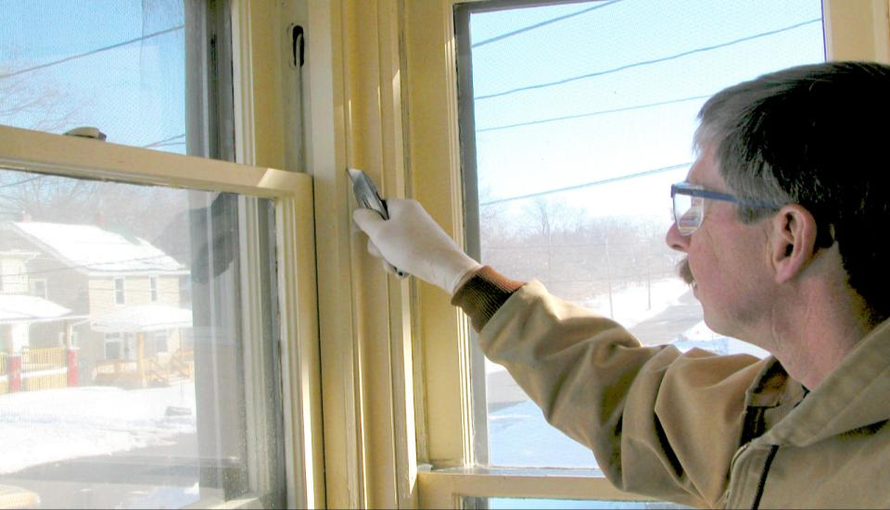
In-Jamb Replacement Method (Double Hung Window)
GENERAL CONSTRUCTION AND CARPENTRY
Sash pulley and cord
Photo courtesy of US Department of Energy
Notes:
These next three slides show the proper sequence and methods for installation of an in-jamb replacement window.
When performing an in-jamb replacement, score the painted mating surfaces of the outer sash stop with a razor knife. Note the sash pulley and cord which must also be removed.

Slide 27
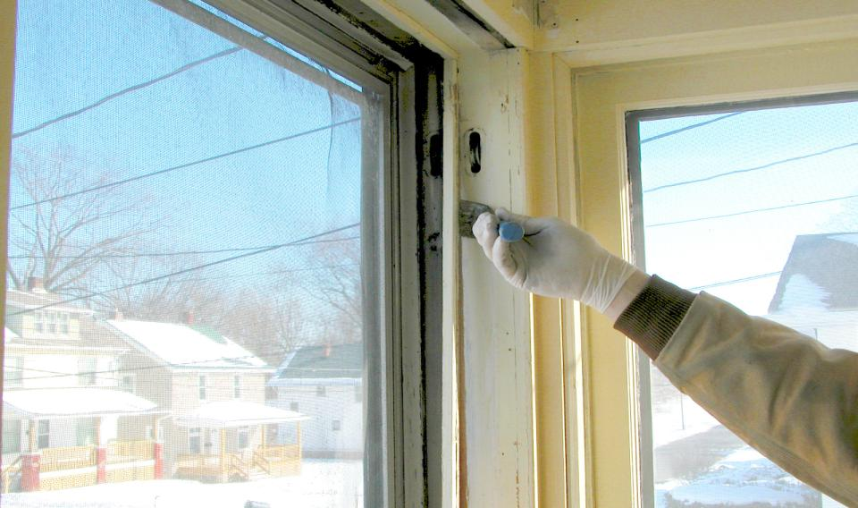
In-Jamb Replacement Method (Double Hung Window)
GENERAL CONSTRUCTION AND CARPENTRY
Sash stop
Photo courtesy of US Department of Energy
Notes:
Next, remove the inner sash stop but leave the outer sash stop. The replacement will be inserted against the outer stop. Then remove the existing storm window.

Slide 28
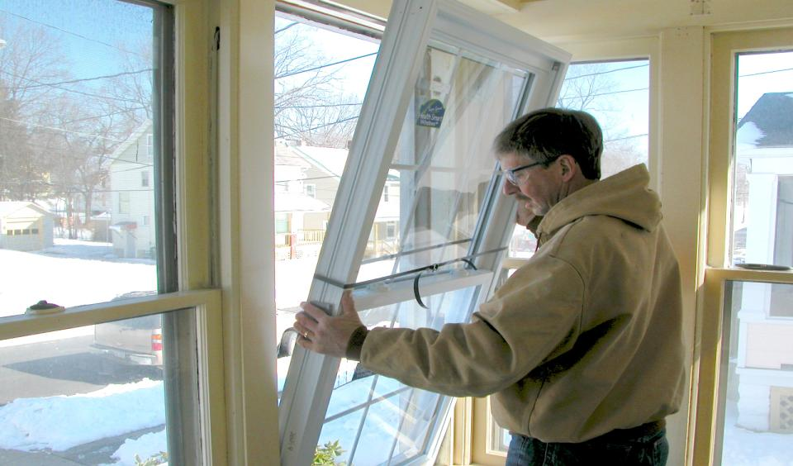
In-Jamb Replacement Method (Double Hung Window)
GENERAL CONSTRUCTION AND CARPENTRY
Photo courtesy of US Department of Energy
Notes:
Install the replacement window per the manufacturer’s instructions.

Slide 29
Doors
GENERAL CONSTRUCTION AND CARPENTRY
Replacements are not cost effective because of their high cost and relatively low impact on energy savings.
Potentially significant air leakage and comfort issues are due to operational problems and poor seals.
Photos courtesy of the US Department of Energy
Notes:
This photo shows a door on a mobile home that is a good candidate for replacement.
Most replacements are not cost effective because of their high cost and relatively low impact on energy savings.
This door may be cost effective to replace due to significant air leakage and comfort issues related to operational problems and poor seals.
Solid wood core doors generally have an R-value of 2.5.
ENERGY STAR-qualified foam-filled steel doors have an R-value close to six.
The relatively small amount of energy savings does not justify the cost of replacement in any but the most extreme circumstances.

Slide 30
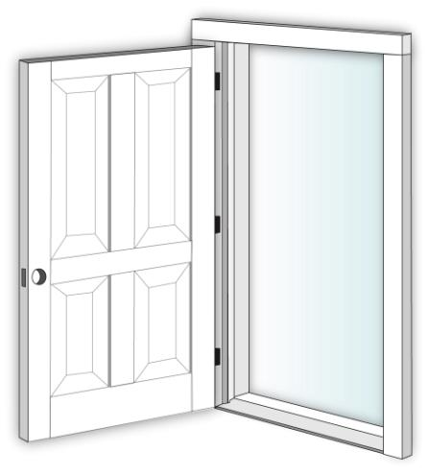
Door Terminology
GENERAL CONSTRUCTION AND CARPENTRY
Top Rail
Hinge
Panel
Hinge Stile
Mullion
Stop
Lock Stile
Jamb
Lock Rail
Casing
Bottom Rail
Threshold
Image developed for US DOE WAP National Standardized Curricula
Notes:
This is an illustration of major door components:
Hinges: The metal objects that attach your door to the jamb, normally with screws. They can be made from brass, steel, iron, or other metals.
Door Casing: A wooden trim around doors that covers the seam between the jamb and the wall.
Jambs: The wood that surrounds the door unit to which the door is attached on the hinge side.
Door Stop: The wood trim fastened to the inside of the jamb that positions the door within the jamb and into the latching mechanism.
Threshold: A beveled wood member fastened to the floor and situated between the side jambs. The threshold seals the space between the bottom of the door and the floor.
On the door itself:
Rails: Horizontal framing members of a door.
Stiles: Full-length vertical framing members of a door.
Mullions: Vertical framing members that don’t run the full length of a door.
Panel: Parts of a door between the rails and stiles or mullions.

Slide 31
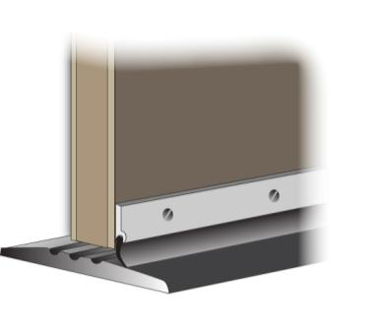
Door Repair and Replacement
GENERAL CONSTRUCTION AND CARPENTRY
Replace doors only when :
It is shown to have a favorable SIR.
It can be justified as an incidental repair.
Apply weatherstripping, door stops, door sweeps, or thresholds.
Repair or replace locksets, latches, and hinges.
Weatherization measures must have an SIR equal to or greater than 1.
Sweep
Threshold
Image developed for US DOE WAP National Standardized Curricula
Notes:
Replace doors only when:
It is shown to have a favorable SIR.
It can be justified as an incidental repair.
Apply weatherstripping, door stops, door sweeps, or thresholds. Repair or replace locksets, latches, and hinges.
Weatherization measures must have an SIR equal to or greater than 1 to be considered.

Slide 32
Notes on Door Replacement
GENERAL CONSTRUCTION AND CARPENTRY
Replace the existing door with a solid core wood door blank. Use this method only if the existing rough opening is reasonably square and the frame is in good shape.
Consider a pre-hung, energy-efficient unit that will fit the rough opening. Accomplished in much less time than retrofitting a door blank.
Manufacture doors on site for special situations, such as open-coal access areas adjacent to conditioned basements.
Employ lead-safe work practices when lead-based paint will be disturbed.
Notes:
There are a couple of options for door replacement:
1) Replace the existing door with a solid core wood door blank.
Use this method only if the existing rough opening is reasonably square and the frame is in good shape.
This involves trimming a solid core door blank to fit, placing hinges, installing a lockset, weatherstripping, and priming.
A skilled carpenter with the right tools can install a door in about two hours.
Manufacture doors on site for special situations such as open coal access areas adjacent to conditioned basements.
Use lead-safe work practices when lead-based paint will be disturbed.
2) Install a pre-hung, energy-efficient unit that will fit the rough opening.
Consider installing a pre-hung unit if a commercially available unit will fit the rough opening.
This can be accomplished in much less time than retrofitting a door blank.
Use lead-safe work practices when lead-based paint will be disturbed.

Slide 33
Summary
GENERAL CONSTRUCTION AND CARPENTRY
A good knowledge of residential construction terminology helps auditors communicate clear instructions to crews and contractors.
Different framing configurations will require different strategies for controlling air leakage pathways.
Window and door replacements are generally not cost effective.
Notes:
A good knowledge of residential construction terminology helps auditors communicate clear instructions to crews and contractors.
Different framing configurations will require different strategies for controlling air leakage pathways.
Window and door replacements are generally not cost effective because they generally do not meet the minimum energy savings to investment ratio required by DOE.
Present this slide as an interactive discussion, soliciting personal examples from the trainees. Add your own personal examples and knowledge to supplement.

