Slide 1
Intermediate Math
WEATHERIZATION ENERGY AUDITOR SINGLE FAMILY
WEATHERIZATION ASSISTANCE PROGRAM STANDARDIZED CURRICULUM – December 2012

Slide 2
Learning Objectives
INTERMEDIATE MATH
By attending this session, participants will be able to:
Apply units of measurement.
Calculate areas and volumes.
Assess building tightness limits.
Calculate CFM₅₀ vs. ACH.
Estimate bags of cellulose.
Calculate appropriate attic and foundation venting.
Discuss refrigerator usage calculations for determining replacement eligibility.
Calculate lighting retrofit savings.
Notes:
By attending this session, participants will be able to:
Apply units of measurement.
Calculate areas and volumes.
Assess building tightness limits.
Calculate CFM₅₀ vs. ACH.
Estimate bags of cellulose.
Calculate appropriate attic and foundation venting.
Discuss refrigerator usage calculations for determining replacement eligibility.
Calculate lighting retrofit savings.

Slide 3
Typical Units
INTERMEDIATE MATH
Surface Area
Volume
Air Flow
Notes:
Surface area:
Length x width (feet x feet)
Units are square feet (sq. ft., ft²)
Volume:
Length x width x height
Units are cubic feet (cu. ft., ft³)
Airflow:
Volume per unit of time
Units are cubic feet per minute (ft³ /min, CFM)
Air changes per hour − need to know house volume to calculate ACH

Slide 4
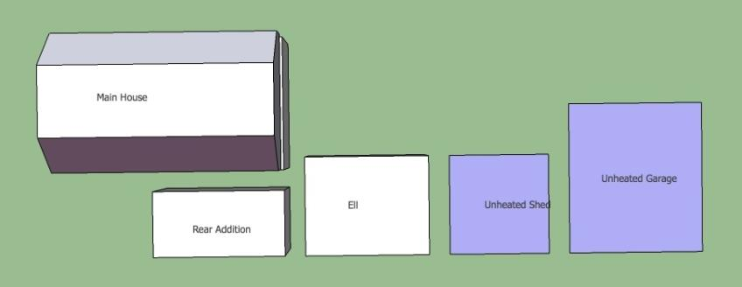
Floor Area
INTERMEDIATE MATH
Conditioned
Unconditioned
Image developed for US DOE WAP National Standardized Curricula
Notes:
Use sketch of floor plan.
Note unconditioned area.
Calculate conditioned area.

Slide 5
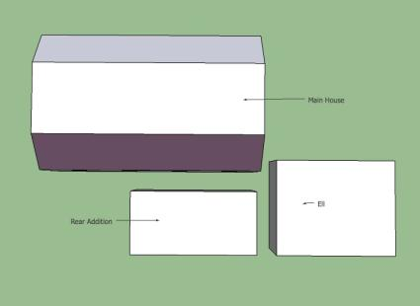
Calculate Conditioned Area
INTERMEDIATE MATH
Area = Length x width
Final units = Square feet
Tackle floor plans in pieces.
Reduce complicated shapes into small, simple shapes.
Image developed for US DOE WAP National Standardized Curricula
Notes:
When calculating conditioned area, remember:
Area = length x width.
Final units = square feet.
Tackle floor plans in pieces.
Reduce complicated shapes into small, simple shapes.
Calculating area is useful for insulation estimating.
Floor area is used later to calculate the conditioned volume, which is used to determine ACH, and cost effectiveness of certain heating and cooling measures.

Slide 6
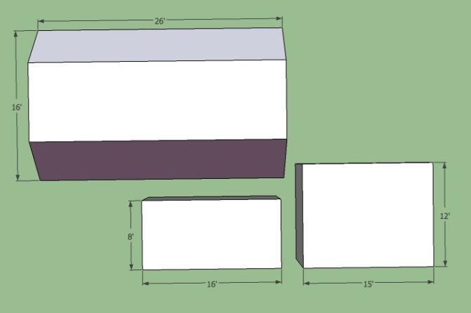
Calculate Conditioned Area
INTERMEDIATE MATH
180 ft²
128 ft²
416 ft²
+ 416 ft²
Main House
1½ Stories
Double area
16’ x 26’ =
416 ft²
1,140 ft²
12’ x 15’ =
16’ x 8’ =
128 ft²
180 ft²
Image developed for US DOE WAP National Standardized Curricula
Notes:
Give students calculators, pencils, and scrap paper and the “Conditioned Area Worksheet,” and let them calculate the answers before moving forward with the presentation.
Click to reveal areas of various sections of the home and the total.

Slide 7
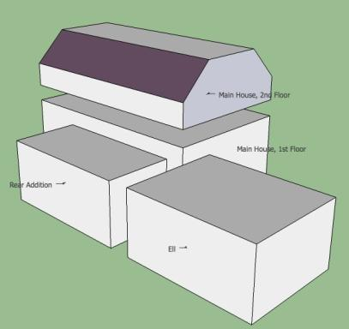
Volume – Keep the Units Straight
INTERMEDIATE MATH
Keep the units straight.
Square Feet x Feet = Cubic Feet
ft² x ft = ft³
Cubic Feet ÷ Feet = Square Feet
= ft²
ft³
= ft²
ft
Image developed for US DOE WAP National Standardized Curricula
Notes:
Keep the units straight.
Square feet x feet = cubic feet (ft³ x ft = ft³)
Cubic feet ÷ feet = square feet (ft³ /ft = ft²)
Often when performing calculations in a hurry, it can be tempting to leave off units and just jot down numbers. Until you are experienced and have a set method for conducting the audit, avoid this temptation. Always note the units of what you are calculating. This can help avoid confusion later on and can help you track errors if your numbers aren’t adding up.

Slide 8
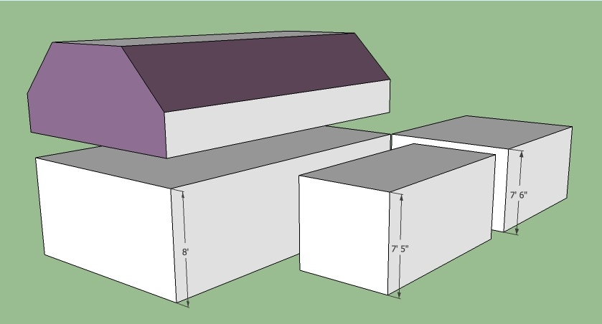
Calculate Conditioned Volume
INTERMEDIATE MATH
Main House, 2nd Fl = Attic Flat = 8’
Eaves Wall = 3’
Ell = 180 ft² x 7’6” = ___
Main House, 1st Fl = 416 ft² x 8 = _
Rear Addition = 128 ft² x 7’ 5” = ___
Image developed for US DOE WAP National Standardized Curricula
Notes:
Areas listed as previously calculated.
Ceiling heights noted from walk-through.
Let students jot down numbers or perform calculations while the slide is displayed. Answers will be revealed two slides later.
Q: Why don’t we include attic spaces in these volume calculations?
A: Those spaces are unconditioned, so the volumes aren’t useful for calculating MVR or ACH. We only need to know the volume of air that is part of the living space and that the client pays to heat or cool.

Slide 9
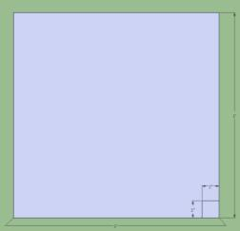
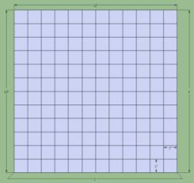
Keep the Units Straight
INTERMEDIATE MATH
1’ x 1’ = 1 ft²
12” x 12” = 144 in² = 1 ft²
300” x 200” = 60,000 in²
60,000 in²
= 417 ft²
144 in²/ft²
Notes:
Calculating feet and inches can get tricky. A foot is 12 inches long, so a square foot contains 12 x 12 square inches.
1 ft x 1 ft = 1 ft²
12 in x 12 in = 144 in² = 1 ft²
300 in x 200 in = 60,000 in²
60,000 in² ÷ 144 in²/1 ft² = 417 ft²

Slide 10
Calculate Conditioned Volume
INTERMEDIATE MATH
Main House, 2nd Fl = Attic Flat = 8’
Eaves Wall = 3’
Ceiling Height = 7’
Ell = 180 ft² x 7’6” = 1,350 ft³
Main House, 1st Fl = 416 ft² x 8 = 3,328 ft³
Rear Addition = 128 ft² x 7’ 5” = 950 ft³
Image developed for US DOE WAP National Standardized Curricula
Notes:
The lower floor of the home, including the addition and ell, are simple rectangles and easy to calculate.
Ell = 180 ft² x 7’6” = 1,350 ft³
Rear addition = 128 ft² x 7’5” = 950 ft³
Main house, first floor = 416 ft² x 8’ = 3,328 ft³
The second floor of the main house (the only section with a second story) is an odd shape due to the sloping ceiling and knee-wall attics. To accurately calculate the second floor, we will need to break down this odd shape into simple parts that are easier to work with. We will need to start with the following dimensions from our walk-through.
Attic flat = 8’
Eaves wall = 3’
Ceiling height = 7’

Slide 11
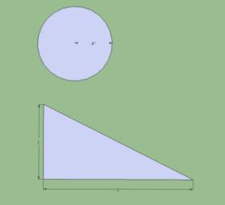
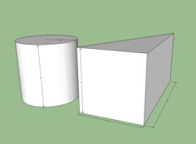
Odd Shapes
INTERMEDIATE MATH
Area:
Triangle = ½ Base x Height
Circle = πr² ; π ≈ 3.14
Volume: (Area x 3rd Dimension)
Triangle = ½ Base x Height x Length
Cylinder = πr² x Height
Images developed for US DOE WAP National Standardized Curricula
Notes:
Break complex shapes down into simple components—circles, triangles, and rectangles—and use the following formulas.
Area
Triangle = ½ base x height
Circle = πr² ; π ≈ 3.14
Volume = area * 3rd dimension
Triangle = ½ base x height x length
Cylinder = πr² x height

Slide 12
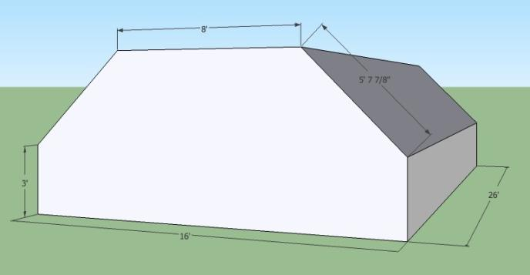
Conditioned Volume: 2nd Floor
INTERMEDIATE MATH
Tackle complex shapes.
Break down into simple shapes.
Main House, 2nd Fl = Attic Flat = 8’
Eaves Wall = 3’
Ceiling Height = 7’
Second Story
Image developed for US DOE WAP National Standardized Curricula
Notes:
This can be broken down in a number of ways. For our example, we will break it down into two rectangles and two triangles.
Dimensions from walk-through:
Attic flat = 8’
Eaves wall = 3’
Ceiling height = 7’

Slide 13
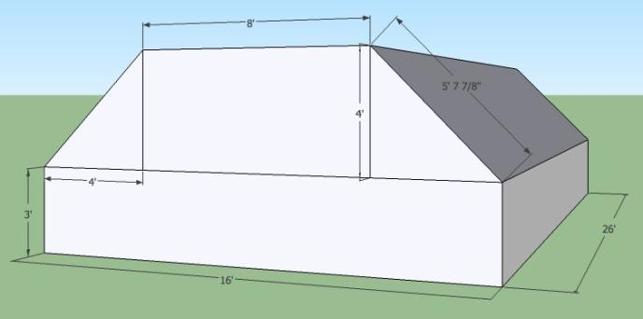
Calculating Volume: 2nd Floor
INTERMEDIATE MATH
Top Rectangle = 8 ft x 4 ft x 26 ft = 832 ft³
* Volume of a triangle = ½ Base x Height x Length
2 Triangles* = 2 x (½ (4 ft x 4 ft) x 26 ft) = 416 ft³
2nd Floor Volume:
832 ft³
1,248 ft³
+ 416 ft³
2,496 ft³
Bottom Rectangle = 16 ft x 3 ft x 26 ft = 1,248 ft³
Image developed for US DOE WAP National Standardized Curricula
Notes:
Let students calculate the various shapes’ volumes and then the total.
Click to reveal answers on the slide.
Top rectangle = 8’ x 4’ x 26’ = 832 ft³
Bottom rectangle = 16’ x 3’ x 26’ = 1,248 ft³
2 triangles = 2 x (½ (4’ x 4’) x 26’) = 416 ft³
Total conditioned volume of 2nd floor = 2,496 ft³

Slide 14
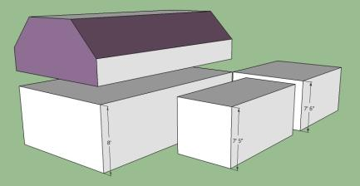
Calculate Conditioned Volume
INTERMEDIATE MATH
Total floor area x 8 can get you close:
1,140 ft² x 8 ft = 9,120 ft³
Ell = 1,350 ft³
Rear Addition = 950 ft³
Main House, First floor = 3,328 ft³
Main House, Second floor = 2,496 ft³
TOTAL = 8,124 ft³
Image developed for US DOE WAP National Standardized Curricula
Notes:
The final step is to add up the volumes of all the sections of the house.
Ell = 1,350 ft³
Rear addition = 950 ft³
Main house, first floor = 3,328 ft³
Main house, second floor = 2,496 ft³
Total = 8,124 ft³
The total floor area x 8’ can get you to an accurate volume.
1,140 ft² x 8’ = 9,120 ft³

Slide 15
Indoor Air Quality “At Risk” Calculation
INTERMEDIATE MATH
At Risk Calc:
For Example:
• 8,400 ft³ minimum
• 2,100 ft³ for each occupant beyond 4
• Compare to actual heated volume
• 5 occupants: 5 - 4 = 1
• 1 x 2,100 ft³ = 2,100 ft³
• 8,400 ft³ + 2,100 ft³ = 10,500 ft³
Our sample home with a volume of 8,124 ft³ is less than the 10,500 ft³ minimum, and is considered “At Risk.”
Notes:
When blower door testing is not possible, some states require the auditor to determine if the home is “at risk” for moisture and indoor air quality (IAQ) problems. Blower door results supersede this calculation.
At risk calculation:
8,400 ft³ minimum
2,100 ft³ for each person over four occupants
Compare to actual heated volume
Five occupants in our sample home: 5 – 4 = 1
1 x 2,100 ft³ = 2,100 ft³ additional space needed to avoid being “at risk”
8,400 ft³ + 2,100 ft³ = 10,500 ft³
Sample home: 8,124 ft³
Click to reveal that sample home is “at risk.”
Home volume of 8,124 ft³ is less than the 10,500 ft³ minimum and is considered “at risk.” With no way to test the actual ACH of the home, most programs would not air seal a home with “at risk” status.

Slide 16
Dividing by Fractions
INTERMEDIATE MATH
Dividing by a fraction is the same as multiplying by the reciprocal.
Reciprocal of ½ is , or 2.
2
1
10 ÷ ½ = 10 x = 10 x 2 =
= 10 x = 10 x 2 =
= x = = = 1½ =
2
20
1
10
2
20
½
1
3
1.5
4
3
2
6
3
4
1
4
2
½
Notes:
Dividing by a fraction is the same as multiplying by the reciprocal. Reciprocal of ½ is ²/₁, or 2.
Click to reveal answers to the calculations.
Distribute “Dividing by Fractions Worksheet.” Let students complete, and then provide answers.

Slide 17
Air Changes per Hour
INTERMEDIATE MATH
ACH₅₀ = CFM₅₀ x 60min/hr ÷ Volume
Volume of conditioned space = 8,124 ft³
Blower door reading = 2,000 CFM₅₀
ACH₅₀ = 2,000 CFM₅₀ x 60 / 8,124 ft³
=
14.77 Air Changes per Hour at 50 Pa
Notes:
To calculate air changes per hour, convert the blower door reading (taken in cubic feet per minute at 50 Pascals) to hours by multiplying by 60 (number of minutes per hour), then dividing by the volume.
ACH₅₀ = CFM₅₀ x 60 min/hr ÷ volume
Volume of conditioned space = 8,124 ft³
Blower door reading = 2,000 CFM₅₀
Click to reveal answer.
ACH₅₀ = 2,000 CFM₅₀ x 60 ÷ 8,124 ft³ = 14.77 ACH at 50 Pa

Slide 18
Percent Infiltration Reduction
INTERMEDIATE MATH
Percentage Reduction Goal
If ACH₅₀ = 11-17, goal is 25%.
If ACH₅₀ = 18-22, goal is 35%.
If ACH₅₀ > 23, goal is 40%.
Example
ACH₅₀ = 14.77, goal is 25%.
100% - 25% = 75% of Pre-Weatherization CFM₅₀ is goal.
Pre-Weatherization 2,000 CFM₅₀
2,000 CFM₅₀ x 75% = 2,000 x 0.75 = 1,500 CFM₅₀
Notes:
Some programs use percent infiltration reduction tables to guide air sealing. Calculating the percent infiltration reduction provides us with the blower door target.
Sample percentage reduction goals:
If ACH₅₀ = 11-17, goal is 25%
If ACH₅₀ = 18-22, goal is 35%
If ACH₅₀ > 23, goal is 40%
Example:
ACH₅₀ = 14.77, goal is 25% infiltration reduction
100% - 25% = 75% of pre-weatherization CFM₅₀ is the goal
To determine air-sealing goal, target CFM₅₀:
Pre-weatherization 2,000 CFM₅₀
2,000 CFM₅₀ x 75% = 2,000 x 0.75 = 1,500 CFM₅₀

Slide 19
Estimating Attic Insulation
INTERMEDIATE MATH
Main house + Addition + Ell = Total attic area
Main house attic = 8’ * 26’ = 208 ft²
Addition = 128 ft²
Ell = 180 ft²
Total attic area = 516 ft²
Bring attic from R-0 to R-40.
Notes:
We will use our sample house from before to estimate attic insulation.
Main house + Addition + Ell = Total attic area
Main house attic = 8’ x 26’ = 208 ft²
Addition = 128 ft²
Ell = 180 ft²
Total attic area = 516 ft²
Based on these totals, installers should bring attic insulation from from R-0 to R-40.

Slide 20
Estimating Attic Insulation
INTERMEDIATE MATH
Sample Coverage Chart for Blown-In Cellulose
R-Value @ 75° Mean Temp. | Minimum Thickness (inches) |  | Maximum Net Coverage (No adjustment for framing) |  |  | Gross Coverage (based on 2” x 6” framing on 16” centers)
To obtain a thermal resistance of: | Installed insulation shouldn’t be less than: | Thickness after settling | Max. Sq. Ft. per Bag | Min. Bags per 1,000 Sq. Ft. | Min. Weight per Sq. Ft. (lbs) | Max. Sq. Ft. per Bag | Min. Bags per 1,000 Sq. Ft.
R-50 | 15.0 | 13.5 | 13.8 | 72.7 | 1.689 | 14.3 | 69.9
R-42 | 12.6 | 11.4 | 16.4 | 61.0 | 1.419 | 17.2 | 58.3
R-40 | 12.0 | 10.8 | 17.2 | 58.1 | 1.351 | 18.1 | 55.4
R-38 | 11.4 | 10.3 | 18.1 | 55.2 | 1.284 | 19.1 | 52.4
R-32 | 9.6 | 8.6 | 21.5 | 46.5 | 1.081 | 22.9 | 43.7
R-30 | 9.0 | 8.1 | 22.9 | 43.6 | 1.014 | 24.5 | 40.8
R-25 | 7.5 | 6.8 | 27.5 | 36.3 | 0.845 | 39.8 | 33.6
R-24 | 7.2 | 6.5 | 28.7 | 34.9 | 0.811 | 31.2 | 32.1
R-22 | 6.6 | 5.9 | 31.3 | 32.0 | 0.743 | 34.3 | 29.2
R-19 | 5.7 | 5.1 | 36.2 | 27.6 | 0.642 | 40.0 | 25.0
R-13 | 3.9 | 3.5 | 52.9 | 18.9 | 0.439 | 58.4 | 17.1
R-11 | 3.3 | 3.0 | 62.6 | 16.0 | 0.372 | 69 | 14.5
Notes:
The sample coverage chart, usually part of the insulation packaging, is used to determine how much insulation will be needed for the attic.
This chart shows how thick the insulation should be to reach R-40 (12 inches).
Click to circle appropriate installed thickness.
The chart includes how many square feet of coverage each bag will provide at that installed depth.
Click to reveal arrow pointing to gross coverage per bag for desired R-value.

Slide 21
Estimating Attic Insulation #1
INTERMEDIATE MATH
Total Attic Area = 516 ft²
Bring Attic from R-0 to R-40
At R-40 w/ 2x6, 16” oc., 1 bag covers 18.1 ft^{2*}
Assume 15% waste allowance
How many bags do you need for the attic?
* From sample coverage chart
Notes:
Total attic area = 516 ft²
Bring attic from R-0 to R-40
At R-40 with 2 x 6 studs, 16” on center (o.c.), 1 bag covers 18.1 ft^{2*}
Some installers use a general rule of thumb to account for spillage or over-packing: Assume 15% waste allowance
*From sample coverage chart
How many bags do you need for the attic?
Let students calculate the answer before proceeding to the next slide.

Slide 22
Estimating Attic Insulation #2
INTERMEDIATE MATH
Total attic area = 516 ft²
Bring attic from R-0 to R-40
Assume 15% waste allowance
516 ft² ÷ 1 bag/18.1 ft² = 28.5 bags of insulation.
28.5 x 1.15 = 32.78 bags = 33 bags (always round up).
Notes:
Total attic area = 516 ft²
Bring attic from R-0 to R-40
516 ft² ÷ 1 bag/18.1 ft²= 28.5 bags of insulation
Click to reveal units cancelling each other out.
Assume 15% waste allowance
Click to reveal number of bags.
28.5 x 1.15 = 32.78 bags = 33 bags (always round up)

Slide 23
Keep the Units Straight
INTERMEDIATE MATH
Label units to keep track.
Units on top and bottom cancel each other out.
Avoid errors such as “gallons of electricity!”
lbs
3.5 lbs/ft³ x 1,000 ft³ = 3.5
x 1,000 ft³ = 3,500 lbs
ft³
3,500 lbs
bag
= 3,500 lbs x
= 97.2 bags
36 lbs/bag
36 lbs
Notes:
Label units to keep track. Units on top and bottom cancel each other out. Avoid errors such as “gallons of electricity!”
Ask for a volunteer to talk through the equations on the slide, indicating which units will cancel out and what the final result will be.
Click to reveal units cancelling each other out.

Slide 24
Estimating Wall Insulation
INTERMEDIATE MATH
Sample Wall Coverage Chart
Maximum Coverage
Sidewalls | Thickness (inches) | Square Feet per Bag |  | Weight per Square Foot
 |  | 16” O.C. | 24” O.C.
R-13 (2x4) | 3.5 | 33.8 | 32.7 | 0.758
R-20 (2x6) | 5.5 | 21.5 | 20.8 | 1.192
How many bags to dense-pack 1,200 ft² of wall with 2 x 4 studs, 16” o.c.?
1,200 ft² _{= 35.5 bags = 36 bags}
33.8 ft²/bag
Notes:
Sample Coverage Chart
How many bags do we need to dense pack 1,200 ft² of wall with 2 x 4 studs, 16”o.c.?
1,200 ft²/33.8 ft²/bag = 35.5 bags = 36 bags
Always assume 15% waste allowance. (Total with waste allowance is 35.5 x 1.15 = 41 bags)

Slide 25
Estimating Wall Insulation
INTERMEDIATE MATH
What density does the chart assume?
Maximum Coverage
Sidewalls | Thickness (inches) | Square Feet per Bag |  | Weight per Square Foot
 |  | 16” o.c. | 24” o.c.
R-13 (2x4) | 3.5 | 33.8 | 32.7 | 0.758
R-20 (2x6 | 5.5 | 21.5 | 20.8 | 1.192
Chart indicates 0.758 lbs/sq. ft.
Each sq. ft. of wall contains: 1 ft x 1 ft x 3.5 inches = 0.2917 ft³
12 in/ft
0.758 lbs/ft² _{= 2.6 lbs/ft}³
0.2917 ft³/ft²
What? So low?
Not really, that accounts for space taken up by framing
Notes:
What density does the chart assume?
Click to cancel out units and circle the answer.
If we calculate the actual volume based on square feet and then use the weight per square foot data from the table, it appears following the chart would result in an installed density of only 2.6 lbs/ft³.
Click to bring text box into view.
The installed density isn’t really as low as it appears in these calculations. The difference is made up with framing within the walls. The framing reduces the actual volume being insulated.

Slide 26
Estimating Wall Insulation
INTERMEDIATE MATH
What if there’s no coverage chart? The math is simple:
How many bags to dense-pack 1,200 ft² of wall with 2 x 4 studs, 16” o.c.?
Assume 3.5 lbs/ft³ & 36 lbs/bag.
1,200 ft² x 3.5 inches = 350 ft³
12 in/ft
350 ft³ x 3.5 lbs/ ft³ = 1,225 lbs
1,225 lbs _{= 34.03 bags = 35 bags}
36 lbs/bag
Same as the chart
Notes:
What if there is no coverage chart? The math is simple:
How many bags to dense pack 1,200 sq. ft. of wall with 2 x 4 studs, 16”o.c.?
Click to reveal math.
Assume 3.5 lbs/ft³ and 36 lbs/bag.
1,200 ft² x 3.5 inches = 350 ft³
12 in/ft
350 ft³ x 3.5 lbs/ ft³ = 1,225 lbs
1,225 lbs = 34.03 bags = 35 bags
36 lbs/bag
We get essentially the same result as when using the information from the coverage chart.

Slide 27
Calculate Wall Insulation: Sample House
INTERMEDIATE MATH
Unconditioned
Conditioned
Image developed for US DOE WAP National Standardized Curricula
Notes:
To estimate the amount of insulation for dense packing the sidewalls:
Calculate total wall area.
Subtract windows and doors.

Slide 28
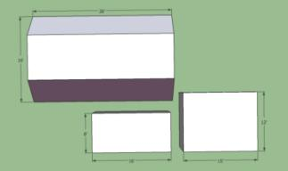
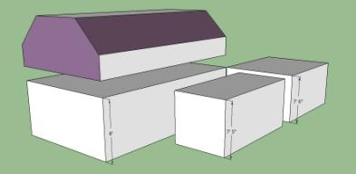
Estimate Wall Insulation: Sample House
INTERMEDIATE MATH
Main House
First Floor = 2(16’ x 8’) + 2(26’ x 8’) =
Second Floor = 2(3’x 26’) + 2(6’ x 26’)* + 2(16’ x 7’) =
Addition = 2(8’ x 7’5”) + (16’ x 7’5”)** =
Ell = (12’ x 7’6”)***+ 2(15’ x 7’6”) =
672 ft²
692 ft²
237 ft²
315 ft²
* Sloped ceiling, from walk-through notes
** Only count one long wall, other wall abuts the home
*** Only count one short wall, other wall abuts the home
Images developed for US DOE WAP National Standardized Curricula
Notes:
Calculate total wall area with the following measurements.
Main house, first floor = 2 (16’ x 8’) + 2 (26’ x 8’) =
Main house, second floor = 2 (3’ x 26’) + 2 (6’ x 26’)* + 2 (16’ x 7’) =
Addition = 2 (8’ x 7’5”) + (16’ x 7’5”)** =
Ell = (12’ x 7’6”)***+ 2(15’ x 7’6”) =
*Sloped ceiling, from walk-through notes
** Only count one long wall; other wall abuts the home
*** Only count one short wall; other wall abuts the home
Let students perform calculations, then click to reveal the answers.
Main house, first floor = 2 (16’ x 8’) + 2 (26’ x 8’) = 672 ft²
Main house, second floor = 2 (3’ x 26’) + 2 (6’ x 26’)* + 2 (16’ x 7’) = 692 ft²
Addition = 2 (8’ x 7’5”) + (16’ x 7’5”)** = 237 ft²
Ell = (12’ x 7’6”)***+ 2 (15’ x 7’6”) = 315 ft²

Slide 29
Wall Insulation: Sample House
INTERMEDIATE MATH
Add total wall area
Subtract doors and windows
Heated space windows & doors:
8 windows, 12.5 ft² each 8 x 12.5 ft² = 100 ft²
2 doors, 20 ft² each 2 x 20 ft² = 40 ft²
Window & door area = 140 ft²
Wall area needing insulation =
672 ft²
692 ft²
237 ft²
+ 315 ft²
1,916 ft²
+
- 140 ft²
1,776 ft²
Notes:
Add total wall area.
Subtract doors and windows.
Heated space windows and doors:
8 windows, 12.5 ft² each
8 x 12.5 ft² = 100 ft²
2 doors, 20 ft² each
2 x 20 ft² = 40 ft²
Window and door area = 140 ft²
Let students perform the calculations.
Click three times to reveal calculated total wall area, windows and doors area, and the resulting wall area needing insulation.

Slide 30
Estimating Wall Insulation: Sample House
INTERMEDIATE MATH
Sample Wall Coverage Chart
Maximum Coverage
Sidewalls | Thickness (inches) | Square Feet per Bag |  | Weight per Square Foot
 |  | 16” O.C. | 24” O.C.
R-13 (2x4) | 3.5 | 33.8 | 32.7 | 0.758
R-20 (2x6 | 5.5 | 21.5 | 20.8 | 1.192
How many bags to dense-pack 1,776 ft² of wall with 2 x 4 studs, 16” o.c.?
1,776 ft² _{= 52.5 bags = 53 bags}
33.8 ft²/bag
Notes:
Now we have the total wall area needing insulation. How many bags of insulation will be needed?
Click to reveal arrow on sample coverage chart pointing at square feet of coverage per bag.
Dividing the wall area by the estimated square feet of coverage per bag gives us the number of bags needed for the job.
Click to reveal calculation and answer.

Slide 31
Attic Venting
INTERMEDIATE MATH
1 ft² NFA of vent needed for every 300 ft² of attic*
If vents are located high and low to induce ventilation, 1 ft² of vent needed for every 600 ft² of attic
1,000 ft² attic with gable vents
1,000 ft² / 600 ft² = 1.67 ft² of vent needed
Two existing gable vents each 12” x 10”
2 x 12” x 10”/144 = 1.67 ft² of existing vent
Is existing venting adequate?
No, must use NFA.
* Assumes ceiling vapor barrier.
Notes:
1 ft² NFA of vent needed for every 300 ft² of attic*
1,000 ft² attic with gable vents
1,000 ft²/600 ft² = 1.67 ft² of vent needed
Two existing gable vents each 12” x 10”
2 x 12” x 10”/144=1.67 ft² of existing vent
Is existing venting adequate?
*Assumes a home in climate zone 6 – 8 with a vapor barrier (painted ceiling).
Click to reveal the answer.
A: No. Total vent area is not the same as NFA.
Refer to “Attic Ventilation” section of this curriculum for more details.

Slide 32
Foundation Venting
INTERMEDIATE MATH
1 ft² of vent needed for every 1,500 ft² of crawl space
1,000 ft² crawl space
1,000 ft² ₌
1,500 ft²
0.67 ft² of vent needed
0.67 ft² x 144 in²/ft² =
96 in² NFA
Notes:
The following guidelines are usually necessary if foundation venting is required.
1 ft² of vent NFA is needed for every 1,500 ft² of crawl space with a ground vapor retarder.
Perform sample calculation based on a 1,000 ft² crawl space.
Let students calculate, then click to reveal the answers.
1,000 ft²/1,500 ft² = 0.67 ft² of vent needed
0.67 ft² x 144 in²/ft² = 96 in² NFA

Slide 33
Refrigerator Calculation
INTERMEDIATE MATH
If existing refrigerator is metered, kWh/year =
0.882 is a factor to adjust estimated energy usage since the crew asks the client not to open and close the refrigerator during metering (Source: John Proctor).
This does not include 7% for defrost cycle.
Metered usage (kWh)
Metering duration (minutes)
x 60
minutes
hour
x 8760
hours
year
0.882
Notes:
The metered usage of refrigerators is converted into kWh per year to determine if replacement is cost effective.
0.882 is a factor to adjust estimated energy usage since the crew asks the client not to open and close the refrigerator during metering.¹
This does not include 7% for the defrost cycle.
For more details on refrigerator metering, usage, and replacement, refer to the “Baseload Measures” section of this curriculum.
¹John Proctor et al. “Refrigerator Metering: Parts 1 and 2, a Customer Energy Efficiency Program and Measurement and Evaluation Program.” Prepared for Pacific Gas and Electric Company, September, 1994.

Slide 34
Lighting Calculation
INTERMEDIATE MATH
To calculate the energy saved through lighting retrofits we need:
Number of bulbs being replaced.
Wattage of existing bulbs.
Wattage of replacement bulbs.
Usage (hrs/day).
Watts
fixture
kW
1,000 Watts
hours
day
days
year
4 ft x (60-13)
x
x 6
x 365
= 412 kWh/yr
Notes:
By calculating the amount of watts saved when CFLs replace incandescent bulbs, we can estimate the energy savings of a CFL retrofit.
You need to know:
Number of replacements.
Wattage of existing bulbs.
Wattage of replacement bulbs.
Usage (hrs/day).
Calculation:
Replacing four 60W incandescent bulbs that are on about six hours per day with 13W CFLs results in annual savings of 412 kWh/yr!
How much money would that save?
Have students calculate based on local electricity rates. (Example: if local rates are $0.11/kWh, annual savings equal 412 x 0.11 = $45.32)
For more details on lighting retrofits, refer to the “Base Load Measures” section of this curriculum.

Slide 35
Summary
INTERMEDIATE MATH
Area (square feet) = length x width
Volume (cubic feet) = length x width x height
Label units to keep them straight.
All area, volume, ACH and estimating calculations rely on basic functions: addition, subtraction, multiplication, and division.
Estimating bags of cellulose requires knowledge of framing type (for walls), attic area and recommended R-values (for attics).
Attic and foundation venting calculations need NFA of vents, not just vent dimensions.
Refrigerator calculations in kWh/year determine cost-effectiveness of replacements.
Lighting savings calculations are based on wattage differences.
Notes:
Area (square feet) = length x width
Volume (cubic feet) = length x width x height
Label units to keep them straight.
All area, volume, BTL, ACH, and estimating calculations rely on basic functions: addition, subtraction, multiplication, and division.
Estimating bags of cellulose requires knowledge of framing type (for walls), and attic area and recommended R-values (for attics).
Attic and foundation venting calculations need NFA of vents, not just vent dimensions.
Refrigerator calculations in kWh/year determine cost-effectiveness of replacements.
Lighting savings calculations are based on wattage differences.
Present this slide as an interactive discussion, soliciting personal examples from the trainees. Add your own personal examples and knowledge to supplement.

